Slide 1
And now...

Slide 2
What we've examined
Data types, operators, variable (container) types, truth, context.
Control flow, loops, blocks, scoping.
References, subroutines, more scoping.
Strict, warnings
Functional functions
Files, IO, Environment.
Regular Expressions.
Object Oriented Programming with Perl
Perl's Core modules.
CPAN and its virtues.
Testing

Slide 3
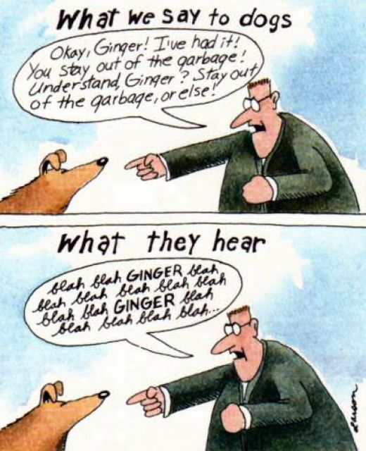

Slide 4
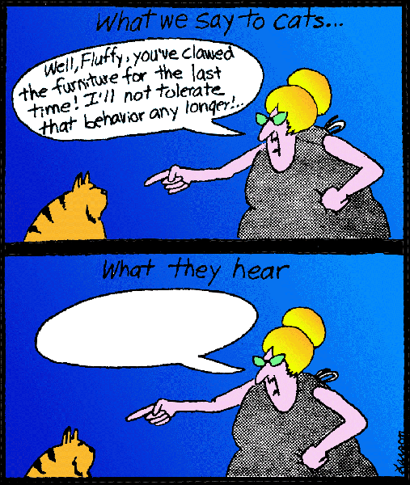

Slide 5
Our time together...
Me
  Blah blah blah blah
  Blah blah blah blah
  Blah blah blah blah
  Blah blah blah blah
  Blah blah blah blah
  Blah blah blah blah
  Blah blah blah blah

Slide 6
Our time together...
Me
  Blah blah blah blah
  Blah blah blah blah
  Blah blah blah blah
  Blah blah blah blah
  Blah blah blah blah
  Blah blah blah blah
  Blah blah blah blah
You
  Somehow managed to learn some Perl, in two days.
  Maybe loved it, maybe hated it.
  Became motivated to dig deeper (hopefully).
  Learned where to start in your digging (hopefully).
  A little more knowledge is a good thing.
    A great thing.

Slide 7
Why Perl?
Rapid development.
Powerful syntax.
Linguistic qualities.
Fun.
A Testing culture.
CPAN
The more you learn about Perl, the more you'll wonder why anyone uses PHP.
Easy things are easy, and hard things are possible.

Slide 8
Perl is designed so that someone just starting out with it can be productive.
(Even after only a couple of days.)

Slide 9
Perl is designed to allow experts to solve really difficult problems without getting in the way.

Slide 10
Here's where to dig next
Use it as much as possible.
  Solve little problems with it.
  Sove big problems with it.
perldoc
Books
  Learning Perl, Intermediate Perl, Programming Perl, Modern Perl, Perl Testing: A Developer's Notebook, Mastering Regular Expressions
CPAN modules and their POD.
Co-workers
PerlMonks
StackOverflow
Salt Lake Perl Mongers ( http://saltlake.pm.org )

Slide 11
Your final assignment for today
Take a couple minutes to send me an email
  What did you like?
  What did you dislike?
  What interests you further?
  What is totally disinteresting to you?
  What would you like to talk about if I come again?
  Anything else that comes to mind.
If you prefer anonymity, say “Someone I know told me...”
I hope to do this again. Your comments will help me make it worthwhile for your company to invite me back.
daoswald@gmail.com

Slide 12
Most of all
THANKS!

Slide 13
Dave Oswald
daoswald@gmail.com

