Slide 1
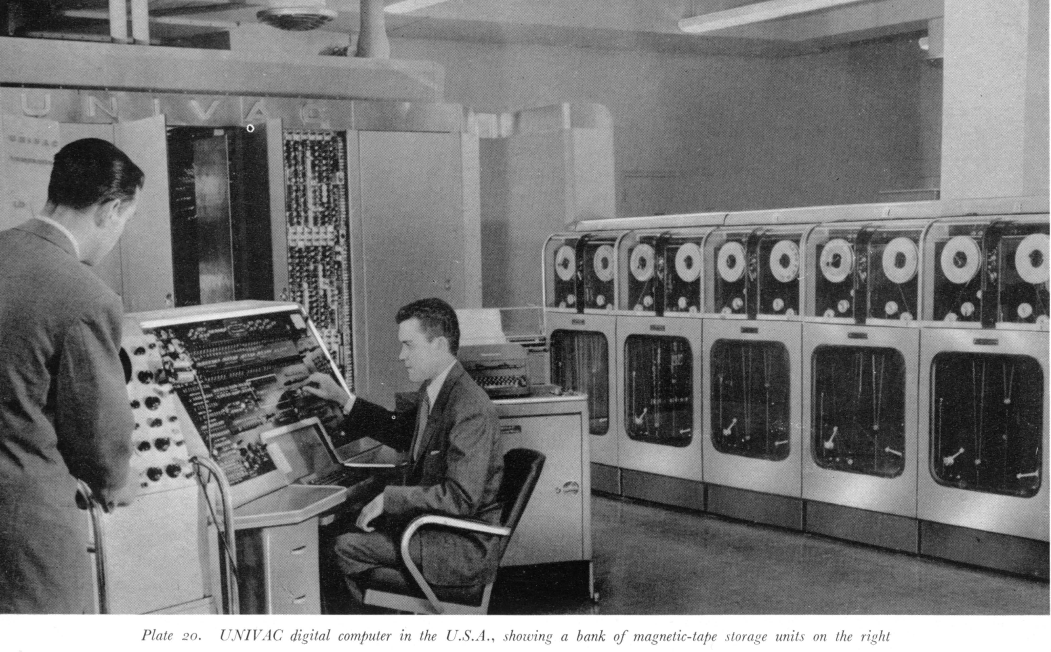
Join the Testing Culture

Slide 2

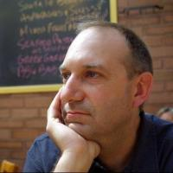
Who am I?
Dave Oswald
Work for Endurance International Group / Bluehost
Salt Lake Perl Mongers
  http://saltlake.pm.org
daoswald@gmail.com

Slide 3
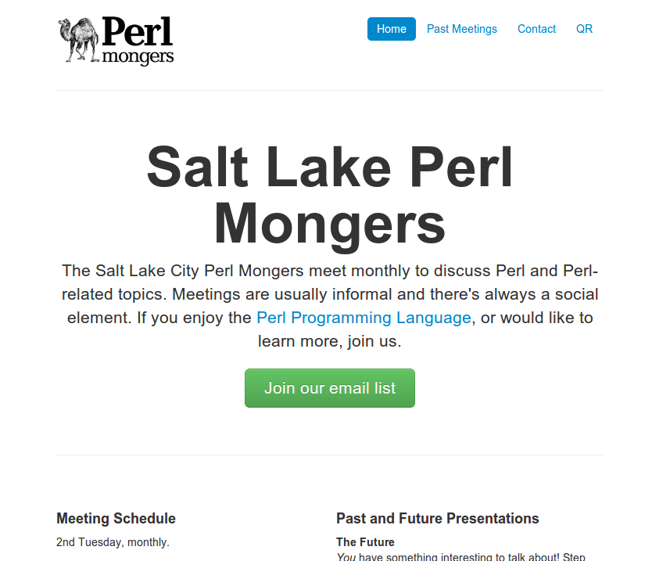
Salt Lake Perl Mongers
The local “Perl Community”
  Monthly meetings.
  Partnership discounts.
  Job announcements.
  Everyone learns and grows.
  For the love of Perl!
  Open Source
http://saltlake.pm.org

Slide 4


Thank you
Endurance International Group
Bluehost

Slide 5

Thank you
Endurance International Group
Bluehost
Perl

Slide 6
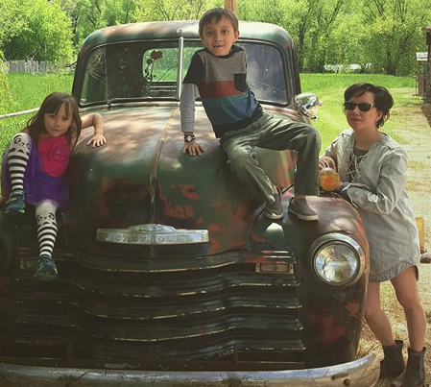
Thank you
Endurance International Group
Bluehost
Perl
My family

Slide 7

Join the Testing Culture

Slide 8
Goals
Learn how to write testable code
Learn how to write unit tests
Learn about the TDD cycle
Explore Test::More
prove our code
Learn about TAP

Slide 9
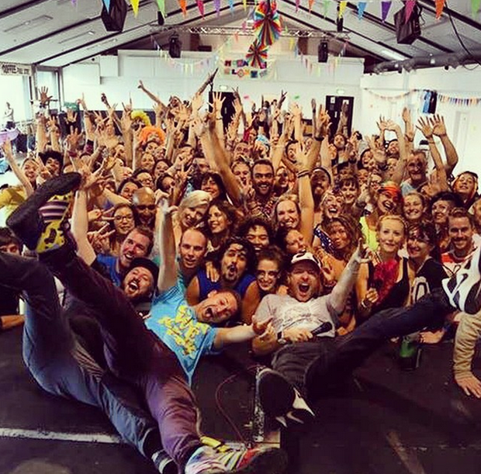
Goals
Learn how to write testable code
Learn how to write unit tests
Learn about the TDD cycle
Explore Test::More
prove our code
Learn about TAP
Have fun!

Slide 10


Slide 11
Resources
Intermediate Perl
Modern Perl
Perl Testing: A Developer's Notebook
Test::More

Slide 12
What is unit testing
For every unit of code (subroutine or class/object method) write code that invokes that unit of code, and verifies the result of running that code is what you expect.
Test as many edge cases and logic paths as possible.

Slide 13
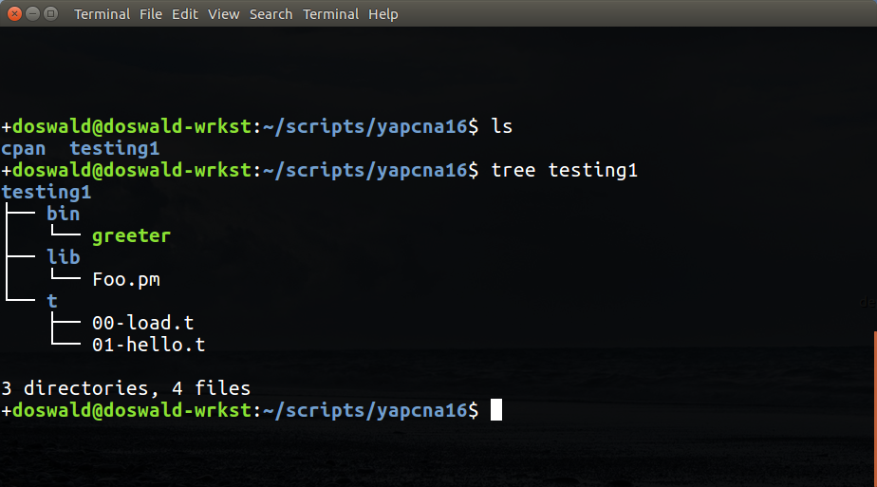

Slide 14

TDD
Test Driven Development

Slide 15

TDD
Test Driven Development

Slide 16
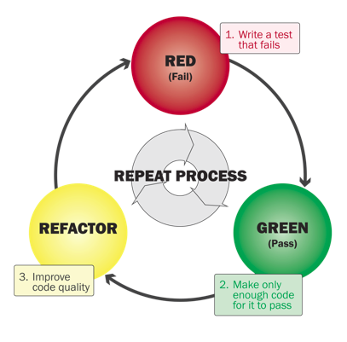

Slide 17
TDD
Test Driven Development
  Write a test that will fail because the code it tests doesn't exist.

Slide 18
TDD
Test Driven Development
  Write a test that will fail because the code it tests doesn't exist.
  Write the simplest code practical that will make the test pass
    A little foresight is useful:
      sub add { return 2 } is not a good solution to a test that calls add(1,1);

Slide 19
TDD
Test Driven Development
  Write a test that will fail because the code it tests doesn’t exist.
  Write the simplest code practical that will make the test pass.
    A little foresight is useful:
      sub add { return 2 } is not a good solution to a test that calls add(1,1);
  Verify that the test now passes.
    Yes, write another test, then code to support it.
    No, fix the code.

Slide 20
TDD
Test Driven Development
  Write a test that will fail because the code it tests doesn’t exist.
  Write the simplest code practical that will make the test pass.
    A little foresight is useful:
      sub add { return 2 } is not a good solution to a test that calls add(1,1);
  Verify that the test now passes.
    Yes, write another test, then code to support it.
    No, fix the code.
  Refactor

Slide 21
TDD Tradeoff
TDD is a slower way to arrive at “Hello world!”, but when you get there it works, and you can move on (in theory).
TDD is a faster way to develop non-trivial solutions.
  Bugs are spotted and fixed as they occur. The source is usually obvious.
Unit tests empower you to make changes. TDD leaves you with code and unit tests.

Slide 22
Testing is easiest when the entity being tested is small and not terribly complex.

Slide 23
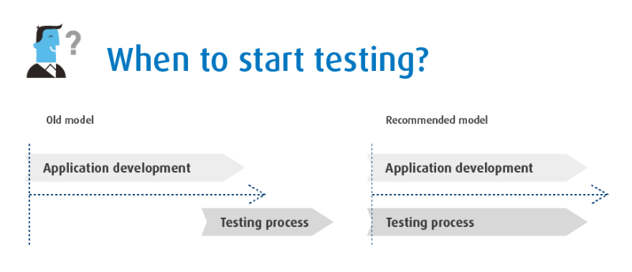

Slide 24
Test and code in small chunks.

Slide 25
Write tests as you proceed.

Slide 26
Automate your “double checking” quick checks.

Slide 27
Modularity
Code small units of functionality.
  They are easier to test than large steaming heaps of spaghetti.
Factor complexity into smaller subroutines so they can be tested in isolation.
Decouple logic from tricky integrations.

Slide 28
Modularity
A word about modular design.
  Non-trivial applications should put as much work into separate-file modules as possible.
  Main application should simply invoke a module and use its interface.
    use strict;
    use warnings;
    use MyModule 'doit';
    my $success = doit();
    die “Success not returned.\n”
    unless $success.

Slide 29
Why?!

Slide 30


Slide 31

It's just easier to test modular code.

Slide 32

It's harder to test main application code, tightly-coupled code, and large complex multi-faceted functions.

Slide 33
A simple application framework
Application directory:
  lib/MyModule.pm
  lib/Some/Other.pm
  t/00-mymodule.t
  t/01-some_other.t
  app.pl

Slide 34
A simple application
  #!/usr/bin/env perl
  use FindBin;
  use lib “$FindBin::bin/lib”;
  use strict;
  use warnings;
  use MyModule;
  use Some::Other;
  # main application code
  my $success = MyModule->new()->go; # Or whatever.
  die “Runtime failed.\n” unless $success;

Slide 35
It takes some work...
In practice it may be hard to boil the entire runtime down to a module with dependencies.
Strive to shift as much business logic as possible into modules. Keep “package main” as simple as possible because it's harder to test application code.

Slide 36

The payoff
As we will see...
  Small subroutines are easy to test.
  Object methods are easy to test.
Separate modules facilitate this testing.

Slide 37
Our examples...
In our examples we will sometimes include subroutines or methods in the same file with test code.
  This will save some time.
  Expanding out to a more traditional structure is not difficult.

Slide 38
Basic Tools of the Trade for Testing
Test::More
  A framework that provides testing tools.
  Produces TAP output (Test Anything Protocol)
Test::Harness
  Executes test suites.
  Reads (consumes) TAP
  Produces “Pass” and “Fail” statistics.
prove
  A command provided by Test::Harness that facilitates the running of tests.

Slide 39
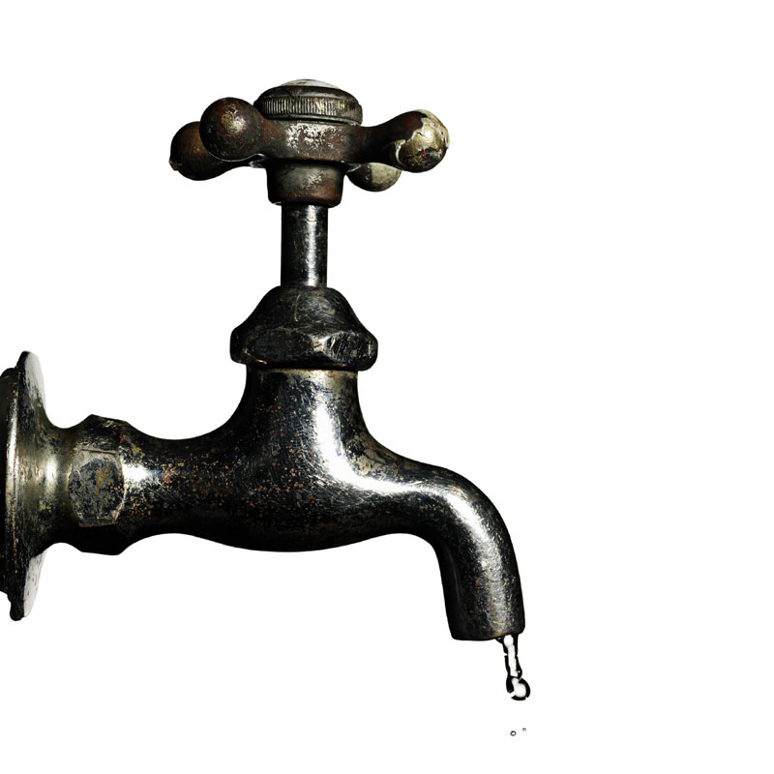
What is TAP?

Slide 40
Test

Slide 41
Test
Anything

Slide 42
Test
Anything
Protocol

Slide 43

Test
Anything
Protocol

Slide 44
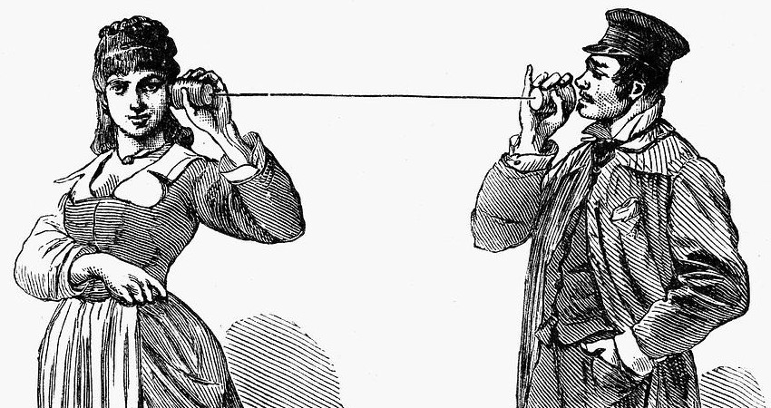
What are protocols for?

Slide 45
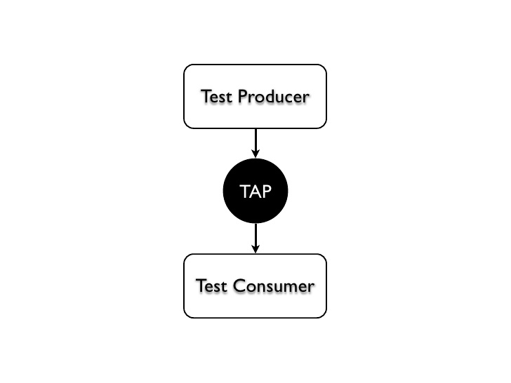

Slide 46
Simple TAP
1..4
ok 1 - Input file opened
not ok 2 - First line of the input valid
ok 3 - Read the rest of the file
not ok 4 - Summarized correctly # TODO Not implemented

Slide 47
A simple set of tests.
use Test::More tests => 4;
sub divide {
my ( $dividend, $divisor ) = @_;
return $dividend / $divisor;
}
ok( divide(4,2) == 2, 'Even positive integers.' );
ok( divide(-3,3) == -1, 'Odd integers, one neg.' );
ok( divide(-6,-1) == 6, 'Two negatives.' );
ok( divide( 3.14, 2 ) < 1.58 && divide( 3.14, 2 ) > 1.56, 'Floating point.' );
done_testing();

Slide 48
A simple set of tests (pass)
use Test::More tests => 4;
sub divide {
my ( $dividend, $divisor ) = @_;
return $dividend / $divisor;
}
ok( divide(4,2) == 2,
'Even positive integers.' );
ok( divide(-3,3) == -1,
'Odd integers, one neg.' );
ok( divide(-6,-1) == 6 ,
'Two negatives.' );
ok( ...floating point test... );
done_testing();
1..4
ok 1 - Even positive integers.
ok 2 - Odd integers, one neg.
ok 3 - Two negatives.
ok 4 – Floating point.

Slide 49
A simple set of tests (failure)
use Test::More;
sub divide {
my ( $dividend, $divisor ) = @_;
return $dividend / $divisor;
}
ok( divide(4,2) == 2,
'Even positive integers.' );
ok( divide(-3,3) == -1,
'Odd integers, one neg.' );
ok( divide(-6,-1) == 5 ,
'Two negatives.' );
done_testing(3);
ok 1 - Even positive integers.
ok 2 - Odd integers, one neg.
not ok 3 - Two negatives.
# Failed test 'Two negatives.'
# at mytest.pl line 16.
1..3
# Looks like you failed 1 test of 3.

Slide 50
What should divide by zero do?
use Test::More;
sub divide {
my ( $dividend, $divisor ) = @_;
# Let's return undef or () on invalid input.
return if $divisor == 0;
return $dividend / $divisor;
}
ok( ! defined( divide(5,0) ), 'Divide by zero.' );

Slide 51
Maybe it’s best to throw an exception?
use Test::More;
sub divide {
my ( $dividend, $divisor ) = @_;
# Let's return undef or () on invalid input.
return if $divisor == 0;
return $dividend / $divisor;
}
my $result = eval { divide(5,0) };
ok( !defined $result, ‘Divide by zero didn’t return a value.’ );
ok( defined $@ && $@ =~ m/zero/, 'Divide by zero threw an exception.' );

Slide 52
Running the tests...
$ perl ./mytest.pl
  ok 1 - Divide by zero.
  1..1
$ prove ./mytest.pl
  ./mytest.pl .. ok
  All tests successful.
  Files=1, Tests=1, 0 wallclock secs ( 0.03 usr 0.00 sys + 0.02 cusr 0.00 csys = 0.05 CPU)
  Result: PASS

Slide 53
Running the tests...
$ perl ./mytest.pl
  ok 1 - Divide by zero.
  1..1
$ prove ./mytest.pl
  ./mytest.pl .. ok
  All tests successful.
  Files=1, Tests=1, 0 wallclock secs ( 0.03 usr 0.00 sys + 0.02 cusr 0.00 csys = 0.05 CPU)
  Result: PASS

Slide 54

Running the tests...
TAP Producer
$ perl ./mytest.pl
  ok 1 - Divide by zero.
  1..1
TAP Consumer
$ prove ./mytest.pl
  ./mytest.pl .. ok
  All tests successful.
  Files=1, Tests=1, 0 wallclock secs ( 0.03 usr 0.00 sys + 0.02 cusr 0.00 csys = 0.05 CPU)
  Result: PASS

Slide 55
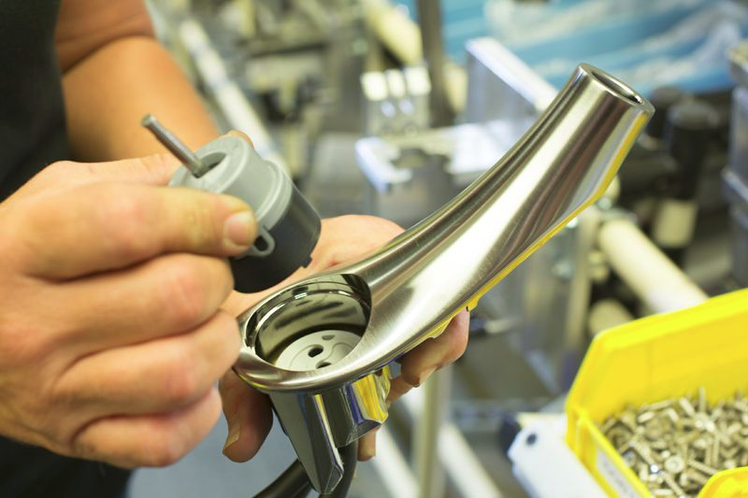
So what is a TAP producer?

Slide 56
So what is a TAP producer?
Just a program that produces TAP output.
#!/usr/bin/env perl
print “ok 1\n”;
print “1..1\n”;

Slide 57

What is a TAP consumer?

Slide 58
What is a TAP consumer?
A program that reads TAP input.

Slide 59
What is a TAP consumer?
A program that reads TAP input.
  Maybe it summarizes it.
  All Tests Successful
  Result: PASS

Slide 60

Maybe you’re not really into Perl

Slide 61
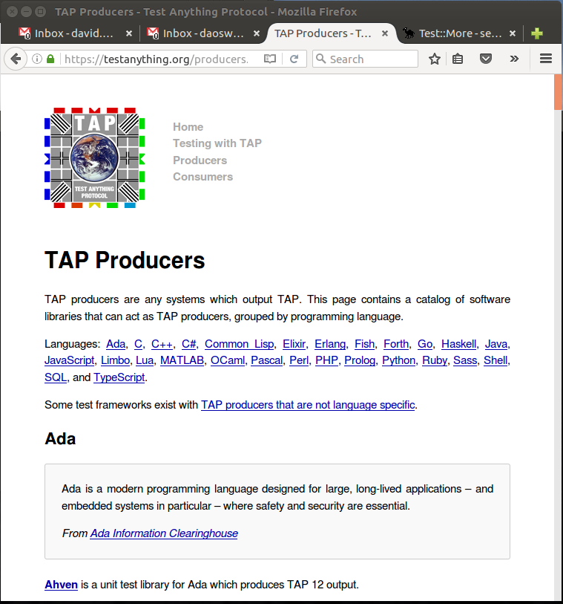
Maybe you’re not really into Perl

Slide 62
Let’s test an exception
use Test::More;
sub divide {
my ( $dividend, $divisor ) = @_;
return $dividend / $divisor;
}
my $rv = eval { divide(5,0); 1; }
ok( !$rv, 'Divide by zero throws.' );
like( $@, qr/^Illegal division/,
'Exception is “Illegal Division”' );

Slide 63
Lets test an execption
use Test::More;
sub divide {
my ( $dividend, $divisor ) = @_;
return $dividend / $divisor;
}
my $rv = eval { divide(5,0); 1; }
ok( !$rv, 'Divide by zero throws.' );
like( $@, qr/^Illegal division/,
'Exception is “Illegal Division”' );
ok 1 - Divide by zero throws.
ok 2 - Exception is "Illegal Division"
1..2

Slide 64
ok()
ok EXPR, NAME
EXPR is evaluated for Boolean truth.
  True is Ok, the test was successful.
  False was not Ok, the test failed.

Slide 65
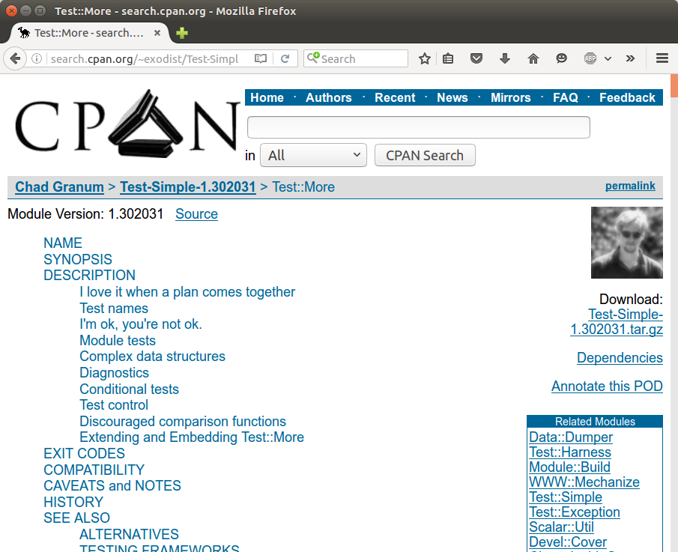
A few more Test::More functions
ok
is
isnt
cmp_ok
like
unlike
is_deeply

Slide 66
Strings
sub alphabetize {
my $str = shift;
return join '', sort
split //, $str;
}
is(
alphabetize(“asdf”),
“adfs”,
“Alphabetized asdf”
);
ok 1 - Alphabetized asdf
1..1

Slide 67
Test::More
ok( BOOLEAN_EXPR, NAME );
is( STRING, WANTED_STRING, NAME );
isnt( STRING, UNWANTED_STRING, NAME );
like( STRING, qr/REGEX/, NAME );
unlike( STRING, qr/REGEX/, NAME );
cmp_ok( GOT, OPERATOR, WANTED, NAME ); # $a, '==', $b
is_deeply( STRUCTURE, WANTED_STRUCT, NAME);

Slide 68
ok()
ok(1+1==2, ‘Addition works.’);

Slide 69
is()
is(join(‘_’, “a”, “b”), “a_b”, “Join works.”);

Slide 70
isnt()
isnt(“apples”, “oranges”,
“apples aren’t oranges”);

Slide 71
like()
like(“possum”, qr/^o?possum$/,
“Scary marsupial alert.”);

Slide 72
unlike()
unlike(‘one’, qr(\d+),
‘We didnt use digits’);

Slide 73
cmp_ok
cmp_ok(1, ‘<’, 2, ‘One is less than two’);
cmp_ok(“Dave”, ‘gt’, “Dan”,
“Dave comes after Dan.”);

Slide 74
is_deeply()
my $structure = [ 1, [ 2, 3 ], [ 4, 5 ], 6 ];
is_deeply(
$structure, [1,[2,3],[4,5],6],
'Structures match recursively.'
);

Slide 75
is_deeply()
my $structure =
[ 1,
[ 2, 3 ],
[ 4, 5 ],
6 ];
is_deeply(
$structure, [1,[2,3],[4,5],6],
'Structures match recursively.'
);
ok 1 - Structures match recursively.
1..1

Slide 76
is_deeply()
my $structure =
[ 1,
[ 2, 3 ],
[ 4, 5 ],
6 ];
is_deeply(
$structure, [1,[2,3],[5,4],6],
'Structures match recursively.'
);
not ok 1 - Structures match recursively.
# Failed test 'Structures match recursively.'
# at mytest.pl line 15.
# Structures begin differing at:
# $got->[2][0] = '4'
# $expected->[2][0] = '5'
1..1
# Looks like you failed 1 test of 1.

Slide 77
Now for a modular approach
lib/MyModule.pm
  package MyModule;
  use Exporter;
  our @ISA = qw( Exporter );
  our @EXPORT = qw( add );
  sub add { return shift() + shift() }
  1;

Slide 78
Tests for our module
t/00-mymodule.t
  # Tell Perl where to find our private lib/
  use FindBin;
  use lib “$FindBin::Bin/../lib”;
  use Test::More;
  use_ok( 'MyModule' ); # Module loads.
  can_ok( 'MyModule', 'add' ); # Module provides...
  can_ok( 'main', 'add' ); # Module exports...
  ok( add( 1, 1 ) == 2, “Positive integers.” );
  done_testing();

Slide 79
Run the tests...
$ perl -Ilib t/00-mymod.t
  ok 1 - use MyModule;
  ok 2 - MyModule->can('add')
  ok 3 - main->can('add')
  1..3
$ prove -l t/00-mymod.t
  t/00-mymod.t .. ok
  All tests successful.
  Files=1, Tests=3, 0 wallclock secs ( 0.03 usr 0.00 sys + 0.03 cusr 0.00 csys = 0.06 CPU)
  Result: PASS

Slide 80
Tools we used in testing our module
Test::More
use_ok
  Test if “use MyModule;” loads ok.
can_ok
  Test if MyModule->can('foo');
prove
  Run the entire test suite.

Slide 81
prove
prove (no arguments)
  Runs all tests in t/*.t including in subdirs.
prove -v
  Verbose; includes all test output.
prove -b
  Runs all tests, looking in blib/ for modules.
prove -l
  Runs all tests, looking in lib/ for modules.
prove -Q
  Print only summary output after all tests are run.
  This is what cpanm uses, internally.
    Well, actually prove -Qb

Slide 82
Subtests
use Test::More;
ok( 1 == 1, 'Yay!' );
subtest 'Multiplication' => sub {
ok( 2 * 2 == 4 );
ok( 3 * -1 == -3 );
done_testing();
};
ok( 2 + 2 == 4 );
done_testing();
ok 1 - Yay!
ok 1
ok 2
1..2
ok 2 - Multiplication
ok 3
1..3

Slide 83
diag, note, explain
diag
  Prints a diagnostic message that won't interfere with test output
  Messages have a # prepended, to comply with TAP standard.
explain
  Formats data structures into human readable format.
note
  Same as diag, but note is only seen if tests are run verbosely.

Slide 84
Examples
Use Test::More;
diag “One plus One equals”, 1+1;
note “Two plus Two equal”, 2+2;
is_deeply( $struct, $wanted, “Datastructure Matches” )
|| diag explain $struct;
done_testing;

Slide 85
Skip, ToDo
SKIP: {
skip “Because.”, 2
if( $condition );
ok(1);
Ok(2);
}
TODO: {
local $TODO
= “Not implemented yet.”
if( $condition);
ok( 0 );
}

Slide 86
When to use skip & todo
skip
  Tests that aren't applicable in a given environment.
  Tests that should only run for a particular user.
  Tests that are only related to releasing.
todo
  Tests that fail but are awaiting bug fixes.
  Tests for code that isn't implemented yet.
  Tests that should arouse suspicion if they unexpectedly pass.

Slide 87
Summary
Testing saves you time.
  Takes awhile to write them, but less time than chasing elusive bugs.
  Write modular code with small units of functionality.
  Test the small parts, then the bigger parts that use the small parts.
  Test every logic path.
  Test edge cases, fence-posts, assumptions, assertions, outliers, and of course, the norms.

Slide 88

Let's find some bugs
sub mycsv {
my $csv_string = $_[0];
my @fields = split /,/, $csv_string;
return @fields;
}

Slide 89
Let's find some bugs
use Test::More;
sub mycsv {
my $csv_string = $_[0];
my @fields = split /,/, $csv_string;
return @fields;
}
is_deeply( [ mycsv("a,b,c") ], ['a', 'b', 'c'], "Simple list." );
is_deeply( [ mycsv('a') ], ['a'], 'Single-field.' );
is_deeply( [ mycsv('Dave,48,m') ], [qw(Dave 48 m)], 'Multi-char fields' );
is_deeply( [ mycsv('"Hello","World"') ], [qw("Hello" "World")], 'Quoted constructs' );

Slide 90
Test run
ok 1 - Simple list.
ok 2 - Single-field.
ok 3 - Multi-char fields
ok 4 - Quoted constructs

Slide 91
Problems.
Someone reported that mycsv() returns a number of fields rather than the fields themselves.
Someone reported that quotes fail to escape embedded commas.

Slide 92
Let's add some tests...
use Test::More;
sub mycsv {
my $csv_string = $_[0];
my @fields = split /,/, $csv_string;
return @fields;
}
is( scalar mycsv('a'), 'a', 'Scalar context' );
is_deeply( [ mycsv('"Doe,John",79') ], [ "Doe,John", 79 ],
"Escaped commas." );
done_testing()

Slide 93
Run the tests
not ok 1 - Scalar context
# Failed test 'Scalar context'
# at mytest.pl line 13.
# got: '1'
# expected: 'a'
not ok 2 - Escaped commas.
# Failed test 'Escaped commas.'
# at mytest.pl line 14.
# Structures begin differing at:
# $got->[0] = '"Doe'
# $expected->[0] = 'Doe,John'
1..2
# Looks like you failed 2 tests of 2.

Slide 94
Bug report
We've discovered that mycsv() has two problems. The first is that when called in scalar context it returns an element count rather than a single element.
The second problem is that quoted constructs aren't properly escaping commas.
Attached is a set of tests that demonstrate the failures. Please let us know if you need any additional information.
use Test::More;
sub mycsv {
my $csv_string = $_[0];
my @fields = split /,/, $csv_string;
return @fields;
}
is( scalar mycsv('a'), 'a', 'Scalar context' );
is_deeply( [ mycsv('"Doe,John",79') ], [ "Doe,John", 79 ], "Escaped commas." );
done_testing();

Slide 95
Even better if there is a patch attached!

Slide 96
And fantastic if the patch uses Text::CSV!

Slide 97
Summary of tools
Test::More
  A TAP producing framework and toolbox of basic testing tools.
CPAN
  Hundreds of other testing tools available that work with Test::More.
    I like to explore CPAN distributions and see what other authors are using.
prove
  Runs all your tests in all files from t/*.t

Slide 98
Explore the Test:: namespace
Test::Exception
Test::Warnings
Test::Core
Test::Deep

Slide 99
JavaScript
http://www.node-tap.org
// test/hello-world.js
var tap = require(‘tap’)
tap.pass(‘this is fine’)
node test/hello-world.js
TAP version 13
ok 1 – this is fine
1..1
# time=26.792ms
npm test
...
test/hello-world.js .............. 1/1
total ............................ 1/1
1 passing (227.745ms)
ok

Slide 100
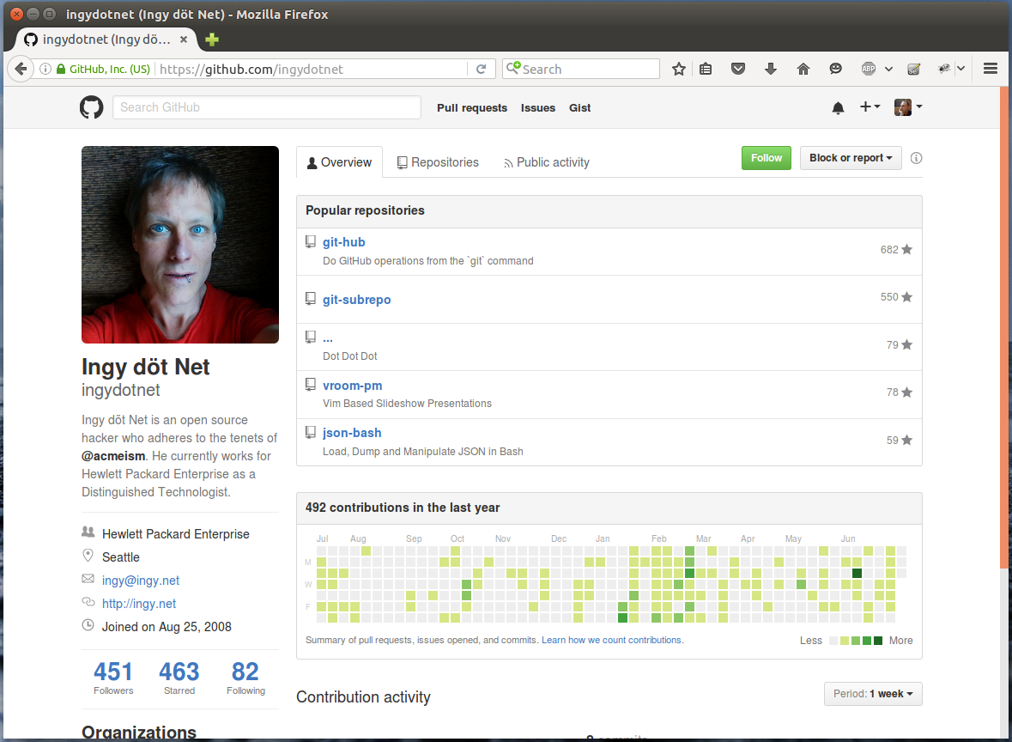
Bash
#!/usr/bin/env bash
TEST_MORE_PATH="/path/to/test-more-bash"
BASHLIB="`
find $TEST_MORE_PATH -type d |
grep -E '/(bin|lib)$' |
xargs -n1 printf "%s:"`"
PATH="$BASHLIB$PATH"
source bash+ :std
use Test::More
plan tests 4
some-command
ok $? 'some-command is ok'
# or:
ok "`some-command`" 'some-command is ok'
is `echo foo` 'foo' 'foo is foo'
like food foo 'food is like foo'
diag "A message for stderr"
TAP Testing for Bash
https://github.com/ingydotnet/test-more-bash

Slide 101
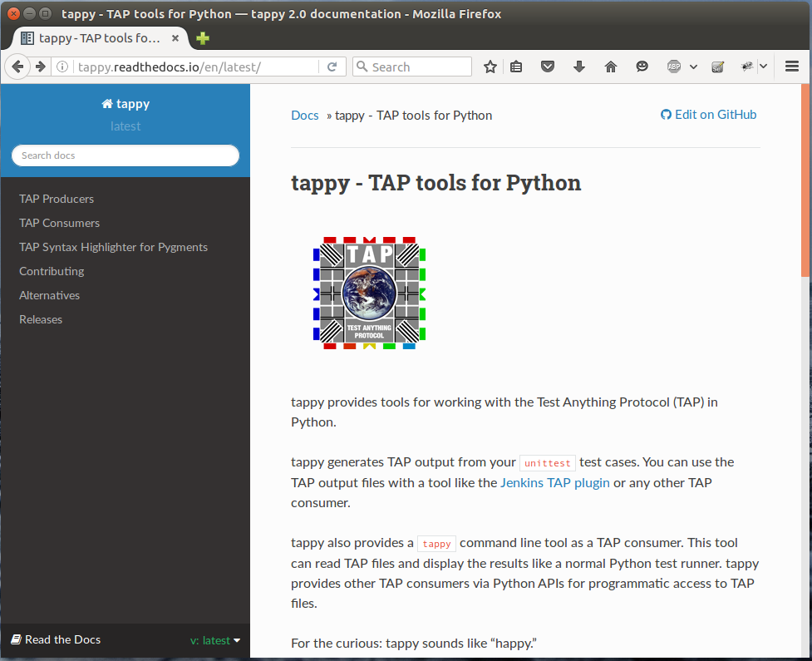
Python tappy

Slide 102
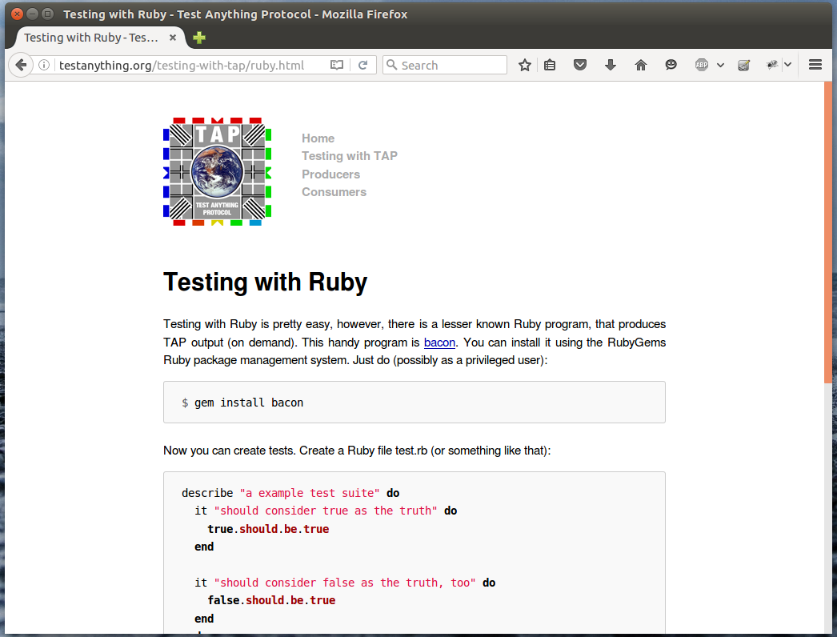
Ruby

Slide 103
Resources
Intermediate Perl
Modern Perl
Perl Testing: A Developer's Notebook
CPAN
  App::prove
  Test::More
  Hundreds of test tools in the Test::* namespace.
  Other distributions (as examples).

Slide 104
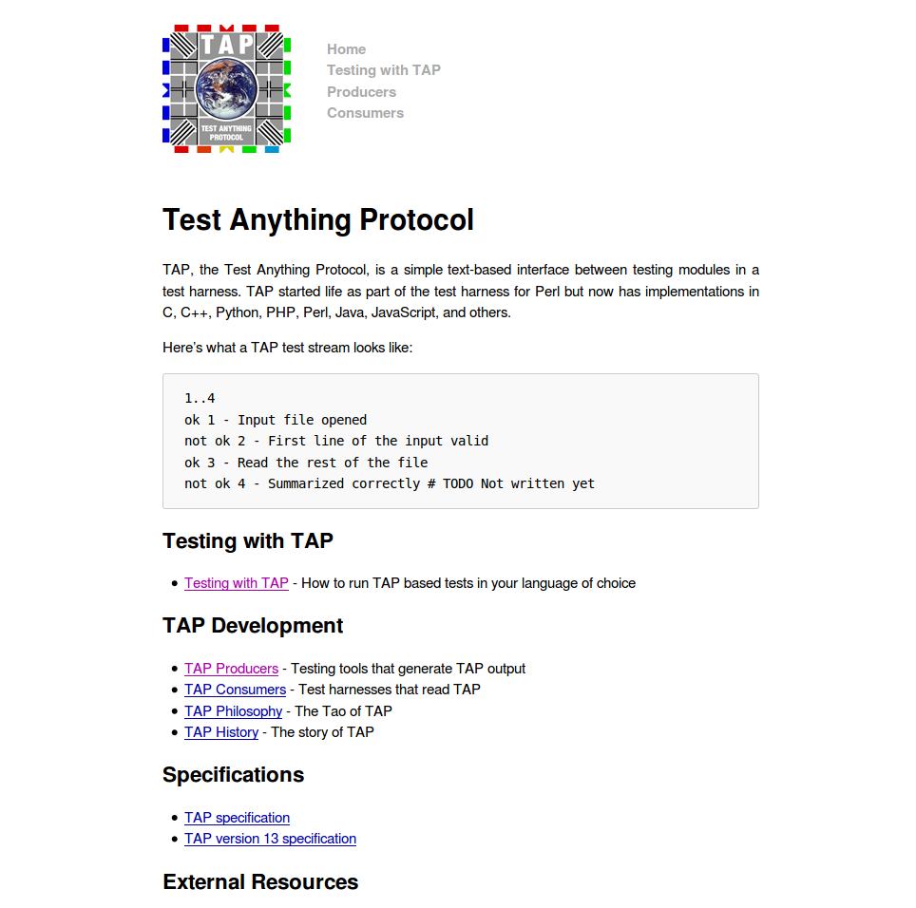
https://testanything.org

