Slide 1




PROJECT REPORT
Subjects: Big Data Applications: Machine Learning at Scale
Music recommendation system
GVHD: Quách Đình Hoàng

Slide 2





MEMBERS GROUP 2
Nguyễn Anh Đắc 19133020
Nguyễn Thanh Tân Kỷ 19133031
Đào Thị Cẩm Tiên 19133055
Lại Hữu Trác 19133059

Slide 3



CONTENTS
INTRODUCTION
DATA EDA
BUILD MODEL
EVALUATE MODEL AND DEMO APP
SUMMARY
QUA LẠI TRANG C

Slide 4



INTRODUCTION
QUAY LẠI TRAN CHƯ

Slide 5











DATASET: Million Song - Recommendation Engines
DATA
Song Dataset: song_id title release
artist_name year
Size: 1.000.000x5
Users Dataset: user_id song_id listen_count
Size: 2.000.000x3

Slide 6

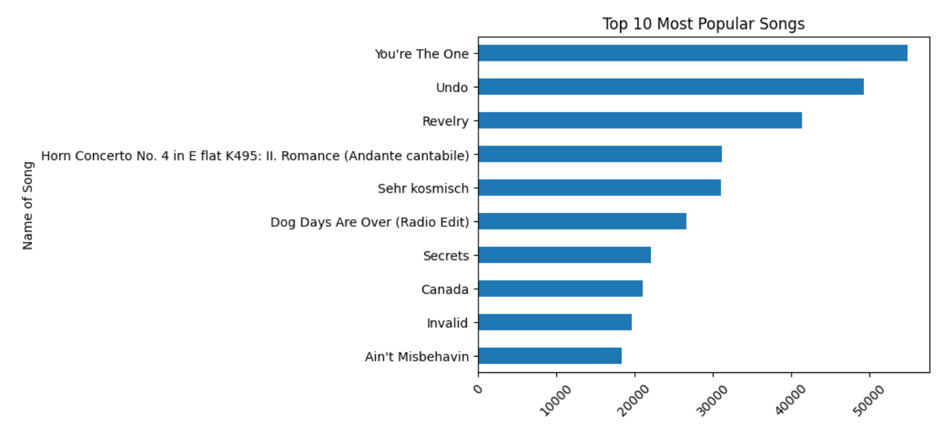
EDA
I TRA
G TRÌ

Slide 7

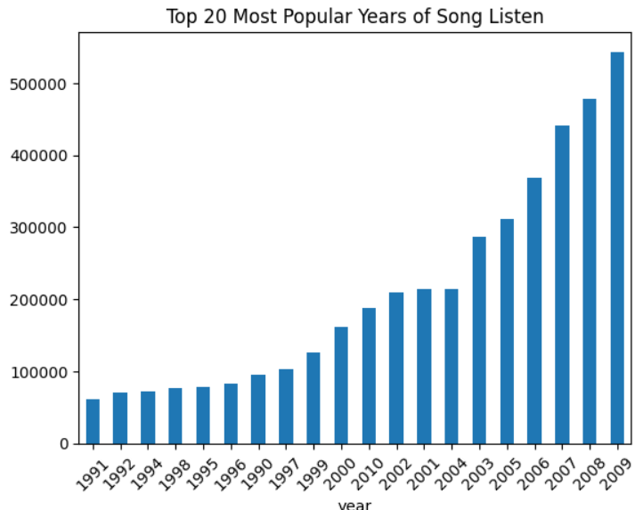
EDA
Q
ẠI TRANG CHƯƠNG

Slide 8

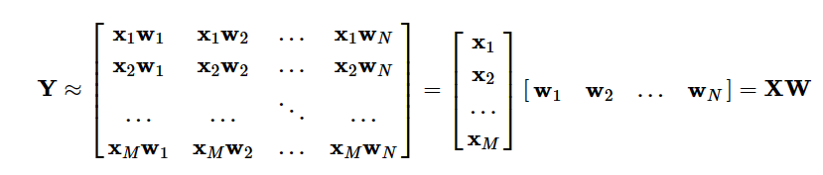
BUILD MODEL
Collaborative filtering ALS
=> Y ≈ XW
ẠI TRANG CHƯƠNG

Slide 9





MODEL
In small set:
For training 60%
For validation 20%
For Test 20%
ALS value:
maxIter ranks
regularizations
Song recommendation system based on the number of listens
Measure: RMSE
ƠNG TRÌNH

Slide 10






MODEL
Training Model:
Input data processing: string-> number Training on training dataset:
ranks = [5, 10, 15, 20]
regularizations = [0.1, 0.05, 0.01]
Evaluate RMSE
Choose the best model
LẠI TRANG CHƯƠNG

Slide 11




MODEL
The best model:
Rank: 20
Regularization: 0.1
RMSE: 6.26
Check on test dataset
RMSE: 7.28
ẠI TRANG CHƯƠNG TRÌNH

Slide 12
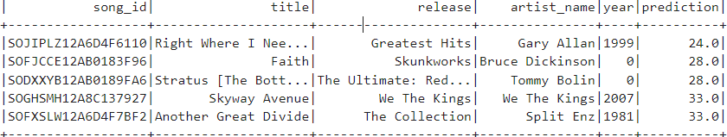
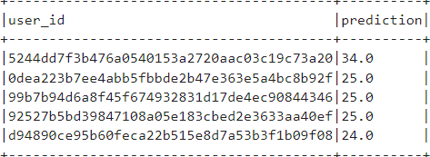
EVALUATE MODEL
Recommend Songs for a user
Recommend users for a song

Slide 13

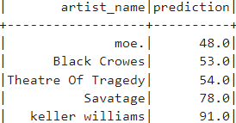
EVALUATE MODEL
Musician recommendation system for users
RMSE:
Best on Validation: 7.48 Test: 10.34
Recommend musicians for users

Slide 14
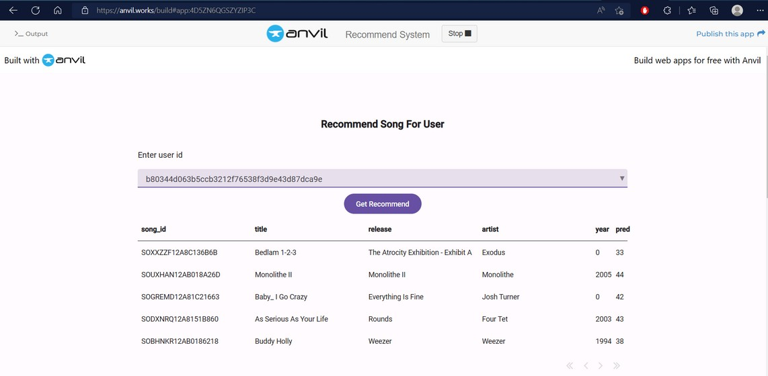
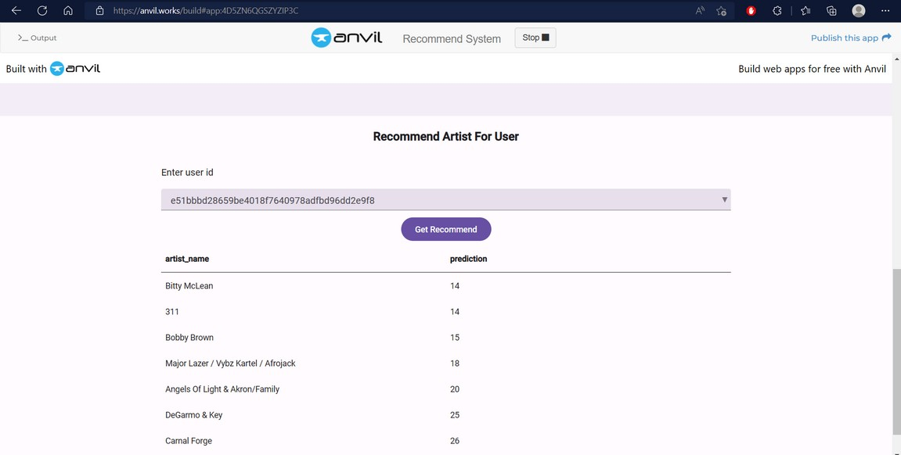
Web Recommedation

Slide 15






SUMMARY
SUMMARY:
Collaborative filtering ALS
=> The best model.
The next development direction:
Deploy on the website and improve request processing speed, interface
ẠI TRANG CHƯƠNG

Slide 16
HCMUTE
THANK FOR WATCHING!!!

