Slide 1


Report
Topic :
Analysis of factors affecting heart disease
Instructors: GV. Quách Đình Hoàng
Implementation group : Group 7
Hoàng Minh Nhật MSSV : 19133042
Đào Thị Cẩm Tiên MSSV : 19133055
Đinh Quốc Hùng MSSV : 19133025
Trần Nguyên Thái Bảo MSSV : 19133010
12/12/2021

Slide 2
Report layout consists of 3 parts
Part 1: Introduction about the topic
Part 2: Description of the data set
Part 3: Data Analysis

Slide 3
Part 1: Introduction about the topic
The reason for choosing the topic :
Heart failure is a common and extremely dangerous disease. According to some scientists, the main cause of heart disease is 11 factors: Age, Sex, ChestPainType, RestingBP, Choleserol, FastingBS, RestingECG, MaxHR, ExerciseAngina, Oldpeak, ST_Slope .
The analysis of factors affecting heart disease contributes to the early diagnosis of the disease, thereby providing timely treatment. Where the machine learning model helps a lot.

Slide 4
Data source of the topic
source : https://www.kaggle.com/fedesoriano/heart-failure-prediction
The dataset is created from 5 small datasets from hospitals at: :
Hungarian Heart Institute. Budapest: Andras Janosi, M.D.
University Hospital, Zurich, Switzerland: William Steinbrunn, M.D.
University Hospital, Basel, Switzerland: Matthias Pfisterer, M.D.
V.A. Medical Center, Long Beach and Cleveland Clinic Foundation: Robert Detrano, M.D., Ph.D.
Donor: David W. Aha (aha '@' ics.uci.edu) (714) 856-8779

Slide 5
Part 2: Description of the data set
Variables :
The data set includes 12 variables, including 918 objects.
category/qualitative variable:
Sex, ChestPainType, RestingECG, ExerciseAngina, ST_Slope ,FastingBS, HeartDisease
numeric/quantitative variable:
Age, RestingBP, Choleserol, MaxHR, Oldpeak

Slide 6
Describe the meaning of variables :
Age: age of the patient [years]
Sex: sex of the patient [M: Male, F: Female]
ChestPainType: chest pain type [TA: Typical Angina, ATA: Atypical Angina, NAP: Non-Anginal Pain, ASY: Asymptomatic]
RestingBP: resting blood pressure [mm Hg]
Cholesterol: serum cholesterol [mm/dl]
FastingBS: fasting blood sugar [1: if FastingBS > 120 mg/dl, 0: otherwise]

Slide 7
Describe the meaning of variables :
RestingECG: resting electrocardiogram results [Normal: Normal, ST: having ST-T wave abnormality (T wave inversions and/or ST elevation or depression of > 0.05 mV), LVH: showing probable or definite left ventricular hypertrophy by Estes' criteria] .
MaxHR: maximum heart rate achieved [Numeric value between 60 and 202] .
ExerciseAngina: exercise-induced angina [Y: Yes, N: No]
Oldpeak: oldpeak = ST [Numeric value measured in depression]
ST_Slope: the slope of the peak exercise ST segment [Up: upsloping, Flat: flat, Down: downsloping]
HeartDisease: output class [1: heart disease, 0: Normal]

Slide 8
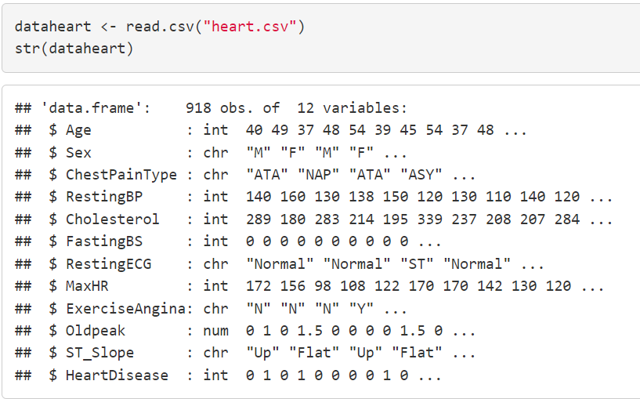
Data set exploration

Slide 9
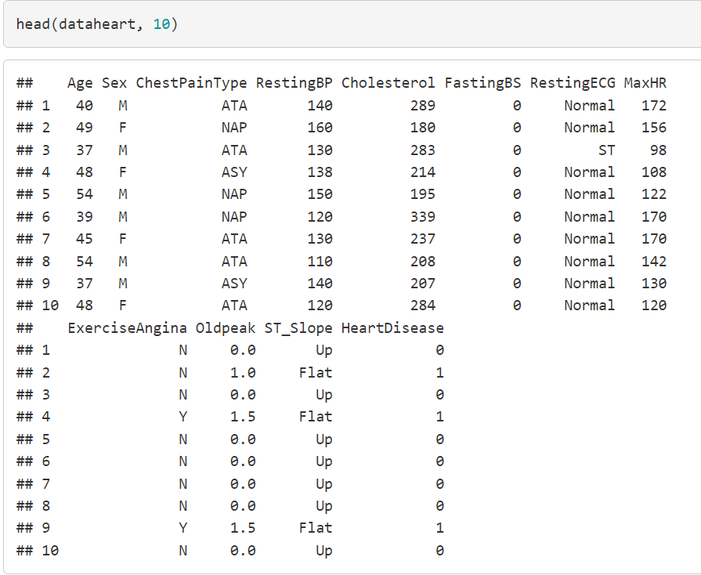
First 10 rows of data set

Slide 10
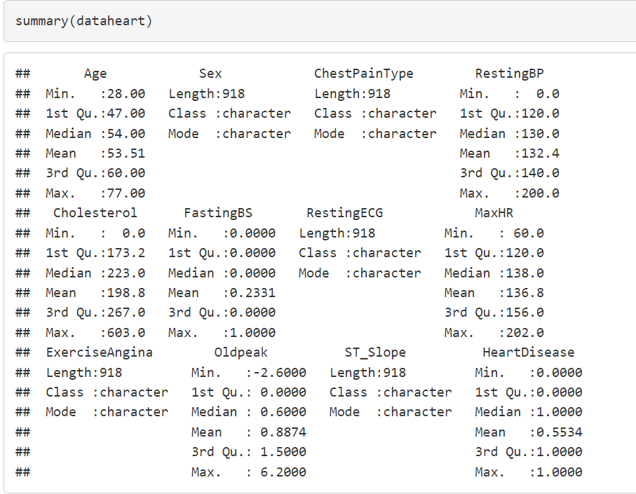
summary

Slide 11
Part 3: Data Analysis
Main Libraries : Tidyverse , dplyr , ggplot2 , e1071 , gbm, rpart .
There are also libraries : psych , Hmisc , sqldf , car , naniar, caret , RANN , na.tools.

Slide 12
1. Overview analysis of factors affecting heart disease?
Predictive variable(X) : 11 variables (Age,Sex,ChestPainType,RestingBP,Cholesterol,FastingBS,RestingECG,MaxHR,ExerciseAngina,Oldpeak,ST_Slope )
Result variables(Y) : count
Meaning : From this analysis helps us understand the distribution of factors that influence heart disease.
Usable chart: histogram
Methods used : descriptive statistics (describing the characteristics of a distribution for variables, categorical variables).

Slide 13
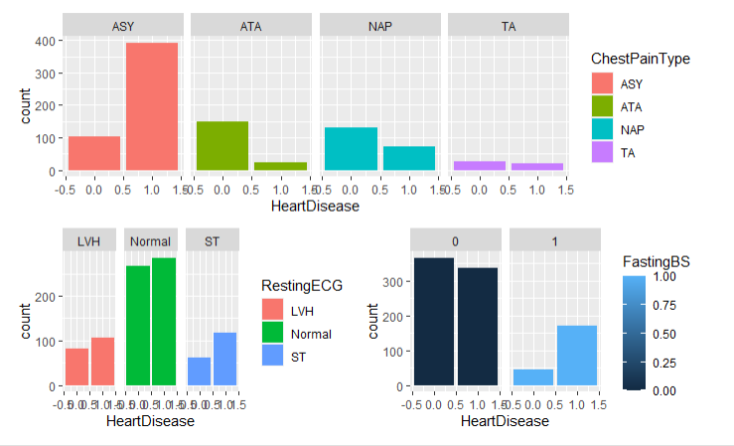
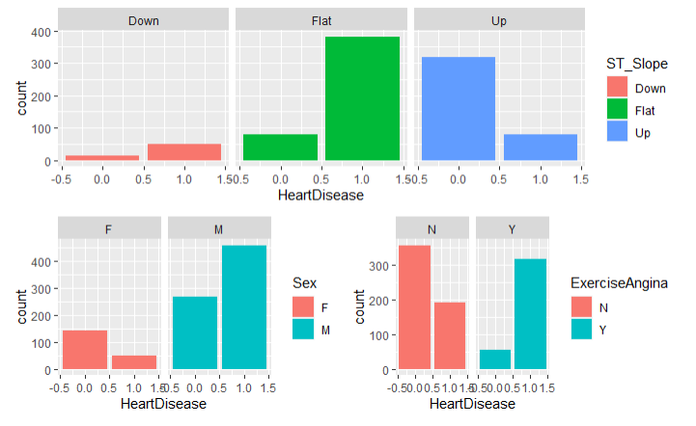
Exploratory analysis for categorical variables
Through the chart, we have some basic observations as follows:
The majority of the data were male and the number of patients with heart disease was greater than the number without;
The number of sick women is less than the number of women who are not sick
Most patients have asymptomatic chest pain
The majority of patients have normal resting ECG results Patients with heart disease experience more exercise-induced angina (approximately 300) than patients with non-exercise angina (approximately 200).
And the majority of patients have a flat heart rate gradient during exercise

Slide 14
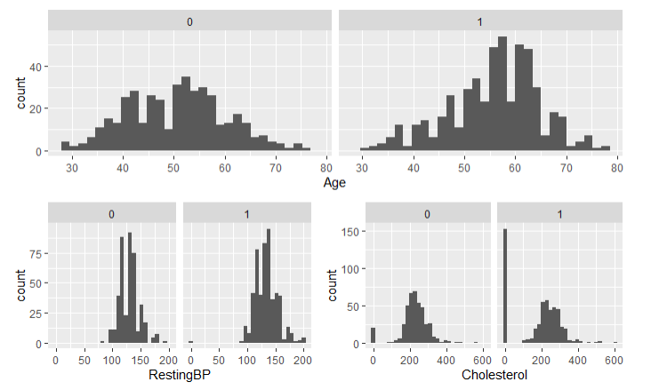
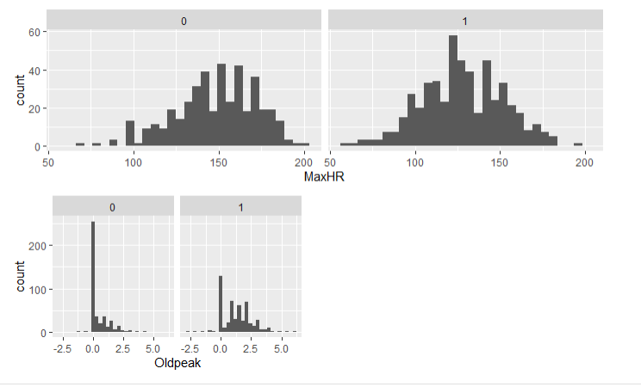
Exploratory analysis for numerical variables
As for age, we see the age most susceptible to heart disease is between 55 and 65.
With cholesterol, we also see many observations with serum cholesterol of 0.
Maximum heart rate was distributed between 60 and 202, with no abnormalities observed.
And finally Oldpeak is the numerical value measured by depression although there are a lot of zeros but a reasonable measure.

Slide 15
2. What are the main factors that cause heart disease?
Predictor variable (X) : 11 variable (Age,Sex,ChestPainType,RestingBP,Cholesterol,FastingBS,RestingECG,MaxHR,ExerciseAngina,Oldpeak,ST_Slope )
Outcome variable (Y) : HeartDisease
Outline: An overview of the factors that affect heart disease, and the major factors that cause heart disease.

Slide 16
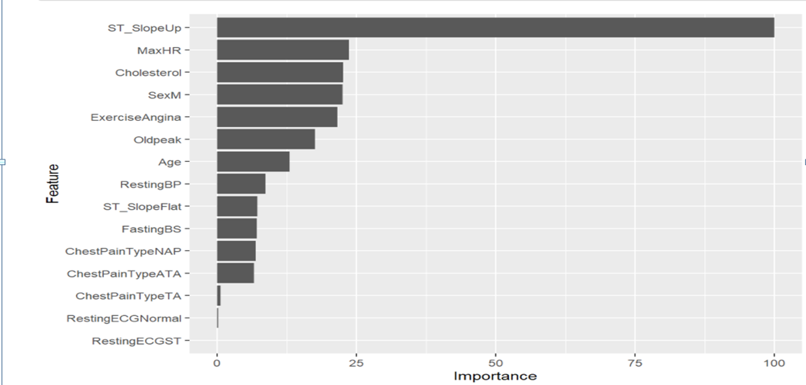
The importance of predictor and outcome variables (HeartDisease)

Slide 17
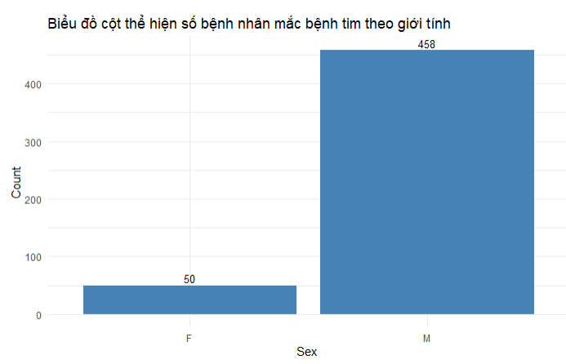
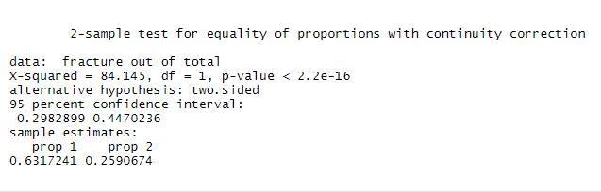
3. Male or female ?

Slide 18
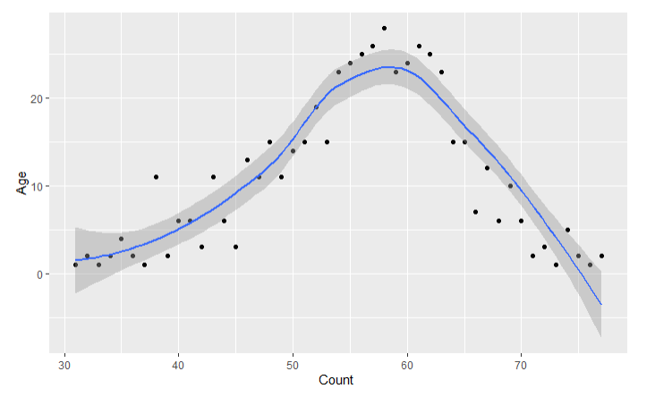
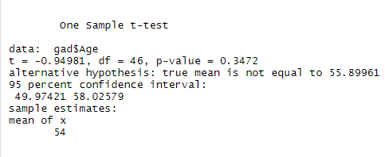
4. Average age of disease

Slide 19
5 . Building a diagnostic model of heart failure based on the data set heart.csv
Predictive variable (X) : Age, Sex, ChestPainType, RestingBP, Choleserol, FastingBS, RestingECG, MaxHR, ExerciseAngina, Oldpeak, ST_Slope.
Result variables (Y) : HeartDisease (1 : at risk of heart disease , 0 : no risk of heart disease) .
Method used: Binary classification method based on SVM (Suport vector machine) Algorithm , KNN , Decision tree .
Source: https://data-flair.training/blogs/e1071-in-r/

Slide 20
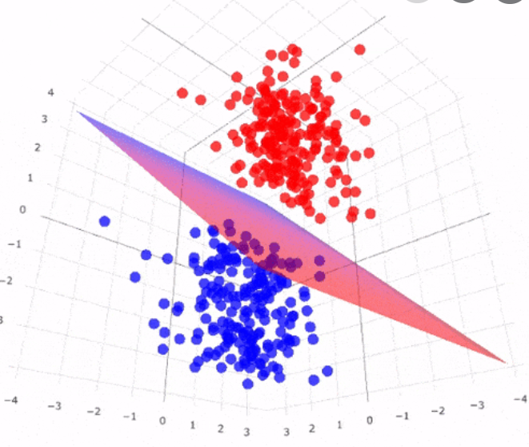
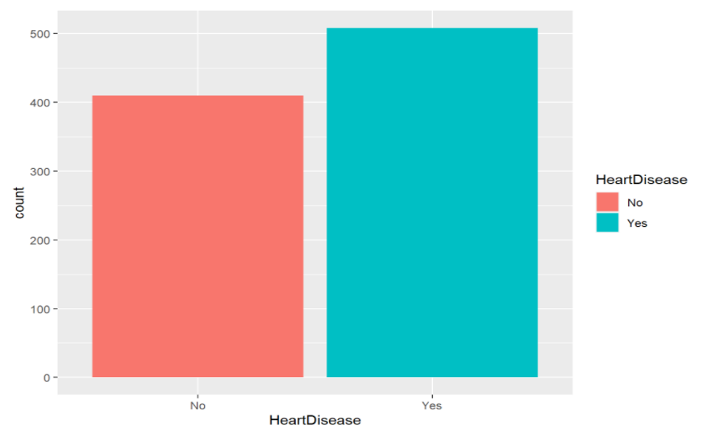
visualization of heart disease variables
Hyper-Plane

Slide 21
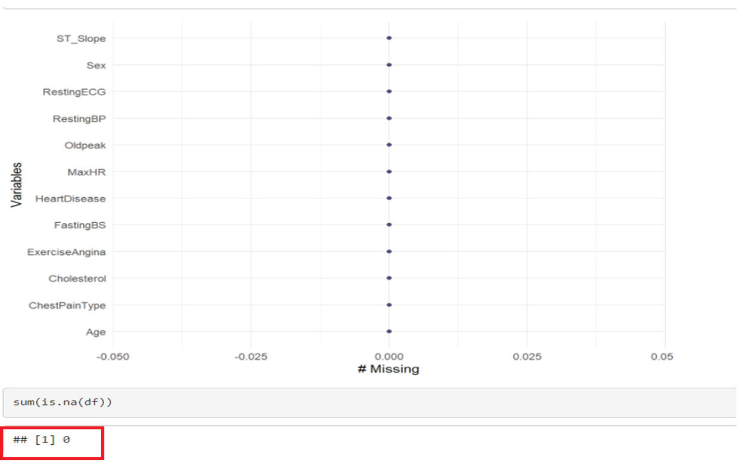
Data processing for machine learning
Check for empty values

Slide 22
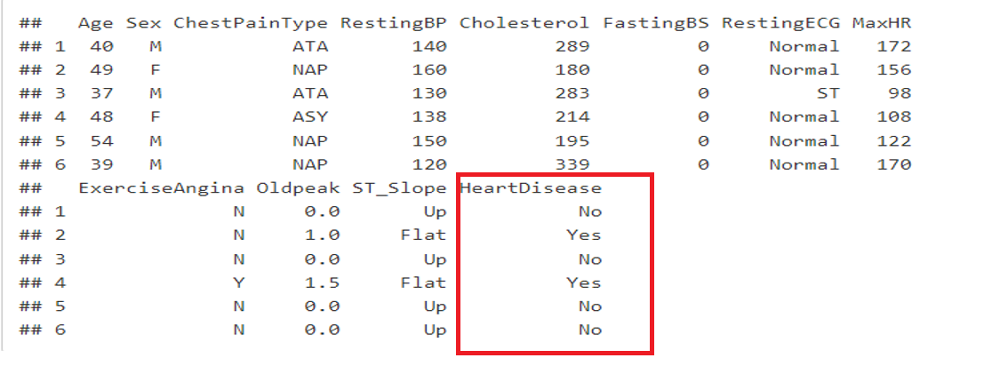
Data processing for machine learning
Convert the data to turn the result into “Yes” or “No”

Slide 23
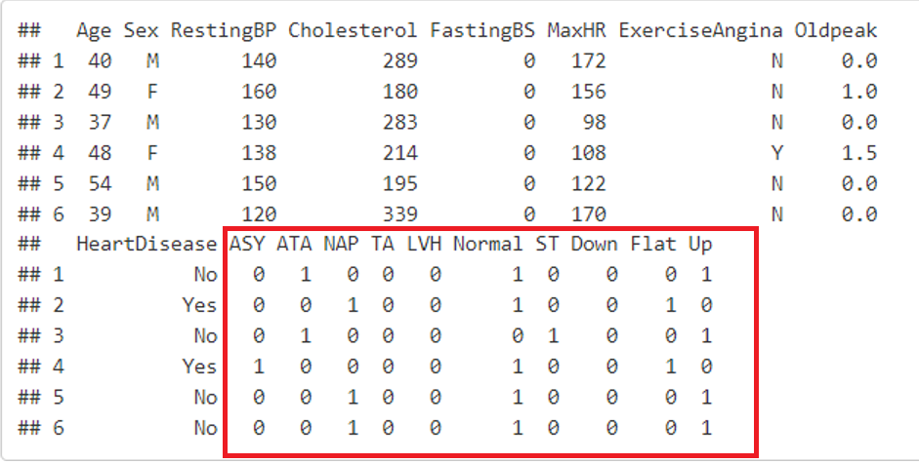
Data processing for machine learning
Convert categorical variables into binary variables

Slide 24
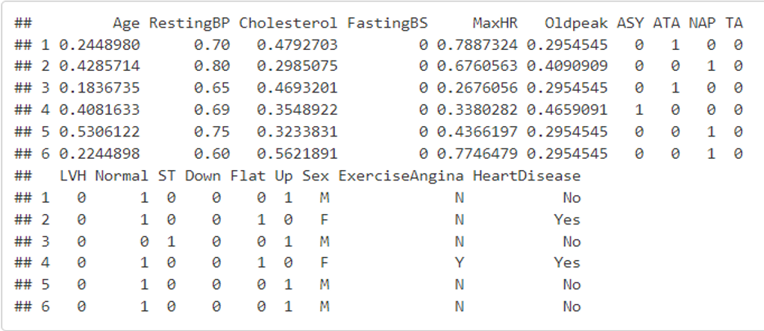
Data processing for machine learning
Rearrange data in dataframe

Slide 25
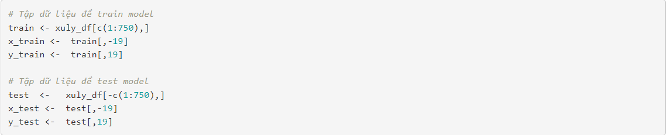
Create model SVM
Split the data set into 2 parts : 80% Train và 20% Test

Slide 26
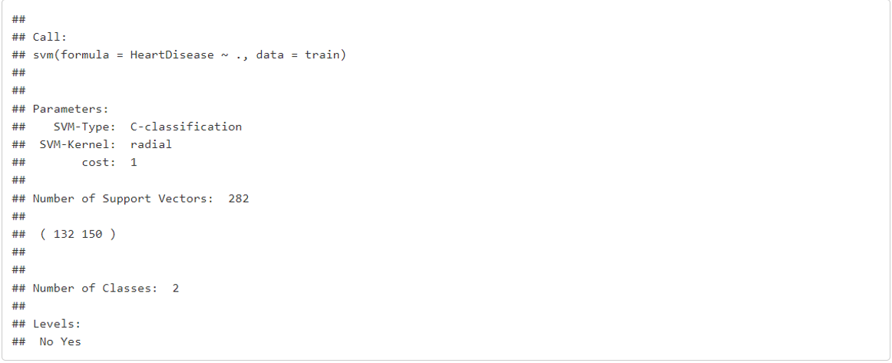
Create model SVM
Train model dựa vào bộ dữ liệu train gồm 750 đối tượng

Slide 27
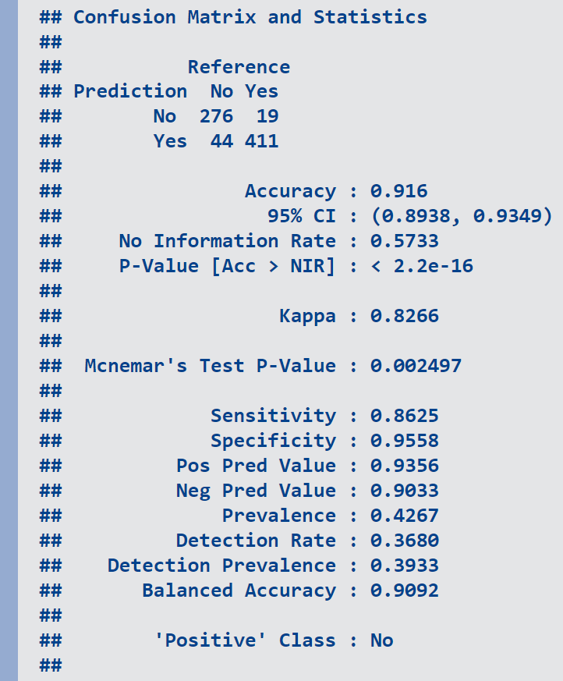
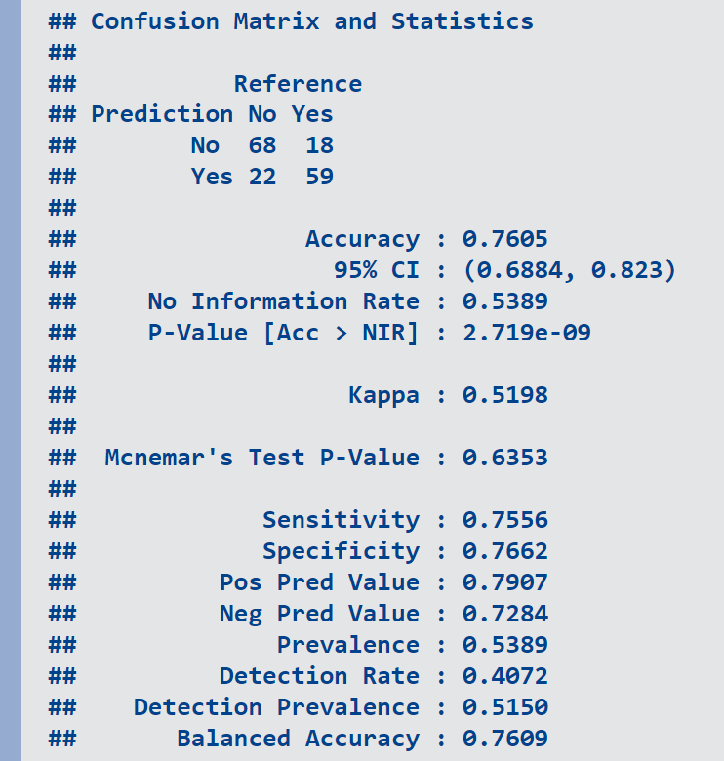
Result evaluation
Result on Train set
Result on Test set

Slide 28
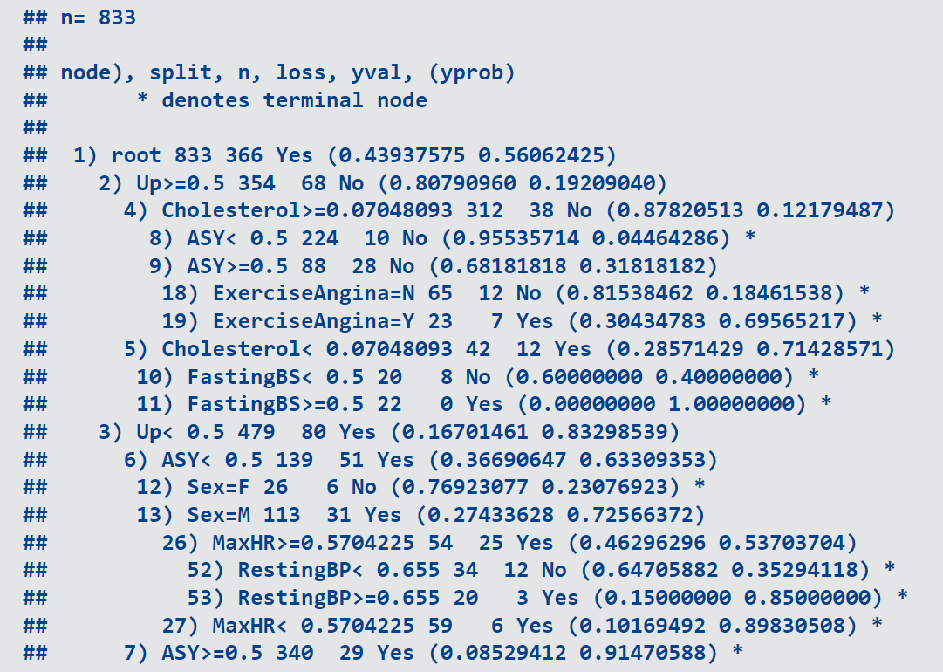
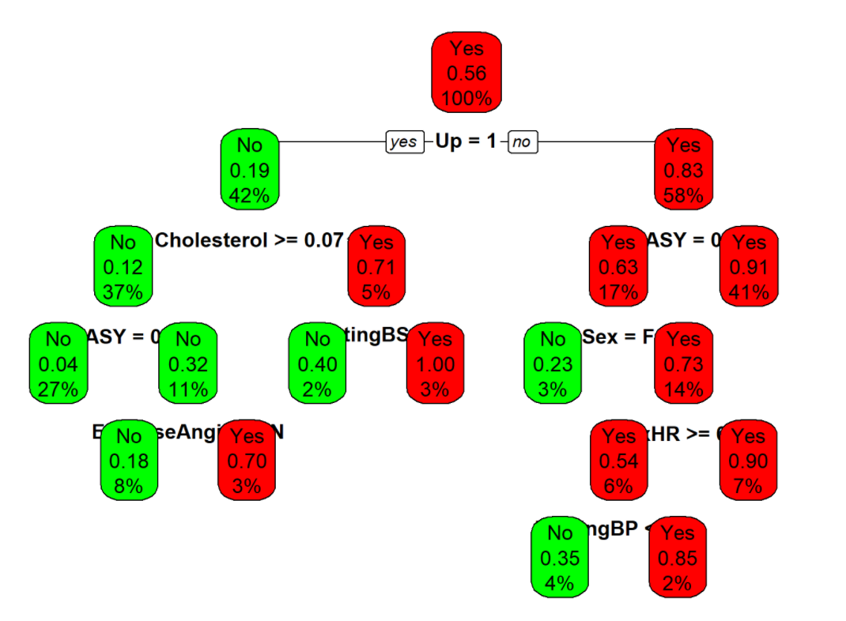
Model Decision Tree
Plot the tree
1
2
3
4
5
6
7
10
11
8
9
13
12
18
19
26
27
52
53

Slide 29
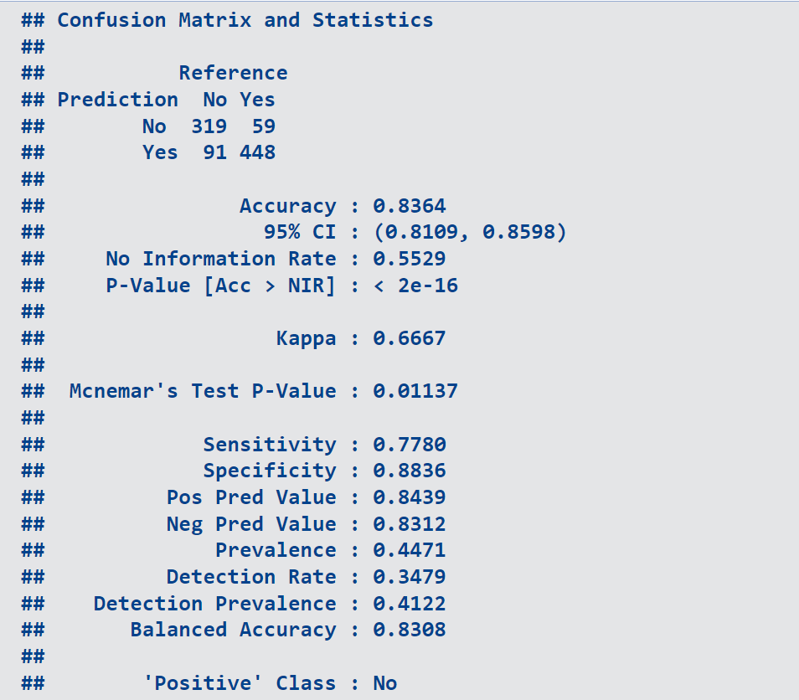
Model Decision Tree
Confusion Matrix
& statistics

Slide 30
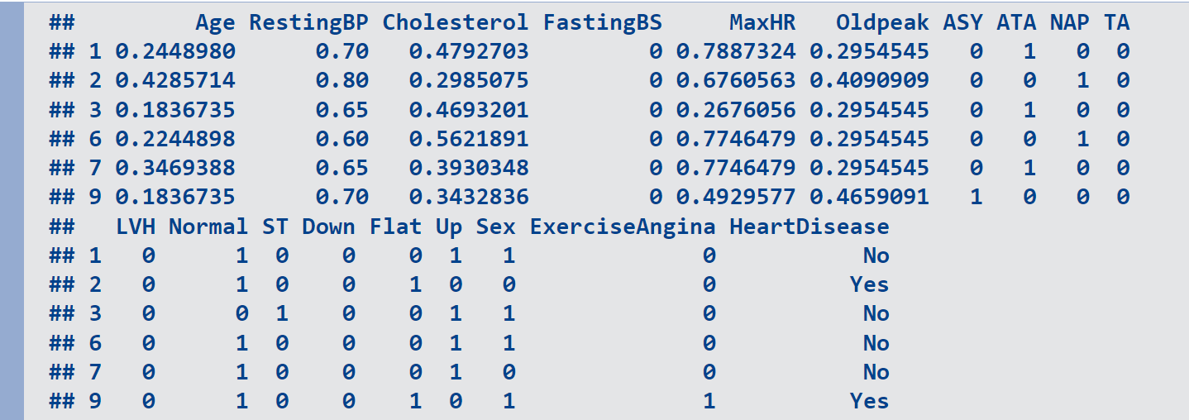
Model KNN (k-Nearest Neighbors )
Convert Sex and ExerciseAngina to Binary

Slide 31
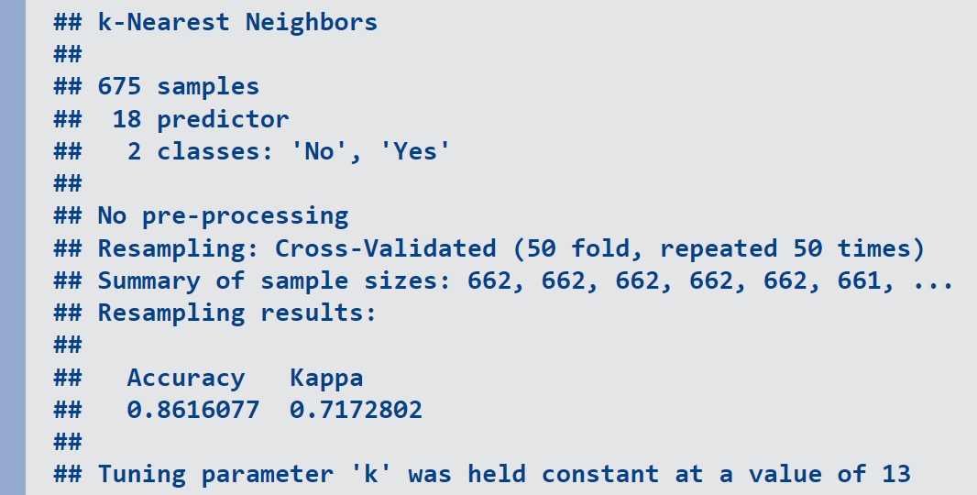
Model KNN (k-Nearest Neighbors )
Result

Slide 32
Result evaluation
 | SVM | KNN | Decision Tree
Độ chính xác | 76.05% | 86.16% | 83.64%
Ưu điểm | Linh hoạt , tiết kiệm bộ nhớ . | Dự đoán dữ liệu mới đơn giản . Độ phức tạp trong quá trình training bằng 0 . | Đơn giản , phổ biến
Nhược điểm | Chưa thể hiện rõ xác suất vì chỉ dựa vào hyper-Plane để phân loại . | Nhạy cảm với dữ liệu nhiễu khi k nhỏ . | Phụ thuộc lớn vào dữ liệu . Hay gặp vấn đề overfitting .

Slide 33


