Slide 1
Team 1: Android Class 15 NIIT-ICT Hà Nội
Subject name: Cẩm nang đi làm

Slide 2
Members
1) Đào Tiến Tú

Slide 3
Máy ảo giả lập: AVD (Android Virtual Device)
- Độ phân giải: 768 x 1280 dpi

Slide 4
Cấu hình chung cho app
Trong file AndroidManifest.xml, ta thiết lập một vài thông số sau:
+) Tên package: package=“com.example.nhom1”
+) Tên app: android:label=“@string/app_name”
+) Tên theme: android:theme=“@style/AppTheme”
+) Tên Activity chính khi khởi động app:
<activity
android:name=“com.example.nhom1.MainActivity”
<intent-filter>
<action android:name=“android.intent.action.MAIN”/>
<category android:name=“android.intent.category.LAUNCHER”/>
</intent-filter>
</activity>

Slide 5
Creating dashboard
Changing background
Example:
Color: #FFFFFF (white)
– Background: #000000 (black)

Slide 6
Building a navigation drawer
The navigation drawer is a panel that transitions in from the left edge of the screen and displays the app’s main navigation options.
When the navigation drawer is expanded, the user can dismiss it in one of four ways:
+=> Touching the content outside the navigation drawer.
+=> Swiping to the left anywhere on the screen (including edge swipe from right)
+=> Touching the app icon/title in the action bar
+=> Pressing Back

Slide 7
When to Use the Navigation Drawer
More than 3 top-level views
Navigation drawers are great for displaying a large number of navigation targets concurrently. Use the navigation drawer if you have more than 3 unique top-level views. If not, use fixed tabs for top-level organization to ease discovery and interaction.
Cross-navigation from lower levels
If your app requires cross-navigating between lower-level screens, consider using the navigation drawer. Because it is accessible from anywhere in the app, the drawer enables efficient navigation from lower-level screens to other important places in your app.
Deep navigation branches
If you have particularly deep branches, navigating to the top-level of your app can become repetitive and cumbersome with Up and Black alone. Since navigation drawer are accessible from anywhere in the app, navigation up to the top level is faster and more efficient.

Slide 8
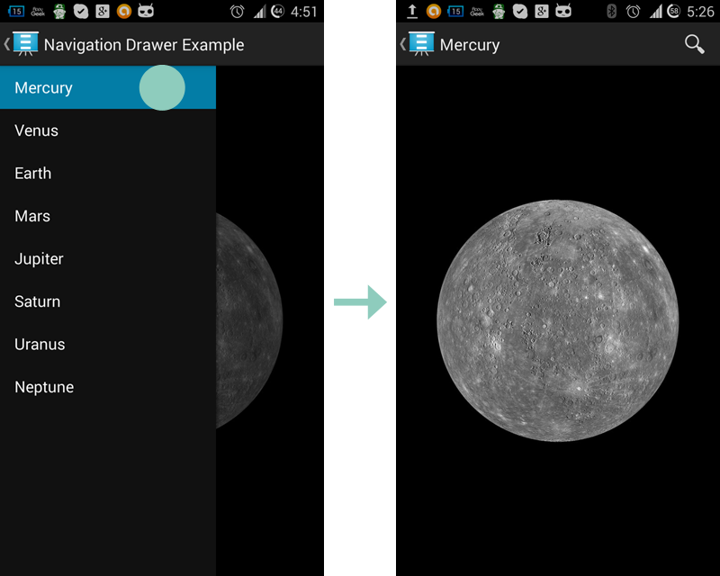
Android Custom Navigation Drawer

Slide 9
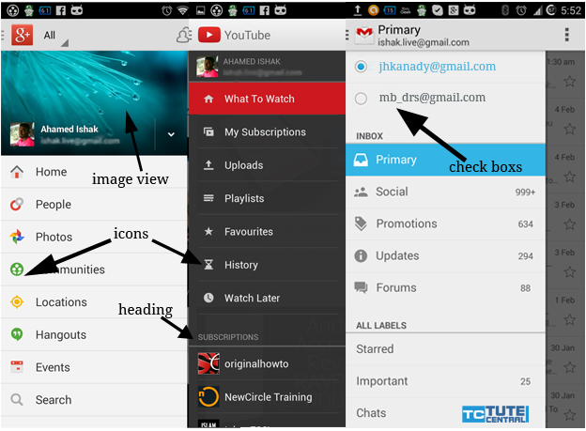
Example Custom Navigation Drawer Apps

Slide 10


Sử dụng các màu sắc cơ bản cho ứng dụng

Slide 11
Chỉ định 1 styles.xml chung
For example, by using a style, I can take this layout XML:
<TextView
android:layout_width=“match_parent”
android:layout_height=“wrap_content”
android:textColor=“#000000”
android:text=“@string/hello” />
And turn it into this:
<TextView
style=“@style/CodeFont”
android:text=“@string/hello”/>

Slide 12
Định nghĩa 1 file styles.xml
Here’s an example file with a single style:
<?xml version=“1.0” encoding=“utf-8”?>
<resources>
<style name=“CodeFont” parent=“@android:style/TextAppearance.Medium”>
<item name=“android:layout_width”>match_parent</item>
<item name=“android:layout_height”>wrap_content</item>
<item name=“android:textColor”>#000000</item>
</style>
</resources>

Slide 13
Tạo Theme cho app
<!– Platform-independent theme providing an action bar in a light-themed activity -->
<style name=“Theme.AppCompat.Light” parent=“Theme.Base.AppCompat.Light”>
<item name=“isLightTheme”>true</item>
<!– Popup Menu styles -->
<item name=“popupMenuStyle”>@style/Widget.AppCombat.Light.PopupMenu</item>
<item name=“textAppearanceLargePopupMenu”>
@style/TextAppearance.AppCompat.Light.Widget.PopupMenu.Large
</item>
<item name=“textAppearanceSmallPopupMenu”>
@style/TextAppearance.AppCompat.Light.Widget.PopupMenu.Small
</item>
</style>

Slide 14

ListView Widget
ListView is a view group that displays a list of scrollable items. The list items are automatically inserted to the list using an Adapter that pulls content from a source such as an array or database query and converts each item result into a view that’s placed into the list.
Here is how your Android listview code looks:
<ListView
android:id=“@+id/listView1”
android:layout_width=“match_parent”
android:layout_height=“wrap_content”>
</ListView>

Slide 15
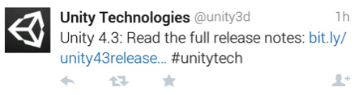
ListItem
An Android listview is made from a group of list items. List items are individual rows in listview where the data will be displayed. Any data in listview is displayed only through listItem. Consider ListView as scrollable group of list items.
This list Item is arranged in a Relative layout with images and multiple text views aligned to each other.
Once we have the listitem, we bind the listview to the Adapter and then use list items to display the data in listview.

Slide 16
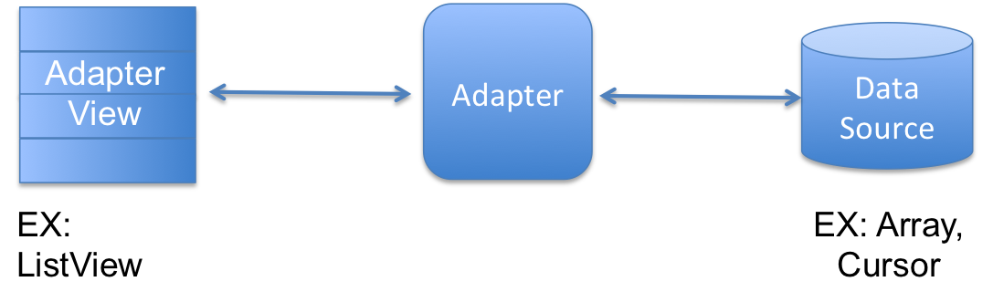
Adapter
Android Adapter is a bridge between the View (ListView) and the underlying data for that view. An adapter manages the data and adapts the data to the individual rows (listItems) of the view.
We bind the adapter with Android listview via setAdapter method.
As stated earlier, Adapters act as a bridge to the views. To interact with the view, adapters call the getView() method which returns a view for each item within the adapter view.

Slide 17

GridView Layout – Menu item Nhà tuyển dụng hàng đầu
- Example:
<?xml version=“1.0” encoding=“utf-8”?>
<GridView xmlns:android=http://schemas.adnroid.com/apk/res/android
android:id=“@+id/gridview”
android:layout_width=“fill_parent”
android:layout_height=“fill_parent”
android:columnWidth=“90dp”
android:numColumns=“auto_fit”
android:verticalSpacing=“10dp”
android:horizontalSpacing=“10dp”
android:stretchMode=“columnWidth”
android:gravity=“center”
/>

Slide 18
Thiết kế cơ sở dữ liệu - database
- Sử dụng csdl SQLite Database

Slide 19
Kết nối tới cơ sở dữ liệu SQLite

Slide 20
Share ý kiến – chia sẻ thông tin
Gmail
g+
SMS

Slide 21
Gửi email trong ứng dụng android

Slide 22
Gửi tin nhắn SMS trong ứng dụng android

Slide 23
Tạo hiệu ứng animation trong việc chuyển giữa các layout
Tạo 1 thư mục chứa các tập tin xml định nghĩa các hiệu ứng (animation).
Một số hiệu ứng bao gồm:
- Fade In
- Fade Out
- Blink
- Zoom In
- Zoom Out
- Rotate
- Move
- Slide Up
- Slide Down
- Bounce
- Sequential Animation
- Together Animation

Slide 24
Android WebView Widget
<?xml version=“1.0” encoding=“utf-8”?>
<WebView xmlns:android=http://schemas.android.com/apk/res/android
android:id=“@+id/webView1”
android:layout_width=“fill_parent”
android:layout_height=“fill_parent”
/>

Slide 25
ScrollView

Slide 26
Chuyển Activity đính kèm dữ liệu

Slide 27
Sử dụng Action Bar trong Android
Menu cho Action Bar
- Tạo 1 tập tin trong thư mục /res/menu/ và đặt tên là activity_main_actions.xml
<?xml version=“1.0” encoding=“utf-8”?>
<menu xmlns:android=http://schemas.adnroid.com/apk/res/android>
<item
android:id=“@+id/action_menuItem1”
android:icon=“drawable/ic_action_menuItem1”
android:showAsAction=“ifRoom”
android:title=“@string/action_menuItem1”
/>
</menu>

Slide 28
Đối với mỗi thẻ item trong menu sẽ có một số thuộc tính như:
+) android:id – id của Action Button
+) android:icon – icon hiển thị cho menu item
+) android:title – tiêu đề hiển thị cho menu item
+) android:showAsAction – xác định việc hiển thị cho Action Button
Trong class thực thi ta khai báo phương thức onCreateOptionsMenu() như sau:
@Override
public boolean onCreateOptionsMenu(Menu menu){
MenuInflater inflater=getMenuInflater();
inflater.inflate(R.menu.activity_main_actions,menu);
return super.onCreateOptionsMenu(menu);
}

Slide 29
Build an Android app using existing SQLite Database

