Slide 1
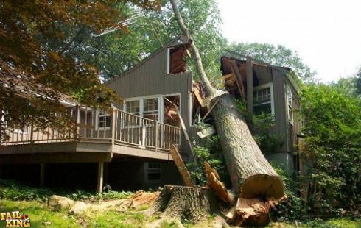
Logging With Lager

Slide 2
What's “Lager”?
It started out as lager
Then it was called Next::OpenSIPS::Log
Now it's Log::Lager.
Thank you Marchex.

Slide 3
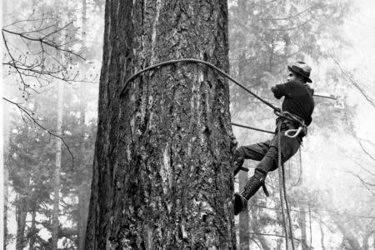
All about logging

Slide 4
Why log?
The poor man's debugger
THE BEST DEBUGGER EVAR
print “WTF is going on?\n”;

Slide 5
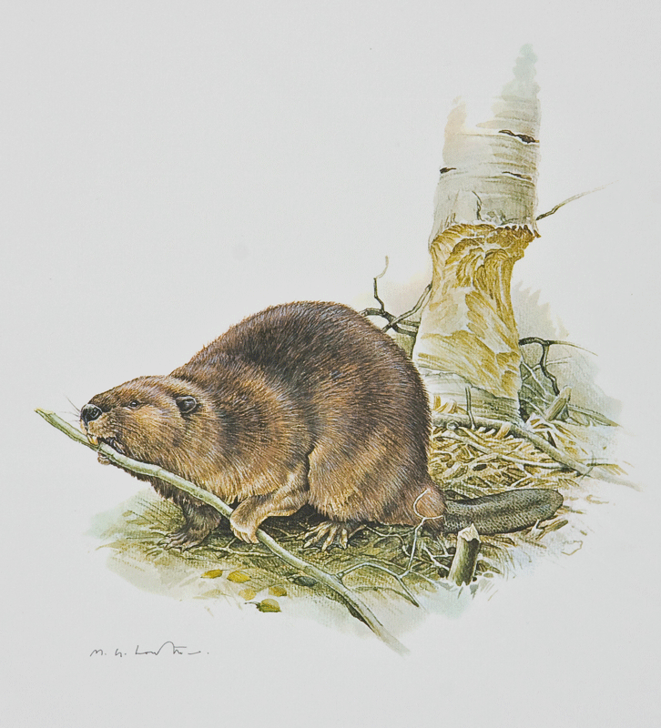
Who loves logs?
Developers
What is going on?
Operations
What did they do this time?

Slide 6
What do devs want?
Easy to write
Easy to add to existing code
Easy to configure when debugging problem code.
Data::Dumper
Stack traces
A pony

Slide 7
What does ops want?
Multiple outputs
Syslog
STDERR
File
Runtime controls
Simple, consistent configuration
Rainbows

Slide 8
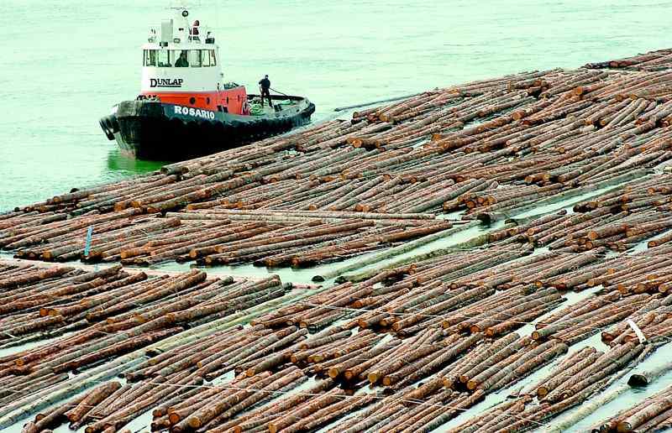
Existing Modules
Millions of them on CPAN
Two popular options:
Log4Perl Log::Dispatch

Slide 9
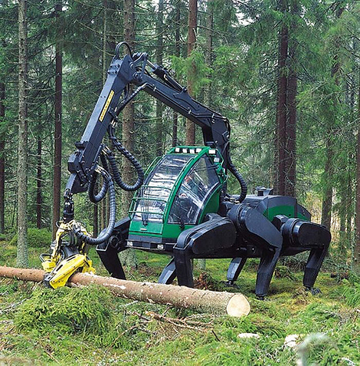
Why make a new logging module?
Everything else sucks
Lager sucks, too
but it sucks less
and
It sucks in new and exciting ways...

Slide 10
Log levels
Sucks: Sorted log levels
TRACE > INFO
Means you can't see TRACE without INFO
Cluttered logs
Sucks less: Orthogonal log levels
Each level is configured independent of the others
Pristine logs

Slide 11

Parsing
Sucks: Random formats require specialized parsers.
Sucks less: Log entries are formatted as JSON
Single line JSON

Slide 12
Configuration Granularity
Sucks: Application wide settings
Sucks less: Focus on trouble spots
Lexical (per block) configuration
with a “kill switch” for ops.
Configure by package name
Configure by subroutine name

Slide 13
Complex Data Structures
Sucks: require manual use of Data::Dumper
Sucks less: Built in data dumping
JSON
Abridged data structures that won't choke JSON
Optional pretty printing

Slide 14
Performance
Sucks: Computing things only to throw them away
Sucks less: Lazy evaluation via callbacks
Callbacks are executed only when a message is emitted.
TRACE sub { expensive_calculation($foo) };

Slide 15
Ease of use
Sucks: Create, configure and pass logging objects
Sucks less: Namespace pollution
Imports logging routines
FATAL ERROR
WARN INFO
DEBUG TRACE
GUTS

Slide 16
Example
sub get_bug_list {
my $sp = shift;
my $url = join '', $BASE, map /##SP##/ ? $sp : $_, @BUGLIST_URL;
my $html = get_url($url);
my $t = HTML::TreeBuilder->new_from_content($html);
return if $t->look_down( class => qr/\bzero_results\b/ );
my $buglist = $t->look_down( class => qr/\bbz_buglist\b/ );
my @buglist = $buglist->look_down(class => qr/\bbz_bugitem\b/);
my @bugs;
for my $bug_item ( @buglist ) {
my %bug;
for my $col ('bz_id_column', 'bz_assigned_to_column', 'bz_short_desc_column' ]) {
my $key = $col;
$key =~ s/bz_(\w*)_column/$1/;
my $e = $bug_item->look_down( class => qr/\b$col\b/ );
$bug{key} = $e->as_text;
}
push @bugs, \%bug;
}
return @bugs;
}

Slide 17
Logging added
use Log::Lager;
sub get_bug_list {
my $sp = shift;
my $url = join '', $BASE, map /##SP##/ ? $sp : $_, @BUGLIST_URL;
TRACE 'Getting bug list', URL => $url, SP => $sp;
my $html = get_url($url);
DEBUG $html;
my $t = HTML::TreeBuilder->new_from_content($html);
if( $t->look_down( class => qr/\bzero_results\b/ ) ) {
WARN 'Zero bugs found';
return;
}
my $buglist = $t->look_down( class => qr/\bbz_buglist\b/ );
my @buglist = $buglist->look_down(class => qr/\bbz_bugitem\b/);
my @bugs;
for my $bug_item ( @buglist ) {
TRACE 'Extracting bug from result set';
GUTS $bug_item;
my %bug;
for my $col ('bz_id_column', 'bz_assigned_to_column', 'bz_short_desc_column' ]) {

Slide 18
Add lexical controls
sub get_bug_list {
use Log::Lager 'enable DTI stack T pretty D';
my $sp = shift;
my $url = join '', $BASE, map /##SP##/ ? $sp : $_, @BUGLIST_URL;
TRACE 'Getting bug list', URL => $url, SP => $sp;
my $html = get_url($url);
DEBUG $html;
my $t = HTML::TreeBuilder->new_from_content($html);
my $t = HTML::TreeBuilder->new_from_content($html);
if( $t->look_down( class => qr/\bzero_results\b/ ) ) {
WARN 'Zero bugs found';
return;
}
my $buglist = $t->look_down( class => qr/\bbz_buglist\b/ );
my @buglist = $buglist->look_down(class => qr/\bbz_bugitem\b/);
my @bugs;
for my $bug_item ( @buglist ) {
my %bug;
TRACE 'Extracting bug from result set';
GUTS $bug_item;
for my $col ('bz_id_column', 'bz_assigned_to_column', 'bz_short_desc_column' ]) {
no Log::Lager 'D';

Slide 19
Production
buggetter-log.conf:
enable FEW disable IDTG
nostack FEWIDTG
compact FEWIDTG
nofatal FEWIDTG
END

Slide 20
Disable lexical controls
buggetter-log.conf:
enable FEW disable IDTG
nostack FEWIDTG
compact FEWIDTG
nofatal FEWIDTG
lexoff
END

Slide 21
Control output
buggetter-log.conf:
enable FEW disable IDTG
nostack FEWIDTG
compact FEWIDTG
nofatal FEWIDTG
lexoff
syslog buggetter LOG_LOCAL0
END

Slide 22
Target a package or sub
buggetter-log.conf:
enable FEW disable IDTG
nostack FEWIDTG
compact FEWIDTG
lexoff
syslog buggetter LOG_LOCAL0
package AT::Bugfest enable DIT
sub AT::Bugfest::broke enable G stack T
END

Slide 23
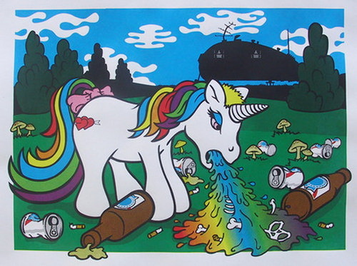
Because I promised it
Rainbows
and a pony!

Slide 24
Questions

