Slide 1
FINAL ASSIGNMENT PRESENTATION
E-Invoice System
Mentor: Nguyễn Thị Ái Vy

Slide 2
CONTENTS
1. Introduction
2. Vision of Solution
3. Design
4. Technical
5. Demo
6. Q&A

Slide 3
Introduction
1

Slide 4

HELLO!
We are Beer Team

Slide 5
TEAM MEMBERS:
Lê Văn Tụ
Phạm Thanh Phong
Nguyễn Hưng Thịnh
Đào Văn Phong
Lê Thị Thu
Ngô Vương Đức Trí

Slide 6
Vision Of Solution
2

Slide 7
Vision Statement
E-Invoice is built for the purpose of monthly invoice
management in a family. It helps us to have an overall
report of monthly expenses so that user could make
plan to save money. User could set an alert for a
limited amount of money consumed every month.

Slide 8
Major Features
Invoices Management
- User_Add Invoice Type
- User_Add Invoice
- User_Set Limit Money
- User_Search Invoice
- User_Delete Invoice
- User_View Invoice
- User_Delete Invoice Type
- User_View Report/Charts
- User_Edit Information
Account Management
- Admin_Add Admin
- Admin_Add Invoice Type
- Admin_Set Trigger Time
- Admin_Search Accounts
- Admin_Delete Invoice type
- Admin_Active/DeActive
Decentralization
- Login
- Logout
- User_Registered

Slide 9
Technical Constrains
Check duplication when adding
Able to send email for monthly notification

Slide 10
Design
3

Slide 11

Physical View

Slide 12
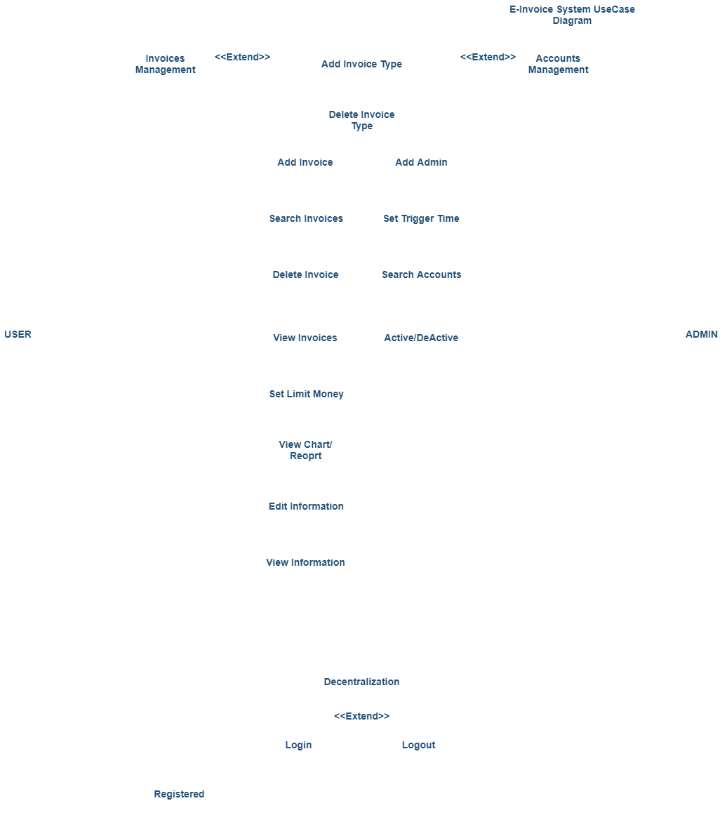
Use Case Diagram

Slide 13
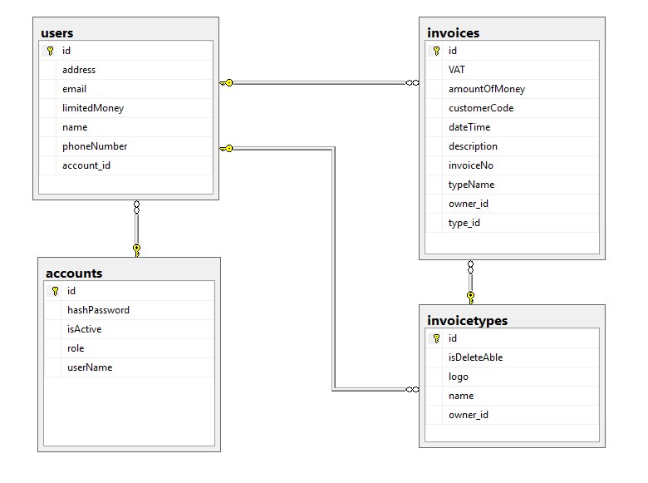
Database Diagram

Slide 14
Technical
4

Slide 15
Technical
Back-end
Front-end
Version Control
- Hibernate
- Database: SQL Server
- Spring MVC
- Spring Security
- JUnit
- JSP
- HTML, CSS
- JavaScript, Jquery
- Bootstrap
- Github

Slide 16
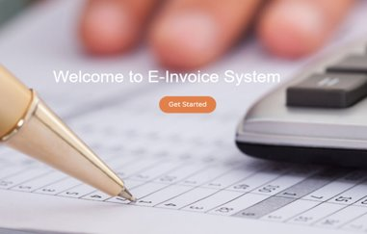
Demo
5

Slide 17
Q&A
6

Slide 18
THANKS FOR YOUR ATTENTION.

