Slide 1
Introducing the Eureka Netflix library

Slide 2
Table of contents
Spring Cloud Config Server
Eureka Service Registry
Router & Load balance
Authentication(SSO)
Monitoring

Slide 3
Spring Cloud Config Server
Spring Cloud Config provides server-side and client-side support for externalized configuration in a distributed system. With the Config Server, you have a central place to manage external properties for applications across all environments. The concepts on both client and server map identically to the Spring Environment and PropertySource abstractions, so they fit very well with Spring applications but can be used with any application running in any language.

Slide 4

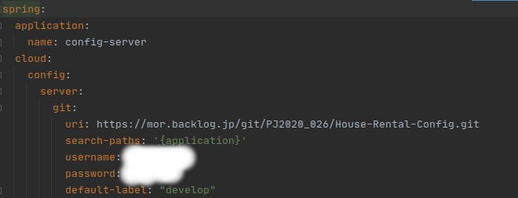

Slide 5
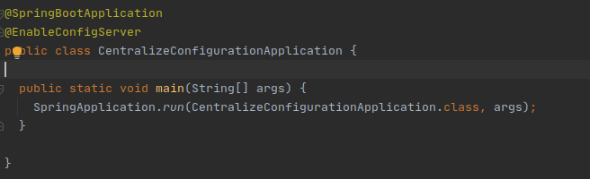

Slide 6
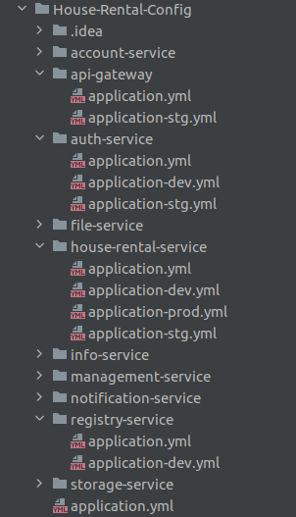

Slide 7
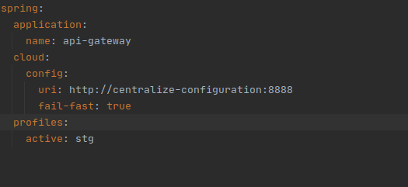

Slide 8
Eureka Service Registry
Eureka Server is an application that holds the information about all client-service applications. Every Micro service will register into the Eureka server and Eureka server knows all the client applications running on each port and IP address. Eureka Server is also known as Discovery Server.

Slide 9

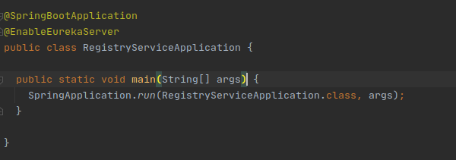

Slide 10
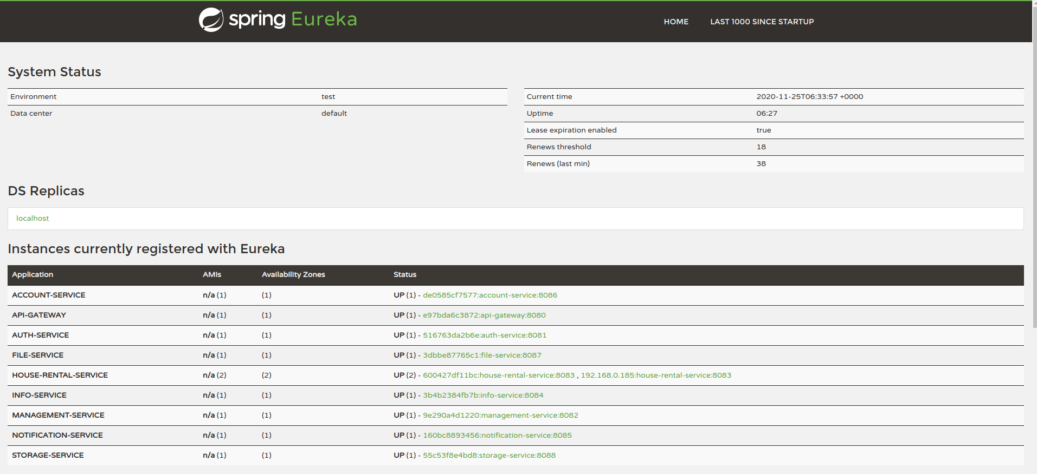

Slide 11
Load balancing & Router
Load Balancing is a concept of distributing the workloads across multiple resources such as servers, clusters, or disk drives
Load Balancing aims to improve the application’s response time, avoiding overloading a single resource, optimizing resource usage, and maximizing throughput

Slide 12
Zuul Proxy
Zuul acts as an API gateway or Edge service. It receives all the requests coming from the UI and then delegates the requests to internal microservices. So, we have to create a brand new microservice which is Zuul-enabled, and this service sits on top of all other microservices. It acts as an Edge service or client-facing service. Its Service API should be exposed to the client/UI. The client calls this service as a proxy for an internal microservice, then this service delegates the request to the appropriate service.

Slide 13
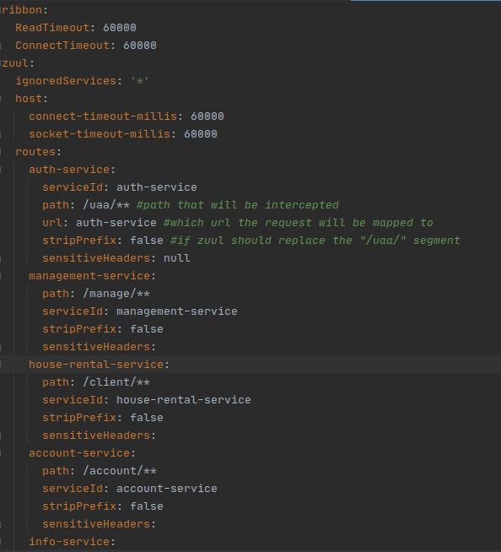

Slide 14
Authentication
Single sign on (SSO)
Authorization server
Resource Server

Slide 15
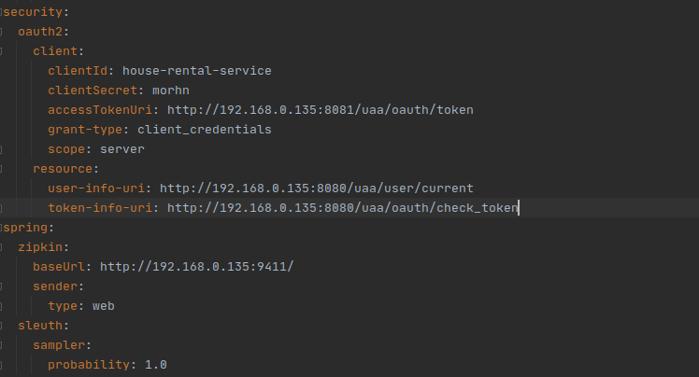

Slide 16
Monitoring
Zipkin is a distributed tracing system. It helps gather timing data needed to troubleshoot latency problems in service architectures. Features include both the collection and lookup of this data.

Slide 17
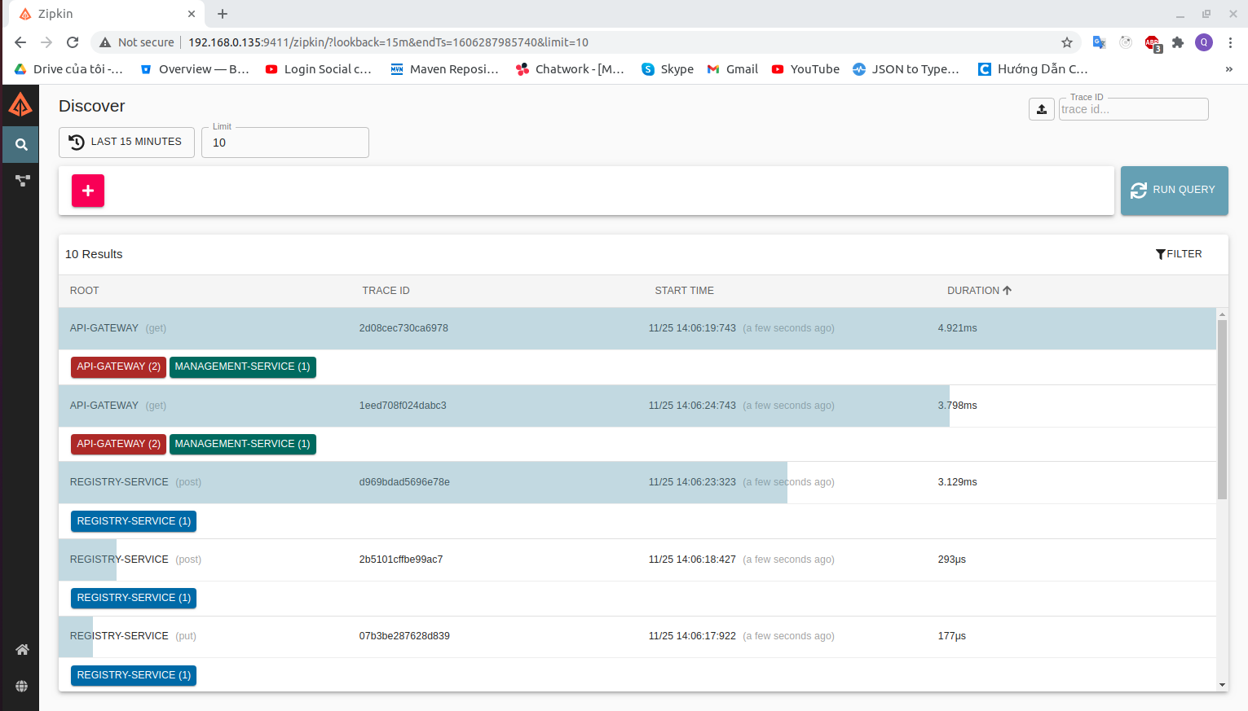

Slide 18
