Slide 1
Web programming report
Ecommerce website
Group 13 Instructor: Dr. Dao Thanh Chung

Slide 2
Team members and contribution
Pham Thai Hung - 20184269
Nguyen Thi Nga - 20184296
Dao Van Thang - 20184304
Order, cart, check out, database
Team leader
Customer, sign in, register
Team member
Index, products page
Team member

Slide 3
TABLE OF CONTENTS
01
02
Introduction
Technological solution
03
04
Database and model
Demo

Slide 4
01
INTRODUCTION

Slide 5
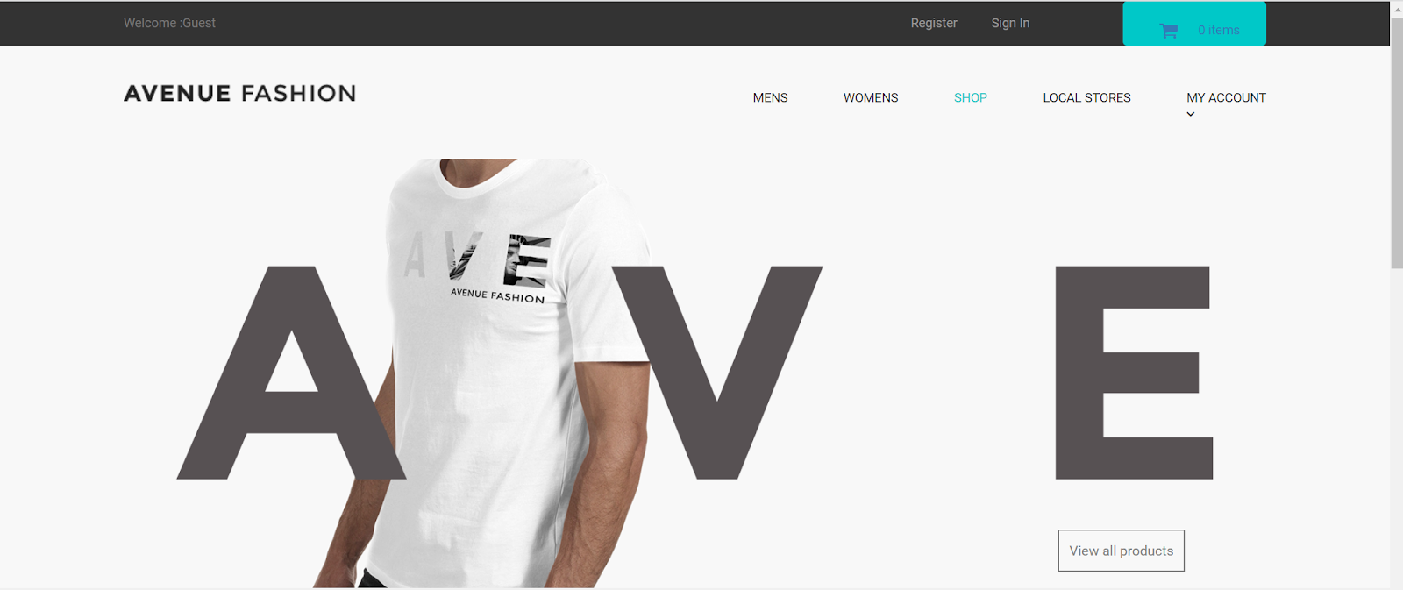
Introduction
About website:
An ecommerce website for online fashion shopping.
Is designed for both men and women
Features all the functionalities of a typical ecommerce website

Slide 6
Site map
Home
Products
Dashboard
About us
Carts
Sign in
Account
Products detail
Check out
Orders
Register

Slide 7
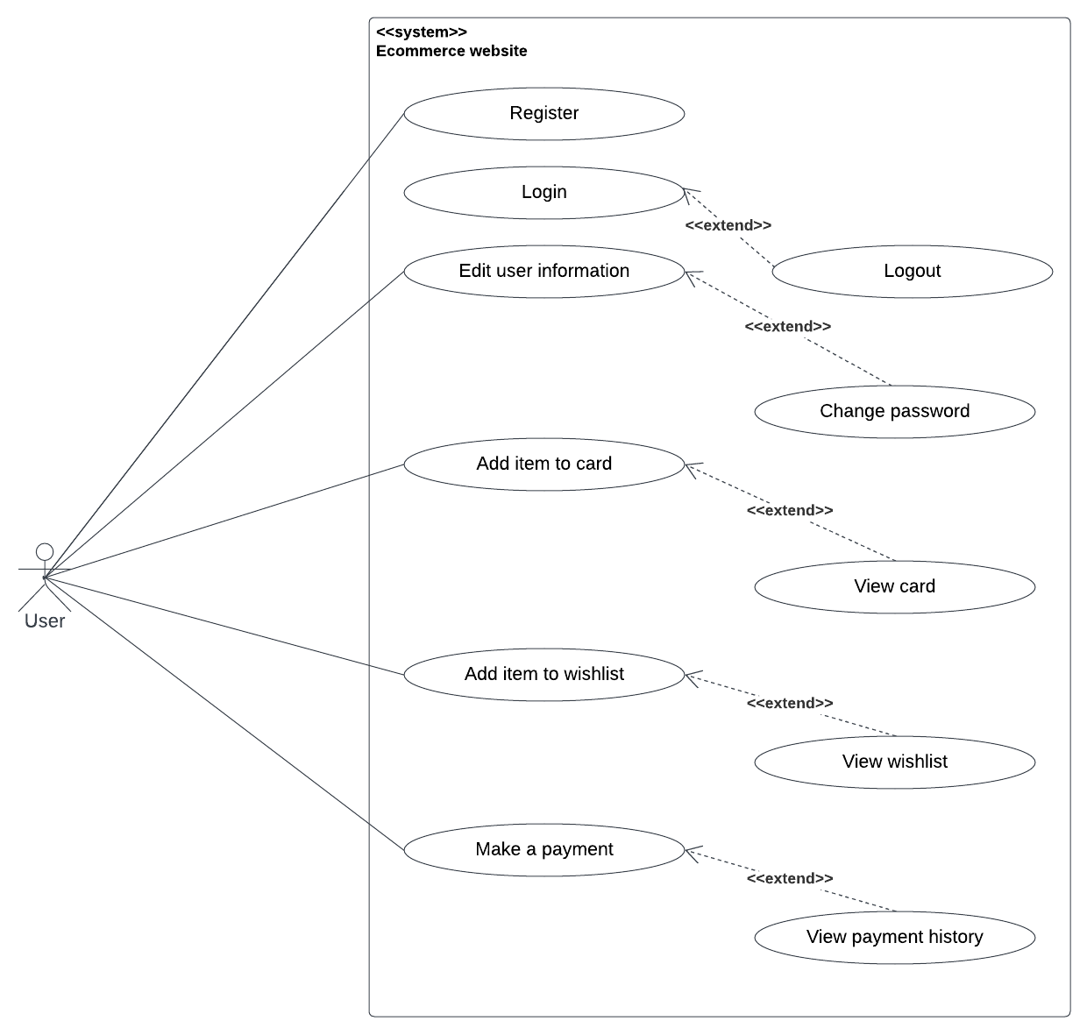
Use case

Slide 8
02
TECHNOLOGICAL SOLUTION

Slide 9
TECHNOLOGICAL SOLUTION
Front-end
Backend
HTML
CSS
Bootstrap
Database: MySql
Programming Language: PHP

Slide 10
03
Database and model

Slide 11
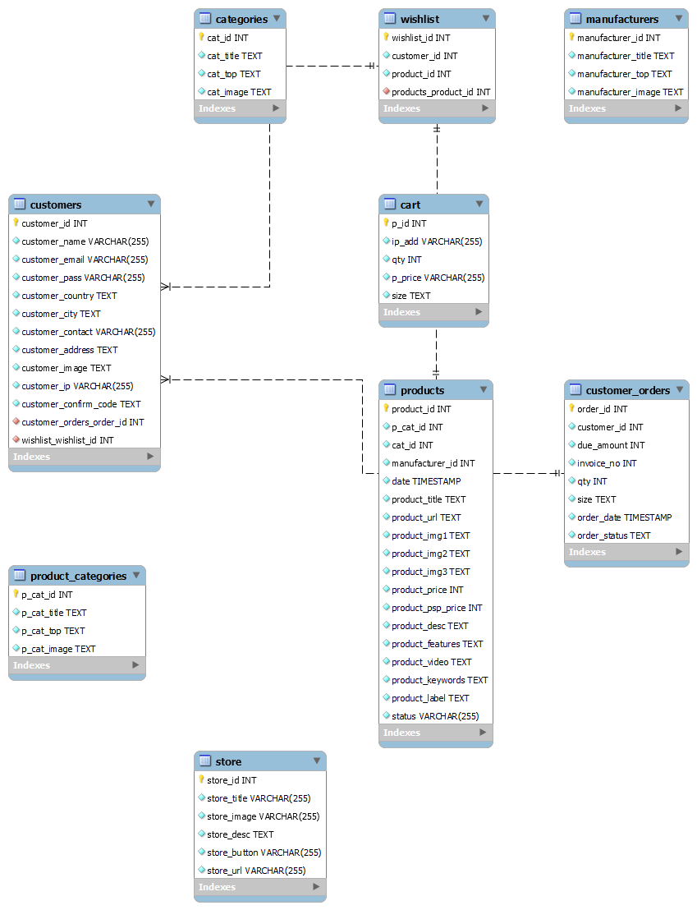
Database and model

Slide 12
04
Demo

Slide 13
THANKS!
Any questions?

