Slide 1
Rabbitmq overview
by six examples

Slide 2
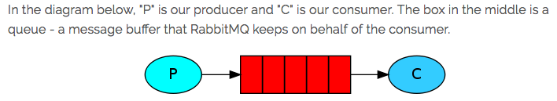
“Hello World”

Slide 3
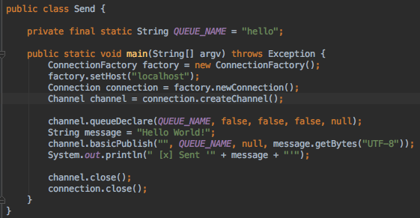

Slide 4
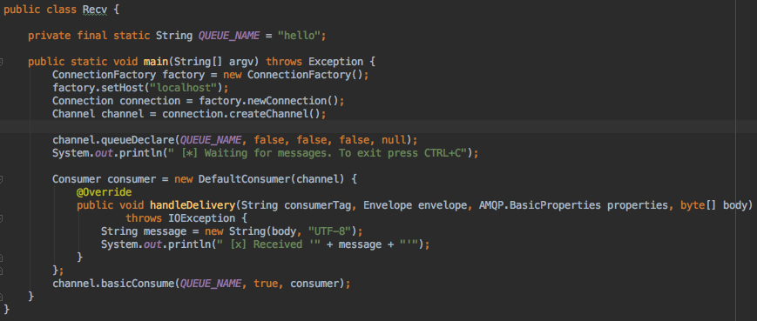

Slide 5
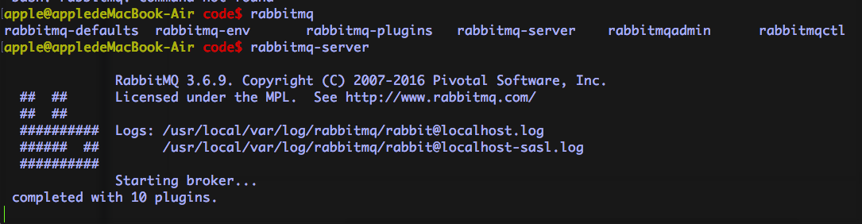
启动rabbitmq

Slide 6
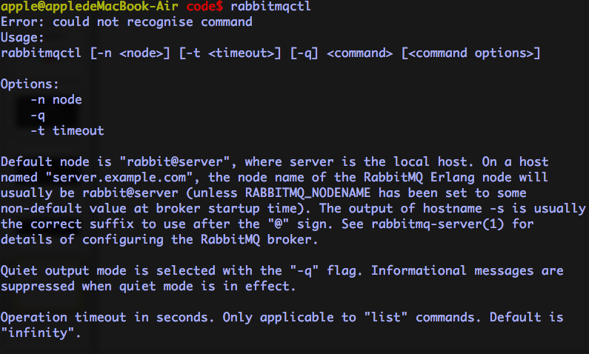

Slide 7
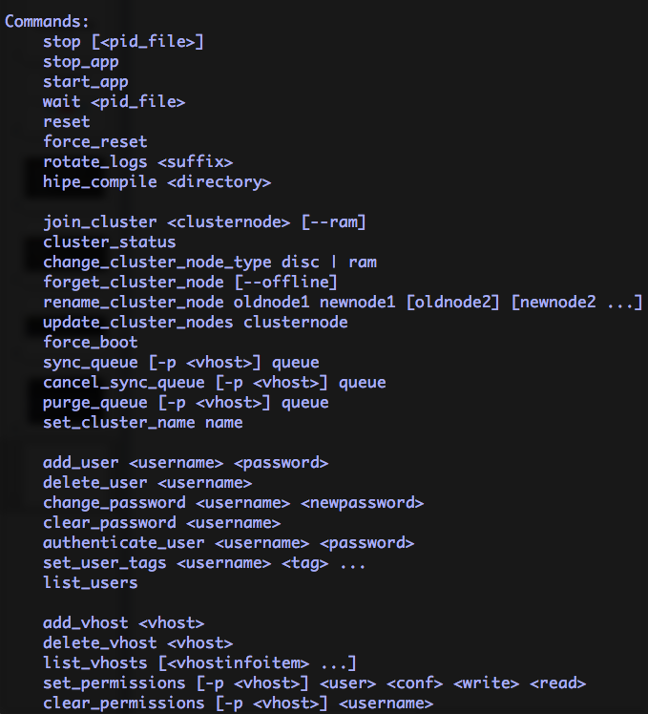

Slide 8
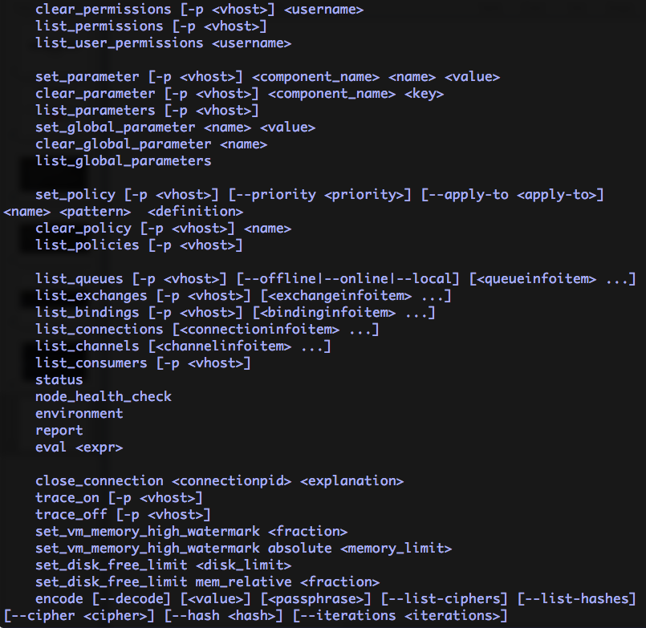

Slide 9
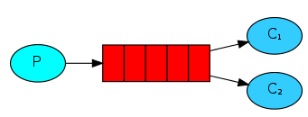
work queues
The main idea behind Work Queues (aka: Task Queues) is to avoid doing a resource-intensive task immediately and having to wait for it to complete. Instead we schedule the task to be done later. We encapsulate a task as a message and send it to a queue. A worker process running in the background will pop the tasks and eventually execute the job. When you run many workers the tasks will be shared between them.

Slide 10
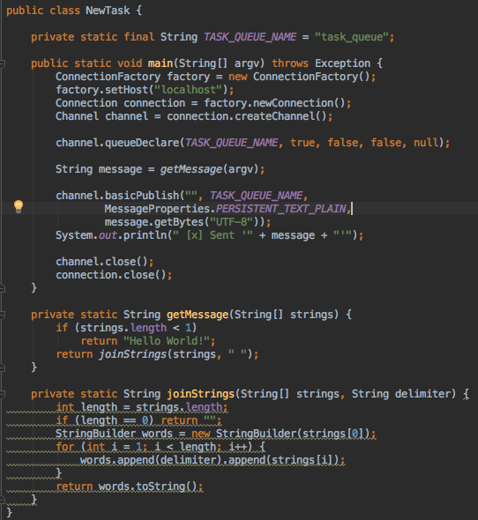

Slide 11
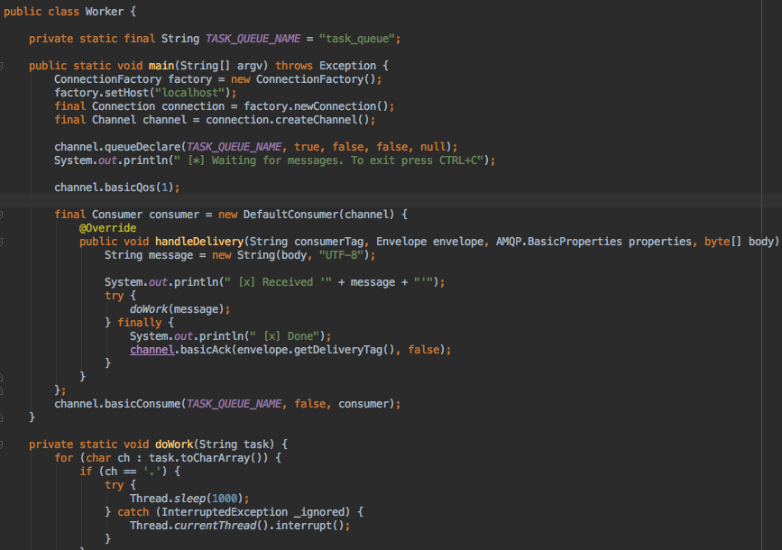

Slide 12
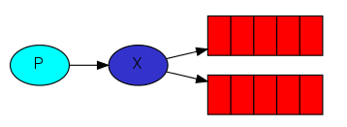
publish-subscribe
• A producer is a user application that sends messages.
• A queue is a buffer that stores messages.
• A consumer is a user application that receives messages.
The core idea in the messaging model in RabbitMQ is that the producer never sends any messages directly to a queue. Actually, quite often the producer doesn't even know if a message will be delivered to any queue at all.
Instead, the producer can only send messages to an exchange. An exchange is a very simple thing. On one side it receives messages from producers and the other side it pushes them to queues. The exchange must know exactly what to do with a message it receives.

Slide 13
Exchange types
direct: routing key == binding key
topic
headers
fanout: mindless broadcasting

Slide 14
Fanout exchange
broadcasting

Slide 15
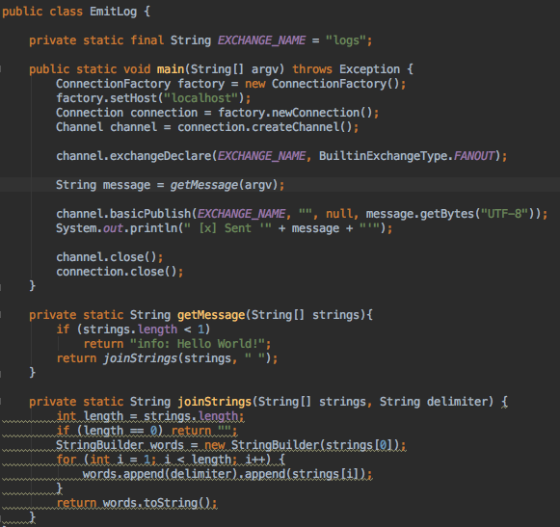

Slide 16
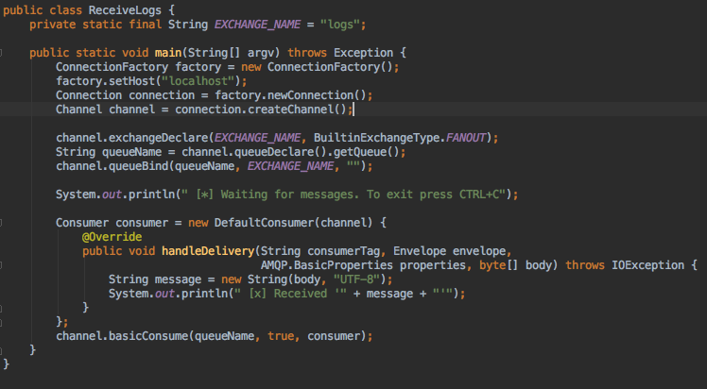

Slide 17
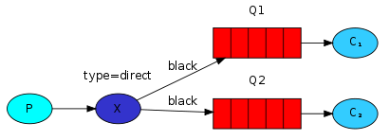
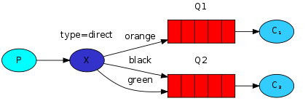
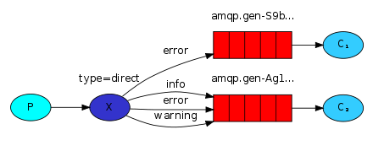
Direct exchange

Slide 18
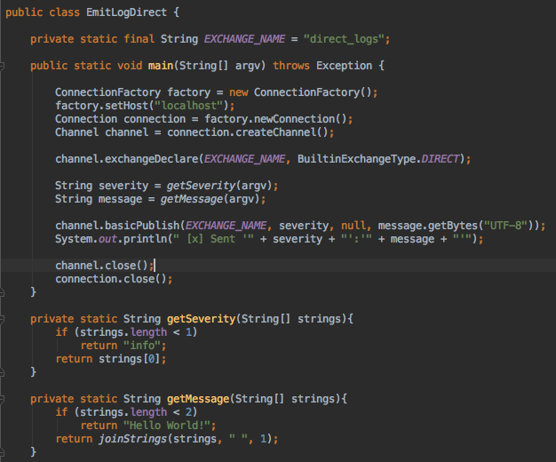

Slide 19
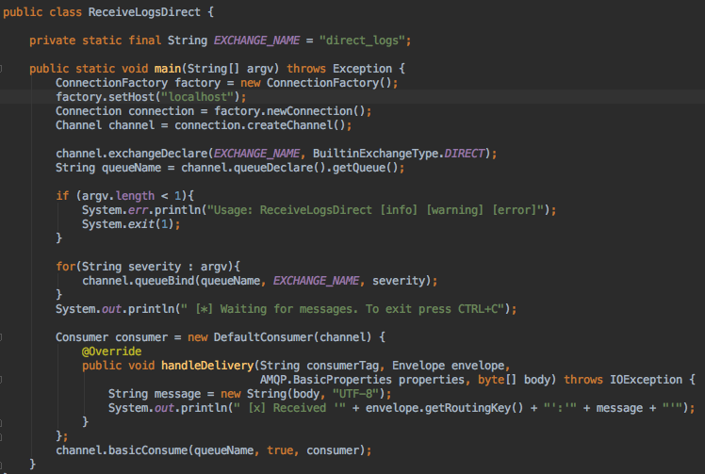

Slide 20
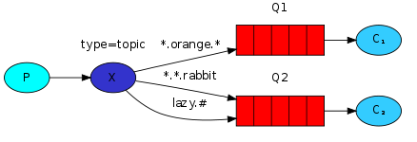
Topic exachange
—- Messages sent to a topic exchange can't have an arbitrary routing_key - it must be a list of words, delimited by dots.
—- The words can be anything, but usually they specify some features connected to the message.
—- A few valid routing key examples: "stock.usd.nyse", "nyse.vmw", "quick.orange.rabbit".
—- a message sent with a particular routing key will be delivered to all the queues that are bound with a matching binding key.
—— * (star) can substitute for exactly one word.
—— # (hash) can substitute for zero or more words.

Slide 21
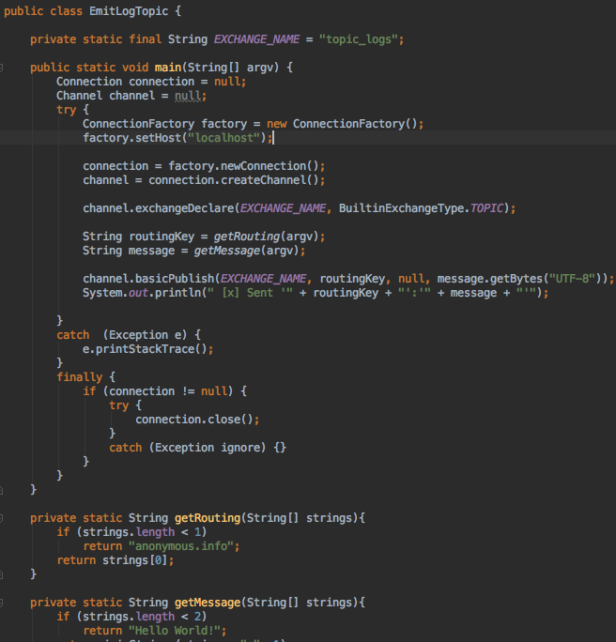

Slide 22
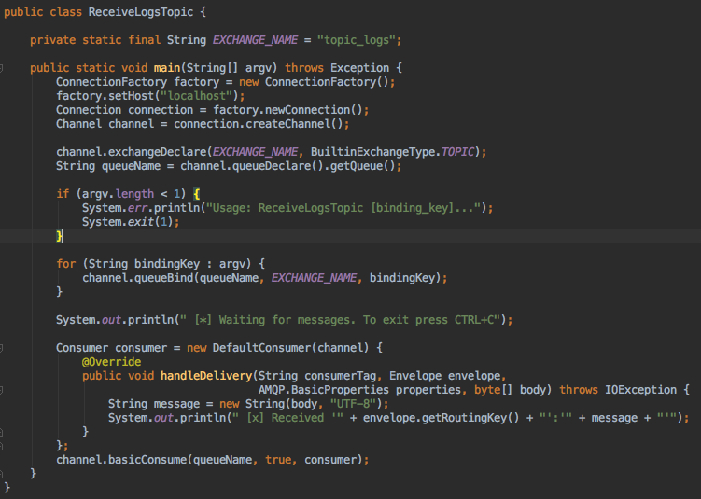

Slide 23
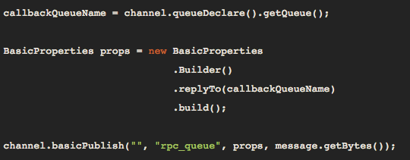
RPC
In general doing RPC over RabbitMQ is easy.
A client sends a request message and a server replies with a response message.
In order to receive a response we need to send a 'callback' queue address with the request.

Slide 24
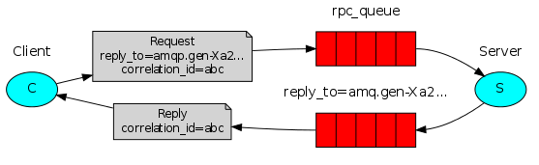

Slide 25
summary
• When the Client starts up, it creates an anonymous exclusive callback queue.
• For an RPC request, the Client sends a message with two properties: replyTo, which is set to the callback queue and correlationId, which is set to a unique value for every request.
• The request is sent to an rpc_queue queue.
• The RPC worker (aka: server) is waiting for requests on that queue. When a request appears, it does the job and sends a message with the result back to the Client, using the queue from the replyTo field.
• The client waits for data on the callback queue. When a message appears, it checks the correlationId property. If it matches the value from the request it returns the response to the application.

Slide 26
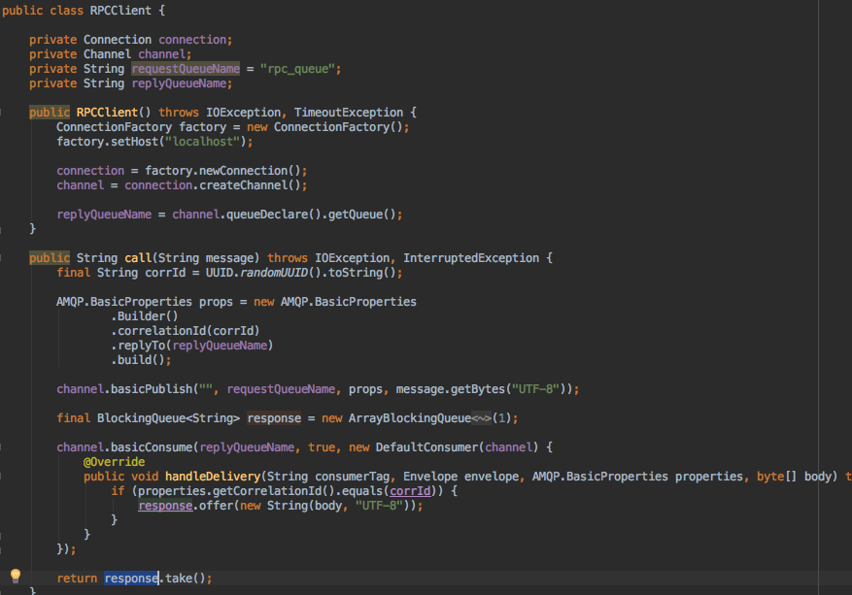

Slide 27
