Slide 1


Numeric and conversion
Validation Test Team
Dao Xuan Truong
01/2021

Slide 2

Agenda
01
Introduction
02
Numeral Systems
03
Number Base Conversion
04
Tips and tricks
05
Tips and tricks

Slide 3
Numeral Systems
Sets of symbols and the rules for using them to represent numbers, which are used to express how many objects are in a given set

Slide 4
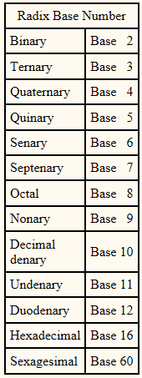
1.The base of a number system
1.1 What is radix base number?
The base of a number system is the number of different symbols available to represent any digit within that system.

Slide 5
Number Base Conversion
Binary
Decimal
Hexadecimal

Slide 6
1.2 Mainly type of radix base number
1.The base of a number system
+ The decimal system (Base 10) has a radix of 10: 0, 1, 2, 3, 4, 5, 6, 7, 8, 9
Ex: 580563
+ The binary system (Base 2) has a radix of 2: 0, 1
Ex: b10111001
+ The hexadecimal (Base 16) has a radix of 16: 0, 1, 2, 3, 4, 5, 6, 7, 8, 9, A, B, C, D, E, F
Ex: 0xF01D

Slide 7
1. The base of a number system
Can you guess?
1100100110
12DF1010

Slide 8
2.1 Bit and Byte
2. How to convert
Bit(Binary Digit):
Bit is the smallest unit of information that can be stored.
It consists of either zero or one.
Example: 1,0
Byte:
- A byte is a sequence of bits.
Byte has been 8 bits in length.
Example: b01000001

Slide 9
2.2 bit field
2. How to convert
b01101001
Bit | 7 | 6 | 5 | 4 | 3 | 2 | 1 | 0
Value | 0 | 1 | 1 | 0 | 1 | 0 | 0 | 1

Slide 10
2. How to convert
Decimal | Binary | Hexadecimal
0 | 0000 | 0
1 | 0001 | 1
2 | 0010 | 2
3 | 0011 | 3
4 | 0100 | 4
5 | 0101 | 5
6 | 0110 | 6
7 | 0111 | 7
8 | 1000 | 8
9 | 1001 | 9
10 | 1010 | A
11 | 1011 | B
12 | 1100 | C
13 | 1101 | D
14 | 1110 | E
15 | 1111 | F

Slide 11
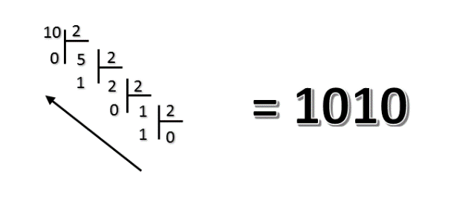
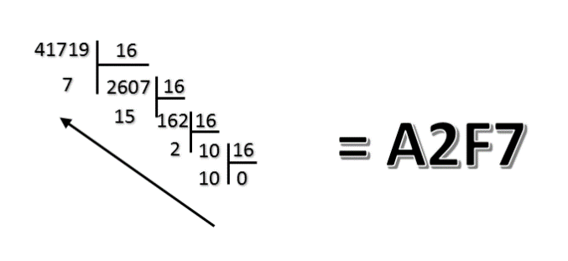
Decimal to other number systems
Divide the number by 2/16.
Get the integer quotient for the next iteration.
Get the remainder for the binary/Hexadecimal digit.
Repeat the steps until the quotient is equal to 0.
Decimal to Binary
Decimal to Hexadecimal
(10)₁₀ = (?)₂
(41719)₁₀ = (?)₁₆
(10)₁₀ = (1010)₂
(41719)₁₀ = (A2F7)₁₆

Slide 12
Decimal to other number systems
Binary to Decimal
Write down the powers of 2.
Under each power of two result, write the corresponding bit value
Multiply each bit value with the corresponding power of 2 and add the products together
The result of the sum is the decimal number
(1010)₂ = (?)₁₀
Step 1
2³ 2² 2¹ 2⁰
Step 2
1 | 0 | 1 | 0
0.2⁰
Step 3
1.2¹
0.2²
1.2³
Step 4
(1001)₂ = (1.2³ + 0.2² + 1.2¹ + 0.2⁰)₁₀ ⁼ (10)₁₀

Slide 13
Decimal to other number systems
Hexadecimal to Decimal
Write down the powers of 16.
Under each power of two result, write the corresponding bit value
Multiply each value with the corresponding power of 16 and add the products together
The result of the sum is the decimal number
(A2F7)₁₆ = (?)₁₀
Step 1
16³ 16² 16¹ 16⁰
Step 2
A | 2 | F | 7
7.16⁰
Step 3
F.16¹
2.16²
A.16³
Step 4
(A2F7)₁₆ = (A.16³ + 2.16² + F.16¹ + 7.16⁰)₁₀
= (10.16³ + 2.16² + 15.16¹ + 7.16⁰)₁₀
= (41719)₁₀

Slide 14
Decimal to other number systems
Binary
1 | 1 | 0 | 0 | 1 | 0 | 1 | 1
Binary
1 | 1 | 1 | 0 | 0 | 1 | 1 | 0
C | B
Hexadecimal
E | 6
Hexadecimal
b11001011 = 0xCB
b11100110 = 0xE6

Slide 15
2.6 Relationship between Binary and Hexadecimal
2. How to convert
Binary
1 | 1 | 0 | 1 | 0 | 1 | 0 | 1
Binary
1 | 1 | 0 | 0 | 0 | 0 | 1 | 0
D | 5
Hexadecimal
C | 2
Hexadecimal
0xD5 = b11010101
0xC2 = b11000010

Slide 16
3. Logical instructions
3.1 Define
A digital computer instruction which forms a logical combination (on a bit-by-bit basis) of its operands and leaves the result in a known location.
NOT, AND, OR, XOR

Slide 17
3. Logical instructions
3.2 NOT
A | NOT A
1 | 0
0 | 1
NOT 0111
= 1000

Slide 18
3. Logical instructions
3.3 AND
A | B | A&B
0 | 0 | 0
0 | 1 | 0
1 | 0 | 0
1 | 1 | 1
0110
AND 1101
= 0100
Check bits 1 or 0 | Clear bit | Check odd & even number
0011 AND 0010 = 0010 | 0110 AND 1101 = 0100 | 0110 AND 0001 = 0000
Bit 1 = 1 | Bit 1 = 0 | Bit 0 = 0

Slide 19
3. Logical instructions
3.4 OR
A | B | A or B
0 | 0 | 0
0 | 1 | 1
1 | 0 | 1
1 | 1 | 1
0110
OR 1010
= 1110
Set bit
0010 OR 1000 = 1010
Bit 3 = 1

Slide 20
3. Logical instructions
3.5 XOR
A | B | A XOR B
0 | 0 | 0
0 | 1 | 1
1 | 0 | 1
1 | 1 | 0
1101
XOR 1011
= 0110
Toggle bit
0010 XOR 1010 = 1000
Bit 1&3 is toggled

Slide 21
Q&A

Slide 22


