Slide 1
LGE Internal Use Only
Radio Pre-Certification IDR
Organization Chart & Resource Plan
Project Schedule
Project Progress
Test Equipment Status
Issues & Risks
2019.11.18
VS DCV

Slide 2





I. Organization
I. Organization Chart
VN Test team
HQ Test team
Duy Nguyen
Kim Hak Su/ 김학수
Part Leader
Project Owner
Anh To
Jung Mi Ra/ 정미라
Test Leader
Project Manager
Anh Tran
Senior
Month | 2019 |  |  |  |  | 2020
 | 8 | 9 | 10 | 11 | 12 | 1 | 2 | 3 | 4 | 5 | 6 | 7 | 8 | 9 | 10 | 11 | 12
DCV Leader | 0.5 | 0.5 | 0.5 | 0.5 | 0.5 | 0.5 | 0.5 | 0.5 | 0.5 | 0.5 | 0.5 | 0.5 | 0.5 | 0.5 | 0.5 | 0.5 | 0.5
DCV Senior | 1.5 | 1.5 | 1.5 | 1.5 | 2.5 | 2.5 | 2.5 | 2.5 | 2.5 | 2.5 | 2.5 | 2.5 | 2.5 | 2.5 | 2.5 | 2.5 | 2.5
DCV total | 2 | 2 | 2 | 2 | 3 | 3 | 3 | 3 | 3 | 3 | 3 | 3 | 3 | 3 | 3 | 3 | 3

Slide 3
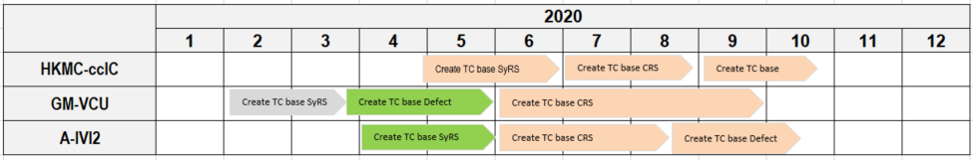
II. Project schedule
Master Schedule
We are here
We are here
Detail Schedule
Completed
In progress
In plan

Slide 4
III. Project progress
Scope
No. | Test Matrix Model | Project scope | No. of test matrix | Investigesting progress
1 | RX_CERT_3727 - Automotive blend Decision | ICAS3 | 222 | DONE
2 | RX_CERT_2738 - Artist Experience | HKMC Gen6 | 4 | DONE
3 | RX_CERT_3327 - Traffic Data | HKMC Gen6 | 26 | In progress
Practice/Executing progress
No. | HW | Description | Test Matrix | No. of Matrix ID | No. of Test case
1 | ICAS3 | FM Acquisition Time | CERT_3727 | 11 | 11
2 | ICAS3 | TC 1st Certification test: HMI, Acquisition time | CERT_3727 | 11 | 77
3 | ICAS3 | Test case HQ transfered | CERT_3727 | 27 | 35
4 | ICAS3 | Test case multi signal | CERT_3727 | 29 | 141
5 | ICAS3 | Failed test case | CERT_3727 | 32 | 50
6 | HKMC Gen6 | Artist Experience | CERT_2738 | 4 | 79
The first Pre-certification test result
Status |  | No. of TC | % | Remark
Total T/C |  | 77 | -
Tested | Passed | 39 | 51%
 | Failed | 38 | 49%
 | Blocked | 0 | 0%
 | Total | 77 | 100%
Notes:
RX_CERT_1243 - Artist Experience
RX_CERT_2738 - Artist Experience
RX_CERT_3327 - Trafic Data
3727: Automotive Blend Decision:
HD HMI
Bit rate error performance
Acquisition time – using audio analyzer, oscilloscope…
Automatic Audio Alignment: output sound change between channel, channel information…
3850: Functional testing – determine bit rate error in special condition, signals… in long time checking (using)

Slide 5
IV. Test Equipment status
No. | Name | Required Quantity | Available | Need more | Status | PIC | Expected available date | Remark
1 | ICAS3 ABT | 2 | 2 | 0 | Done | DCV
2 | ICAS3 NAR Board | 2 | 2 | 0 | Done | DCV
3 | Quadlock | 2 | 2 | 0 | Done | DCV
4 | URT5000 | 2 | 2 | 0 | Done | DCV |  | Share with other projects.
5 | URT3000 | 1 | 1 | 0 | Done | DCV
6 | RF Divider | 2 | 2 | 0 | Done | DCV
7 | RF Cable | 4 | 10 | 0 | Done | DCV
8 | RF Connector | 3 | 3 | 0 | Done | DCV
9 | RF Gender | 4 | 4 | 0 | Done | DCV
10 | Audio Analyzer | 1 | 0 | 1 | In-progress | HQ | 12/08/2019
11 | Audio Recording device: Artesia | 1 | 1 | 0 | Done | HQ
12 | HKMC Gen6 test set | 1 | 1 | 0 | Done | DCV
13 | HKMC Gen6 RF cable set | 1 | 1 | 0 | Done | HQ

Slide 6
V. Issue & Risk
No. | Description | Type | Cause / Request / Action Plan / Progress | PIC | Priority | Issue Date | Deadline | Remark
 |  |  |  |  | 1: High ~ 5: Low | (MM/DD) | (MM/DD)
1 | Limitation of using URT5000 | Risk | Schedule of using URT5000 devices is conflicted with others team. - Short term: Check weekly - Long term: Not fixed. | Anh.To | 3 | 8/26 | 11/30 | - FPT: Testing schedule fix but does not have free time to share. - DCV: Testing schedule does not fix, can borrow whenever it is available.
2 | Need one more test member | Risk | Plan to make FIT test case related to HD radio(A-IVI2, HKMC ccIC). Requirement analysis , Test Case mapping , create new TC , Test guide | Duy2.nguyen | 1 | 11/14 | 12/16

Slide 7
LGE Internal Use Only/
HD Radio Cert Matrix 3727
HD Radio Cert Matrix 3727 Overview
Set up environment with multiple signals and demo
Evaluate HMI/LGE Issue
2019.11.18
VS DCV

Slide 8
HD Radio Cert Matrix 3727 Overview
HD Radio Cert Matrix 3727 purpose:
HMI, HD Signal Reception
Analog Signal Reception
Maximum Power
Interference-FM Interference Performance
FM Long-term Stability
BER Performance | Hybrid-FM Hybrid BER Performance Testing
Subjective Audio Stereo Separation
…
Required environment:
- Connected to Single Radio Generator
- Connected to Multi Radio Generator
Notes:
Tổng hợp các Tc có mục đích:
Kiểm tra độ tiếp nhận thông tin HD, analog, tín hiệu vs mức phát lớn, hiệu suất can thiệp (giao thoa), độ ổn định trong thời gian dài, Hiệu suất Bit Error Rate, âm thanh chia ra loa trái, phải,…

Slide 9
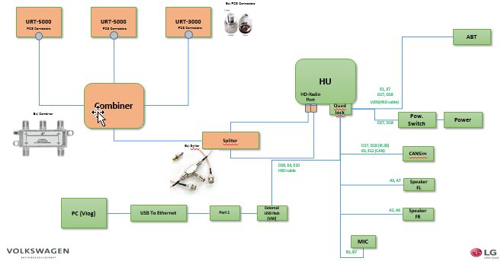
II. Set up environment with multiple signals and demo
HD-Radio multiple signals Test Environment Diagram (without Test Bench):

Slide 10
II. Set up environment with multiple signals and demo
Running TC Evaluate the Tuning Experience-704.2.auto
Purpose: Check the multi HD signal reception and the Tuning HD programs experience in Preset List
Test Environment information:
Connected to Multi Radio Generator
Pre-Condition:
1. HU power is ON
2. URT5000 and antenna are connected
3. Serial2 (VLOG) on PC is connected to HU and run
4. Radio setting > HD Radio Active
Test steps.Actions:
1. Run URT 1 Tool
2. Select vector signal: IB_FMr450_e1wfr1382.bin
3. Change a Frequency :100.5 MHz
4. Change a Signal Power : -60.0dBm
5. Run URT 2 Tool
6. Select vector signal: IB_FMr450_e1wfr1386.bin
7. Change a Frequency :93.5 MHz
8. Change a Signal Power : -60.0dBm
9. Play both URT
10. HU Change a Frequency : 100.5MHz and 93.5MHz
11. Select Station list
12. Add HD4 on 100.5 MHz and HD1, HD2 on 93.5 MHz to Preset List
13. Select Preset
14. Select program HD4
15. Select program HD1

Slide 11
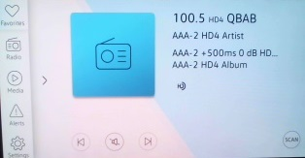
II. Set up environment with multiple signals and demo
Expected results HD4 Program:
1. Zero audio anomalies | Zero data anomalies (Yes)
2. Check the HD Radio Technology Activated State:
- Acquired Digital Audio.
- HD Radio Indicator illuminated.
- Acquired SIS Data
3. (Call sign in GEM: QBAB)
4. (Station slogan: HD-4 Slogan for AAA-2)
5. Program Number displayed: 3
6. Acquired PSD:
- (Song title, Artist, Album in HU HMI): "AAA-2 +500ms 0 dB HD4 Title"; "AAA-2 HD4 Artist"; "AAA-2 HD4 Album"
- (Genre: Null in GEM)
- (Comment: Null in Serial2)
Make sure that the Data displayed correctly by referring (SIS, PSD by referring document TE_CERT_2094 - Test vector description - revision S > SIS details: Page 632,634; PSD detail: Page 635 )

Slide 12
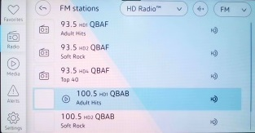
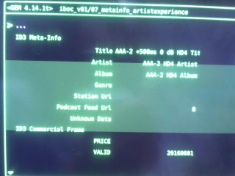
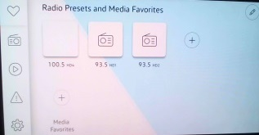
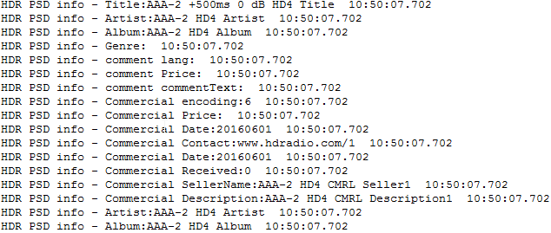
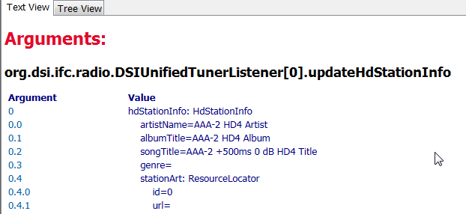
II. Set up environment with multiple signals and demo

Slide 13
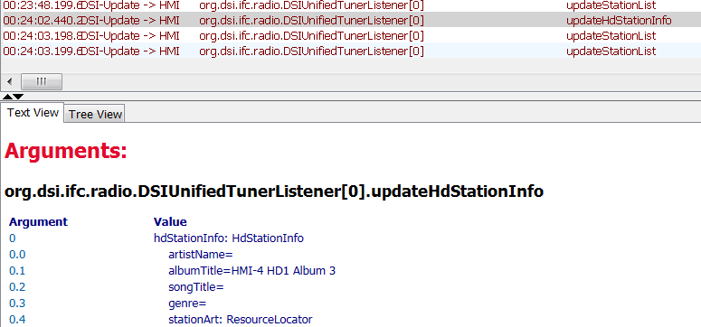
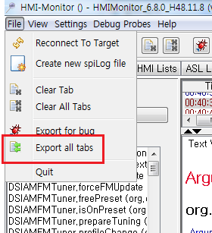
III. Evaluate HMI/LGE Issue
What is HMI/LGE Issue?
- HMI Issue: DSI information is checked in HMI Monitor Log but HMI Update is not working
- LGE Issue: When DSI information is not confirmed in HMI Monitor Log
Run Test case 6e.auto
Check the DSI Log:
- Select updateHDStatinInfo -> Text View Details
Save HMI Log and report
- File → Export all tabs
Notes:
When executing, we meet the bug: Unable to display the info. of the song on the HMI. So we need to define whether it’s HMI issue or LGE issue.
But what is HMI issue and LGE issue?
….
And How to check, get the log and report to the Dev team.

Slide 14
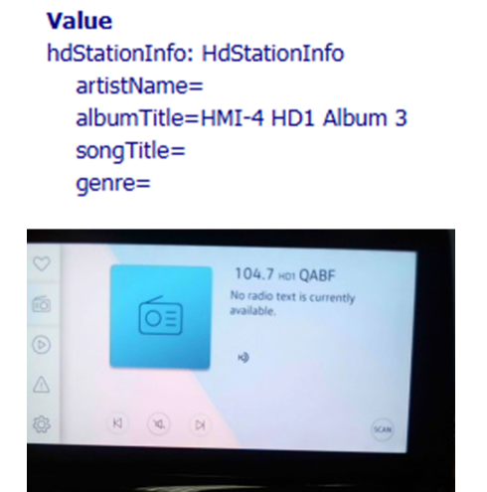
TC 6e.auto
Test Environment information:
Connected to Single Radio Generator
Pre-Condition:
1. HU power is ON
2. URT5000 and antenna are connected
3. Serial2 (VLOG) on PC is connected to HU and run
4. Radio setting > HD Radio Active
Expected Results:
(1. Null > 2. Null > 3. HMI-4 HD1 Album 3 )
Observed:
(1. Null > 2. Null > 3. Null)
Test steps.Actions:
1. Run URT Tool
2. Select vector signal: IB_FMr450_e1wfr1504.bin
3. Change a Frequency :104.7 MHz
4. Change a Signal Power : -60.0dBm
5. HU Change a Frequency : 104.7MHz
6. Select Station list
7. Select program HD1
8. Verify with the first 3 songs in this program.
Check the Album in HU HMI
(1. Null > 2. Null > 3. HMI-4 HD1 Album 3 )

Slide 15
Appendix 1. Training Plan
 | 12/8 ( Sun ) | 12/9 ( Mon ) | 12/10 ( Tue ) | 12/11 ( Wed ) | 12/12 ( Thu ) | 12/13 ( Fri ) |  | 12/16 ( Mon ) | 12/17 ( Tue ) | 12/18 ( Wed )
09:00~12:00 |  | Start Meeting 09:30~11:30 | Traffic data Certi | Traffic data Certi | Traffic data Certi SW Update Fail Recovery | Audio Analyzer Test |  | MRC Test | Traffic Data Audi Analzer MRC Test | VN > KR
13:00~18:00 | KR > VN | Traffic data Certi | Traffic data Certi | Traffic data Certi | Meeting - HD Radio TC workshop Pjt : A-IVI2 ,HKMC ccIC 13:00~15:00 - internally 15:30~17:30 - with FIT member | Audio Analyzer Test |  | MRC Test | HD Radio Q&A
 |  |  | Meeting - Projection TC Workshop Pjt : A-IVI2 , HKMC ccIC , GM VCU 14:00~15:00 - internally 15:30~17:30 - with FIT member |  |  |  |  |  | Meeting and Review

Slide 16


