Slide 1
VT IDR (FAT)
No. | Agenda | Time |  | Place | Presenter
1. | VW ICAS3 ST | 16:00 ~ 16:30 | 30’ | Innovation Room | Ms. Thuy Le

Slide 2
LGE Internal Use Only
FPT should remove this
<ProjectName> IDR
Organization Chart & Resource Plan
Project Schedule
Project Progress
Test Equipment Status
Issues & Risks
2019. 12. 16
VS DCV
FPT should remove this

Slide 3
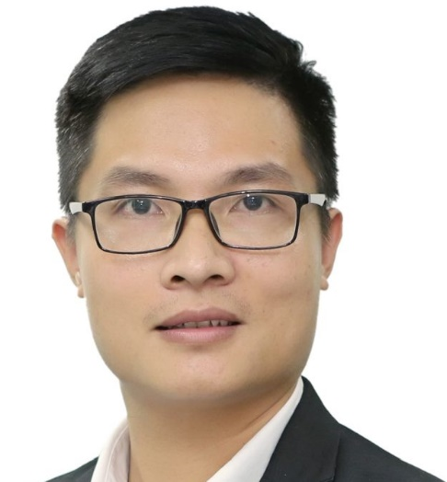




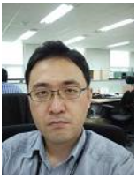
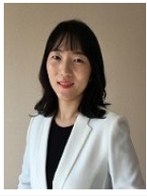


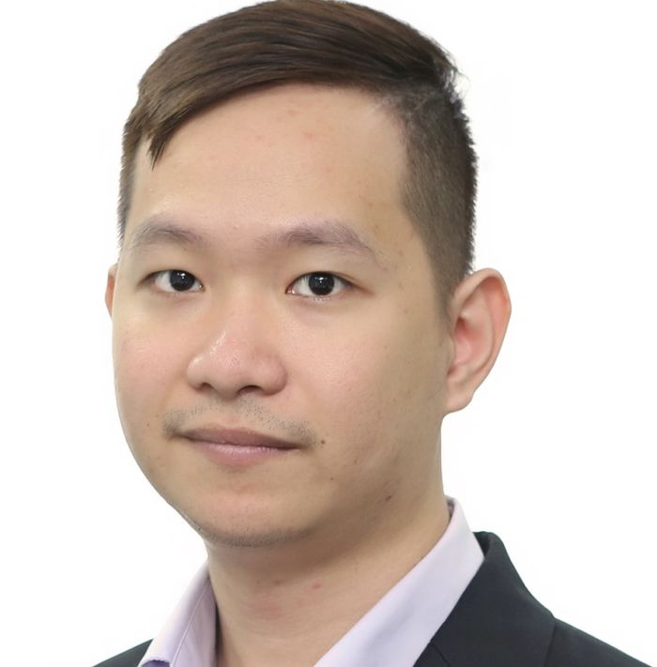

I. Organization Chart & Resource Plan
VN Test Team
HQ Test Team
Truong Dao
Kim Hak Su/ 김학수
Part Leader
Project Owner
To T Van Anh (G2)
Tran T Ha Chinh (G2)
N Van Duong(G2)
Choo Yeanwoong
Kim Junghee
FDT
Test Leader
Cluster
BT, Wifi
Project Manager: BT, Wifi
Project Manager: HD Radio
N Thu Huyen (G2)
N T Phuong(G2)
Truong Khanh Cuong (G3)
Radio
Cluster
BT, Wifi
Tran T Van Anh(G1)
Radio
Project | Month
 |  | 1 | 2 | 3 | 4 | 5 | 6 | 7 | 8 | 9 | 10 | 11 | 12
HD Radio | DCV TL | 0.5 | 0.5 | 0.5 | 0.5 | 0.5 | 0.5 | 0.5 | 0.5 | 0.5 | 0.5 | 0.5 | 0.5
 | DCV Tester | 2.5 | 2.5 | 2.5 | 2 | 3 | 3 | 3 | 4 | 4 | 4 | 4 | 4
 | Total | 3 | 3 | 3 | 2.5 | 3.5 | 3.5 | 3.5 | 4.5 | 4.5 | 4.5 | 4.5 | 4.5
Cluster | DCV TL | 0 | 0 | 0 | 0.5 | 0.5 | 0.5 | 0.5 | 0.5 | 0.5 | 0.5 | 0.5 | 0.5
 | DCV Tester | 0 | 0 | 0 | 1 | 2 | 2 | 2 | 3 | 3 | 3 | 3 | 3
 | Total | 0 | 0 | 0 | 1.5 | 2.5 | 2.5 | 2.5 | 3.5 | 3.5 | 3.5 | 3.5 | 3.5
Bluetooth_Wifi | DCV TL | 0 | 0 | 0 | 0 | 0 | 0.5 | 0.5 | 0.5 | 0.5 | 0.5 | 0.5 | 0.5
 | DCV Tester | 1 | 2 | 2 | 2 | 3 | 2.5 | 2.5 | 2.5 | 2.5 | 2.5 | 2.5 | 2.5
 | Total | 1 | 2 | 2 | 2 | 3 | 3 | 3 | 3 | 3 | 3 | 3 | 3
AA/CP/ML | DCV TL | 0 | 0 | 0 | 0 | 0 | 0 | 0.25 | 0.25 | 0.25 | 0.25 | 0.25 | 0.25
 | DCV Tester | 0 | 0 | 0 | 0 | 0 | 0 | 1.5 | 1.5 | 1.5 | 1.5 | 1.5 | 1.5
 | Total | 0 | 0 | 0 | 0 | 0 | 0 | 1.75 | 1.75 | 1.75 | 1.75 | 1.75 | 1.75
OTA | DCV TL | 0 | 0 | 0 | 0 | 0 | 0 | 0.25 | 0.25 | 0.25 | 0.25 | 0.25 | 0.25
 | DCV Tester | 0 | 0 | 0 | 0 | 0 | 0 | 2 | 2 | 2 | 2 | 2 | 2
 | Total | 0 | 0 | 0 | 0 | 0 | 0 | 2.25 | 2.25 | 2.25 | 2.25 | 2.25 | 2.25
 | DCV total | 4 | 5 | 5 | 6 | 9 | 9 | 13 | 15 | 15 | 15 | 15 | 15
New
Moved out
Move to other project
Leaders
BT: Bluetooth
FO / Sub TL
1 / 6

Slide 4
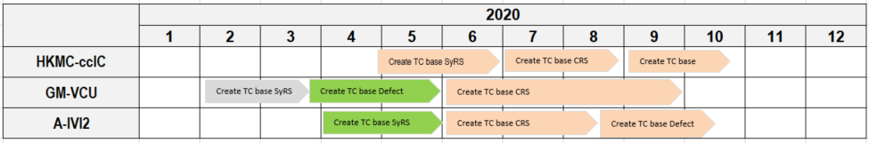
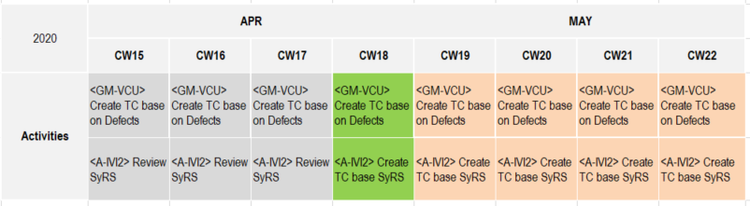
II. Project schedule
Master Schedule
We are here
Detail Schedule
We are here
Completed
In progress
In plan

Slide 5
III. Project progress
Scope
No. | Test Matrix Model | Project scope | No. of test matrix | Investigesting progress
1 | RX_CERT_3727 - Automotive blend Decision | ICAS3 | 222 | DONE
2 | RX_CERT_2738 - Artist Experience | HKMC Gen6 | 4 | DONE
3 | RX_CERT_3327 - Traffic Data | HKMC Gen6 | 26 | In progress
Practice/Executing progress
No. | HW | Description | Test Matrix | No. of Matrix ID | No. of Test case
1 | ICAS3 | FM Acquisition Time | CERT_3727 | 11 | 11
2 | ICAS3 | TC 1st Certification test: HMI, Acquisition time | CERT_3727 | 11 | 77
3 | ICAS3 | Test case HQ transfered | CERT_3727 | 27 | 35
4 | ICAS3 | Test case multi signal | CERT_3727 | 29 | 141
5 | ICAS3 | Failed test case | CERT_3727 | 32 | 50
6 | HKMC Gen6 | Artist Experience | CERT_2738 | 4 | 79
The first Pre-certification test result
Status |  | No. of TC | % | Remark
Total T/C |  | 77 | -
Tested | Passed | 39 | 51%
 | Failed | 38 | 49%
 | Blocked | 0 | 0%
 | Total | 77 | 100%
Notes:
RX_CERT_1243 - Artist Experience
RX_CERT_2738 - Artist Experience
RX_CERT_3327 - Trafic Data
3727: Automotive Blend Decision:
HD HMI
Bit rate error performance
Acquisition time – using audio analyzer, oscilloscope…
Automatic Audio Alignment: output sound change between channel, channel information…
3850: Functional testing – determine bit rate error in special condition, signals… in long time checking (using)

Slide 6
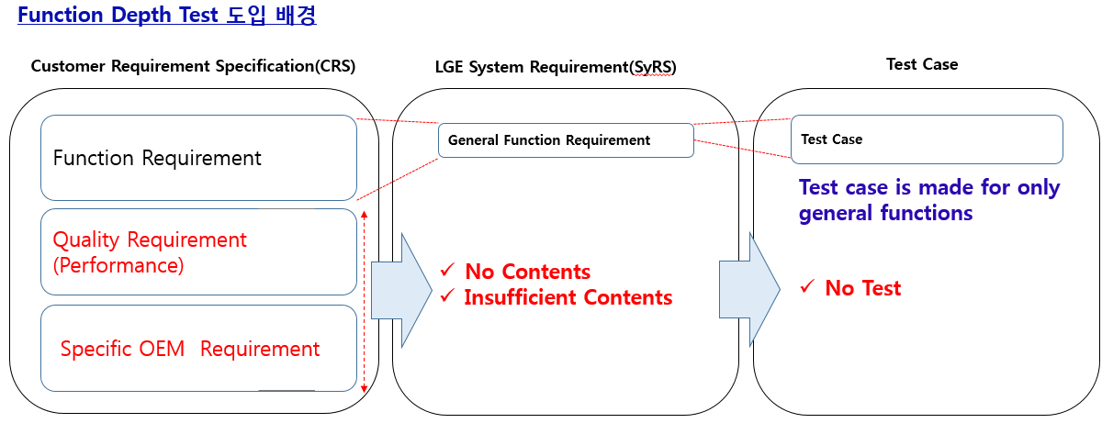
II. TC Concept
Test Case design
Test Case deliver to FIT team
Analyze SyRS and FIT TC
Analyze CRS
Test Case design
Test Case deliver to FIT team
Analyze issue in other project
Teat Case design
Test Case deliver to FIT team
Stage 1
Stage 2
Stage 3

Slide 7
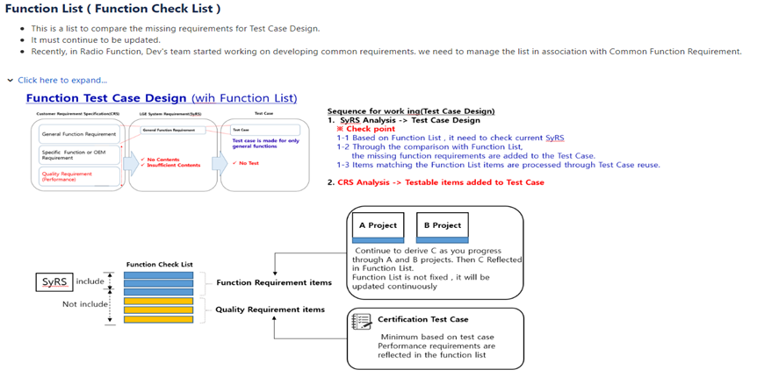
III. Concept
3 / 6

Slide 8
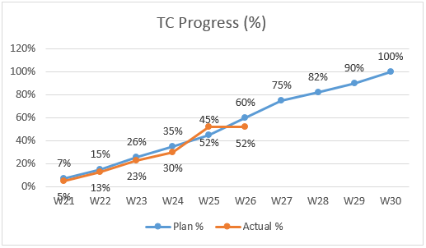
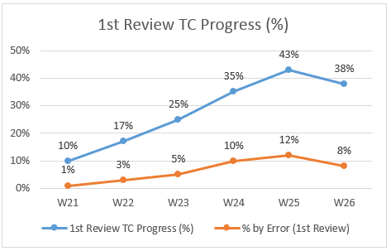
III. Project Progress – T/C Progress
No | Main functions (Main Features) | Total REQ ID | Testable REQ ID | Making TC |  |  | 1st (Peer) Review |  |  | 2nd (Sampling) Review |  | Final Review (HQ) |  | Deadline to send to HQ | Remark
 |  |  |  | REQ Coverage % | T/C Done | TC Density (TC/REQ) | Review |  | by Error (%) | Review (%) | by Error (%) | Review (%) | by Error (%)
 |  |  |  |  |  |  | Progress % | Score
Grand Total |  | 289 | 288 | 52% | 422 | 19.0 | 51% | - | 15% | 20% | 18% | 3% | 7%
1 | Power Management | 15 | 15 | 100% | 45 | 21 | 100% | 70 | 9% | 32% | 12% | 13% | 8% | 17/06/22
2 | Sound Control | 10 | 10 | 100% | 30 | 35 | 100% | 65 | 33% | 43% | 15% | 14% | 6% | 17/06/22
3 | Setup | 22 | 21 | 95% | 55 | 20 | - | - | - | - | - | - | - | 17/07/06
4 | Complex operation | 5 | 5 | 20% | 4 | - | - | - | - | - | - | - | - | 17/07/26
5 | OSD | 5 | 5 | - | - | - | - | - | - | - | - | - | - | 17/07/26
6 | Analog radio | 18 | 18 | 100% | 54 | 22 | - | - | - | - | - | - | - | 17/07/06
7 | Media Player | 30 | 30 | 100% | 80 | 22 | 100% | 80 | 6% | 39% | 24% | - | - | 17/06/09
8 | External device | 1 | 1 | 100% | 5 | 108 | 100% | 70 | 23% | 46% | 8% | - | - | 17/06/26
9 | Voice memo | 8 | 8 | - | - | - | - | - | - | - | - | - | - | 17/07/18
10 | Android Auto | 28 | 28 | 89% | 68 | - | - | - | - | - | - | - | - | 17/07/06
11 | CarPlay | 36 | 36 | 78% | 81 | - | - | - | - | - | - | - | - | 17/07/11
12 | CarLife | 22 | 22 | - | - | - | - | - | - | - | - | - | - | 17/07/18
13 | Mirror Link | 29 | 29 | - | - | - | - | - | - | - | - | - | - | 17/07/25
14 | Bluetooth | 55 | 55 | - | - | - | - | - | - | - | - | - | - | 17/08/09
15 | Wifi | 5 | 5 | - | - | - | - | - | - | - | - | - | - | 17/08/09
3 / 6

Slide 9
III. Project Progress – T/C Progress
Review SyRS/CRS tesability
 | Module | Total | Testable | UnTestable
SyRS | Bluetooth
 | Wifi
CRS | Bluetooth
 | Wifi
Convert GMV2 defects to TC
Item | Issue number of Issue | Issues Checked | Issue remaining | TC converted | Status | Action
HGMVTHR, HGMVT0 | 814 | 345 | 469 | 345 | Doing | Converting
GMVTWO | 385 | 385 | 0 | 207 | Doing | Reviewing
VTWO | 6 | 6 | 0 | 3 | Doing | Reviewing
GMCADILLAC | 8 | 8 | 0 | 8 | Doing | Reviewing
3 / 6

Slide 10
V. Test Equipment status
No. | Name | Required Quantity | Available | Need more | Status | PIC | Expected available date | Remark
1 | ICAS3 ABT | 2 | 2 | 0 | Done | DCV
2 | ICAS3 NAR Board | 2 | 2 | 0 | Done | DCV
3 | Quadlock | 2 | 2 | 0 | Done | DCV
4 | URT5000 | 2 | 2 | 0 | Done | DCV |  | Share with other projects.
5 | URT3000 | 1 | 1 | 0 | Done | DCV
6 | RF Divider | 2 | 2 | 0 | Done | DCV
7 | RF Cable | 4 | 10 | 0 | Done | DCV
8 | RF Connector | 3 | 3 | 0 | Done | DCV
9 | RF Gender | 4 | 4 | 0 | Done | DCV
10 | Audio Analyzer | 1 | 0 | 1 | In-progress | HQ | 12/08/2019
11 | Audio Recording device: Artesia | 1 | 1 | 0 | Done | HQ
12 | HKMC Gen6 test set | 1 | 1 | 0 | Done | DCV
13 | HKMC Gen6 RF cable set | 1 | 1 | 0 | Done | HQ
6 / 6

Slide 11
V. Issues & Risks
No. | Description | Type | Cause / Request / Action Plan / Progress | PIC | Priority | Issued Date | Deadline | Remark
 |  |  |  |  | (1 High~5 Low) | (MM/DD) | (MM/DD)
1 | Quality of TC is not good | Issue | Cause + Lack of experienced members + lack of resources (2/3 members is allocated 2. Action: |  | 1 | 06/02 | 06/09
2 | Create TC for SyRS status “out of scope” | Risk | Cause: Require from HQ: Create TC for all status 2. Action: |  | 2 | 06/02 | 06/09
3 | TC maybe not delivery on time | Risk | Cause: + Schedule is overlap between FDT and FIT team + Take time to review TC due to lack of resource Action: + Check with FIT team and |  | 4 | 05/15 | 06/09
4 |  | Risk |  |  | 3 | 06/02
6 / 6

Slide 12
Thank you

Slide 13
Appendix 1: Assignment
Module | Sub- Function | No. Of TCs | Tester | FO
 | Grand Total/Rate | 7195 | 29
Wireless | Messaging | 91 | C Minh (FPT) | Minh Ngo (FPT)
 |  | 183 | Nhung (FPT)
 | Phone | 221 | Thao (FPT)
 |  | 275 | Lan (FPT)
 |  | 253 | Hong (FPT)
 |  | 115 | Ban (FPT)
 |  | 91 | Tham Le (FPT)
HMI | Input_Service | 7 | Tuyet (FPT) | Thom Le (FPT)
 | Language-Change | 107 | Phuong (FPT)
 | Option-HMI | 76 | Nguyet (FPT)
System | Trace-Replay | 1 | Thai (FPT)
 | USB | 30 | Tram (FPT)
 | Wireless-Charging | 22 | Ban (FPT)
Wireless | Bluetooth | 172 | Tham Le (FPT)
 |  | 152 | Nguyet (FPT)
 | NFC | 15 | Tram (FPT)
 | Organizer | 235 | Quy (FPT)
 |  | 47 | Quynh (FPT)
 |  | 300 | Thúy (FPT)
 | WLAN | 150 | Phuong (FPT)
 |  | 224 | Giap (FPT)
Media | Media | 220 | Quynh (FPT) | Chinh Tran (DCV)
 |  | 192 | Giang (FPT)
 |  | 258 | Huyen (FPT)
 |  | 200 | Tram (FPT)
 |  | 152 | Thủy 2 (FPT)
Wireless | User Profile Handling | 100 | C Chinh (DCV)
App Connect | Android Auto | 66 | Thu (FPT) | Cuong Tran (DCV)
 |  | 70 | Y (DCV)
 |  | 61 | Tuyet (FPT)
 | Phone Connection Manager | 230 | Hoa (FPT)
 |  | 151 | Y (DCV)
 |  | 70 | c Vinh (DCV)
CarIF | Car Standard Software | 470 | Hien (DCV)
 |  | 232 | Huyen (DCV)
 |  | 80 | Huyen (DCV)
 | Car Standard Software-SAFE | 139 | Hien (DCV)
Radio | Radio-AM-FM-IBOC | 195 | c Vinh (DCV)
 |  | 157 | Cuong (DCV)
App Connect | App Connect | 75 | Tuyet (FPT) | Nguyet Nguyen (DCV)
 | CarPlay | 176 | Thu (FPT)
Audio | Audio Management | 200 | Lan Anh (FPT)
 |  | 243 | Nga (DCV)
 | Early Sound | 33 | Lan Anh (FPT)
 | ICC | 9 | Lan Anh (FPT)
 | NotificationAudioProxy | 23 | Lan Anh (FPT)
 | NotificationSoundHandler | 41 | Lan Anh (FPT)
 | Speech Quality | 4 | Lan Anh (FPT)
App Connect | MirrorLink | 169 | Phuong (DCV) | Phuc Truong (DCV)
Ethernet | Digital Transmission Audio | 3 | Thai (FPT)
 | Digital Transmission Video | 6 | Thai (FPT)
 | Networking | 94 | Thai (FPT)
Logging | Platform Monitor | 37 | Thai (FPT)
 | Tracing | 115 | Thai (FPT)
Media | Audio_Video_Codec | 11 | C Chinh (DCV)
SAI | SAI | 39 | Phuc (DCV)
SDS | Speech Dialog | 57 | Phuong (DCV)
 |  | 50 | Y (DCV)
A. 1 / 2

