Slide 1


Numeric and conversion
Validation Test Team
Dao Xuan Truong
01/2021

Slide 2

Agenda
01
Introduction
02
Numeral Systems
03
Number Base Conversion
04
Tips and tricks
05
Tips and tricks

Slide 3
Numeral Systems
Sets of symbols and the rules for using them to represent numbers, which are used to express how many objects are in a given set

Slide 4
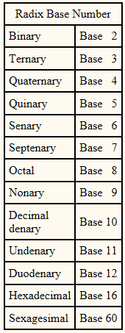
1.The base of a number system
1.1 What is radix base number?
The base of a number system is the number of different symbols available to represent any digit within that system.

Slide 5
Number Base Conversion

Slide 6
1.2 Mainly type of radix base number
1.The base of a number system
+ The decimal system (Base 10) has a radix of 10: 0, 1, 2, 3, 4, 5, 6, 7, 8, 9
Ex: 580563
+ The binary system (Base 2) has a radix of 2: 0, 1
Ex: b10111001
+ The hexadecimal (Base 16) has a radix of 16: 0, 1, 2, 3, 4, 5, 6, 7, 8, 9, A, B, C, D, E, F
Ex: 0xF01D

Slide 7
2. How to convert
Decimal | Binary | Hexadecimal
0 | 0000 | 0
1 | 0001 | 1
2 | 0010 | 2
3 | 0011 | 3
4 | 0100 | 4
5 | 0101 | 5
6 | 0110 | 6
7 | 0111 | 7
8 | 1000 | 8
9 | 1001 | 9
10 | 1010 | A
11 | 1011 | B
12 | 1100 | C
13 | 1101 | D
14 | 1110 | E
15 | 1111 | F

Slide 8
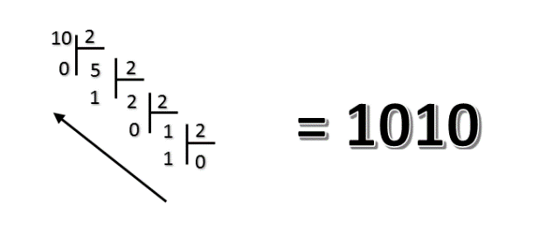
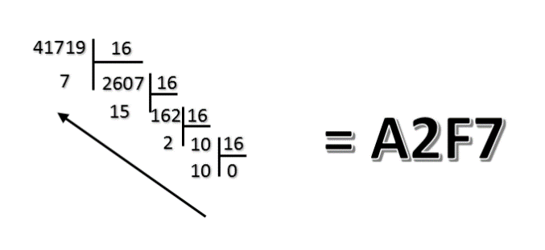
Decimal to other number systems
How to convert
Divide the number by 2/16.
Get the integer quotient for the next iteration.
Get the remainder for the binary/Hexadecimal digit.
Repeat the steps until the quotient is equal to 0
Example
Decimal to Binary
Decimal to Hexadecimal
(10)₁₀ = (?)₂
(41719)₁₀ = (?)₁₆
(10)₁₀ = (1010)₂
(41719)₁₀ = (A2F7)₁₆

Slide 9
Binary to Decimal
How to convert
Write down the powers of 2.
Under each power of two result, write the corresponding bit value
Multiply each bit value with the corresponding power of 2 and add the products together
The result of the sum is the decimal number
Example
(1010)₂ = (?)₁₀
STEP 1
2³ 2² 2¹ 2⁰
STEP 2
1 | 0 | 1 | 0
0.2⁰
1.2¹
STEP 3
0.2²
1.2³
STEP 4
(1010)₂ = (1.2³ + 0.2² + 1.2¹ + 0.2⁰)₁₀
= (10)₁₀

Slide 10
Hexadecimal to Decimal
How to convert
Write down the powers of 16.
Under each power of two result, write the corresponding bit value
Multiply each value with the corresponding power of 16 and add the products together
The result of the sum is the decimal number
Example
(A2F7)₁₆ = (?)₁₀
STEP 1
16³ 16² 16¹ 16⁰
STEP 2
A | 2 | F | 7
7.16⁰
F.16¹
STEP 3
2.16²
A.16³
(A2F7)₁₆ = (A.16³ + 2.16² + F.16¹ + 7.16⁰)₁₀
= (10.16³ + 2.16² + 15.16¹ + 7.16⁰)₁₀
= (41719)₁₀
STEP 4

Slide 11
Binary to Hexadecimal
How to convert
1. Write down the binary number and group the digits (0’s and 1’s) in sets of four. Start doing this from the right. If the leftmost group doesn’t have enough digits to make up a set of four, add extra 0’s to make a group.
2. Write 8, 4, 2 and 1 below each group. These are the weights of the positions or place holders in the number (2³, 2², 2¹ and 2⁰).
3. Every group of four in binary will give you one digit in hexadecimal. Multiply the 8, 4, 2 and 1’s by the digit above.
4. Add the products within each set of four. Write the sums below the groups they belong to.
5. The digits you get from the sums in each group will give you the hexadecimal number, from left to right.
Example
(10101101)₂ = (?)₁₆
 | 1010 | 1101
 | 8 4 2 1 | 8 4 2 1
 | 8 0 2 0 | 8 4 0 1
 | 10 (10 = 8+2) | 13 (13 = 8+4+1)
 | A | D
 | (10101101)₂ = (AD)₁₆
01.
STEP
02.
STEP
03.
STEP
04.
STEP
05.
STEP

Slide 12
Hexadecimal to Binary
How to convert
1. Write down the hex number. If there are any, change the hex values represented by letters to their decimal equivalents.
2. Each hex digit represents four binary digits and therefore is equal to a power of 2. The rightmost digit equals to 2⁰ (1), the next one equals to 2¹ (2), the next one equals to 2² (4) and the leftmost one equals to 2³ (8). Write these numbers (8, 4, 2 and 1) below the hex values.
3. Determine which powers of two (8, 4, 2 or 1) sum up to your hex digits. For example, if one of your hex values is 10, this means 8 and 2 sum up to 10 (4 and 1 are not used). If your hex number is 2, only 2 is used; 8, 4 and 1 are not.
4. Write down 1 below those 8, 4, 2 and 1’s that are used. Write down 0 below those that are not used.
5. Read the 1’s and 0’s from left to right to get the binary equivalent of the given hex number.
Example
(4FA)₁₆ = (?)₂
01.
 | 4 | F | A
 | 4 | 15 | 10
 | 8 4 2 1 | 8 4 2 1 | 8 4 2 1
 | 8 4 2 1 | 8 4 2 1 | 8 4 2 1
 | (4 = 4) | (15 = 8+4+2+1) | (10 = 8+2)
 | 0100 | 1111 | 1010
 | (4FA)₁₆ = (10011111010)₂
STEP
02.
STEP
03.
STEP
04.
STEP
05.
STEP

Slide 13
Decimal to other number systems
Binary
1 | 1 | 0 | 1 | 0 | 1 | 0 | 1
Binary
1 | 1 | 0 | 0 | 0 | 0 | 1 | 0
D | 5
Hexadecimal
C | 2
Hexadecimal
(11001011)₂ = (CB)₁₆
(11100110)₂ = (E6)₁₆
Binary
1 | 1 | 0 | 1 | 0 | 1 | 0 | 1
Binary
1 | 1 | 0 | 0 | 0 | 0 | 1 | 0
D | 5
Hexadecimal
C | 2
Hexadecimal
(D5)₁₆ = (11010101)₂
(C2)₁₆ = (11000010)₂

Slide 14
2. Bit and Byte
Define
Bit(Binary Digit):
Bit is the smallest unit of information that can be stored.
It consists of either zero or one.
Example: 1,0
Byte:
- A byte is a sequence of bits.
Byte has been 8 bits in length.
Example: b01000001
Bit field
Bit | 7 | 6 | 5 | 4 | 3 | 2 | 1 | 0
Value | 0 | 1 | 1 | 0 | 1 | 0 | 0 | 1

Slide 15
3. Logical Shift
These instructions shift an operand over a number of bit positions specified in a count operand contained in the instruction.
Left Shift
Example: Left shift 2 positions
Before
1 0 0 0 1 1 0 1 ………0 1 0 0 1 1
After
0 0 1 1 0 1 ………0 1 0 0 1 1 0 0
Right Shift
Example: Right shift 3 positions
Before
1 0 0 0 1 1 0 1 ………0 1 0 0 1 1
After
0 0 0 1 0 0 0 1 1 0 1 ………0 1 0

Slide 16
3. Logical instructions
1. NOT
3. OR
A | NOT A
1 | 0
0 | 1
A | B | A or B
0 | 0 | 0
0 | 1 | 1
1 | 0 | 1
1 | 1 | 1
NOT(0111)
= 1000
0110
1010
= 1110
2. AND
4. XOR
A | B | A&B
0 | 0 | 0
0 | 1 | 0
1 | 0 | 0
1 | 1 | 1
A | B | A XOR B
0 | 0 | 0
0 | 1 | 1
1 | 0 | 1
1 | 1 | 0
0110
1101
= 0100
1101
1011
= 0110

Slide 17
Q&A

Slide 18


