Slide 1
Physical Diagnostic TCP
Vi2.nguyen + Khanhly.nguyen

Slide 2
• Diagnostic Message Strategy - USDT And UUDT Messages
The USDT format refers to those messages which may be segmented into multiple CAN transmission frames, depending on the number of data bytes transmitted.
UUDT format refers to those messages which shall always be a single frame response.
$2xx = physical request CAN Identifier
$5xx = UUDT response CAN Identifier
$6xx = USDT response CAN Identifier

Slide 3
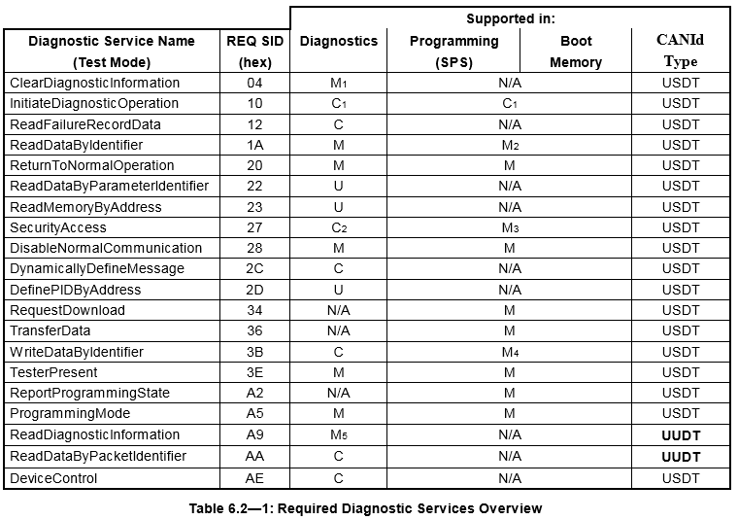
• Diagnostic Message Strategy - USDT And UUDT Messages
Notes:
Request : USDT + UUDT (A9, AA)
Response: USDT + UUDT

Slide 4
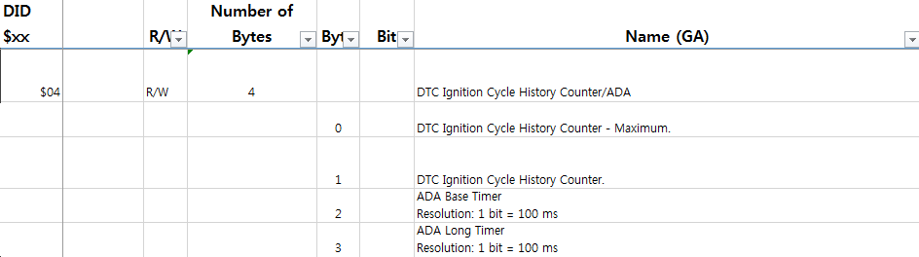
• Memory
DID (Data Identifier)
TCP / VCP setting data
Timer, Counter, Function enable / disable ETC
Compare value, range(Read & Write) with ALDL Spec
Default Value Check target memory
[Definition of DID$04]

Slide 5
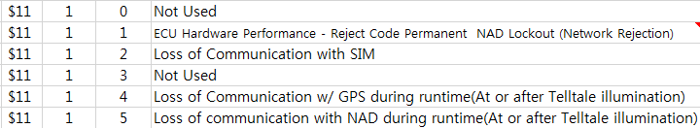

• Memory
PID (Parameter Identifier)
- Stored vehicle state from vehicle message
Battery state, Fuel info, Tire state......
DPID ( Data Packet Identifier)
Trouble info / Network status
[PID$C003 & C003]
[Trouble information]
[Network status]

Slide 6
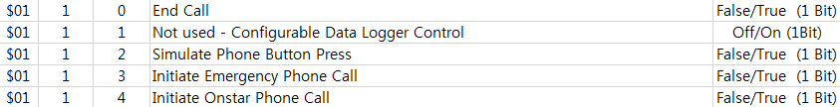
• Memory
CPID (Control Packet Identifier)
Writable only, Memory for Device control
Key pad, Call end, ECU reset....
[CPID$01]

Slide 7
• CAN message
Single Frame
Valid Length : Defines a valid length in the frame
Service ID : Service ID for request
Sub Function : Sub Function ID – optional
Required data : Data service detail
[Single Frame structure]
Valid Length(1 byte)
Service ID(1 byte)
R Required data(5~6 byte)
Service Sub Function

Slide 8
• CAN message
Multi Frame
Flow Status : Status information on the receiving side
Block Size : Number of frames to receive after flow control
ST min : Interval of frames to receive after flow control
Sequence Number : Response frame number
[Multi Frame structure (First Frame, Flow control, Consecutive Frame)]
PCI=$1
(4 bit)
Valid Length
(1.5 byte)
Service ID
(1 byte)
Required data(5~6 byte)
Service Sub Function
PCI=$3
(4 bit)
Flow Status
(4 bit)
Block Size
(1 byte)
Separation Time minimum
(1 byte)
PCI=$2
(4 bit)
Sequence Number
(4 bit)
Required data

Slide 9
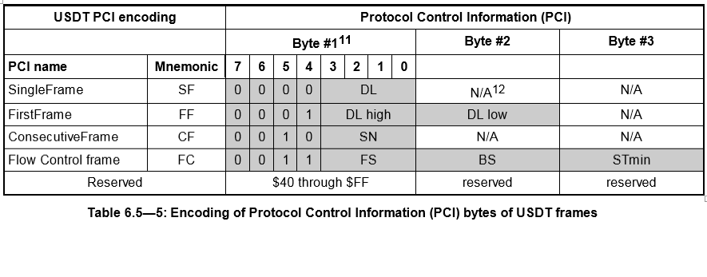
Eg:
Read Diagnostic Data Block send $24D 02 1A 01 <- SF
Send $24D 30 00 00 <- FC
TCP should respond with Response:
64D 10 08 5A 01 XX XX XX XX <- FF
64D 21 XX XX <- CF
Notes:
Flow stt has 2 values: 0 (clear to set) and 1 (wait)
Block size: number of CF before FC
Stmin: time between CFs
SN: 1->F, next round 0->F

Slide 10
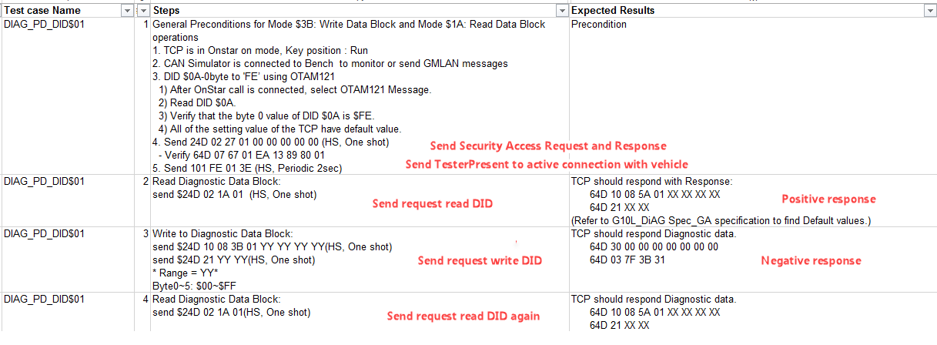
• How to read Test case_DIAG_PD_DID$XX

Slide 11
• How to read Test case_DIAG_PD_DID$XX (Positive Response)
$24D 02 1A 01
USDT request
PCI (Valid length)
SID Request (SIDRQ)
DID
$24D 30 00 00
USDT request
PCI ($3 + Flow status)
Block size
ST min
$64D 10 08 5A 01 XX XX XX XX
USDT response
PCI ($1+ DL high)
DL low (Valid length)
SID Response (SIDPR = SIDRQ +$40)
DID
Data
$64D 2X XX XX
USDT response
PCI ($2 + Sequence Number)
Data
Data

Slide 12
• How to read Test case_DIAG_PD_DID$XX (Negative Response)
$64D 03 7F 3B 31
USDT response
PCI (Valid length)
Negative response
DID
Negative response code (Request Out of Range)

Slide 13
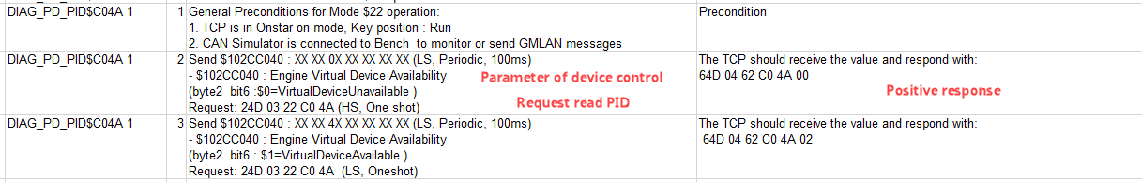
• How to read Test case_DIAG_PD_PID$XX XX
$102CC040 XX XX 4X XX XX XX XX
CAN ID
Other value
Value of Device control parameter
Other value
$24D 03 22 C0 4A
USDT request
PCI (Valid length)
SID Request (SIDRQ)
PID
$64D 04 62 C0 4A 02
USDT response
PCI (Valid length)
SID Response
(SIDPR = SIDRQ +$40)
PID
Response value

Slide 14
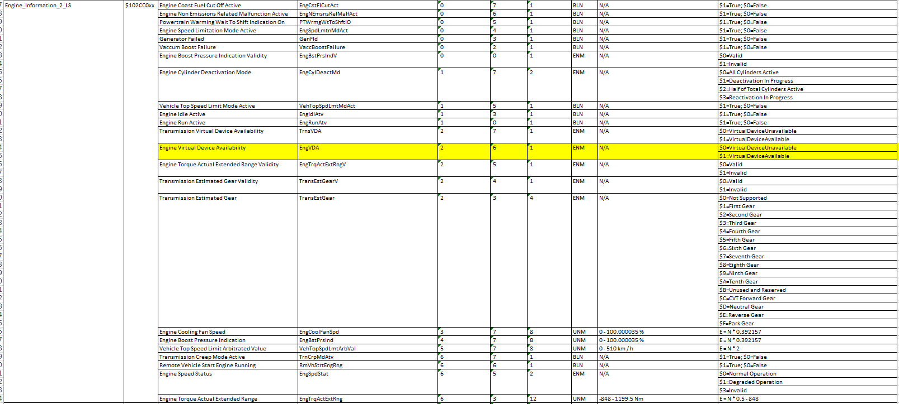
• How to read Test case_DIAG_PD_PID$XX XX Check request message by refer CAN database

Slide 15
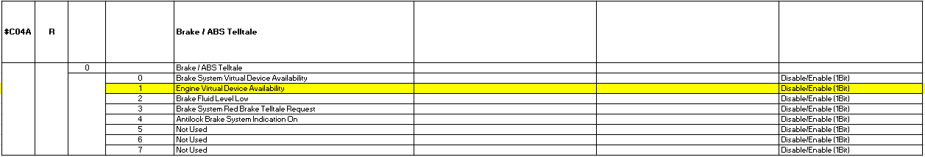
• How to read Test case_DIAG_PD_PID$XX XX Check response message by refer ALDL spec

Slide 16
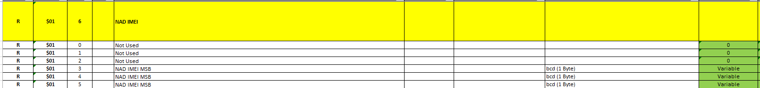
• How to read Test case_DIAG_PD_DID$XX Check response message by refer ALDL spec

Slide 17
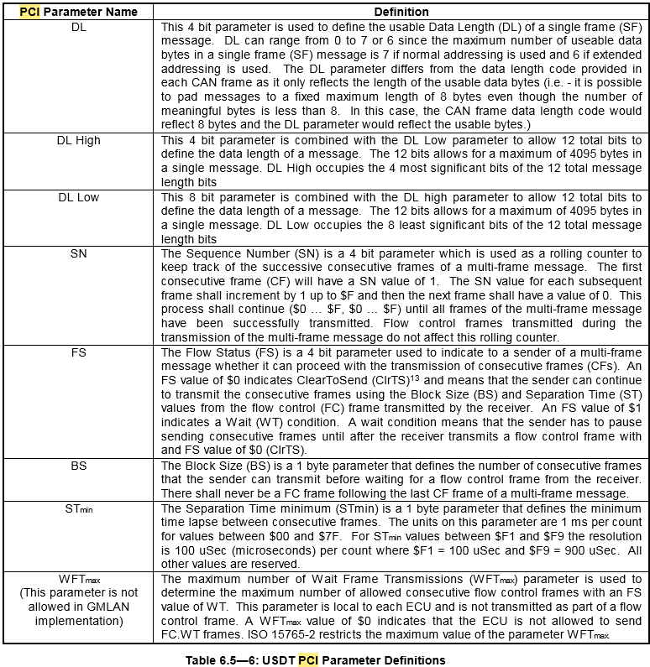
• APENDIX A: PCI Parameter definitions

Slide 18
• APENDIX B: Types of Diagnostic Service
[Diagnostic Service list]
SID | Description | SID | Description
$04 | Clear Diagnostic Information | $2D | Define PID By Address
$10 | Initiate Diagnostic Operation | $34 | Request Download
$12 | Read Failure Record Data | $36 | Transfer Data
$1A | Read Data By Identifier | $3B | Write Data By Identifier
$20 | Return To Normal Mode | $3E | Tester Present
$22 | Read Data By Parameter Identifier | $A2 | Report Programmed State
$23 | Read Memory By Address | $A5 | Programming Mode
$27 | Security Access | $A9 | Read Diagnostic Information
$28 | Disable Normal Communication | $AA | Read Data By Packet Identifier
$2C | Dynamically Define Message | $AE | Device Control

Slide 19
• APENDIX B: Types of Diagnostic Service
[Supported Service ID]
기능 | SID | Description
Memory Read / Write | $1A | Read Data By Identifier
 | $3B | Write Data By Identifier
 | $22 | Read Data By Parameter Identifier
 | $AA | Read Data By Packet Identifier
 | $AE | Device Control
DTC | $04 | Clear Diagnostic Information
 | $A9 | Read Diagnostic Information
Programming | $34 | Request Download
 | $36 | Transfer Data
 | $A2 | Report Programmed State
 | $A5 | Programming Mode
Session Control | $10 | Initiate Diagnostic Operation
 | $20 | Return To Normal Mode
 | $28 | Disable Normal Communication
 | $3E | Tester Present

Slide 20
• APENDIX B: Types of Diagnostic Service
[Negative Response Code list]
NRC | Description | NRC | Description
$11 | Service Not Supported | $78 | Response Pending
$12 | Sub Function Not Supported | $81 | Scheduler Full
$22 | Condition error Or Sequence error | $85 | General Programming Failure
$31 | Request Out Of Range | $89 | Device Type Error
$35 | Invalid Key | $99 | Read For Download DTC Stored
$36 | Exceed Number Of Attempts | $E3 | Device Control Limits Exceeded
$37 | Required Time Delay Not

