Slide 1
PD-TC Execution
1.DID Range Check
2.PID Test
3.CPID Test
4.DPID Test
5.PD Service Test
6.Etc
7.Common
8.Sample test cases

Slide 2
DID Range Check (1/2)
Write DID: 3B
DID can be write if it marked as RW in ALDL
Almost DID need Security Unlock to Write Data – refer to
For DID need Security unlock, before write data to DID need:
Send below message:
24d 01 3e (maintain Diagnostic service because the request seed or almost request diagnostic service only impact 5s)
24d 02 27 01 (request seed)
While DID A0 still from FE – 01, only request seed can unlock security. This value is decreased 1 after every IGN OFF to ON
If DID A0 = 00 we cannot change value of it except re-flashing
For DID A0 = 00, After request seed we need send key: 24d 04 27 02 xx xx (xx xx is information in Positive response of request seed)
ALDL spec can be changed from build version to version so it is better if refer to ALDL spec every time do DID range check rather than TCs
Depend on Resolution and Range to know DID range and check the boundary (some times it’s noted in Note column)

Slide 3
DID Range Check (2/2)
Read DID: 1A
Request message: 24D 02 1A xx
For DID <= 6 bytes length
Response: 54d xx 5A xx xx xx xx…
For DID > 6 bytes length:
Response:
First frame: 64d 10 xx 5A xx xx xx xx xx
Send Flow control: 24D 30 0n YY to read more data
n = 0: read all
n: Number of CF (the frame data after first frame)
YY (Stmin): the minimum time lapse between consecutive frames
Consecutive frame: Start from 21 to 2F then continue with 20 to 2F to the end of data
Example: DIAG_AC006

Slide 4
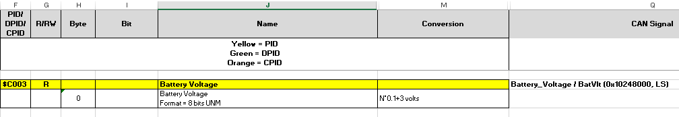
PID Test (1/3)
Because PID is Vehicle Information so we need simulate CAN signal before check the PID value
Almost PID case is same value with CAN signal, some specific cases below need a little bit calculation:
PID C03D:
Rolling Count signal: $3F9 00 xx xx 00 00 00 00 00 (HS, Oneshot)
Counter and Rolling Count Reset: $3F9 80 00 00 00 00 00 00 00 00 (HS, Oneshot)
To save to PID we need send two signals of Rolling Count, we call are Old and New
Case1: Old < new and new – old < 2000: Data will not be saved to PID until IGN OFF to ON
Case2: Old <new and new – old > = 2000: PID = Original + (new – old)/200
Case3: Old > new: PID = Original + ((FFFF – old) + new)/200
Note: the remainder will be saved to memory and will be added to next calculation
Maximum of Rolling count is set by: 3,4byte of DID $67
Example: DIAG_AC189

Slide 5
PID Test (2/3)
2. PID C03E:
Almost same with C03D
Based on the below signal: Fuel Alcohol Composition signal
$3FB XX 40 (HS, Oneshot) => In that case 40 = 25%
PID = Original + Hex((Dec(Accumulated Fuel Injected Delta)-Dec($Remainder) * 25%)/200
In case Fuel Alcohol Composition signal #25% and PID C03E has remainder after /200, if next signal of Rolling Count is received then new PID must plus the remainder of C03E
PID = Original + Hex((Dec(Accumulated Fuel Injected Delta)-Dec($Remainder) * X%) + Remainder/200
Note: Power OFF to ON to reset the PID
Same as History DTC, PID first will be saved to volatile memory. If go to DRX then On it will be saved to NVM and only re-flash can deleted the value
Example: DIAG_AC201
3. PID C040:
Message signal= 102EC0CB 01 AB CE …
0000 000 1 1010 1011 1100 111 0 …
Value in C040= 1101 0101 1110 0111 (D5 E7)
Example: DIAG_AC211

Slide 6
PID Test (3/3)
4. Some PID GPS information ( Hex -> Dec):
Invalid Status GPS => PID: 0000
Valid Status GPS => PID: displayed exactly like in ATT
Example: DIAG_AC128
5. Internal PID:
Diagnostic module will read, range check only.
Example: DIAG_AC162
6. Other module PID:
PID for RR module: C045, C046. C047, C048
PID for EAVB: C061, C062, C063
PID for Supper Cruise: C066, C067, C068
PID for Wifi infor: C03B
For above PID, diagnostic module will read, range check only. Others will be covered by other modules
Example: DIAG_AC440, DIAG_AC415, DIAG_AC471

Slide 7
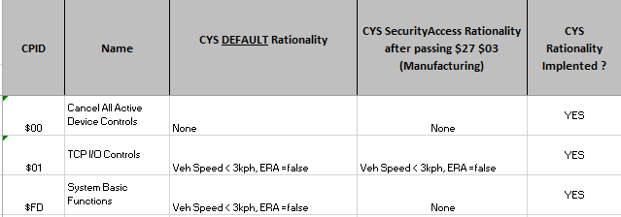
CPID Test (1/1)
CPID is Write only DID (Cannot read its values)
CPID $00: Cancel All Active Device Control
CPID $01:
Terminated normal call (Cannot terminate Collision, OCC initiated or Emergency call)
3BA press
Control Telltale status
CPID $FD:
Disable all system output ($FD $80): All messages from the VCP/TCP ($97) will freeze for 5s or if cannot stop, it must be maintain data.
Example: NCA message has no data, so it may be still running
ECU reset (VCP/TCP soft reset) ($FD $40)
Reset Source ID: Clear DTC from source ID (during this time VCP/TCP will not check DTC U-code – 5s impact)
If environment is not in Restrictions, it shall send a negative response ($7F $E3 $XX $XX – Device Control Limits Exceeded)
Example: DIAG_AC313, DIAG_AC326

Slide 8
DPID Test (1/3)
Need to know how to setup some DTC – refer to
Cannot test DTC: NAD lockout (will be checked in NAD module and need network simulator), Wifi communication DTC (need physical break Wifi chipset)
DTC cannot simulate current DTC: WDT and General checksum (only history set)
1. DPID $11:
Simulate DTC then check value changed in DPID
Byte 0 (Current) and Byte 1 (History): Communication Errors
Bit 5: Loss communication with NAD. After make NAD fail via QXDM -> DRx -> Ignition ON -> Check DTC
Byte 2 (Current) and Byte 3 (History): Memory Errors
Example: DIAG_AC265
2. DPID $12:
Check Audio, BUB, & Keypad and Watch dog Time Stamp status
Ignition OFF/ON will reset all bit of DPID$12

Slide 9
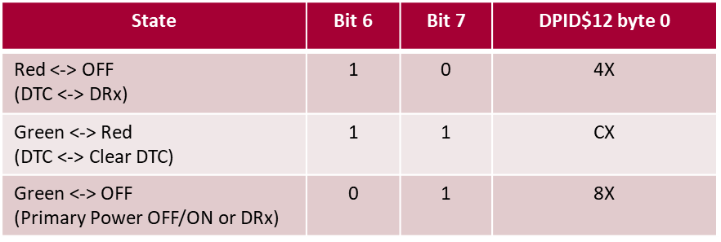
DPID Test (2/3)
- Byte 0: Check Audio, BUB, & Keypad LED
Bit 0 (Audio): After change DID$65 -> Make Call -> Check voice and DPID
Bit 6, 7: Check LED as bellow table
Byte 1: Check Keypad Input when pressed
Byte 2~5: Check Watch dog Time Stamp (history)
Eg: 86 13 07 34
Year (2010+X): 8= 2018
Month= 6 Day= 19 Hours (GPS) Minutes
Example: DIAG_AC282
3. DPID $14:
Byte 0~3: Latitude. Dec(Byte 0~3)/3600000 must equal with value displayed in ATT/GNSS

Slide 10
DPID Test (3/3)
Byte 4-5: PDOP. Dec(Byte4-5)/10 must equal with value displayed in ATT/GNSS
Example: DIAG_AC286
4. DPID $15:
Byte 0~3: Longitude. Dec(Byte 0~3)/3600000 must equal with value displayed in ATT/GNSS
Byte 4-5: HDOP
Invalid GPS: Current HDOP=50
Valid GPS: Current HDOP=0.5
Example: DIAG_AC287
5. DPID $16:
Byte 0: Check signal strength (enm_sigqualstrg): Combine read value with Conversion value in ALDL/”Protocol Related” sheet then compare to value displayed in ATT/NAD/RSSI
Byte 1: Check Call Mode and Free Band control (enm_frequencybandcontrol): Combine read value with Conversion value in ALDL/”Protocol Related” sheet then compare to value displayed in ATT/NAD/Service available
Byte 2~4: Check current PLMN (MCC & MNC)
Byte 5: Check call status Indicator (enm_callstatindic) Combine read value with Conversion value in ALDL/”Protocol Related” sheet then compare to value displayed in OCC or call status
Example: DIAG_AC288
6. DPID $17:
Byte 3 bit 0: Check MDM reset by SW Watchdog (history)
Cannot test: Reset by Cranking, MDM CPU Watchdog, MICOM reset by MICOM HW Watchdog, MICOM external Watchdog
Example: DIAG_AC296

Slide 11
PD Service Test (1/1)
DID $04:
Byte 0: DTC Ignition Cycle History Counter (Maximum) to clear DTC
Byte 1: Counter= 00 (DTC) or Counter increase by 1 until reach Maximum value as Byte 0
101 FE 02 10 02: Disable all DTCs (no check DTCs when this request has been kept)
101 FE 02 10 03: Enable DTC during DevCtrl
101 FE 02 10 04: Wake up link
101 FE 01 28: Disable Normal Communication (same as $10 $02). Restriction: Speed <3kph, ERA= false
101 FE 01 A2: Response $E2 XX (XX: Programmed state 10.16_2)
101 FE 02 A5 01: Initiate request programming mode
101 FE 02 A5 02: Initiate request programming mode (High speed)
101 FE 02 A5 03: Enable programming mode (mandatory send this request to enter programming mode
Unlock security $27 $01 or $27 $02
All these request can be terminated by:
24D 01 20: Return to Normal mode, or
101 FE 01 3E (Tester present) time out
Example: DIAG_AC331

Slide 12
Etc (1/1)
PNICNI
Please refer this table to find CAN ID and USDT Response ID mapping with Target ID (for some wrong test cases):
Target ID | Message ID (HS) | Message ID (LS) | UUDT Res ID | USDT Res ID
13 | 7E3 |  | 5EB | 7EB
CF | 755 |  | 5ED
14 | 25E |  |  | 65E
21 | 25B |  | 55B
2B | 254 |  | 554
85 |  | 256 | 556
BC |  | 24B | 54B
75 |  | 255 | 555
A4 |  | 24F | 54F
CB | 7E4 |  | 5EC | 7EC
13 (ODB) | 7E1 |  |  | 7E9 (7E1+0x08)
Some Target ID does not support for TCP MY21: $6F, $33, $80, $66, $81
Target ID $90, $91 do not use HS or LS to send => Can not test (GMTELECOM-499)
Example: DIAG_AC375

Slide 13
Common (1/1)
CAN message clarify to two types:
Signal: Single frame only
Service: Always HS.
For multiple frame: Request message starts from 1
Target send Flow control 30 0x (x: number of CF)
How to know CAN message from targeted ID node
Use ALDL spec, DID sheet, [Region] Value column
Find Diagnostic Address (Name column) of ECU you want
ex: CSM/RADIO Diagnostic Address is 80
CSM/RADIO Diagnostic Address CSM= Center Stack Module |  |  | HexDump (1 Byte) | 80
CAN Identifier (lower byte) - Primary HS GMLAN 3 |  |  | HexDump (1 Byte) | 00
CAN Identifier (lower byte) - Primary HS GMLAN |  |  | HexDump (1 Byte) | 00
CSM/RADIO/CHM CAN Identifier (lower byte) - LS GMLAN |  |  | HexDump (1 Byte) | 44
CSM/RADIO CAN Identifier (lower byte) - LS GMLAN |  |  | HexDump (1 Byte) | 44
According to the table above, targeted ID node of Radio/CSM is 80, it using LS GM LAN with CAN message is 244 – normally start from 2
ECM Diagnostic Address ECM = Engine Control Module |  |  | HexDump (1 Byte) | 11
ECM CAN Identifier (lower byte) - Primary HS GMLAN UUDT response CAN Identifier = $5E8 USDT response CAN Identifier = $7E8 |  |  | HexDump (1 Byte) | E0
CAN Identifier (lower byte) - LS GMLAN 3 |  |  | HexDump (1 Byte) | 00
CAN Identifier (lower byte) - LS GMLAN |  |  | HexDump (1 Byte) | 00
According to the table above, targeted ID node of ECM is 11, it using HS GM LAN with CAN message is 7E0 ( not 2E0 because the CANID start from E)
Negative response always start from 6 (exception is 7xx)
When you need simulate any low speed message from BCM, first OFF BCM button on bench then use CAN device to send the message. At that time using IGN or door signal will not send any signal to CAN BUS

Slide 14
Sample test cases (1/1)
Main function | Test case ID
DID Range Check | DIAG_AC001 DIAG_AC006
PID test | DIAG_AC221 DIAG_AC189 DIAG_AC201 DIAG_AC211
CPID test | DIAG_AC313 DIAG_AC318 DIAG_AC326
DPID test | DIAG_AC265 DIAG_AC283 DIAG_AC286 DIAG_AC287 DIAG_AC288 DIAG_AC296
PD Service Test | DIAG_AC331 DIAG_AC466
Etc | DIAG_AC117 DIAG_AC375 DIAG_AC394

