Slide 1
SCLib: A Practical and Lightweight Defense against Component Hijacking in Android Applications
Daoyuan Wu, Yao Cheng,
Debin Gao, Yingjiu Li, and Robert H. Deng
School of Information Systems,
Singapore Management University

Slide 2
Component Hijacking on Android
Permission misuse;
Data leak
Adversary
caller app
NDSS’11: Woodpecker
CCS’12: CHEX
NDSS’13: ContentScope
Victim
callee app
Attack
component
Exported
component
Android framework and kernel
IPC request/flow
Notes:
The adversary is a caller app, and the victim is a callee app that contains a component that is exported. The attack component in the caller app sends a crafted IPC (inter-process communication) request to the exported component to maliciously trigger its code execution for a privileged operation, e.g., permission misuse [21] and data manipulation [26].

Slide 3
Existing Works
Firmware modification
App
repackaging
Rarely adopted by smartphone vendors;
Performance overhead is usually high.
Violate Android’s key-based app verification;
May break the code quality and also the law.
A comprehensive comparison on existing defenses is available in Table 1 of our paper.
Notes:
take advantage of the open-sourced nature of Android to make code changes and provide more secure OS design principles, but in the real world, they were not adopted by smartphone vendors. Additionally, end users have no capability to flash the modified firmware in general.
firmware modification approaches have to monitor all IPC communications in all apps within the system.

Slide 4
SCLib: Secure Component Library
Incoming IPC flow
Victim
app
Risky component
Intercepted IPC flow
AC Decision
Rest of code
1
2
4
3
SCLib
Identifying Risky Components (Step 1)
Extracting Enforcement
Primitives (Step 3)
Adding Stub Codes in Entry Functions (Step 2)
Enforcing In-App
Access Control (Step 4)
Compiling-time Phase
Run-time Phase
Entry functions
SCLib’s stub codes
Notes:
we provide a new perspective to practically defending against component hijacking. Our solution is a secure component library, shorted as SCLib, which performs in-app mandatory access control on behalf of app components.

Slide 5
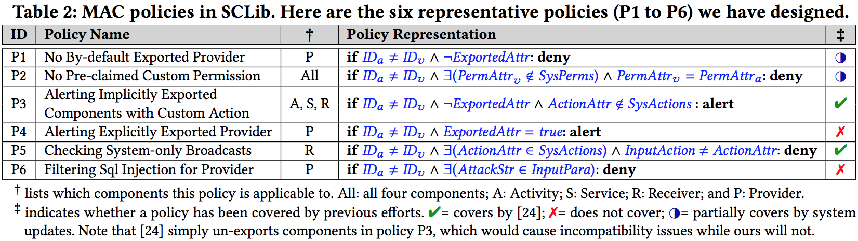
In-app MAC Policy Design
Fix system weaknesses
Prevent developer mistakes
Stop a common attack
Cover all four types of components
Policies are enforced only at entry points.
P1: fixing by-default exported content providers in many (legacy) apps compiled with targetSdkVersion* <= 4.2.
* Wu et al. Measuring the Declared SDK Versions and Their Consistency with API Calls in Android Apps. WASA’17.

Slide 6
Recovering Caller Identity
Android fails to provide the caller identity information to most of callee components:
Binder.getCallingUID() works only in the Binder thread* in which most components’ entry functions do not run.
For each risky IPC call intercepted, we retrieve the recent Binder logs from:
/sys/kernel/debug/binder/transaction_log
······
177341: call from 7569:7590 to 173 :0 node 176320 handle
177342: reply from 173:1462 to 597:624 node 0 handle -1
177343: async from 173:475 to 597:0 node 857 handle 2
177344: reply from 173:310 to 7569:7590 node 0 handle -1
177345: call from 6767:6767 to 597 :0 node 4298 handle 1
177346: reply from 597:1277 to 6767:6767 node 0 handle -1
······
(attack app)
The nearest app process
1st “call from” with callee PID
(victim app)
* Backes et al. Scippa: System-Centric IPC Provenance on Android. ACSAC’14.
Notes:
The first step is to locate the Binder log that “calls from” the callee PID for the first time, i.e., the transaction 177345. Then we trace back to identify the first app process, i.e., PID 7569, which is the caller app we are looking for. Since there is no fixed PID pattern for non-system processes, we further extract the corresponding UID and package name for analysis. More specifically, if the UID is smaller than 10000 or if the package name is a system binary, it must be a system process.
Here the attack app (PID: 7569) and the victim app (PID: 6767) here leverage the surfaceflinger and system_server processes to delegate their communication.

Slide 7
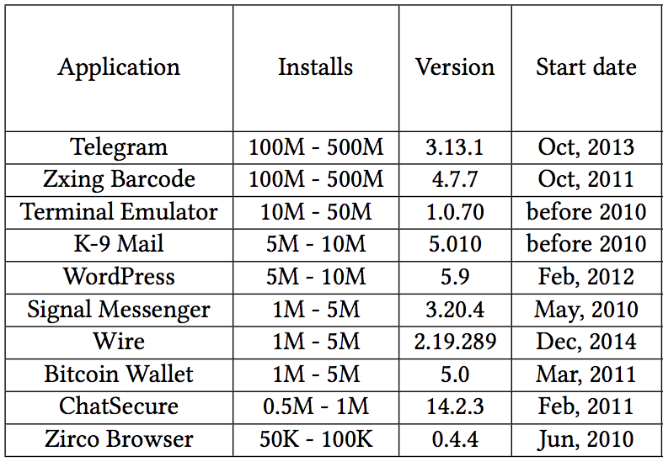
Evaluation
We select ten high-profile open source apps that are well-tested:
Identify 35 risky components that SCLib can contribute more protection.

Slide 8
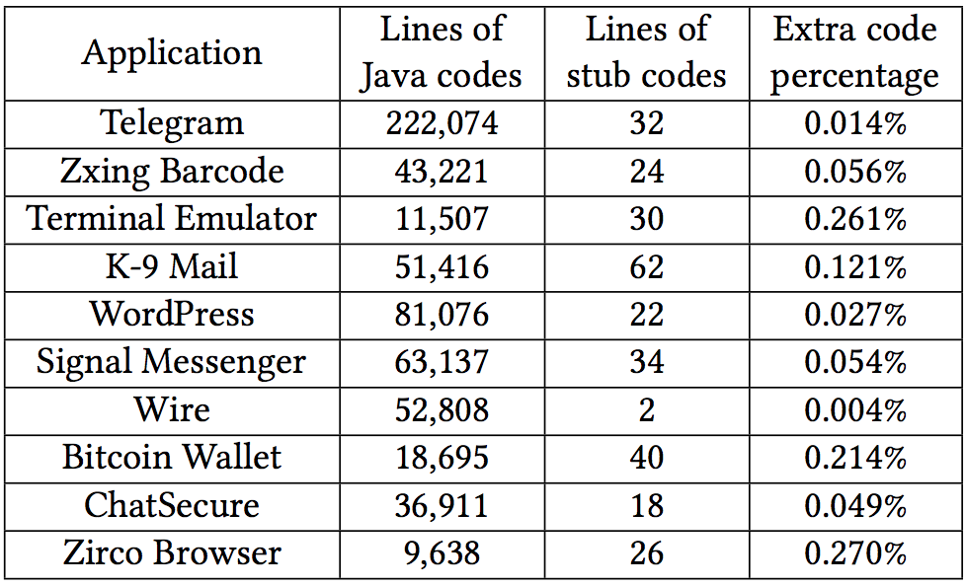
Code Footprint
SCLib introduces negligible code footprint — less than 0.3% stub code in all cases.

Slide 9
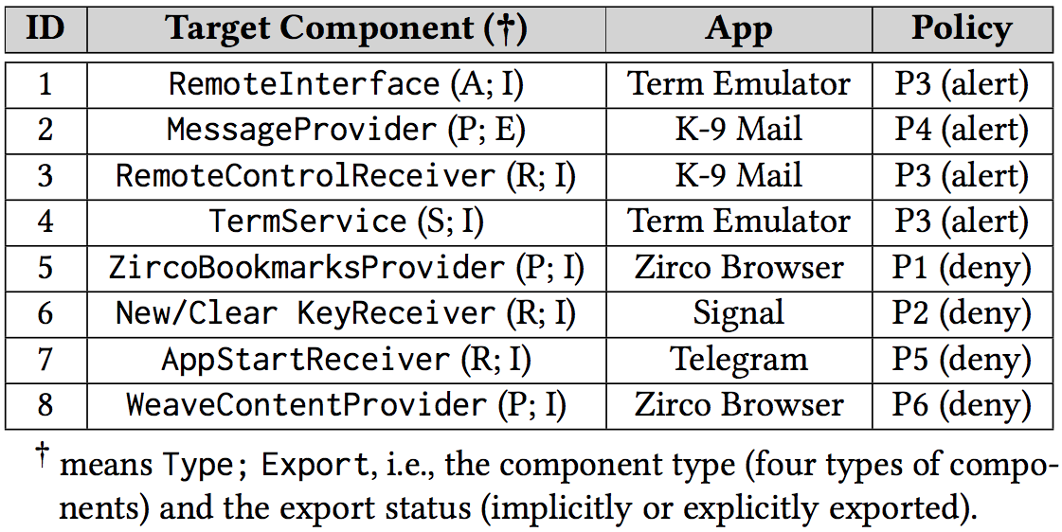
Security Evaluation
We perform eight detailed security case studies to demonstrate SCLib’s unique values.
Fixing vulnerable components
without losing compatibility.
Enforcing security beyond Android’s existing security mechanisms.
Fixing system weaknesses with a broader platform and app coverage.

Slide 10
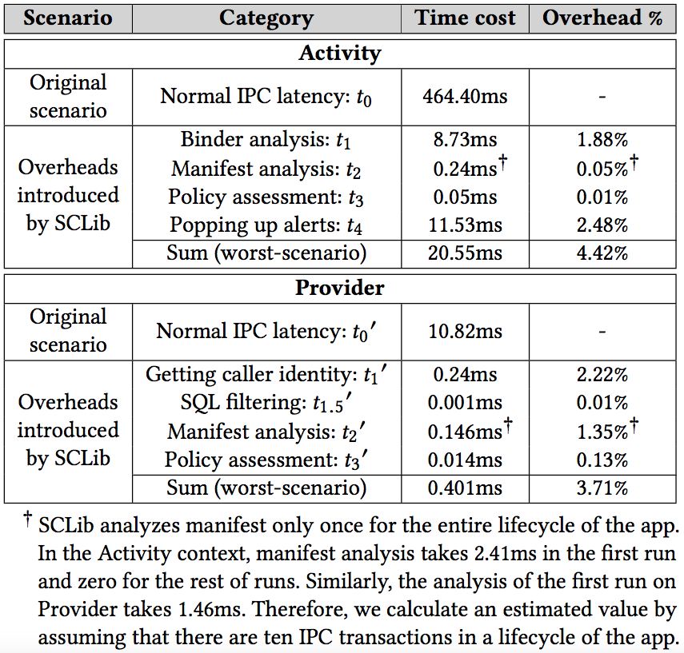
Performance Evaluation
Notes:
We evaluate the performance overhead of SCLib under different scenarios.
The cumulative overhead (i.e., the worst-scenario overhead) is below 5% for both components.
The absolute timing overhead is also unnoticeable to human users.

Slide 11
Conclusion
We presented SCLib, Secure Component Library, towards practically defending against Android Component Hijacking.
We overcame some notable challenges, e.g., in-app MAC policy design and recovering caller identity.
We demonstrated the unique security values and the modest overhead of SCLib.
Contact: Daoyuan Wu (dywu.2015@smu.edu.sg)

Slide 12
Backup slides

Slide 13
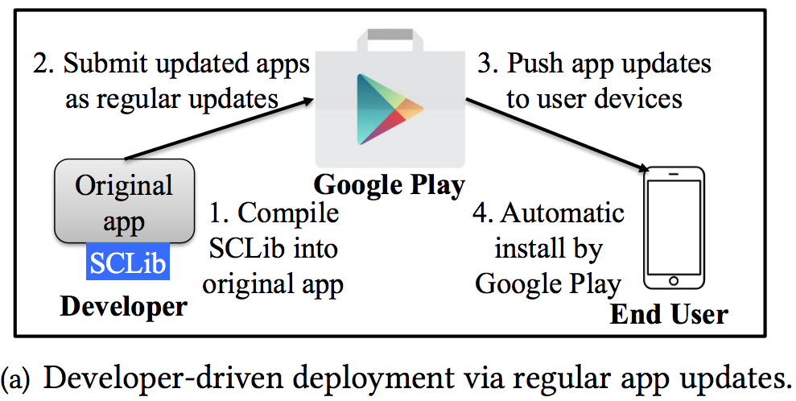
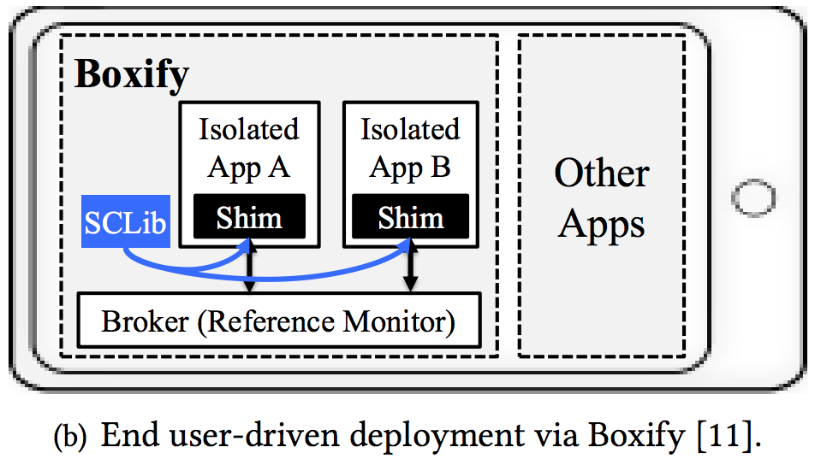
Two Deployment Models

