Slide 1
Campus Taste Archive
校园食鉴录
A Real-Name Campus Review Platform
TEAM 3
张庭宁 12411233
胡子晗 12412451
MIS205 Database Project

Slide 2
Agenda
Problem & Target User
System Demo (CRUD + Auth)
Reflections & Learnings

Slide 3
01
Problem &Target User
Why we built this and who it's for

Slide 4
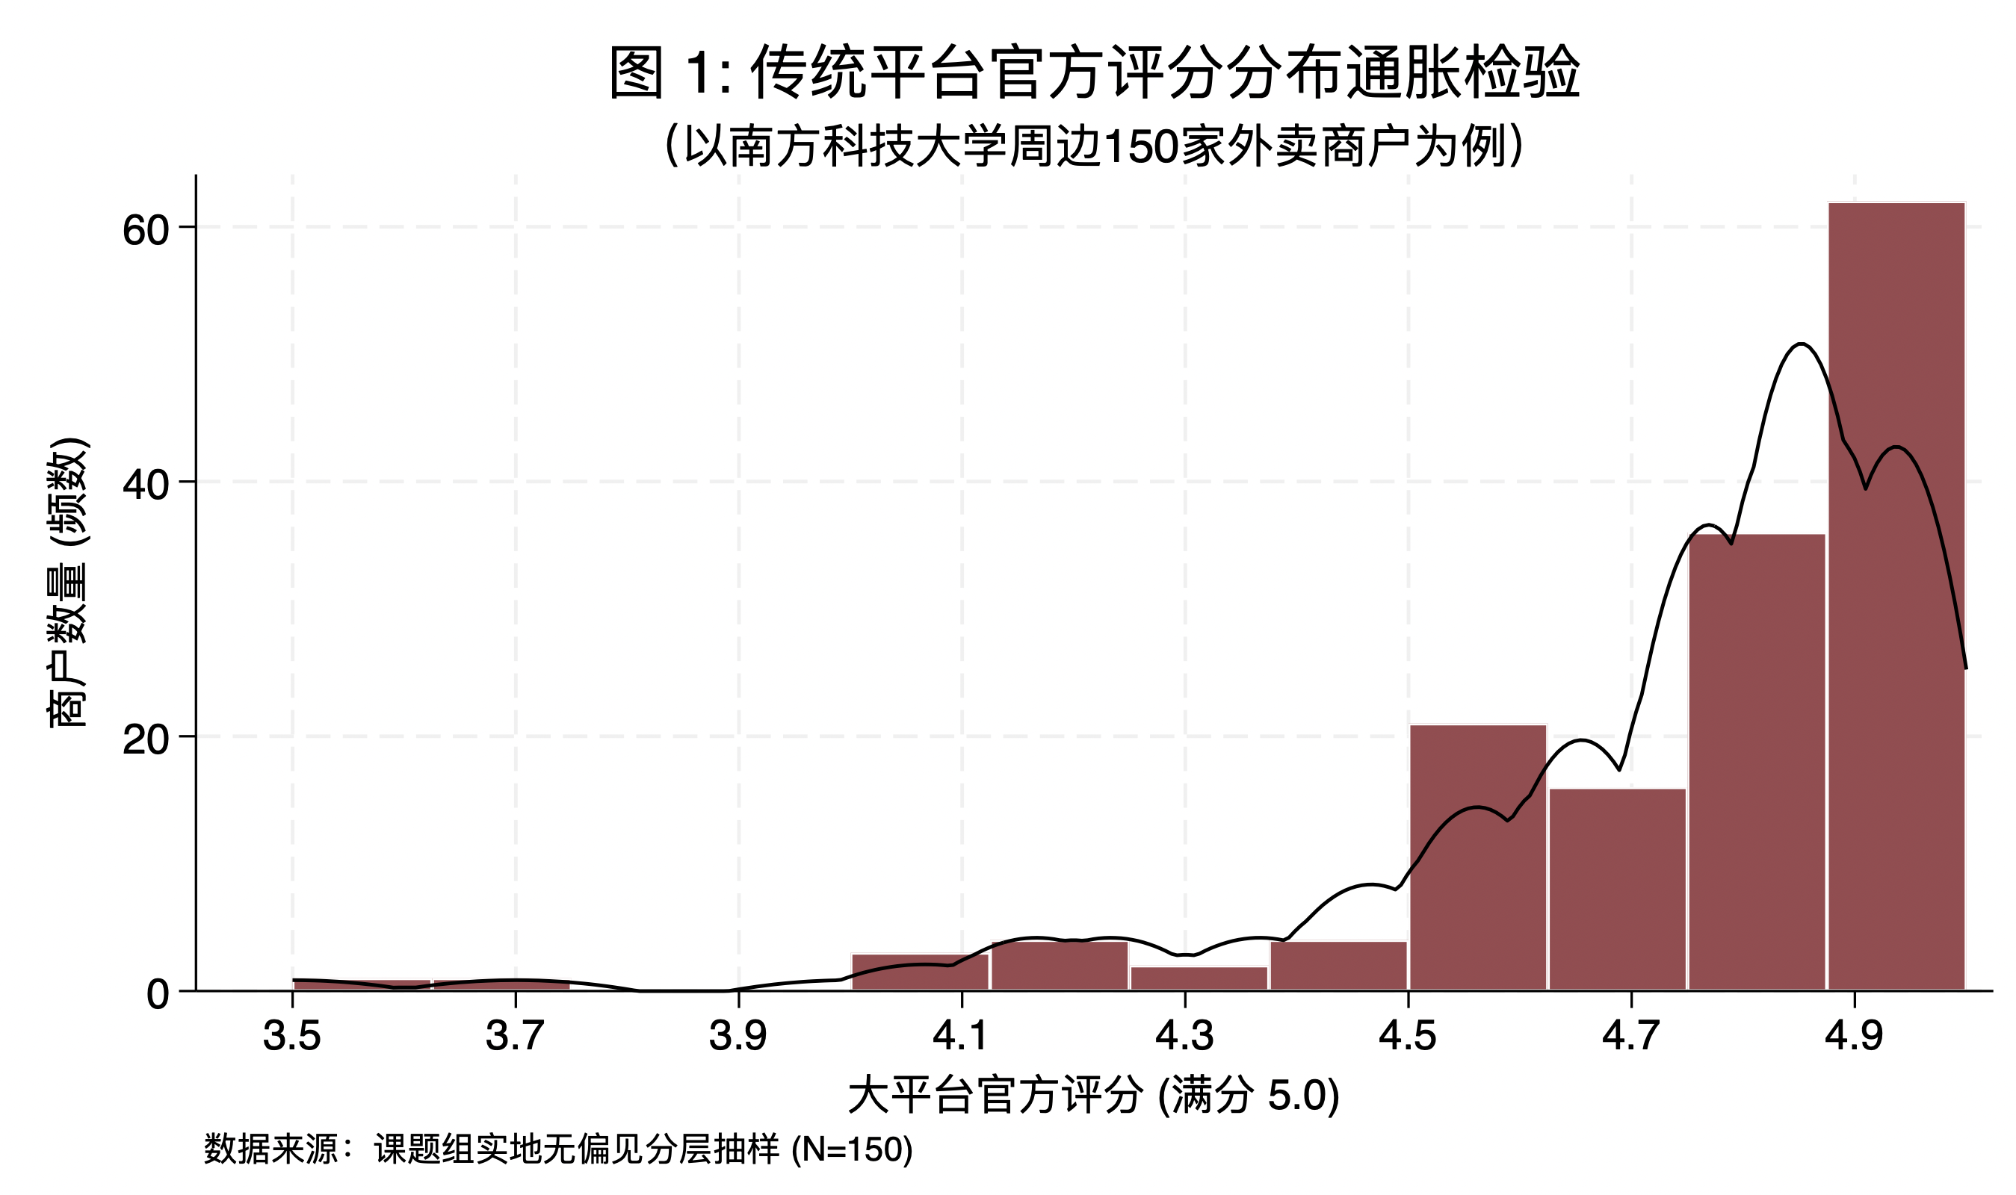
The Problem: Fake Reviews Everywhere
College students face three critical pain points
FAKE REVIEWS FLOODED
Existing platforms are overwhelmed with paid reviews. It's nearly impossible to tell which reviews are genuine.
NO CAMPUS FOCUS
General review platforms lack campus-specific shop coverage. Students can't find reviews for shops near their university.
Rating inflation is evident, with most delivery platform scores clustering at the high end.
ANONYMOUS MANIPULATION
Anonymous accounts allow one person to create multiple profiles, flooding the platform with biased or fake ratings.

Slide 5
Our Solution: Real-Name Red & Black List
A trusted review platform built exclusively for college students
REAL-NAME AUTH
RED & BLACK LIST
STAR + TAG SYSTEM
Each account binds to one unique student ID. Database-level UNIQUE constraint prevents one person from registering multiple accounts.
Reviews tagged as Red List (recommended, 4-5 stars) or Black List (avoid, 1-2 stars). Clear visual distinction for quick decisions.
5-star ratings with multi-dimensional tags (food, value, service). PostgreSQL array type enables flexible tag filtering.
"Let every student shop with confidence — no more blind buying."

Slide 6

02
System Demo
Database design, authentication, CRUD, and search

Slide 7
Database Schema: Two Core Entities
PostgreSQL on Supabase with optimized indexes and RLS policies
Users
id | UUID | Supabase Auth PK
email | VARCHAR | NOT NULL, UNIQUE
student_id | VARCHAR | UNIQUE — anti-spam
student_name | VARCHAR | Real name required
school_name | VARCHAR | University name
is_verified | BOOLEAN | Default FALSE
created_at | TIMESTAMP | DEFAULT NOW()
KEY DESIGN DECISIONS
Student_id UNIQUE constraint at database level completely prevents multi-account spam
Composite index (shop_name, rating) optimizes GROUP BY aggregation for search
Soft delete (is_deleted) preserves data integrity and enables audit trails
Posts
id | BIGSERIAL | Auto-increment PK
user_id | UUID | FK → Users, CASCADE
shop_name | VARCHAR | Composite index
rating | INTEGER | CHECK 1-5
type | VARCHAR | 'RED' or 'BLACK'
tags | TEXT[] | PostgreSQL array
is_deleted | BOOLEAN | Soft delete flag
RLS policies enforce row-level security — users only access their own data
Tags array (TEXT[]) with GIN index supports flexible multi-dimensional filtering

Slide 8

Authentication & Security Design
Three-layer security architecture
1
REAL-NAME VERIFICATION
Users must submit school name, real name, and student ID. The UNIQUE constraint on student_id prevents duplicate registrations.
2
ROUTE GUARDS
Frontend route guards intercept unauthenticated access. Copy-pasting internal URLs after logout triggers forced redirect to login page.
3
JWT + RLS
Every API request validates JWT tokens server-side. Row Level Security policies ensure users can only access and modify their own data.

Slide 9
Full CRUD Operations
Complete lifecycle of a review post
CREATE
READ
UPDATE
DELETE
Verified users create posts with shop name, star rating, Red/Black type, title, content, and tags. user_id auto-fills from session.
Public browsing with fuzzy search by shop name. Filter by Red/Black type, star rating, or tags. Results sorted by recency.
Users edit their own posts only. Ownership validation checks user_id match. All fields editable with same validation as create.
Soft delete sets is_deleted = TRUE. Post disappears from user view but remains in database for audit and data integrity.
Ownership validation on every operation — users can only modify their own posts via user_id checks

Slide 10

Smart Search & Rating Aggregation
Search with statistical aggregation powered by PostgreSQL
HOW IT WORKS
GROUP BY rating aggregates all reviews per star level, computing count and average in a single query
Composite index (shop_name, rating) ensures sub-second response even with thousands of reviews
Star histogram visually displays rating distribution alongside average score and total review count

Slide 11

03
Reflections
What we learned from building with AI

Slide 12
What Worked & What Was Hard
WORKED WELL
CHALLENGES
Supabase Auth + PostgreSQL streamlined backend — authentication, database, and API in one platform
Composite index design — balancing query performance for search vs. write overhead on insert
RLS policies provided built-in security without writing custom middleware for every endpoint
JWT session edge cases — handling expired tokens, concurrent logins across tabs
Soft-delete pattern protected data integrity while giving users the expected "delete" experience
Privacy vs. verification — real-name requirement creates tension with user anonymity preferences
Key takeaway: Security and usability are always in tension — every design choice involves trade-offs

Slide 13

Reflection on Using AI Tools
Session handling — AI missed edge cases like token refresh race conditions; manual testing revealed gaps
How AI helped — and where we had to push back
WHERE AI HELPED
WHERE WE PUSHED BACK
Schema design — AI suggested field types, constraints, and index strategies that matched our requirements
UI/UX design — AI-suggested frontend designs lacked visual polish and were not user-friendly; we refined layouts and interactions to improve usability
RLS policy design — initial AI-authored Row Level Security rules contained critical flaws that prevented post deletion; we reworked the logic to align with our access-control requirements
Auth flow structure — AI outlined the verification → login → route guard pattern we implemented
SQL generation — aggregation queries, RLS policies, and trigger functions were drafted quickly
"AI is a powerful assistant, but domain judgment and critical evaluation remain essential."

Slide 14

Thank You
Campus Taste Archive — Real Reviews, Real Students
Questions & Answers Welcome

