Slide 1
Dan Parkes Inventory Management Project

Slide 2

Who am I?
A project to showcase what I have learnt at the Academy

Slide 3

Specification
Specified functionality
User/order/item
Create/update/delete

Slide 4
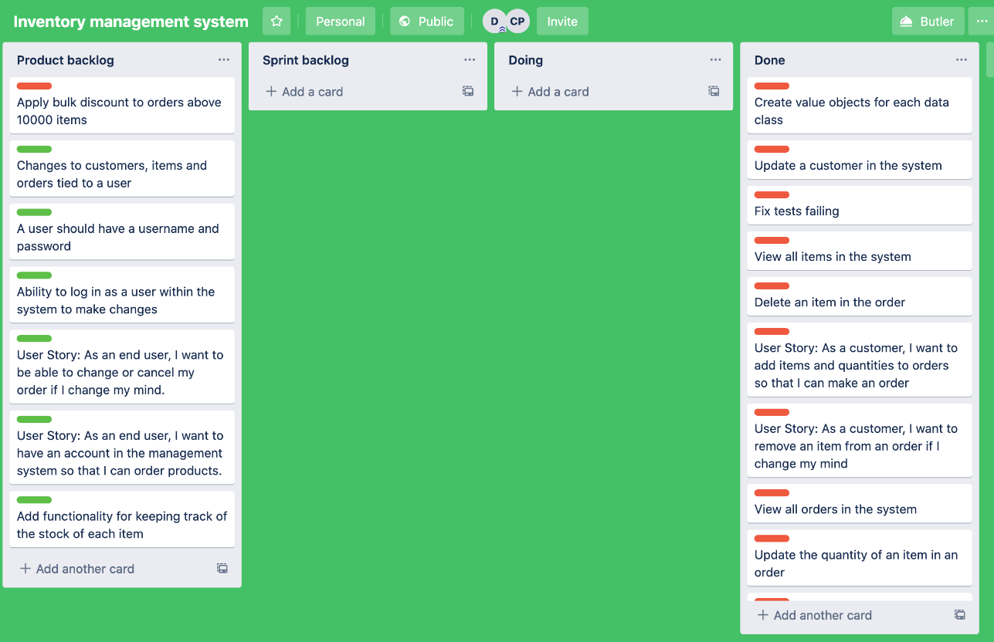
Agile
Trello board
Github
Issues
Feature/branch
Pull requests

Slide 5
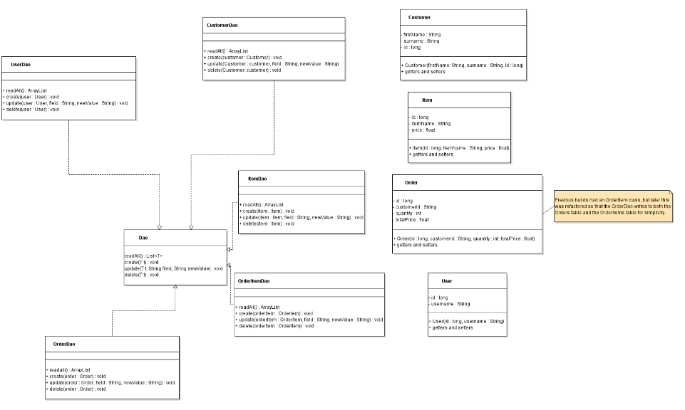
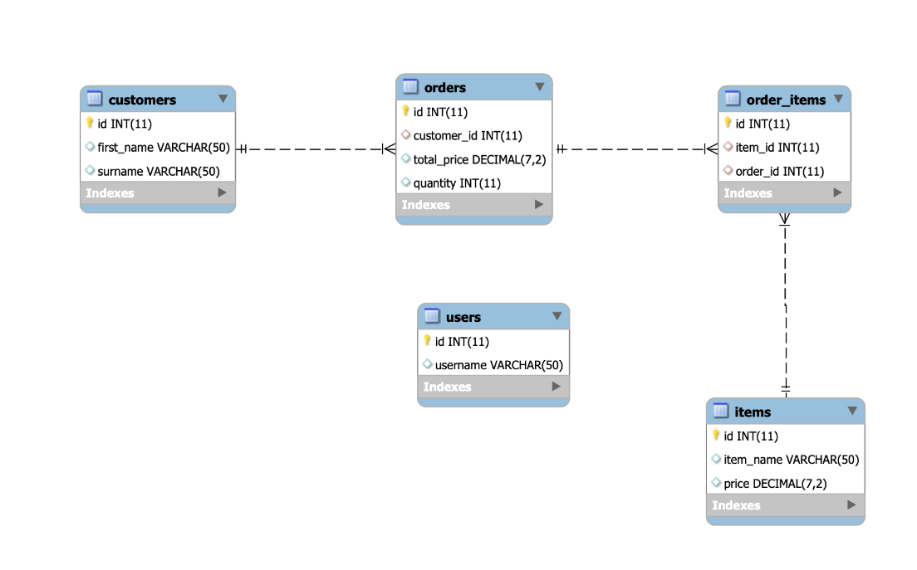
Analysis and Design
UML diagram
ERD – Entity Relationship Diagram

Slide 6
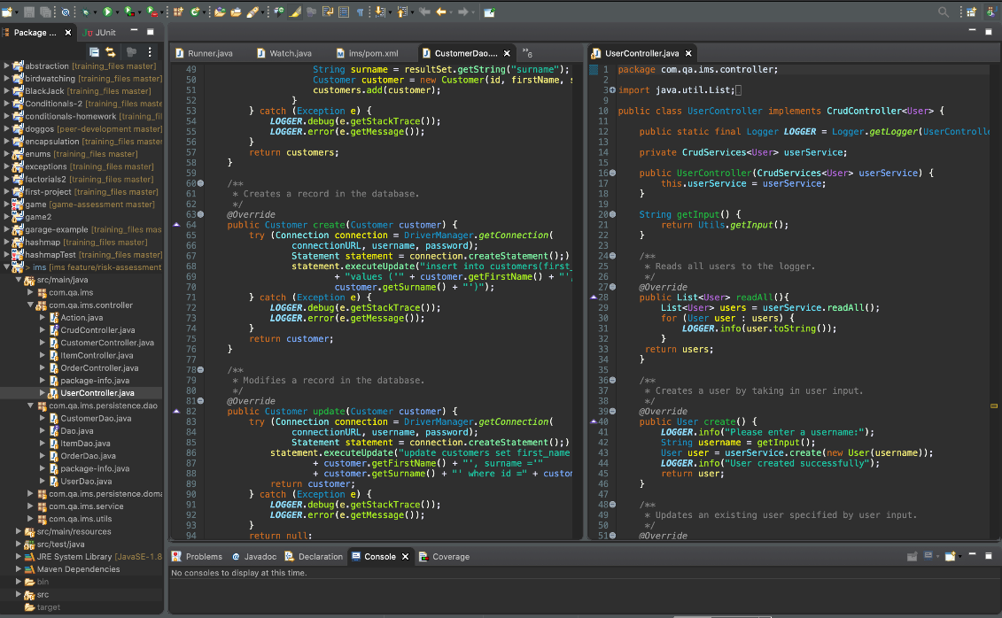
The Code
Controller – Services – DAO structure for maintainability
Connects to GCP database for which user has to authenticate when they log in

Slide 7
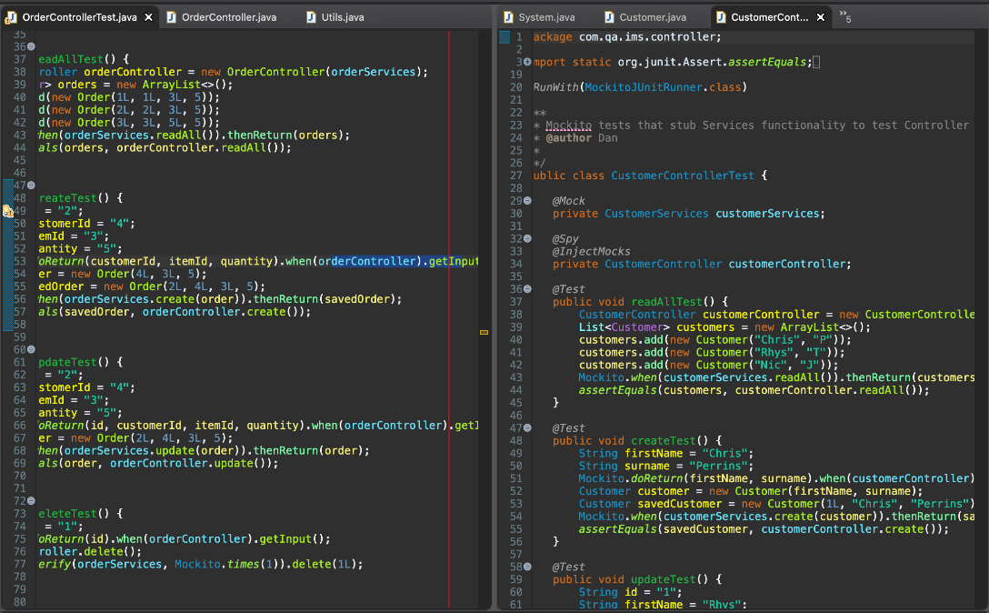
Testing
~70% coverage
~55% in SonarQube
Integration and unit tests
Mockito

Slide 8

System and Build
Automation using Jenkins
Ran Maven including tests
Uploaded to SonarQube for quality assessment and Nexus to store executable

Slide 9
Thanks for listening!

