Slide 1
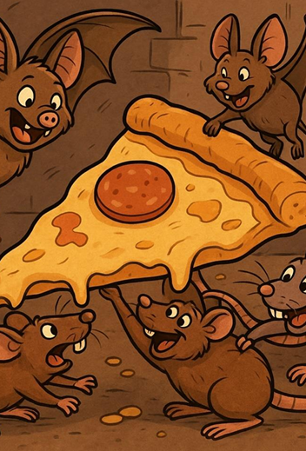
Do Bats Perceive Rats not just as competitors for food but also as potential predators?
Group Number (HIT 140 2025 Darwin Group 63)
Team Members:
Prakash Bhattarai (S394859)
Dipesh Wagle (S394745)
Pralin Dhungana(S395785)
Bishal Dahal (S388095)
Submission Date: 11/09/2025

Slide 2
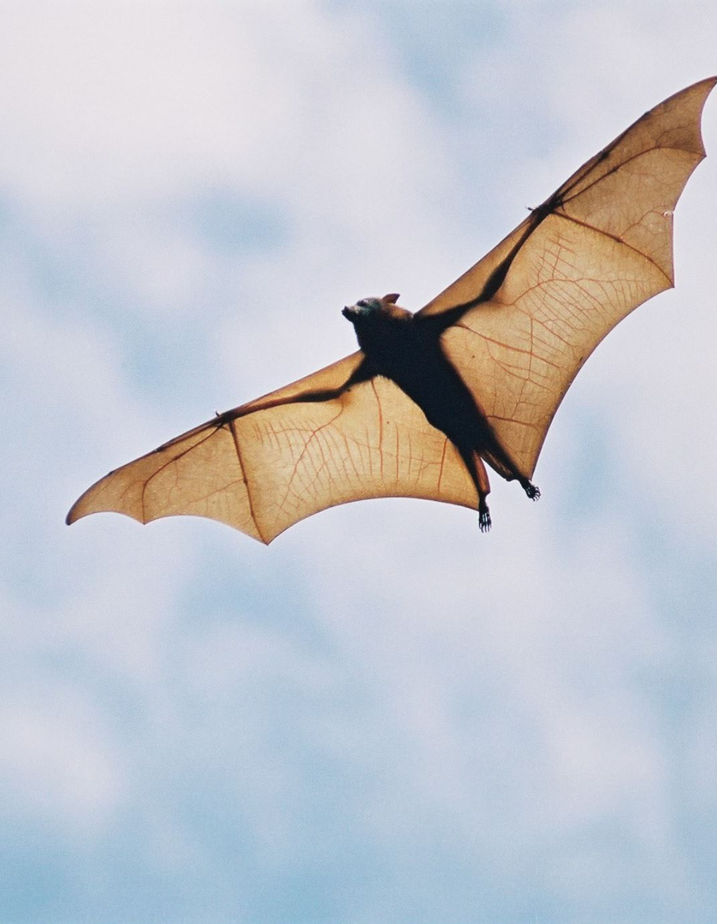
Introduction & Goals of the Research
Why is this research so important?
Content:
Bats and rats compete for food sources.
However, rats might act as the predators of bats because of their aggressive nature.
We can understand more about the bats’ behavior for locating food and defending themselves by finding out whether they are aware of the potential threats from rats.
Our Main Question: Do bats see rats both as threats and competitors?

Slide 3
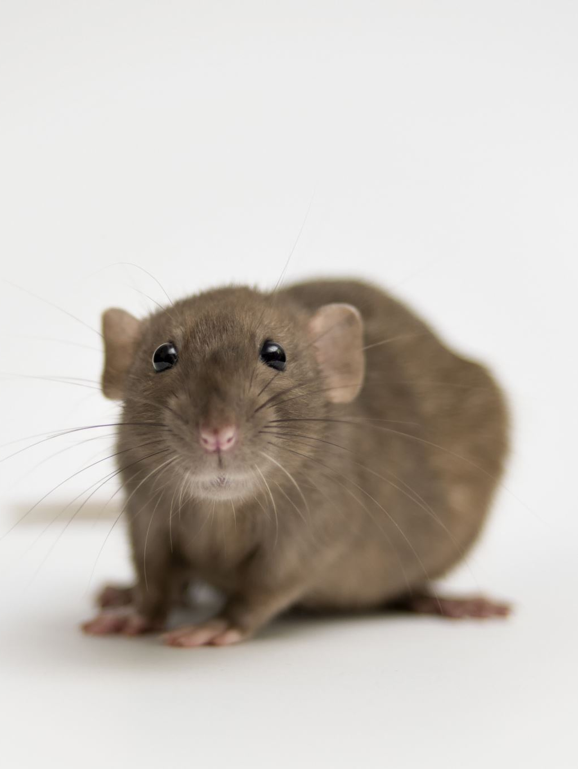
Hypothesis
What We Predicted
If bats see rats as predators, we will observe:
Increased Vigilance: Bats take a longer time to approach the food.
Avoidance Behavior: Bats’ landings would be fewer when rats were present.
Changed Risk-Reward Behavior: Their feeding success rates would change.

Slide 4
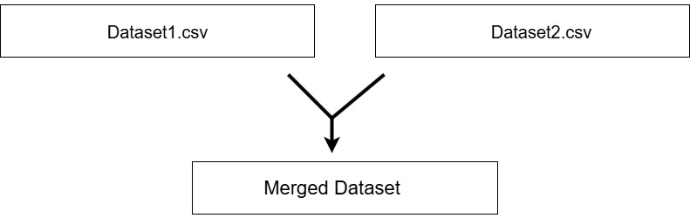
Our Datasets
Title: We worked with two different datasets, i.e., dataset1.csv and dataset2.csv
Dataset 1: Individual Events
Summarized records of single bat landings.
Column Names: bat_landing_to_food, risk, reward, habit
Dataset 2: Sequential Data
Combined the data in time intervals.
Column Names: bat_landing_number, food_availability, rat_minutes
Action: We merged these datasets by month and hours_after_sunset for a complete analysis.
Visual:
By adding a simple graphic here: two boxes labeled "Dataset1.csv" and "Dataset2.csv" with arrows pointing to a third box labeled "Merged Dataset"

Slide 5
Our Method : Data Preparation
Step 1: Data Cleaning
Content: How we made sure of the quality of data:
We handled missing values (e.g., filled empty habit column’s data with “Unknown”
We converted time columns to a standard datetime format.
We created rat present flag (0=Control, 1= Rat_Present).
We handled outliers in the ‘bat_landing_to_food’ column.

Slide 6
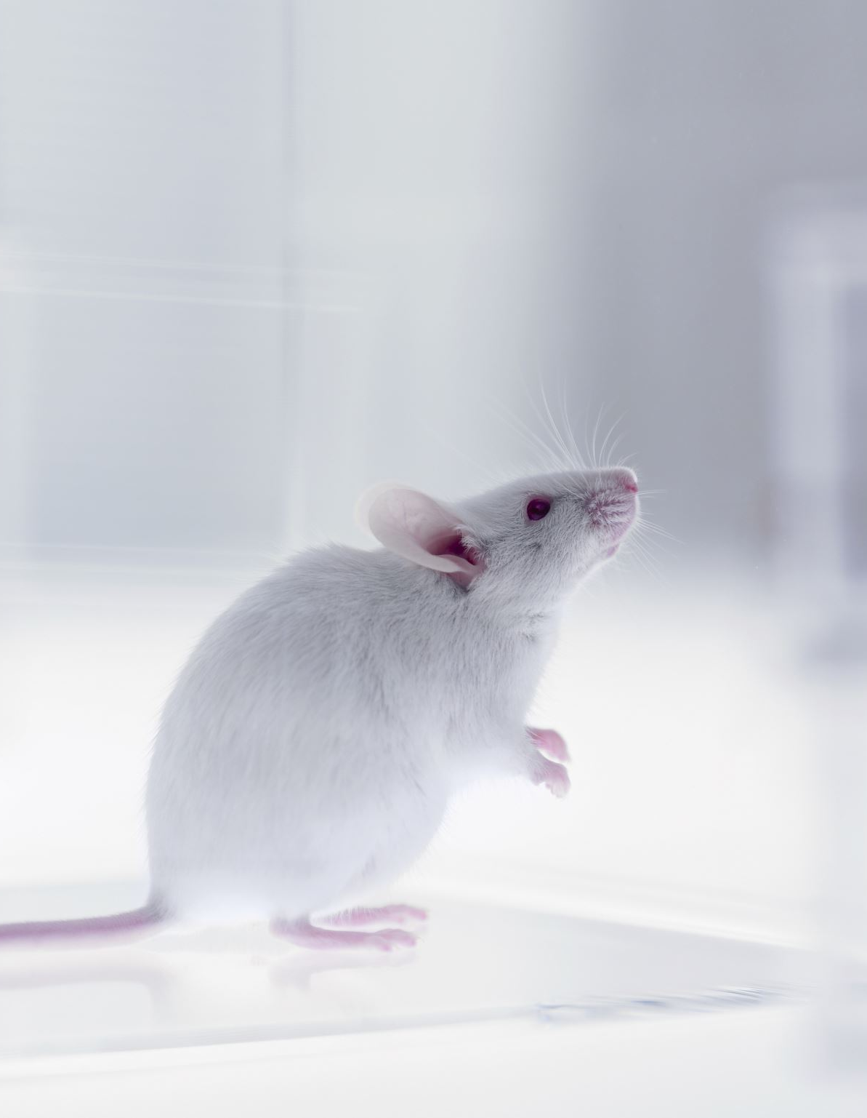
Analytical Approach
Behavioral Nature for Fear/Avoidance:
1. Time to Land on Food (caution) 2. Bat Landing Rate (avoidance) 3. Feeding with Rat Present (boldness)

Slide 7
Approach 1: Population Level Avoidance
Used Time Series dataset Proxy: bat_landing_number Compared control (no rats) vs. rat-present conditions Statistical tests: Confidence intervals and hypothesis testing

Slide 8

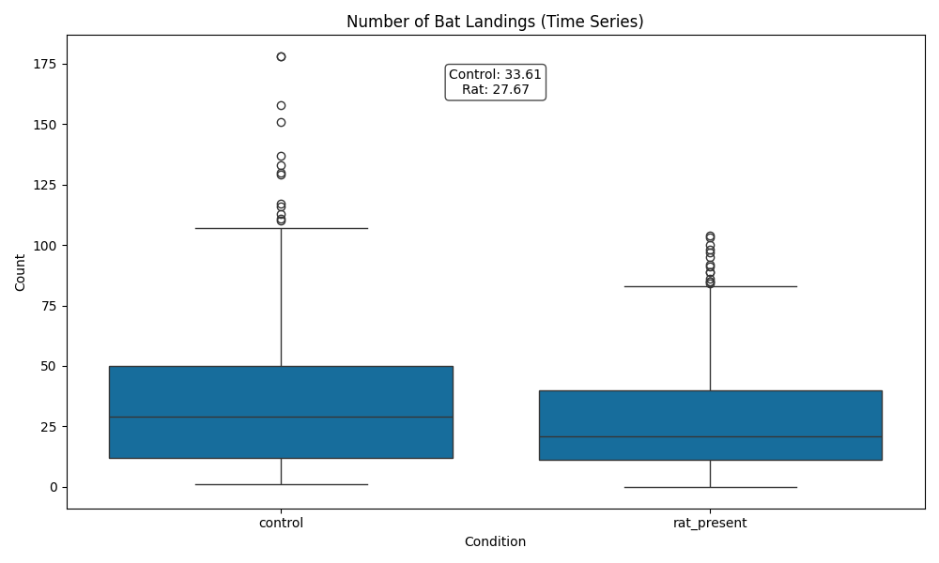
Approach 1 Results
Descriptive Statistics: - Control mean: 33.61 landings - Rat-present mean: 27.67 landings - Difference: 5.94 landings
Statistical Conclusion:
95% CI shows a significant difference > 0 p-value < 0.05 → Reject null hypothesis Conclusion: Rats significantly deter bats from landing

Slide 9
Approach 2: Individual Level Boldness
Used Individual Events dataset Proxy: BAT_EAT_WITH_RAT (1=eats with rat, 0=waits) Tested proportion of bold feeding events

Slide 10
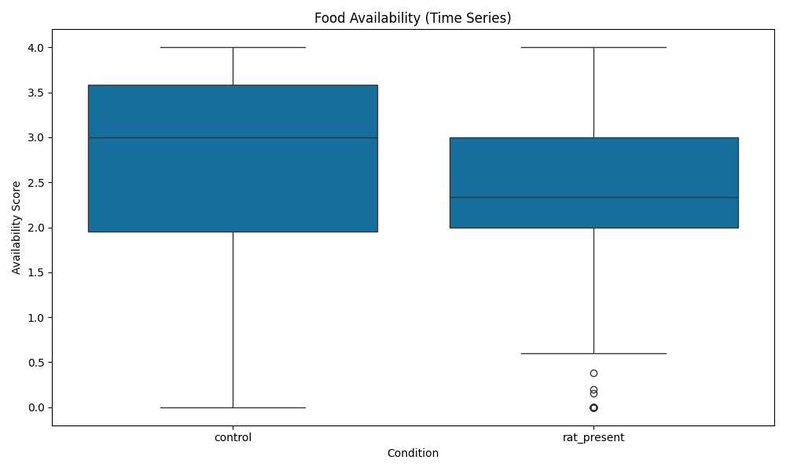
Approach 2 Results
Statistical Conclusion: Proportion of bold events > 0.5 with 95% confidence p-value < 0.05 → Reject null hypothesis Conclusion: Among bats that land, the majority feed on rats present.
Contradictory Findings: 1. Population Level: Rats deter landing (avoidance) 2. Individual Level: Bold feeding when rats present

Slide 11
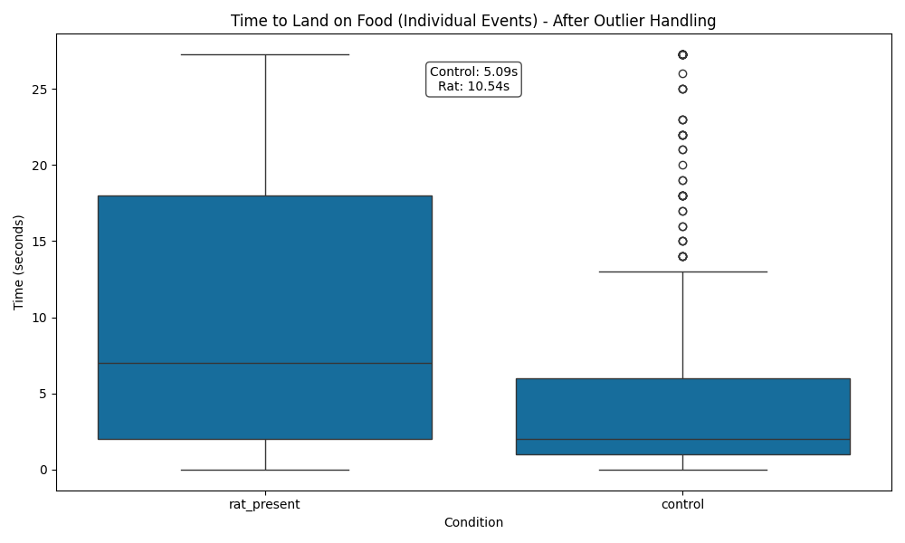
Visual Evidence
Time to Land on Food: Control: 5.09 seconds Rat Present: 10.54 seconds

Slide 12
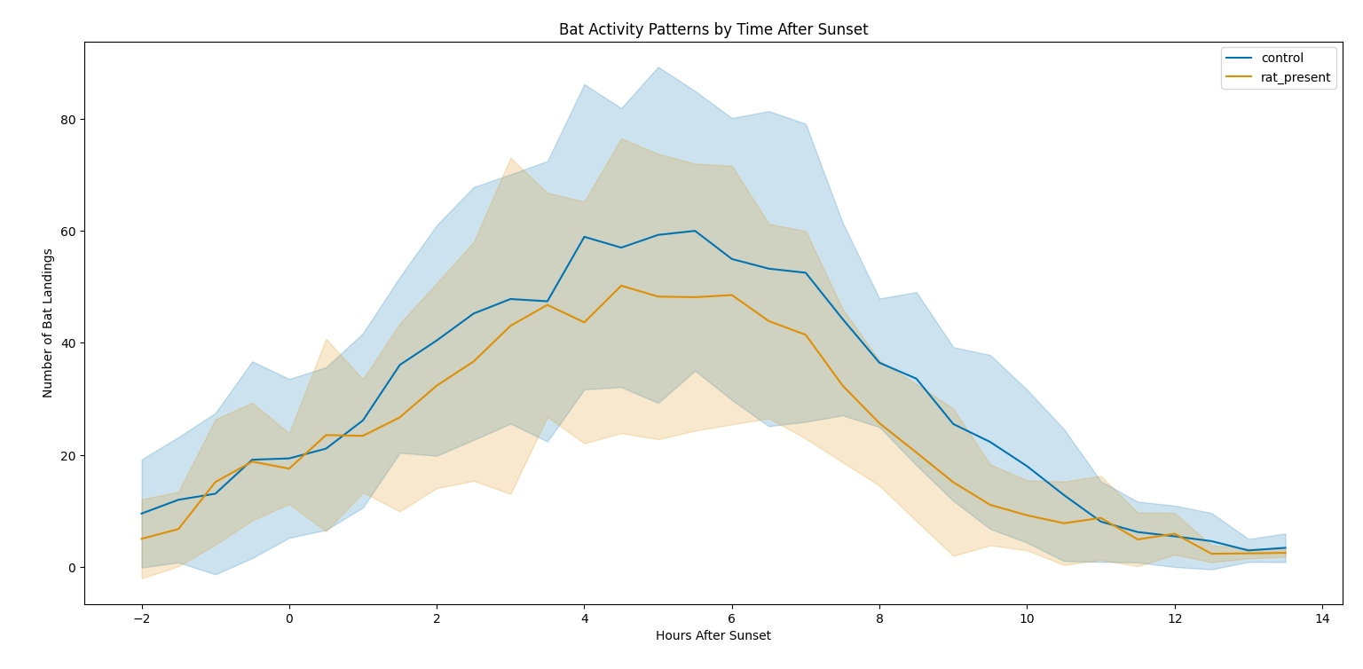
Additional Visualisation
Decreased landing frequency with rat's present
Change of bat activity by the time after sunset

Slide 13
Statistical Analysis
Strong Statistical Methods
Outlier Handling: We used the Inter Quartile Range(IQR) method to cap extreme values in the column named ‘time_to_food’ for dataset1.csv
Normality Check: When assessing the distribution of key variables, the data for ‘bat_landing_to_food’ were found to be non-normally distributed (p < 0.05).
Chosen Test: Due to non-normal distribution, we used the Mann-Whitney U test for comparing the median ‘bat_landing_to_food_processed’ between groups of bats (control and rat present). This test is more reliable to our data.
Effect Size: Calculated Cohen's d to measure the practical importance of our findings.

Slide 14
Why Our Approach?
Why Mann-Whitney U? Parametric tests like the t-test require normally distributed data. Our data violated this assumption, so we used a more reliable non-parametric test to ensure our results are valid and trustworthy.
Why Cohen's d? A p-value only tells us if an effect exists. Cohen's d tells us the size of the effect (e.g., small: 0.2, medium: 0.5, large: 0.8), which is crucial for interpreting the real-world significance.

Slide 15
Conclusion & Answer
Increased Vigilance: Bats take more than twice as long to land on food when rats are present.
Avoidance: The number of bat landings significantly drops in the presence of rats.
Reduced Foraging Opportunities: Food availability scores are lower when rats are present.
No Change in Post-Rat Arrival Delay: Time after rat arrival did not differ significantly.

Slide 16
Limitations & Future Work
Study Limitations & Future Research:
Important for understanding interspecies interactions Wildlife management implications
Future research: Habituation patterns over longer periods Individual differences in boldness Environmental moderating factors

Slide 17
Q&A
Thank You
Questions?

