Slide 1
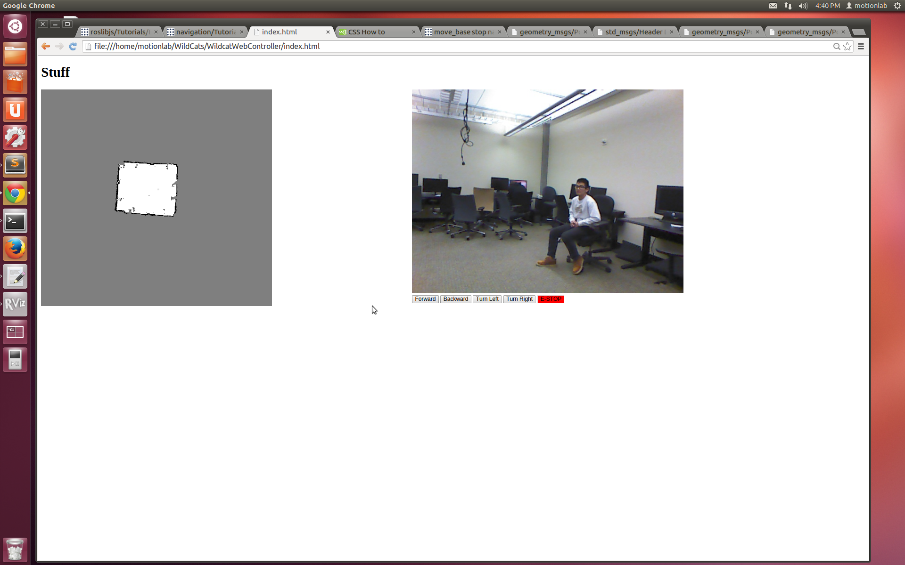
External camera feed – use to decide where to send the bot to
E-STOP – in case robot must be stopped ASAP
Manual controls – in case of trouble with nav goals
Map of 003D – double click anywhere on it to send the robot to that location

