Slide 1
Protein Language Models

Slide 2
Practical Applications of Protein Language Models
Protein engineering: Predict mutation effects, design variants
Drug discovery: Target identification, binding site analysis
Evolutionary analysis: Phylogenetic relationships, selection pressure
Functional annotation: Predict function for novel sequences
Quality control: Assess synthetic sequence viability

Slide 3
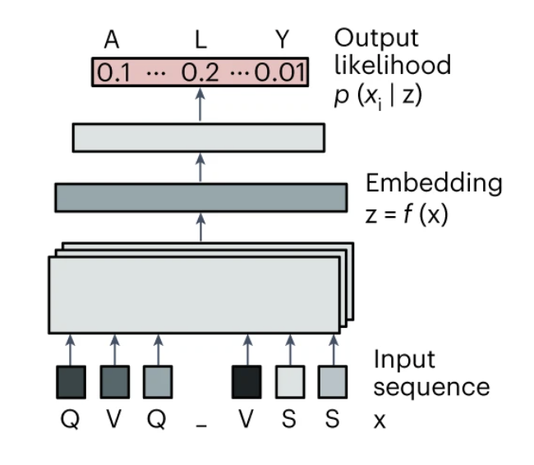
What are Protein Language Models (pLMs)?
Large neural networks trained on millions of protein sequences
  Uniprot, BFD, OAS, etc.
Learn statistical patterns in amino acid sequences without explicit structural or functional labels (usually)
Capture evolutionary relationships, structural constraints, and functional dependencies
Can enable zero-shot predictions for unseen proteins
https://www.nature.com/articles/s41587-023-01763-2/figures/1

Slide 4
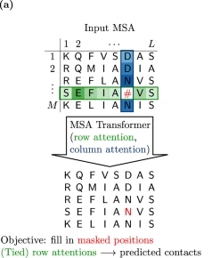
Training - Masked Language Modeling
Hide/mask random amino acids in protein sequences (often 15-20%)
Train model to predict the masked residues from context
Self-supervised learning - no labels required
Model learns: local patterns, long-range dependencies, evolutionary constraints
https://www.nature.com/articles/s41467-022-34032-y

Slide 5
Common Protein Language Model Architectures
ESM series: Transformer-based, bidirectional context
ProtBERT: BERT architecture adapted for proteins
  Bidirectional Encoder Representations from Transformers
AlphaFold2 language model: Structure-aware components
  Uses an Evoformer architecture
ProtGPT2: GPT2 transformer architecture
  Trained to predict the next token using only context upstream
All use attention mechanisms to capture sequence dependencies

Slide 6
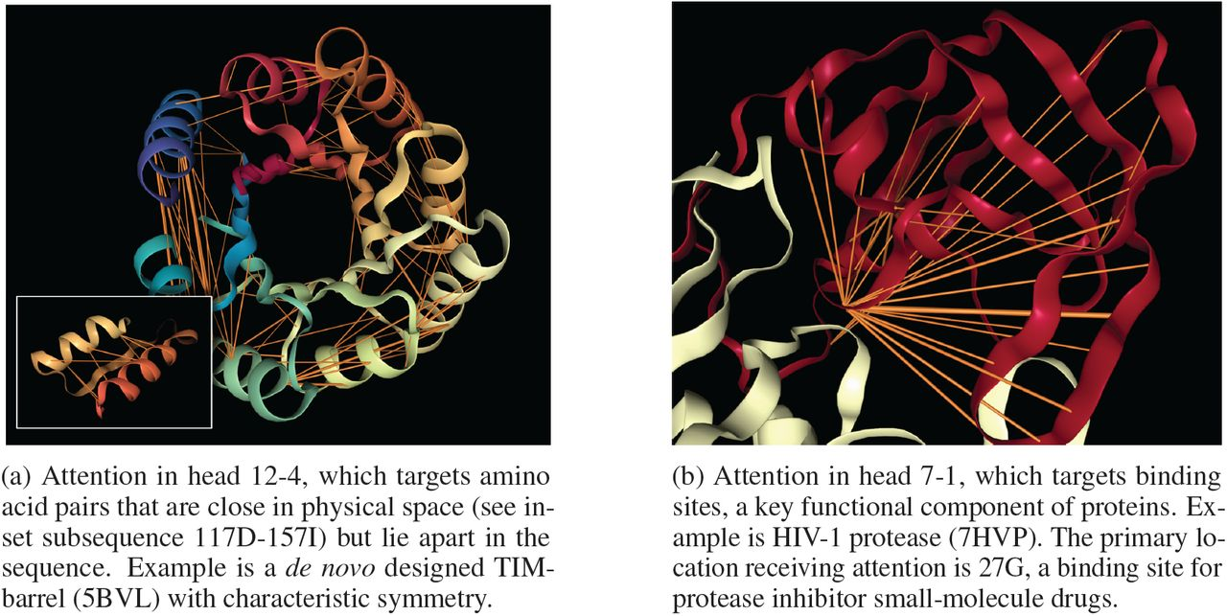
Transformers Provide an Attention Mechanism
Self-attention enables global context: Each position attends to all other positions simultaneously
Attention weights reveal biological relationships: Strong weights often correspond to physical contacts
Multi-head attention: Different heads capture different types of interactions (local vs. long-range)
Layer-specific patterns: Early layers focus
on sequence neighbors, later layers capture
structural contacts
https://www.biorxiv.org/content/10.1101/2020.06.26.174417v1.full

Slide 7
Overview of steps for pLM application
Preparation of input sequence using model-specific syntax
Tokenization
Model assessment
Output extraction
Data analysis
  Customized to application goals

Slide 8
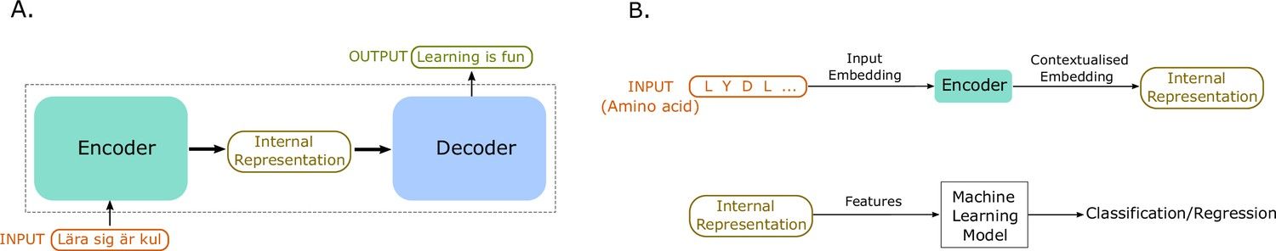
From sequence to tokens
Amino acid sequences → tokenized input
Each amino acid becomes a token (20 standard + special tokens)
Special tokens: [CLS], [SEP], [MASK], [PAD]
  IgLOO tokens incorporate CDR structural information (arXiv: 2509.08707)
Position encodings added to preserve sequence order

Slide 9
Example tokenization and masking
Our peptide complex of interest: METHIONINE:CYSTEINE
We wish to mask the fourth letter of each peptide…
ESM-2: <cls>MET<mask>IONINE<pad>CYS<mask>EINE<eos>
ProtBERT: [CLS] M E T [MASK] I O N I N E [SEP] C Y S [MASK] E I N E [SEP]
Notes:
<cls>: classification token indicating start of the sequence
<eos>: end of sequence

Slide 10
Comparing Protein Language Models (pLMs)
Model | Type | Mask Token | Spacing | Specialization
ESM-2 | ESM | <mask> | No | General proteins
ProtBERT | BERT | [MASK] | Yes | General proteins
IgBERT | BERT | [MASK] | Yes | Antibodies
AMPLIFY | ESM | <mask> | No | Optimized Training

Slide 11
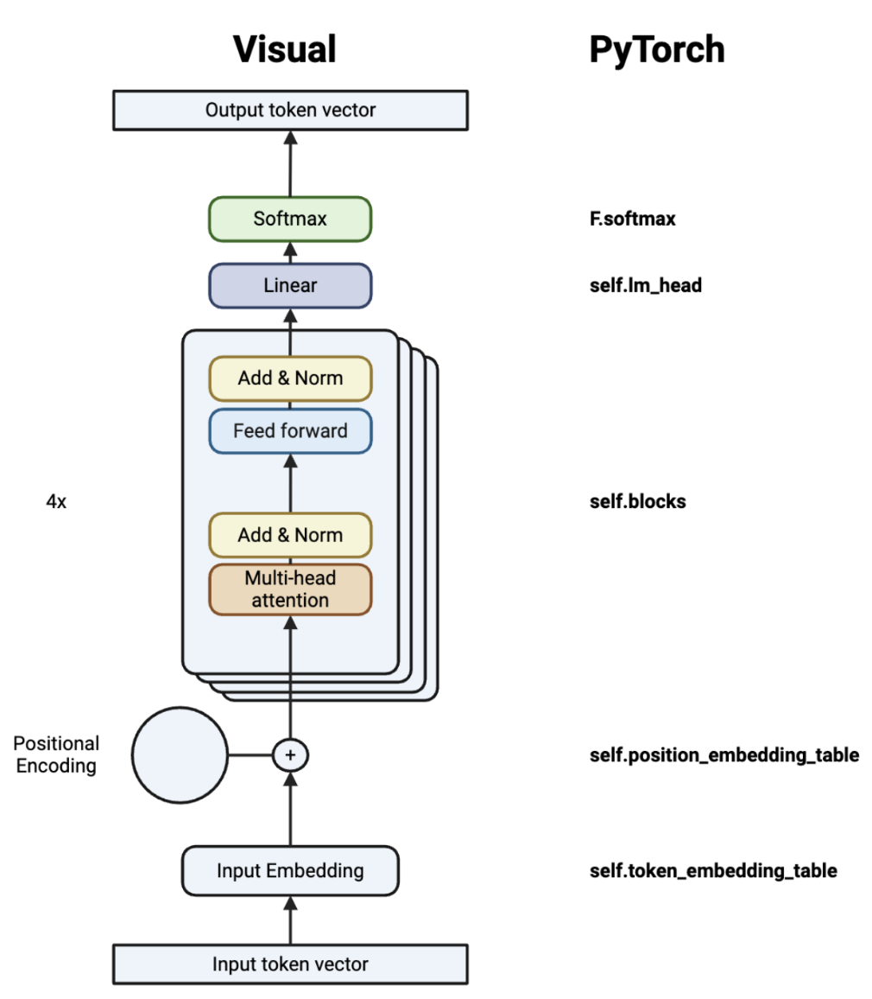
From Tokens to Logits
Input tokens → embedding layer → transformer blocks
  Self-attention captures residue relationships
  Feed-forward networks process attended representations
Output: logits for each position
  Raw prediction of likelihood for each token at each site
Softmax function converts logits to probabilities
GitHub: GrayLab/DL4Proteins

Slide 12
Model Outputs of a Protein Language Model
Logits: Raw model outputs before normalization
  Lower/negative: low likelihood
  Higher/positive: high likelihood
  Used to calculate Probabilities: Softmax-normalized logits (sum to 1.0)
    Higher probabilities indicate model confidence in amino acid choice
Loss, when labels are provided
  Average cross-entropy loss across all positions
Hidden states (sometimes referred to as embeddings)
  One for each layer in the model plus the embeddings (Layer 0)
  Useful for extracting what is learned in each layer of the model
Attention weights
  For each layer, the attention weights of the sequence (NxN)
  Which other positions are important to this one?

Slide 13
Logits provide position-wise fitness prediction metrics
Probability:
  Likelihood that amino acid exists at that position
Fitness score = log(P(mutant)) - log(P(wild-type))
  Positive scores suggest beneficial mutations
  Negative scores suggest deleterious mutations
Positional Entropy (Positional Perplexity):
  Indication of model certainty - low: confident prediction with one clear answer. High: uncertain prediction with many possible options.
  High entropy regions may require greater effort in design, more variants validated in the lab
  Caution: Different from information content used in sequence logos, where score is a measure of conservation

Slide 14
Scoring of the full protein sequence using logits
Mean Entropy: measure of uncertainty in the model prediction
Mean Perplexity: how “surprised” a LM is by the sequence
  Interpretation: lower - sequence is more natural; higher- unusual sequence
  Caution in proper interpretation for sequences with repeating motifs or amino acids
Protein Evolutionary Fitness
  Marginal method: Sum position-wise scores across sequence
  Masked marginal: Mask each position individually, sum log-likelihoods
  Wild-type marginal: Single forward pass, extract all position probabilities
  Trade-offs between accuracy (masked marginal) and computational cost (wild-type marginal)

Slide 15
Hidden States & Embeddings
Hidden states are extracted from intermediate transformer layers
Each residue is represented as high-dimensional vector (64-5120 dimensions)
Capture semantic relationships between amino acids
Different layers capture different types of information
Can be extracted per-residue or averaged per-protein

Slide 16
Analyses using the Hidden States & Embeddings
Position-wise Evolution of Prediction Confidence
  Early layers are often high entropy, while learning local patterns. Confidence increases across middle layers, incorporating secondary structure, for example. Late layers have highest confidence once global context is integrated.
  Correct prediction in middle layers, then wrong in late layers indicates model “overthinking”
Representation Similarity Analysis
  Tracking change between layers aids identification of “important” layers
Feature recognition and specialization
  Learning of general patterns, structure, etc.
  Train simple classifiers on each layer to see what information is encoded
Attention pattern tracking across layers
  Local -> mid-range -> global

Slide 17
Summary: What Each Layer Encodes
Layer Range | Information Encoded | Probing Task Performance | Attention Pattern
Early (1-5) | Amino acid chemistry Local patterns Hydrophobicity/charge | High on AA properties | Local (±3 positions)
Middle (6-15) | Secondary structure Shore-range contacts Structural motifs | High on 2° structure | Medium range (±10 positions)
Late (16-30) | Tertiary structure Long-range interactions Function/domain | High on function/fold | Global (full sequence)

Slide 18
Practical applications arising from Hidden Layers
Feature extraction for ML
  For example, regression analysis. Use middle layers for structure-related tasks, later layers for function prediction. In practice, regress against all layers to find best performing layer
  Layer selection depends on downstream task
    Common choices: layer 6-12 for ESM-1b, layer 15-25 for ESM-2
Uncertainty Quantification
  If early layers are confident but late layers uncertain - unusual sequence
Model Interpretability

Slide 19
Further Use of Hidden Layers & Embeddings
Dimensionality reduction
  For visualization, use PCA, t-SNE, UMAP
Clustering
  Group proteins by functional/structural similarity
Regression
  Predict experimental values (stability, activity)
  Requires training data
Classification
  Protein families, localization, function
Embeddings can capture features difficult to engineer manually

Slide 20
Attention patterns inform position interdependence
Local vs Global Dependencies
  "How much does the model need to look at position j to understand position i?"
Pairwise dependencies can be used in Contact Prediction
Functional Motif Detection
Design-critical position analysis
  Which positions might constrain amino acid identity

Slide 21
Application of Attention to Protein Design
Rational Mutation Strategy
  Independent sites have low epistasis and might be mutated one at a time
  Local interdependence - co-optimize with neighbors
  Couple positions require combinatorial libraries or ML-guided design
Identify Conserved Interaction Networks
  Protein cores
  Domain interfaces (e.g. V_{H}/V_{L})
Predict Mutation Impact
  How many other positions might be affected by mutating this position?
Usually baked in to the application workflow

Slide 22
Limitations and Considerations for pLMs

Slide 23
Metrics for Confidence
Perplexity
  Overall sequence naturalness (< 20 = good, > 40 = problematic)
Entropy
  Position-specific uncertainty (< 2 bits = confident)
Top-k Probability
  How concentrated is the prediction?
  Conserved antibody disulfide or CDR-H3 tip?
Ensemble Agreement
  Do different models agree?

Slide 24
Sources of Uncertainty
Epistemic (Model) Uncertainty
  Training bias such as database composition, gaps in training data, novel chemistries (NCAAs)
  Model or hardware capacity limitations requiring truncation of very long proteins
Aleatoric (Data) Uncertainty: true biological variability, flexibility
Out-of-Distribution
  Novel sequences unlike anything in training data
  E.g., assessment of non-antibody sequences with antibody-fine-tuned model

Slide 25
Known Failure Modes and Workarounds
Failure Mode | Why pLMs Fail | Key Workaround | When to Trust pLM
Intrinsically Disordered Regions | No fixed structure; high sequence variability | Use IUPred, focus on properties (FCR, NCPR) | OK for detecting IDRs; specialized methods for sequence design
Membrane proteins | Training bias toward soluble proteins | TMHMM, DeepTMHMM, membrane-specific pLMs | Caution in TM regions
Signal peptides | Cleaved, not in mature protein database | SignalP, analyze mature protein separately | After removing signal peptide
Low complexity | Paradoxically low perplexity despite being unusual | SEG filtering, composition analysis | Use composition metrics instead
Rare families | Insufficient training examples | MSA-based methods, AlphaFold validation | When combined with homolog consensus (e.g., MSA)
PTMs | pLMs only see 20 standard amino acids | PTM-specific predictors (NetPhos, NetNGlyc) | For unmodified sequence context only

Slide 26
Practical Guidelines for Biologics
DO
Use pLMs for well-characterized frameworks (antibodies, common scaffolds)
Calculate confidence metrics for all predictions
Combine with structure prediction (e.g., AlphaFold pLDDT)
Use ensemble approaches when critical
Validate high-uncertainty predictions experimentally
DON'T
Trust predictions on highly unusual sequences without taking proper precautions
Ignore perplexity warnings or other out-of-distribution signals
Use pLMs alone for disordered regions
Assume all positions are equally reliable
Skip experimental validation for lead candidates

Slide 27
Integration with Experimental Work
Computational Screening: Use pLMs to filter large libraries (trust high-confidence predictions)
Focused Libraries: Generate 10-50 variants around high-confidence predictions with more variation at high-entropy positions
Iteration: Use experimental data to refine computational predictions
  Refine interpretation
  Fine-tune the model
  Lab-in-the-loop methods

Slide 28
Choosing the Right Model
Task requirements: Speed vs. accuracy trade-offs
Sequence length: Model-specific limitations
Computational resources: Model size considerations
ESM-3: Excellent performance, largest resource requirements, custom license
ESM-1b: Good balance of performance and efficiency, permissive license
Consider fine-tuning for specific tasks

Slide 29
Fine-tuning vs. Zero-shot Prediction
Zero-shot: Use pre-trained model directly without additional training
  Best for: General fitness prediction, contact prediction, basic functional analysis
  Advantages: No data required, immediate use, generalizes well
Fine-tuning: Additional training on task-specific data
  Best for: Specific protein families, particular experimental conditions, specialized tasks
  Requirements: Labeled dataset (100s-1000s examples), computational resources
Real-world Example: Enzyme Thermostability Prediction
  Zero-shot approach: Use ESM-2 to predict mutation effects based on sequence likelihood
  Works well to cull obvious deleterious mutations
  May miss subtle thermostability-specific effects
Fine-tuning approach: Train on thermostability experimental data (e.g., melting temperatures)
  Collect 500+ enzyme variants with measured Tm values
  Fine-tune ESM-2 embeddings → regression model for Tm prediction
  Result: Better accuracy for thermostability specifically, but may lose generalizability

Slide 30
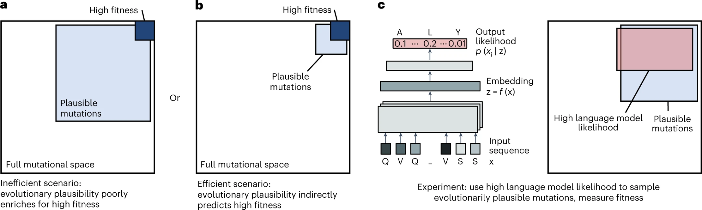
Discussion on how efficient evolution works

Slide 31
Activities
pLM Basics
  Tokenization, Scoring, Embeddings
Uncertainty Quantification
  Perplexity, Entropy, and Performance
Efficient Evolution
  Run the example command-line implementation via Google Colab
  Explore the code at https://github.com/brianhie/efficient-evolution
    Follow the functions back from bin/recommend.py to understand the use of logits and embeddings in the decode or soft_reconstruct functions of bin/amis.py
Mutation Landscape Regressions
  Performing regressions from pLM embeddings using labeled data
Antibody Triaging using Embeddings (Optional)
  An implementation of Sweet-Jones & Martin’s “An antibody developability triaging pipeline exploiting protein language models”, mAbs, 2025. DOI: 10.1080/19420862.2025.2472009
Choosing a pLM (Optional)
  As understood in the Uncertainty Quantification notebook, pLM performance can vary greatly. A comparative benchmark of pLMs should be performed at the beginning of any study. This notebook illustrates one framework for that preliminary experiment.

Slide 32
Food for thought
Question 1: You're designing a therapeutic antibody CDR-H3 loop (15 residues, disordered in absence of antigen). The pLM gives a perplexity of 35 and high entropy (> 3 bits) for most positions. How would you proceed?
Question 2: A colleague proposes using pLM predictions alone to humanize 50 positions in a murine antibody. The overall perplexity is 18. What additional analyses would you request before proceeding?
Question 3: You need to optimize stability of a novel protein scaffold with no close homologs in UniProt. What are the limitations of using pLMs here? What complementary approaches would you use?
Question 4: Design an experimental validation strategy for a library of 100 pLM-designed variants with perplexities ranging from 12 to 45. How would you prioritize testing?

