Slide 1
ASP.NET Core MVC
Strongly Typed View
ViewModel, list view, layout view and its sections
ViewStart and View Imports cshtml
Reference kudvenkat video tutorials: https://www.youtube.com/playlist?list=PL6n9fhu94yhVkdrusLaQsfERmL_Jh4XmU
11/10/2020

Slide 2
Extra info
When I created a new application using Visual Studio, I used
Click “Create a new project”
Select “ASP.NET Core Web Application”, click Next
Specify project name e.g. “EmployeeManagement”, click Next
Select “ASP.NET Core 3.1” from the dropdown, and “Web Application (Model-View-Controller)” in the project template list, click Create
Also note that in ASP.NET Core 3.1, when you follow kudvenkat’s tutorial, you will run into this error Using 'UseMvc' to configure MVC is not supported while using Endpoint Routing
I solved the above by applying the 3rd answer in the Startup.cs ConfigureServices() function:
services.AddMvc(option => option.EnableEndpointRouting = false)

Slide 3
Part 25: Strongly Typed View in ASP.NET Core MVC
3 ways to pass data to View:
ViewData
ViewBag
Strongly Typed View
Benefits of using Strongly Typed View
- Code intellisense
- Compile time error checking
- Avoid developer spelling mistake

Slide 4
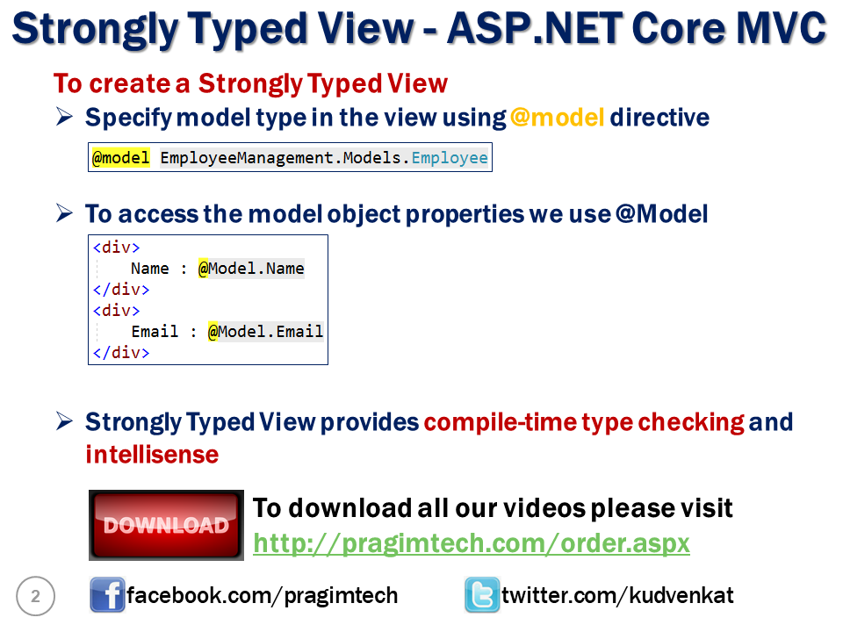

Slide 5
Part 26: ViewModel
Include PageTitle and Employe – all data we need
Create new folder ViewModels in the root
Create a class HomeDetailsViewModel.cs in this folder
Also called Data Transfer Object (DTO for short)

Slide 6
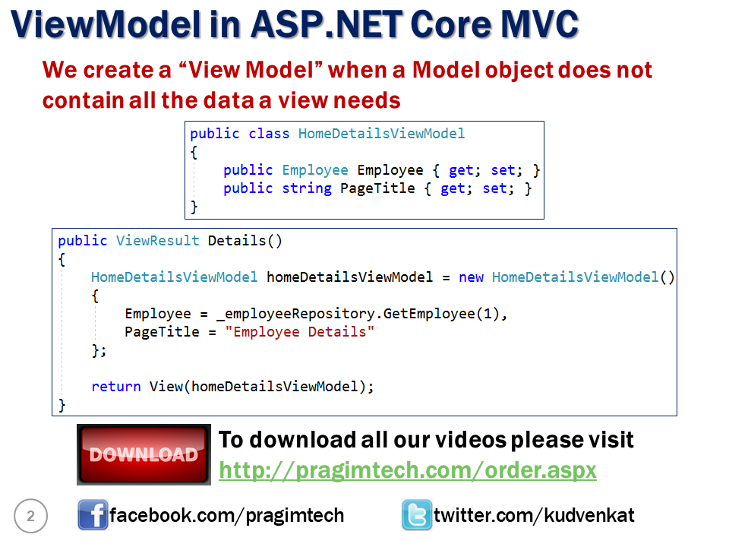

Slide 7
Part 27: List View
To populate our Home View with the list of employees, we need to use the List View, which will involve IEnumerable

Slide 8
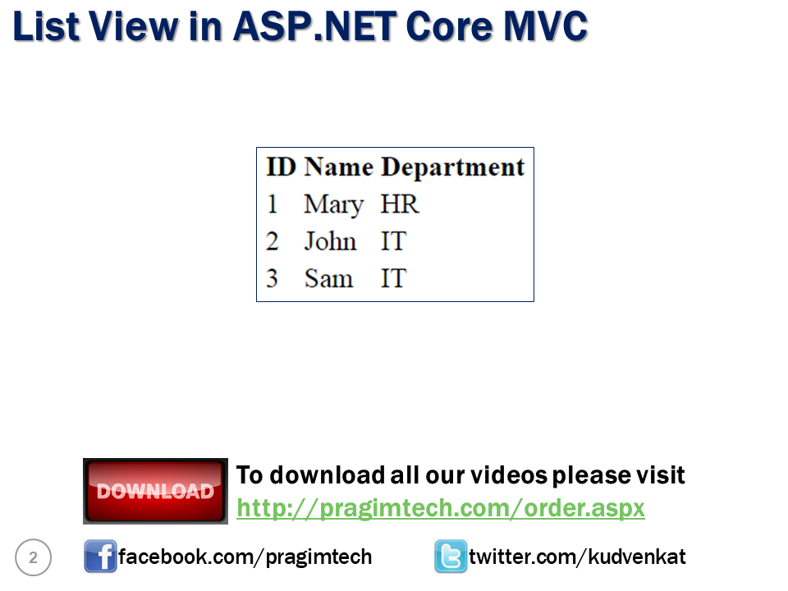

Slide 9
Code Change
Modify IEmployeeRepository interface to include GetAllEmployees() method. As you can see this method returns the list of all employees.
Modify MockEmployeeRepository to implement returning the list of employees
Modify HomeController Index to return all employees list as model
Modify Index.cshtml to include a table, using foreach to loop through the Enumerable list

Slide 10
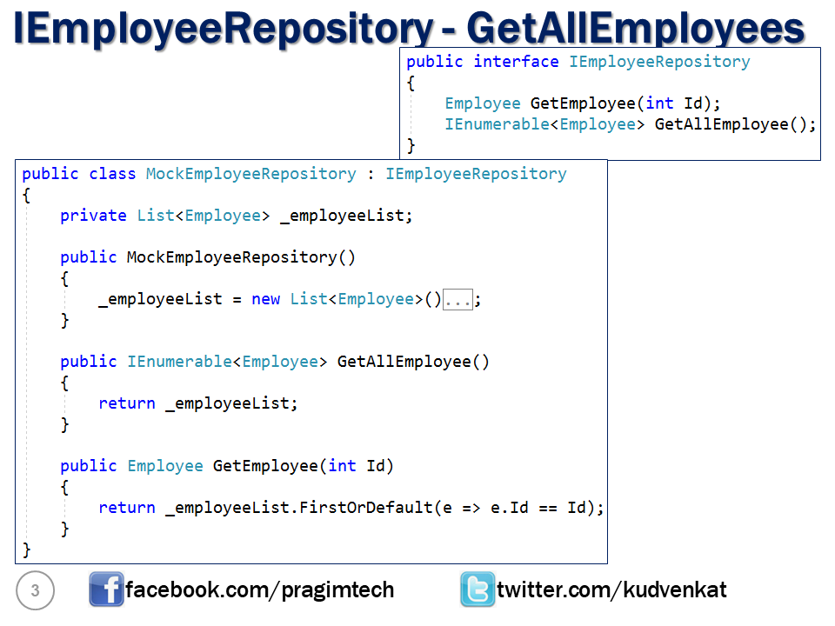

Slide 11
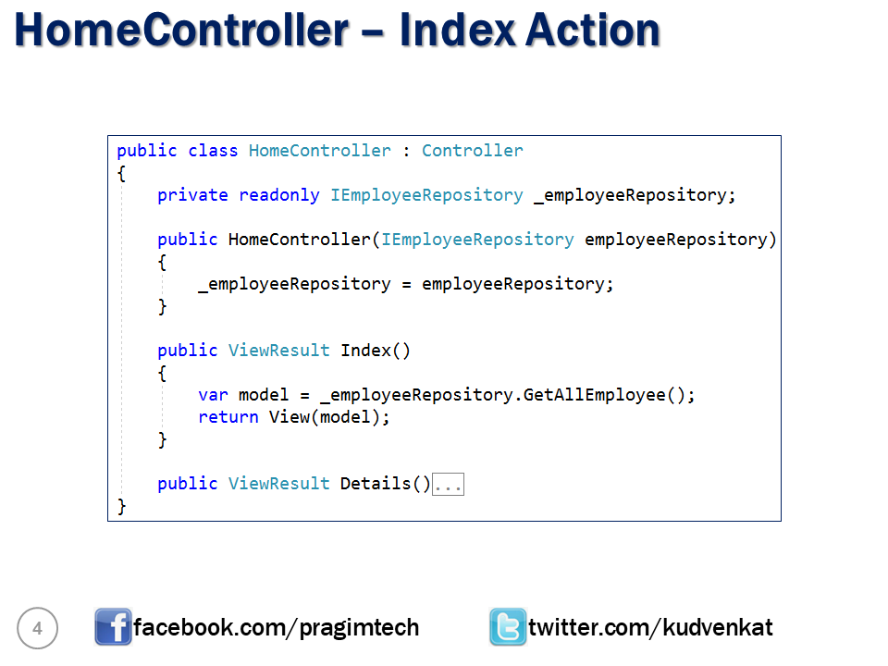

Slide 12
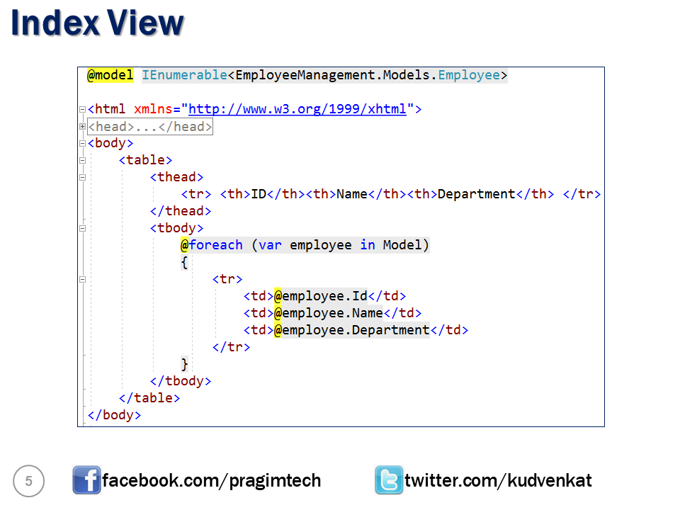

Slide 13
Part 28: Layout View
Most of the web applications have these sections
Header
Footer
Navigation menu
View specific content

Slide 14
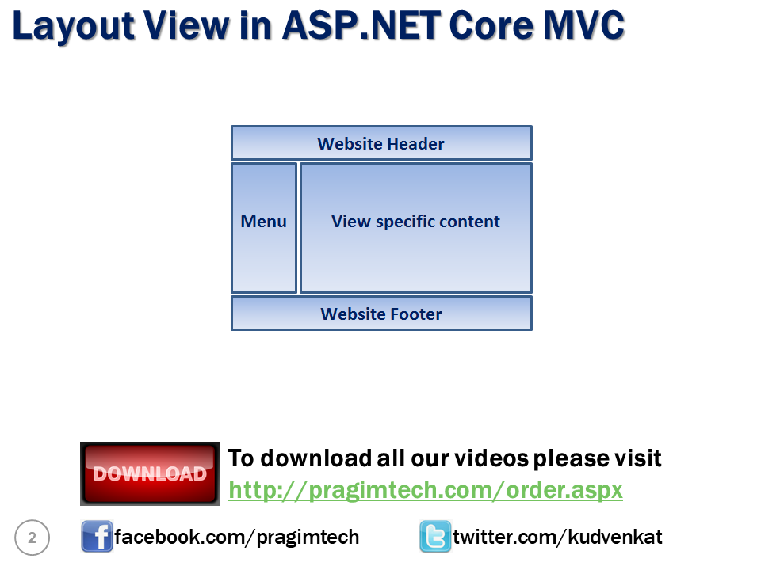

Slide 15
Creating a Layout View
Right click on "Views" folder and add "Shared" folder.
Right click on "Shared" folder and select "Add" - "New Item"
In the "Add New Item" window search for Layout
Select "Razor Layout" and click the "Add" button
A file with name _Layout.cshtml will be added to the "Shared" folder

Slide 16
Using the Layout View
Modify details.cshtml
Remove HTML, head and body tags
Include Layout file
Set ViewBag.Title

Slide 17
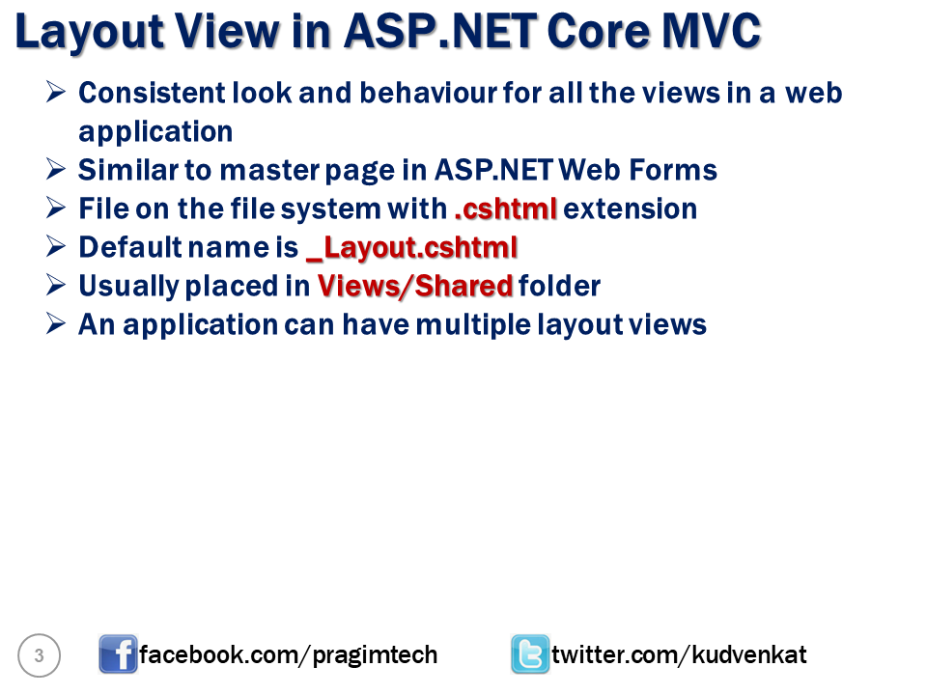

Slide 18
Part 29: Sections in layout page
A layout page can include a section which is optional or mandatory
An example to use this is custom JavaScript files
Making the layout section option
Option 1: @RenderSection("Scripts", required: false)
Option 2:
@if (IsSectionDefined("Scripts")) { @RenderSection("Scripts", required: false) }
Use the @section in the details view

Slide 19
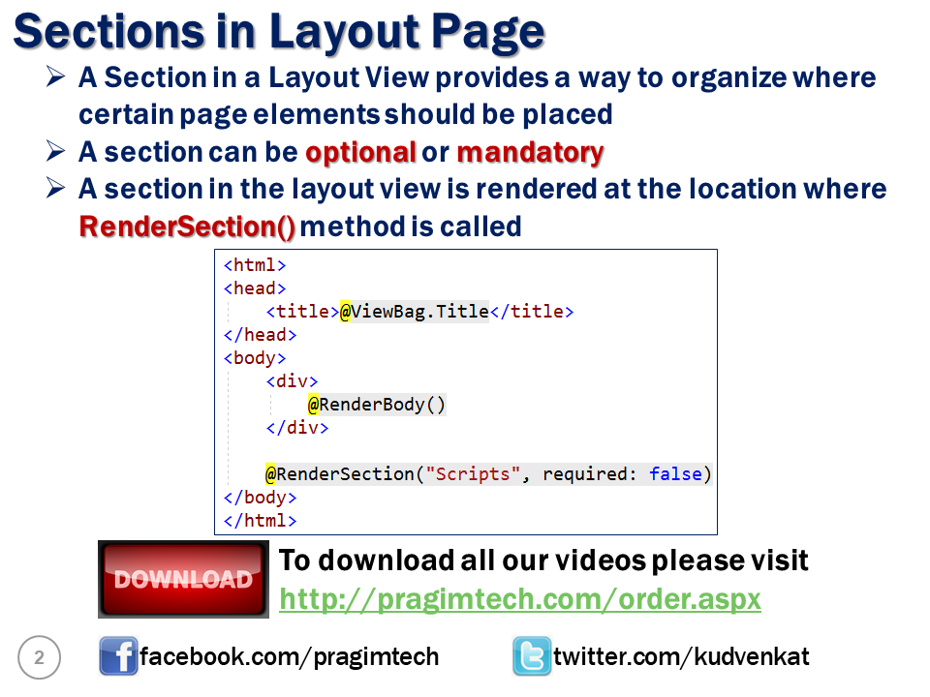

Slide 20
Part 30: _ViewStart.cshtml
Use this to set the Layout property of every view without having to repeat yourself and reduce maintenance overhead
Use the _ViewStart.cshtml file
@{ Layout = "_Layout"; }
This file is hierarchical – you can override in the sub-folder by having the same file there.
Use logic to select different layout views
@{ if (User.IsInRole("Admin")) { Layout = "_AdminLayout"; } else { Layout = "_NonAdminLayout"; } }

Slide 21
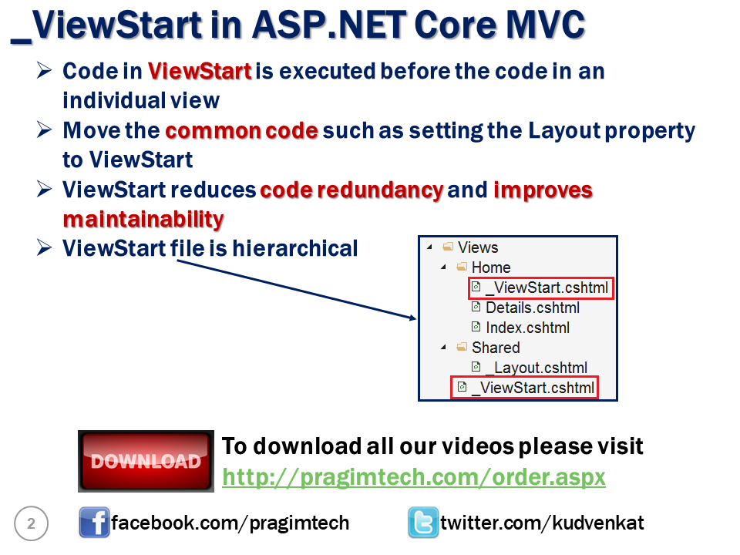

Slide 22
Part 31: _ViewImports.cshtml
Use this file to import common namespaces
Default in .NET Core 3.1

Slide 23
