Slide 1
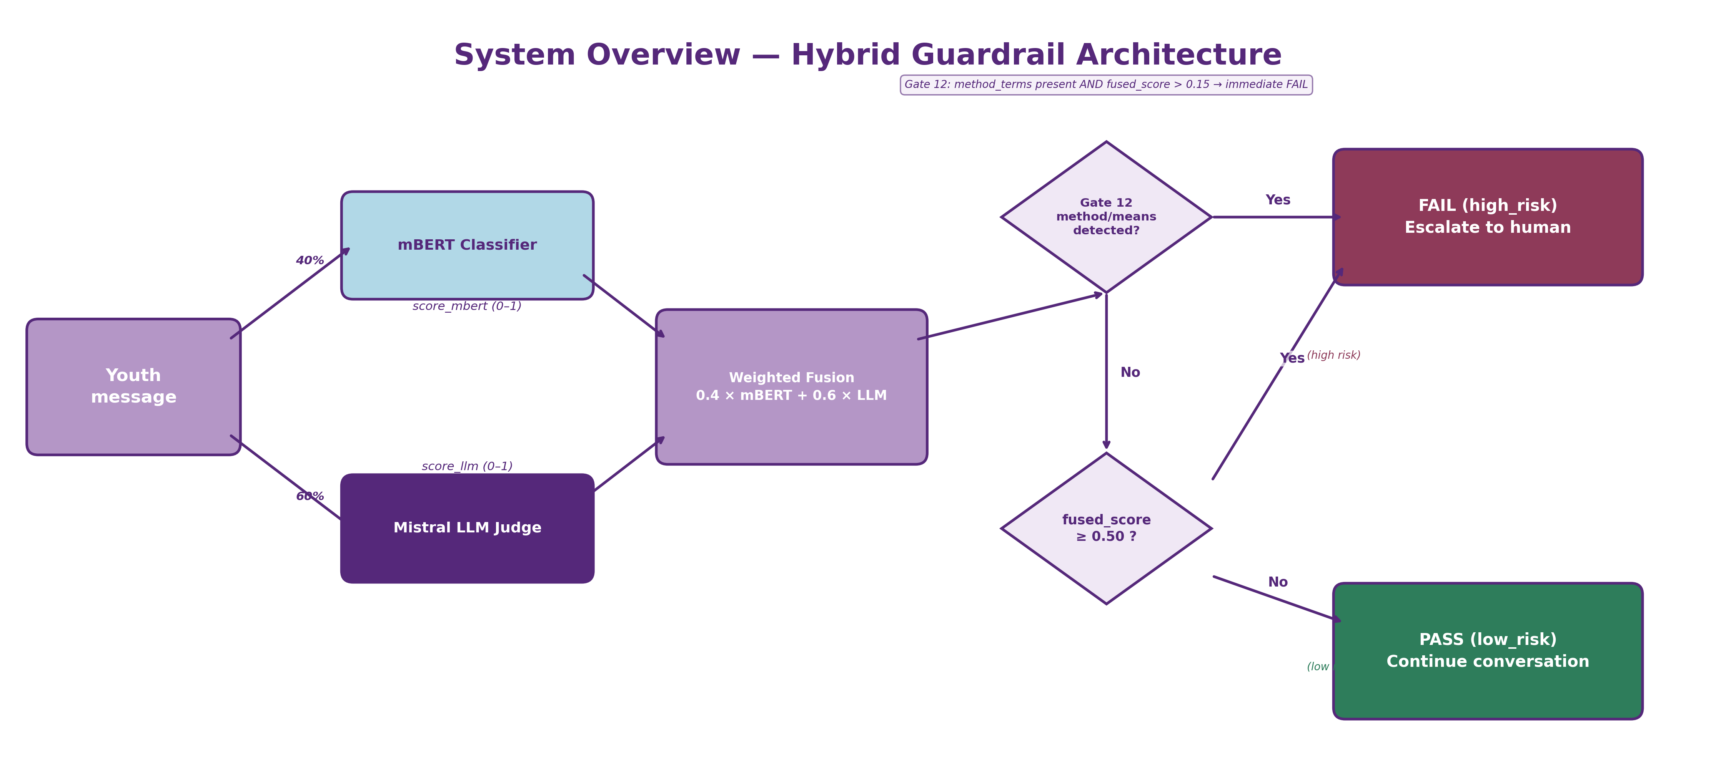
System Overview — Hybrid Guardrail Architecture

