Slide 1


r/wallstreetbets Sentiment Analysis
Shashank Nagaraja
IST 652 Final Project

Slide 2
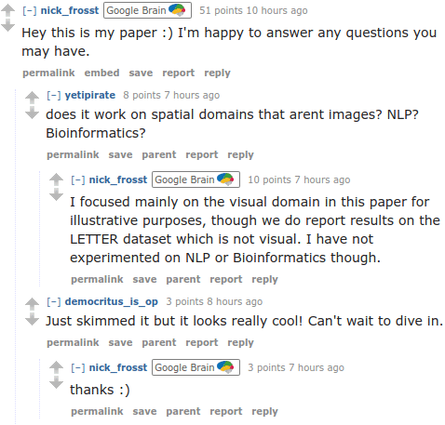
Reddit & WSB
Reddit:
Social media platform
Network of communities based on interest
Largely text focused, ability to start “threads” with comments & upvotes
WSB:
Group for people to discuss trades, gains, losses
Disseminate information about potential portfolio positions
Show off gains and losses
Have fun

Slide 3


Data Sources
PRAW: API wrapper for Reddit’s API
Wraps around Reddit API
Easy to use interface to pull Reddit posts
Cannot query posts from a particular date
Need to re-acquire user/client keys every hour
Kaggle
Pre-digested dataset
Readily Accessible
PRAW API Wrapper: https://github.com/praw-dev/praw
Kaggle Dataset: https://www.kaggle.com/gpreda/reddit-wallstreetsbets-posts

Slide 4
Data
~ 42k Posts in total
Field | Type | Information
title | Text | Post Title content
score | Float | Upvote Score (corrected for number of comments % impressions)
id | String | Unique identifier
url | URLs | URLs mentioned in post
comms_num | Integer | Number of direct comments
created | UNIX Timestamp | Post Time
body | Text | Post Body content

Slide 5
Preprocessing
Regex
Remove Whitespace
Substitute Emojis 🔥
Tokenize
TweetTokenizer (NLTK)
Dates
Parse UNIX Timestamps
Remove outliers
Remove URLs, @mentions and #hashtags
Remove stopwords
Remove Profanity
Sync Timezones to PST

Slide 6
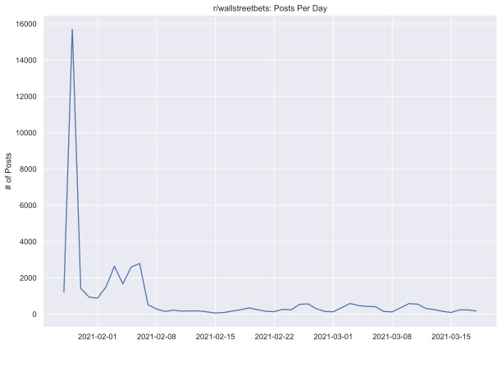
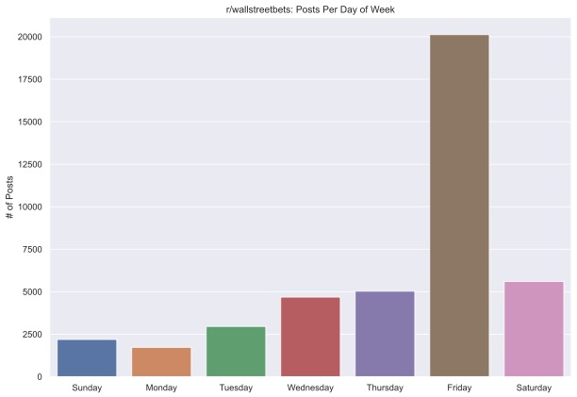
Data
Initial frenzy followed by lull in posts
Second wave of posts after initial bump
Steady influx of posts after initial frenzy

Slide 7
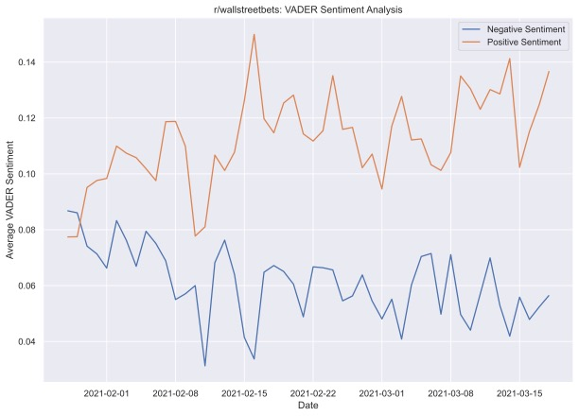
VADER Sentiment Analysis
Valence Aware Dictionary and sEntiment Reasoner is a lexicon and rule-based sentiment analysis tool that is specifically attuned to sentiments expressed in social media.
Eg.: “Awesome” > “Good”, “Terrible” < “Meh”

Slide 8
Named Entity Recognition
Information extraction to locate and classify named “entities” form unstructured text.
The economy has been showing signs of emerging from the pandemic crisis with renewed vigor, with spending picking up, manufacturing strengthening and employers adding workers. Hiring increased in February, with 379,000 added jobs — more than double January's total.
Credit card data from JPMorgan Chase showed that consumer spending jumped last week as the $1,400 checks that are going to most adults under President Joe Biden's $1.9 trillion emergency aid package began to be paid out. The Treasury says it has so far distributed 127 million payments worth $325 billion.
NER pipelines can recognize People, Organizations, Dates, Monetary Figures and more…

Slide 9
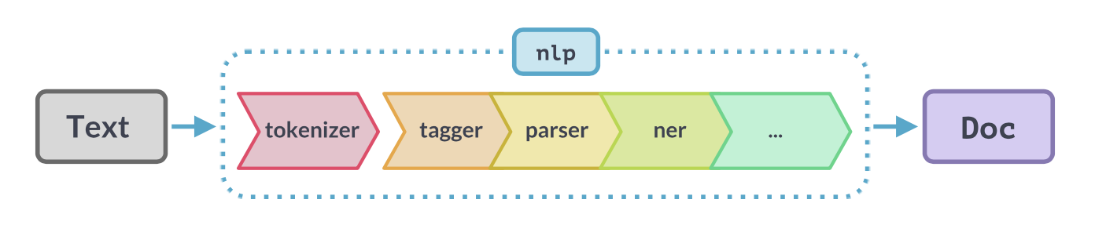
spaCy
Open source NLP algorthms for Python
Automated pipelines for multiple languages
Provides pre-trained models to use on unstructured text

Slide 10
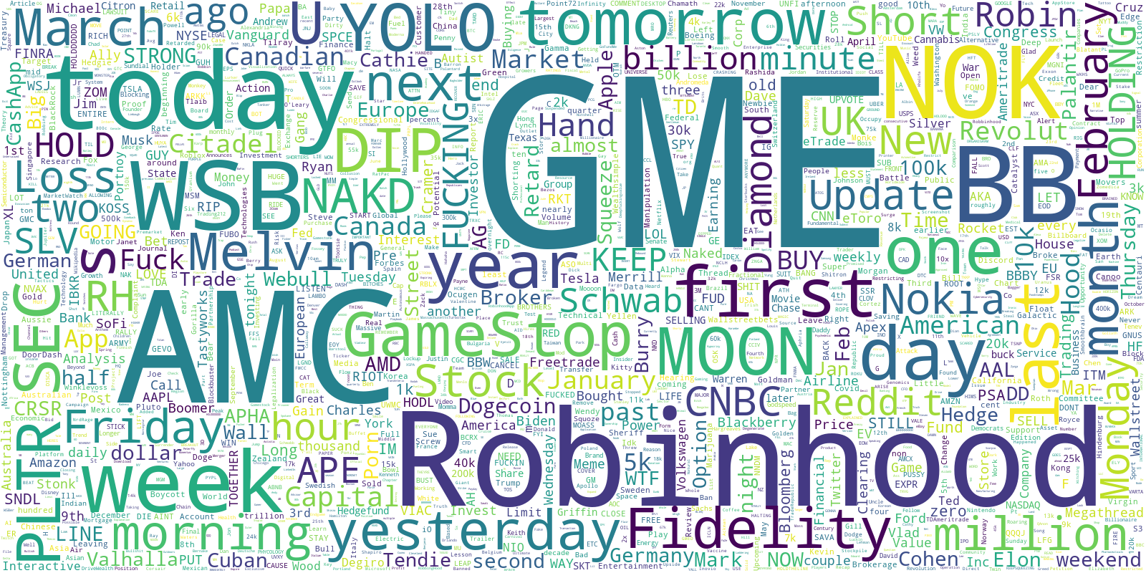
r/wallstreetbets: Named Entities

Slide 11
Results and Takeaways
Gamestop ($GME) was not the only security involved in the trading frenzy
Intense hype followed by lull in posts
Increasingly positive sentiment as “short squeeze” progressed
Cloud computing can make lengthy, impossible tasks into fast, expensive tasks

Slide 12
Challenges Faced
So many posts, so little compute power
Pushing 42,000 through an advanced NLP pipeline costs time, or money
Tradeoff influences choice of hardware
2014 Macbook Pro: 23 Days (Free)
Google Compute: 6 mins (200$)
Reddit API
Forced to resubmit queries due to Reddit throttling requests
Inability to access historical posts, had to build script to run daily
Specific trading lingo and sarcasm in posts

Slide 13
Questions?

Slide 14
Thank You!

