Slide 1
Network Intrusion Detection
CAPSTONE PROJECT
Presented By:
Name: Sampad Pal
College: Department of Engineering and Technological Studies , University Of Kalyani
Branch: Information Technology

Slide 2
OUTLINE
Problem Statement
Proposed System/Solution
System Development Approach
Algorithm & Deployment
Result
Conclusion
Future Scope
References

Slide 3
Problem Statement
Create a robust network intrusion detection system (NIDS) using machine learning. The system should be capable of analyzing network traffic data to identify and classify various types of cyber-attacks (e.g., DoS, Probe, R2L, U2R) and distinguish them from normal network activity. The goal is to build a model that can effectively secure communication networks by providing an early warning of malicious activities.

Slide 4
Proposed Solution
To address the network intrusion detection challenge, a machine learning-based model is developed using network traffic data from the Kaggle dataset. The approach includes:
Data Collection & Preprocessing: Cleaning and preparing network traffic features.
Feature Engineering: Transforming and selecting relevant features for higher accuracy.
Model Training: Using IBM Watson AutoAI to explore and optimize classifiers (e.g., Random Forest).
Model Evaluation: Assessing accuracy, precision, recall, and confusion matrix.
Deployment: Deploying the trained model on IBM Cloud Lite using Watson Studio for real-time intrusion detection through an API endpoint.

Slide 5
System Approach
The system development process utilizes IBM Cloud infrastructure to ensure scalability and real-time performance. Key components include:
IBM Watson Studio: For model training and deployment.
IBM Cloud Object Storage: For securely storing and accessing the dataset.
IBM Cloud Lite Services: Used to host and deploy the fault detection model via API.

Slide 6
Algorithm & Deployment
Algorithm Used: Random Forest Classifier (AutoAI optimized using Snap ML)
Data Input: Network traffic features(e.g. protocol_type , src_byte,flag etc)
Training Approach: Supervised Learning using AutoAI in IBM Watson Studio
Reason for Selection: Random Forest is robust, handles non-linear data well, and gives high accuracy for multiclass problems like intrusion detection.
Deployment: The trained model is deployed via IBM Watson Studio, providing an API endpoint for real-time predictions and integration into smart grid systems.

Slide 7
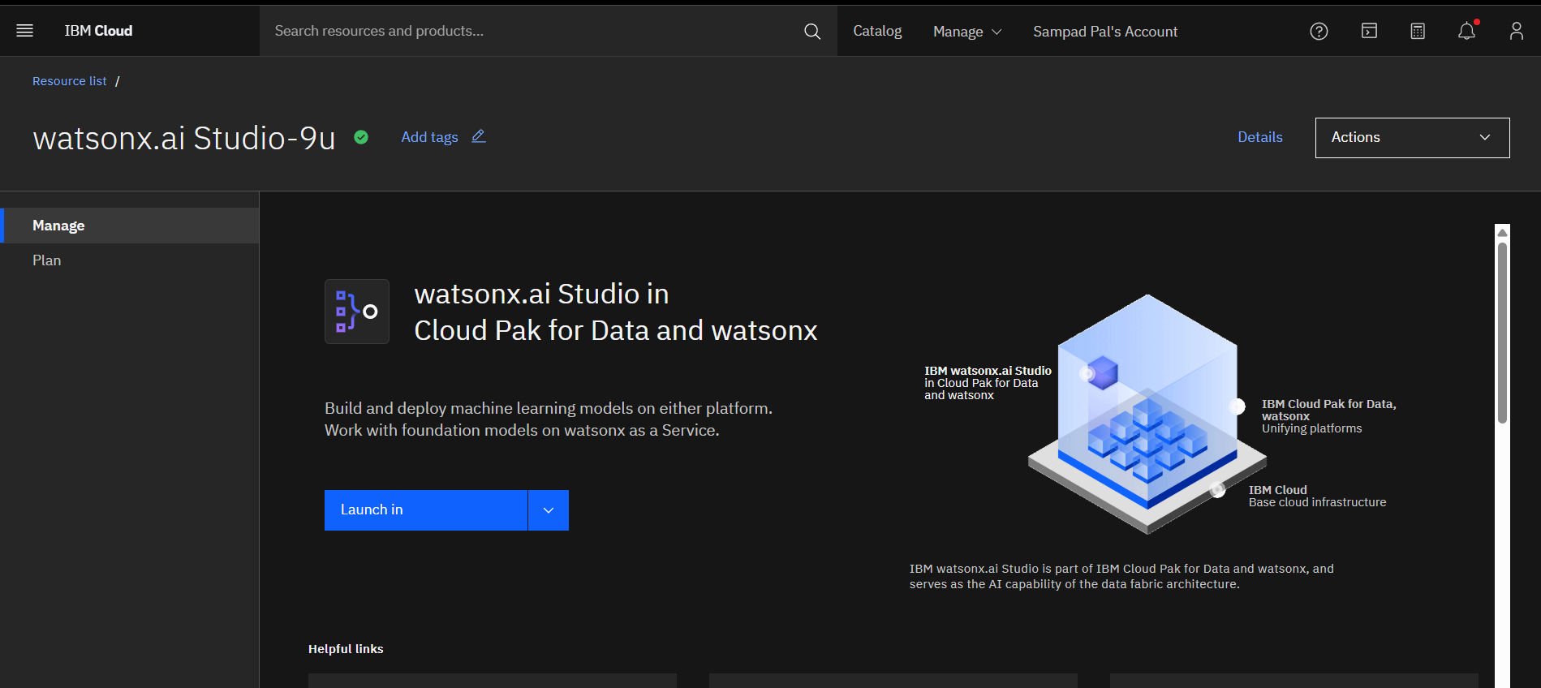
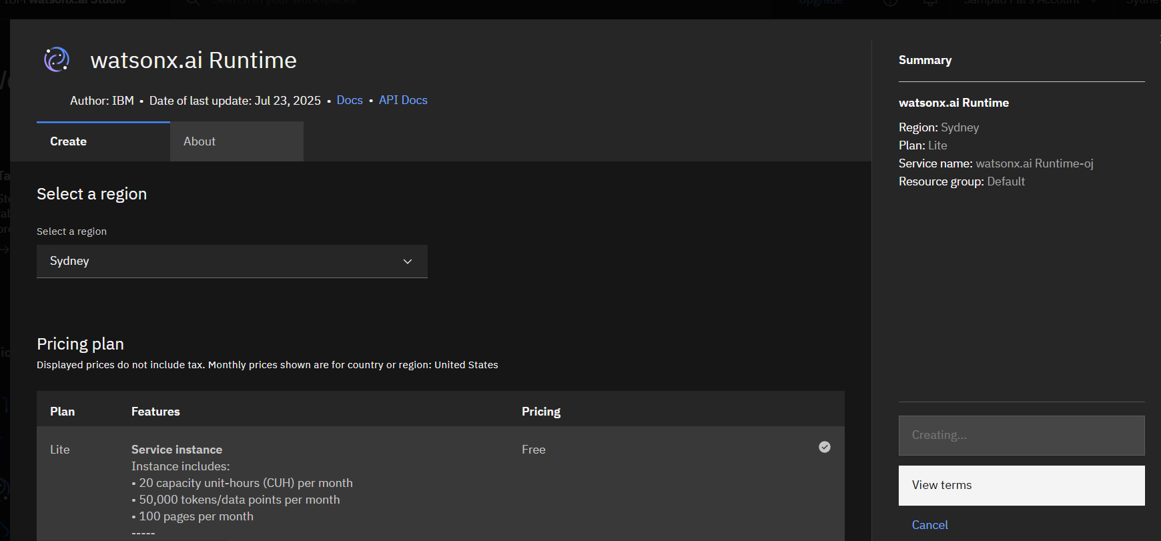
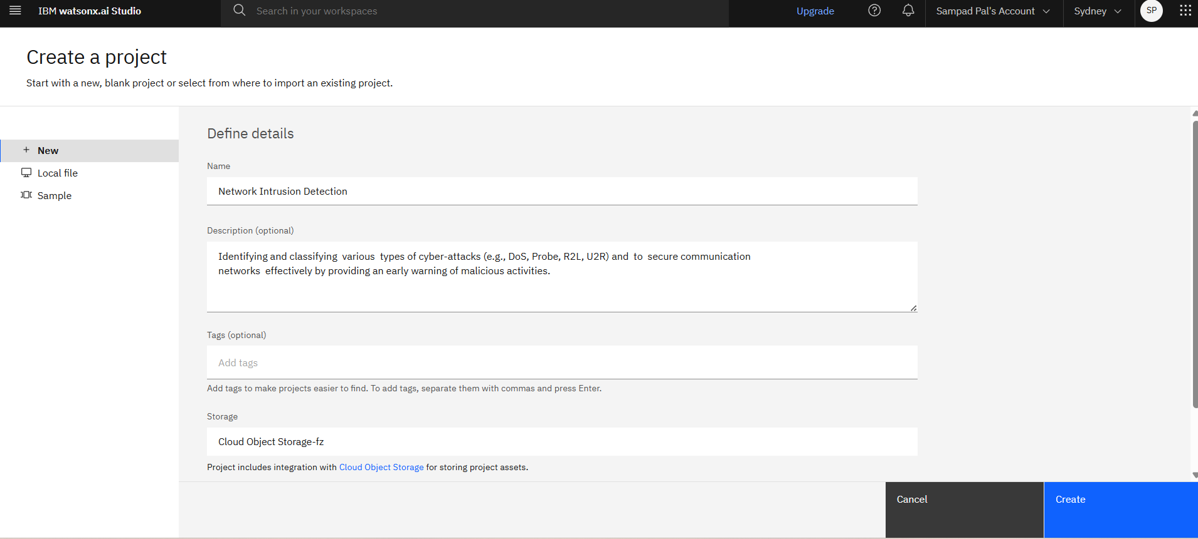
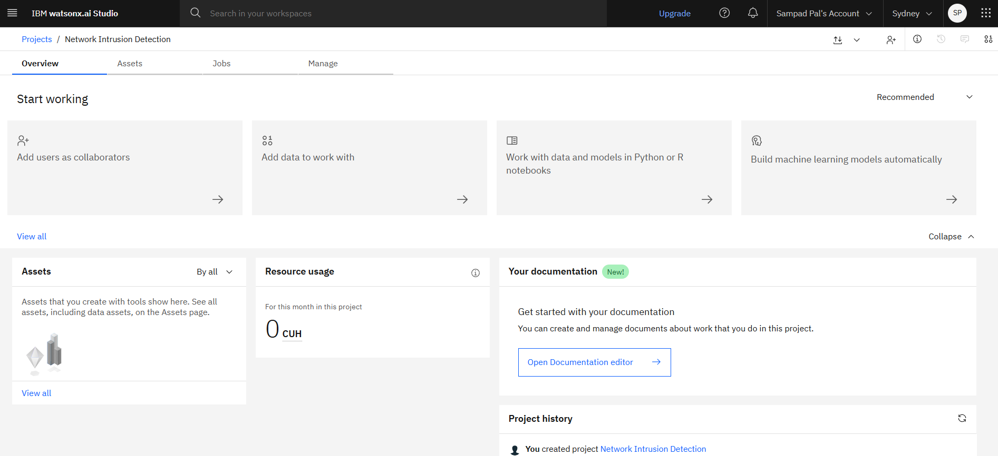
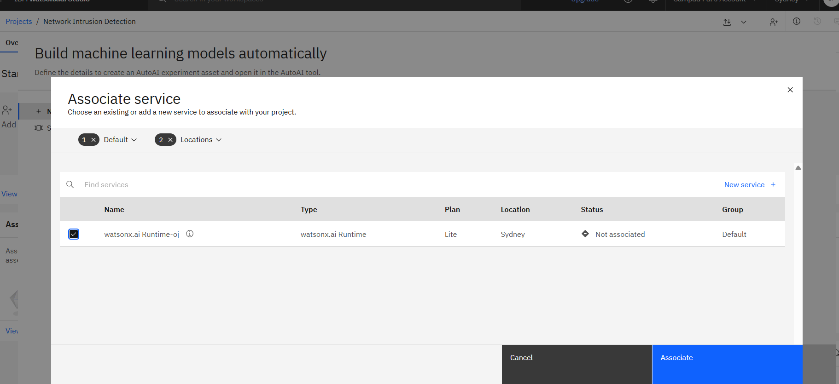
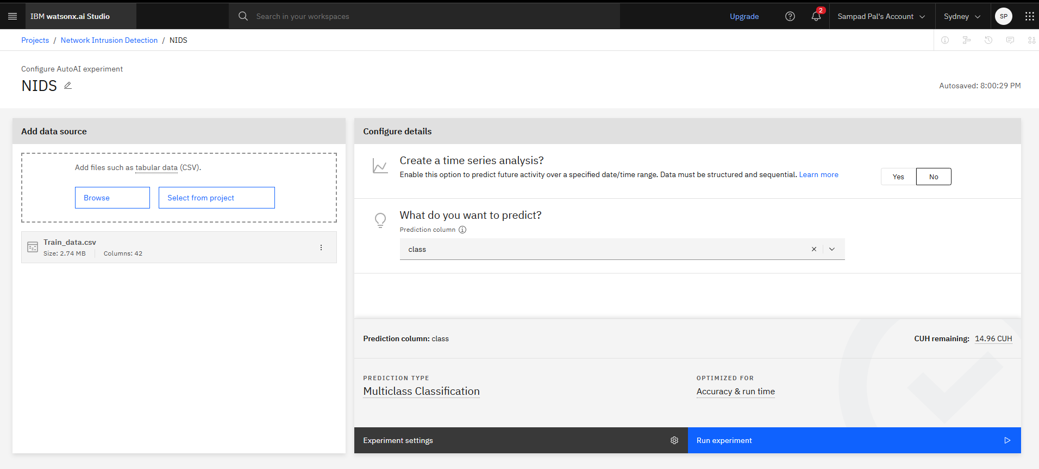
Some Steps

Slide 8
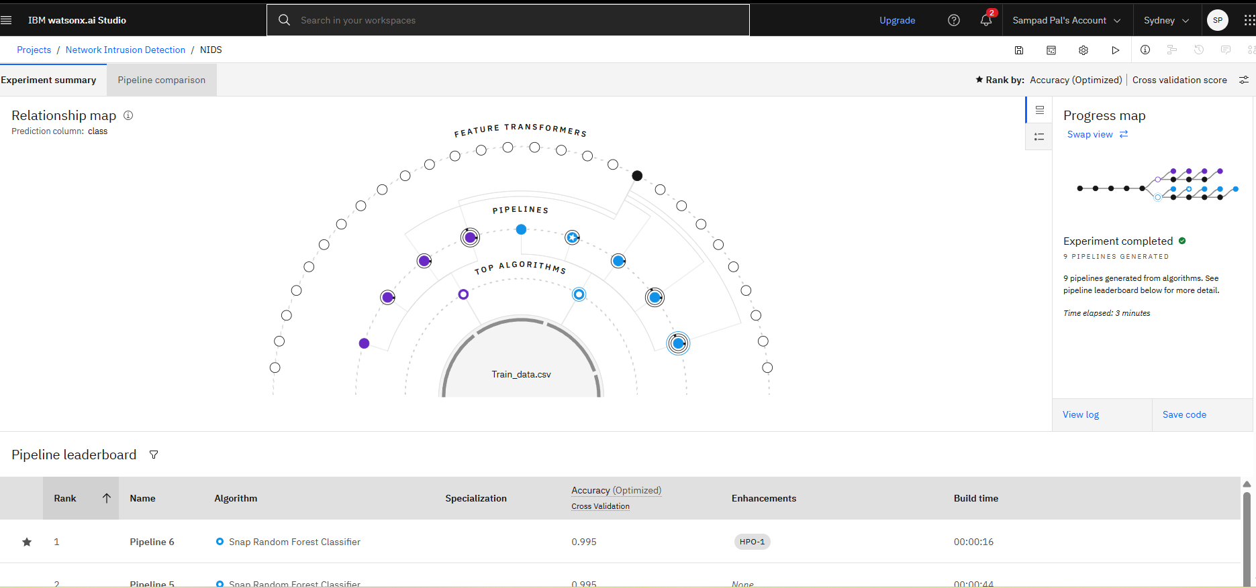
Result

Slide 9
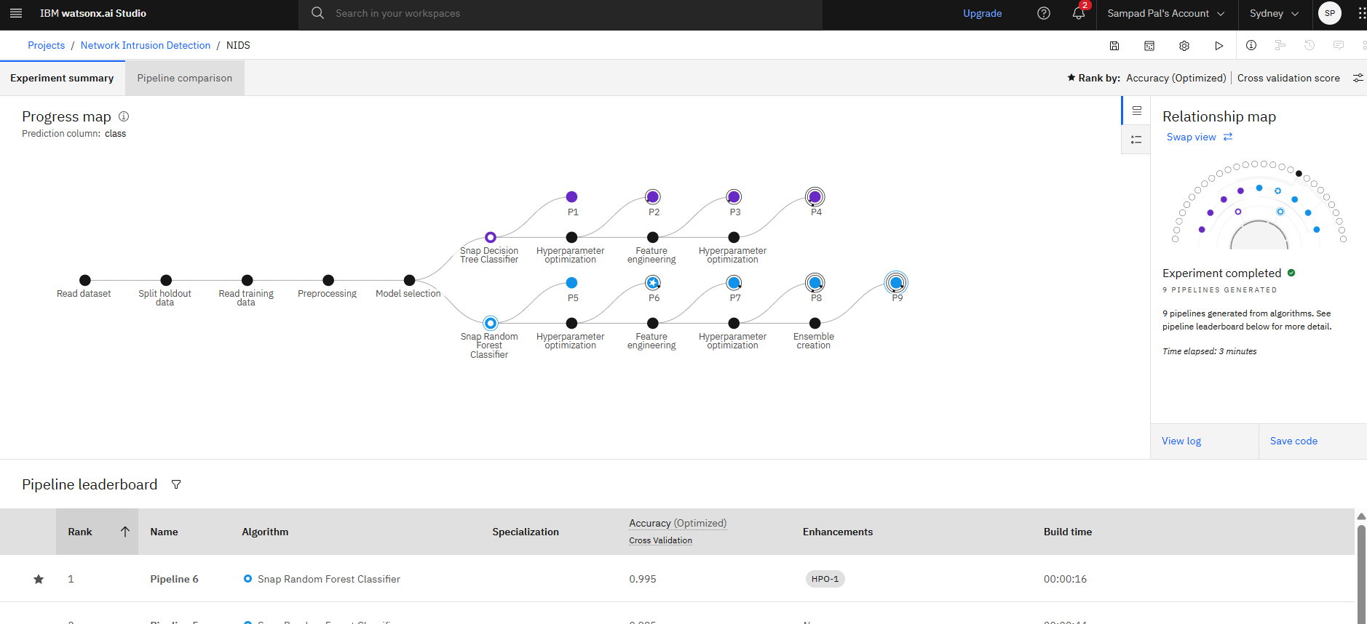
Result

Slide 10
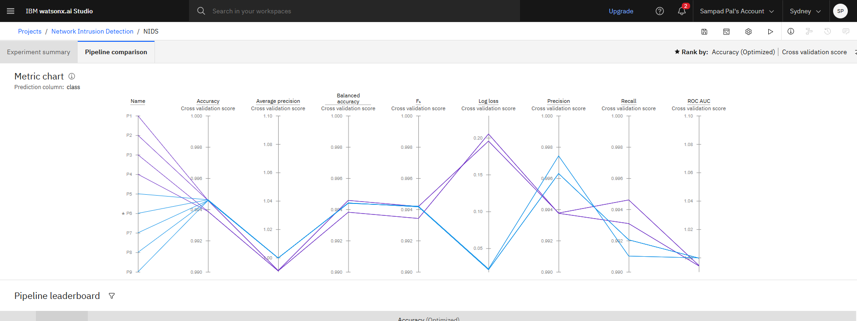
Result

Slide 11
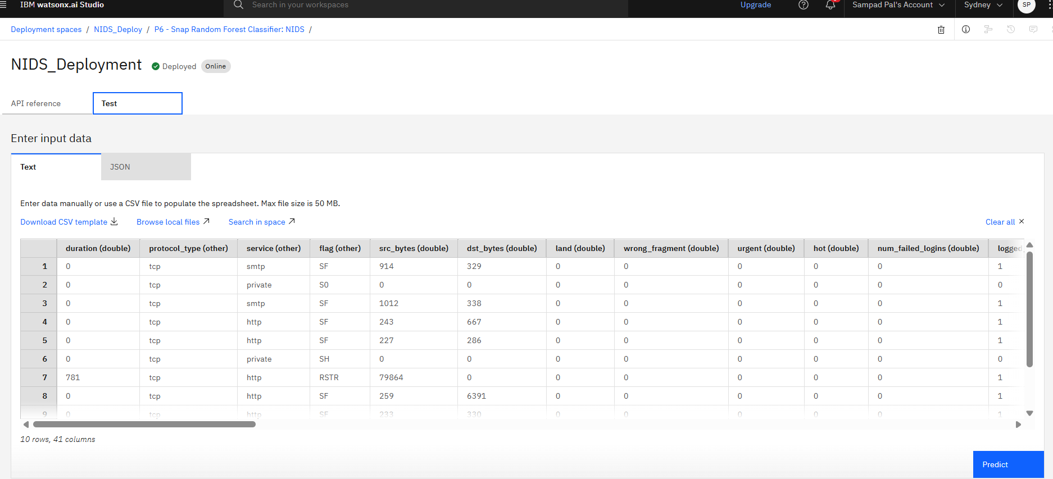
Result

Slide 12
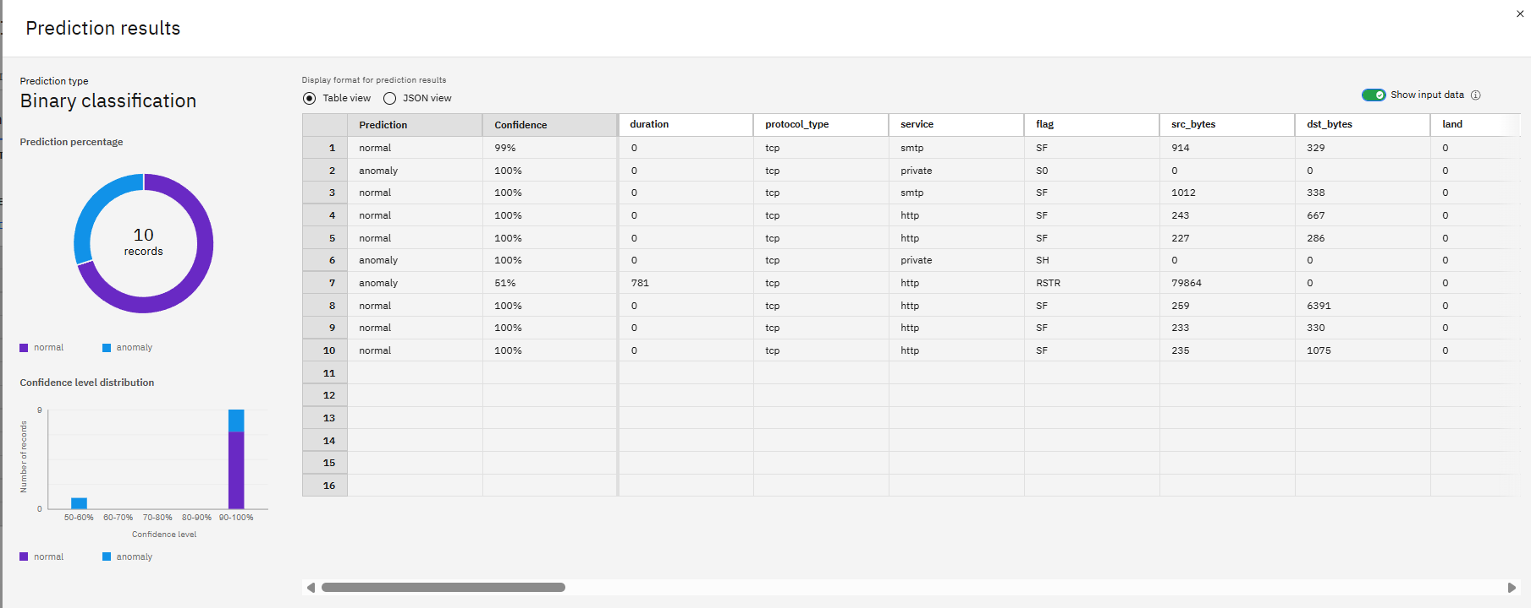
Result

Slide 13
Conclusion
The proposed NIDS effectively classifies network traffic into normal and malicious categories using supervised machine learning. Leveraging IBM Watson AutoAI, the system automates feature selection, model tuning, and deployment. The Random Forest model achieved high classification performance, demonstrating its capability in early intrusion detection.
The use of cloud deployment ensures scalability, easy access, and real-time integration with existing network systems. Challenges faced included dealing with class imbalance and high-dimensional feature space, which were mitigated by AutoAI’s automated preprocessing pipeline.

Slide 14
Future scope
Class-Specific Detection: Extend model to separately classify attack types (DoS, Probe, R2L, U2R).
Deep Learning Integration: Use advanced models like LSTM or autoencoders for anomaly detection in sequential network data.
Real-Time Monitoring: Integrate the deployed model with network sensors for live threat detection dashboards.
Edge Computing: Deploy lightweight versions of the model on IoT/edge devices for low-latency detection.
Adaptive Learning: Implement online learning to update the model with new attack types as they evolve.

Slide 15
References
IBM Documentation – https://www.ibm.com/products/watson-studio
Kaggle Dataset – https://www.kaggle.com/datasets/sampadab17/network-intrusion-detection

Slide 16

IBM Certifications

Slide 17

IBM Certifications

Slide 18
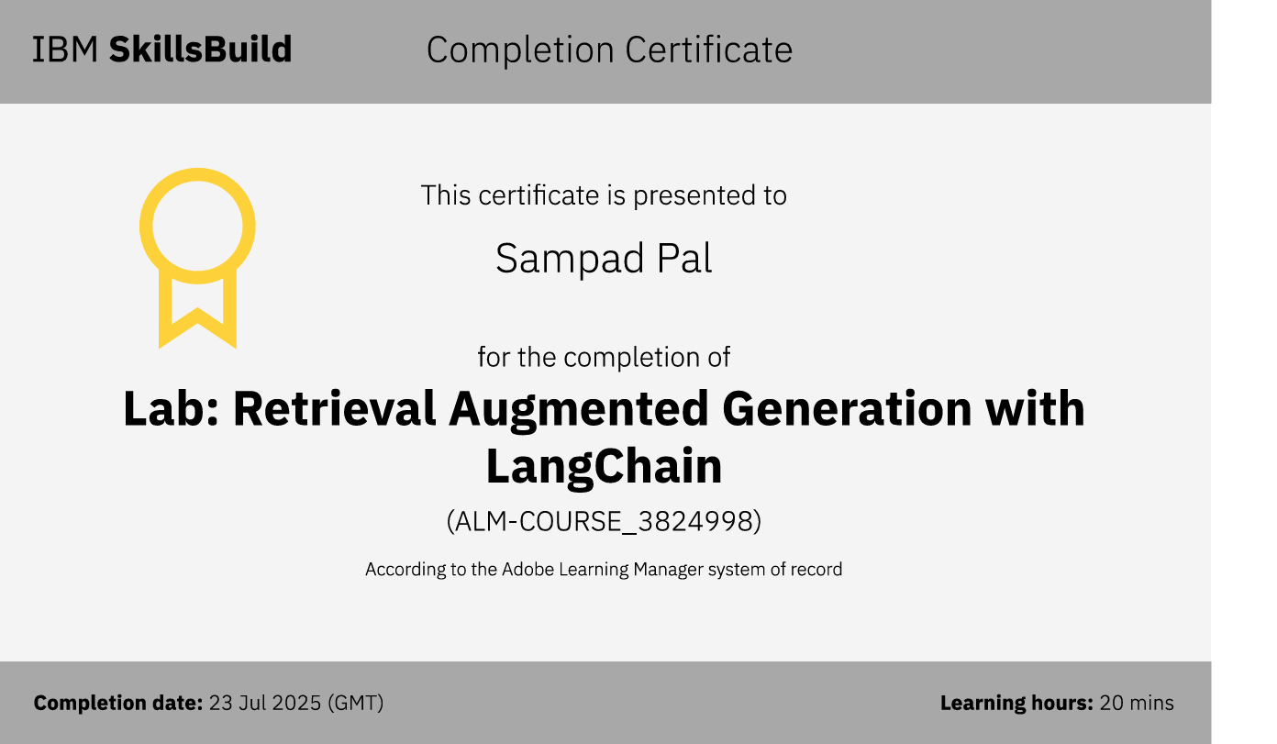
IBM Certifications

Slide 19

dapmaS-dev/Network-Intrusion-Model

Slide 20
THANK YOU

