Slide 1

Bank marketing
Predicting Term Deposit Subscription

Slide 2
Dataset
Data collected from May 2008 to June 2013
Originally 21 features including demographic variables, number of campaign contacts, success rate of previous campaign, as well as economic indicators (such as Euribor 3-month rate)
41188 observations
[Moro et al., 2014] S. Moro, P. Cortez and P. Rita. A Data-Driven Approach to Predict the Success of Bank Telemarketing. Decision Support Systems, Elsevier, 62:22-31, June 2014
Available here: https://archive.ics.uci.edu/ml/datasets/Bank+Marketing#
‘Duration’ is leaked and must be dropped. Kaggle dataset has a variable ‘balance’, which is not identified in the UCI dataset or by the article authors.

Slide 3
Objective
The main objective is to have people agree to make a long-term deposit with the bank
Precision: Positive class is ‘yes’, so false positives would be predicting that the person will say yes when they will say no. Want to avoid these to minimize inconvenience caused to people and cost of our staff’s time, but can tolerate some false positives if this means getting more business.
Recall: False negatives are when we predict a ‘no’ when the person will, in fact, say yes. The cost of this prediction is not getting a client. In a sales situation, wish to avoid this and would rather make more calls. Thus focus on recall over precision.

Slide 4
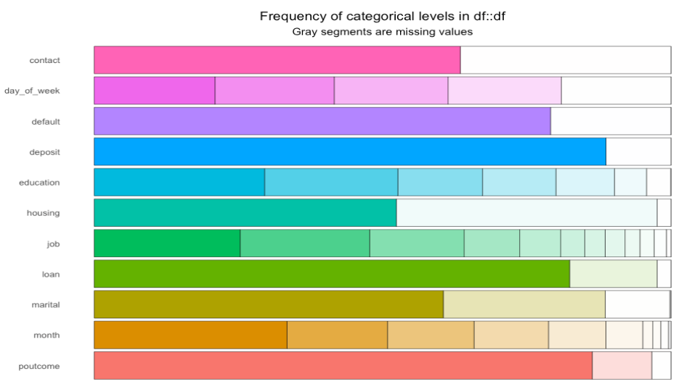
Distributions of categorical variables
‘Deposit’ is highly imbalanced, with 89% saying no and 11% saying yes.
Can achieve 89% accuracy on our prediction by having the model state that the person will not deposit
If needed, sacrifice accuracy to get higher recall
Excluded the leaked variable duration. This variable has been used (on Kaggle and elsewhere) to get a more accurate model, but is not know to the bank before a call.

Slide 5
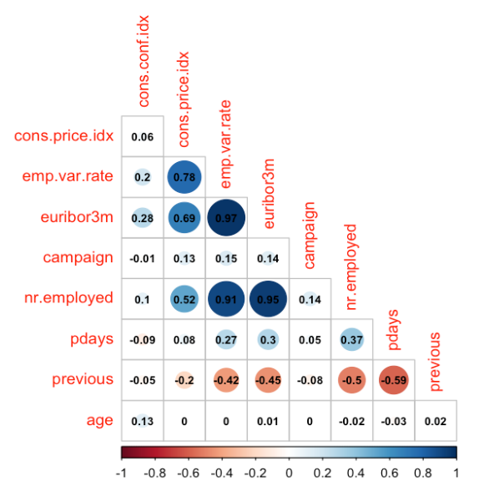
Correlations
High positive correlations between eurobor3m and consumer price index
Low correlations between euribor3m and
pdays ( number of days that passed by after the client was last contacted from a previous campaign)
previous (number of contacts performed before this campaign and for this client (numeric))
Main economic indicators are highly correlated

Slide 6
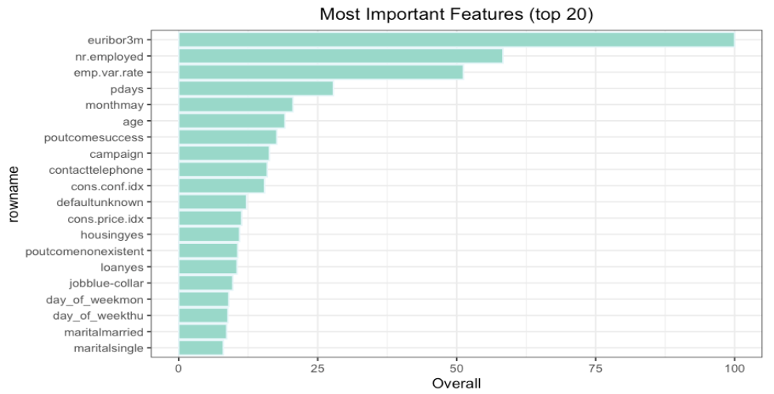
Feature importances and model
Feature importances after running a random forest model
Can capture 60% of people saying yes to a deposit by getting 3 yeses to every 5 noes in the group we identify
The best observed on data without leakage. More accurate models generally used leaked variable ‘duration’

Slide 7
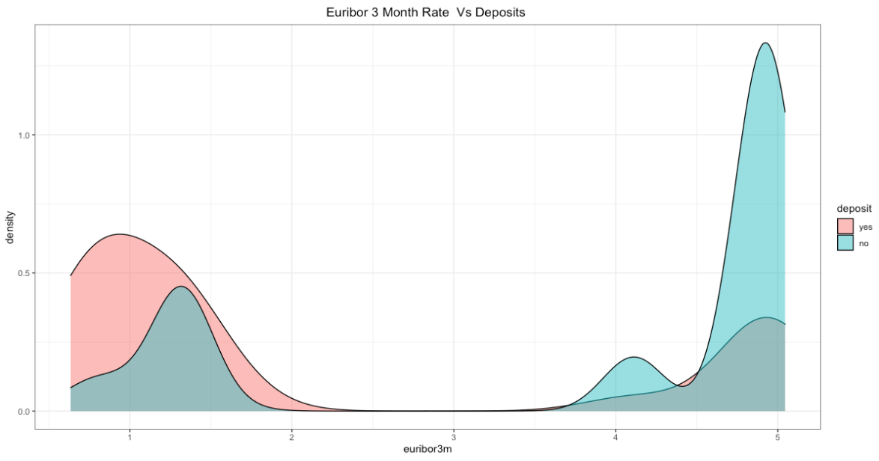
Euribor 3m an deposits
From May 2008 until 2010, Euribor 3-month rate was high but decreasing, so there were fewer purchases of long-term deposits
Direction of change is more important than magnitude in interpreting this pattern

Slide 8
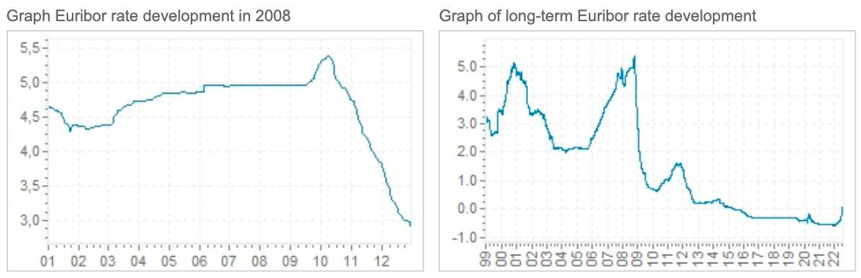
Interest rates and deposits
The 3 month Euribor interest rate is the interest rate at which a selection of European banks lend one another funds denominated in euros whereby the loans have a maturity of 3 months.
Source: https://www.global-rates.com/en/interest-rates/euribor/2008.aspx

Slide 9
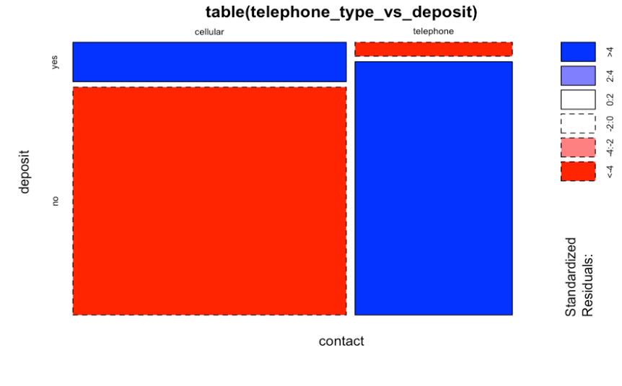
Telephone type vs deposit
Cellular contact are more likely to say yes

Slide 10
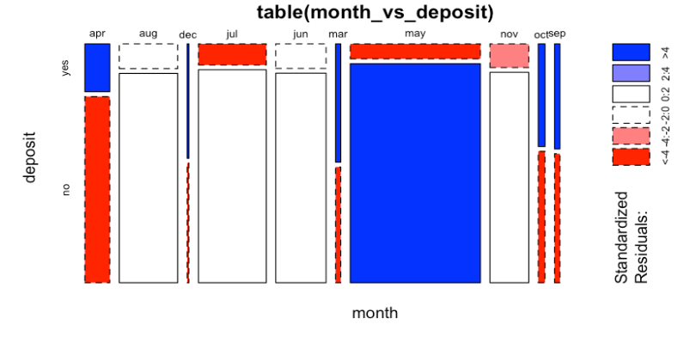
Deposits by month
High frequency of yeses in April, March, October, September, and December
A lot of activity in May, but most people say no: perhaps rework the timing of calls to have more calls be placed in April, March, October, September, and December

Slide 11
Business Concerns
“It is difficult to financially quantify costs, since long term deposits have different amounts, interest rates and subscription periods.” (Moro et al., 2014)
Client stress and intrusiveness associated with outbound calls should also be considered, as the bank is maximizing lifetime value of doing business with the customer
“The 2008 financial crisis increased the pressure for Portuguese banks to increase long term deposits.”(Moro et al., 2014)
According to https://www.erieri.com/salary/job/call-center-agent/Portugal, the average salary of a call center agent in Portugal is €8/hour (about $8.08/hour). Assume there are down times, so the lowest price per hour is about $10.
According to salaryexplorer.com, an average bank worker in Portugal earns about €18.70/hour ($18.87/hour). Assume there are down times, so the lowest price per hour is $20.

Slide 12
Cost comparison
 | Cost of Yeses (in hours) | Cost of Noes (in hours) | Total Cost LB (in $) | Total Cost UB (in $)
No ML | 1097 | 3448 | $45402+ C(intangible high) | $90803+ C(intangible high)
ML | 1097 | 680 | $17772+ C(intangible low) | $35544+ C(intangible low)
Mixed | 1386 | 1959 | $33464+ C(intangible medium) | $66927+ C(intangible medium)
Difference (No ML-ML) | 0 | 2768 | $27629+(C(intangible high)-C(intangible low)) | $55259+(C(intangible high)-C(intangible low))
Difference (Mixed-ML) | 289 | 1279 | $15691+(C(intangible medium)-C(intangible low)) | $31383+(C(intangible medium)-C(intangible low))
FOOTNOTES
Assuming an approximately uniform distribution of yeses and noes
ML model assumes we get data on customers for whom deposit data is not available (same size as our dataset for ease of calculations)
Intangible costs are long-term reputational damage to the company from customers being (repeatedly) inconvenienced with offers that are of no interest to them, the ensuing loss in long-term customer value, opportunity costs of having employees work on more promising directions (offer a more appropriate products to customers), etc.
LB is lower bound
UB is upper bound
Mixed strategy is strategy of identifying as positives any clients for which the model predicts their probability of saying a yes as at least 30%

Slide 13
Business recommendation
Adopt the ML strategy if long-term customer value and intangible costs are a significant concern and campaign resources are limited. This will allow getting 63% of all potential yeses at low cost.
Try to reach out to these customers in April, March, October, September, or December
After these customers are contacted, design a different product that would have a higher success rate with the remainder of potential contacts
Adopt a mixed strategy of contacting clients for which the model predicts their probability of saying a yes as at least 30% if intangible costs and campaign resources are moderate. This will allow getting 80% of all potential yeses at moderate cost.
Adopt a strategy of contacting all customers if have large campaign resources, are less concerned with intangible costs, and the cost of missing some of the yeses is particularly high. This will allow getting 100% of all potential yeses at higher cost.

Slide 14
Future work
Call direction (inbound vs outbound) is not available in the UCI dataset and would be very helpful to have for the business. Moro et al. had this feature and found it to be the most important feature after the Euribor 3-month rate.
Having the dates from Euribor 3-month rate would allow one to perform separate analyses for pre- and post-financial crisis or get a more accurate overall model. Also, could build more reliable validation and test sets (Euribor 3m rates alone cannot be used to reliably deduce dates).
What other data can be obtained to allow us to build a better model?
Could we do some quality assurance on the calls using NLP to detect the sentiment in the call and the variation in this sentiment throughout the call?
Could we use the data to match our ‘no’ customers with a more appropriate product?
Use AB Testing with profit per person metric to compare model performance in real life.
Which strategy works best given the bank’s profitability and long-term customer value metrics?
Monitor for model drift

Slide 15

Appendix

Slide 16
Variable descriptions
Input variables:
# bank client data:
1 - age (numeric)
2 - job : type of job (categorical: 'admin.','blue-collar','entrepreneur','housemaid','management','retired','self-employed','services','student','technician','unemployed','unknown')
3 - marital : marital status (categorical: 'divorced','married','single','unknown'; note: 'divorced' means divorced or widowed)
4 - education (categorical: 'basic.4y','basic.6y','basic.9y','high.school','illiterate','professional.course','university.degree','unknown')
5 - default: has credit in default? (categorical: 'no','yes','unknown')
6 - housing: has housing loan? (categorical: 'no','yes','unknown')
7 - loan: has personal loan? (categorical: 'no','yes','unknown')
# related with the last contact of the current campaign:
8 - contact: contact communication type (categorical: 'cellular','telephone')
9 - month: last contact month of year (categorical: 'jan', 'feb', 'mar', ..., 'nov', 'dec')
10 - day_of_week: last contact day of the week (categorical: 'mon','tue','wed','thu','fri')
11 - duration: last contact duration, in seconds (numeric). Important note: this attribute highly affects the output target (e.g., if duration=0 then y='no'). Yet, the duration is not known before a call is performed. Also, after the end of the call y is obviously known. Thus, this input should only be included for benchmark purposes and should be discarded if the intention is to have a realistic predictive model.

Slide 17
Variable descriptions
# other attributes:
12 - campaign: number of contacts performed during this campaign and for this client (numeric, includes last contact)
13 - pdays: number of days that passed by after the client was last contacted from a previous campaign (numeric; 999 means client was not previously contacted)
14 - previous: number of contacts performed before this campaign and for this client (numeric)
15 - poutcome: outcome of the previous marketing campaign (categorical: 'failure','nonexistent','success')
# social and economic context attributes
16 - emp.var.rate: employment variation rate - quarterly indicator (numeric)
17 - cons.price.idx: consumer price index - monthly indicator (numeric)
18 - cons.conf.idx: consumer confidence index - monthly indicator (numeric)
19 - euribor3m: euribor 3 month rate - daily indicator (numeric)
20 - nr.employed: number of employees - quarterly indicator (numeric)
Output variable (desired target):
21 - y - has the client subscribed a term deposit? (binary: 'yes','no')

Slide 18
A note on mosaic plots
The colors represent the level of the residual for that cell / combination of levels. The legend is presented at the plot's right. More specifically, blue means there are more observations in that cell than would be expected under the null model (independence). Red means there are fewer observations than would have been expected. You can read this as showing you which cells are contributing to the significance of the chi-squared test result.
Source: https://stats.stackexchange.com/questions/147863/how-to-interpret-the-residual-colors-on-a-mosaic-plot

Slide 19
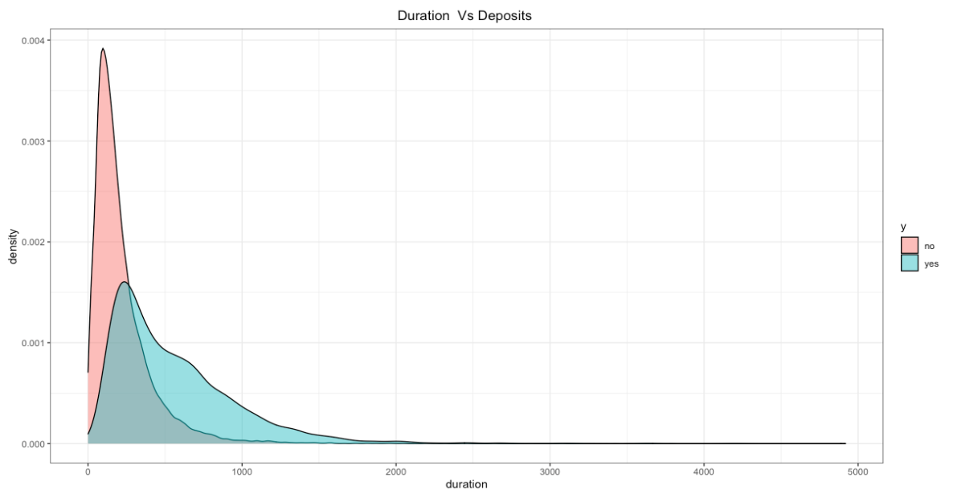
Duration vs deposits

Slide 20
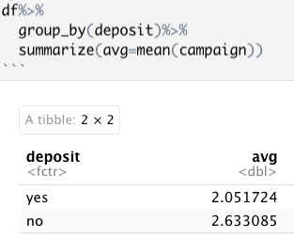
Summaries useful for date calculations

Slide 21
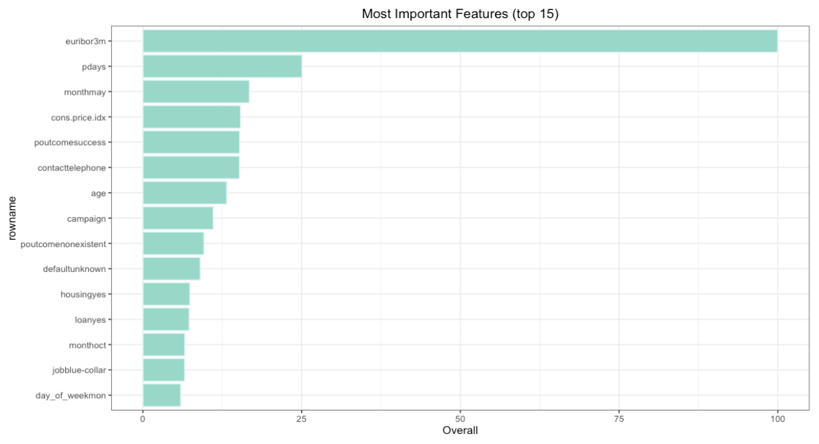
Smaller feature set importances
Interestingly, dropping emp.var.rate, cons.conf.idx, nr.employed produced a model with about the same recall and accuracy. For ease of use, may rely on this model for R Shiny app
emp.var.rate: employment variation rate - quarterly indicator (numeric)
cons.conf.idx: consumer confidence index - monthly indicator (numeric)
nr.employed: number of employees - quarterly indicator (numeric)

Slide 22
Interest rates and deposits
In periods of rising interest rates, consumers are more likely to purchase term deposits since the increased cost of borrowing makes savings more attractive. Also, with higher market interest rates, the financial institution will need to offer the investor a higher rate of interest, so the investor also earns more.
When interest rates decrease, consumers are encouraged to borrow and spend more, thereby stimulating the economy. In a low interest rate environment, demand for term deposits can decrease since investors can typically find alternative investment vehicles that pay a higher rate.
Term deposits are an extremely safe investment and are therefore very appealing to conservative, low-risk investors.
Source: https://www.investopedia.com/terms/t/termdeposit.asp

Slide 23
Modeling approach
Outline:
1. Do some preliminary visualizations (already checked that there are no na’s)
2. Split into training, validation, and test sets
3. Fit a random forest, which performed better than gradient boosting
4. Do visualizations for the features identified as important by the random forest
5. Present the results

Slide 24
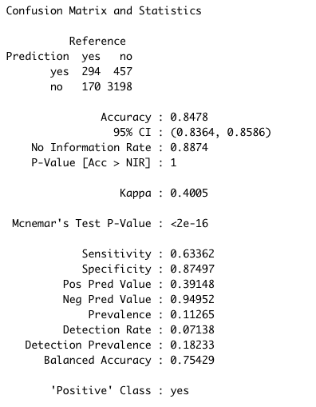
model stats

Slide 25
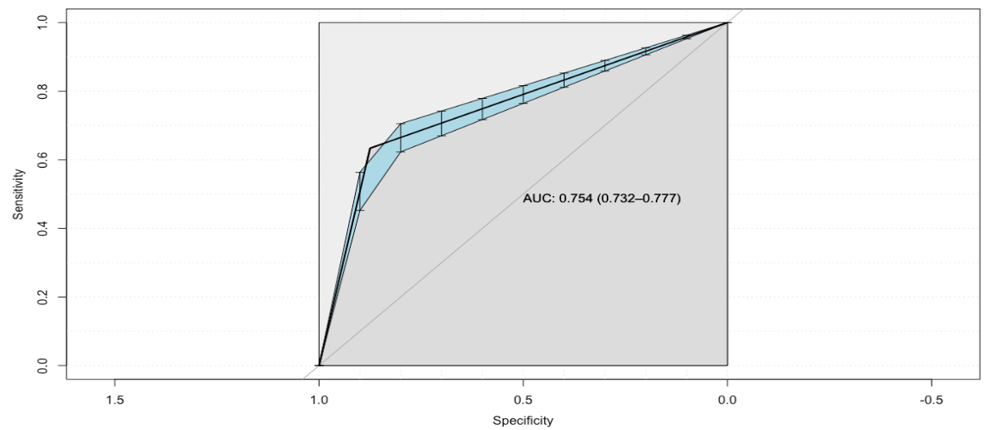
Roc curve

Slide 26
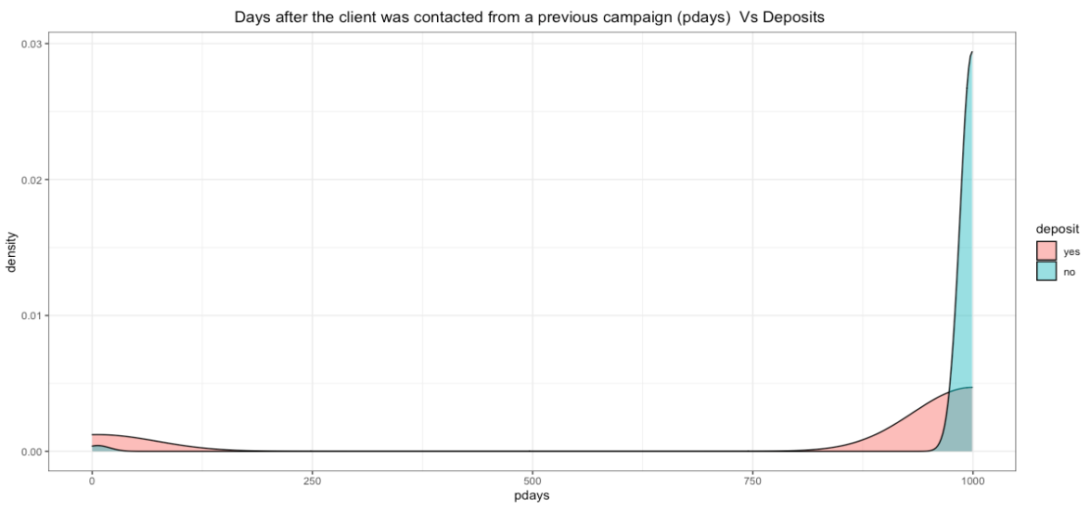
Days since last contact and deposit

Slide 27
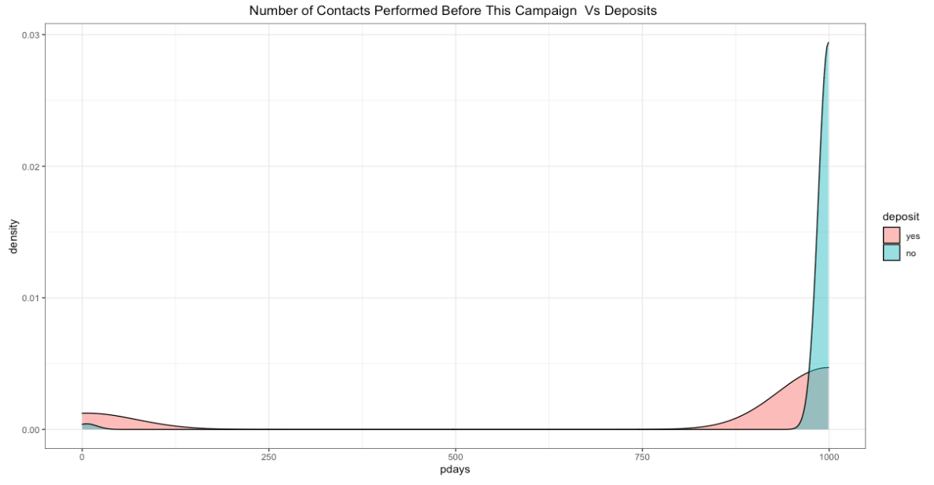
Number of contacts vs deposits

Slide 28
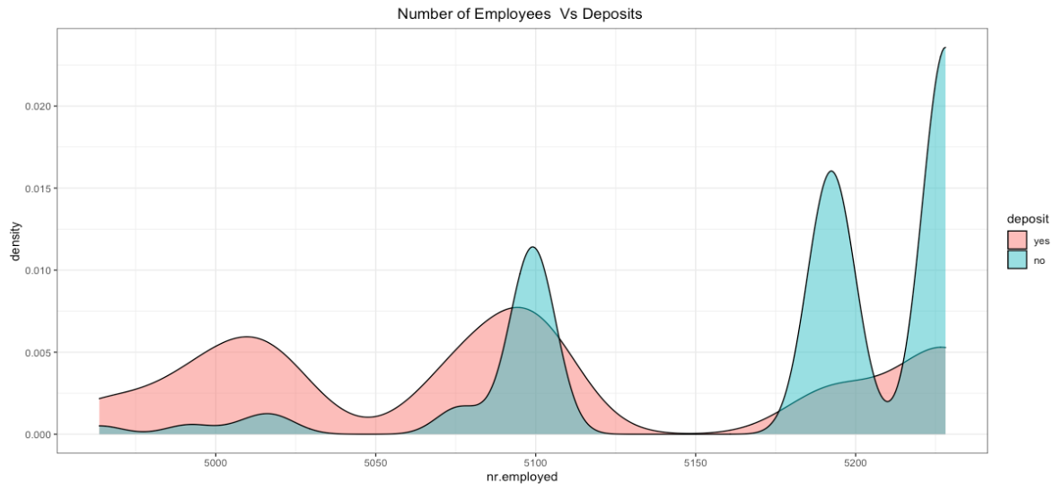
Number of employees vs deposits

Slide 29
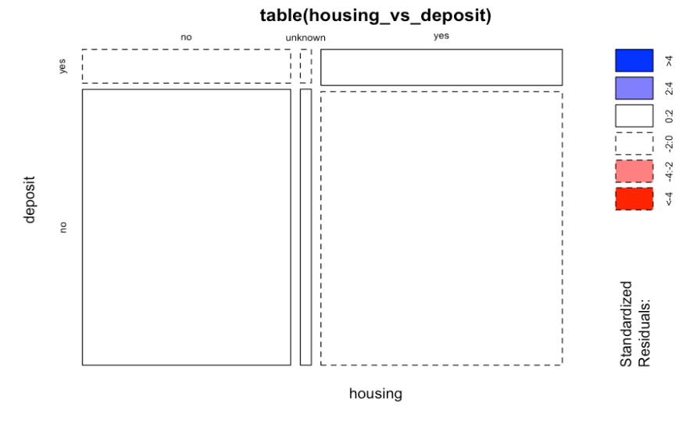
Housing vs deposit

Slide 30
Cost of no-ml strategy
Assuming a uniform distribution of yeses and noes, to reach 63% of the possible yeses, the bank would call .63362*41188=26098 customers.
11.265% (2940) will say yes, with a length of call per yes being 553.1912 seconds, for a total of 452 hours.
88.735% (23158) will say no, with a length of call per yes being 220.8448 seconds, for a total of 1420 hours
Lower bound cost of acquiring 63% yeses: $10/hr*(1870)hrs= $18,700+Cost(long-term customer value and reputation costs loses)+Opportunity cost of spending many employee hours on the campaign
Upper bound cost of acquiring 63% yeses: $20/hr*(5850)hrs= $37,400 +Cost(long-term customer value and reputation costs loses) )+Opportunity cost of spending many employee hours on the campaign

Slide 31
Cost of ml strategy
Identified a group of 7510 customers, about 2940 of whom will say yes
Cost of 452 hours for the yeses and 280 hours for the noes
Lower bound cost of acquiring 62% yeses: $10/hr*(732)hrs= $7320+Cost(long-term customer value and reputation costs loses)
Smaller than $18,700 and the reputation cost to the company, long-term customer value losses, reputation costs, and opportunity costs are much smaller
Upper bound cost of acquiring 62% yeses: $20/hr*(5850)hrs= $14640 +Cost(long-term customer value and reputation costs loses)+Opportunity cost of spending many employee hours on the campaign
Smaller than $37,400 and the reputation cost to the company, long-term customer value losses, reputation costs, and opportunity costs are much smaller

Slide 32
Image source
License | CC LIcensed
Description | Zarco & Bank of Portugal (Funchal)
Date | 18 September 2017, 11:59
Source | Zarco & Bank of Portugal (Funchal)
Author | VillageHero from Ulm, Germany
Link | https://commons.wikimedia.org/wiki/File:Zarco_%26_Bank_of_Portugal_(Funchal)_(38044349796).jpg

