Slide 1

Bank marketing
Predicting Term Deposit Subscription

Slide 2
Dataset
Data collected from 2008 to 2013
Originally 21 features including demographic variables, number of campaign contacts, success rate of previous campaign, as well as economic indicators (such as Euribor 3-month rate)
[Moro et al., 2014] S. Moro, P. Cortez and P. Rita. A Data-Driven Approach to Predict the Success of Bank Telemarketing. Decision Support Systems, Elsevier, 62:22-31, June 2014
Available here: https://archive.ics.uci.edu/ml/datasets/Bank+Marketing#

Slide 3
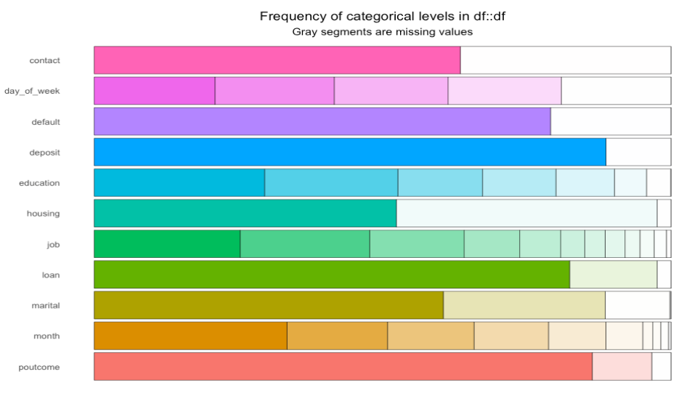
Distributions of categorical variables

Slide 4
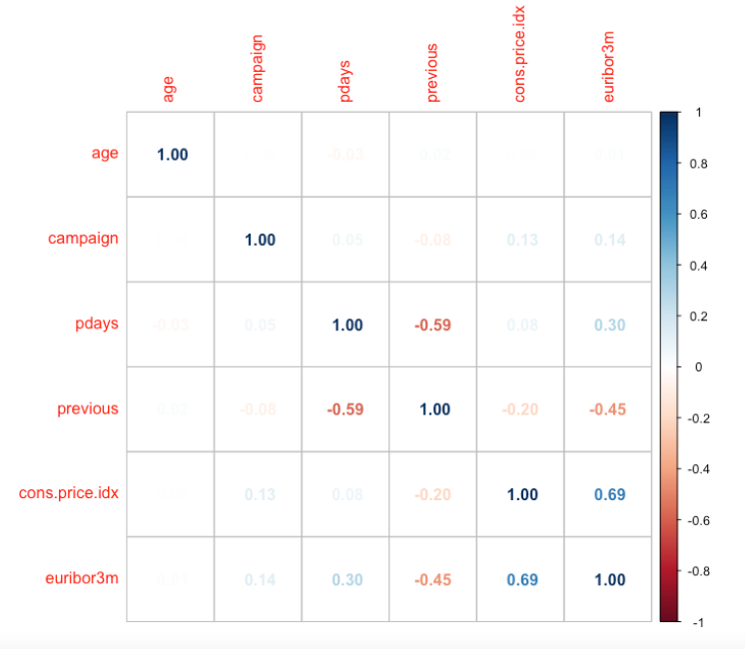
Correlations
High positive correlations between eurobor3m and consumer price index
Low correlations between euribor3m and
pdays ( number of days that passed by after the client was last contacted from a previous campaign)
previous (number of contacts performed before this campaign and for this client (numeric))

Slide 5
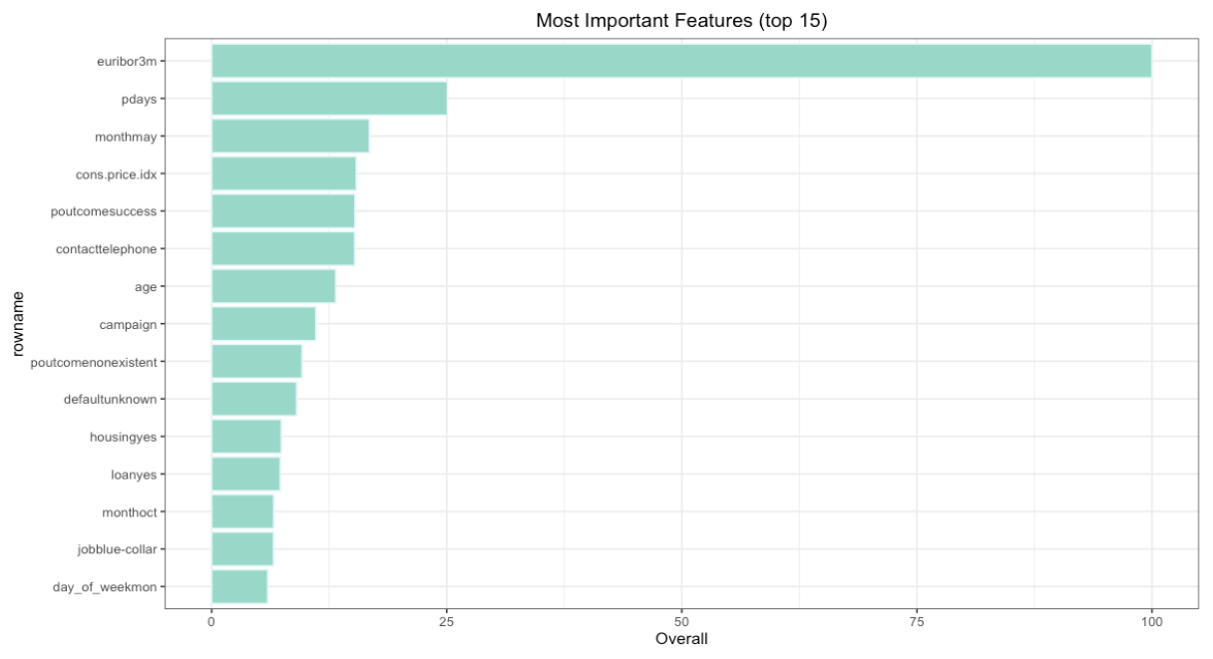
Feature importances and model
Feature importances after running a random forest model
Excluded the leaked variable duration
Can capture 60% of people saying ‘yes’ to a deposit by getting 3 yeses to every 5 no’s in the group we identify

Slide 6
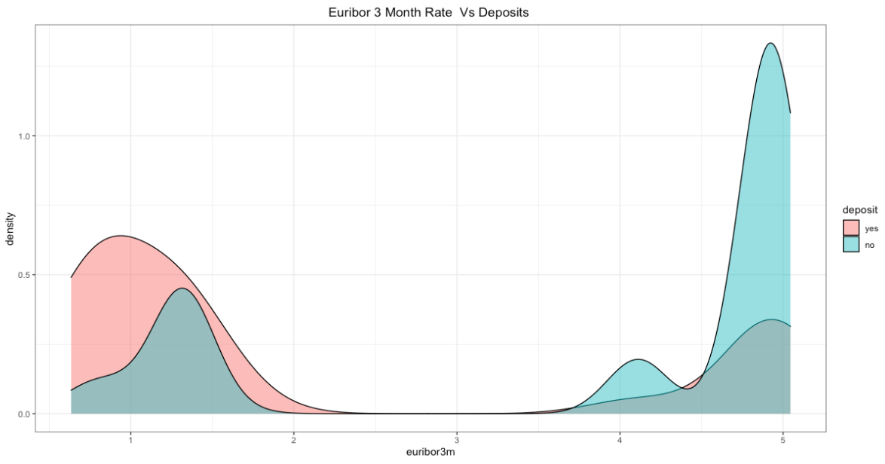

Slide 7
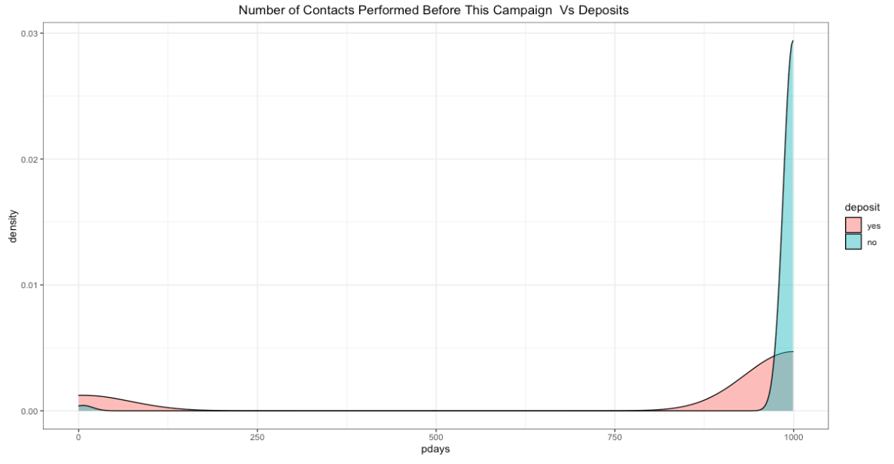

Slide 8
Appendix

Slide 9
Variable descriptions
Input variables:
# bank client data:
1 - age (numeric)
2 - job : type of job (categorical: 'admin.','blue-collar','entrepreneur','housemaid','management','retired','self-employed','services','student','technician','unemployed','unknown')
3 - marital : marital status (categorical: 'divorced','married','single','unknown'; note: 'divorced' means divorced or widowed)
4 - education (categorical: 'basic.4y','basic.6y','basic.9y','high.school','illiterate','professional.course','university.degree','unknown')
5 - default: has credit in default? (categorical: 'no','yes','unknown')
6 - housing: has housing loan? (categorical: 'no','yes','unknown')
7 - loan: has personal loan? (categorical: 'no','yes','unknown')
# related with the last contact of the current campaign:
8 - contact: contact communication type (categorical: 'cellular','telephone')
9 - month: last contact month of year (categorical: 'jan', 'feb', 'mar', ..., 'nov', 'dec')
10 - day_of_week: last contact day of the week (categorical: 'mon','tue','wed','thu','fri')
11 - duration: last contact duration, in seconds (numeric). Important note: this attribute highly affects the output target (e.g., if duration=0 then y='no'). Yet, the duration is not known before a call is performed. Also, after the end of the call y is obviously known. Thus, this input should only be included for benchmark purposes and should be discarded if the intention is to have a realistic predictive model.

Slide 10
Variable descriptions
# other attributes:
12 - campaign: number of contacts performed during this campaign and for this client (numeric, includes last contact)
13 - pdays: number of days that passed by after the client was last contacted from a previous campaign (numeric; 999 means client was not previously contacted)
14 - previous: number of contacts performed before this campaign and for this client (numeric)
15 - poutcome: outcome of the previous marketing campaign (categorical: 'failure','nonexistent','success')
# social and economic context attributes
16 - emp.var.rate: employment variation rate - quarterly indicator (numeric)
17 - cons.price.idx: consumer price index - monthly indicator (numeric)
18 - cons.conf.idx: consumer confidence index - monthly indicator (numeric)
19 - euribor3m: euribor 3 month rate - daily indicator (numeric)
20 - nr.employed: number of employees - quarterly indicator (numeric)
Output variable (desired target):
21 - y - has the client subscribed a term deposit? (binary: 'yes','no')

Slide 11
Image source
License | CC LIcensed
Description | Zarco & Bank of Portugal (Funchal)
Date | 18 September 2017, 11:59
Source | Zarco & Bank of Portugal (Funchal)
Author | VillageHero from Ulm, Germany
Link | https://commons.wikimedia.org/wiki/File:Zarco_%26_Bank_of_Portugal_(Funchal)_(38044349796).jpg

