Slide 1
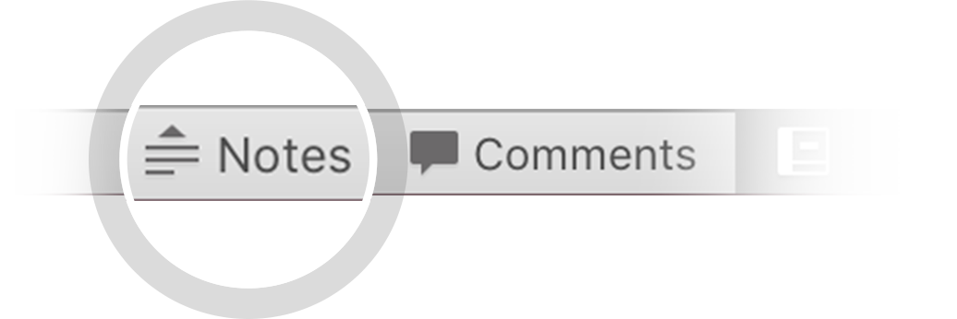
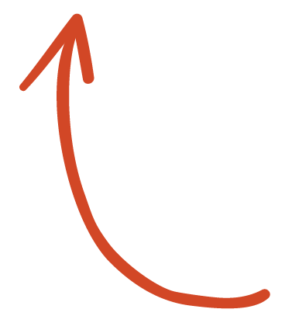
Here's your outline to get started
Key facts about your topic
Market segmentation is the activity of dividing a broad consumer or business market, normally consisting of existing and potential customers, into sub-groups of consumers based on some type of shared characteristics.
See more: Open the Notes below for more information.
Notes:
QuickStarter has created an outline to help you get started on your presentation. Some slides include information here in the notes to provide additional topics for you to research.

Slide 2
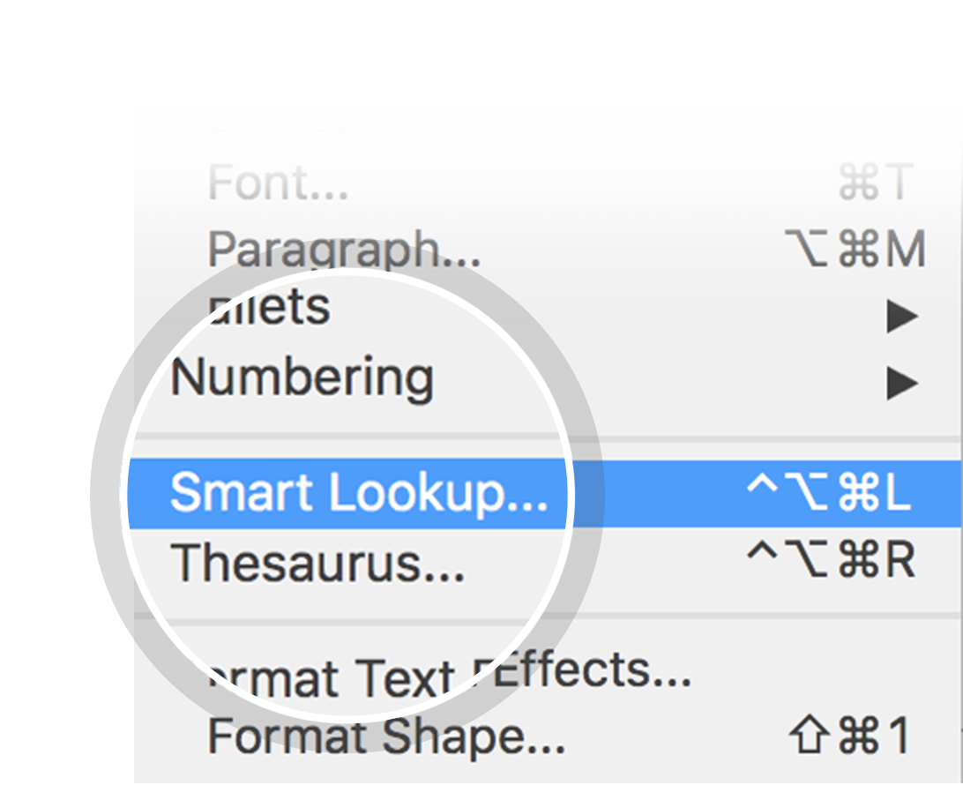
Related topics to research
Positioning
Target market
Marketing
Psychographic segmentation
Niche market
Distribution
Marketing communications
Pricing
Promotion
Mass marketing
Use Smart Lookup to learn more
1
Highlight one of the related topics
Right-click on the topic
Choose "Smart Lookup"
2
3

Slide 3
Market Segmentation

Slide 4
Data source and brief description
Data source: https://www.kaggle.com/datasets/imakash3011/customer-personality-analysis or https://www.kaggle.com/datasets/jackdaoud/marketing-data?select=ifood_df.csv. Provided by Dr. Omar Romero-Hernandez of UC Berkeley
2240 individual observations on
Customer characteristics (year of birth, education, income, number of children, etc.)
Products (aggregated amounts spent of wines, fruit, sweets, etc.)
Promotion acceptance for 5 campaigns
Number of purchases done on the web, using catalog, or in store, as well as the total number of web visits
Some missing income observations and extreme outliers in income and age

Slide 5
Key questions
Who are the customers that bring the most revenue to the company?
Who are the customers who could bring more revenue to the company?
To which campaigns do these customers respond?
Where do different groups of customer shop? (in store, online, over catalog)
Any additional business insights about the customers?

Slide 6
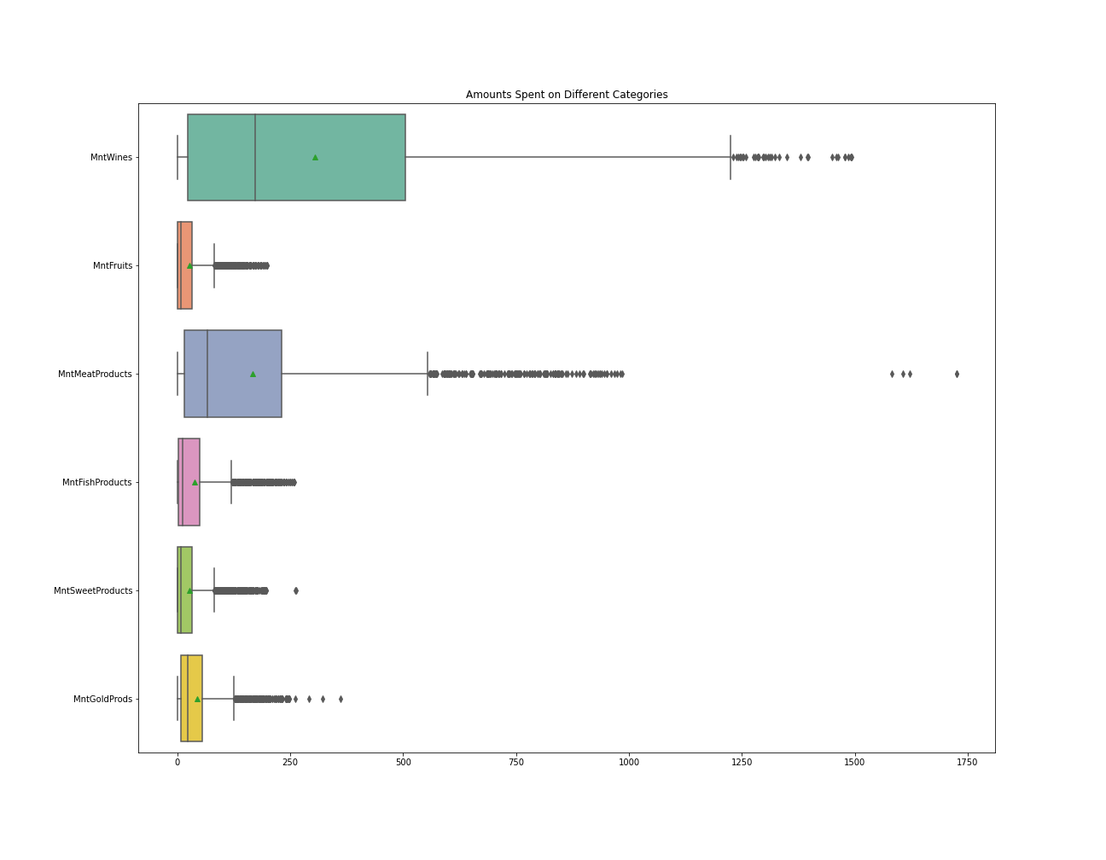
Amounts spent by category
High spending on wines and meat
Spending amounts are skewed to the right for all categories
Questions: What can we say about the spending patterns of different groups of customers?

Slide 7
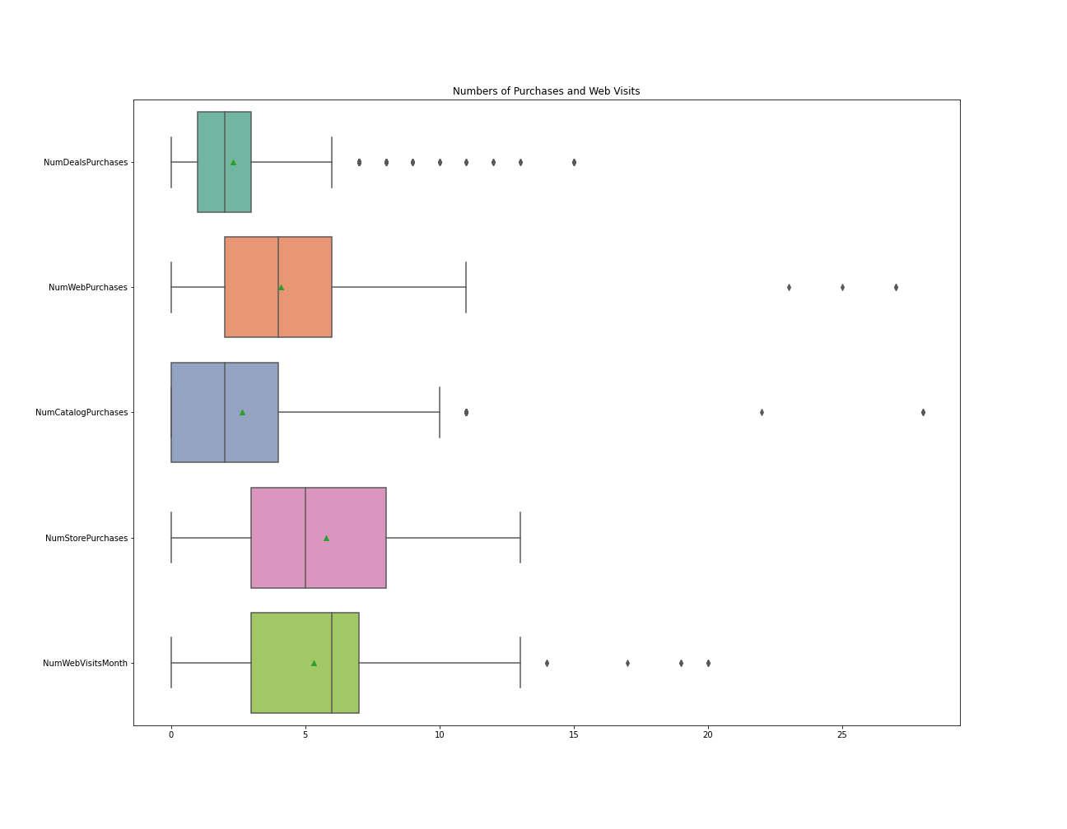
Numbers of purchases by medium
Customers shopping in store make the greatest median number of purchases, followed by web and catalog purchases
High median number of monthly web visits
Questions: Who shops in store? who shops on the web? Who uses the catalog?

Slide 8
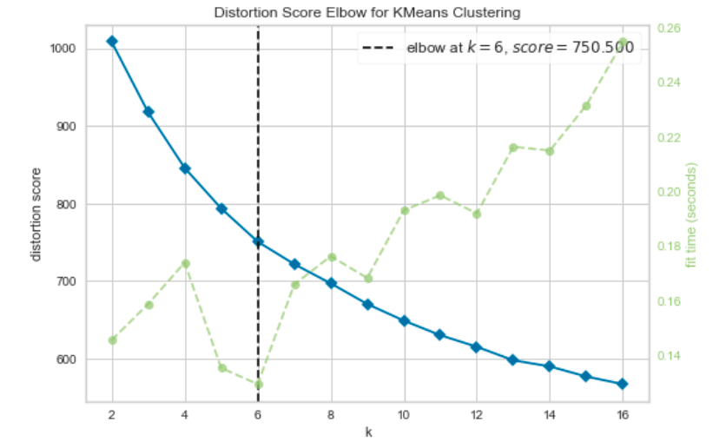
Kmeans clustering algorithm
Select k as the number of groups to cluster for
Randomly pick k points in the data as centroid points
Assign each non-centroid point to its closest centroid
Recalculate centroid points by taking the average of all surrounding points assigned to that cluster
Repeat steps 3-4 until calculated centroid points do not move anymore.

Slide 9
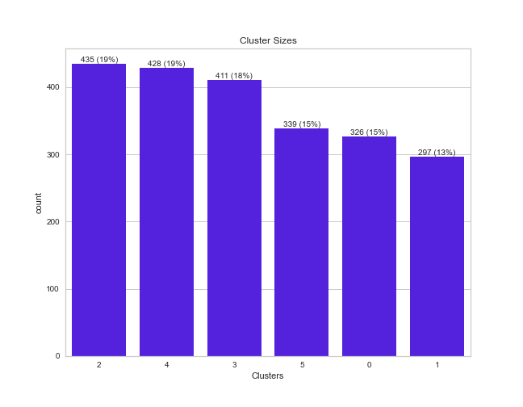
Cluster sizes
2 and 4 are the biggest clusters
Q: Will they bring in the most revenue?

Slide 10
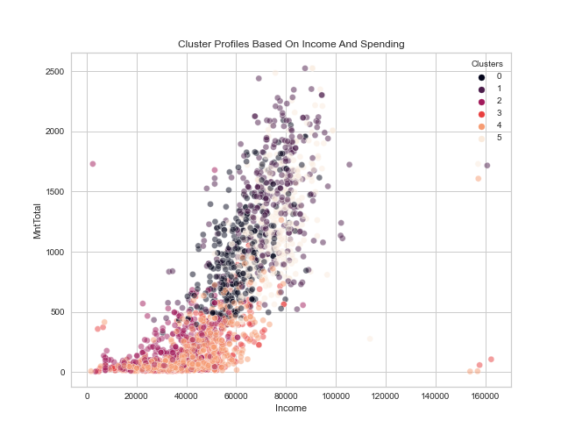
Cluster profiles based on income and spending
A: Possibly not, as this look at income and spending for various clusters indicates

Slide 11
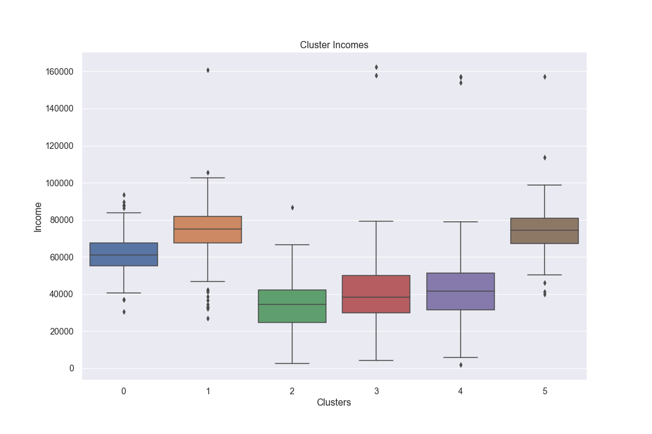
Clusters by income
Clusters 5 and 1 have the highest incomes, followed by Cluster 0.
Clusters 2-4 have below median income for all customers.

Slide 12
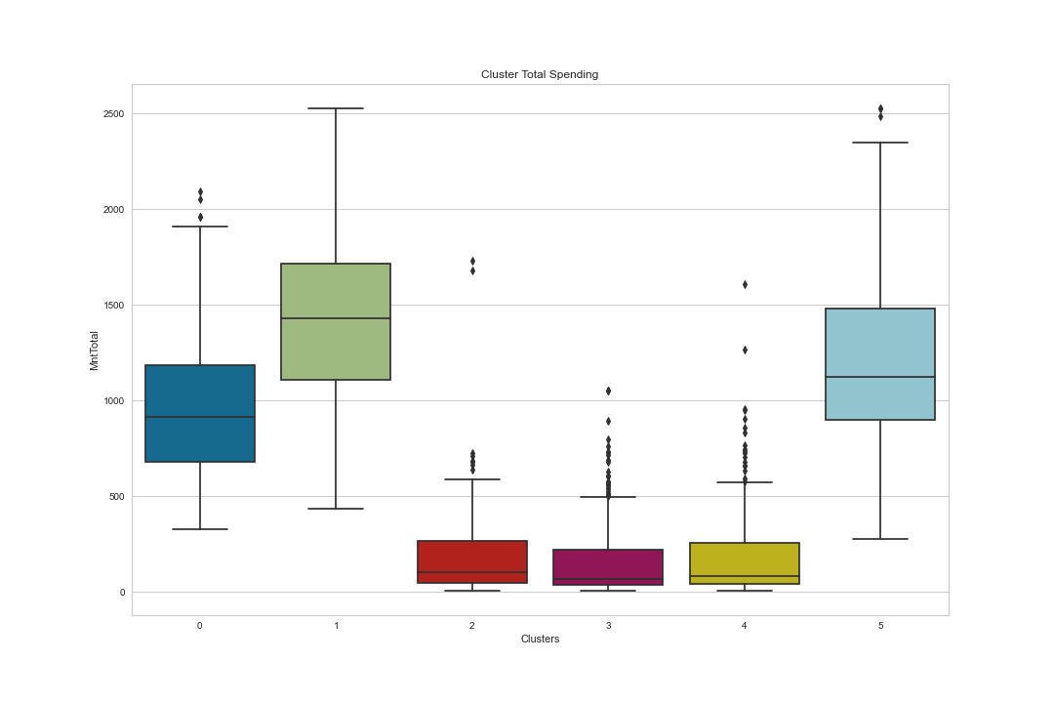
Total Spending by cluster
Cluster 1 customers spend the most, followed by Cluster 5 and 0 customers

Slide 13
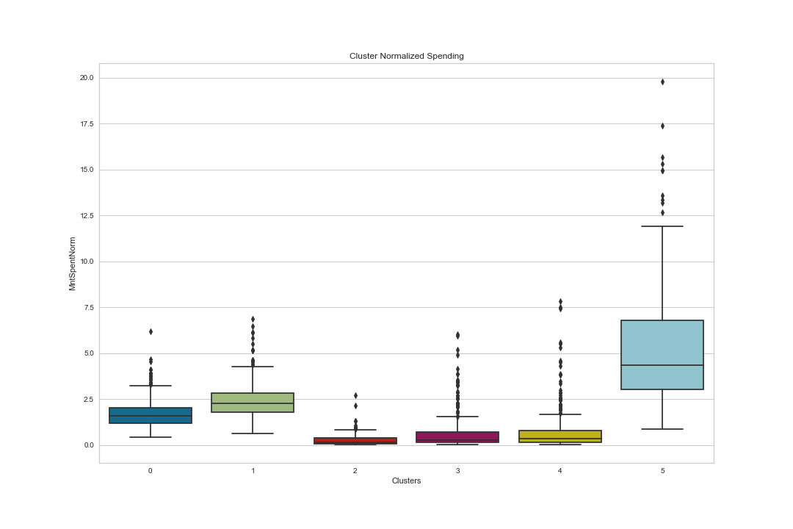
Cluster normalized Spending
When normalized by length spent as customer, Cluster 5 customers spend much more than Cluster 1 customers!
Cluster 0 customers follow
These patterns hold by category as well (wine, meats, etc.)

Slide 14
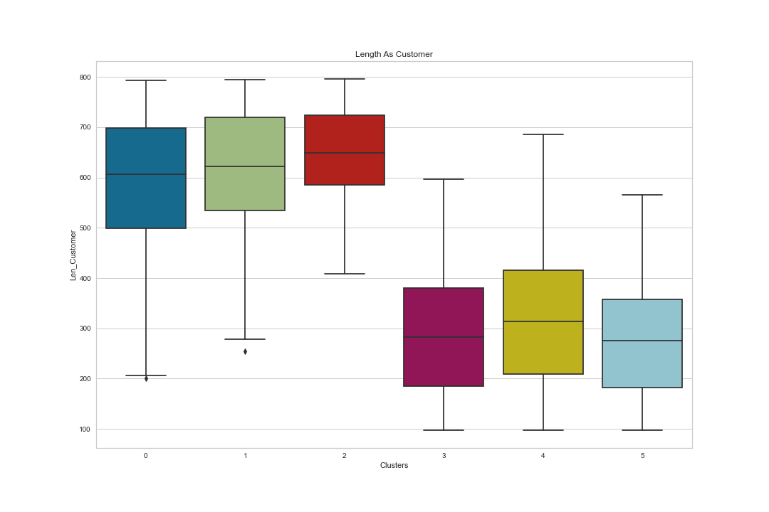
Length as customer
Cluster 5 customers are more recent, along with those in clusters 3 and 4
Cluster 1 customers are loyalty customers, along with those in clusters 0 and 3

Slide 15
Clusters by number of children
Cluster 5 customers are slightly more likely to have at least once child than Cluster 1
Over 90% of Cluster 1 customers have at least 1 child, which could explain their lower spending

Slide 16
Clusters by number of children
Cluster 5 customers are more likely to have at least once child than Cluster 1
Over 90% of Cluster 1 customers have at least 1 child, which could explain their lower spending

Slide 17
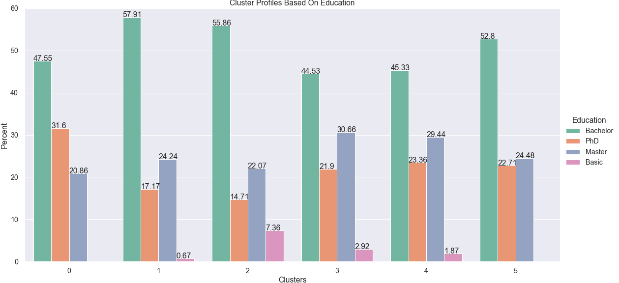
Clusters by Education
Cluster 5 have more advanced degrees than Cluster 1
Cluster 1 customers have the most PhDs, but probably have less disposable income due to having more children

Slide 18
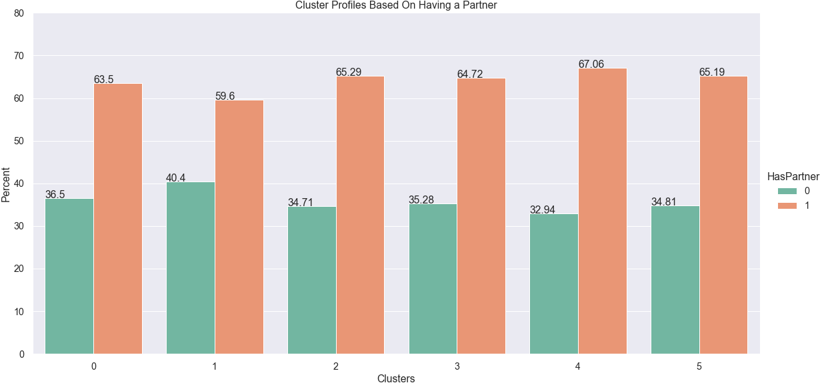
Clusters Based on having a partner
Clusters are similar in that respect, with Cluster 4 customers most likely to have a partner and Cluster 1 least likely

Slide 19
Cluster characteristics summary

Slide 20
Radar Plot

Slide 21
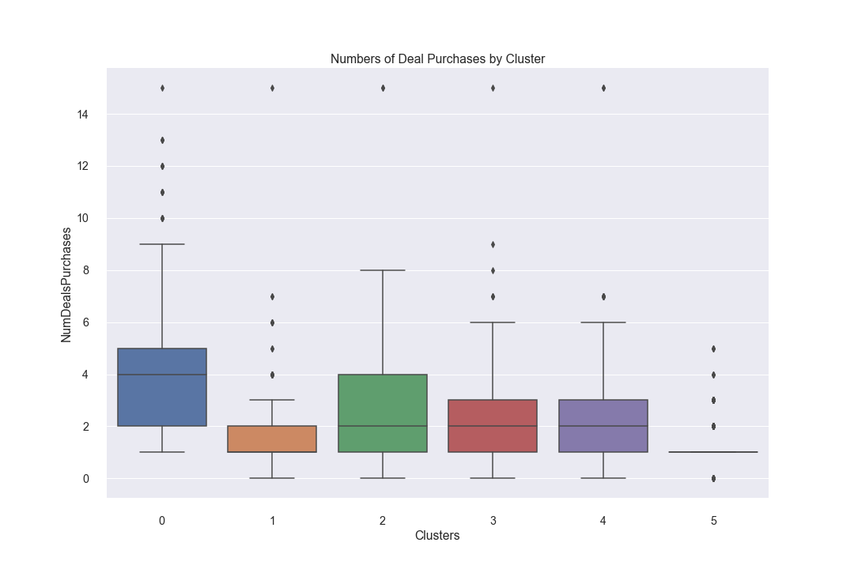
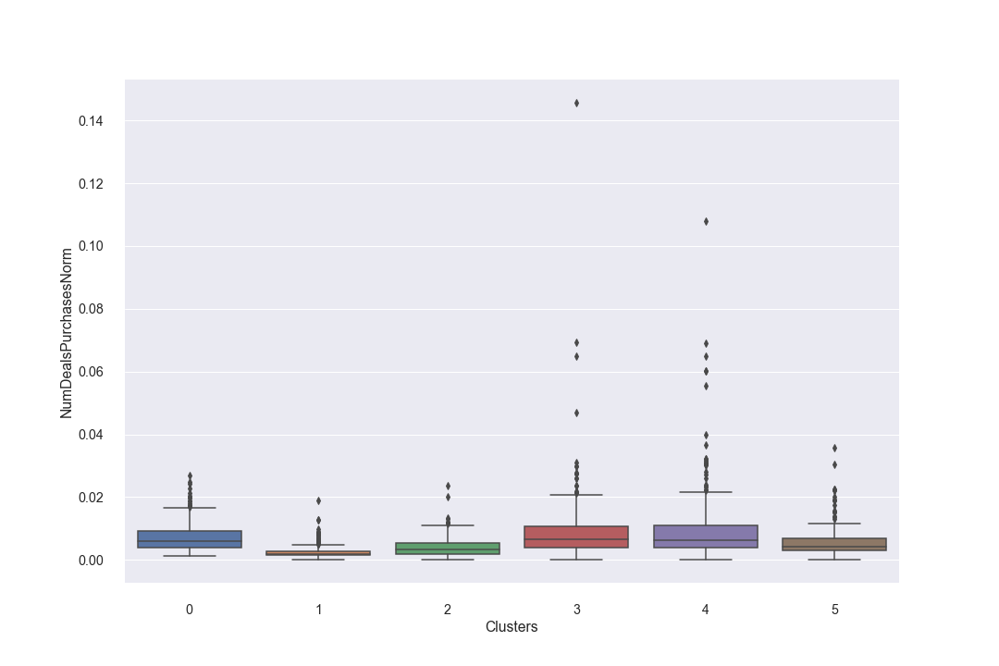
Deals
Takeaway: If we want to reach Cluster 0, target deals at that cluster
Clusters 1 and 5 are not very responsive to deals
Upon normalization, Clusters 2-4 are also responsive to deals. Target deals at these customers.

Slide 22
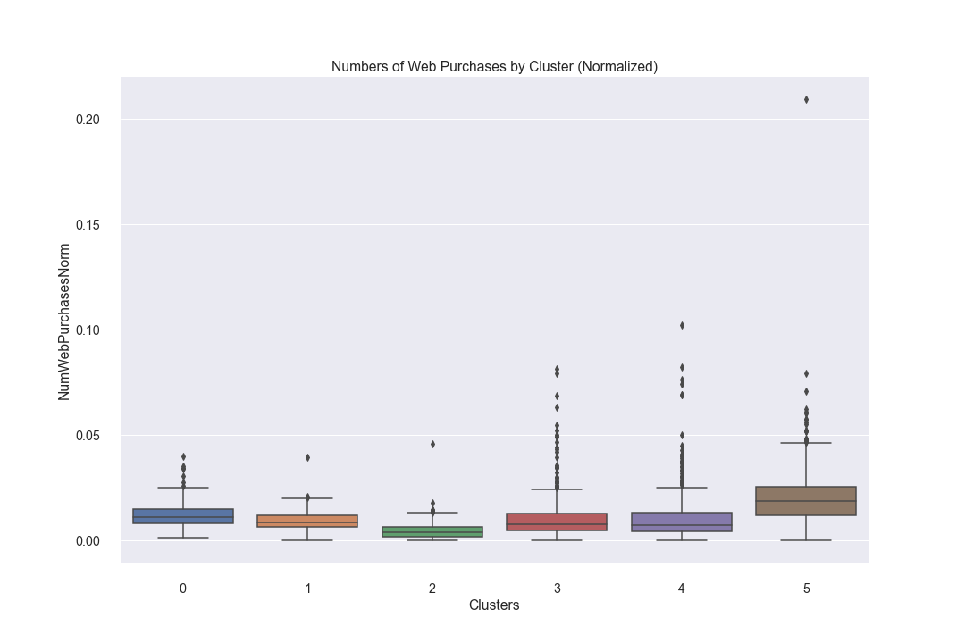
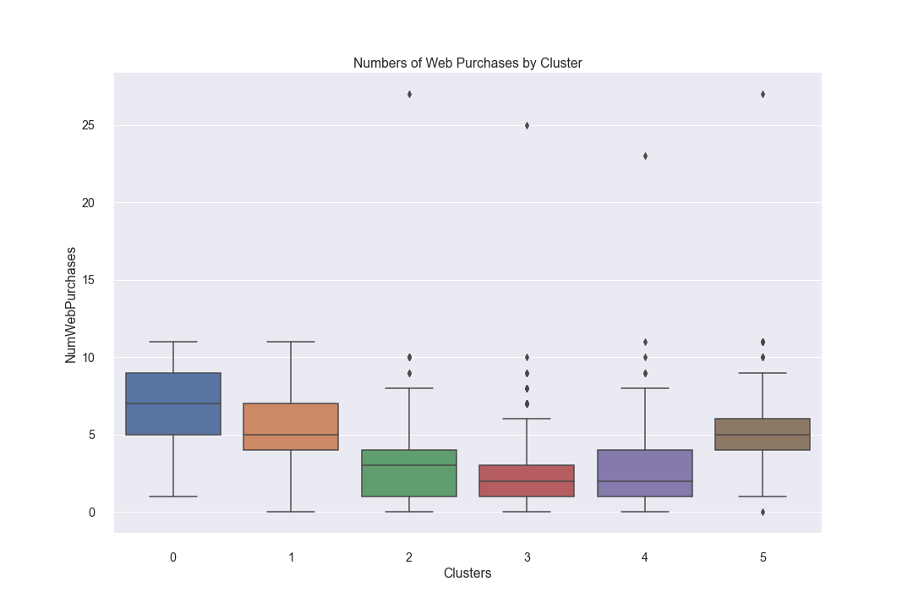
Purchase Channel (web)
When normalized, Cluster 5 shops on the web more than the other clusters. Concentrate on making/keeping the web page appealing.
Clusters 0 and 1 follow

Slide 23
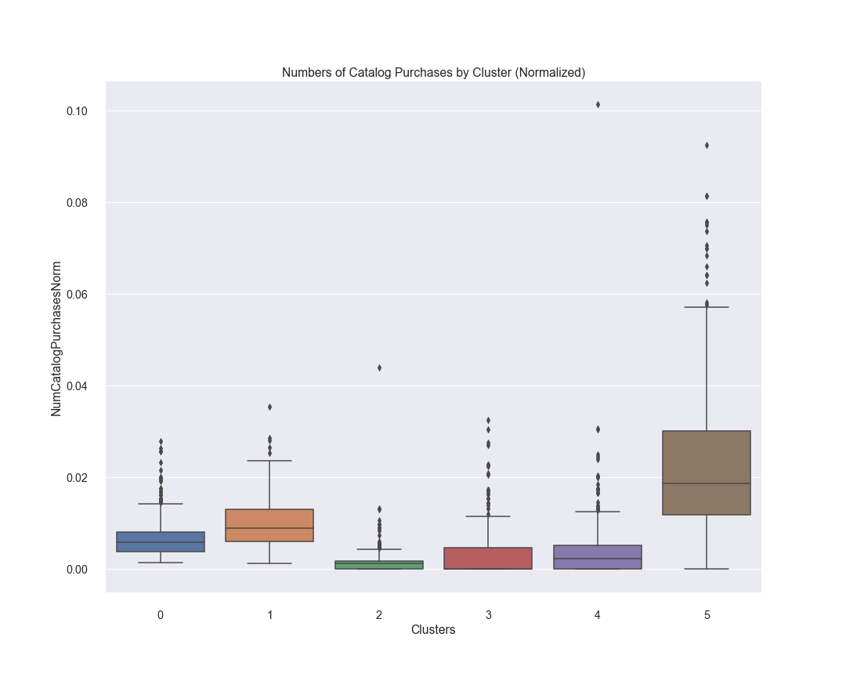
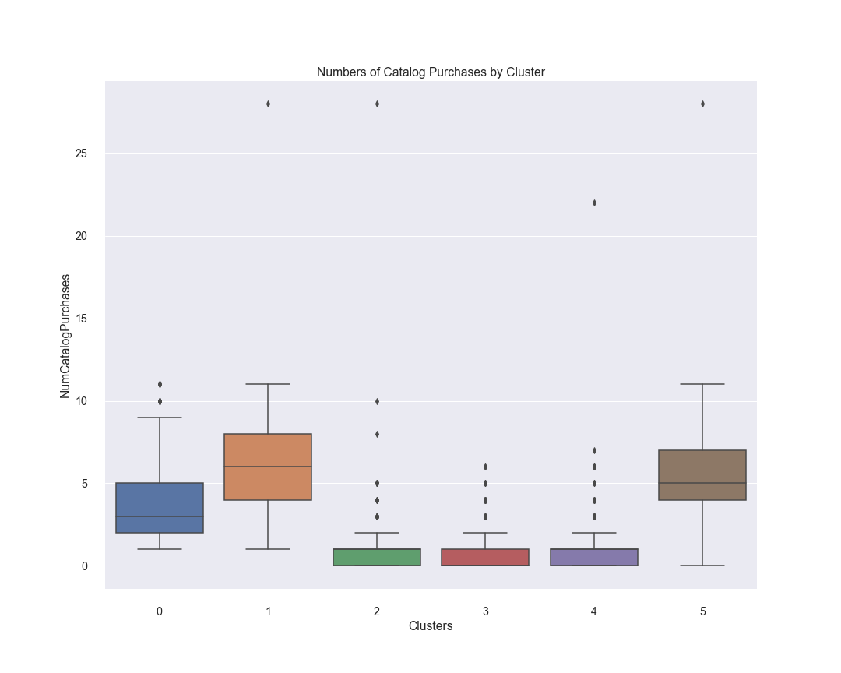
Purchase Channel (Catalog)
When normalized, Cluster 5 shops via catalog more than the other clusters. Make sure to have a polished catalog.
Clusters 1 and 0 follow

Slide 24
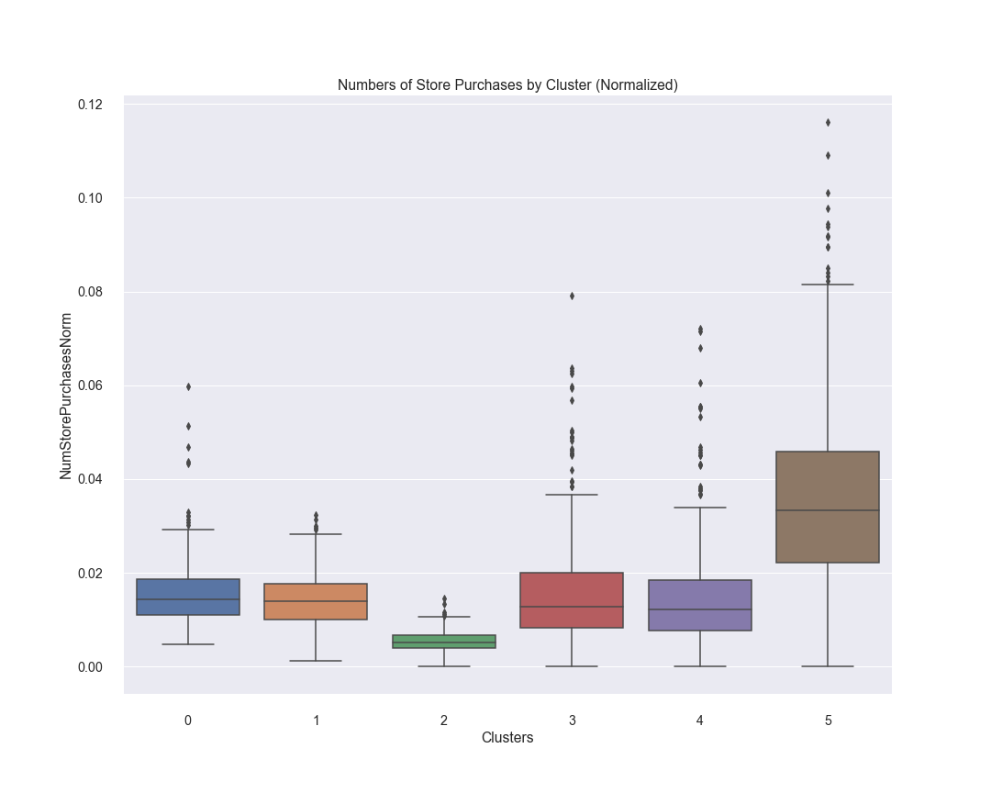
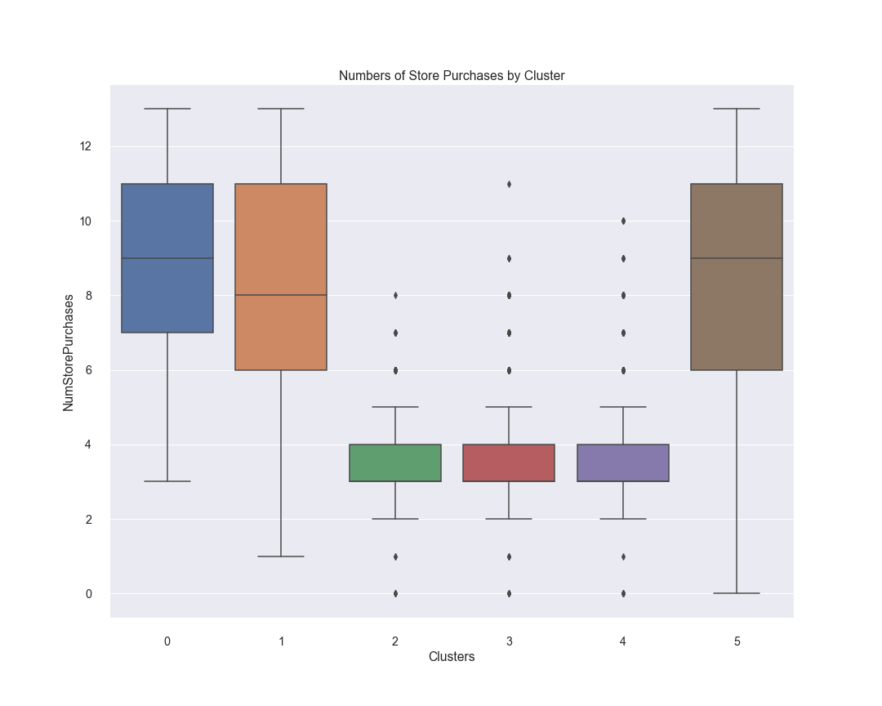
Purchase Channel (Store)
Cluster 5 has a strong propensity to shopping in store, buying more than any other cluster and about as much as they buy using the catalog and web combined. Make these customers’ in-store experience customers pleasant.

Slide 25
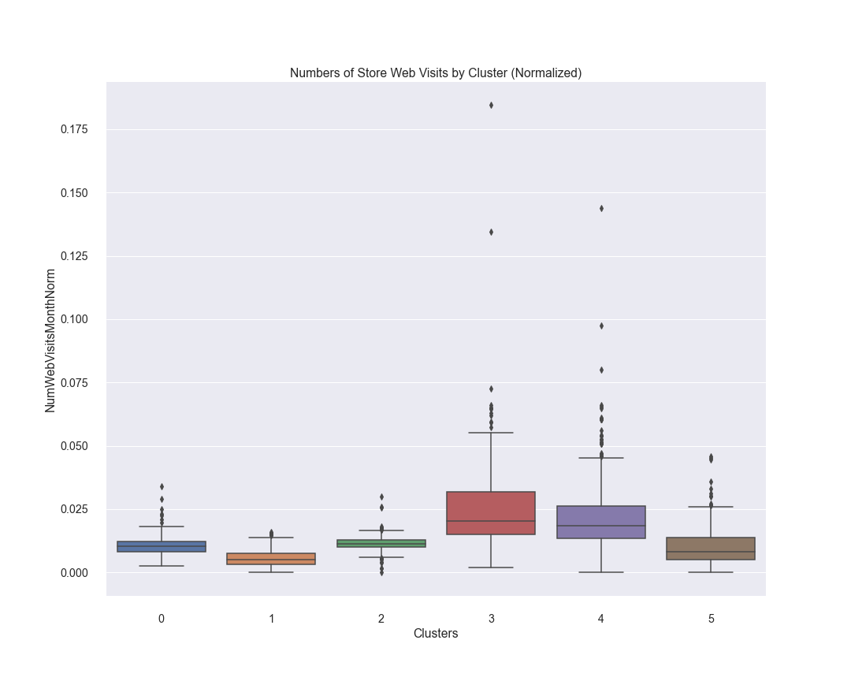
Web visits
Clusters 2-4 are the most active on the web when normalized by length as customers. Historically, Cluster 1 has also been active. Cluster 5 probably use the web with the intention of making a purchase rather than looking for deals. Do not worry about targeting online deals at them.

Slide 26
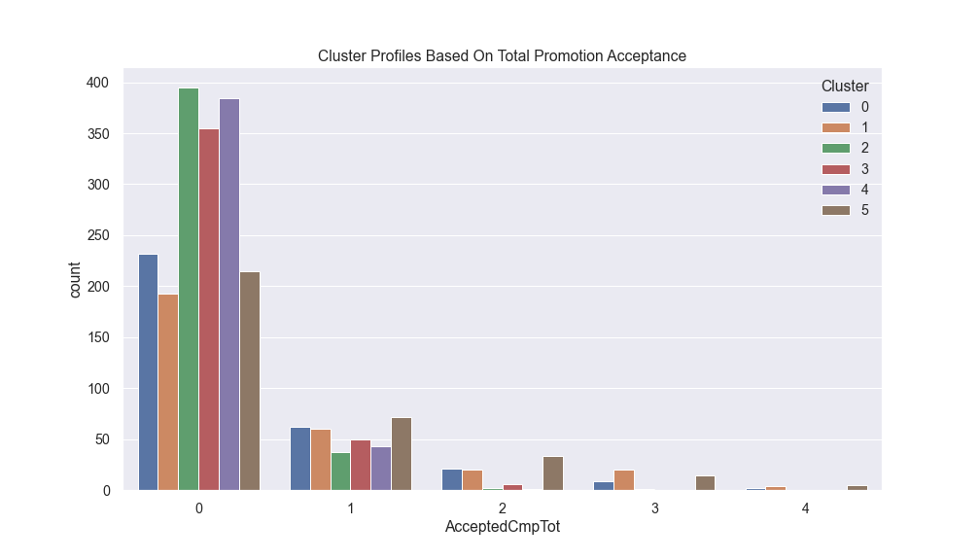
Campaign acceptance
Campaigns were moderately successful
No customer accepted all 5 campaigns

Slide 27
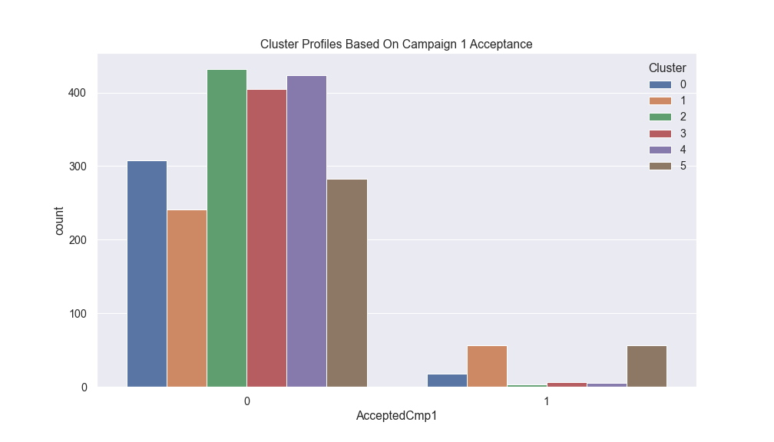
Campaign1 acceptance
Campaign 1 was most successful with Clusters 1 and 5
Try to replicate this campaign if want to attract those customers

Slide 28
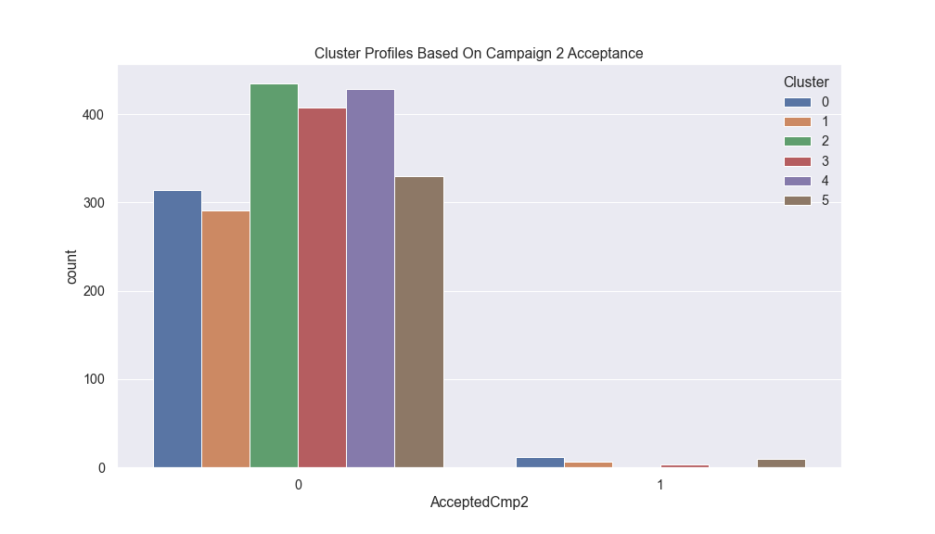
Campaign 2 acceptance
Campaign 2 had a very low response rate
Learn from this campaign in order not to repeat it

Slide 29
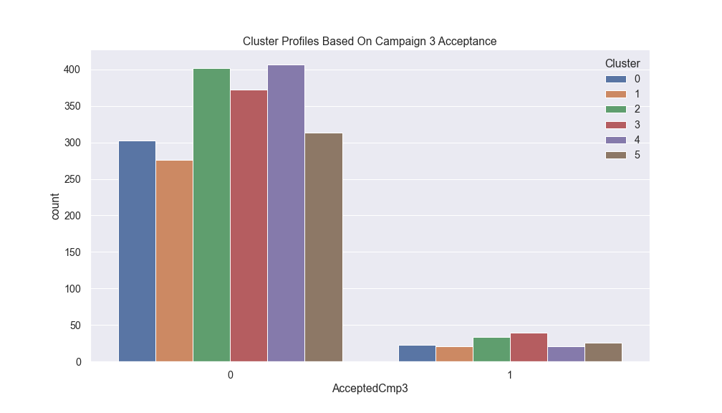
Campaign 3 acceptance
Campaign 3 was particularly successful with Clusters 2 and 3
Target campaigns like this at these customers

Slide 30
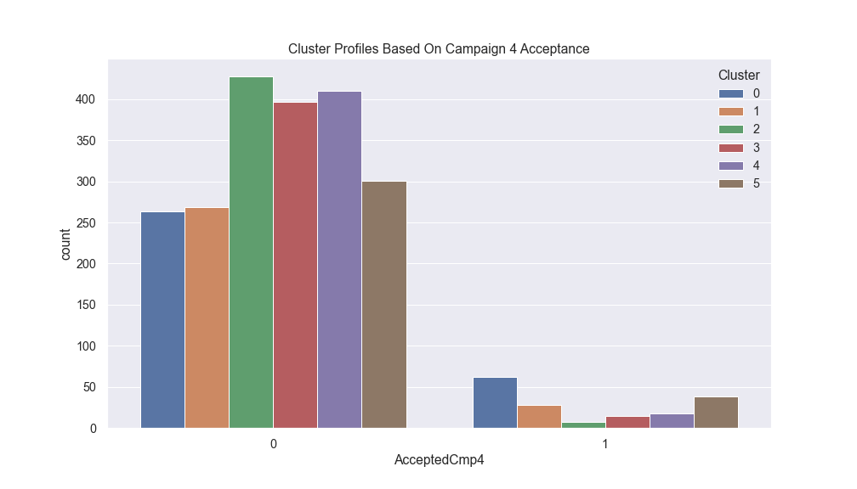
Campaign 4 acceptance
Campaign 4 was particularly successful with Clusters 0, which is a high-potential cluster
Replicate the best parts of this campaign to attract those clusters

Slide 31
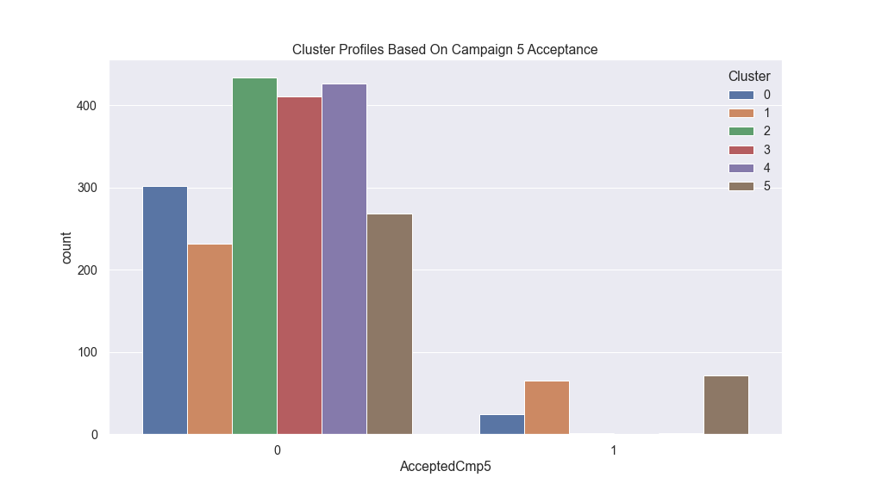
Campaign 5 acceptance
Like Campaign 1, Campaign 5 was particularly successful with Clusters 1 and 5
The store had a good idea with these campaigns
Improve campaigns like this one to attract even more such customers

Slide 32
Summary of findings

Slide 33
Notes
MinMax vs NormalScaler

Slide 34
Appendix
MinMax vs NormalScaler
DBSCAN

Slide 35
Contents
Definition and brief explanation
History
Criticisms
Market segmentation strategy
Segmentation, targeting, positioning
Identifying the market to be segmented
Bases for segmenting consumer markets
Selecting target markets
Developing the marketing program and positioning strategy
Basis for segmenting business markets
Use in customer retention
Segmentation: algorithms and approaches
Companies (proprietary segmentation databases)

Slide 36
Definition and brief explanation

Slide 37
History

Slide 38
Criticisms

Slide 39
Market segmentation strategy

Slide 40
Segmentation, targeting, positioning

Slide 41
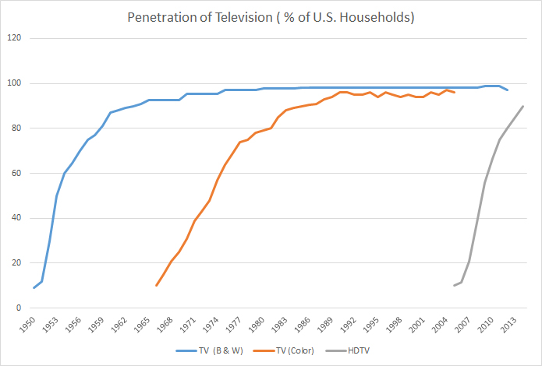
Identifying the market to be segmented

Slide 42
Bases for segmenting consumer markets
Look in the slide notes below for topics to consider talking about
Notes:
Consider talking about:
Geographic segmentation
Demographic segmentation
Psychographic segmentation
Behavioural segmentation
Other types of consumer segmentation

Slide 43
Selecting target markets
Look in the slide notes below for topics to consider talking about
Notes:
Consider talking about:
Criteria for evaluating segment attractiveness

Slide 44
Developing the marketing program and positioning strategy

Slide 45
Basis for segmenting business markets

Slide 46
Use in customer retention

Slide 47
Segmentation: algorithms and approaches
Look in the slide notes below for topics to consider talking about
Notes:
Consider talking about:
A-priori segmentation
Post-hoc segmentation
Statistical techniques used in segmentation
Data sources used for segmentation

Slide 48
Companies (proprietary segmentation databases)

Slide 49
Works cited

