Slide 1
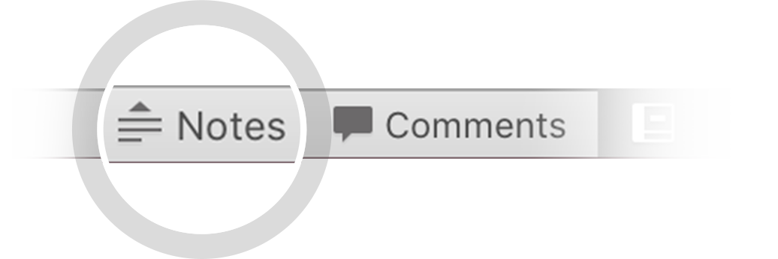
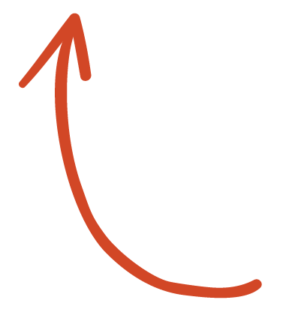
Here's your outline to get started
Key facts about your topic
Market segmentation is the activity of dividing a broad consumer or business market, normally consisting of existing and potential customers, into sub-groups of consumers based on some type of shared characteristics.
See more: Open the Notes below for more information.
Notes:
QuickStarter has created an outline to help you get started on your presentation. Some slides include information here in the notes to provide additional topics for you to research.

Slide 2
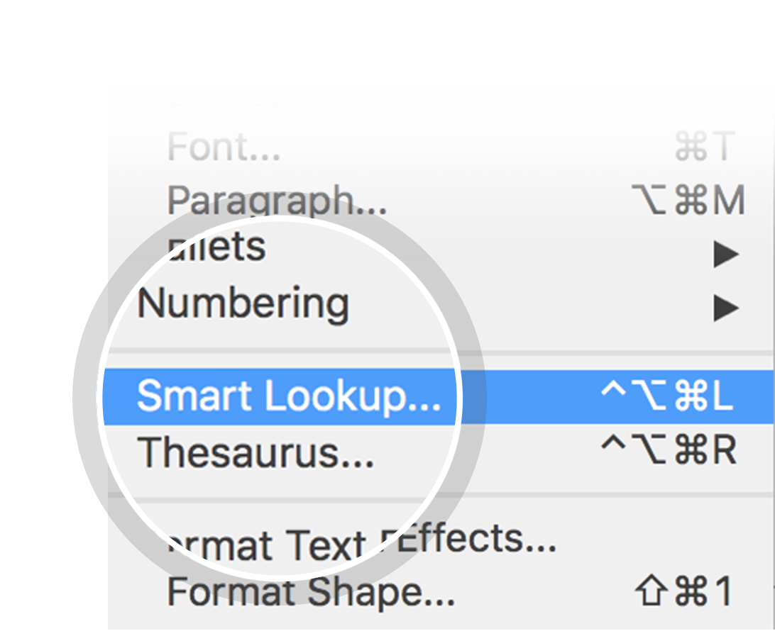
Related topics to research
Positioning
Target market
Marketing
Psychographic segmentation
Niche market
Distribution
Marketing communications
Pricing
Promotion
Mass marketing
Use Smart Lookup to learn more
1
Highlight one of the related topics
Right-click on the topic
Choose "Smart Lookup"
2
3

Slide 3
Market Segmentation

Slide 4
Data source and brief description
Data source: https://www.kaggle.com/datasets/imakash3011/customer-personality-analysis or https://www.kaggle.com/datasets/jackdaoud/marketing-data?select=ifood_df.csv. Provided by Dr. Omar Romero-Hernandez of UC Berkeley
2240 individual observations on
Customer characteristics (year of birth, education, income, number of children, etc.)
Products (aggregated amounts spent of wines, fruit, sweets, etc.)
Promotion acceptance for 5 campaigns
Number of purchases done on the web, using catalog, or in store, as well as the total number of web visits
Some missing income observations and extreme outliers in income and age

Slide 5
Key questions
Who are the customers that bring the most revenue to the company?
Who are the customers who could bring more revenue to the company?
To which campaigns do these customers respond?
Where do different groups of customer shop? (in store, online, over catalog)
Any additional business insights about the customers?

Slide 6
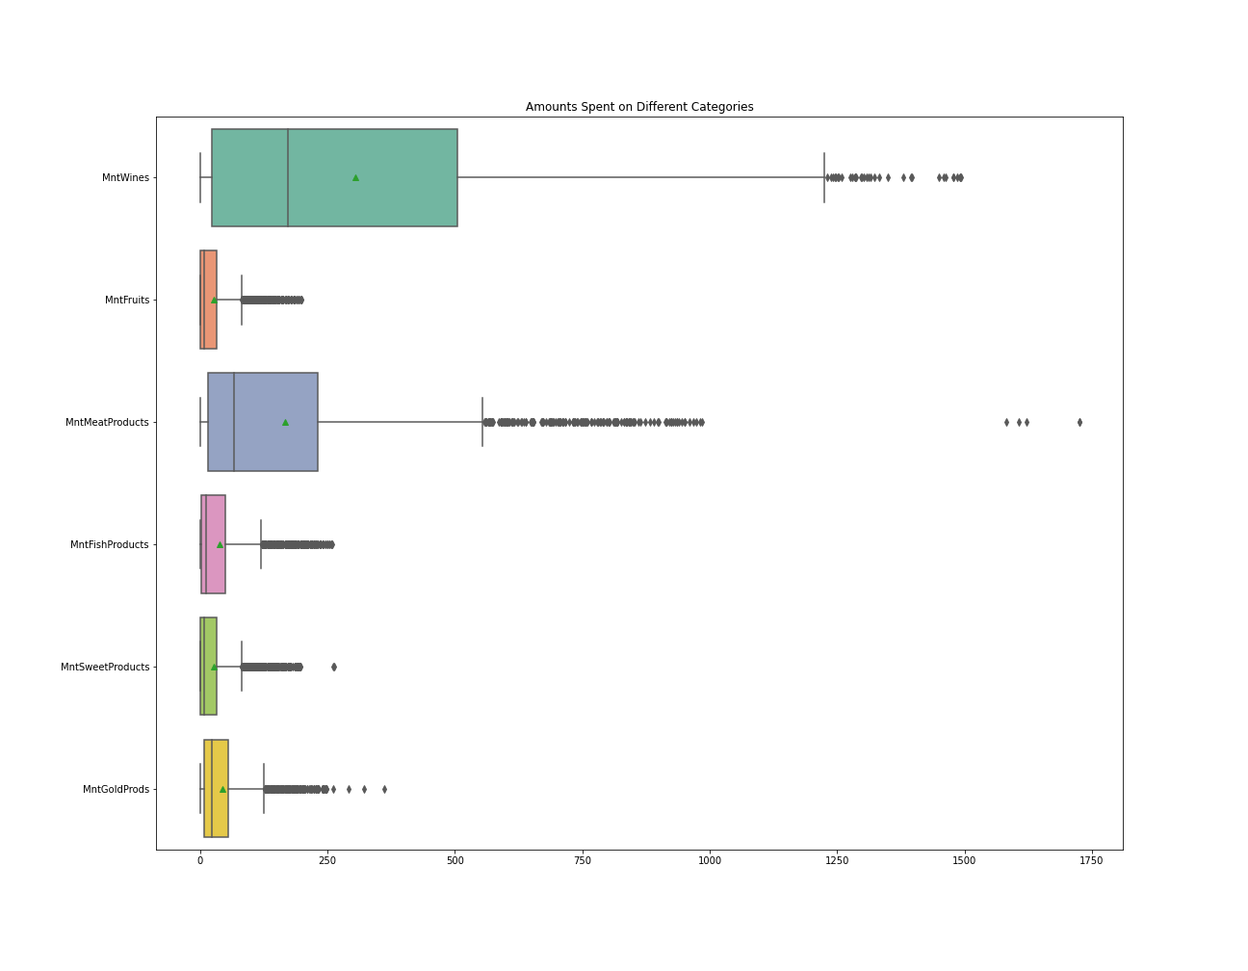
Amounts spent by category
High spending on wines and meat
Spending amounts are skewed to the right for all categories
Questions: What can we say about the spending patterns of different groups of customers?

Slide 7
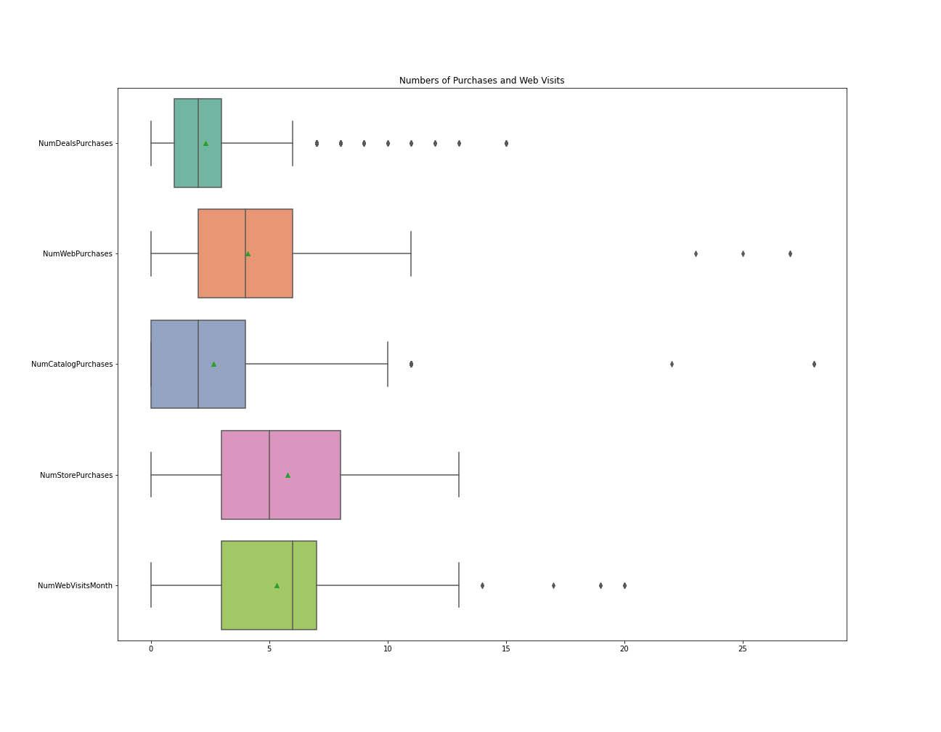
Numbers of purchases by medium
Customers shopping in store make the greatest median number of purchases, followed by web and catalog purchases
High median number of monthly web visits
Questions: Who shops in store? who shops on the web? Who uses the catalog?

Slide 8
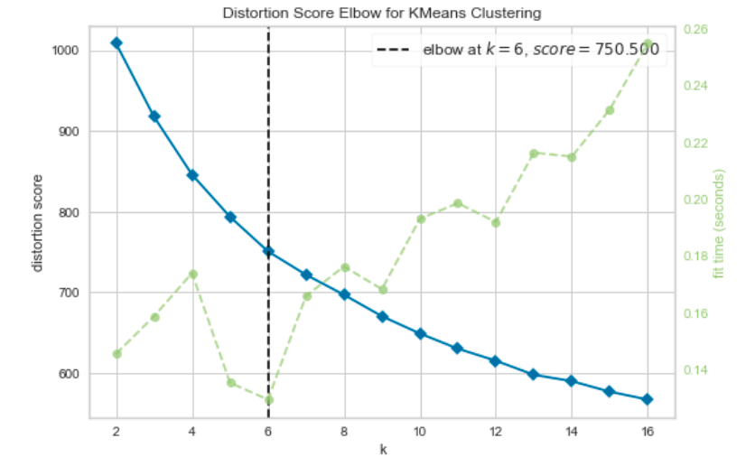
Kmeans clustering algorithm
Select k as the number of groups to cluster for
Randomly pick k points in the data as centroid points
Assign each non-centroid point to its closest centroid
Recalculate centroid points by taking the average of all surrounding points assigned to that cluster
Repeat steps 3-4 until calculated centroid points do not move anymore.

Slide 9
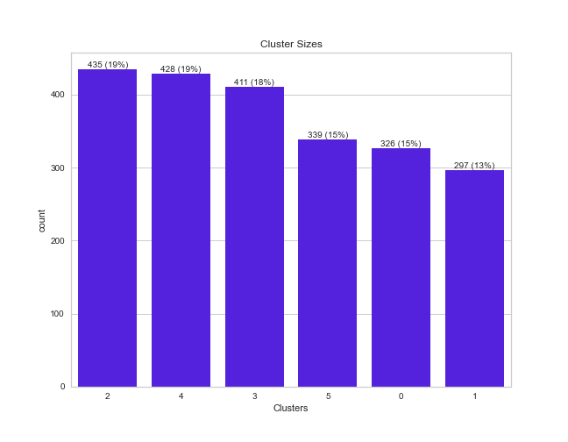
Cluster sizes
2 and 4 are the biggest clusters
Q: Will they bring in the most revenue?

Slide 10
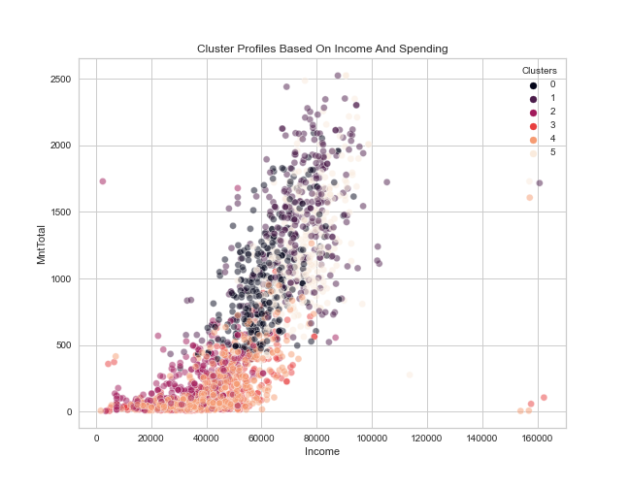
Cluster profiles based on income and spending
A: Possibly not, as this look at income and spending for various clusters indicates

Slide 11
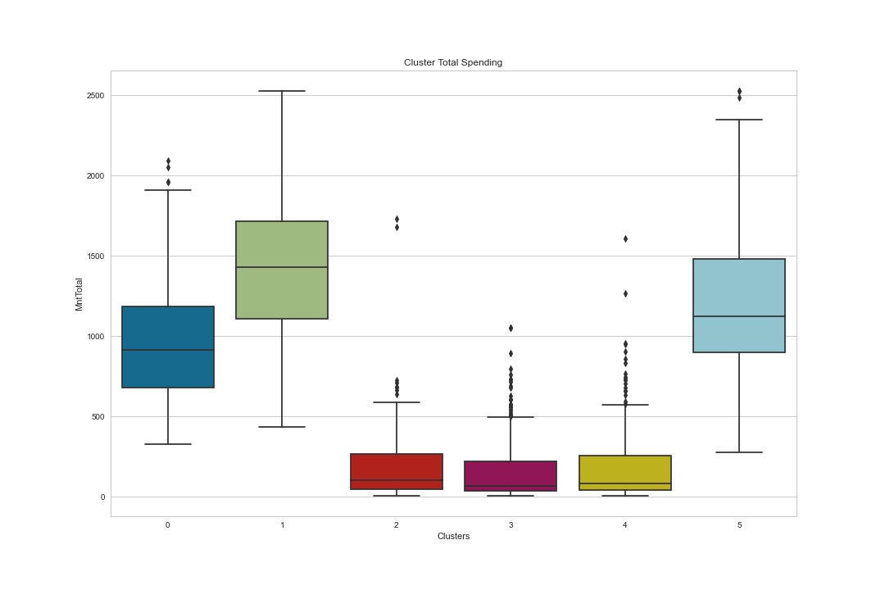
Total Spending by cluster
Cluster 1 customers spend the most, followed by Cluster 5 and 0 customers

Slide 12
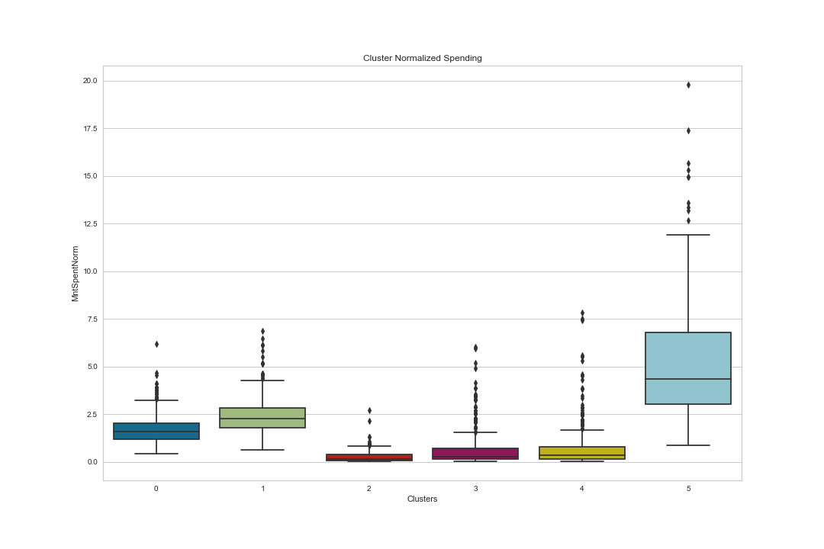
Cluster normalized Spending
When normalized by length spent as customer, Cluster 5 customers spend much more than Cluster 1 customers!
Cluster 0 customers follow
These patterns hold by category as well (wine, meats, etc.)

Slide 13
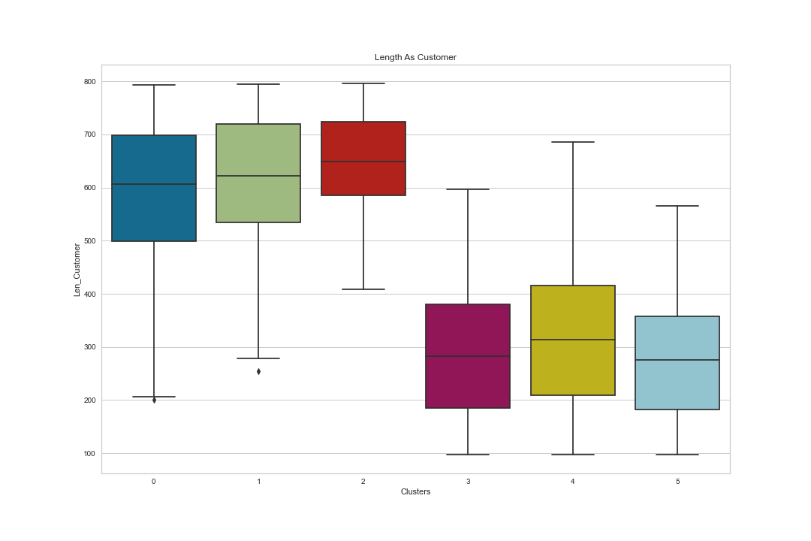
Length as customer
Cluster 5 customers are more recent, along with those in clusters 3 and 4
Cluster 1 customers are loyalty customers, along with those in clusters 0 and 3

Slide 14
Cluster profile by education and Number of children Cluster 5 customers are More likely to have at least one child and are even more highly educated than cluster
C

Slide 15
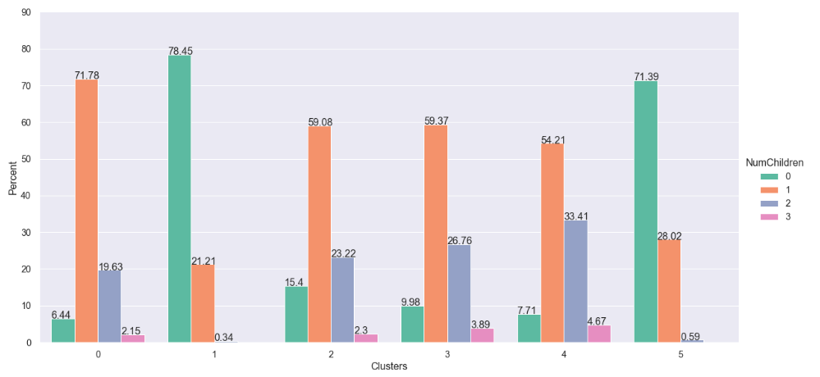
Length as customer
Cluster 5 customers are more recent, along with those in clusters 3 and 4
Cluster 1 customers are loyalty customers, along with those in clusters 0 and 3

Slide 16
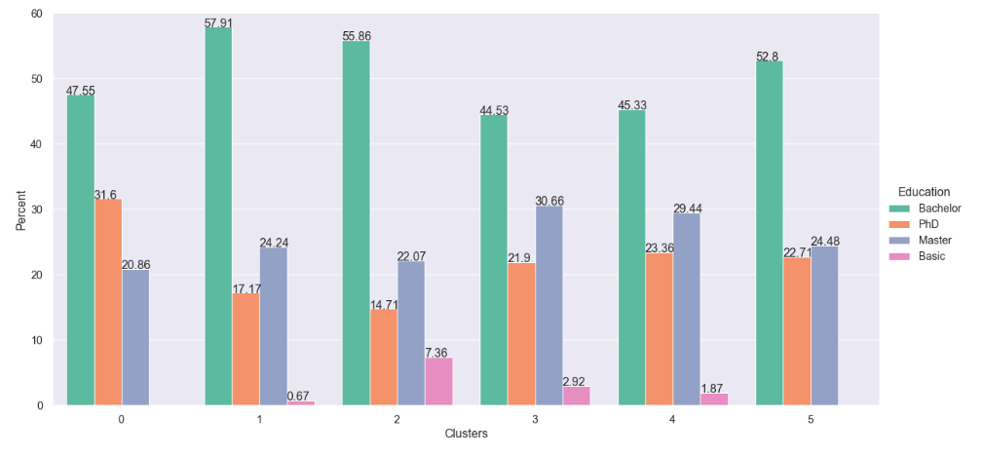
Length as customer
Cluster 5 customers are more recent, along with those in clusters 3 and 4
Cluster 1 customers are loyalty customers, along with those in clusters 0 and 3

Slide 17
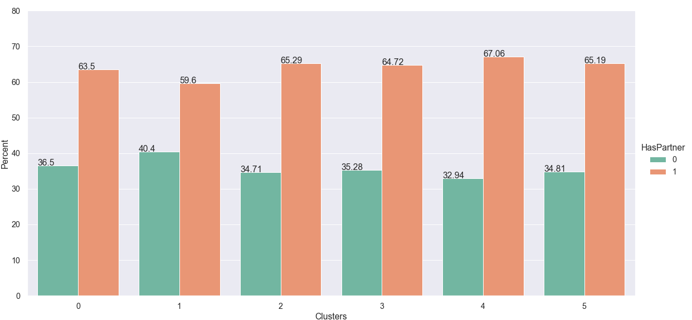
Length as customer
Cluster 5 customers are more recent, along with those in clusters 3 and 4
Cluster 1 customers are loyalty customers, along with those in clusters 0 and 3

Slide 19
Deals

Slide 20
Purchase Medium

Slide 21
Accepted campaigns

Slide 24
Summary of findings

Slide 25
Contents
Definition and brief explanation
History
Criticisms
Market segmentation strategy
Segmentation, targeting, positioning
Identifying the market to be segmented
Bases for segmenting consumer markets
Selecting target markets
Developing the marketing program and positioning strategy
Basis for segmenting business markets
Use in customer retention
Segmentation: algorithms and approaches
Companies (proprietary segmentation databases)

Slide 26
Definition and brief explanation

Slide 27
History

Slide 28
Criticisms

Slide 29
Market segmentation strategy

Slide 30
Segmentation, targeting, positioning

Slide 31
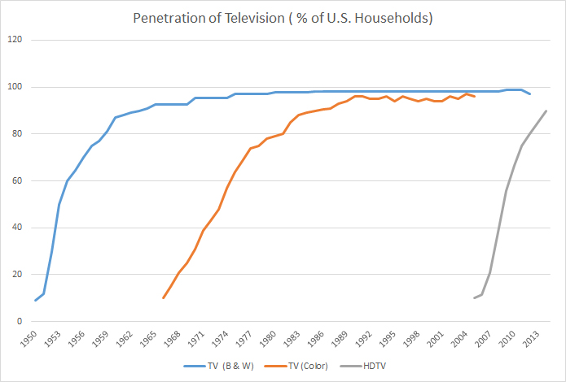
Identifying the market to be segmented

Slide 32
Bases for segmenting consumer markets
Look in the slide notes below for topics to consider talking about
Notes:
Consider talking about:
Geographic segmentation
Demographic segmentation
Psychographic segmentation
Behavioural segmentation
Other types of consumer segmentation

Slide 33
Selecting target markets
Look in the slide notes below for topics to consider talking about
Notes:
Consider talking about:
Criteria for evaluating segment attractiveness

Slide 34
Developing the marketing program and positioning strategy

Slide 35
Basis for segmenting business markets

Slide 36
Use in customer retention

Slide 37
Segmentation: algorithms and approaches
Look in the slide notes below for topics to consider talking about
Notes:
Consider talking about:
A-priori segmentation
Post-hoc segmentation
Statistical techniques used in segmentation
Data sources used for segmentation

Slide 38
Companies (proprietary segmentation databases)

Slide 39
Works cited

