Slide 1
Customer Segmentation
Maximizing revenue and judging campaign effectiveness

Slide 2
Data source and brief description
Data source: https://www.kaggle.com/datasets/imakash3011/customer-personality-analysis or https://www.kaggle.com/datasets/jackdaoud/marketing-data?select=ifood_df.csv. Provided by Dr. Omar Romero-Hernandez of UC Berkeley
2240 individual observations on
Customer characteristics (year of birth, education, income, number of children, etc.)
Products (aggregated amounts spent of wines, fruit, sweets, etc.)
Promotion acceptance for 5 campaigns
Number of purchases done on the web, using catalog, or in store, as well as the total number of web visits
Span 796 days (2012-2014)
Some missing income observations and extreme outliers in income and age

Slide 3
Key questions
Who are the customers that bring the most revenue to the company?
Who are the customers who could bring more revenue to the company?
To which campaigns do these customers respond?
Where do different groups of customer shop? (in store, online, over catalog)
Any additional business insights about the customers?

Slide 4
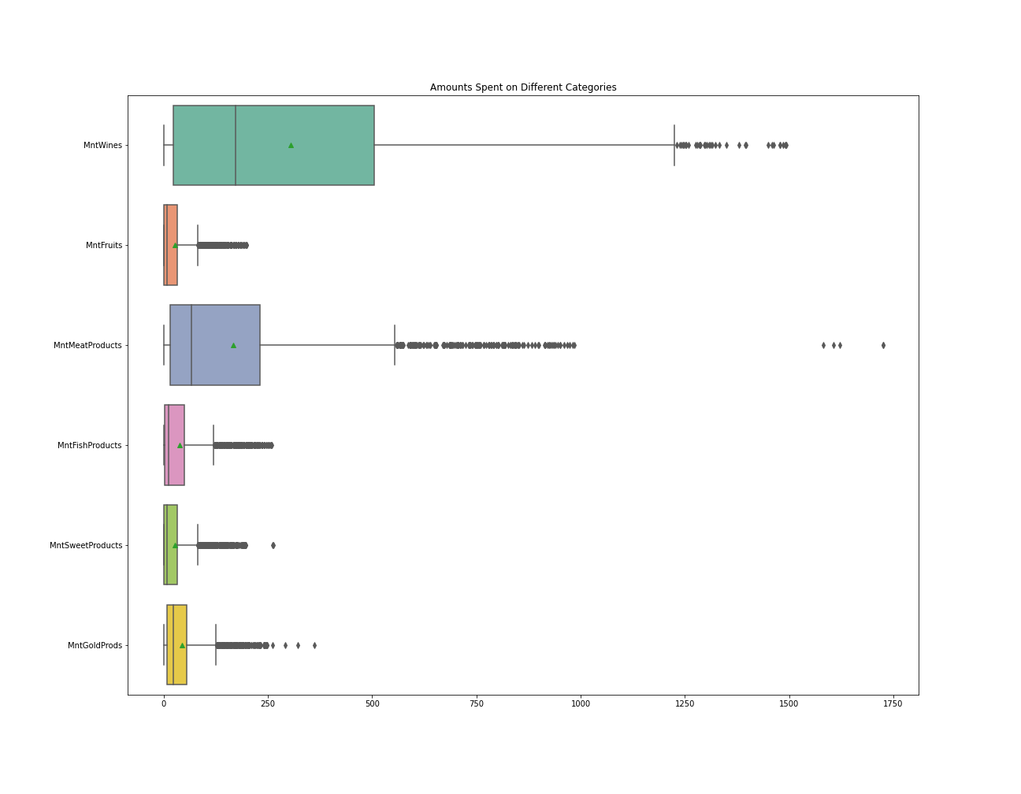
Amounts spent by category
High spending on wines and meat
Spending amounts are skewed to the right for all categories
Questions: What can we say about the spending patterns of different groups of customers?

Slide 5
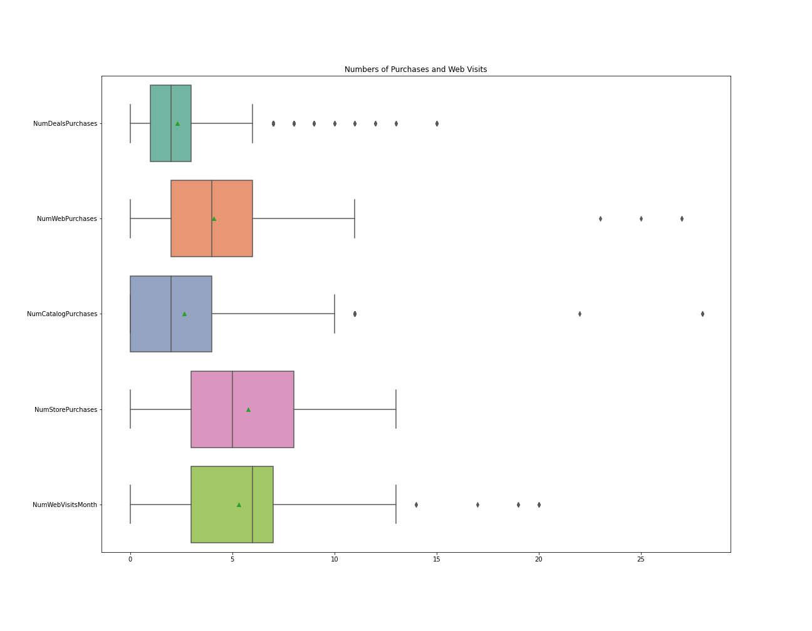
Numbers of purchases by medium
Customers shopping in store make the greatest median number of purchases, followed by web and catalog purchases
High median number of monthly web visits
Questions: Who shops in store? Who shops on the web? Who uses the catalog?

Slide 6
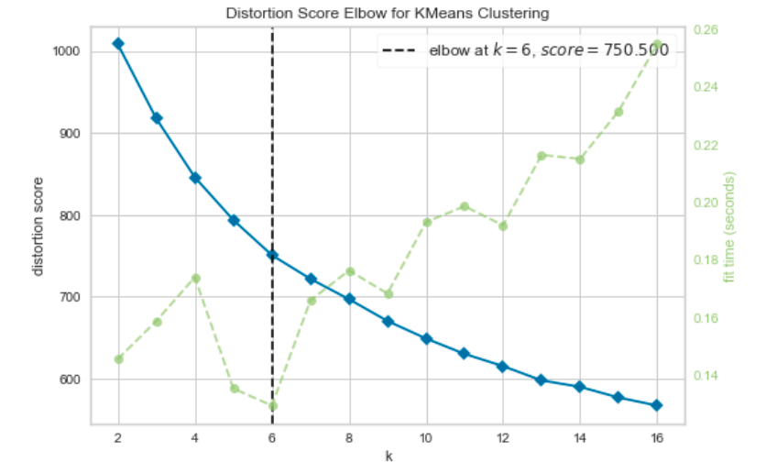
Kmeans clustering algorithm
Select k as the number of groups to cluster for.
Randomly pick k points in the data as centroid points.
Assign each non-centroid point to its closest centroid.
Recalculate centroid points by taking the average of all surrounding points assigned to that cluster.
Repeat steps 3-4 until calculated centroid points do not move anymore.
Good explanation at https://www.youtube.com/watch?v=hDmNF9JG3lo&ab_channel=ArtificialIntelligence-AllinOne

Slide 7
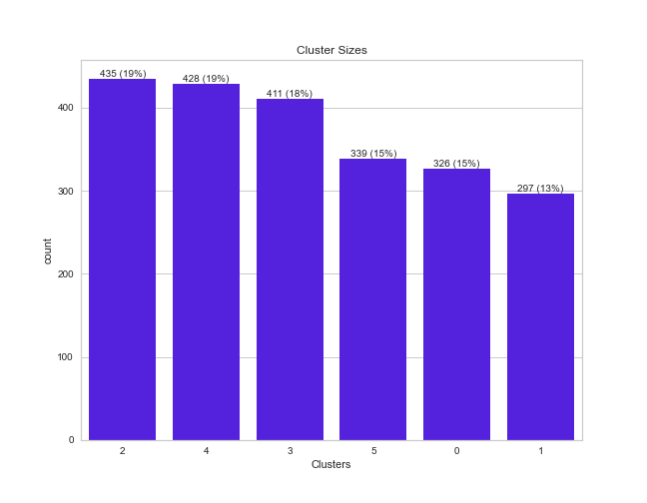
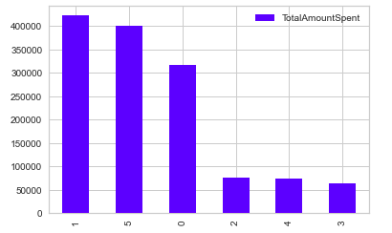
Cluster sizes and revenues
2 and 4 are the biggest clusters
Clusters 1, 5, and 0 spend much more than the other clusters

Slide 8
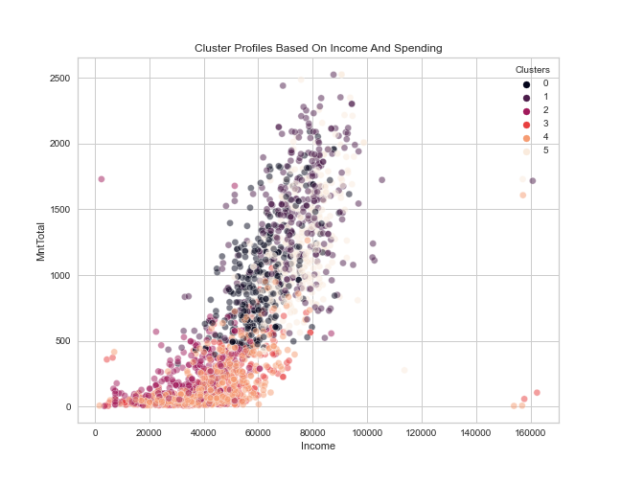
Cluster profiles based on income and spending
A: Possibly not, as this look at income and spending for various clusters indicates

Slide 9
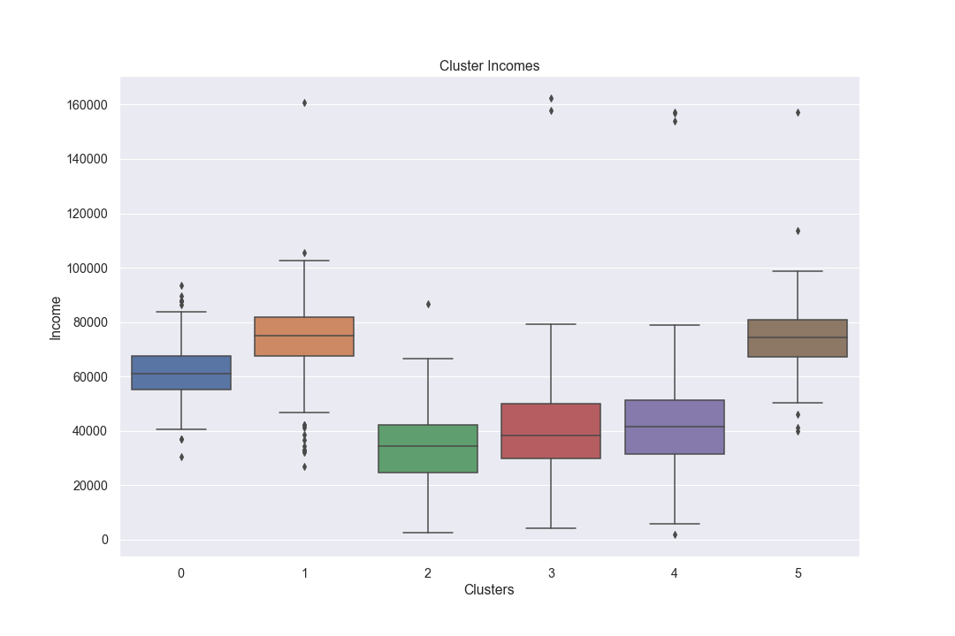
Clusters by income
Clusters 5 and 1 have the highest incomes, followed by Cluster 0.
Clusters 2-4 have below median income for all customers.

Slide 10
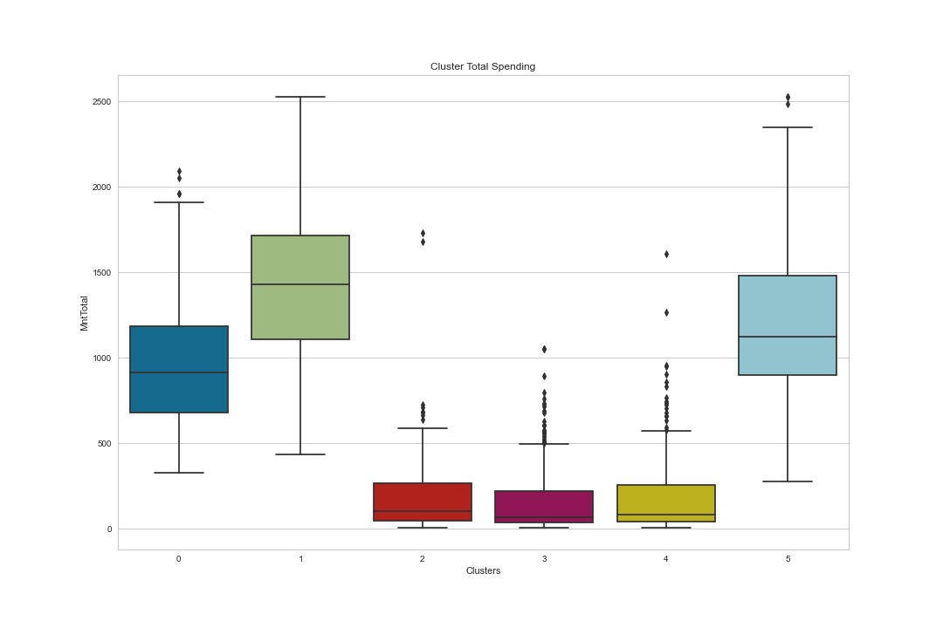
Total Spending by cluster
Cluster 1 customers spend the most, followed by Cluster 5 and 0 customers

Slide 11
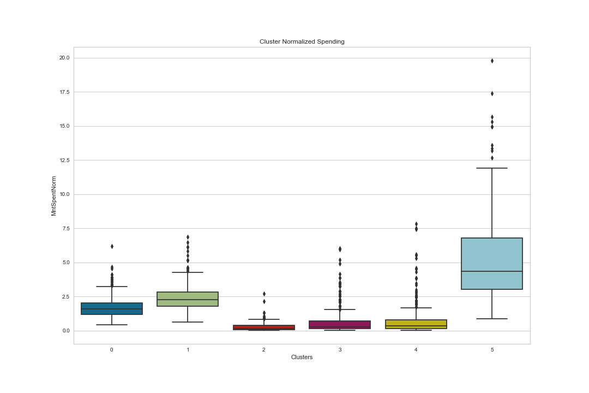
Cluster normalized Spending
When normalized by length spent as customer, Cluster 5 customers spend much more than Cluster 1 customers!
Cluster 0 customers follow
These patterns hold by category as well (wine, meats, etc.)

Slide 12
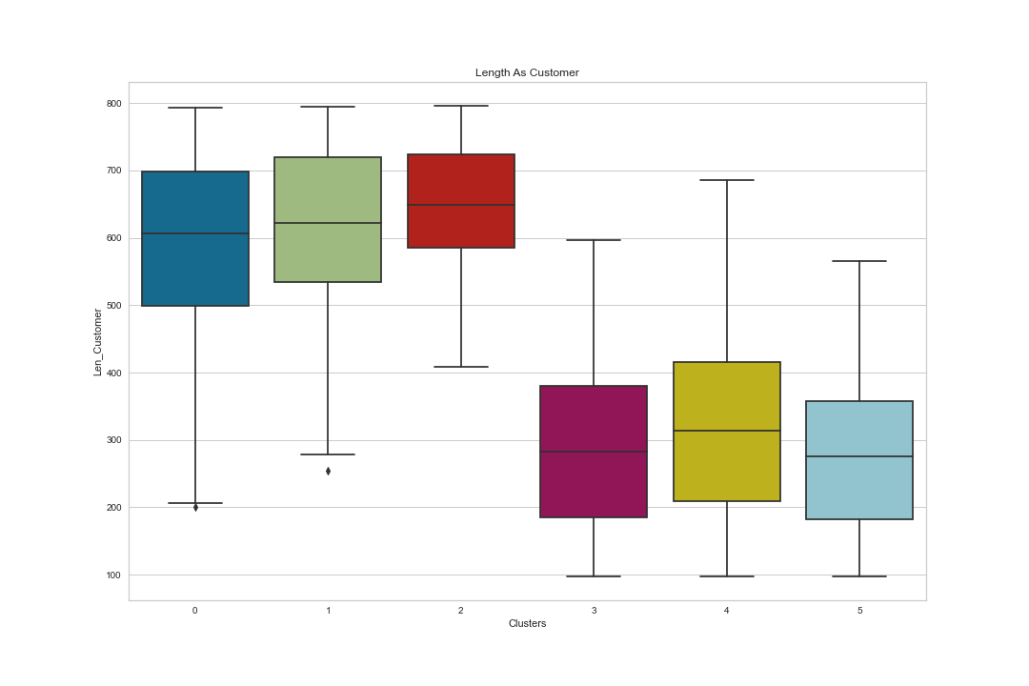
Length as customer
Cluster 5 customers are more recent, along with those in clusters 3 and 4
Cluster 1 customers are loyalty customers, along with those in clusters 0 and 3

Slide 13
Clusters by number of children
Cluster 5 customers are slightly more likely to have at least once child than Cluster 1
Over 90% of Cluster 1 customers have at least 1 child, which could explain their lower spending

Slide 14
Clusters by number of children
Cluster 5 customers are more likely to have at least once child than Cluster 1
Over 90% of Cluster 1 customers have at least 1 child, which could explain their lower spending

Slide 15
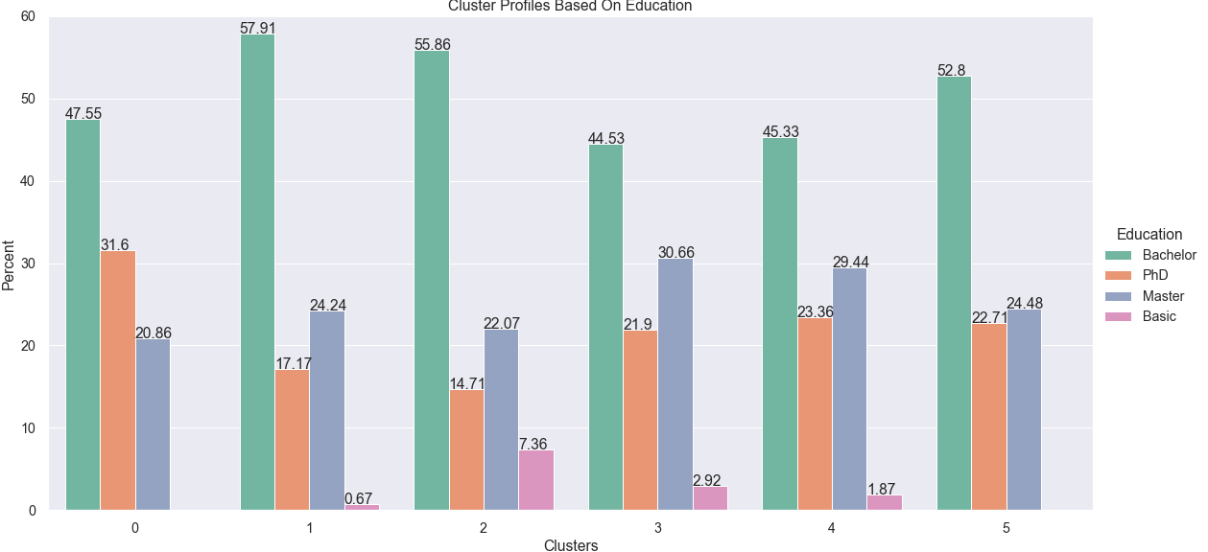
Clusters by Education
Cluster 5 have more advanced degrees than Cluster 1
Cluster 1 customers have the most PhDs, but probably have less disposable income due to having more children

Slide 16
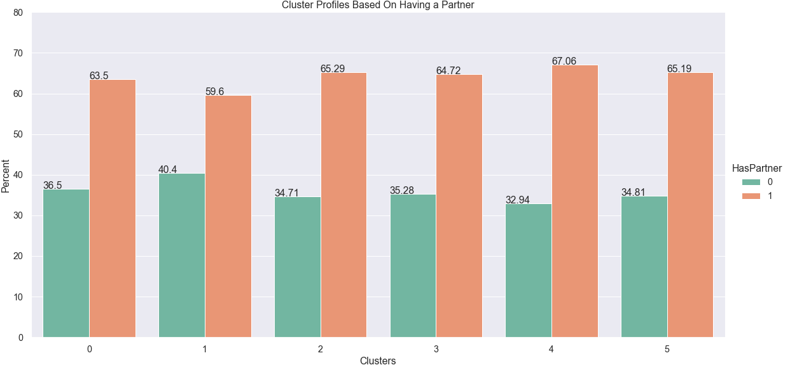
Clusters Based on having a partner
Clusters are similar in that respect, with Cluster 4 customers most likely to have a partner and Cluster 1 least likely

Slide 17
Cluster characteristics summary
Clusters 1 and 5 are the high spenders with high income. Cluster 1 consists of loyalty customers but Cluster 5 customers spend the most per day. Apart from time spent as customers, they are similar in most key dimensions, with Cluster 1 being slightly better educated, having more children, and having slightly higher likelihood of having a partner.
Clusters 0-2 are the loyalty customers and Clusters 3-5 are the newer customers.
Cluster 1 customers also have higher than average income, but probably have less disposable income due to having children
Clusters 2-4 have lower income, are more likely to have children, and spend less

Slide 18
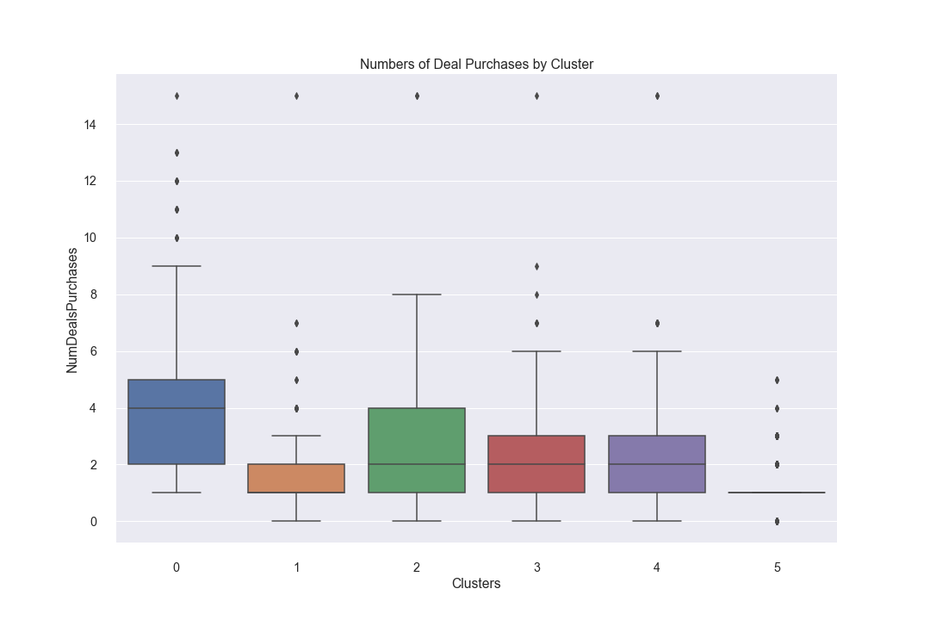
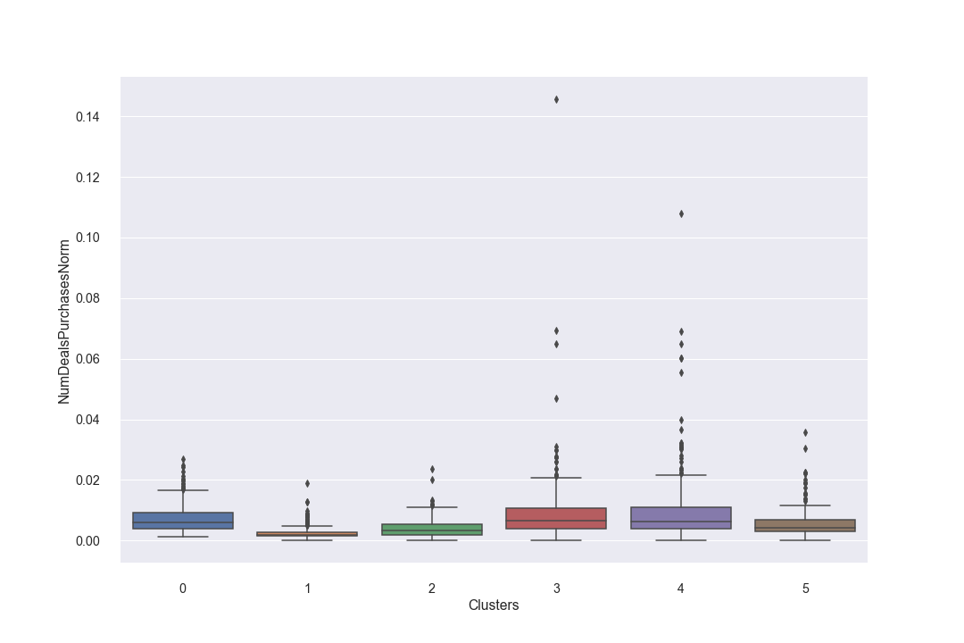
Deals
Takeaway: If we want to reach Cluster 0, target deals at that cluster
Clusters 1 and 5 are not very responsive to deals
Upon normalization, Clusters 2-4 are also responsive to deals. Target deals at these customers.

Slide 19
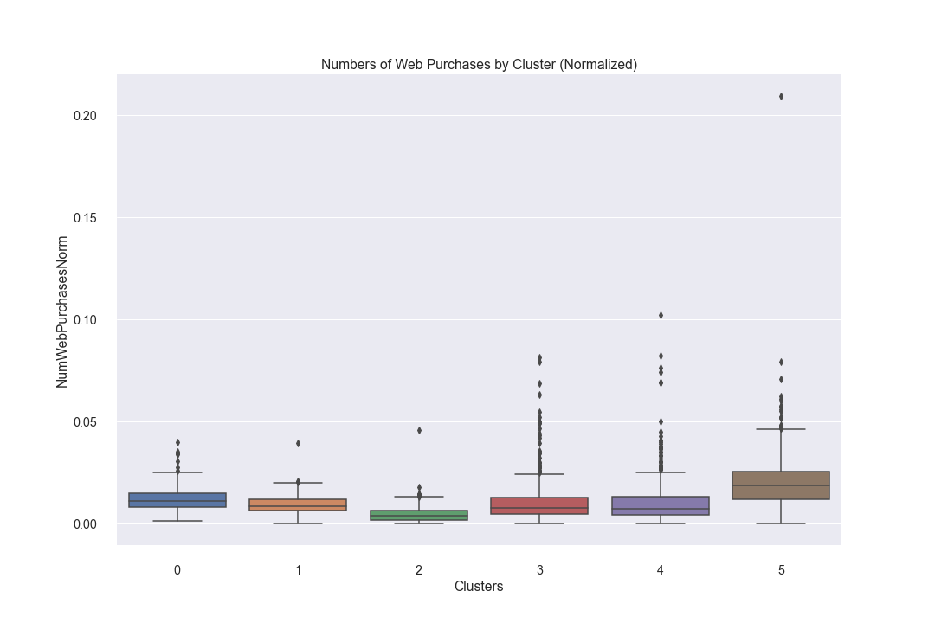
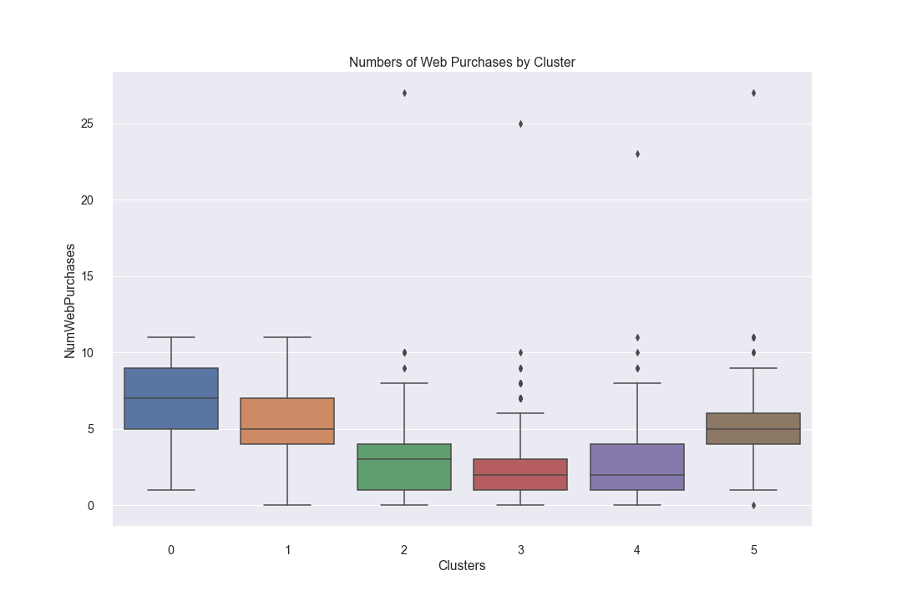
Purchase Channel (web)
When normalized, Cluster 5 shops on the web more than the other clusters. Concentrate on making/keeping the web page appealing.
Clusters 0 and 1 follow

Slide 20
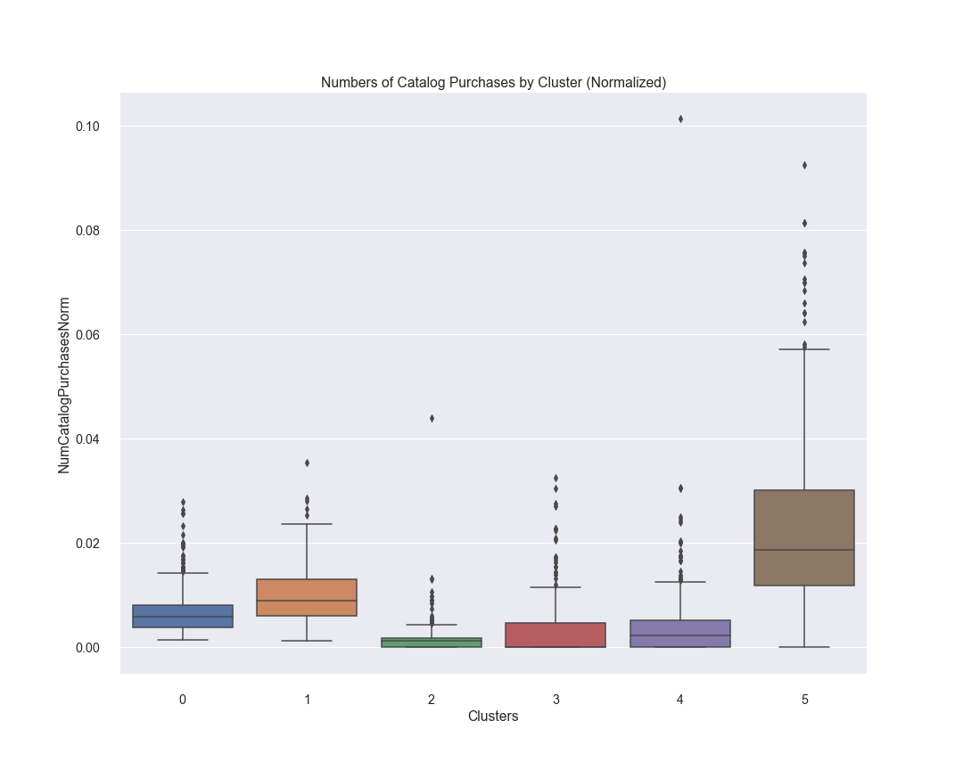
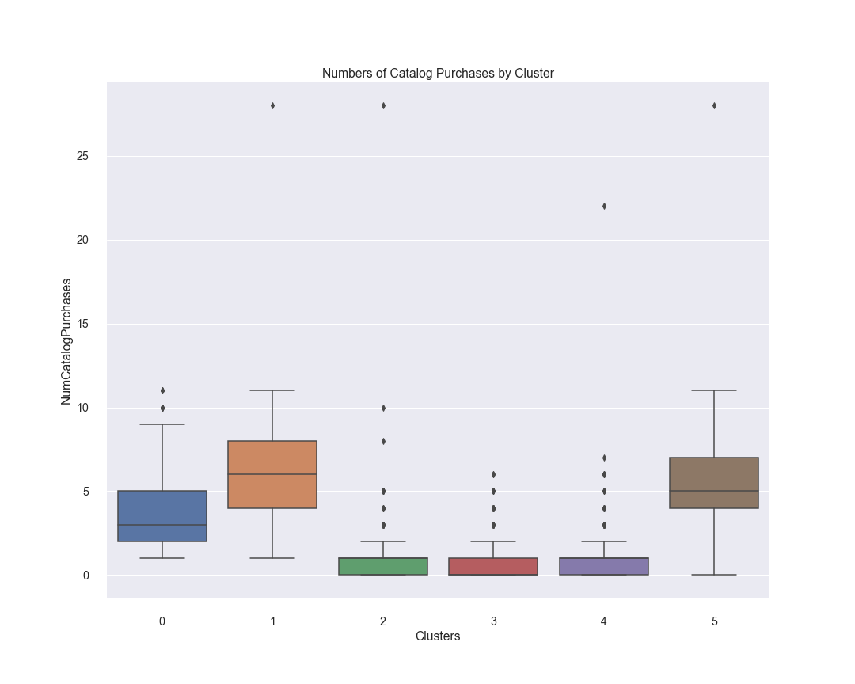
Purchase Channel (Catalog)
When normalized, Cluster 5 shops via catalog more than the other clusters. Make sure to have a polished catalog.
Clusters 1 and 0 follow

Slide 21
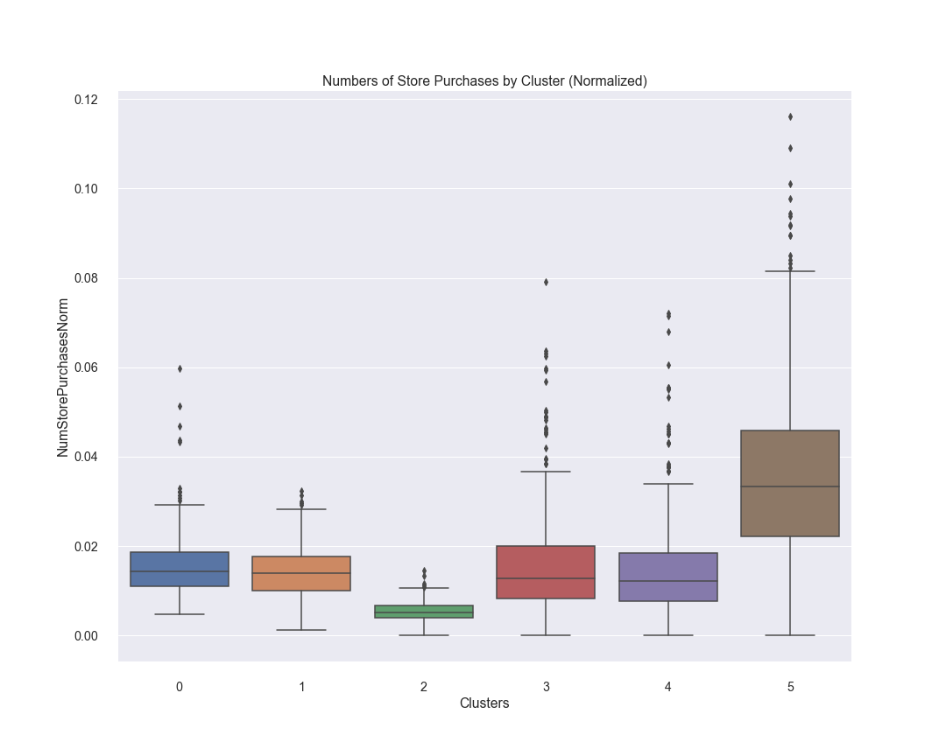
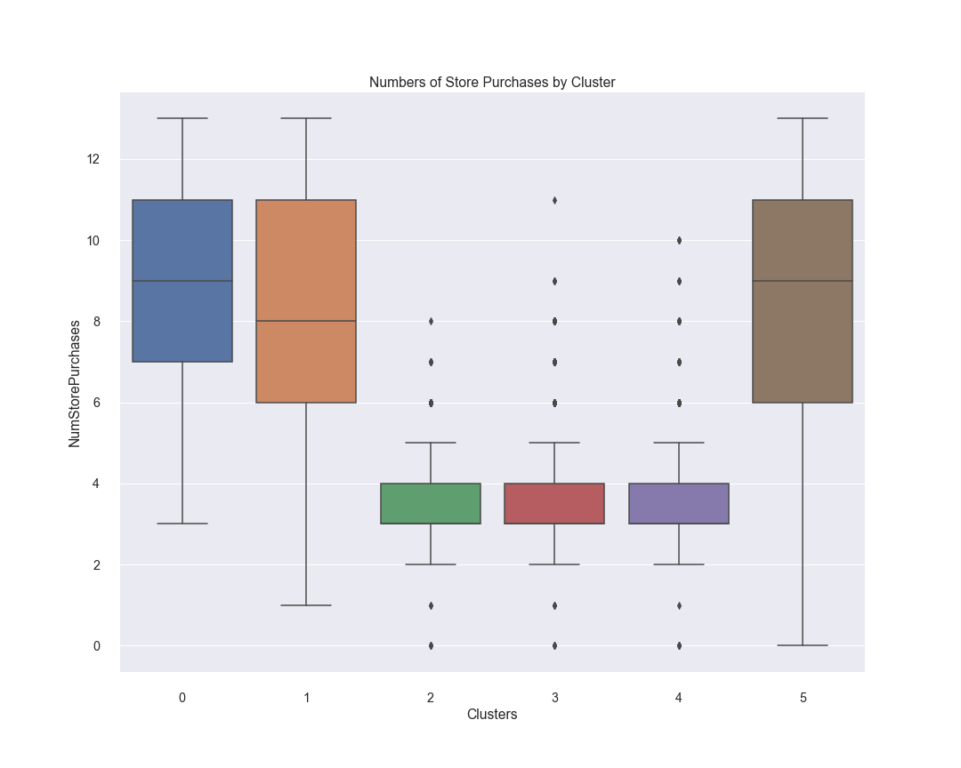
Purchase Channel (Store)
Cluster 5 has a strong propensity to shopping in store, buying more than any other cluster and about as much as they buy using the catalog and web combined. Make these customers’ in-store experience customers pleasant.

Slide 22
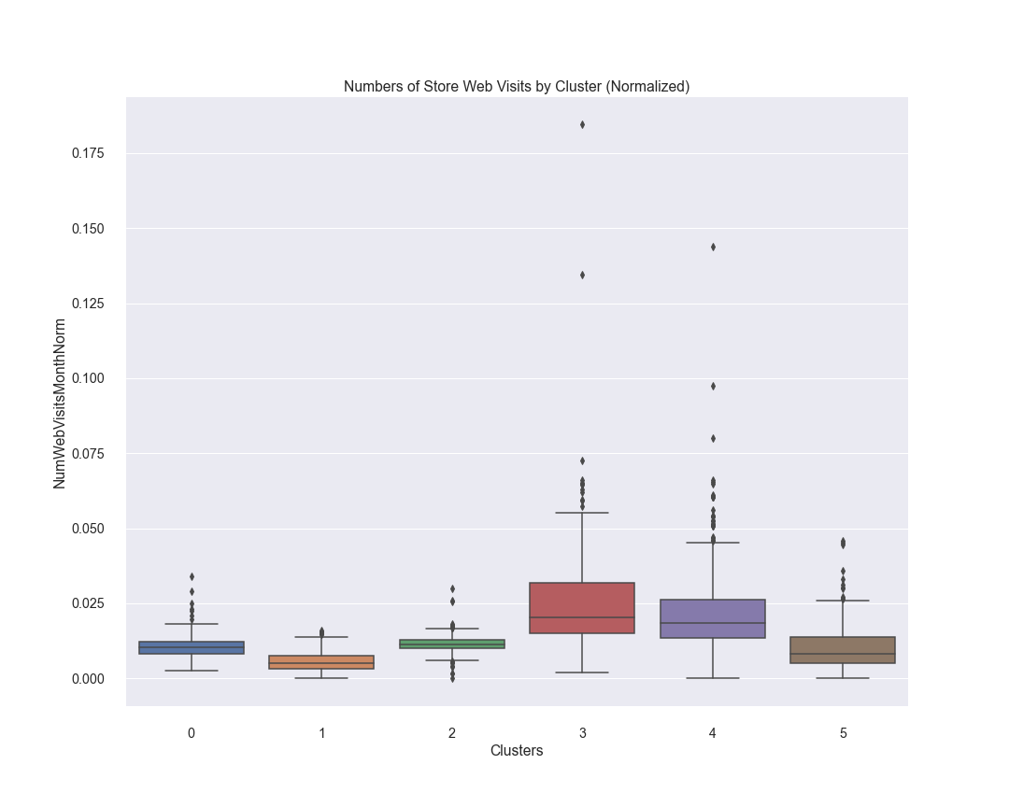
Web visits
Clusters 2-4 are the most active on the web when normalized by length as customers. Historically, Cluster 1 has also been active. Cluster 5 probably use the web with the intention of making a purchase rather than looking for deals. Do not worry about targeting online deals at them.

Slide 23
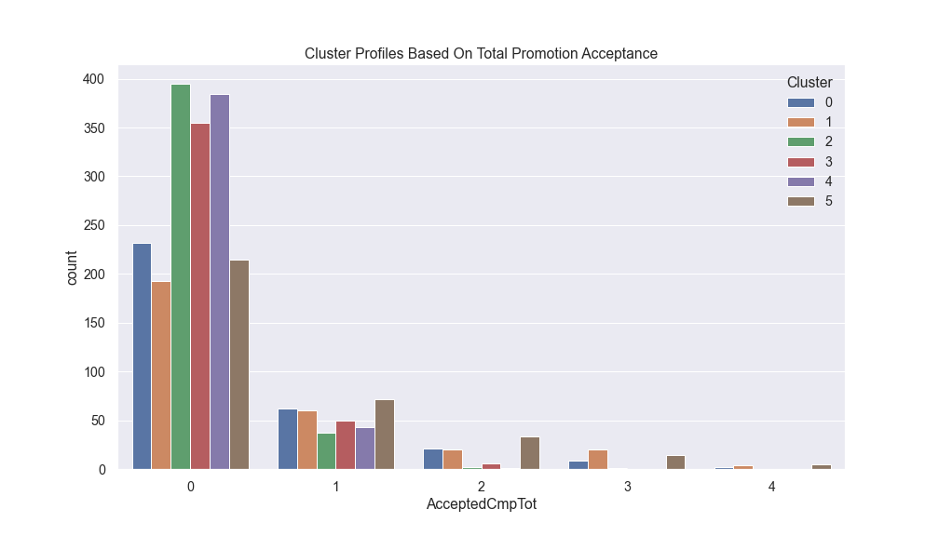
Campaign acceptance
Campaigns were moderately successful
No customer accepted all 5 campaigns

Slide 24
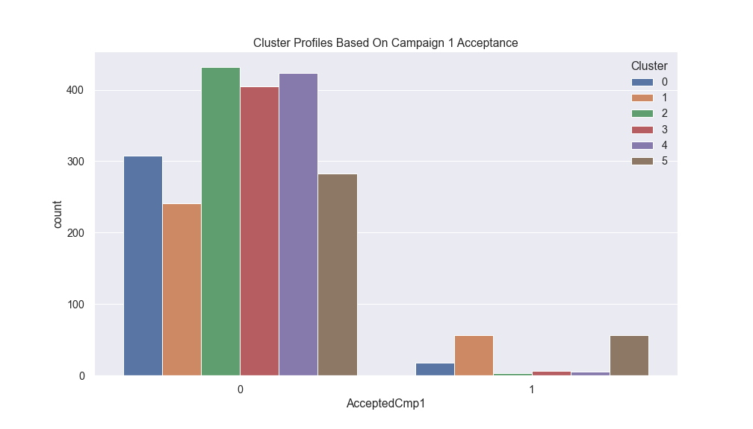
Campaign1 acceptance
Campaign 1 was most successful with Clusters 1 and 5
Try to replicate this campaign if want to attract those customers

Slide 25
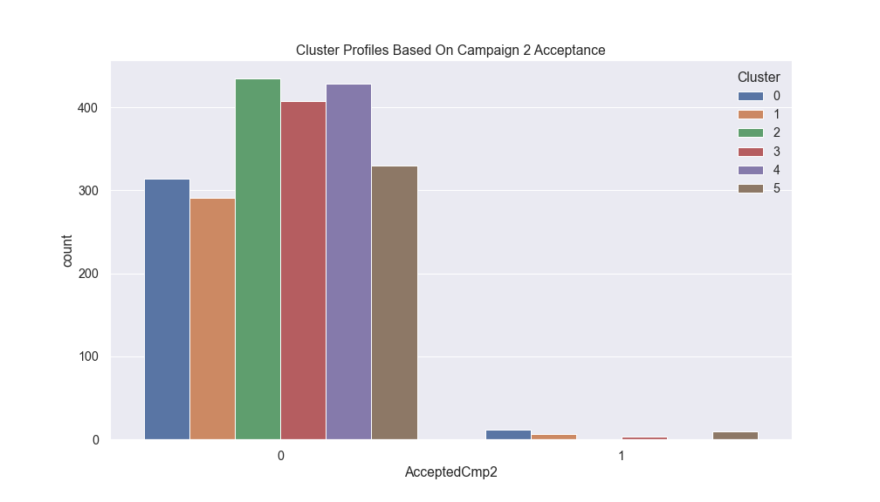
Campaign 2 acceptance
Campaign 2 had a very low response rate
Learn from this campaign in order not to repeat it

Slide 26
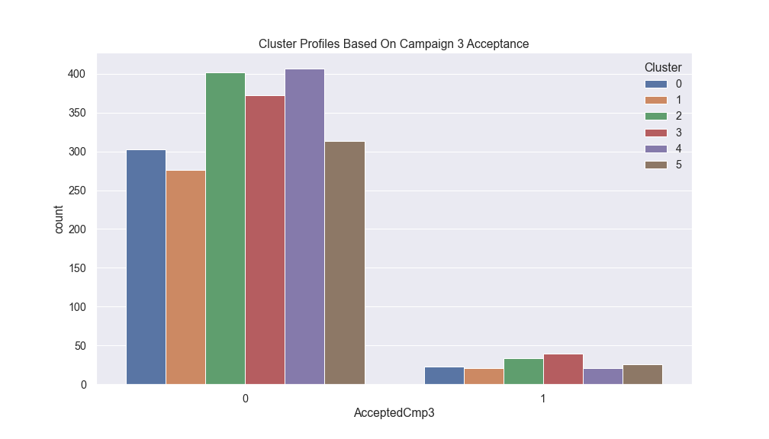
Campaign 3 acceptance
Campaign 3 was particularly successful with Clusters 2 and 3
Target campaigns like this at these customers

Slide 27
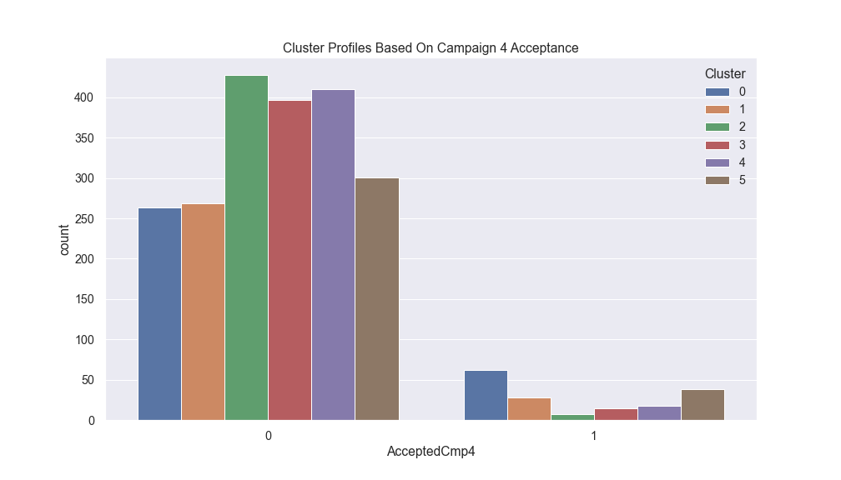
Campaign 4 acceptance
Campaign 4 was particularly successful with Clusters 0, which is a high-potential cluster
Replicate the best parts of this campaign to attract those clusters

Slide 28
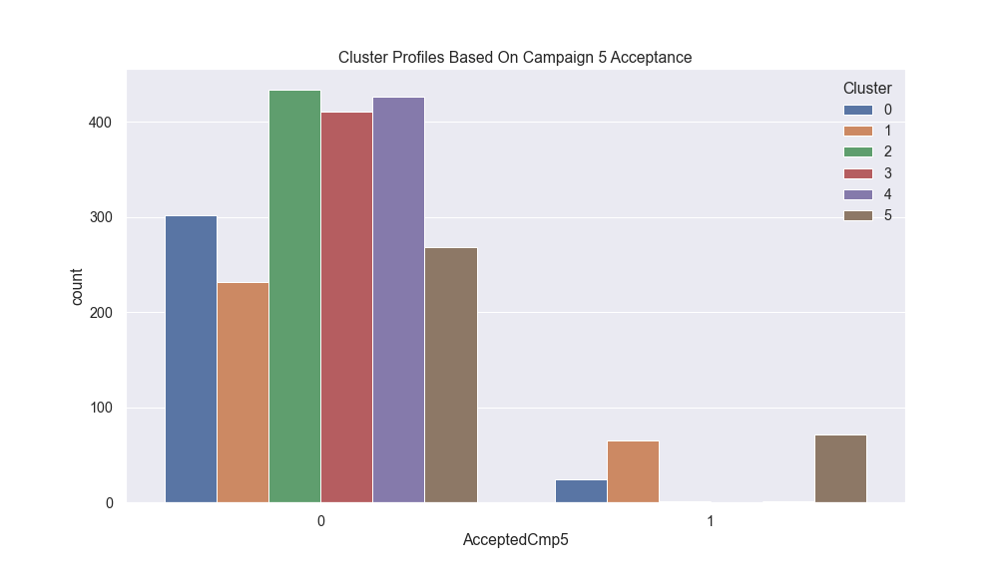
Campaign 5 acceptance
Like Campaign 1, Campaign 5 was particularly successful with Clusters 1 and 5
The store had a good idea with these campaigns
Improve campaigns like this one to attract even more such customers

Slide 29
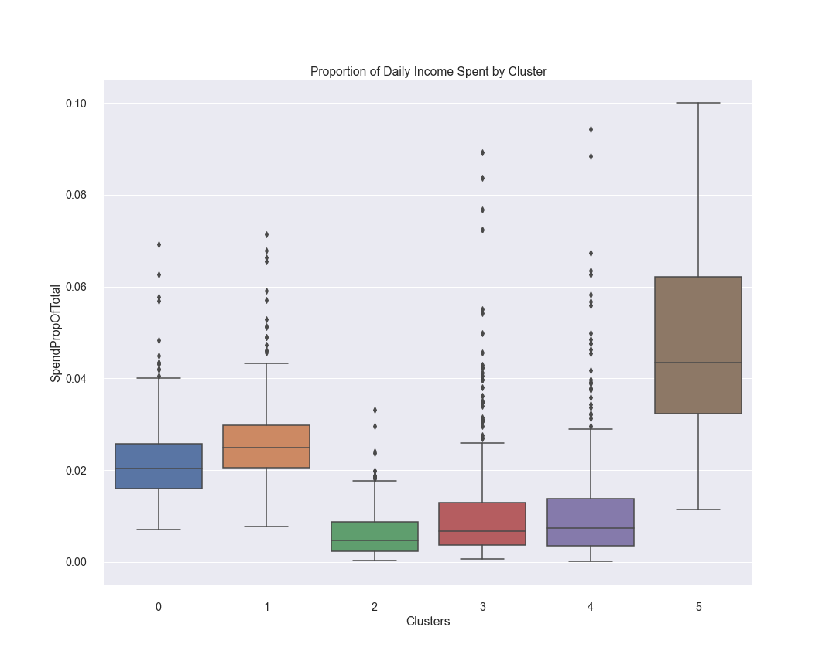
Spending as proportion of daily income
Cluster 5 is still in the lead followed by Clusters 1 and 0. Cluster 5 spends over 4% of their income at the store while Clusters 0 and 1 spend just over 2%.
Look for ways to attract customers away from the alternatives

Slide 30
Summary of findings
If run deals, target these at Clusters 2-4
Concentrate on making/keeping the web page appealing for Clusters 0, 1, and 5
Make sure to have a polished catalog, especially for Cluster 5 customers, who could bring in the most revenue in the future
Make customers’ in-store experience customers pleasant as high-spending clusters seem to value it
Learn from Campaign 2 in order to not repeat it
Concentrate on running and improving campaigns like Campaign1 and 5, as these attract the high-spending customers
Concentrate on identifying and attracting customers like Cluster 5 for highest future expected revenue
Look for ways to attract customers away from the alternatives as customers spend a moderate proportion of their daily income at the store ways to attract customers away from the alternatives

Slide 31
Future work (part 1)
It would be helpful to have more information about the data set and the store in order to answer the following questions:
What do we know about the rationale behind each campaign? What distinguishes the campaigns?
What more can we learn about our customers? Specifically, are there factors that differentiate Cluster 5 that are not in the data? (Surveys)
What else can be learned about the way the store is making customers in-store and online shopping experience pleasant? Are there way to improve?
Can the store learn to do profitable business with Cluster 2-4?

Slide 32
Future work (part ii)
Get more granular data on store purchases
Get data on campaign costs
Get more data on profitability rather than just revenue, as profitability is the key objective
Do A/B testing to judge the effectiveness of recommendations
Are Cluster 5 customers just a more recent group of Cluster 1 customers? If so, can we reengage Cluster 1 and find ways to keep Cluster 5 continually engaged?

Slide 33
Notes
Please see the full repo at https://github.com/dapopov-st/Customer-Segmentation for further details
Results of preliminary experiments are in the Preliminary_work_and_experiments directory
Special thanks to Zeyu Zhang, David Kressley, Kyle Gallatin, and Philippe Heitzmann for crucial feedback and support

