Slide 1

dApp实战：合约的撰写、部署与应用
Respondent: Tai Jiang

Slide 2

CONTENTS
1. Introduction
2. Preliminary
3. Framework
4. Workflow
5. Development

Slide 3
01.
Introduction

Slide 4

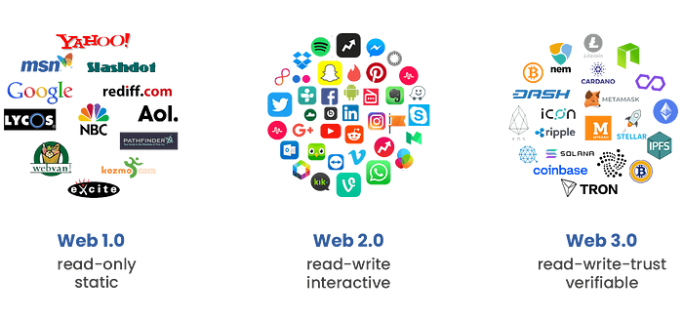
1. Introduction
Evolution from Web1.0 to Web3.0
K. Nath, S. Dhar, and S. Basishtha, “Web 1.0 to web 3.0-evolution of theweb and its various challenges,” in 2014 International Conference onReliability Optimization and Information Technology (ICROIT). IEEE,2014, pp. 86–89.
Notes:
This is the evolution,
Web1 was static. It allowed users to read information, but interaction was minimal.
Web2 brought dynamic content and social platforms. Users could not only consume but also create. However, control became concentrated in a few tech giants, raising issues of centralization, data ownership, and privacy.
Web3 represents the next step: a decentralized web built on blockchain. In Web3, users own their data, applications run on decentralized protocols, and communities govern platforms collectively.

Slide 5

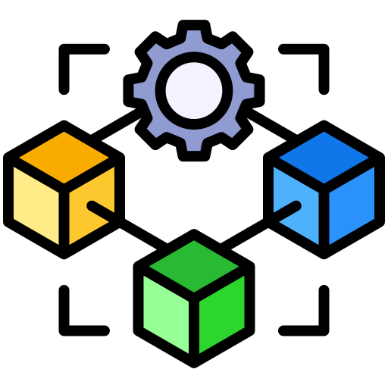
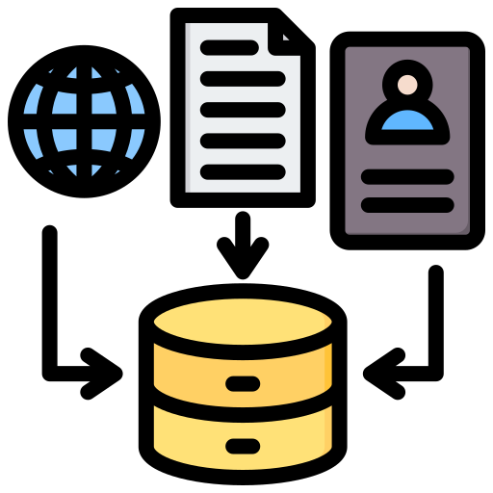
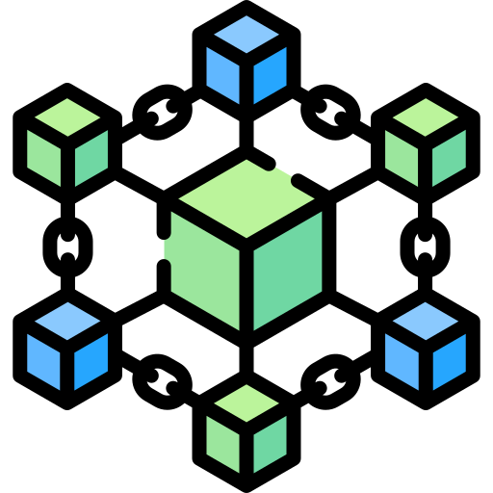
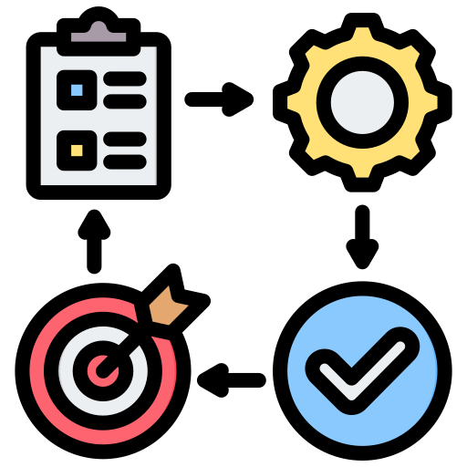
1. Introduction
Compare web2.0 and web3.0
Web2.0
Offline
Web3.0
Institute
Data
dApp1
App
Database
Blockchain
dApp2
Action

Slide 6
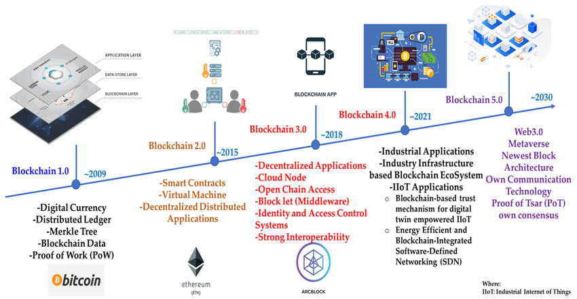
1. Introduction
Evolution from Blockchain1.0 to blockchain5.0

Slide 7
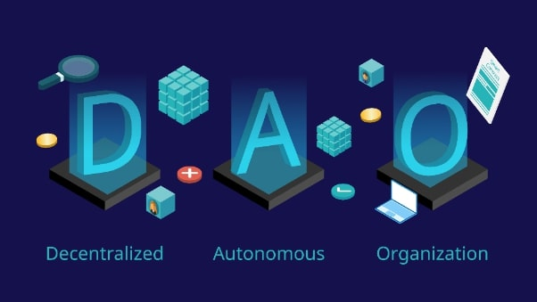
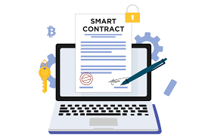
1. Introduction
Blockchain-Derived Technologies
M. Alharby, A. Aldweesh, and A. v. Moorsel, “Blockchain-based smartcontracts: A systematic mapping study of academic research (2018),”in 2018 International Conference on Cloud Computing, Big Data andBlockchain (ICCBB), 2018, pp. 1–6.
W. A. Kaal, “A decentralized autonomous organization (dao) of daos,”Available at SSRN 3799320, 2021.

Slide 8
02.
Preliminary

Slide 9
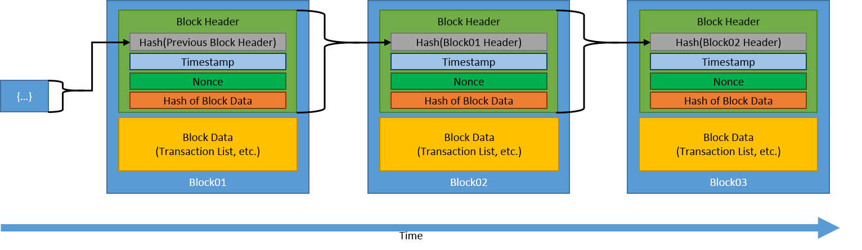
2. Preliminary
Data to Smart Contract
Hex
Bit
Smart Contract

Slide 10
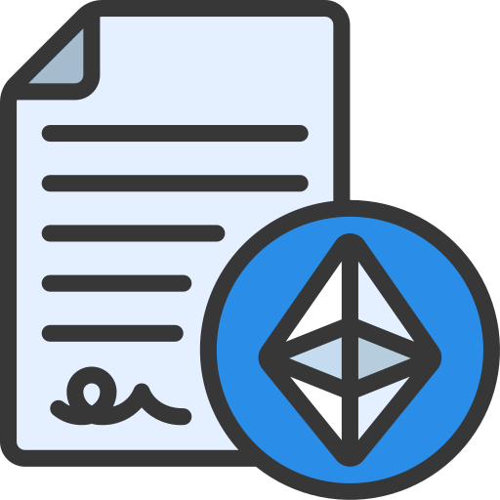

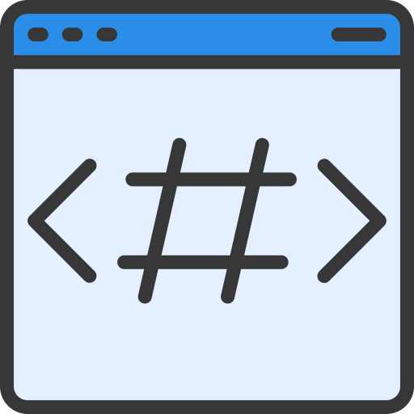


2. Preliminary
Minimal Sample of dApp
Smart Contract
Artifact
Blockchain
compile
deploy
TXID
User
Hello world
Interpreter
set
get
Hello world

Slide 11
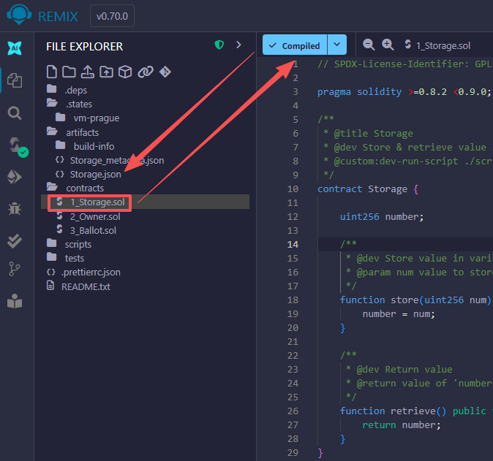
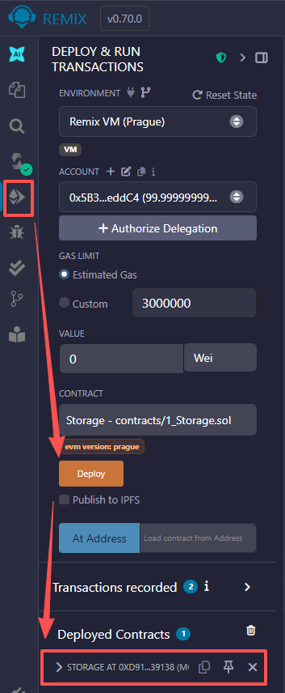
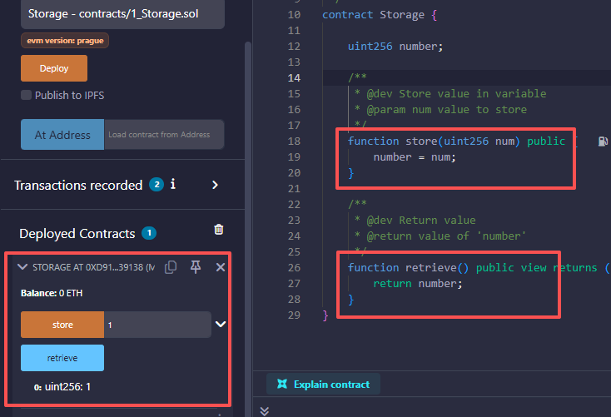
2. Preliminary
Tutor in Remix
https://remix.ethereum.org/

Slide 12
03.
Framework

Slide 13
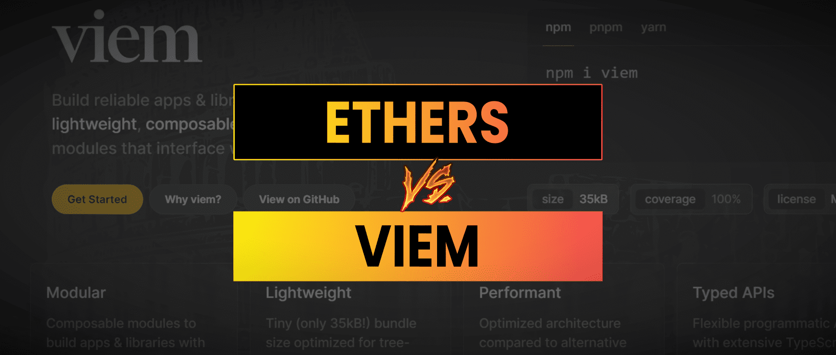
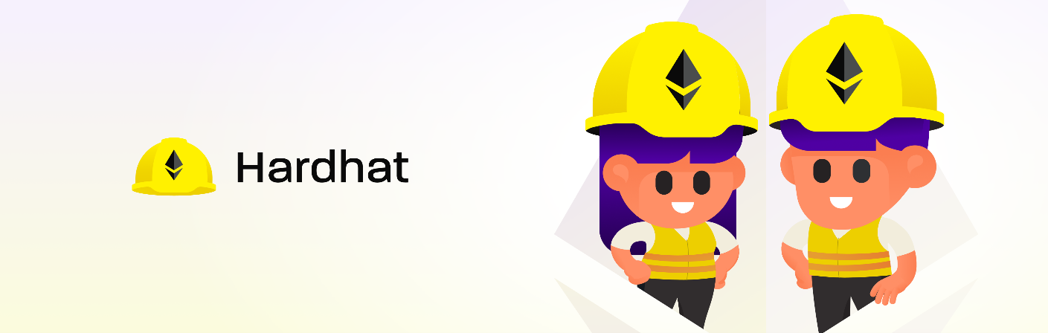
3.Framework
Technology selection
Compile & deploy
dApp
https://hardhat.org
https://viem.sh

Slide 14
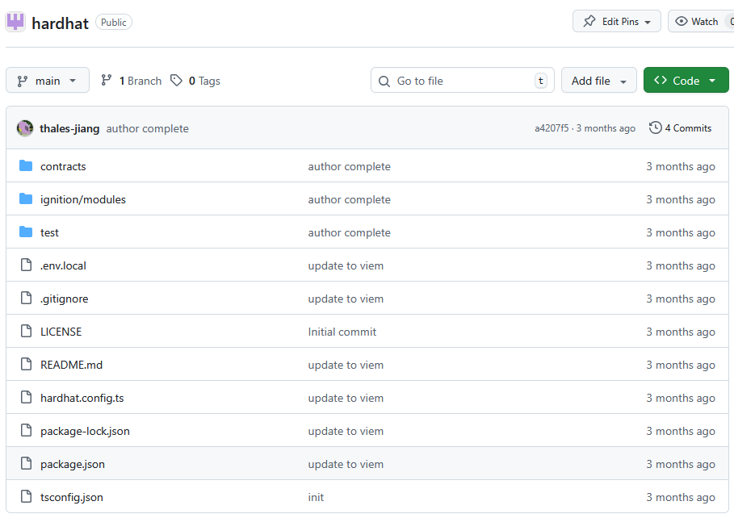
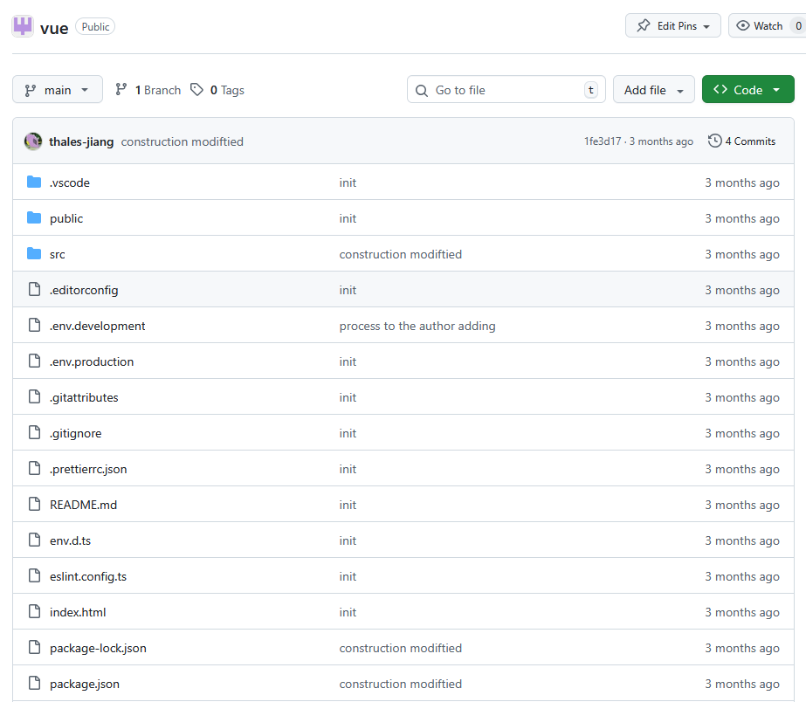
3.Framework
Repository
https://github.com/dapp-journal/hardhat
https://github.com/dapp-journal/vue

Slide 15
04.
Workflow

Slide 16
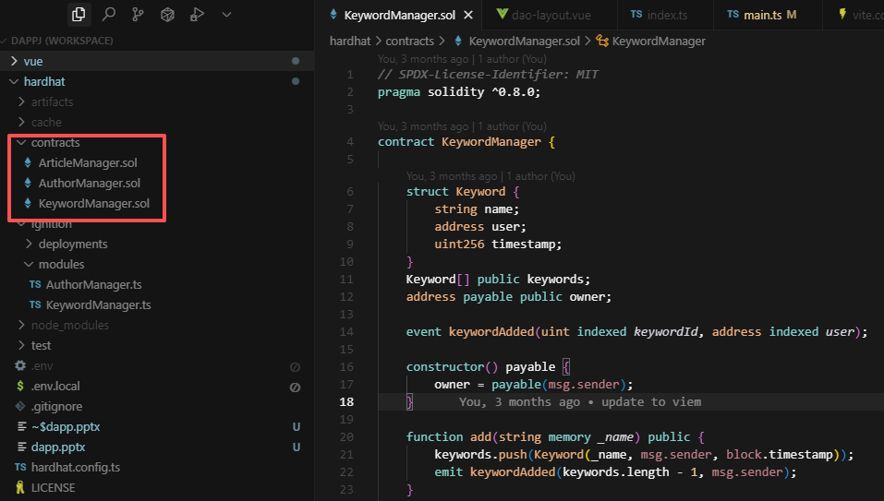
4.Workflow
Writing Smart Contract
https://docs.soliditylang.org

Slide 17
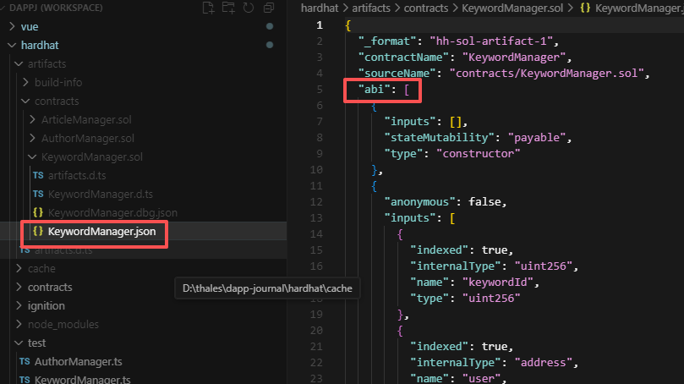
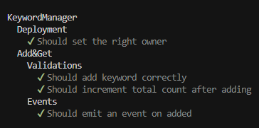
4.Workflow
Test and Compile Smart Contract
npx hardhat test
test solidity
product artifact
https://docs.soliditylang.org

Slide 18
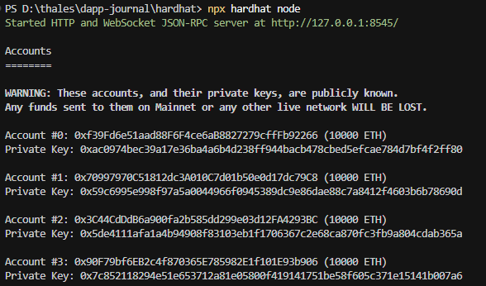
4.Workflow
Local Blockchain (Optional)
Account address
Account Private Key

Slide 19
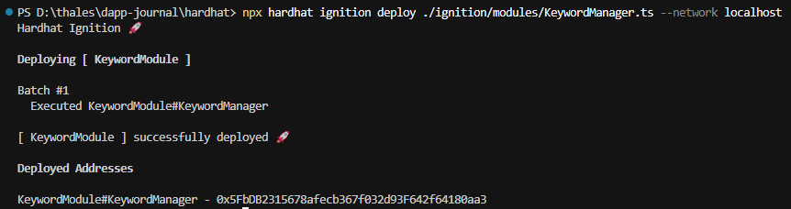
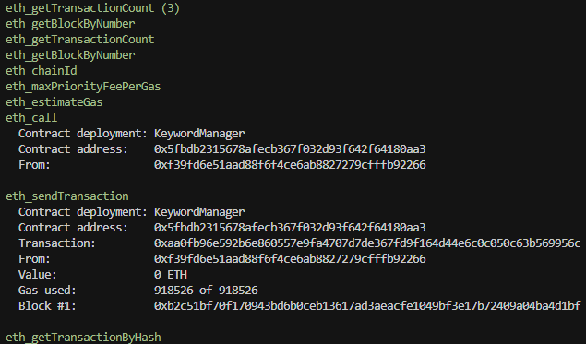
4.Workflow
Deploy Smart Contract
Deploy Command
Blockchain Transaction
TXID

Slide 20
05.
dApp Development

Slide 21
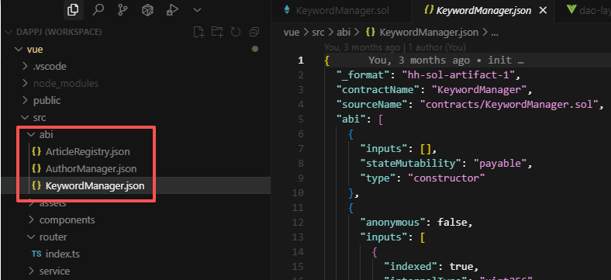
5.Development
Apply Smart Contract
Copy Artifact of Solidity to dApp Project
ABI(application programming interfaces)

Slide 22

5.Development
Write Contract
TXID
export function addKeyword(name: string) {
return walletClient.writeContract({
address: contractKeyword,
abi: keywordAbi,
functionName: 'add',
args: [name],
account: hardhatAccount
});
}
Artifact
function: add
args: name
account: optional

Slide 23
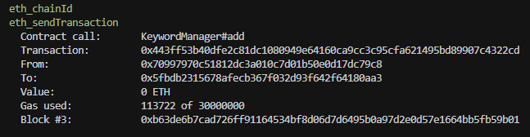
5.Development
Write Contract Logs
From: account to execute
To: contract address

Slide 24


5.Development
Read Contract
export function getKeywordByIndex(index: number) {
return publicClient.readContract({
address: contractKeyword,
abi: keywordAbi,
functionName: 'get',
args: [index]
}) as Promise<IKeyword>;
}
export function getKeywords() {
return publicClient.readContract({
address: contractKeyword,
abi: keywordAbi,
functionName: 'getList'
}) as Promise<IKeyword[]>;
}
Public

Slide 25
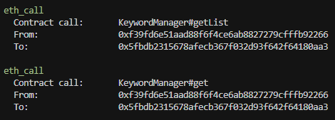
5.Development
Read Contract Logs
Public needn’t gas

Slide 26
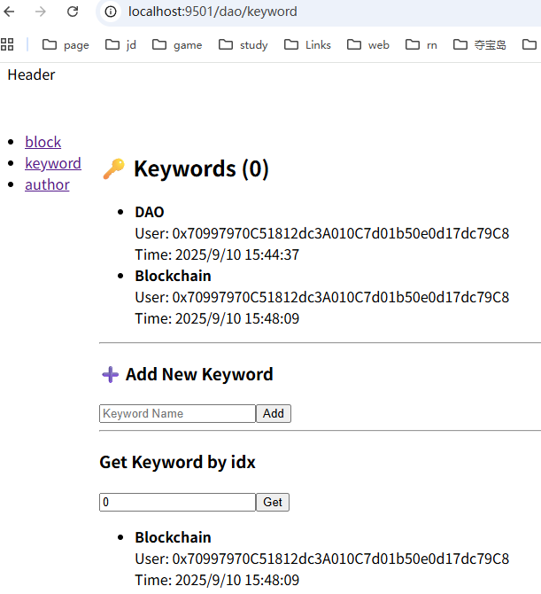
5.Development
Surface
npm start
run project
getList
add(name)
get(index)

Slide 27
THANKS
Respondent: Tai Jiang

