Slide 1
CL and JavaCL

Slide 2
The birth of Open CL
Many devices supports various computation accelerators.
NVIDIA, ATI, Intel, Cell.
All fall under the Single Instruction Multiple Data (SIMD) idea.
Today, this was extended and they all support some hybrid between SIMD and MIMD.
What MIMD do you know?
Each company implemented its own language for SIMD.
No good separation between the hardware layer and the software layer. Why?

Slide 3
The birth of OpenCL
2008, Apple is pushing toward a standard that creates the separation between layers. Why?
Working group created in 2008.
Goal: Create a unified standard for heterogeneous computing.
CPU
GPU
CELL
CPU
GPU
CELL
CPU
GPU
CELL
GPU
DSP
DSP

Slide 4
OpenCL Goals
Resource utilization: be able to use all the computation resources in the hardware.
Efficient & Effective parallelism:
Task & Data parallelism
Abstract the hardware specifications.
Provide ability to decide on calculations accuracy.
Support for every type of hardware. Servers, desktops, laptop, etc.

Slide 5
OpenCL general overview
Foo
Zoo
boo
Host
Context
Queue
Kernels
Queue
foo
doo
Device 0
Device 1

Slide 6
OpenCL The host program
The host porgram is a program that control and run kernels on the various devices.
In order to run a kernel we need to build an environment.
The environment is a sequences of nested choices:
Platform: The OpenCL implementation to use.
Context: The device grouping and memory areas.
Command queue: Communicating with the computing devices
Run the program.

Slide 7
OpenCL - Platform
The platform is a representation on an openCL implementation.
You can have more than one on your computer.
A platform might not encompass ALL the computing devices in your computer.
All the platforms encompass ALL the computing devices in your computer.
Example 1.

Slide 8
OpenCL - Devices
A platform contains computing devices, e.g, CPU, GPU, etc.
Each devices has a capabilities.
Via the platform we can get all the devices beneath it.
Devices tells you information like the name, the vendor, number of devices, etc.
Example 2
What are all these numbers? Are some familiar to you?

Slide 9
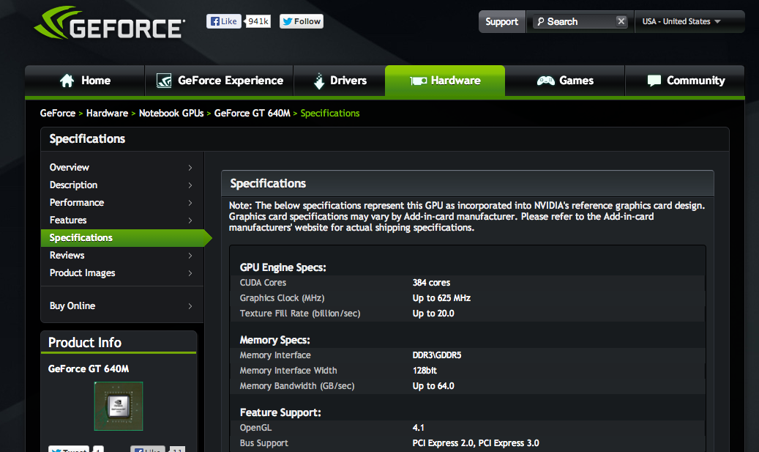

Slide 10
OpenCL context
Context is a collection of devices that a host program can send programs to.
The same device can be in multiple contexts.
You can not mix devices from different contexts.
Your host can create as many contexts as it wants.
Example 3.

Slide 11
OpenCL – Command queue
The command queue is a direct relation between the host and the device.
There are many types of queues. Profiling, out of sequences.
Host
Read
Execute
Copy
Device 0
Device 1

Slide 12
OpenCL – The program & Kernels
Computing unit is a slave.
It needs: instructions & data to operate.
The host must provide the compute unit with the instructions (the program) and the data.
The program concept is an encapsulation of a set of instructions can be run on compute device.
Kernels are generated from a program.
A kernel is dispatched on the command queue to the device.

Slide 13
OpenCL – running a kernel
In order to run a kernel we need to provide data.
In regular OpenCL it is all pointrs business.
In JavaCL we need to use buffers.
JavaCL uses BridJ to provide pointers and operate with them.
In order to run a kernel we will need
Create input/output pointers
Move the data to the computing device.
Run the kernel.
Move the results back

