Slide 1
Android Testing
Zach McCormick

Slide 2
Agenda
Why Spend Time Testing?
Maven & the Android Ecosystem
Unit Testing
Integration Testing
Acceptance Testing
Code Coverage & Code Quality
Q & A

Slide 3
Why Spend Time Testing?

Slide 4
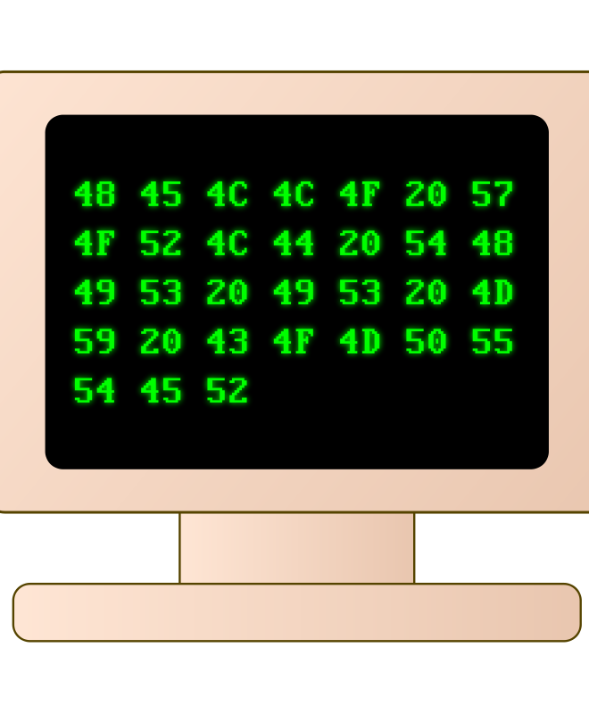
Why?
Write it and forget it
Easier refactoring
Find problems early
Living design documents
Interface vs. Implementation
Reduce assumptions

Slide 5



How?
JUnit
TestNG
Robolectric
Maven SureFire/FailSafe
Robotium
Cucumber

Slide 6
Maven and the Android Ecosystem

Slide 7
Is it still hard to set up, hard to use, and lacking in some areas?
Sort of… but it’s a lot better!

Slide 8

Why Maven?
Portable builds
Multi-module support
Have you used Eclipse recently??? ☺
Ant is great, but it’s practically its own language
Gradle is promising!

Slide 9
Overall, Maven is great if you don’t mind doing everything the “Maven” way!

Slide 10
Maven Plugins
com.google.android-android
com.google.android-support-v4
org.robolectric-robolectric
junit-junit
org.mockito-mockito-all
com.jayway.maven.plugins.android.generation2-android-maven-plugin
org.codehaus.mojo-emma-maven-plugin
org.apache.maven.plugins-maven-surefire-plugin
org.eclipse.m2e-lifecycle-mapping

Slide 11
Maven Plugins (cont.)
com.google.android-android-test
com.jayway.android.robotium-robotium-solo
emma-emma
info.cukes-cucumber-android
info.cukes-cucumber-core
info.cukes-cucumber-picocontainer
org.apache.maven.plugins-maven-antrun-plugin

Slide 12
Unit Testing

Slide 13
JUnit, Robolectric, and Mockito
Robolectric
Emulates a significant part of android.jar
Runs on your machine, not your phone
Some parts incomplete, but very easy to implement your own shadowing
Mockito
Allows you to do cool things
Count number of method calls
Enforce big O notation (super cool!)
Construct mock versions of complicated objects that give canned answers

Slide 14
Example
@Test
public void testActivityLifecycle() {
HelloAndroidActivity activity =
Robolectric.buildActivity(HelloAndroidActivity.class)
.create().visible().get();
activity.finish();
}

Slide 15
Example 2
@Test
public void testMock() {
Object imaginaryDatabase = Mockito.mock(Object.class);
when(imaginaryDatabase.toString()).thenReturn("cool!");
assertEquals(imaginaryDatabase.toString(), "cool!");
}

Slide 16
What’s even cooler?
Add RoboGuice!
Dependency injection framework for Android based on Google Guice
You can create test modules to provide injected mock objects, allowing you to mock functionality deep in your code
Easy to write/read test cases
Comparatively no setup code required

Slide 17
Integration Testing

Slide 18
Robotium, Mockito, and Dexmaker
Robotium
Like Selenium
UI can be tested
Black box testing
Robotium recorder
Not open source/free
Cool enterprise tool for recording UI tests
Mockito (& Dexmaker)
Can mock objects even inside Dalvik
Dexmaker is needed as a dependency
Wear your hard hat (might need to fight through version/config hell)

Slide 19
Example
@UiThreadTest
public void testClickBar() {
HelloAndroidActivity activity = getActivity();
Solo solo = new Solo(getInstrumentation(), activity);
activity.clickBar(null);
assertTrue(solo.waitForText("result3"));
}

Slide 20
Acceptance Testing

Slide 21
Robotium, Cucumber, and Gherkin
Robotium
Same as last section – easy UI, Android shortcuts
Cucumber
Acceptance testing
Non programmers can write test code too!
GREAT for clients
Gherkin
Language for acceptance tests
Plain English
And French, Spanish, Hungarian, Arabic… and LOLCAT too!
Tools for English → Testing Code

Slide 22
Example (Gherkin)
Feature: Button
Pressing the Foo or Bar button should do some stuff.
Scenario Outline: Press the button and get a result
Given I have a HelloAndroidActivity
When I press the <button> button
Then I should see <result> in the textview
Examples:
| button | result |
| Foo | result2 |
| Bar | result3 |

Slide 23
Example (Gherkin)
Feature: Button
Pressing the Foo or Bar button should do some stuff.
Scenario Outline: Press the button and get a result
Given I have a HelloAndroidActivity
When I press the <button> button
Then I should see <result> in the textview
Examples:
| button | result |
| Foo | result2 |
| Bar | result3 |

Slide 24
Example (Cucumber)
Annotations:
@Given("^I have a HelloAndroidActivity$")
method()…
@When("^I press the (\\S+) button$")
method(String s)…
@Then("^I should see (\\S+) in the textview$")
method(String s)…

Slide 25
Code Coverage and Code Quality

Slide 26
Emma, Jacoco, and Cobertura
Emma
Code coverage tool
Bytecode rewriting/instrumenting before running
Works on Android/Dalvik and regular JVM
Jacoco
Same guys as Emma
Newer (Emma last release was ‘05)
Cobertura
Comparable features
I’ve never used it

Slide 27
Findbugs and Checkstyle
Findbugs
Static analysis
Widely used
20 point scale
Examples:
Reversed method arguments
hasNext() invokes next()
hashCode() on array
Checkstyle
Ensures coding standards
Tabs vs. spaces
Other formatting
Highly flexible

Slide 28
Compile Application
Create Integration Tests APK
Emma Merge (ant task)
Emma Bytecode Processing
Run Integration Tests
Emma Report (ant task)
Run Unit Tests in JVM
Create Acceptance Tests APK
Create DEX/APK
Run Acceptance Tests
Zach’s Testing
Process

Slide 29
Walkthrough Q&A Others’ Experiences with Testing

