Slide 1




An Electronic-Photonic
Co-Design Approach with piel
Dario A Quintero Dominguez
PhD Student
Notes:
Hi, my name is Dario. I am doing my PhD in the university of Bristol, and this has been one of my projects. So we’ll go through this python package called piel for integrated electronic-photonic codesign and simulation.

Slide 2
Outline
Motivations for Electronic-Photonic Co-Design
  Why Open-Source?
The piel Toolchain
Examples towards a Full-Flow Demo
Notes:
We’ll first start with why this package? Why codesign? Why open source?
Go through the piel toolchain.
Then we’ll go through a demo.

Slide 3
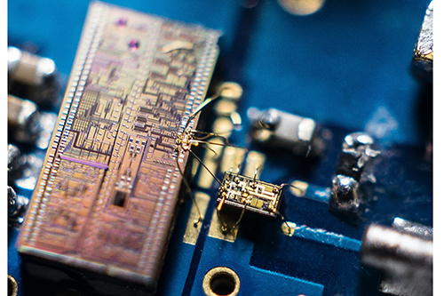
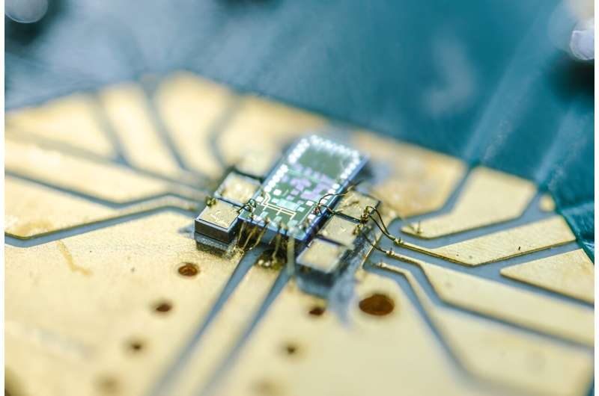

Motivations for Co-Design
Tasker, Joel F., et al. "Silicon photonics interfaced with integrated electronics for 9 GHz measurement of squeezed light." Nature Photonics 15.1 (2021): 11-15.
Tasker, J. F., Frazer, J., Ferranti, G., & Matthews, J. C. (2024). A Bi-CMOS electronic photonic integrated circuit quantum light detector. Science Advances, 10(20), eadk6890.
Applications:
- Quantum Photonics/Computation (my research)
- Telecommunications / HPC
- Sensing / Lidar / Automotive
- Photonic / Neuromorphic Computation
Challenges:
- Co-simulation feedback complexity
- Co-design tools are not well integrated
- One domain design decision could break the whole system.
Notes:
More and more in different fields we’re starting to see electronic-photonic applications. They might involve systems that look like these two where we have an electronic system working alongside a photonic system in real time.
Interesting applications come from this as in doing computation with analog photonics, lower energy telecommunications, advanced metrology, neuromorphic and quantum computation.
Cosimulating these systems is very challenging, transferring data across co-design tools could be better, making a bad design decision on one domain can break the whole system.

Slide 4
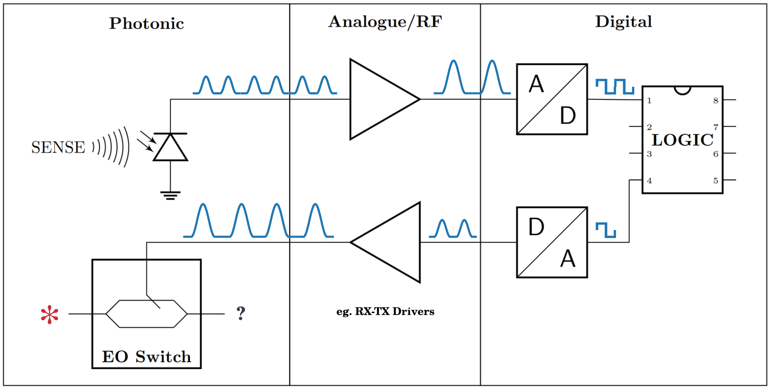
A Fully Concurrent Electronic-Photonic System
Notes:
What I want to build, personally, is a system that looks like this: a fully-concurrent electronic-photonic system. This means when light and electronics signals interact, feedback and feedforwad in real time. I’d like to simulate this to some level in real time – and that it’s easy to see how design decisions on one domain affect the other.

Slide 5
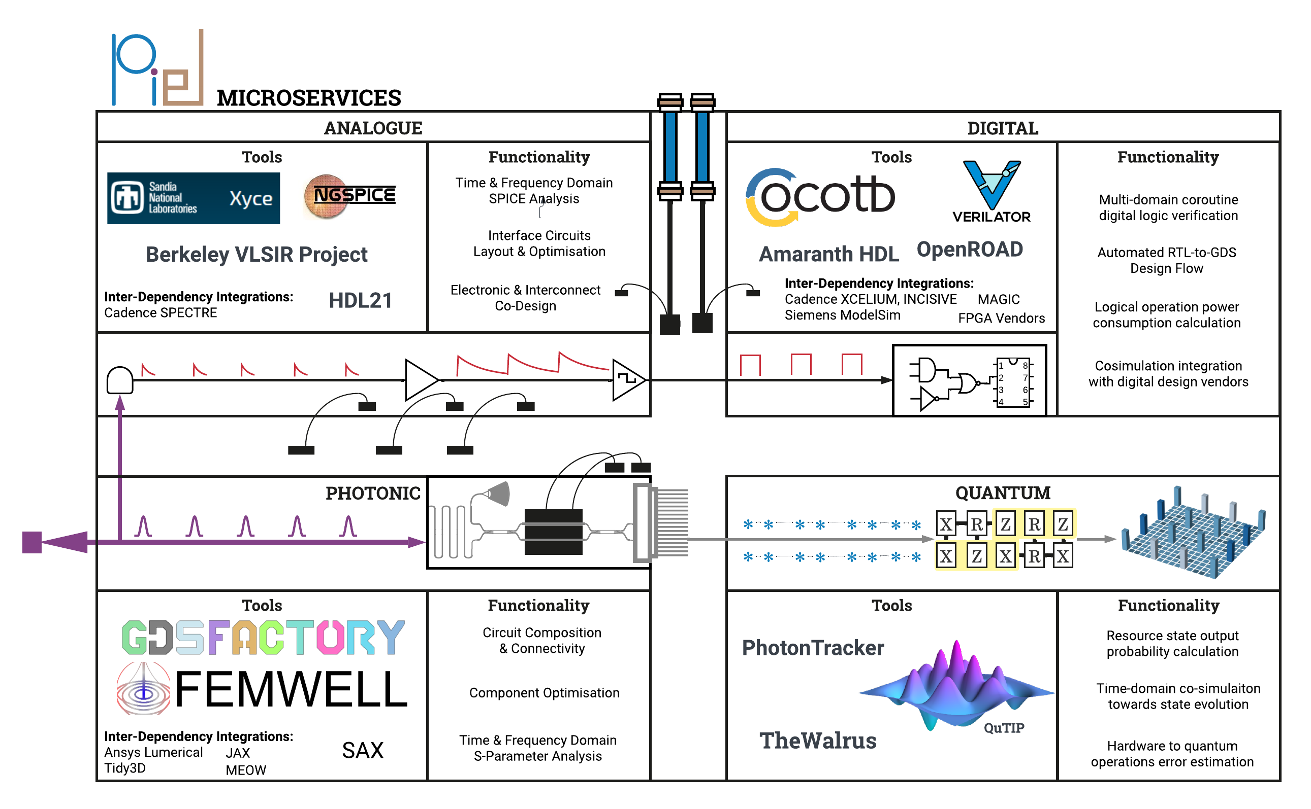
The piel Toolchain
Notes:
The power of open-source software is that it is much easier to interact and extend to simulate these type of complex systems than propietary software – especially if you are simulating physics no one has done before. The challenge is actually doing that, because it easily becomes a dependency hell in terms of maintenance and extensibility. The structure of piel is a microservice with well defined integration points between the tools. It is then easier to build more complex functionality between the design and simulation domains at this higher level. It also means that if a subroutine has to be optimized in say, rust, then there are also strong integration points. Written in python so that it is more accesible, but on the lower level interacts with multiple languages.
Make pictures the whole slide. Show transients, impedances and reactances that come from here. Introduce the switch really quite basic, maybe at that point start and end annotated diagram differfent tools used at each of these steps. Phase modulator, why want to change a phase to make it switch. Brightness and phase.

Slide 6
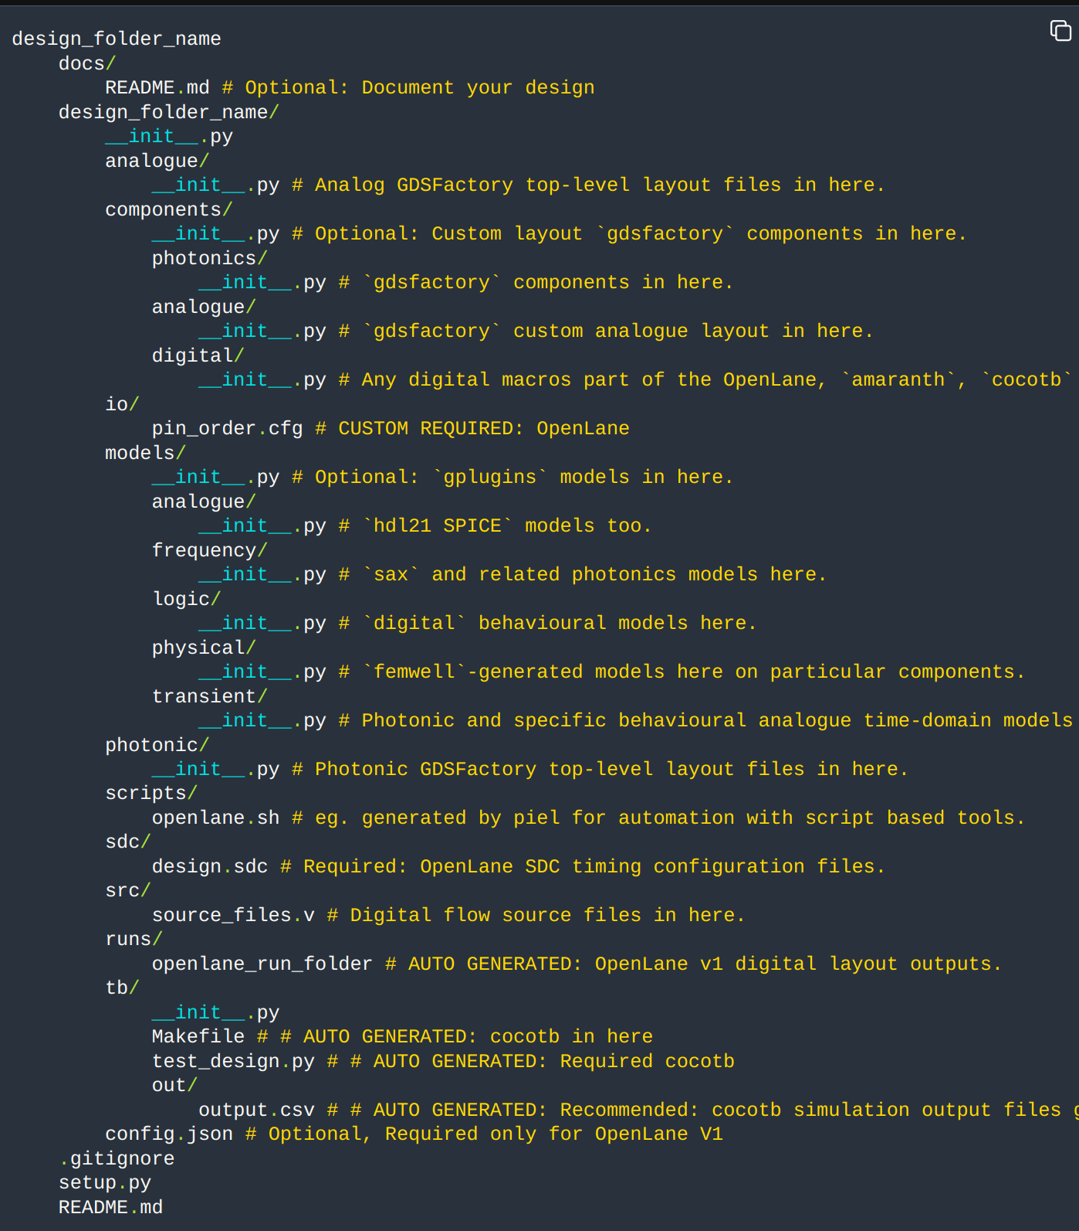
Co-Design Project Structure
Compatibility Between Toolsets
Encoded Directory Operation Mapping
Notes:
What I want to build, personally, is a system that looks like this: a fully-concurrent electronic-photonic system. This means when light and electronics signals interact, feedback and feedforwad in real time. I’d like to simulate this to some level in real time – and that it’s easy to see how design decisions on one domain affect the other.

Slide 7
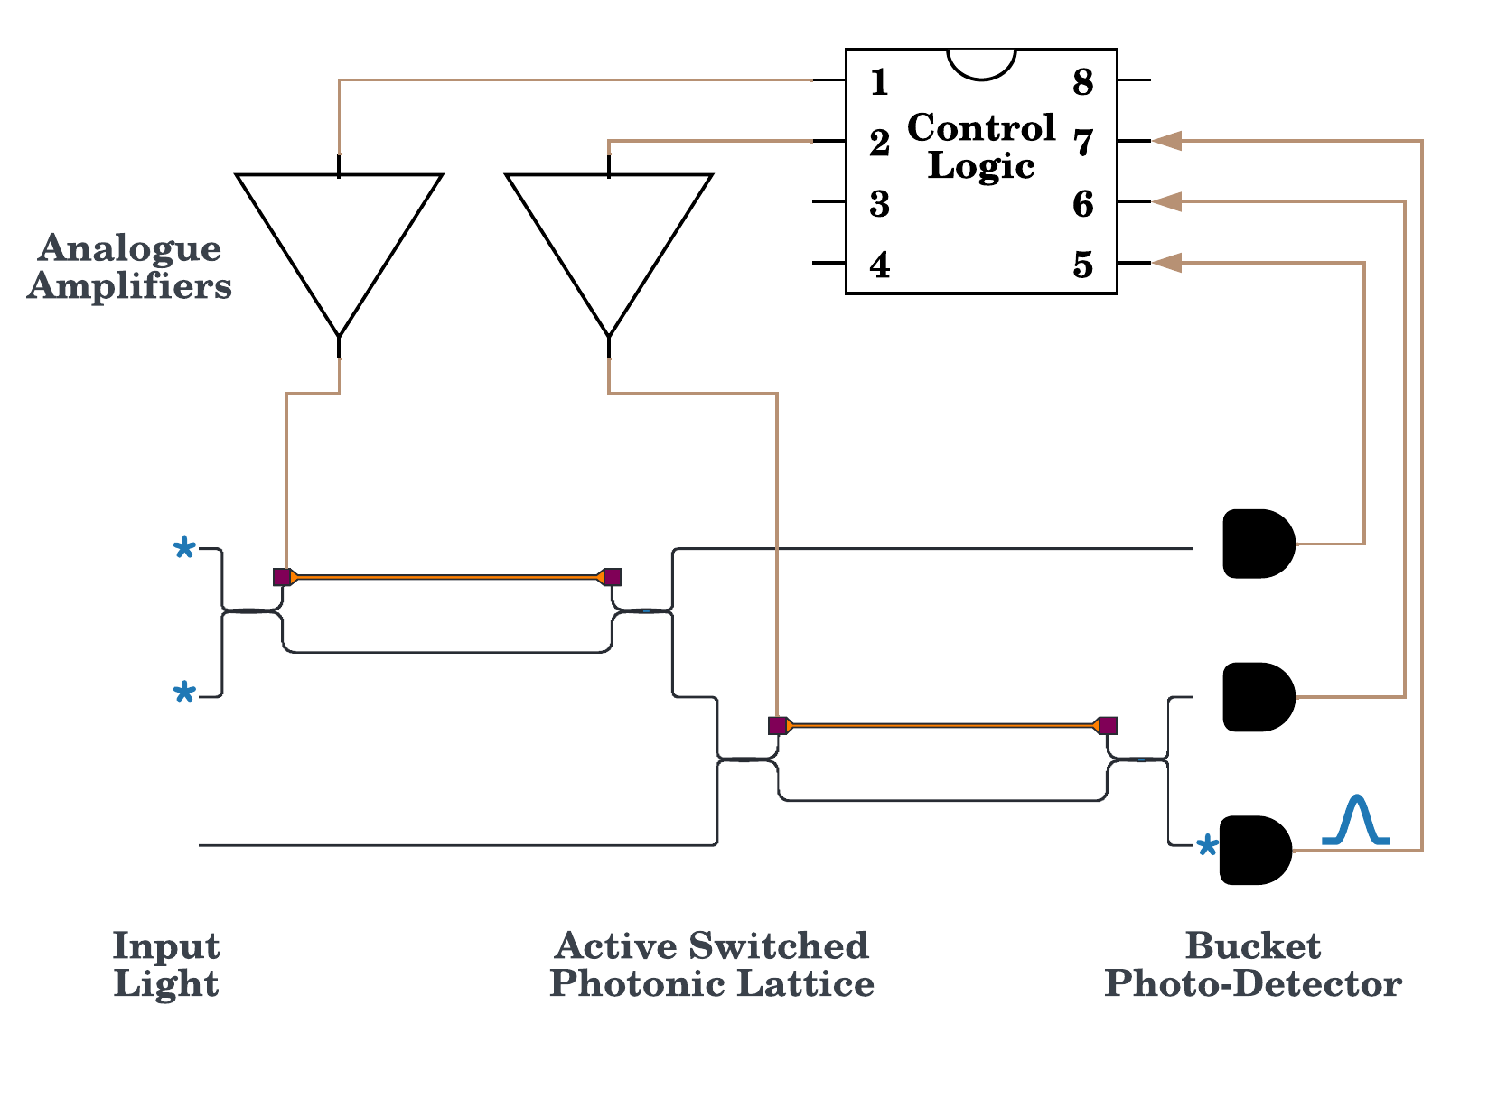
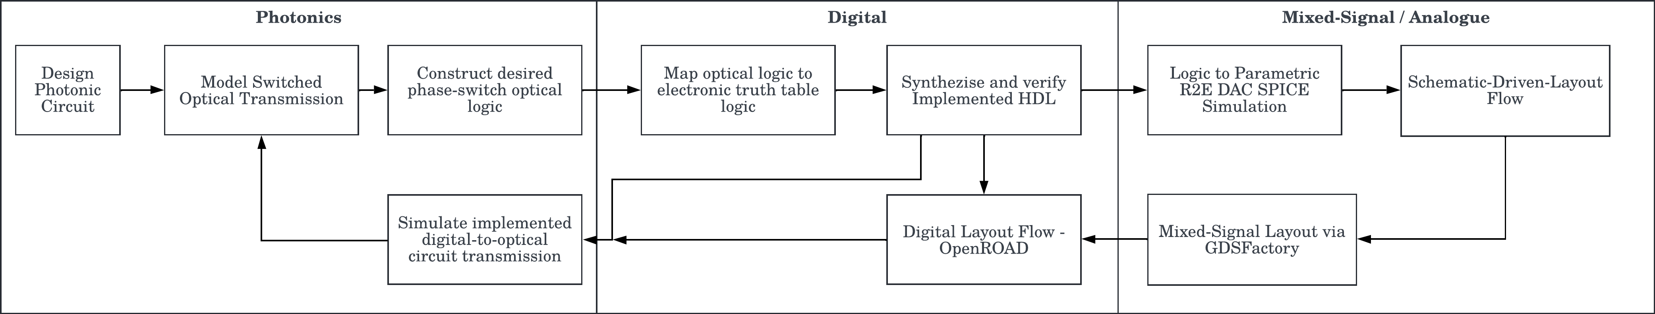
Designing and Simulating
Towards an (incomplete)
Full Flow Example
Notes:
The power of open-source software is that it is much easier to interact and extend to simulate these type of complex systems than propietary software – especially if you are simulating physics no one has done before. The challenge is actually doing that, because it easily becomes a dependency hell in terms of maintenance and extensibility. The structure of piel is a microservice with well defined integration points between the tools. It is then easier to build more complex functionality between the design and simulation domains at this higher level. It also means that if a subroutine has to be optimized in say, rust, then there are also strong integration points. Written in python so that it is more accesible, but on the lower level interacts with multiple languages.
Make pictures the whole slide. Show transients, impedances and reactances that come from here. Introduce the switch really quite basic, maybe at that point start and end annotated diagram differfent tools used at each of these steps. Phase modulator, why want to change a phase to make it switch. Brightness and phase.

Slide 8
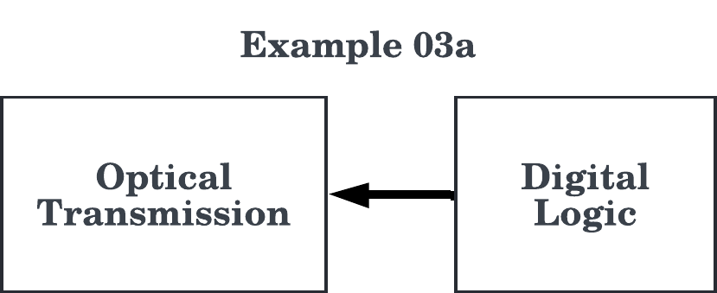
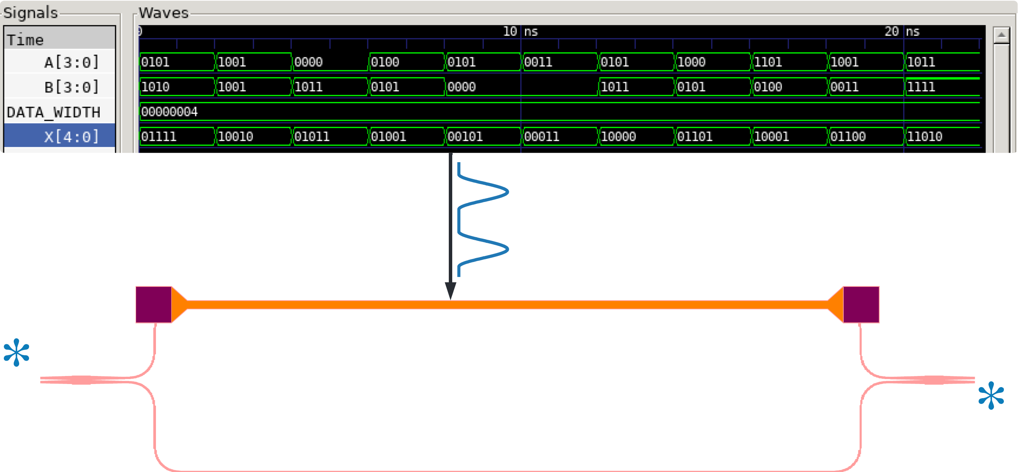
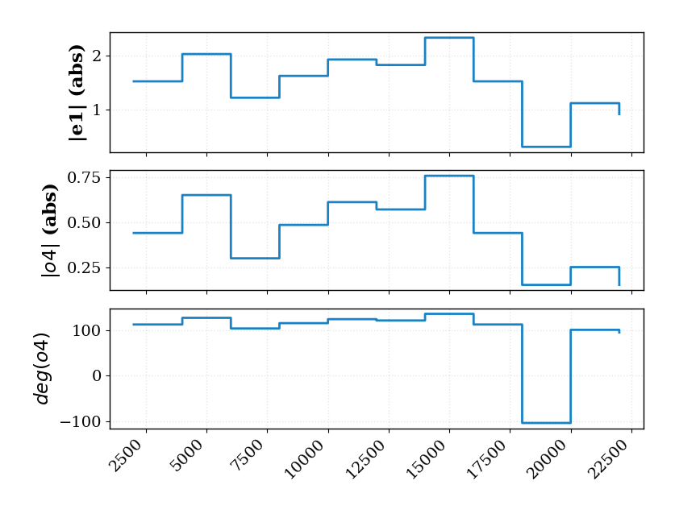
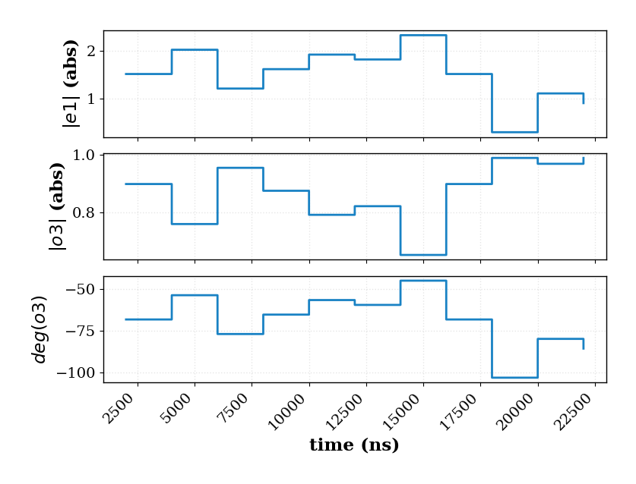
Simulation Capabilities
Example 3a
Notes:
What I want to build, personally, is a system that looks like this: a fully-concurrent electronic-photonic system. This means when light and electronics signals interact, feedback and feedforwad in real time. I’d like to simulate this to some level in real time – and that it’s easy to see how design decisions on one domain affect the other.

Slide 9
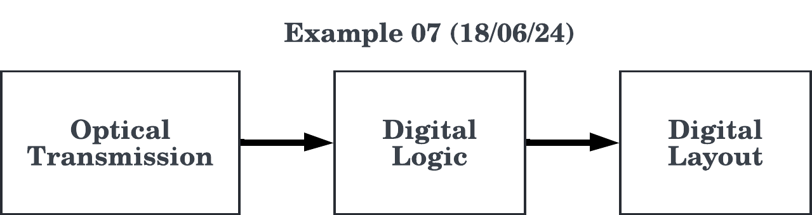
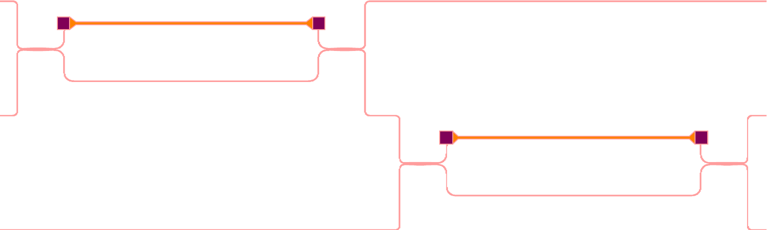
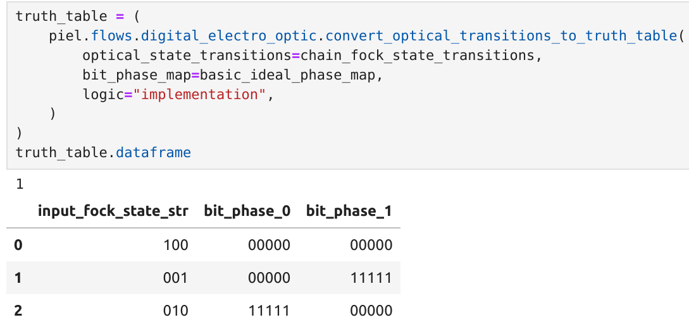
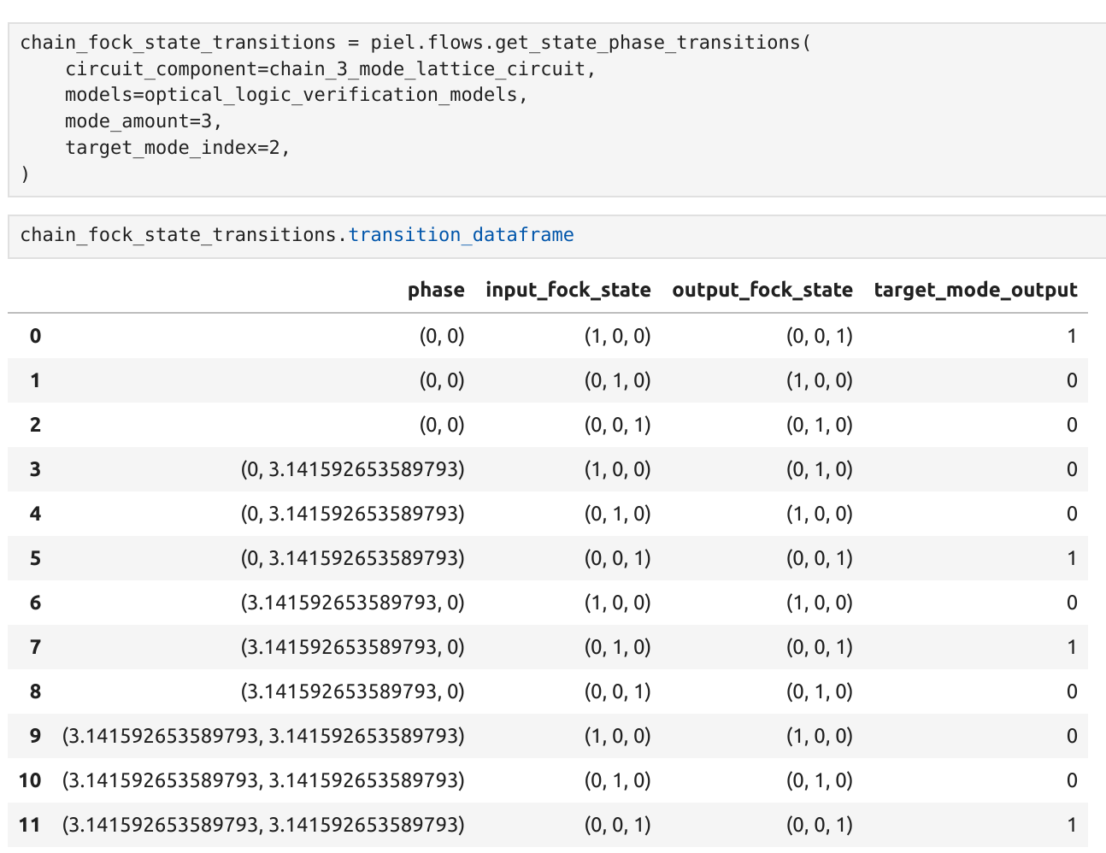
Simulation Capabilities
Example 7
Notes:
What I want to build, personally, is a system that looks like this: a fully-concurrent electronic-photonic system. This means when light and electronics signals interact, feedback and feedforwad in real time. I’d like to simulate this to some level in real time – and that it’s easy to see how design decisions on one domain affect the other.

Slide 10
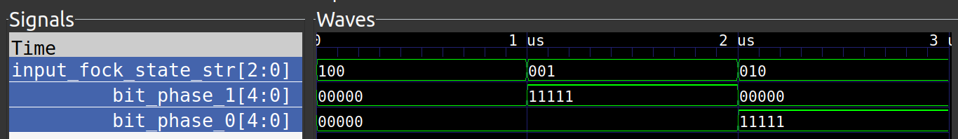
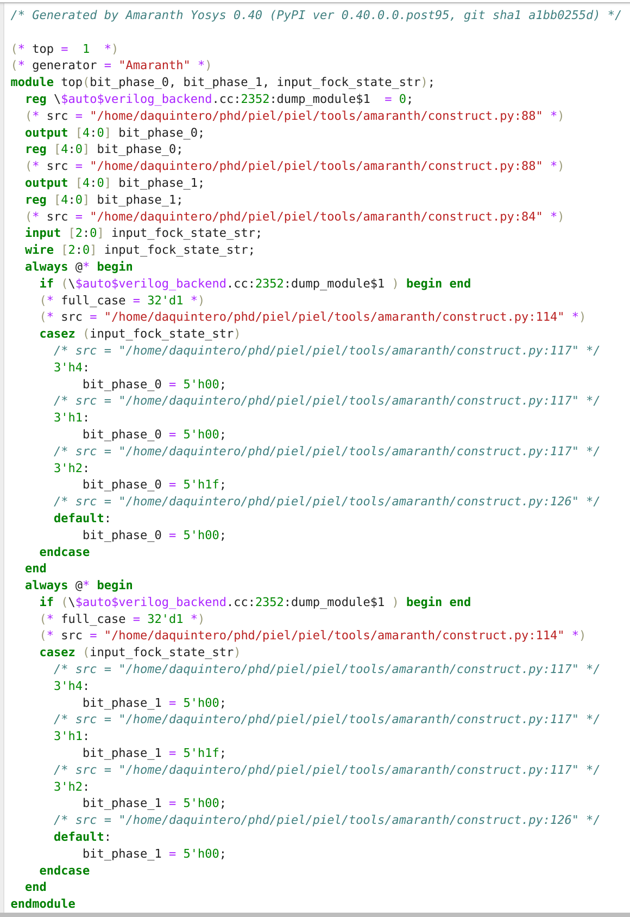
Simulation Capabilities
Example 7
Notes:
What I want to build, personally, is a system that looks like this: a fully-concurrent electronic-photonic system. This means when light and electronics signals interact, feedback and feedforwad in real time. I’d like to simulate this to some level in real time – and that it’s easy to see how design decisions on one domain affect the other.

Slide 11
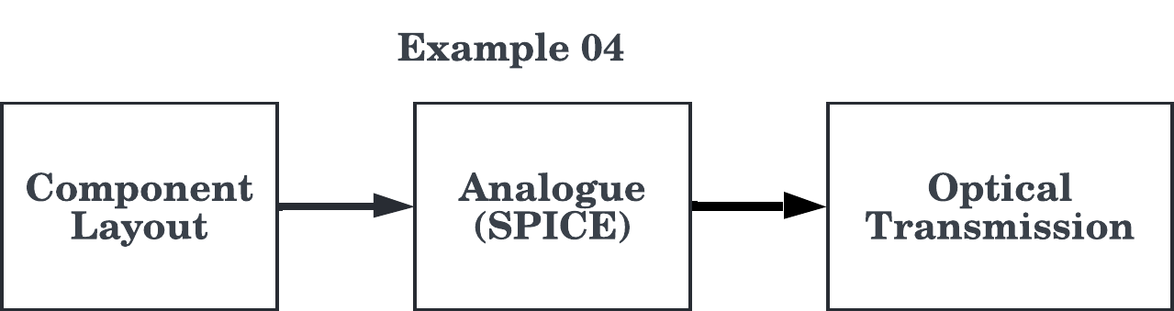
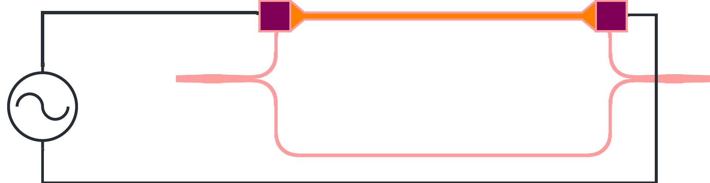
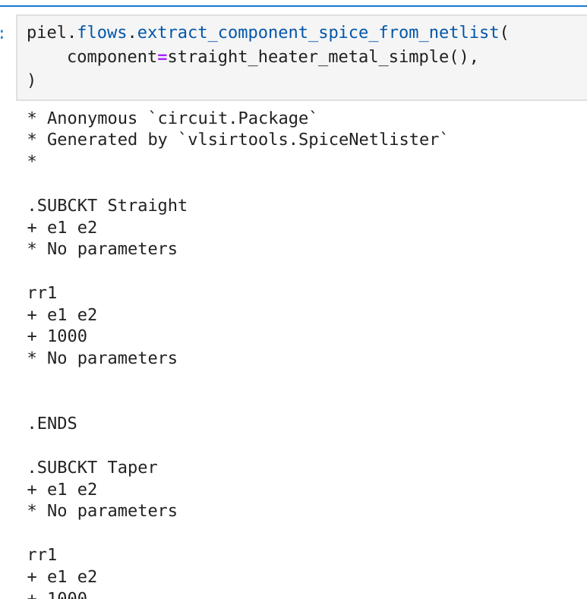
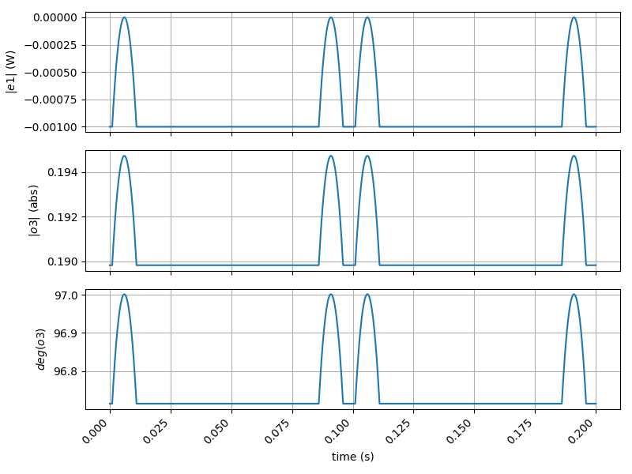
The piel Toolchain
Notes:
The power of open-source software is that it is much easier to interact and extend to simulate these type of complex systems than propietary software – especially if you are simulating physics no one has done before. The challenge is actually doing that, because it easily becomes a dependency hell in terms of maintenance and extensibility. The structure of piel is a microservice with well defined integration points between the tools. It is then easier to build more complex functionality between the design and simulation domains at this higher level. It also means that if a subroutine has to be optimized in say, rust, then there are also strong integration points. Written in python so that it is more accesible, but on the lower level interacts with multiple languages.
Make pictures the whole slide. Show transients, impedances and reactances that come from here. Introduce the switch really quite basic, maybe at that point start and end annotated diagram differfent tools used at each of these steps. Phase modulator, why want to change a phase to make it switch. Brightness and phase.

Slide 12
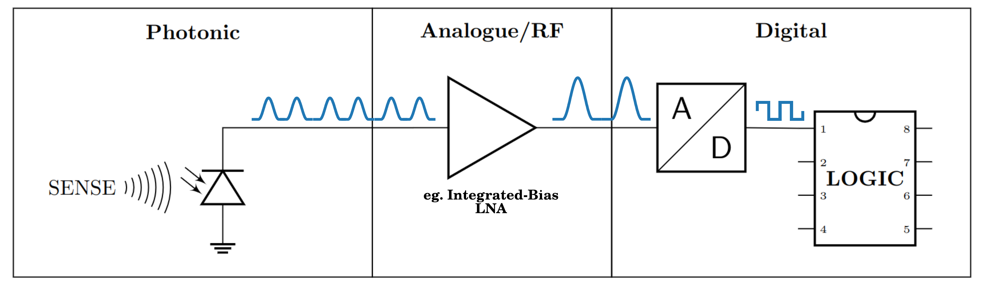
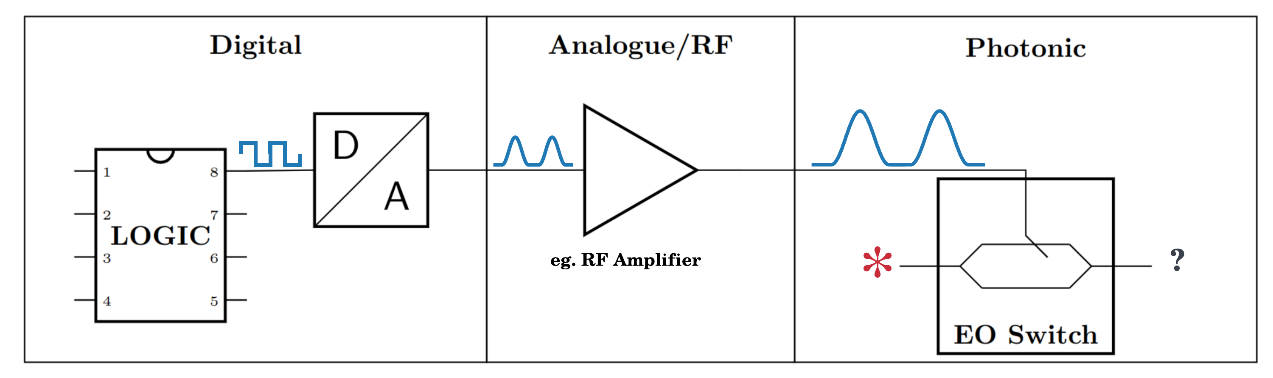
Appendix
Notes:
Why is this interesting?
Talk about the results that are coming out
Why do we care about the different graphs that come up and what they mean for the applications?
Motivation more part, help bridge people with domains.
More motivation, why is this solved by telecom.
Scrolling through code, pull out graphs and pictures of the chips. Focus on powerpoint, scrolll through lots and lots of code. Most safer bet. Generating something cool, audiovisual, suggest dedicated environment scripts, box of code that. Reading it does one thing. Choice pick screenshot. Take some time. Work out first sentence. Starting.

