Slide 1
Data Visualization and Plotting with Python Jupyter notebook (Anaconda)
Biomedical Data Science Initiative class @ NIA/NIH
Dr. Showkat Dar
PostDoc
Computational Genomics Unit (LGG)
Class Times: 12:30-2:00 pm Tuesday, June 11th and Thursday, June 13th, 2024 Class link: https://nih.zoomgov.com/j/1613089725?pwd=dE8reWkzRnBSaTRWNXB4Sk5XWElDQT09

Slide 2
Our Schedule -> Hands-On :: 2-way Learning
Day-I:
Background - Rules for better figures
Hands-on – Introduction to Python's plotting libraries (Matplotlib and Seaborn)
Basic plotting techniques (line graphs, bar charts, and histograms) and saving plots in different formats.
Day-II:
4. Advanced visualizations (heatmaps, pair plots, and time series visualization)
5. Best practices in data visualization.

Slide 3
Day-I
Background - Rules for better figures

Slide 4
Definition - data visualization?
Data visualization is the graphical representation of information and data.
By using visual elements like charts, graphs, and maps, data visualization tools provide an accessible way to see and understand trends, outliers, and patterns in data.
Excellent way to present data to non-technical audiences without confusion.
Data visualization tools and technologies are essential to analyze massive amounts of information (BIG-DATA) and make data-driven decisions.
https://www.tableau.com/learn/articles/data-visualization#definition
Notes:
https://www.tableau.com/learn/articles/data-visualization#definition

Slide 5
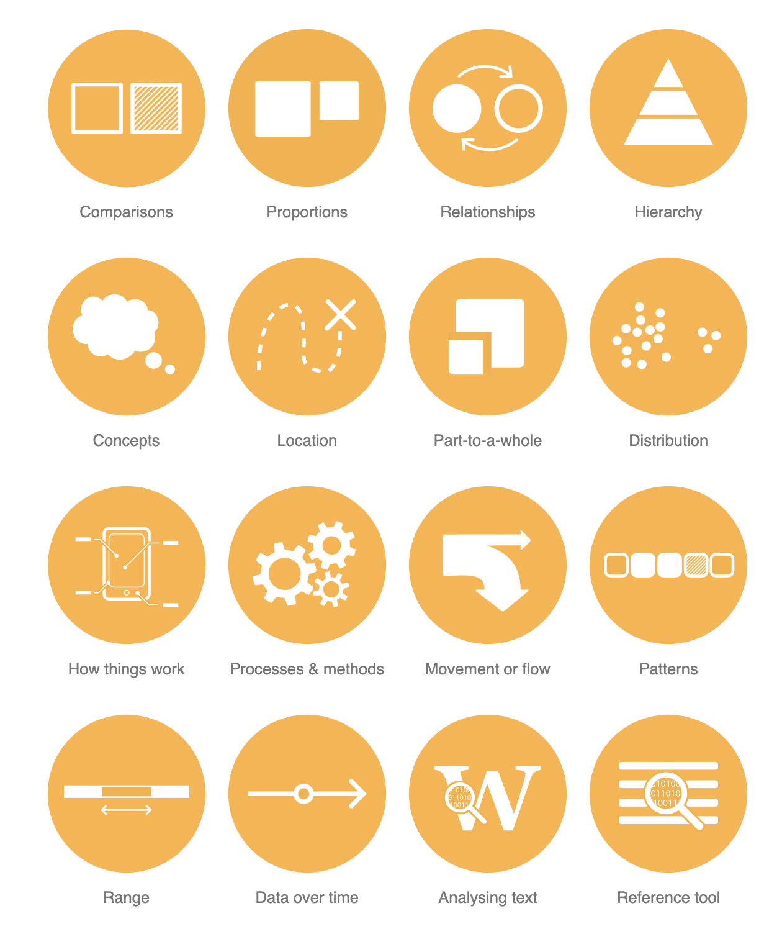
What do you want to show?
https://datavizcatalogue.com/search.html

Slide 6
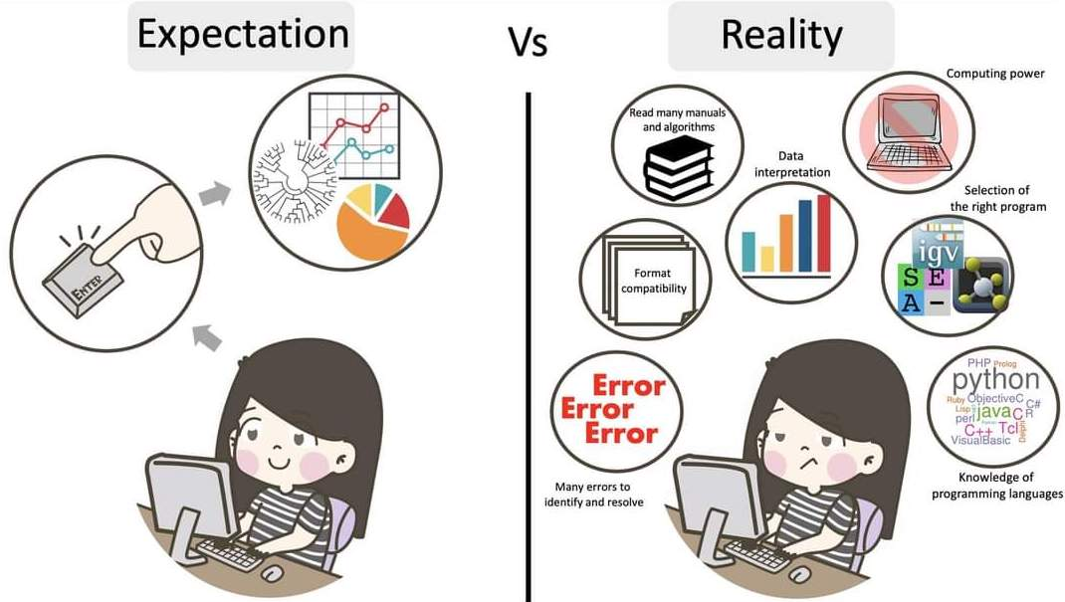
Adopted from https://training.galaxyproject.org/
Notes:
https://training.galaxyproject.org/training-material/topics/assembly/tutorials/get-started-genome-assembly/slides-plain.html

Slide 7
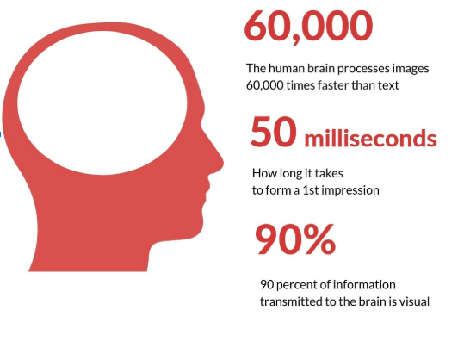
Humans process visual data better.
https://mastertcloc.unistra.fr
Notes:
Our eyes can register more than 36000 visual messages per hour that accounts to 10 visuals per second.
More than 90 percent of the information that is transmitted to the brain is visual
When it comes to processing information, a brain can process visuals 60,000 times faster than any text.
https://mastertcloc.unistra.fr/2019/07/22/digital-marketing-strategy/

Slide 8
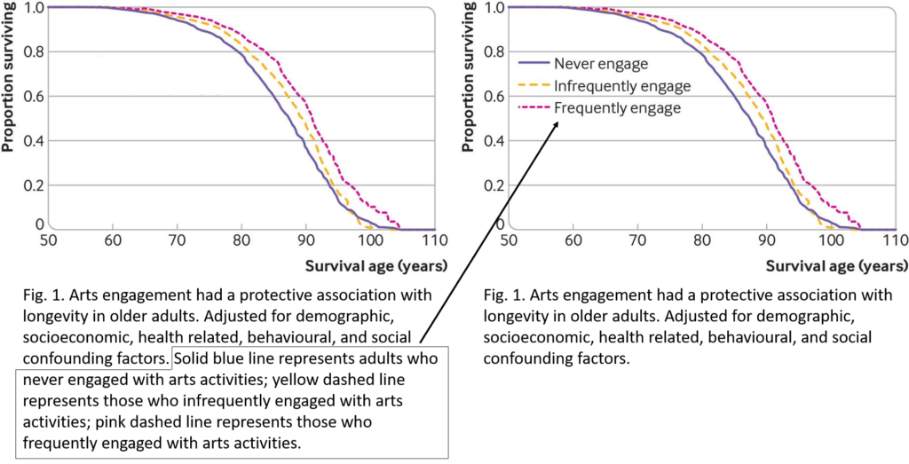
Examples…

Slide 9
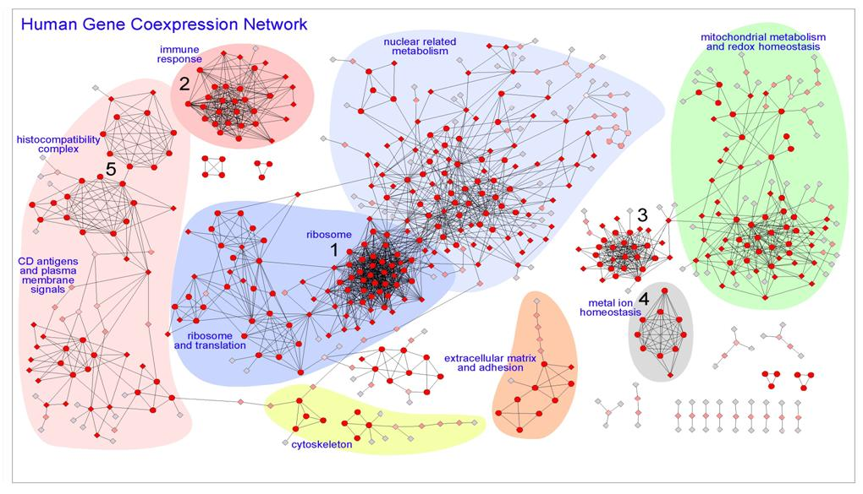
http://bioinfow.dep.usal.es/pages/coexpression/index.html
Notes:
http://bioinfow.dep.usal.es/pages/coexpression/index.html

Slide 10
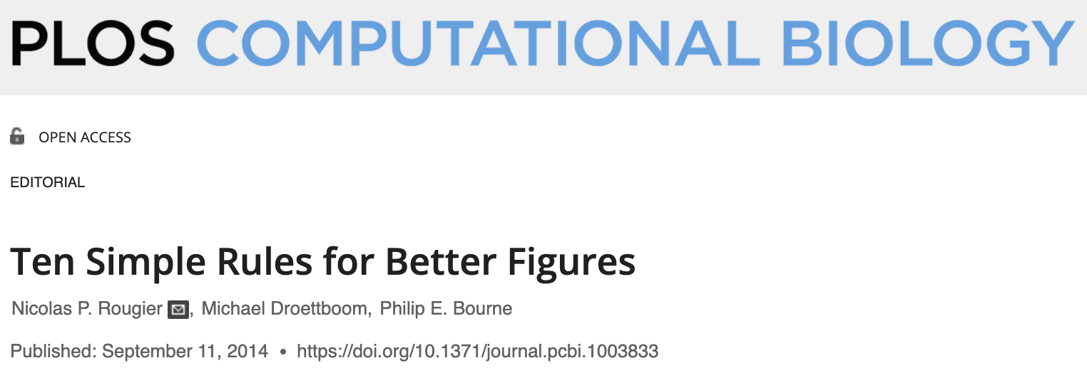
Ten Simple Rules for Better Figures
https://journals.plos.org/ploscompbiol/article?id=10.1371/journal.pcbi.1003833
Notes:
https://journals.plos.org/ploscompbiol/article?id=10.1371/journal.pcbi.1003833

Slide 11
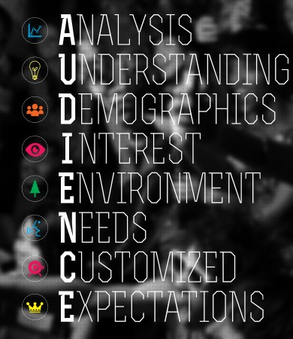
Rule 1: Know Your Audience
Understand the audience and the message.
Design figures based on audience needs.
Simple figures for the general public; detailed figures for scientific journals.
Add extra information for students to ensure understanding.

Slide 12
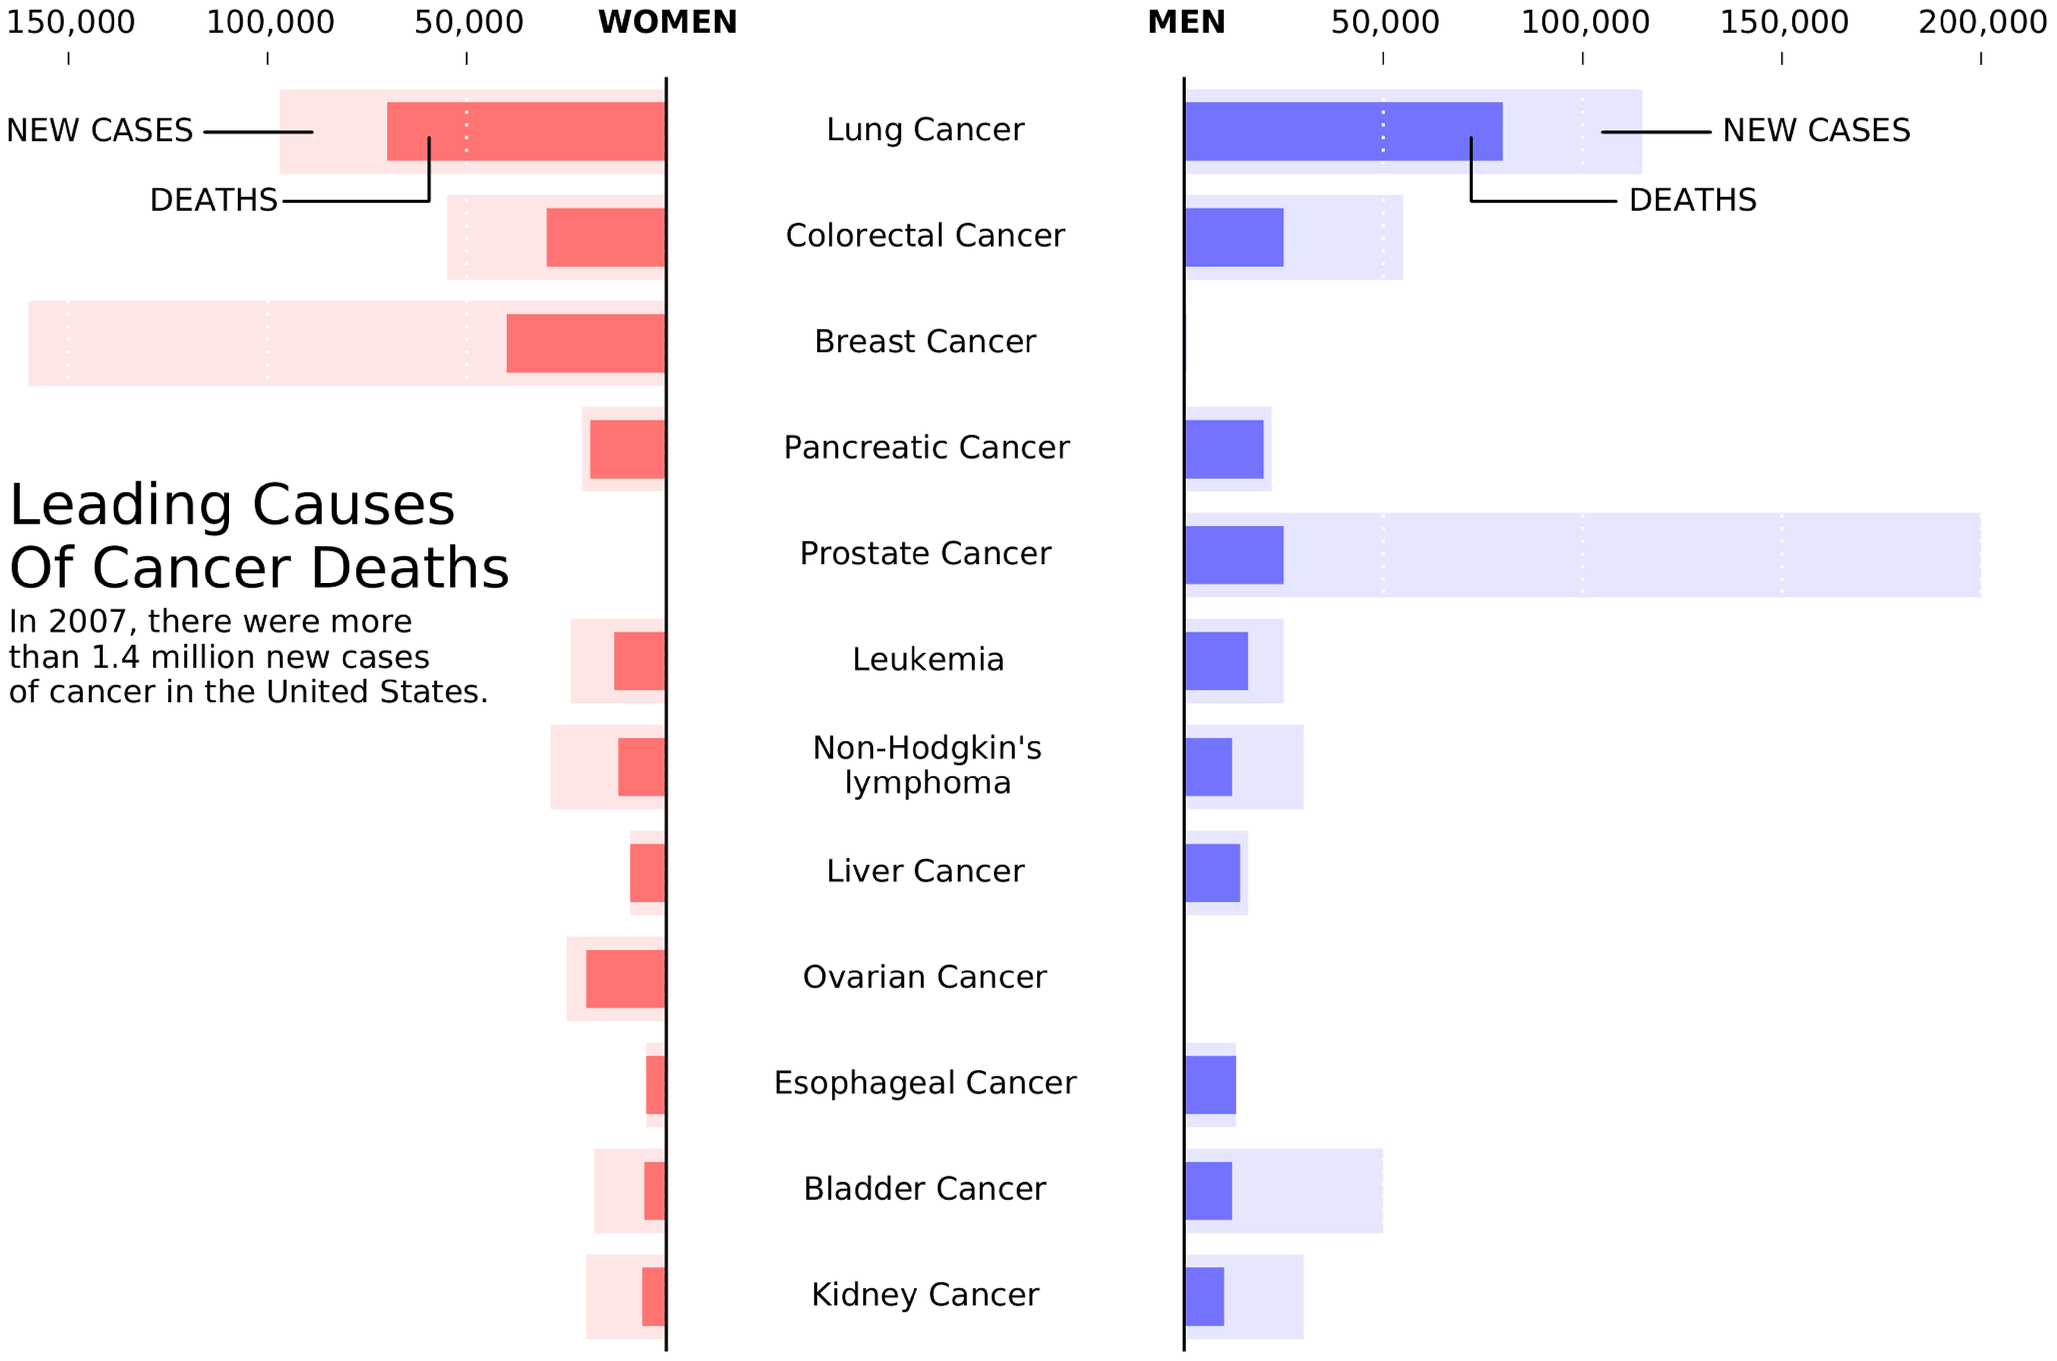
Rule 2: Identify Your Message
Clearly define the message of the figure.
Design figures to express the message effectively.
A clear message increases the impact of the figure.
This is a remake of a figure that was originally published in the New York Times (NYT) in 2007. This new figure was made with matplotlib using approximated data. The data is made of four series (men deaths/cases, women deaths/cases) that could have been displayed using classical double column (deaths/cases) bar plots. However, the layout used here is better for the intended audience.

Slide 13
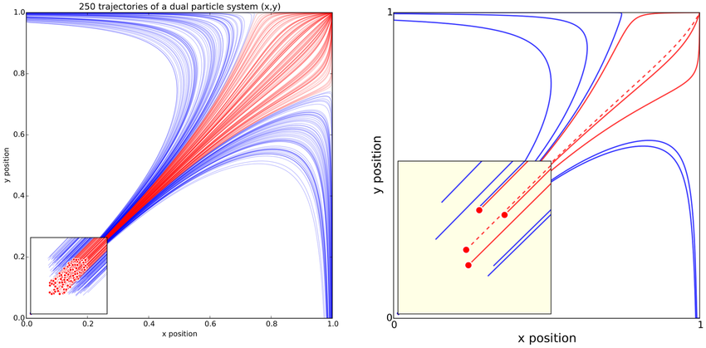
Rule 3: Adapt the Figure to the Support Medium
Tailor figures to the display medium (poster, screen, paper).
Keep figures simple and clear for oral presentations.
Include more details in figures for journal articles.
Oral
Presentation
Manuscript
Simulation of the trajectories of a dual-particle system, where each particle interacts with the other. Depending on the initial conditions, the system may end up in three different states

Slide 14
Rule 4: Captions Are Not Optional
Use captions to explain the figure.
Provide details that can't be visually represented.
Anticipate questions and include necessary information.

Slide 15
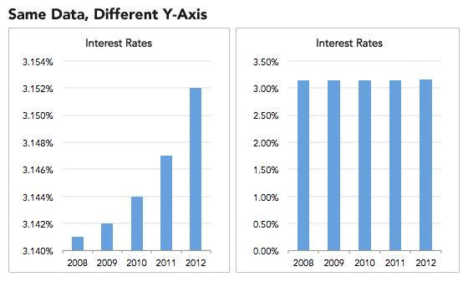
Rule 5: Do Not Trust the Defaults
Default settings may not suit your figure's needs.
Manually adjust settings for clarity and precision.
Customize colors, fonts, and styles to enhance the message.

Slide 16
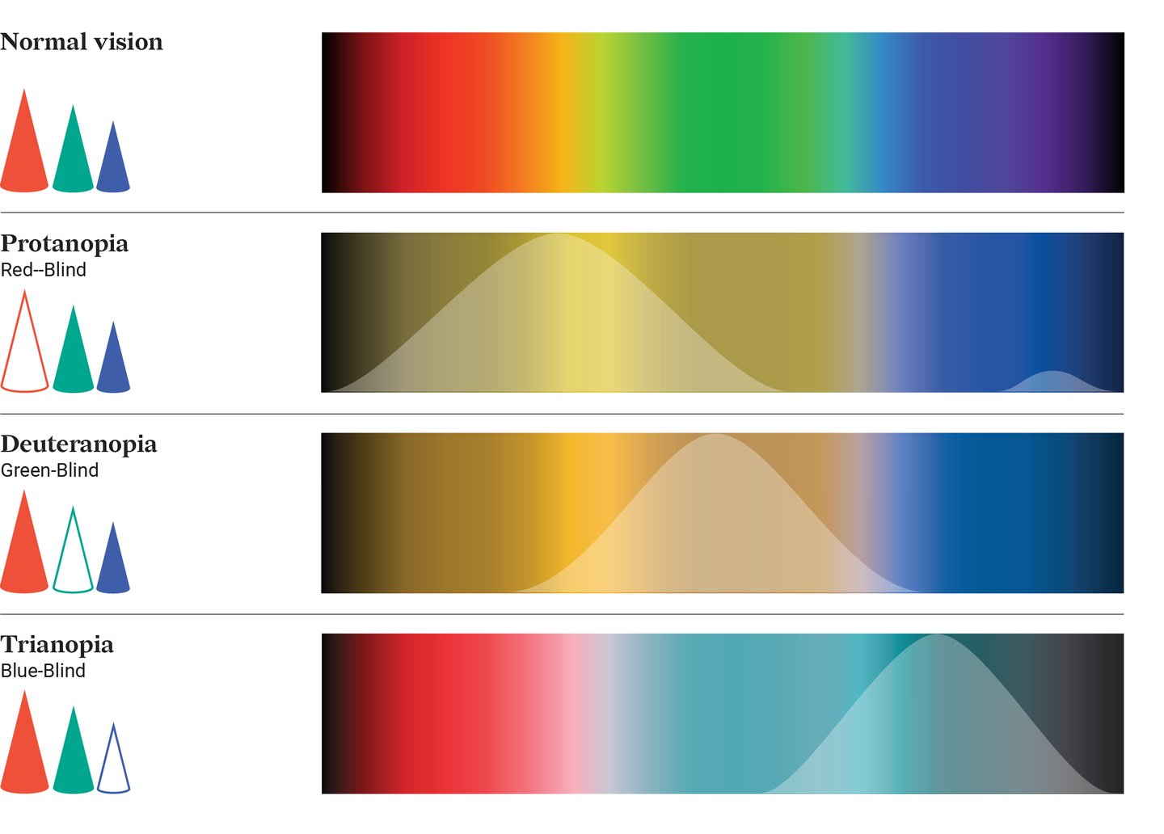
Rule 6: Use Color Effectively
Use color to highlight important elements.
Avoid unnecessary colors.
Choose the appropriate colormap for your data type.
Consider color blindness in your color choices.

Slide 17
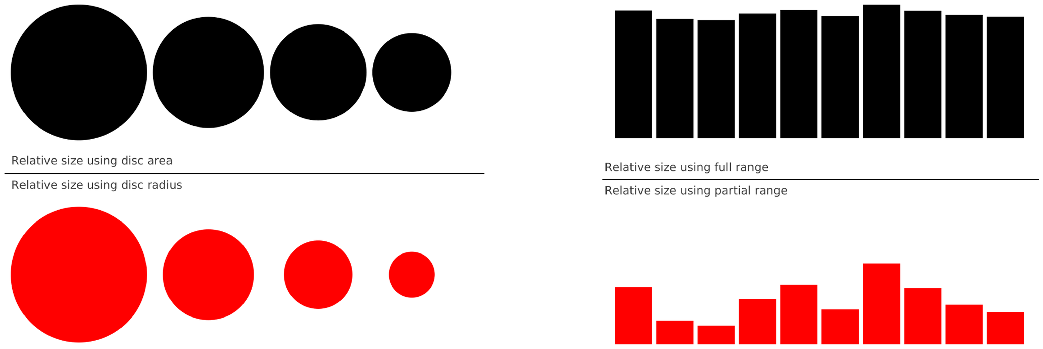
Rule 7: Do Not Mislead the Reader
Represent data accurately and objectively.
Avoid visual distortions and misleading scales.
Use simple plots and appropriate labels.
Notes:
On the left part of the figure, we represented a series of four values: 30, 20, 15, 10. On the upper left part, we used the disc area to represent the value, while in the bottom part we used the disc radius. Results are visually very different. In the latter case (red circles), the last value (10) appears very small compared to the first one (30), while the ratio between the two values is only 3∶1. This situation is actually very frequent in the literature because the command (or interface) used to produce circles or scatter plots (with varying point sizes) offers to use the radius as default to specify the disc size. It thus appears logical to use the value for the radius, but this is misleading. On the right part of the figure, we display a series of ten values using the full range for values on the top part (y axis goes from 0 to 100) or a partial range in the bottom part (y axis goes from 80 to 100), and we explicitly did not label the y-axis to enhance the confusion. The visual perception of the two series is totally different. In the top part (black series), we tend to interpret the values as very similar, while in the bottom part, we tend to believe there are significant differences. Even if we had used labels to indicate the actual range, the effect would persist because the bars are the most salient information on these figures.

Slide 18
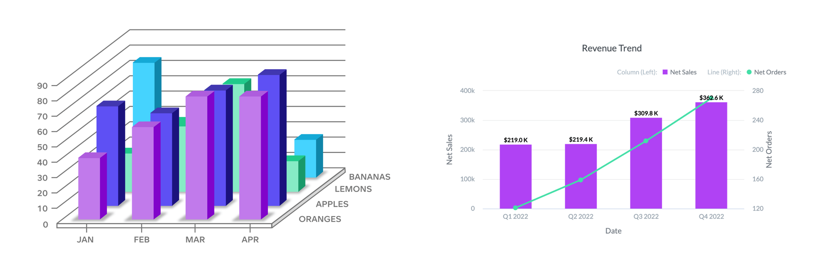
Rule 8: Avoid “Chartjunk”
Eliminate unnecessary visual elements.
Keep the design clean and focused on the data.
Justify any additional elements to avoid clutter.

Slide 19
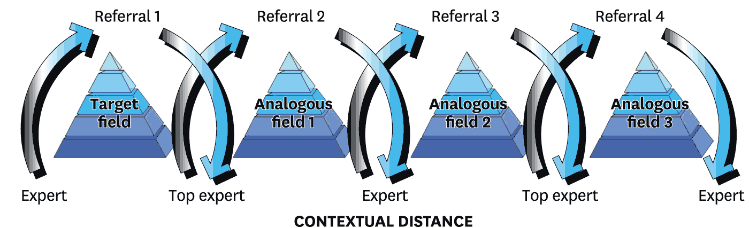
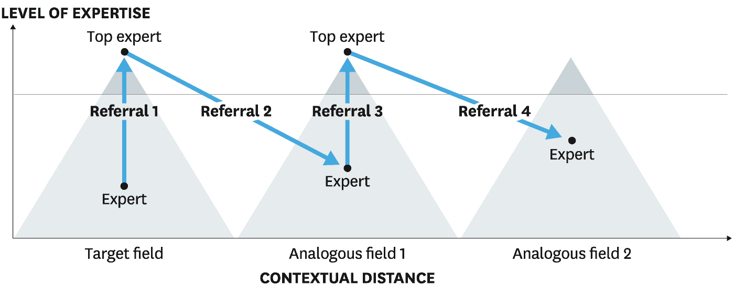
Rule 9: Message Trumps Beauty
Prioritize clarity and readability over aesthetics.
Follow scientific best practices for figure design.
Avoid purely aesthetic designs that compromise data integrity.
How does a pyramid search work?
Notes:
Here the color gradient, the drop shadows, and the 3-D pyramids distract us from the idea. The arrows don’t actually demonstrate how a pyramid search works. And experts and top experts are placed on the same plane instead of at different heights to convey relative status.

Slide 20
Rule 10: Get the Right Tool
Use appropriate tools for different types of figures.
Explore open-source tools for flexibility and control.
Familiarize yourself with specialized software for better results.
https://datavizcatalogue.com/search.html

Slide 21
Break !

Slide 22
2. Hands-on
Introduction to Python's plotting libraries :
Matplotlib and Seaborn

Slide 23
Requirements:
System installed Jupyter notebook (Anaconda) with packages python (), matplotlib and seaborn.
Internet connection

Slide 24
Python Data Visualization Libraries
Matplotlib :
A foundational library for creating static, animated, and interactive visualizations in Python. Matplotlib is versatile, supporting a wide range of plot types and customization options. It integrates well with Numpy for handling complex numerical data and allows exporting visualizations in various formats. URL:: https://matplotlib.org/
Seaborn :
Built on top of Matplotlib, Seaborn simplifies the creation of beautiful, informative statistical graphics. It offers enhanced support for themes and color palettes and integrates seamlessly with Pandas for structured data visualization. Seaborn is ideal for users seeking attractive default styles and color schemes.
URL:: https://seaborn.pydata.org/
Notes:
https://matplotlib.org
https://seaborn.pydata.org

Slide 25
Python Data Visualization Libraries (others)
Plotly : A library for making interactive, publication-quality graphs online. Plotly's strength lies in its ability to create complex, interactive plots that are web-friendly.
Altair :Focused on declarative statistical visualization, Altair is built on Vega-Lite and allows for concise, intuitive plot creation.
Bokeh :Targets web browsers for output, offering interactive, web-ready visualizations. Bokeh is suitable for creating interactive plots, dashboards, and data applications.
GeoPandas: Extends Pandas for working with geospatial data, integrating with libraries like Shapely and Fiona for geometric operations and file access, respectively.
Python Data Visualization with Hex: Hex is a popular polyglot development environment that allows you to write code in multiple languages in the same environment.

Slide 26
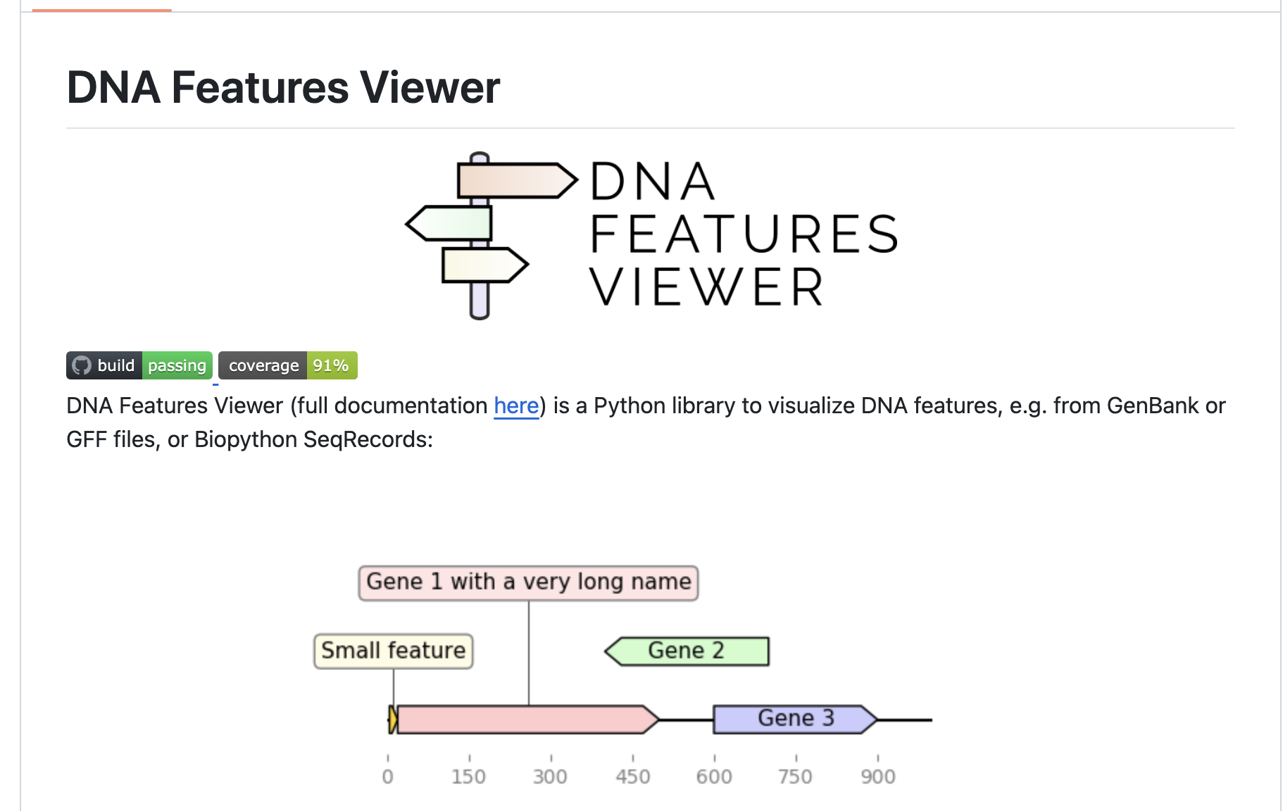
DNA Features Viewer
DNA Features Viewer is a Python library to visualize DNA features, e.g. from GenBank or Gff files, or Biopython SeqRecords.
https://github.com/Edinburgh-Genome-Foundry/DnaFeaturesViewer

Slide 27
Python 3rd-party and user-contributed packages
A list of packages that extend Matplotlib. These are maintained and distributed independently from Matplotlib so go to the website listed for instructions.
https://matplotlib.org/mpl-third-party/

Slide 28
What we need for visualization?
Step 1. Data in proper format like table, no-zeros, NA’s, missing values, empty values.
Step 2. Create the environment for the plotting like
python→ matplotlib, seaborn (in Jupyter notebook).
Step 3. Loading the libraries and data.
Step 4. Creating the required plots.
Step 5. Saving the plot (and further modification in Photoshop/Affinity etc).

Slide 29
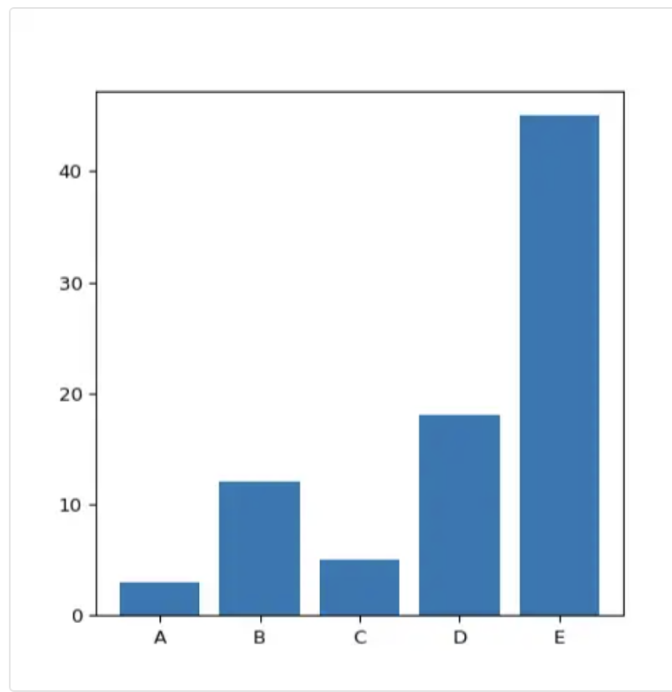
Matplotlib : Barplot
import matplotlib.pyplot as plt
# Make a random dataset:
height = [3, 12, 5, 18, 45]
bars = ['A', 'B', 'C', 'D', 'E']
# Create bars
plt.bar(bars, height)
# Show graphic
plt.show()
# Save figure in different formats
plt.savefig('bar_plot.png') # Save as PNG
plt.savefig('bar_plot.pdf') # Save as PDF
plt.savefig('bar_plot.svg') # Save as SVG
https://python-graph-gallery.com/barplot/
Notes:
https://python-graph-gallery.com/barplot/

Slide 30
3. Basic plotting techniques
Line graphs, bar charts, and histograms) and more …
Saving plots in different formats

Slide 31
Matplotlib – Examples/Gallery
https://matplotlib.org/stable/gallery/
Notes:
https://matplotlib.org/stable/gallery/

Slide 32
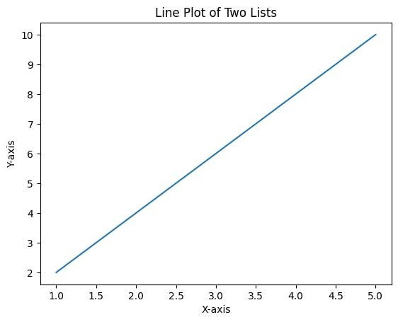
Matplotlib : Plotting categorical variables
import matplotlib.pyplot as plt
# Sample data
listOne = [1, 2, 3, 4, 5]
listTwo = [2, 4, 6, 8, 10]
# Create a line plot
plt.plot(listOne, listTwo)
# Add labels and title
plt.xlabel(‘X-axis’)
plt.ylabel(‘Y-axis’)
plt.title(‘Line Plot of Two Lists’)
# Show the plot
plt.show()
plt.savefig(‘Lineplot.tiff’)
Lineplot
Notes:
https://matplotlib.org/stable/gallery/lines_bars_and_markers/categorical_variables.html#sphx-glr-gallery-lines-bars-and-markers-categorical-variables-py

Slide 33
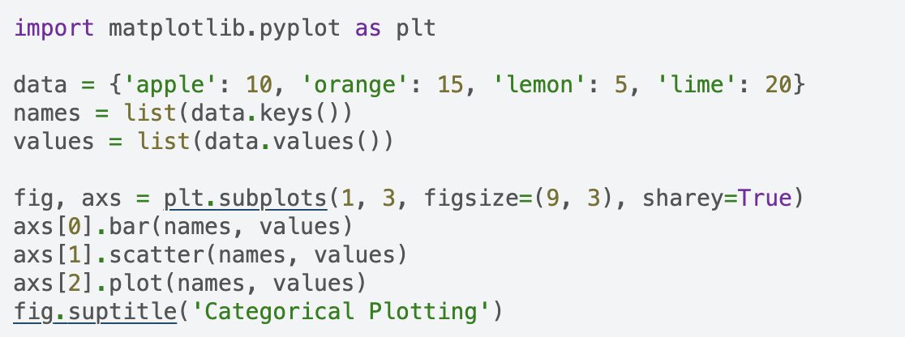
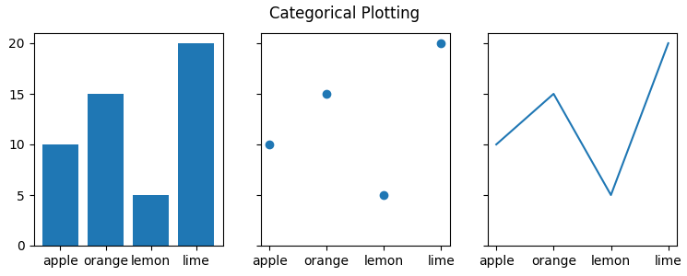
Matplotlib : Plotting categorical variables
Barplot Scatterplot Lineplot
https://matplotlib.org/stable/gallery/lines_bars_and_markers/categorical_variables.html#sphx-glr-gallery-lines-bars-and-markers-categorical-variables-py
Notes:
https://matplotlib.org/stable/gallery/lines_bars_and_markers/categorical_variables.html#sphx-glr-gallery-lines-bars-and-markers-categorical-variables-py

Slide 34
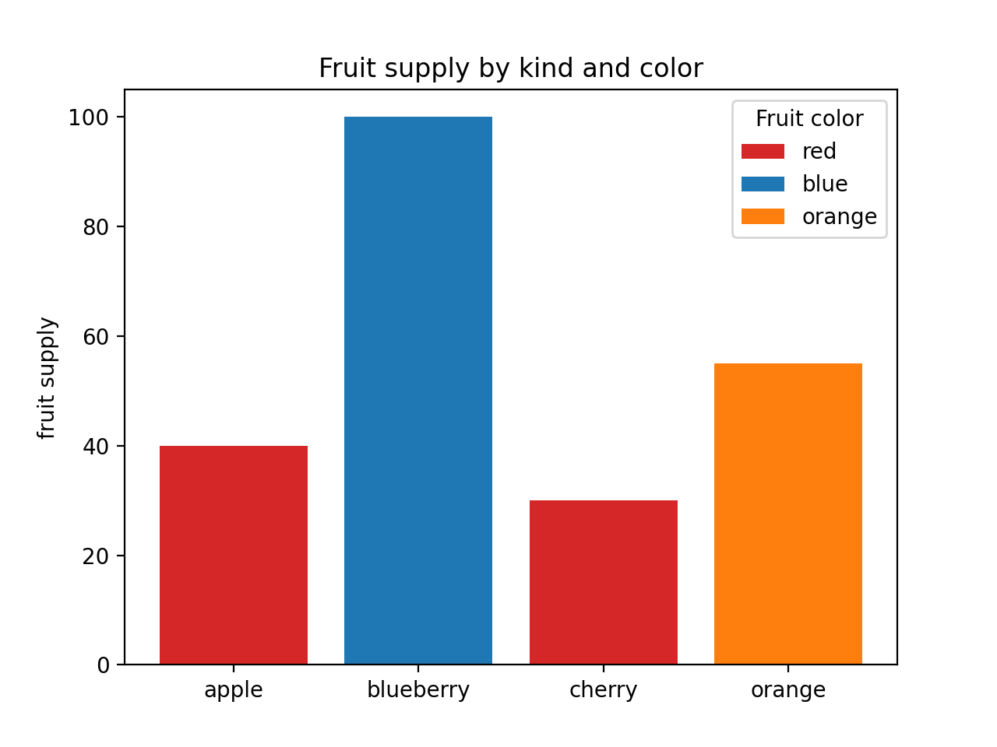
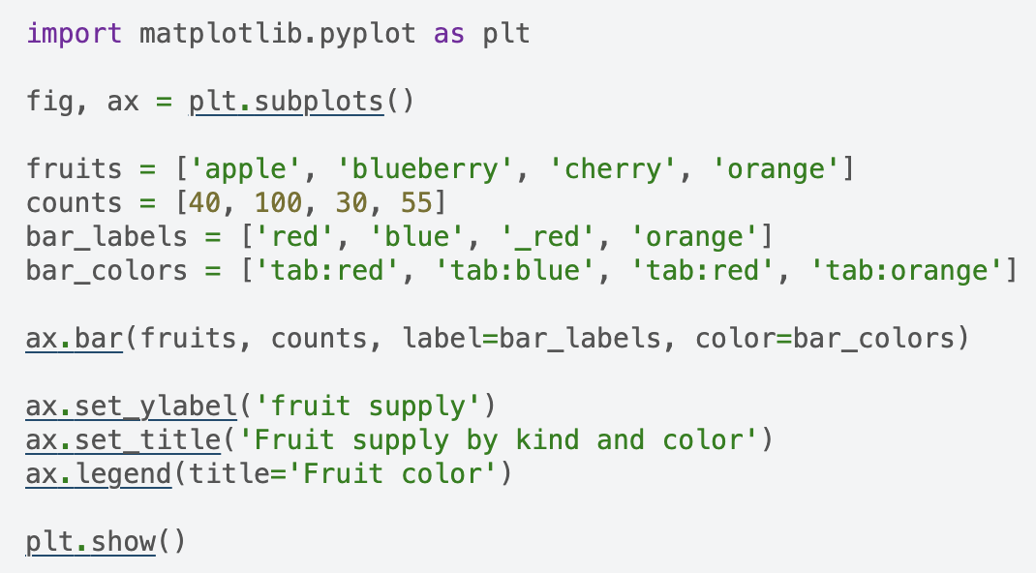
Matplotlib : Lines-bars-and-markers-bar-colors
https://matplotlib.org/stable/gallery/lines_bars_and_markers/bar_colors.html#sphx-glr-gallery-lines-bars-and-markers-bar-colors-py
Notes:
https://matplotlib.org/stable/gallery/lines_bars_and_markers/bar_colors.html#sphx-glr-gallery-lines-bars-and-markers-bar-colors-py

Slide 35
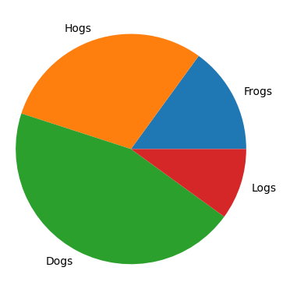

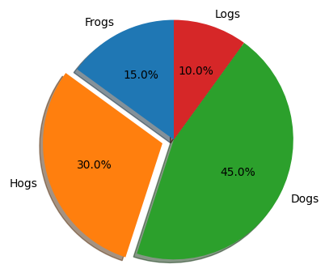
Matplotlib : Pie charts
https://matplotlib.org/stable/gallery/pie_and_polar_charts/pie_features.html#sphx-glr-gallery-pie-and-polar-charts-pie-features-py
Notes:
https://matplotlib.org/stable/gallery/pie_and_polar_charts/pie_features.html#sphx-glr-gallery-pie-and-polar-charts-pie-features-py

Slide 36
Seaborn – Examples/Gallery
https://seaborn.pydata.org/examples/index.html
Notes:
https://seaborn.pydata.org/examples/index.html

Slide 37
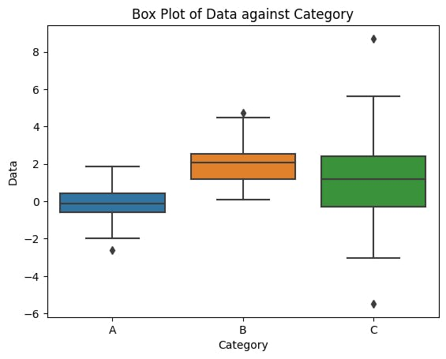
seaborn : Boxplot
import seaborn as sns
import numpy as np
import pandas as pd
# Generate random data
np.random.seed(42)
dataOne = np.random.normal(0, 1, 100)
dataTwo = np.random.normal(2, 1, 100)
dataThree = np.random.normal(1, 2, 100)
# Combine the data into a DataFrame
data = np.concatenate([dataOne, dataTwo, dataThree])
categories = np.repeat(['A', 'B', 'C'], 100)
df = pd.DataFrame({'Category': categories, 'Data': data})
# Create a figure with specific dimensions (width, height) plt.figure(figsize=(10, 6))
# Create a box plot
sns.boxplot(x='Category', y='Data', data=df)
# Add title
plt.title('Box Plot of Data against Category’)
# Show the plot
plt.show()

Slide 38
seaborn : Boxplot - code-decoded -I
import seaborn as sns
import numpy as np
import pandas as pd
seaborn (sns): A Python visualization library based on matplotlib that provides a high-level interface for drawing attractive and informative statistical graphics.
numpy (np): A fundamental package for scientific computing with Python, used for creating and manipulating numerical data.
pandas (pd): A data manipulation and analysis library for Python, which provides data structures like DataFrame to work with structured data.

Slide 39
seaborn : Boxplot - code-decoded -I
# Generate random data
np.random.seed(42)
dataOne = np.random.normal(0, 1, 100)
dataTwo = np.random.normal(2, 1, 100)
dataThree = np.random.normal(1, 2, 100)
np.random.seed(42): Sets the seed for the random number generator to ensure reproducibility. The seed value 42 ensures that the same random numbers are generated each time the code is run.
dataOne = np.random.normal(0, 1, 100): Generates 100 random numbers from a normal distribution with a mean of 0 and a standard deviation of 1.
dataTwo = np.random.normal(2, 1, 100): Generates 100 random numbers from a normal distribution with a mean of 2 and a standard deviation of 1.
dataThree = np.random.normal(1, 2, 100): Generates 100 random numbers from a normal distribution with a mean of 1 and a standard deviation of 2.

Slide 40
seaborn : Boxplot - code-decoded -III
data = np.concatenate([dataOne, dataTwo, dataThree])
categories = np.repeat(['A', 'B', 'C'], 100)
df = pd.DataFrame({'Category': categories, 'Data': data})
data = np.concatenate([dataOne, dataTwo, dataThree]): Combines the three datasets into a single array.
categories = np.repeat(['A', 'B', 'C'], 100): Creates an array of category labels ('A', 'B', 'C'), each repeated 100 times to match the data points.
df = pd.DataFrame({'Category': categories, 'Data': data}): Creates a DataFrame with two columns, 'Category' and 'Data', where each row represents a data point and its corresponding category.

Slide 41
seaborn : Boxplot - code-decoded -IV
# Create a figure with specific dimensions (width, height) plt.figure(figsize=(10, 6))
# Example: 10 inches wide, 6 inches high
# Create a box plot
sns.boxplot(x='Category', y='Data', data=df)
Creates a box plot using Seaborn. The x-axis represents the 'Category', and the y-axis represents the 'Data'. The box plot visualizes the distribution of the data for each category, showing the median, quartiles, and potential outliers.
plt.title('Box Plot of Data against Category’)
Adds a title to the box plot.

Slide 42
seaborn : Boxplot - code-decoded -IV
> Save the plot
# Save as PNG
plt.savefig('box_plot.png’)
# Save as PDF
plt.savefig('box_plot.pdf’)
# Save as SVG
plt.savefig('box_plot.svg')

Slide 43
End Of the Day -I
Enjoy the data Visualization.
Thank you!
Reach me @
Showkat.dar@nih.gov
Showkat.dar19@gmail.com
Mob: 443-248-8491
B –Wing, 10th Floor, LGG, NIA/NIH.

Slide 44
Thank you!
Reach me @
Showkat.dar@nih.gov
Showkat.dar19@gmail.com
Mob: 443-248-8491
B –Wing, 10th Floor, LGG, NIA.

