Slide 1
Quarto Basics
With 1 qmd or ipynb file output many file formats You are the next quarto author!

Slide 2
Table of contents
Polar Axis

Slide 3
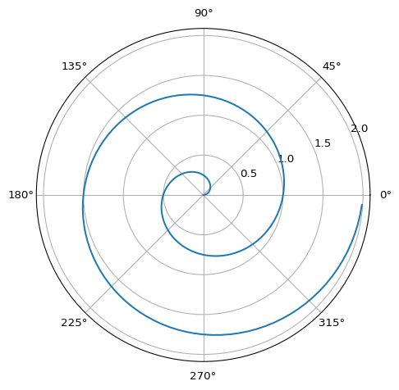
Polar Axis
For a demonstration of a line plot on a polar axis, see Figure 1.

