Slide 1
Quarto Basics
Easy to use You are the next quarto author!

Slide 2
Table of contents
Polar Axis

Slide 3
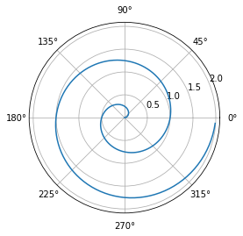
Polar Axis
For a demonstration of a line plot on a polar axis, see Figure 1.

