Slide 1
Increment: the decision
A fixed promotion budget needs an incremental-margin decision.

Slide 2
Measurement
Randomization gives the ITT; SRM and uncertainty are gates.

Slide 3
Learning
Propensity predicts outcomes; uplift estimates treatment response.

Slide 4
The result
Synthetic business case: 5.26 INR per eligible user above random at 50% budget

Slide 5
Marketplace
Capacity and interference can reverse a customer-level optimum.

Slide 6
Rollout
Persistent holdout, staged gates, guardrails, and retraining triggers.

Slide 7
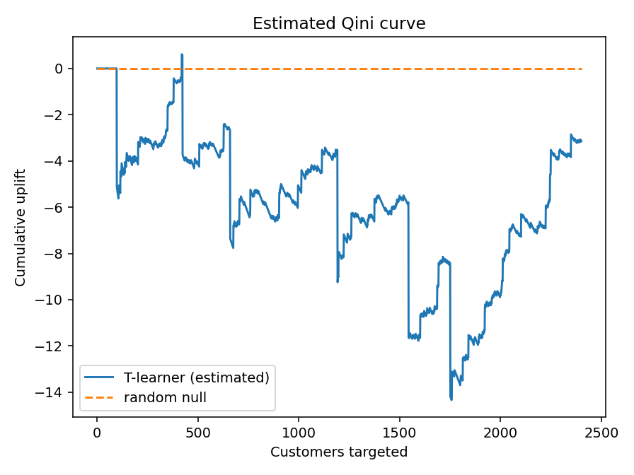
Qini

Slide 8
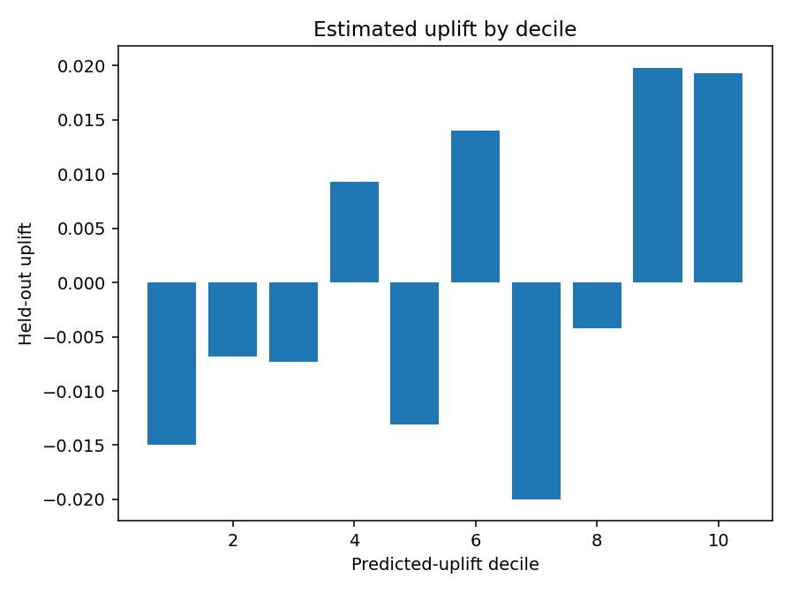
Uplift deciles

Slide 9
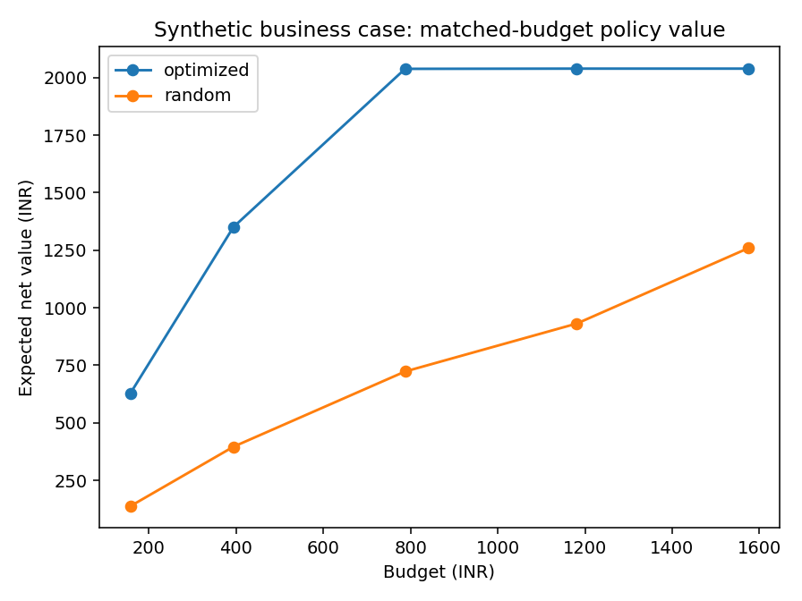
Profit vs budget

