Slide 1
IMAGE DEHAZING
Mentor: Dr.Mrinmoy Ghorai
Group no: 20

Slide 2

TEAM
Dara Deepak S20190010037
C. Guru Nithin Reddy S20190010028
Paindla Yashwanth Kumar S20190010130
Kona Pavan Kumar S20190010095

Slide 3
TABLE OF CONTENTS
Problem Definition
Challenges
Motivation
Literature Survey
Methodology
Dataset
Results
Conclusions
References

Slide 4
PROBLEM DEFINITION
1

Slide 5
Problem Definition
The images in outdoor scenes are generally degraded by different weather condition. Atmospheric phenomena like fog and haze may degrade the visibility of the scene significantly.
We need to restore the image in the absence of the ground truth image, in a computationally inexpensive manner.

Slide 6

The Idea…
The basic observation is that on haze-free outdoor images, most of the non-sky patches, at least one color channel has very low intensity at some pixels. The low intensities in the dark channel are mainly due to:
Dark objects, shadows of trees and rocks.
Colorful objects Examples - green, red, yellow, blue
Since the natural outdoor images are usually colorful and full of shadows, it is reasonable to generalize the observation.

Slide 7
CHALLENGES
2

Slide 8
Challenges
Find a way to solve the ambiguity problem between images color and depth in dehazing.
Create a more robust model for dehazing in inhomogeneous atmosphere.
Develop a reliable image quality assessment mechanism to evaluate the quality of dehazing algorithms.

Slide 9
MOTIVATION
3

Slide 10
Motivation
Under bad weather conditions, such as fog and haze, the quality of images degrades severely due to the influence of particles in the atmosphere. Suspended particles scatter light and result in attenuation of reflected light from the scene.
The performance of vision algorithms will inevitably suffer from the biased, low contrast scene radiance. It is therefore necessary for computer vision systems to improve the visual effects of the image and highlight image features.
The development of image dehazing methods has been beneficial to many real-world applications, including outdoor video surveillance, analysis of remote sensing imagery, and driver assistance systems. These techniques can also be transferred to underwater image enhancement and enhancement of images acquired in rain or snow.

Slide 11
LITERATURE SURVEY
4

Slide 12
Literature Survey
Hybrid Single Image Dehazing with Bright Channel and Dark Channel Priors” “Jehoiada Jackson¹, Oluwasanmi Ariyo¹, Kingsley Acheampong¹, Maxwel Boakye², Enoch Frimpong², Eric Ashalley³, Younbo Rao^{1*}
Dark channel prior (DCP) and Bright channel prior (BCP) for single image dehazing is used.
This method achieves air light approximations by implementing numerical proximity of atmospheric light, which use the average value of the DCP and BCP.

Slide 13
Literature Survey
"Haze Removal using the Difference-Structure-Preservation Prior" Linyuan He, Jizhong Zhao Associate Member, IEEE, Nanning Zheng Fellow, IEEE, and Duyan Bi.
To solve the problem, we meticulously analyze the optical model and recast the initial transmission map under an additional boundary prior.
For better preservation of the results, the difference-structure-preservation dictionary could be learned such that the local consistency features of the transmission map could be well preserved after coefficient shrinkage.

Slide 14
Literature Survey
"Fast Single Image Dehazing with Robust Sky Detection" sebastian salazare.ulises moya-sanchez 2,3 (2020)
The DARK CHANNEL PRIOR(DCP) has shown remarkable results in image dehazing with three main limitations: high time consumption, artifact generation, and sky region oversaturation.
Therefore current work has focused on improving processing time without losing restoring quality and avoiding image artifacts during image dehazing.

Slide 15
METHODOLOGY
5

Slide 16

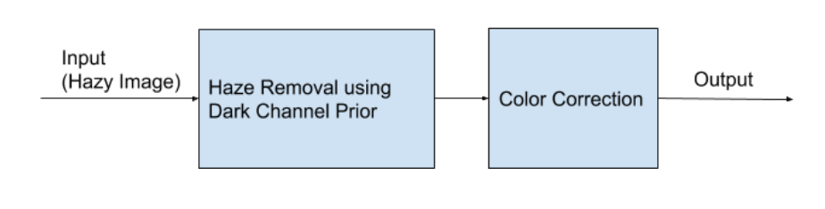
Methodology
Methodology

Slide 17
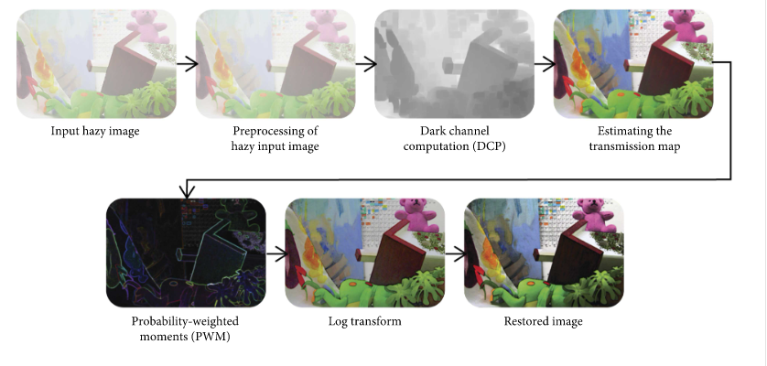
Methodology

Slide 18


Methodology
Preprocessing of a Hazy Input Image:
In the preprocessing stage, colored hazy images are used as an input. The haze imaging equation is normalized as follows:
Dark Channel Computation:
The computational criteria of dark channel prior are based on an observation in RGB images.Considering a normalized image from equation, its dark channel is mathematically defined as follows:

Slide 19


Methodology
Estimating the Transmission Map:
The transmission map is estimated by assuming the atmospheric light A is known.Assuming transmission to be constant for the small local patch we apply the dark channel on equation on both sides:
We will find dark channel prior k by using

Slide 20
DATASET
6

Slide 21
Dataset
For hazed images we have used our own dataset.
The total number of images used are 500, for training we have used 400 images and for testing we have used 100 images.
Link for the dataset - Dataset
Compared to other widely used datasets, this dataset contains a high quality images with high resolution.
In our dataset we have both Indoor and outdoor image dataset

Slide 22
RESULTS
7

Slide 23
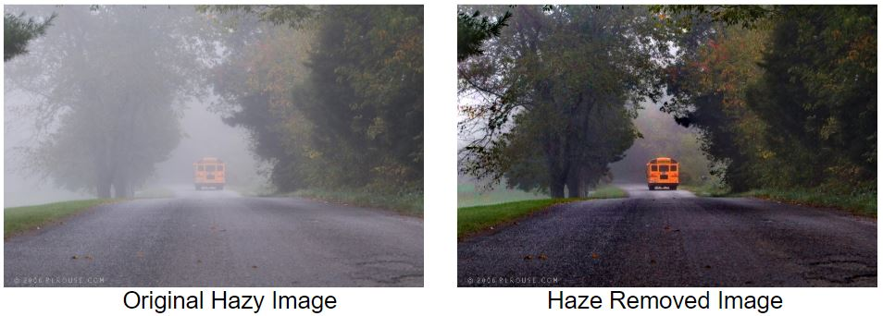
Results

Slide 24
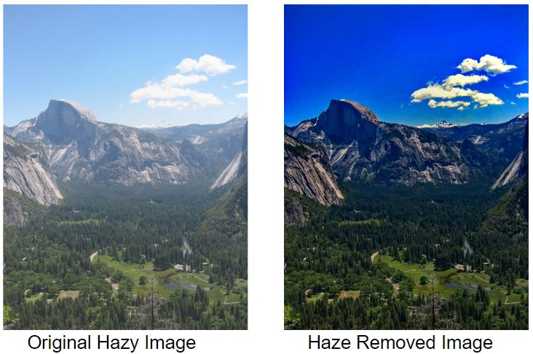
Results

Slide 25
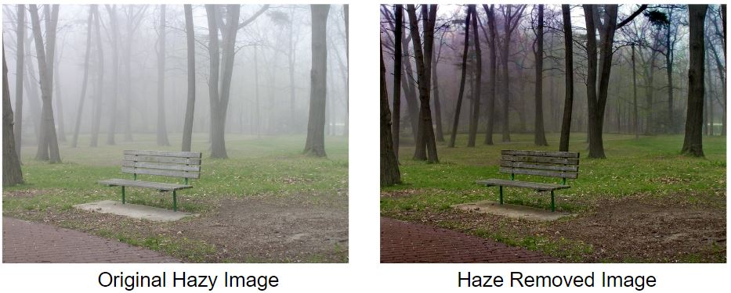
Results

Slide 26
CONCLUSION
8

Slide 27
Conclusion
This work provides good performance for the task of obtaining haze less image both qualitative and quantitative manner.
Experimental results show the proposed methods estimates haze accurately, the reconstruct images are more realistic and detailed information is restored.

Slide 28
REFERENCES
9

Slide 29
References
[1] He, Kaiming, Jian Sun, and Xiaoou Tang. "Single image haze removal using dark channel prior." IEEE transactions on pattern analysis and machine intelligence 33.12 (2010): 2341-2353.”
[2] Salazar-Colores, Sebastián, et al. "Fast single image defogging with robust sky detection." IEEE access 8 (2020): 149176-149189.
[3]Ancuti, Codruta O., et al. "O-haze: a dehazing benchmark with real hazy and haze-free outdoor images." Proceedings of the IEEE conference on computer vision and pattern recognition workshops. 2018.
[4] Ancuti, Cosmin, et al. "I-HAZE: a dehazing benchmark with real hazy and haze-free indoor images." International Conference on Advanced Concepts for Intelligent Vision Systems. Springer, Cham, 2018.
[5] Jackson, Jehoiada, et al. "Hybrid single image dehazing with bright channel and dark channel priors." 2017 2nd International Conference on Image, Vision and Computing (ICIVC). IEEE, 2017.

Slide 30
THANKS!

