Slide 1
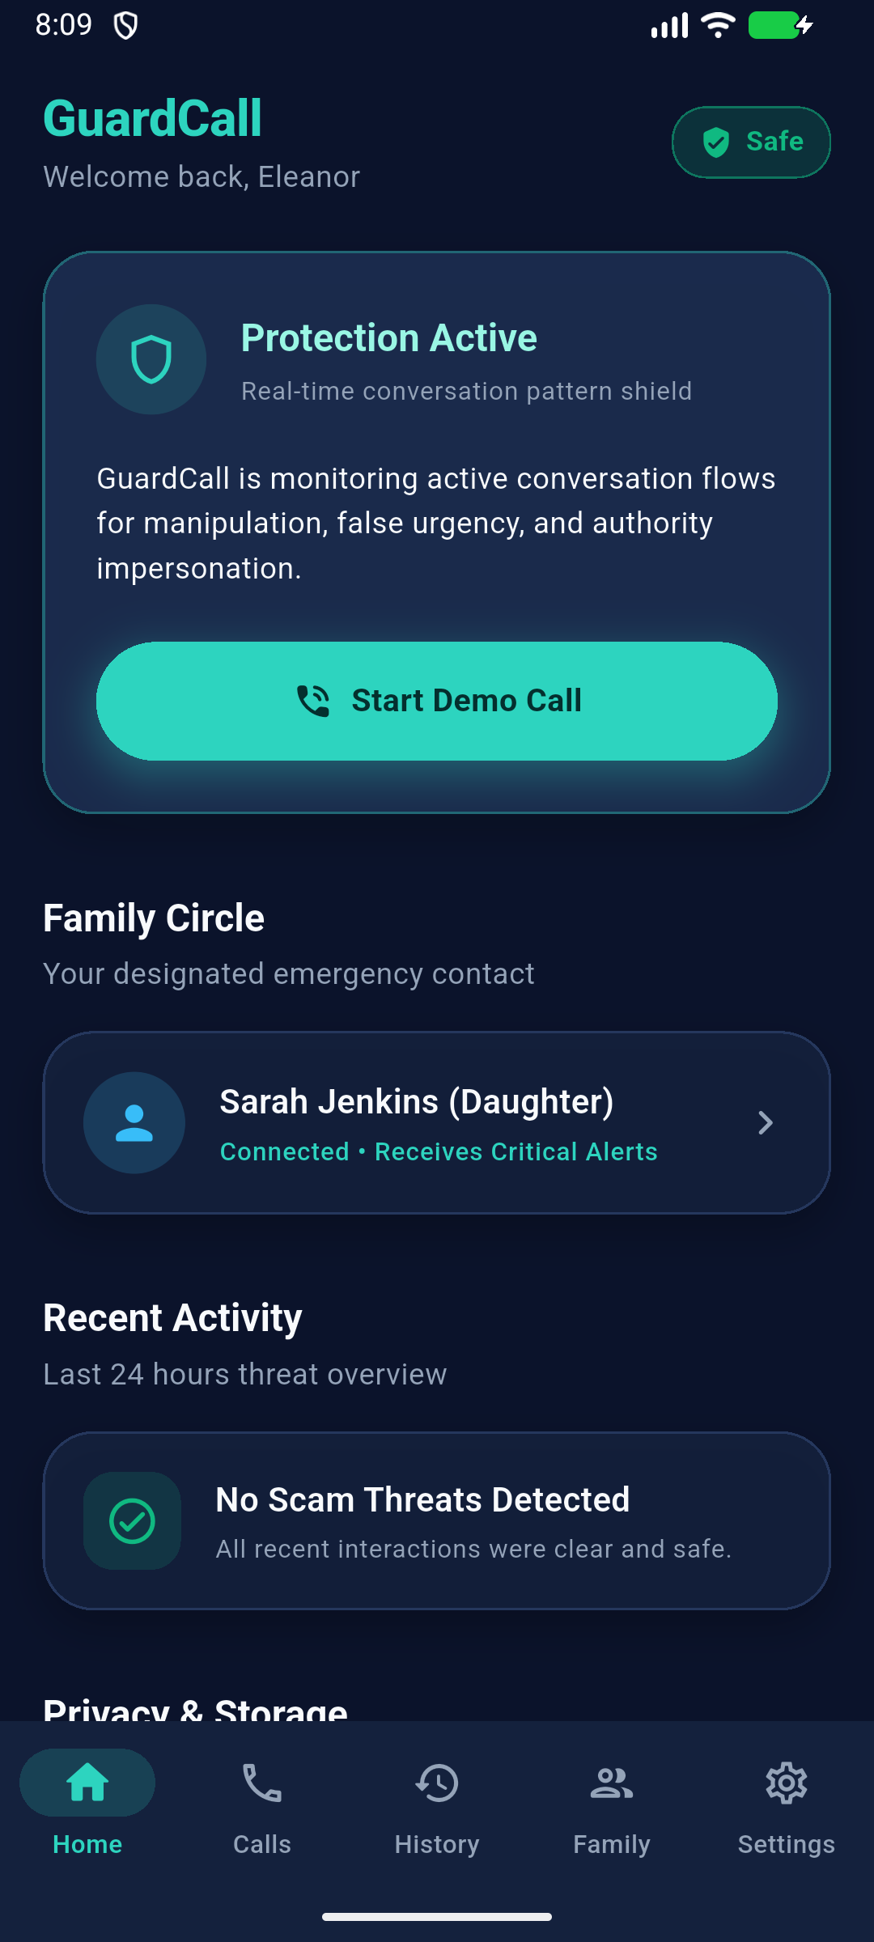
HACKATHON INNOVATION 2026
GUARDCALL
AI-Powered Phone Scam Shield
Real-time conversational manipulation defense for vulnerable seniors — engineered with zero audio retention, zero transcript storage, and proactive family escalation.
✦ Zero-Audio Privacy • ✦ Behavioral Detection • ✦ 100% Offline Demo
2026
Notes:
Every 15 seconds, a senior is targeted by a phone scammer. Traditional spam blockers check caller IDs, but scammers spoof numbers in seconds. We built GuardCall: the first real-time conversational scam shield that protects seniors while preserving 100% privacy.

Slide 2
PROBLEM STATEMENT
The Crisis: Psychological Coercion Bypasses Firewalls
Scammers do not hack phone systems—they hack human fear, trust, and authority.
01
$10B+
ANNUAL GLOBAL LOSSES
02
70%+
VICTIMS ARE ELDERLY
03
100%
ISOLATED DURING CALL
Devastating Financial Extortion
• Digital Arrest & Fake KYC scams siphon seniors' life savings in minutes.
• Authority Impersonation: Callers pretend to be Police, CBI, or Bank Managers.
• High cognitive overload prevents elders from verifying claims.
Artificial Urgency & Coercion
• Scammers engineer acute panic: 'Your account is blocked in 10 minutes!'
• Fear of arrest and legal penalty paralyses critical decision-making.
• Independent elders have zero real-time guidance when under duress.
Enforced Social Isolation
• Scammer command: 'Stay on the line. Do not hang up or tell family.'
• The victim is intentionally isolated from their support network.
• Existing tools provide no safe mechanism to alert relatives mid-call.
2026
Notes:
Scammers no longer rely on simple phishing links. They call victims directly, impersonate law enforcement, and induce severe panic. The senior is trapped alone on the call, isolated from their loved ones, until their money is transferred.

Slide 3
MARKET GAP
Why Existing Defenses Consistently Fail
Static lookup databases and cloud recorders cannot protect seniors in real time.
01 • CROWDSOURCE LAG
Caller ID Lookups (Truecaller)
02 • DAMAGE ALREADY DONE
Post-Mortem Bank SMS Alerts
03 • PRIVACY & LEGAL BARRIER
Cloud Audio Recorders
• Relies on historical user reports.
• Completely blind to newly bought SIMs, VoIP spoofing, and virtual numbers.
• First dozens of victims are defrauded before any number is flagged as spam.
• SMS arrives after the money has already left the account.
• Victims are pressured to divulge OTPs within 60 seconds under duress.
• Bank freezes cannot reverse instant UPI or cryptocurrency transfers.
• Recording telephone calls violates two-party wiretapping consent laws.
• Storing private audio on cloud servers creates severe liability risks.
• Seniors refuse intrusive spyware that listens into personal family chats.
2026
Notes:
Number-lookup apps only flag scammers after victims have already lost money. And recording phone calls to cloud servers creates massive privacy violations. We need a solution that analyzes conversational intent in real time without recording private audio.

Slide 4
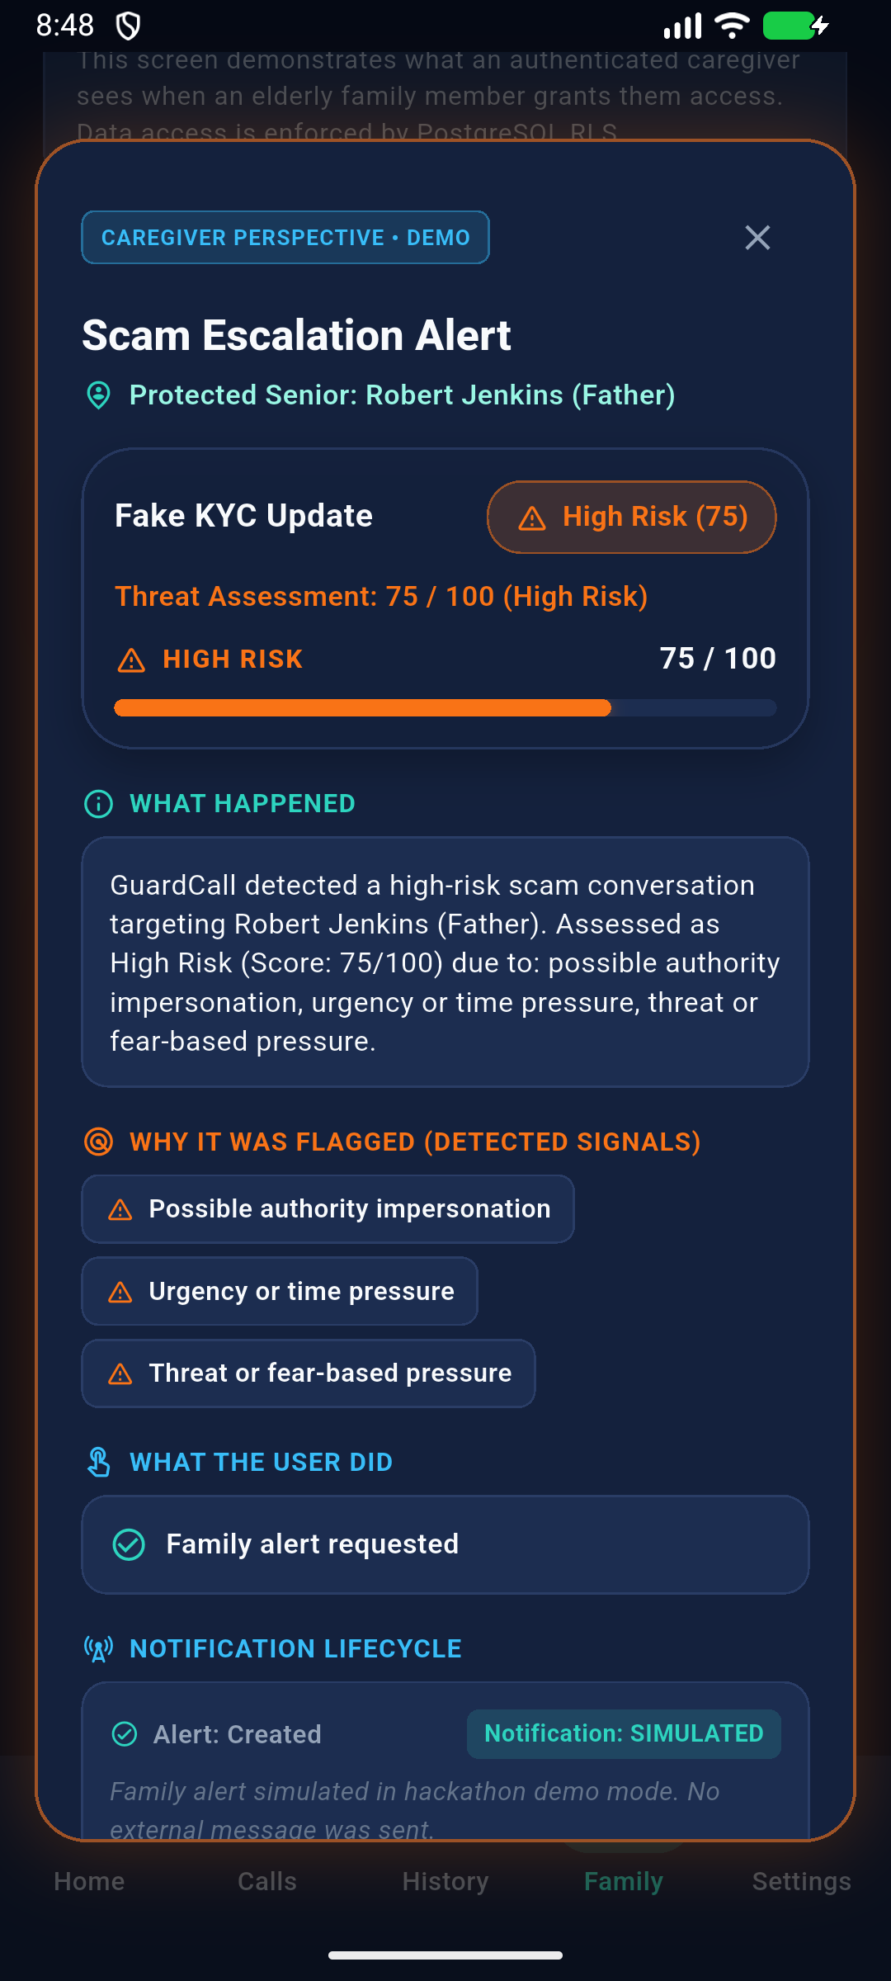
PROPOSED SOLUTION
GuardCall: Behavioral Scam Detection & Caregiver Shield
1. Real-Time Psychological Signal Detection
Analyzes conversation dynamics (authority impersonation, urgency, coercion, OTP demands) rather than caller IDs.
2. Accessible Heads-Up Senior Intervention
Prominent high-contrast warning dialog automatically interrupts coercive calls with 1-tap 'END CALL'.
3. Zero-Audio, Zero-Transcript Privacy
Transient RAM analysis only. Audio is never recorded to disk; conversations are never stored or shared.
4. Proactive Family Circle Escalation
Seniors can tap 'Alert Family' to send structured threat telemetry to authorized caregivers without sharing audio.
5. False-Positive Immunity Benchmark
Distinguishes legitimate bank advisories ('We never ask for OTP') from fraud, preserving user trust.
2026
Notes:
GuardCall acts like an intelligent guardian sitting right beside the senior. It listens to conversational tactics—urgency, threats, OTP demands—and displays clear, easy-to-read interventions, allowing the elder to end the call or immediately escalate to their family.

Slide 5
ARCHITECTURE PIPELINE
THE PROCESS: Transient Intelligence Flow
Strict decoupling of speech processing, threat intelligence, and user presentation.
01
INGESTION
02
TRANSCRIBE
03
ANALYSIS
04
SCORING
05
INTERVENE
Audio Ingestion
• Transient audio chunks in device RAM only.
• Zero disk storage of raw voice.
Transient STT
• Abstracted SpeechToText service.
• Flushed immediately after inference.
Detection Engine
• Multi-turn sequence heuristic rules.
• Tracks compounding threat signals.
Risk Tiering
• 0-39: Safe
• 40-70: Suspicious
• 71-84: High Risk
• 85-100: Critical
Dual Delivery
• Senior: High-contrast Warning HUD.
• Caregiver: Telemetry alert without audio.
2026
Notes:
Our pipeline feeds transient audio chunks through speech recognition directly into a multi-turn heuristic engine. When compounding threats like urgency and OTP requests occur in sequence, the risk score surges past threshold, instantly triggering intervention dialogues.

Slide 6
EVALUATOR DEMO CENTER
100% Deterministic Offline Evaluation
Judges can test realistic scam scenarios with zero network latency or cloud credentials.
THE NUMBERS
0 / 100
SAFE SCORE ON BENCHMARK CALLS
75 / 100
HIGH RISK INTERVENTION TRIGGER
5
REALISTIC OFFLINE SCENARIOS
0ms
NETWORK LATENCY DURING DEMO
5 Scripted Multi-Turn Evaluation Scenarios
1. Fake KYC Update (High Risk):
Turn 1: Bank claim (10) ➔ Turn 2: Urgency ('Expires today') ➔ Turn 3: Threat ➔ Turn 4: OTP demand ➔ Surges to 75 / 100 High Risk.
2. Digital Arrest Threat (Critical Threat):
Impersonating police claiming contraband parcel. Demands isolation ➔ Surges to 90 / 100.
3. Grandchild Emergency (High Risk):
Fabricated hospital distress demanding urgent UPI deposit ➔ High Risk.
4. Legitimate Bank Alert (BENCHMARK - 0/100 Safe):
Bank rep: 'We never ask for your OTP/PIN/password' ➔ Stays at 0 / 100 Safe (Proves zero false positives).
5. Hospital Appointment Reschedule:
Routine clinical appointment call ➔ Benchmark 0 / 100 Safe.
2026
Notes:
To prove reliability, we built a deterministic Demo Center with 5 diverse scenarios. In the KYC demo, notice how caller urgency elevates the risk to 75, triggering the intervention dialog. And crucially, legitimate bank calls remain at 0/100, proving zero false positives.

Slide 7
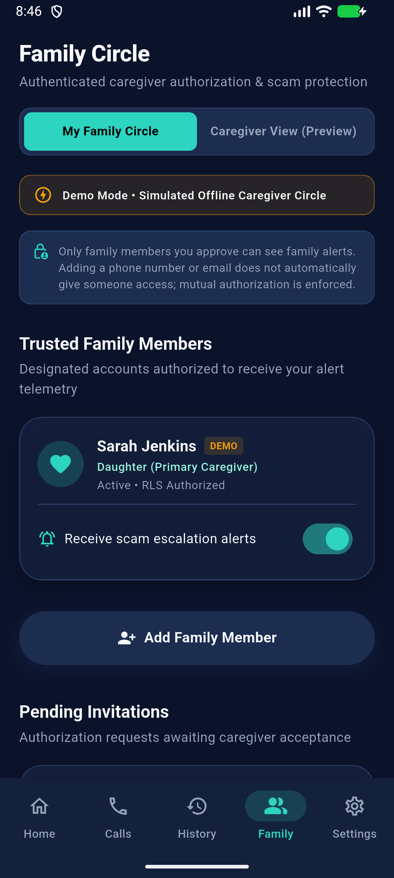
PRIVACY ARCHITECTURE
Privacy-by-Design: Zero Audio, Zero Transcripts
Protecting elderly citizens from financial exploitation without sacrificing their dignity.
100% PRIVATE TO SENIOR
🔒 ZERO Audio Recorded or Shared
Microphone audio is transient in RAM only. Zero recordings on disk or cloud.
🔒 ZERO Full Transcripts
Spoken words and personal dialogue are NEVER stored or sent to caregivers.
🔒 ZERO Credential Storage
OTPs, card numbers, or passwords spoken are automatically scrubbed by AppLogger.
🤝 Mutual Dual Authorization
Caregivers must be explicitly invited and authenticated before alerts activate.
STRUCTURED TELEMETRY ONLY
🛡️ Mathematical Threat Score
Caregivers receive risk tier: 'Score: 75/100 (High Risk)'.
🏷️ Behavioral Manipulation Tags
['Authority Impersonation', 'Urgency', 'OTP Solicitation'].
💡 Safe Recommended Action
'Call your parent immediately. Confirm no OTP was shared.'
✅ Senior Intervention Action
Logged: 'Senior selected: Alert Family / End Call'.
2026
Notes:
Privacy is our core architectural pillar. Caregivers never hear the conversation or read personal transcripts. They receive only structured threat metadata: the risk score, the detected signals, and the action taken.

Slide 8
ENGINEERING EXCELLENCE
Production-Hardened Mobile Tech Stack
Clean layered architecture, elderly accessibility, and 223 automated tests.
01 • MOBILE CLIENT
02 • AI DETECTION PIPELINE
03 • QUALITY ASSURANCE
Flutter 3.x / Dart 3.x
• Material 3 UI with custom accessible primitives (GlassCard, RiskBadge).
• Large touch targets (48dp+) & high contrast for seniors.
• Native Reduce Motion toggle disabling dynamic glows.
• Zero dangerous permissions in AndroidManifest.xml.
3 Modular Engines
• 1. Offline Mock: 100% in-memory heuristic engine.
• 2. Edge Function Proxy: Supabase serverless protecting API keys.
• 3. Direct Dev: Gemini 1.5 Flash / GPT-4o-mini testing.
• AppLogger scrubbing credentials automatically.
223 / 223 Tests Passing
• 223 automated unit, widget, and domain tests passing.
• Supabase Auth & PostgreSQL Row-Level Security (RLS).
• Provider-neutral NotificationService architecture.
• Zero horizontal overflow mobile safety layout.
2026
Notes:
Built with Flutter for smooth cross-platform delivery and Supabase for secure cloud synchronization. Our engine is completely modular, and our entire pipeline is backed by 223 passing automated tests.

Slide 9
GROWTH STRATEGY
PROJECT TIMELINE: Commercial Viability & Scale
From working hackathon prototype to nationwide telecom and consumer protection.
PHASE 01 • TODAY
Hackathon Working Prototype
PHASE 02 • 6–12 MOS
On-Device SLMs (MediaPipe/ONNX)
PHASE 03 • SCALE
Telecom Carrier Integration
• Standalone Flutter Android client.
• Deterministic 5-scenario Demo Center.
• Multi-turn heuristic scam engine.
• Privacy-first Caregiver Telemetry Circle.
• 223/223 automated tests passing.
• Local Small Language Models for 100% offline neural inference.
• Zero cloud latency and air-gapped privacy.
• Multi-lingual Indian dialect coverage: Hindi, Telugu, Tamil, Marathi.
• Voice biometrics for synthetic voice clone detection.
• Direct partnerships with mobile carriers (Airtel, Jio, etc.).
• Carrier-level call stream inspection with user consent.
• Native companion dialer app integration.
• Automated 1-tap reporting to National Cybercrime Portal (NCRP 1930).
2026
Notes:
We engineered GuardCall with accessibility at the center, including native reduce-motion toggles. While we demonstrate this today with controlled audio inputs, our roadmap includes deploying lightweight on-device SLMs and partnering directly with telecom carriers.

Slide 10
GUARDCALL — RESTORING CONFIDENCE IN PHONE CALLS
THANK YOU!
Seniors should never have to fear answering their phones, and families shouldn't have to live with anxiety.
✦ Proactive Fraud Defense • ✦ 100% Zero-Audio Privacy • ✦ Connected Family Circle
👉 WE INVITE YOU TO EXPERIENCE THE LIVE SIMULATION IN OUR DEMO CENTER NOW!
2026
Notes:
GuardCall gives seniors the independence they deserve, and gives families peace of mind. Thank you, and we invite you to experience the live multi-turn simulation right now!

