Slide 1
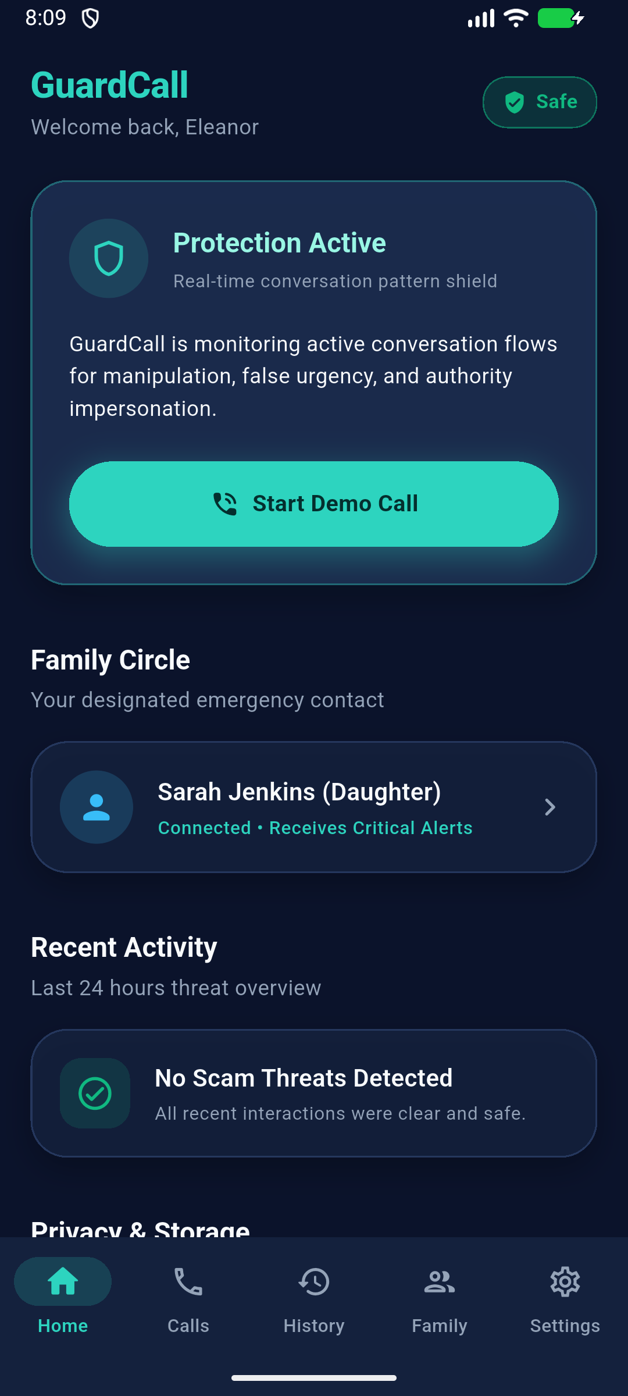
GUARDCALL
AI-Powered Phone Scam Shield
Real-time conversational manipulation defense for vulnerable seniors — engineered privacy-first with zero raw audio retention and proactive family escalation.
🛡️ Zero-Audio & Zero-Transcript Privacy
🧠 Real-Time Psychological Pattern Detection
👨‍👩‍👧 Proactive Family Circle Escalation
⚡ 100% Deterministic Offline Demo Center
Notes:
Every 15 seconds, a senior is targeted by a phone scammer. Traditional spam blockers check caller IDs, but scammers spoof numbers in seconds. We built GuardCall: the first real-time conversational scam shield that protects seniors while preserving 100% privacy.

Slide 2
PROBLEM ANALYSIS
The Problem: Sophisticated Psychological Coercion
Scammers don't hack devices—they hack human psychology through fear, authority, and urgency.
🚨 $10B+ Financial Drain
• Impersonation & Digital Arrest scams cause catastrophic financial loss globally.
• Senior citizens and elderly individuals living alone are prime targets.
• Life savings are wiped out within a single 15-minute phone call.
🧠 Psychological Exploitation
• Scammers engineer acute panic: 'Your account will be suspended in 10 minutes!'
• Fake Authority: Impersonating police, central banks, customs, and telecom officials.
• High cognitive overload renders traditional advice ineffective in the moment.
🔒 Enforced Social Isolation
• Scammers enforce secrecy: 'Do not tell your children or you will face immediate arrest.'
• The victim is kept on the line continuously to block second opinions.
• Seniors face high-stakes intimidation completely alone.
Notes:
Scammers no longer rely on simple phishing links. They call victims directly, impersonate law enforcement, and induce severe panic. The senior is trapped alone on the call, isolated from their loved ones, until their money is transferred.

Slide 3
DEFENSE GAP
Why Existing Defenses Fall Short
Static phone number lookups and cloud-recording architectures cannot solve live phone fraud.
❌ Static Caller ID Blacklists
• Apps like Truecaller rely on historical crowdsourced reports.
• Useless against VoIP spoofing, SIM swaps, and freshly purchased burner numbers.
• The first hundreds of victims are already defrauded before a number is flagged.
❌ Post-Mortem Bank Alerts
• SMS security alerts arrive after the transaction is executed.
• Victims are pressured to bypass 2FA by reading out OTPs under duress.
• Reactive transaction freezes are too late to stop instant wire transfers.
❌ Cloud Recording Violations
• Cloud call recorders violate wiretap and telecommunications privacy laws.
• Uploading audio or transcripts creates extreme liability and user mistrust.
• Seniors refuse intrusive surveillance software that monitors personal life.
Notes:
Number-lookup apps only flag scammers after victims have already lost money. And recording phone calls to cloud servers creates massive privacy violations. We need a solution that analyzes conversational intent in real time without recording private audio.

Slide 4
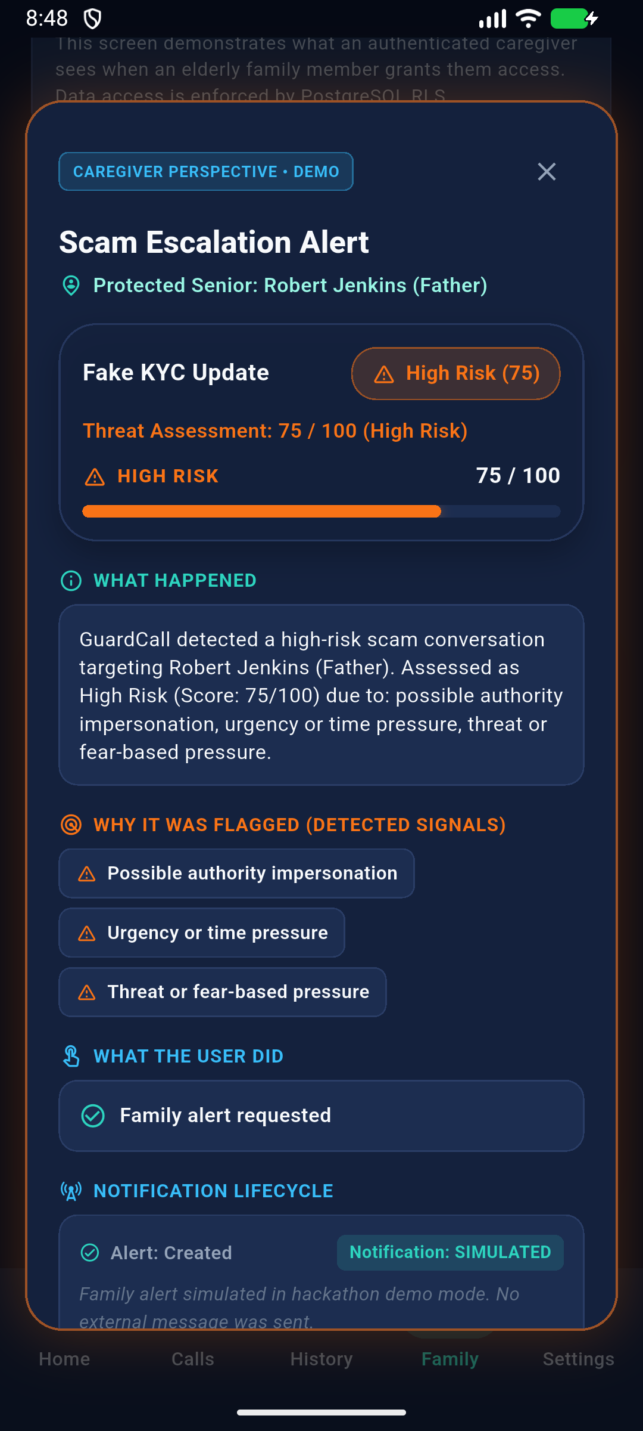
PROPOSED SOLUTION
The Solution: Behavioral Intent Recognition
Shifting scam defense from 'Who is calling?' to 'What are they psychologically attempting to do?'
🛡️ GuardCall: Real-Time Protective Shield
1. Behavioral Signal Detection: Identifies manipulation markers (urgency, legal threats, authority impersonation, credential harvesting) in real time.
2. Explainable Threat Scoring: Categorizes risk into 4 clear tiers (Safe, Suspicious, High Risk, Critical Threat) with plain-language rationales.
3. Proactive Senior HUD: Interrupts high-pressure calls with high-contrast, accessible warnings giving simple actions: 'END CALL' or 'ALERT FAMILY'.
4. Family Circle Escalation: Relays structured threat telemetry directly to designated caregivers without exposing the elder's private conversation.
5. False-Positive Immunity: Differentiates legitimate banking advisories from coercive phishing.
Notes:
GuardCall acts like an intelligent guardian sitting right beside the senior. It listens to conversational tactics—urgency, threats, OTP demands—and displays clear, easy-to-read interventions, allowing the elder to end the call or immediately escalate to their family.

Slide 5
SYSTEM ARCHITECTURE
End-to-End System Architecture
Transient in-memory speech evaluation orchestrated with zero disk caching.
1. Audio Ingestion
• Transient in-memory audio buffers.
• Zero audio files stored on device disk.
• Compliant with OS security boundaries.
2. Transient Speech-to-Text
• Abstracted SpeechToTextService layer.
• Converts dialogue to short conversational chunks.
• Flushed immediately from RAM.
3. Detection Engine
• Multi-turn compounding heuristic analysis.
• Context-aware banking filters.
• Sequence escalation tracking.
4. Harmonized Risk Tiering (0-100)
• 0–39: Safe (No action)
• 40–70: Suspicious (Elevated awareness)
• 71–84: High Risk (Senior Warning HUD popup)
• 85–100: Critical Threat (Immediate escalation & siren)
5. Dual-Action Delivery
• Senior Intervention: High-contrast HUD dialog with 'End Call'.
• Caregiver Circle: Relays structured threat metadata to family.
• Zero personal transcript shared with anyone.
Notes:
Our pipeline feeds transient audio chunks through speech recognition directly into a multi-turn heuristic engine. When compounding threats like urgency and OTP requests occur in sequence, the risk score surges past threshold, instantly triggering intervention dialogues.

Slide 6
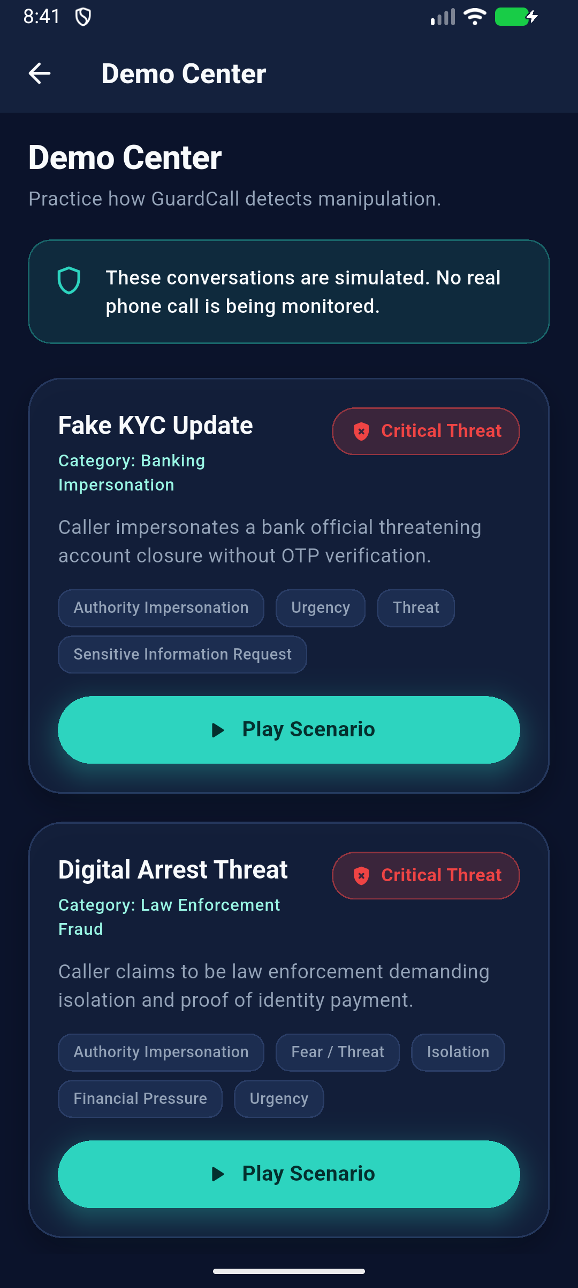
LIVE DEMO READINESS
Deterministic Demo Center & Scenarios
100% offline, zero-network dependency built for reliable hackathon evaluation.
🧪 5 Scripted Multi-Turn Scenarios
1. Fake KYC Update (Banking Impersonation):
Escalates urgency ('Account blocked in 10 mins') ➔ OTP demand ➔ Surges to 75 / 100 High Risk.
2. Digital Arrest Threat (Law Enforcement):
Fake police/customs intimidation claiming illegal parcel ➔ Surges to 90 / 100 Critical Threat.
3. Grandchild Emergency (Distress Extortion):
Emotional panic claiming hospital emergency requiring urgent UPI transfer ➔ High Risk.
4. Legitimate Bank Alert (BENCHMARK):
Official bank advisory: 'We never ask for OTP/PIN' ➔ Stays firmly at 0 / 100 Safe (Zero false positive).
5. Hospital Appointment Reschedule: Routine clinical call ➔ 0 / 100 Safe.
Notes:
To prove reliability, we built a deterministic Demo Center with 5 diverse scenarios. In the KYC demo, notice how caller urgency elevates the risk to 75, triggering the intervention dialog. And crucially, legitimate bank calls remain at 0/100, proving zero false positives.

Slide 7
PRIVACY & ETHICS
Privacy-by-Design: Zero Audio, Zero Transcripts
Protecting seniors from fraud without sacrificing their personal dignity or privacy.
🔒 What Stays 100% Private to Senior
❌ ZERO Audio Recorded or Shared:
Microphone audio is never recorded, saved to disk, or streamed to caregivers.
❌ ZERO Conversation Transcripts:
Spoken words and sensitive dialogues are never saved or delivered in notifications.
❌ ZERO PII / Credential Storage:
OTPs, bank names, and passwords spoken during calls are never persisted.
🛡️ What Caregivers Receive (Telemetry Only)
✅ Mathematical Threat Score:
e.g. Risk Score: 75/100 (High Risk Threat).
✅ Behavioral Manipulation Tags:
e.g. ['Authority Impersonation', 'Urgency', 'OTP Demand'].
✅ Senior Action Taken:
e.g. 'Senior selected: Alert Family / End Call'.
✅ Mutual Dual-Consent Authorization:
Strictly requires mutual invite acceptance.
Notes:
Privacy is our core architectural pillar. Caregivers never hear the conversation or read personal transcripts. They receive only structured threat metadata: the risk score, the detected signals, and the action taken.

Slide 8
ENGINEERING RIGOR
Technical Stack & Production Hardening
Modular mobile client architecture with 223 passing automated tests.
📱 Mobile Client (Frontend)
• Flutter 3.x / Dart 3.x (Material 3)
• Custom Accessible Primitives (GlassCard, RiskBadge)
• Native Reduce Motion support & large touch targets
🧠 Detection Engine (3 Modes)
• Mode 1: In-memory Heuristic Mock Engine (Offline demos)
• Mode 2: Edge Function Proxy (Supabase Serverless)
• Mode 3: Direct Dev Mode (Gemini 1.5 Flash / GPT-4o-mini)
☁️ Backend & Security
• Supabase Auth & PostgreSQL database schema
• Row Level Security (RLS) enforcing mutual family ties
• Provider-neutral NotificationService architecture
✅ Testing & Verification
• 223 / 223 automated tests passing in Flutter test suite
• Zero dangerous runtime permissions in AndroidManifest
• AppLogger scrubbing credentials and sensitive tokens
Notes:
Built with Flutter for smooth cross-platform delivery and Supabase for secure cloud synchronization. Our engine is completely modular, and our entire pipeline is backed by 223 passing automated tests.

Slide 9
FUTURE ROADMAP
Real-World Viability & Future Roadmap
Bridging hackathon prototype to nationwide telecom and consumer protection.
📍 Phase 1: Prototype (Today)
• Standalone Flutter Android client.
• Deterministic 5-scenario Demo Center.
• Multi-turn heuristic scam engine.
• Privacy-first Family Circle escalation.
• 223/223 automated tests passing.
⚡ Phase 2: On-Device SLMs
• Local Small Language Models (SLMs) via MediaPipe / ONNX.
• 100% offline, zero-latency on-device reasoning.
• Multi-lingual Indian dialect support (Hindi, Telugu, Tamil, Marathi).
• Voice biometrics for impersonation detection.
🌐 Phase 3: Telco Partnerships
• Integration with telecom carriers (Airtel, Jio, etc.) for native network-level shielding.
• Hardware-agnostic VoIP dialer integration.
• National Cybercrime Reporting Portal (NCRP) one-tap incident forwarding.
Notes:
We engineered GuardCall with accessibility at the center, including native reduce-motion toggles. While we demonstrate this today with controlled audio inputs, our roadmap includes deploying lightweight on-device SLMs and partnering directly with telecom carriers.

Slide 10
GuardCall: Restoring Confidence in Every Call
Seniors should never have to fear answering their phones, and families shouldn't have to worry.
🛡️ Proactive Defense
Detects psychological coercion dynamically before money is transferred.
🔒 Absolute Privacy
Zero audio recorded, zero transcripts saved. 100% privacy by design.
👨‍👩‍👧 Family Connected
Empowers elders with an instant safety bridge to their trusted caregivers.
✨ READY FOR LIVE DEMONSTRATION IN THE DEMO CENTER — THANK YOU! ✨
Notes:
GuardCall gives seniors the independence they deserve, and gives families peace of mind. Thank you, and we invite you to experience the live multi-turn simulation right now!

