Slide 1


Slide 2
Hello everybody out there using minix –
I’m doing a (free) operating system (just a hobby, won’t be big and
professional like gnu) for 386(486) AT clones. This has been brewing
since april, and is starting to get ready. I’d like any feedback on
things people like/dislike in minix, as my OS resembles it somewhat
(same physical layout of the file-system (due to practical reasons)
among other things).
I’ve currently ported bash(1.08) and gcc(1.40), and things seem to work.
This implies that I’ll get something practical within a few months, and
I’d like to know what features most people would want. Any suggestions
are welcome, but I won’t promise I’ll implement them :-)
Linus
PS. Yes – it’s free of any minix code, and it has a multi-threaded fs.
It is NOT protable (uses 386 task switching etc), and it probably never
will support anything other than AT-harddisks, as that’s all I have :-(.

Slide 3
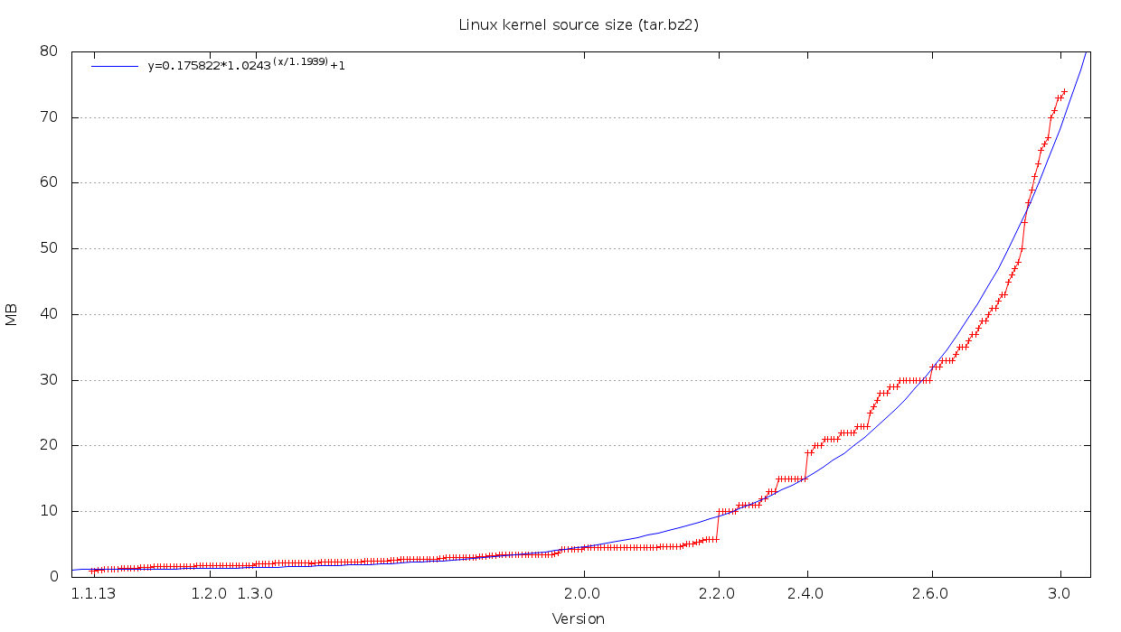

Slide 4
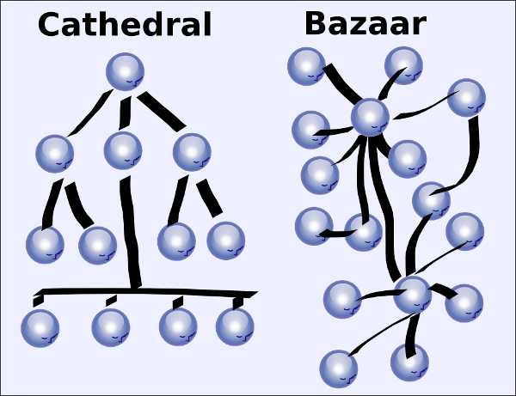
Development

Slide 5
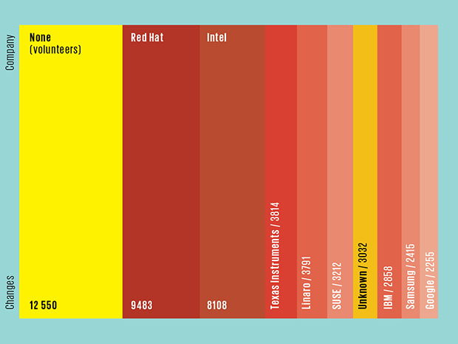
Development (Who makes linux?)

Slide 6

What about GNU?
https://gnu.org/

Slide 7
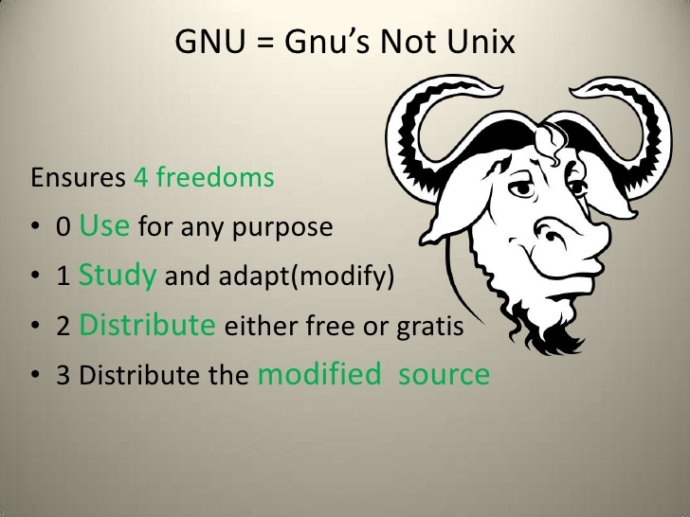
What about GNU?
https://gnu.org/

Slide 8
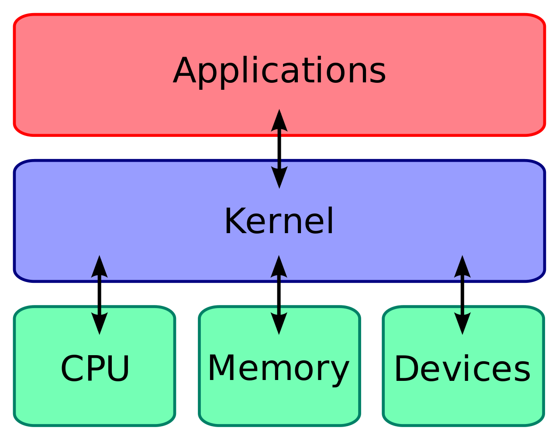
Ok, what's a kernel?

Slide 9
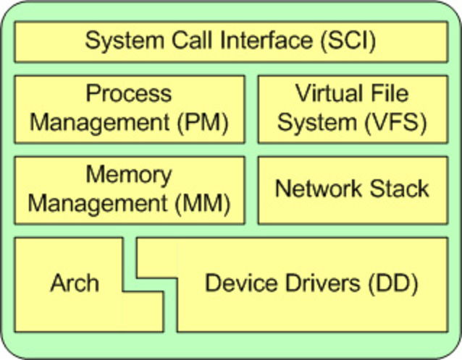
Ok, what's a kernel?

Slide 10
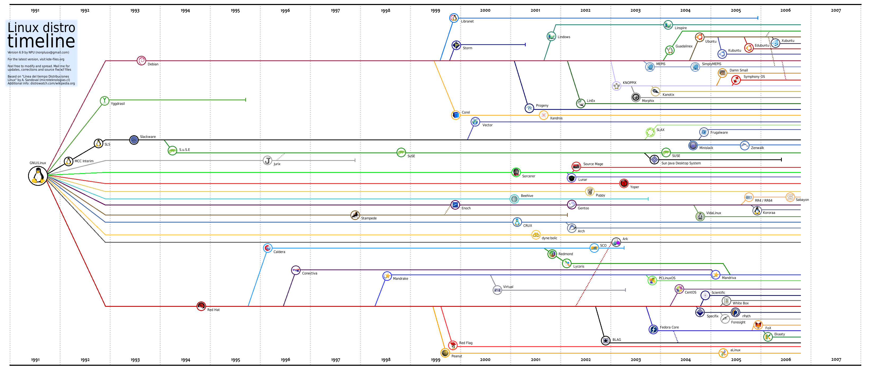
Right. Back to “linux”. Distros.

Slide 11
What makes a distro?
A community
Common items
  A package manager
  An install image
  A philosophy

Slide 12
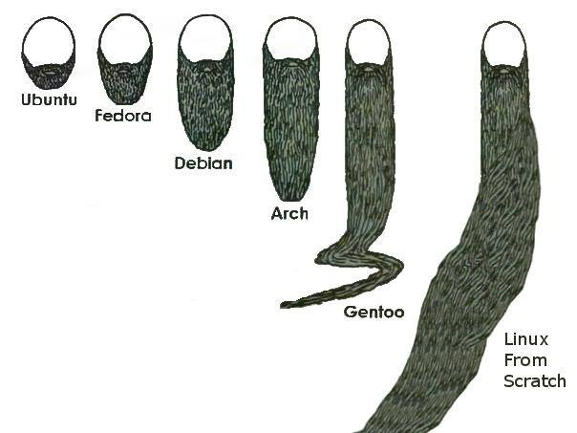
Distros

Slide 13

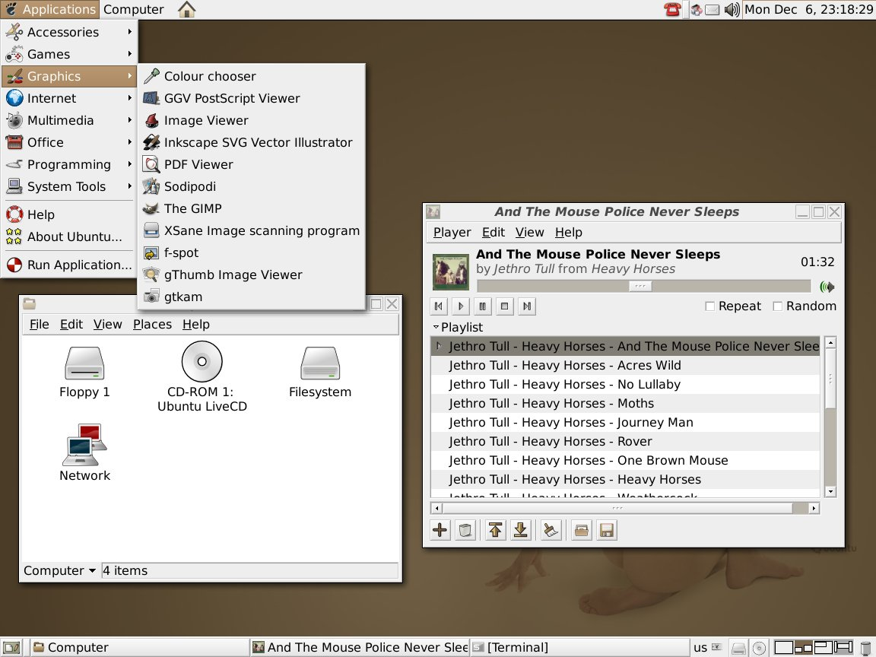
Distros

Slide 14
Distros
Regular and Predictable Releases
The Ubuntu team releases a fresh Ubuntu every six months. It includes the latest kernel, X, Gnome and other key applications, and is supported with security updates for 18 months. The first public release of Ubuntu was the Ubuntu 4.10 Preview (codenamed "the Warty Warthog", or just "Warty"). You can download the CD and burn it yourself or have us ship you a CD.
To download: Visit our download page.
To order a pressed CD: Fill in your shipping address in Shipit - the Ubuntu CD Distribution System. We won't give or sell your information to anyone or use it for anything other than sending you these CDs. If you are part of a library or other community system, you are welcome to request CDs for that group, such as a LUG or school.

Slide 15
Distros
Fast, Easy Install
Ubuntu doesn't have a pretty graphical installer, it has a FAST and EASY installer. OK, there are still a couple of places where you need to know what you are doing, but the defaults will work for most people. We have kept the distribution installation CD set down to one single CD, everything else is available online if you need it. On a typical computer, the Ubuntu installation should be done in less than 25 minutes.
The installer may not be GUI, but you only ever need to use it once, because we support ongoing upgrades via the network, from version to version. You never need to reinstall the operating system, just upgrade from each released version to the next when you want to.

Slide 16

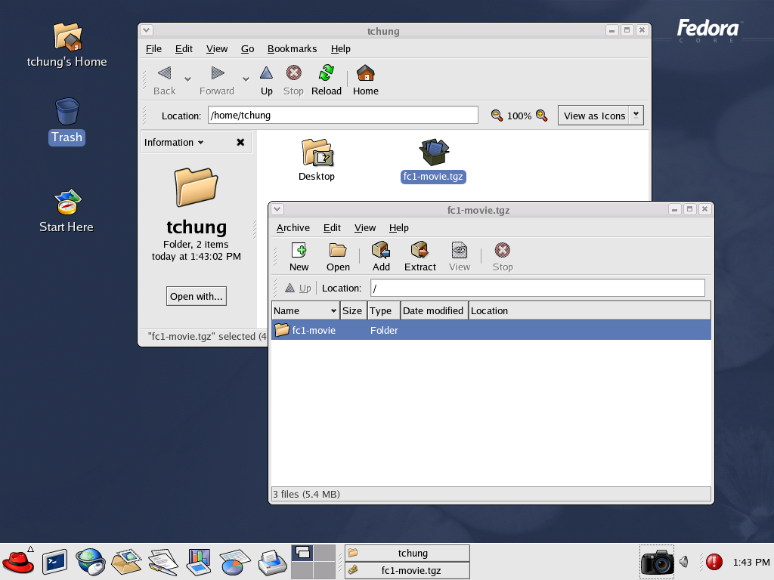
Distros

Slide 17
Distros
Objectives of Fedora Core:
Create a complete general-purpose operating system with capabilities equivalent to competing operating systems, built for and by a community — those who not only consume, but also produce for the good of other community members.
Build the operating system exclusively from open source software.
Do as much of the development work as possible directly in the upstream packages. This includes updates; our default policy will be to upgrade to new versions for security as well as for bugfix and new feature update releases of packages.
Provide a robust development platform for building software, particularly open source software.

Slide 18
Distros
Objectives of Fedora Core:
Be on the leading edge of open source technology, by adopting and helping develop new features and version upgrades.
Emphasize usability and a "just works" philosophy in selecting default configuration and designing features.
Promote rapid adoption of new releases by maintaining easy upgradeability, with minimal disturbances to configuration changes.
Include a range of popular packages, beyond those included in Red Hat's commercially supported products. (Limited, of course, to packages that Red Hat can legally provide; also limited to quality packages as defined by our standards.)
Establish and implement technical standards for packages to ensure quality and consistency of the operating system.

Slide 19
Distros
Objectives of Fedora Core:
Establish and implement technical standards for packages to ensure quality and consistency of the operating system.
Produce robust releases approximately 2-3 times per year, using a time-based release model: A time for a feature freeze is set in advance, and an expected schedule for test releases is produced before the feature freeze date. (Important feature schedules will be taken into account when setting the schedule for Fedora Core releases.)
Provide timely (though not guaranteed — no Service Level Agreements apply) updates for robust releases, over a useful release lifetime.
Create an environment where third party packages are easy to add and positive encouragement and support exists for third party packaging.

Slide 20
Distros
Objectives of Fedora Core:
Form the basis of Red Hat's commercially supported operating system products.
Promote a global perspective by supporting as many languages and geographic locales as possible.
Releases will always be available for free download in RPM, SRPM, and ISO formats.
Non-Objectives of Fedora Core:
Slow rate of change.
Enabling commercial support, particularly Service Level Agreements.
Being a dumping ground for unmaintained or poorly designed software.

Slide 21
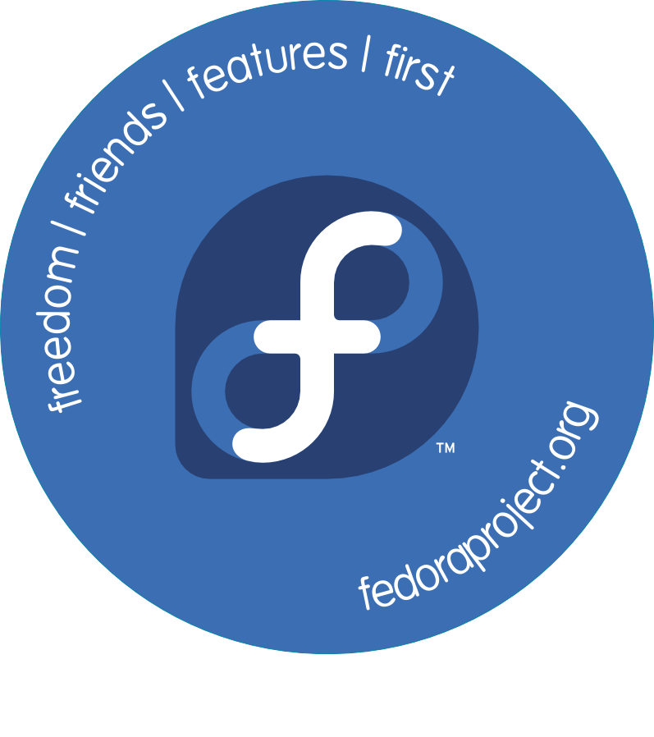
Distros

Slide 22

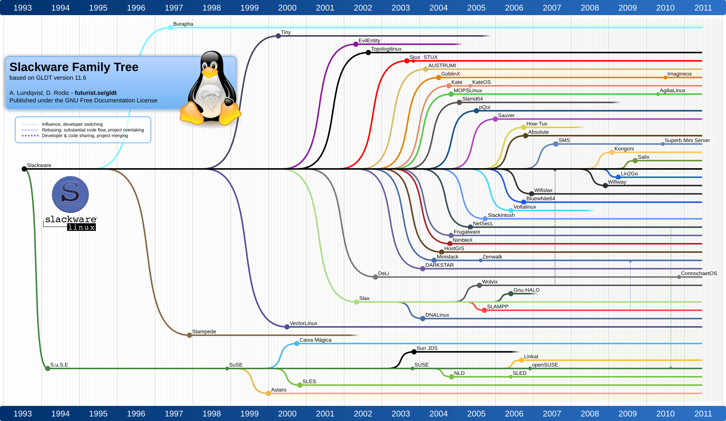
Distros

Slide 23
Distros
The Slackware Philosophy
Since its first beta release in April of 1993, the Slackware Linux Project has aimed at producing the most "UNIX-like" Linux distribution out there. Slackware complies with the published Linux standards, such as the Linux File System Standard. We have always considered simplicity and stability paramount, and as a result Slackware has become one of the most popular, stable, and friendly distributions available.

Slide 24

Distros
Short:
Arch Linux is an i686-optimized linux distribution targeted at competent linux users (read: not afraid of the commandline)

Slide 25

Distros
Simplicity
Arch Linux defines simplicity as without unnecessary additions or modifications. It ships software as released by the original developers (upstream) with minimal distribution-specific (downstream) changes: patches not accepted by upstream are avoided, and Arch's downstream patches consist almost entirely of backported bug fixes that are obsoleted by the project's next release.
In a similar fashion, Arch ships the configuration files provided by upstream with changes limited to distribution-specific issues like adjusting the system file paths. It does not add automation features such as enabling a service simply because the package was installed. Packages are only split when compelling advantages exist, such as to save disk space in particularly bad cases of waste. GUI configuration utilities are not officially provided, encouraging to perform most system configuration from the shell and a text editor.

Slide 26

Distros
Gentoo Linux is designed for the developer, power user and enthusiast. Incorporating the latest sources and technologies (such as ReiserFS and the Portage™ system), Gentoo Linux was created to provide the ultimate Linux experience. If you've tried all the other distros and you're still not satisfied, then you need to experience Gentoo.
Note: The gentoo penguin is the fastest penguin in the world.

Slide 27
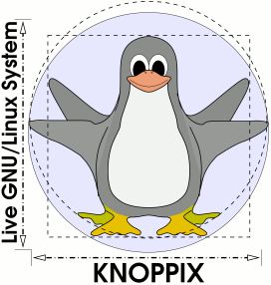
Distros
Knoppix is a bootable CD with a collection of GNU / Linux software, automatic hardware detection and support for many graphics cards, sound cards, SCSI and USB devices and other peripherals. KNOPPIX can be adapted and used as a platform for commercial software product demos as a Linux demo, educational CD, rescue system, or. It is necessary to install anything on your hard drive. The CD can be installed on executable software by decompression, up to 2 gigabytes.

Slide 28
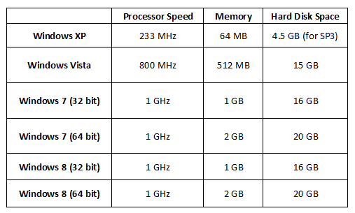
Hardware

Slide 29
Hardware
1.3.1. Minimum System Configuration (Fedora 23)
The figures below are a recommended minimum for the default installation. Your requirements may differ, and most applications will benefit from more than the minimum resources.
1GHz or faster processor
1GB System Memory
10GB unallocated drive space

Slide 30

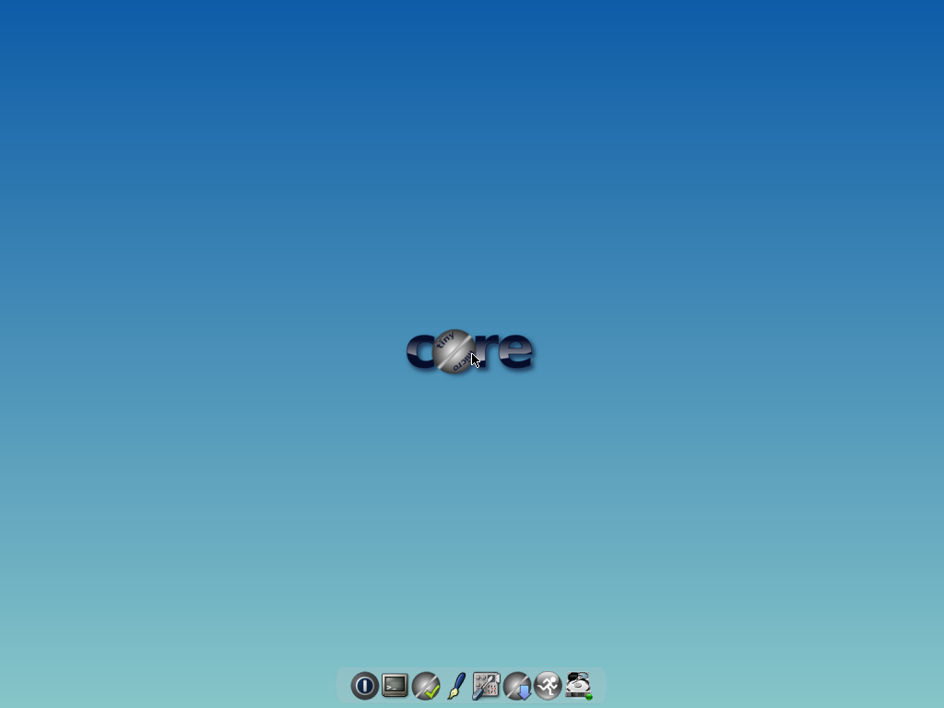
Tiny Core Linux

Slide 31
Tiny Core Linux
An absolute minimum of RAM is 46mb. TC won't boot with anything less, no matter how many terabytes of swap you have.
Microcore runs with 28mb of ram.
The minimum cpu is i486DX (486 with a math processor).
A recommended configuration:
Pentium 2 or better, 128mb of ram + some swap

Slide 32
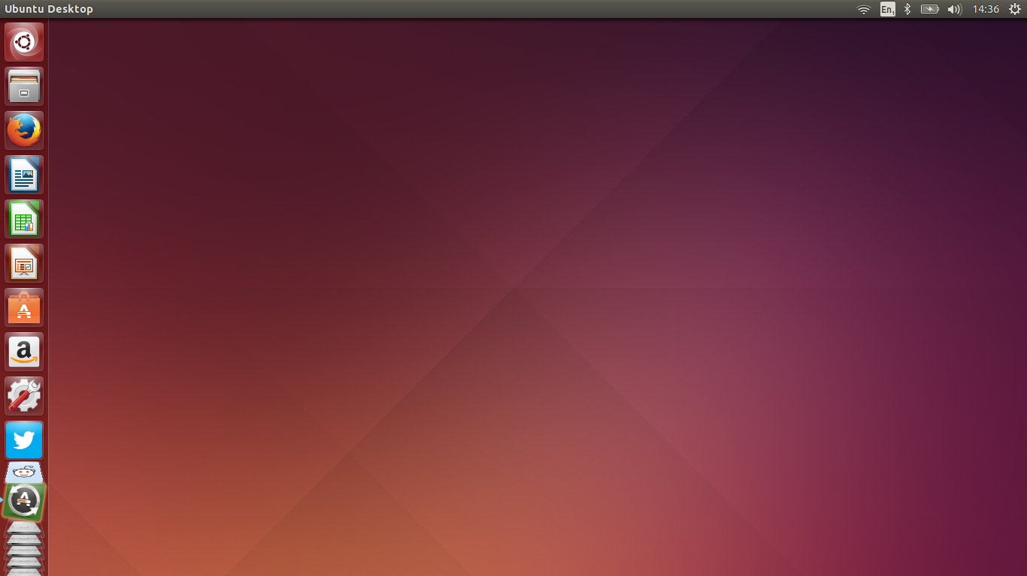
Window managers: Unity

Slide 33
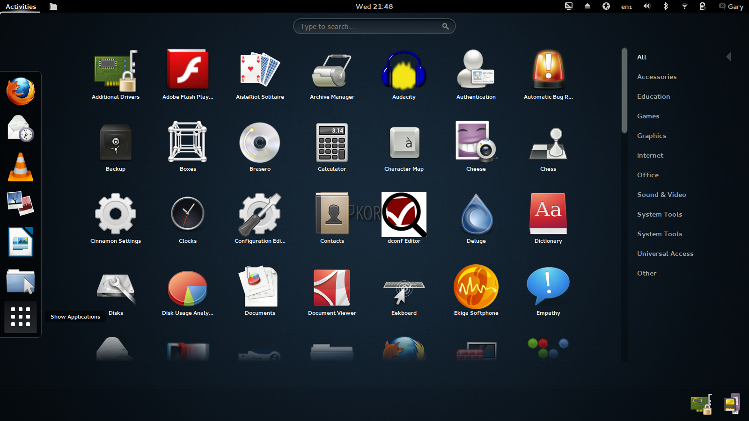
Window managers: Gnome

Slide 34
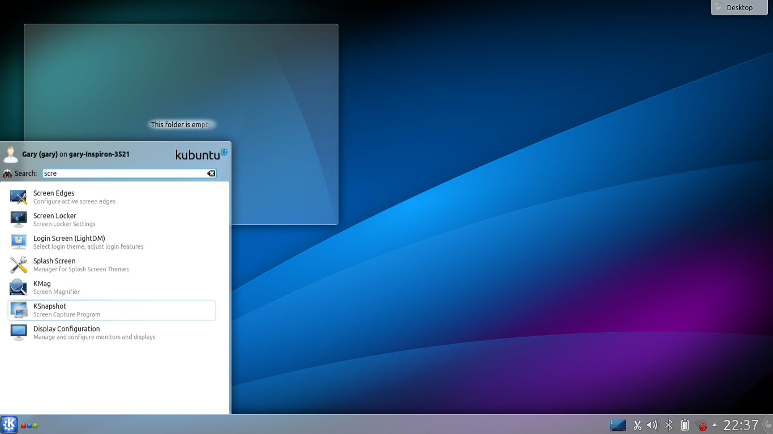
Window managers: KDE

Slide 35
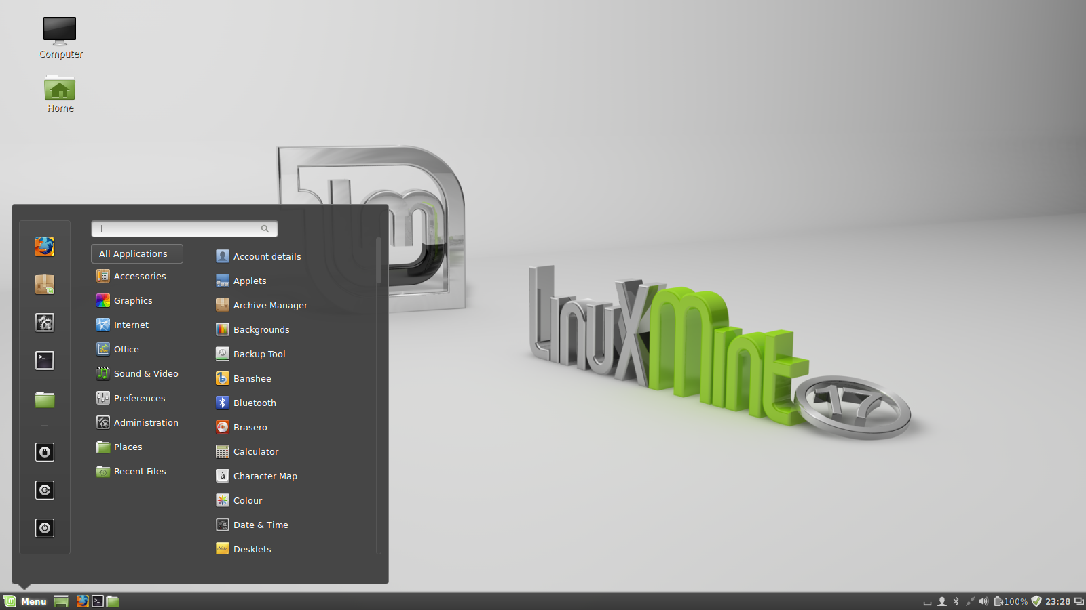
Window managers: Cinnamon

Slide 36
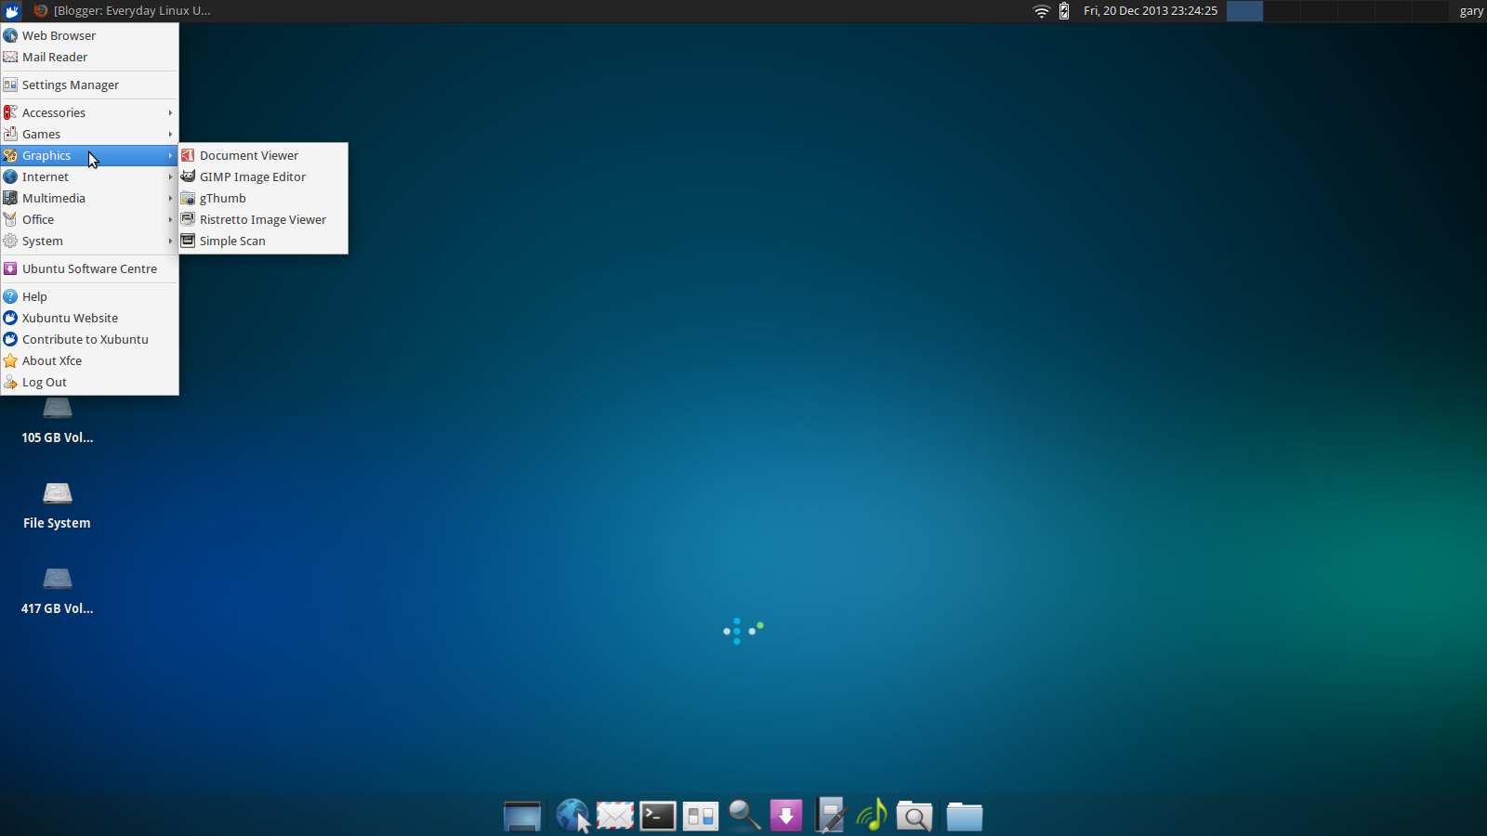
Window managers: XFCE

Slide 37
Package Managers
Apt/apt-get/apt-cahce/apt-info/whatever else
  Debian/Ubuntu
Yum
  Fedora 1-22/RedHat 1-7
Dnf
  Fedora 23+/Redhat 8+(?)
Zypper
  Suse
Pacman
  ArchLinux
Emerge
  Gentoo

Slide 38
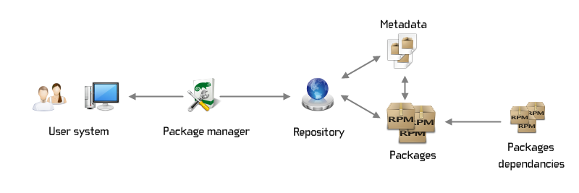
Package Managers

Slide 39
Package Managers
Fedora:
dnf update
dnf search <some term>
dnf install <some package>
dnf history list/redo/rollback/info

Slide 40
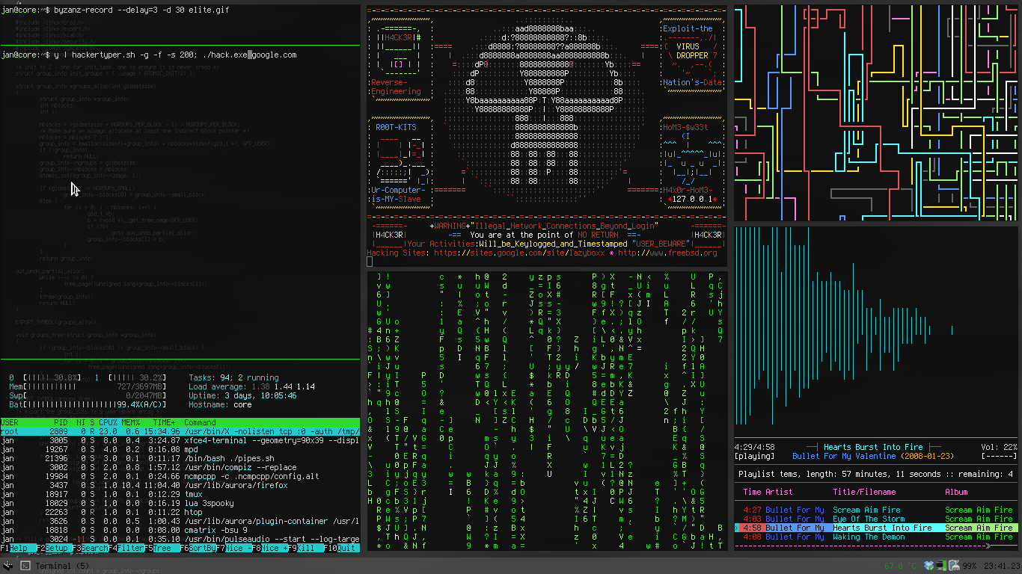
The command line

Slide 41
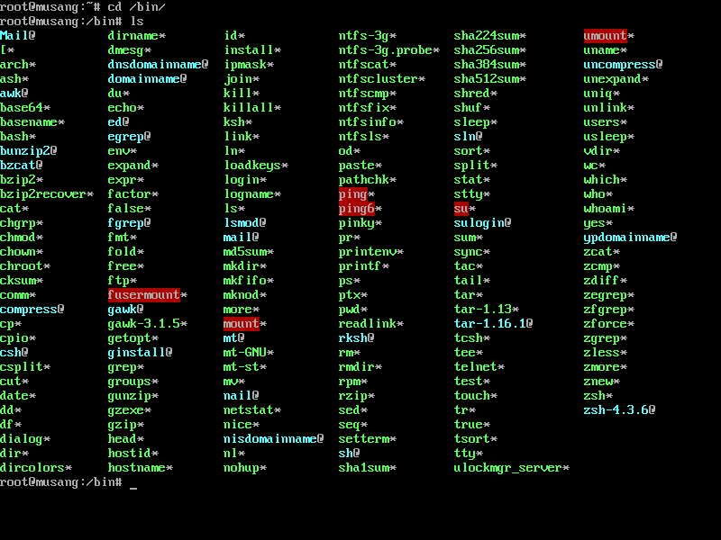
The command line

Slide 42
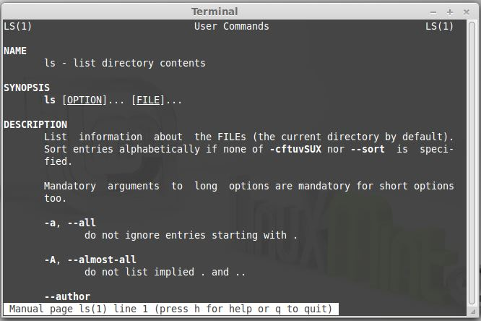
The command line

Slide 43
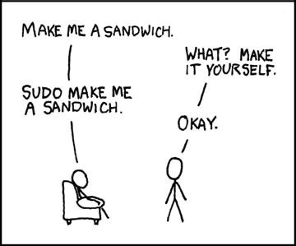
The command line.

Slide 44
The command line
nc -l 127.0.0.1 9001 | nc 128.171.10.79 9001
Use netcat (nc) to listen on one port
Pipe output (all traffic that shows up)
Into netcat to a remote machine on some port
One line = tcp mirror

Slide 45
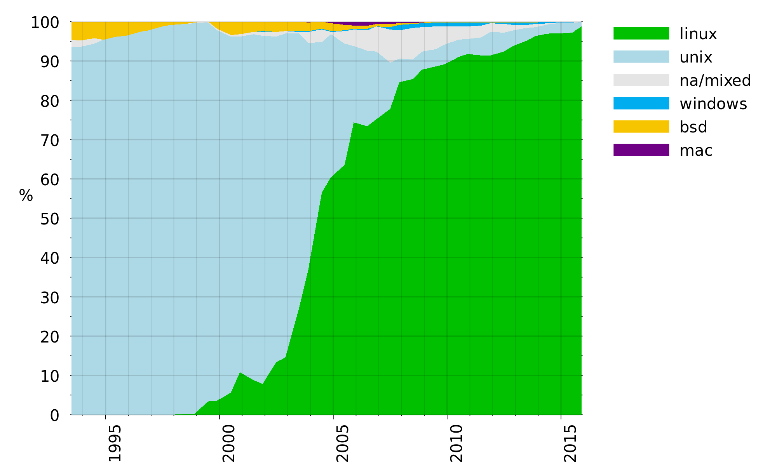
Linux in HPC

Slide 46
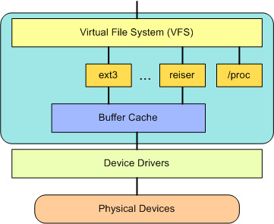
Filesystems

Slide 47
Filesystems
Ext(ended) Filesystem{1,2,3,4}
  Dates back to 1992
  Still relevant
Ext 2
  Dates to 1993
  Max volume: 32TB
  Max file size 16GB – 2TB (depending on block size)
  UTF-8 file name support (in 1993!)
  More: https://en.wikipedia.org/wiki/Ext2

Slide 48
Filesystems
XFS
  Built for NASA in 1994
  Released under the GPL in 2000
  Max volume size: 16EB
  Max file size: 8EB (minus 1 byte)
  Very high performance
  The “big” linux filesystem

Slide 49
Filesystems
XFS
  Built for NASA in 1994
  Released under the GPL in 2000
  Max volume size: 16EB
  Max file size: 8EB (minus 1 byte)
  Very high performance
  The “big” linux filesystem

Slide 50
Filesystems
ReiserFS
  Introduced in 2001 by Hans Reiser
  Very fast with “lots of small files” (Under 4KB)
  B+ tree directory structure
  4032 byte long file names
  Development abruptly ended in 2008

Slide 51
Filesystems
btrfs
  Introduced in 2009
  B-Trees everywhere
  Lots of cool features
    Checksumming
    Snapshots
    Compression
  Huger than XFS
  Development ongoing. Inspired by ReiserFS and ZFS

Slide 52
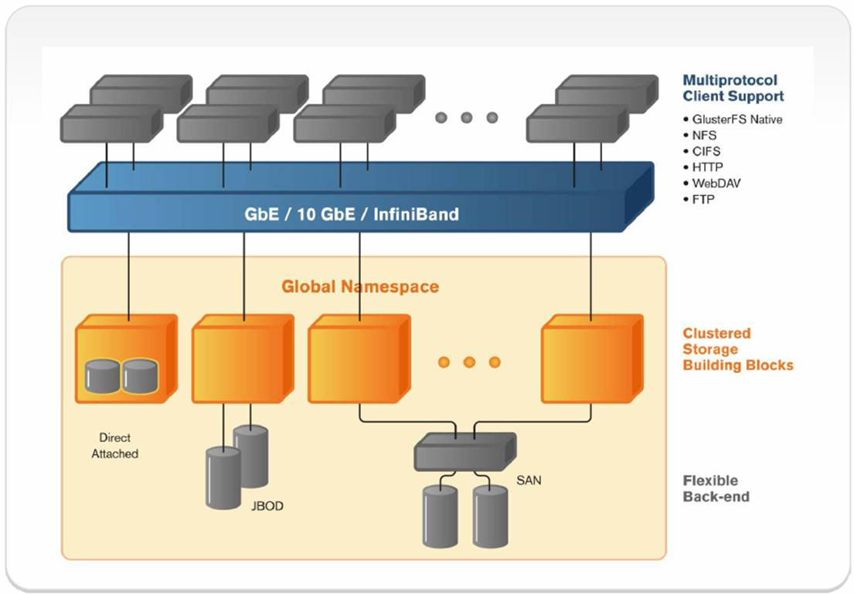
Filesystems
GlusterFS

Slide 53
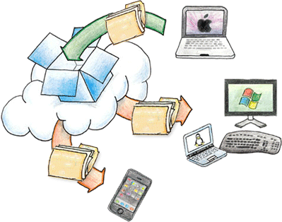
Filesystems

Slide 54
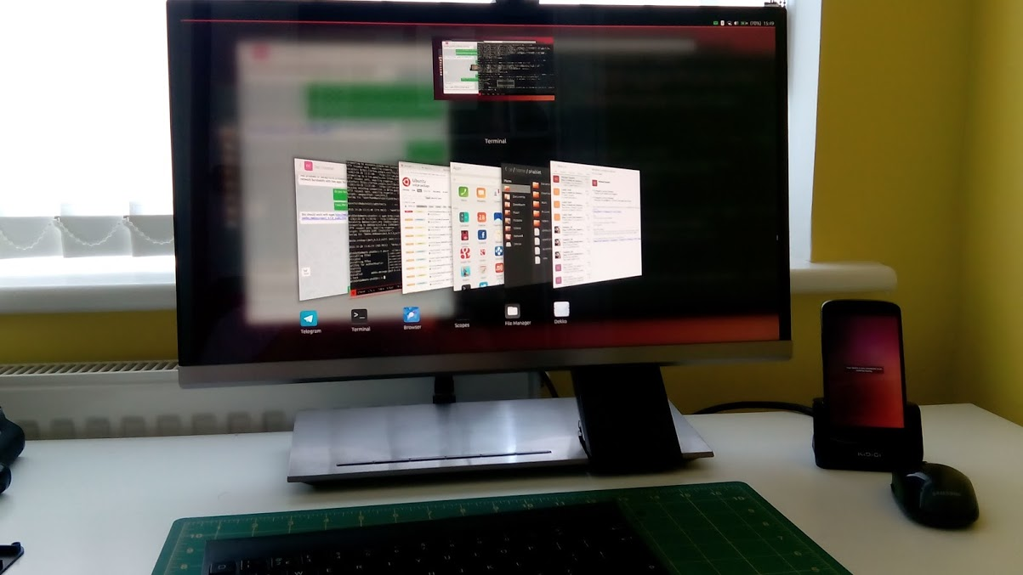
Linux in phones (no not android)
https://www.youtube.com/watch?v=fiEkCaA_P7c

Slide 55
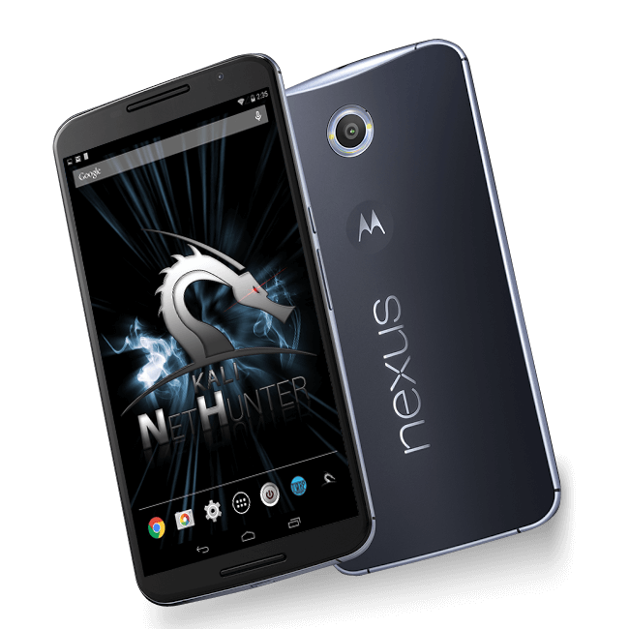
Linux in phones (ok some android)

Slide 56
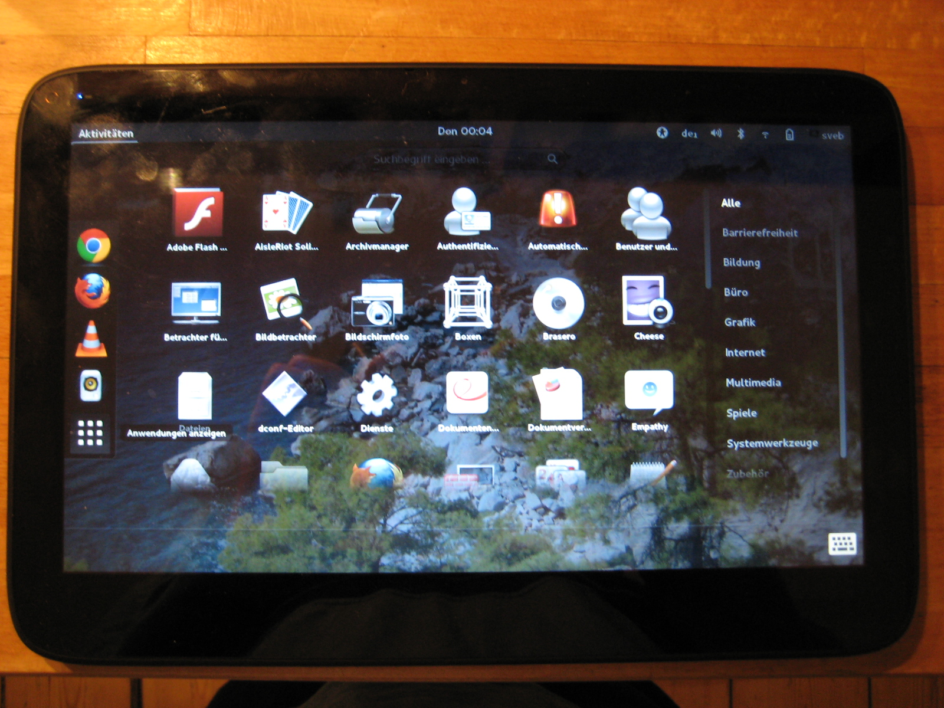
Linux in tablet (no more android)

Slide 57
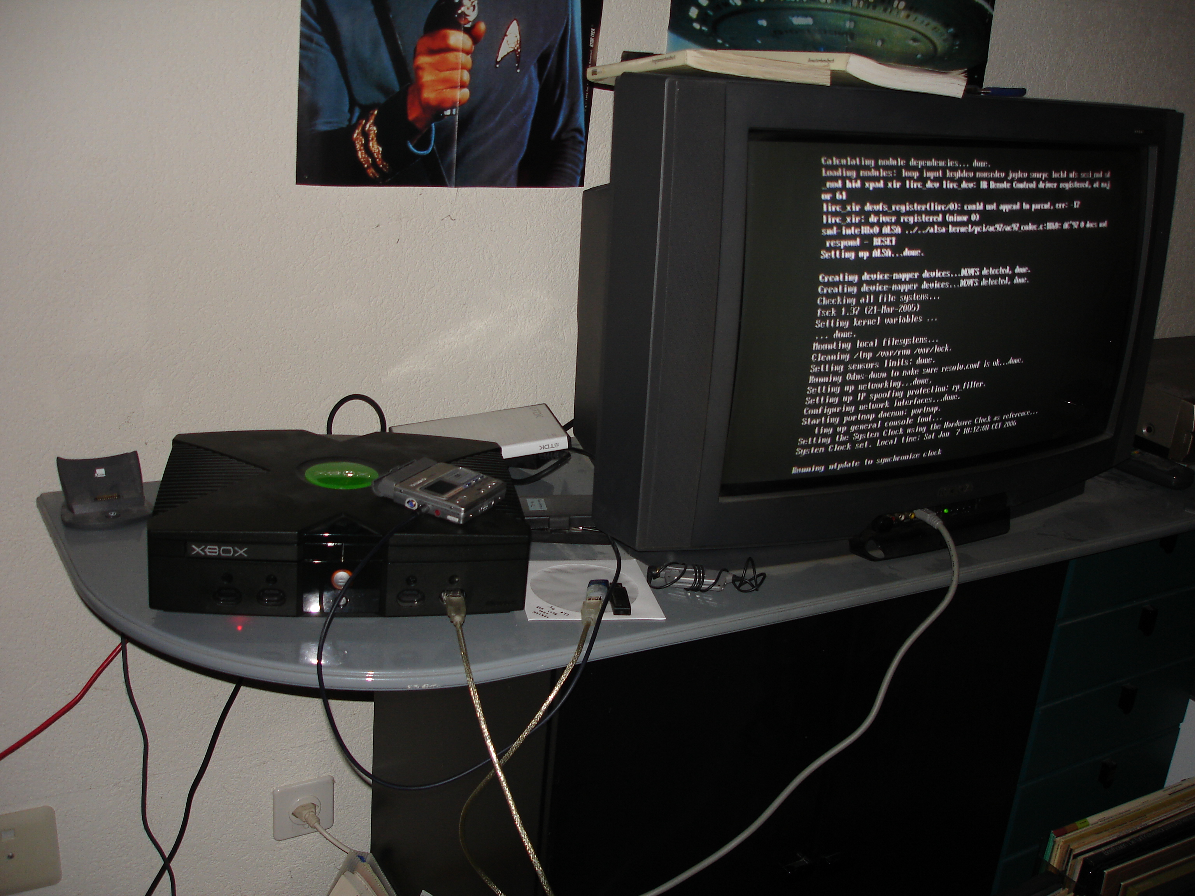
Linux in gaming

Slide 58
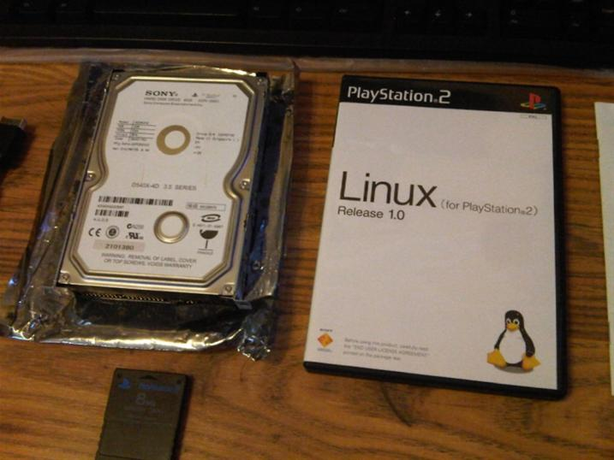
Linux in gaming

Slide 59
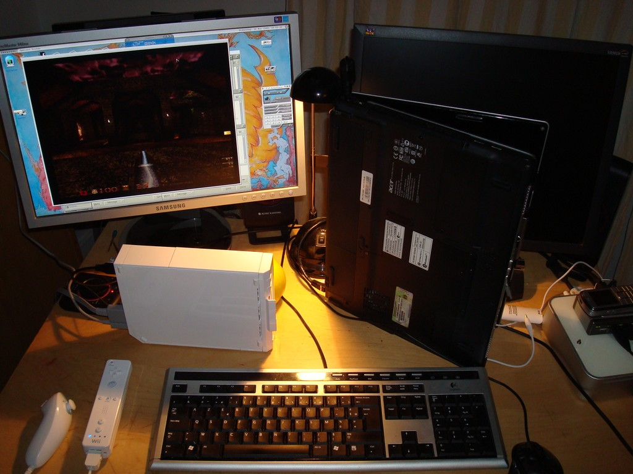
Linux in gaming

Slide 60
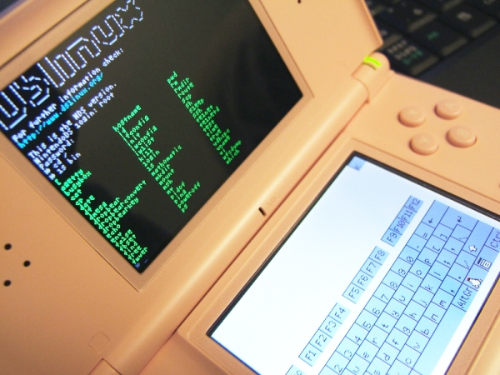
Linux in gaming

Slide 61
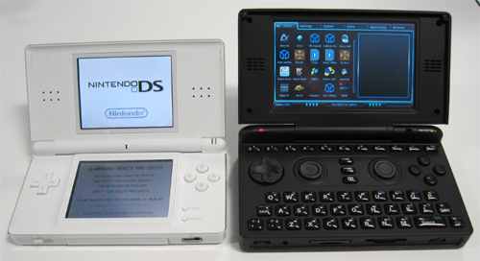
Linux in gaming

Slide 62
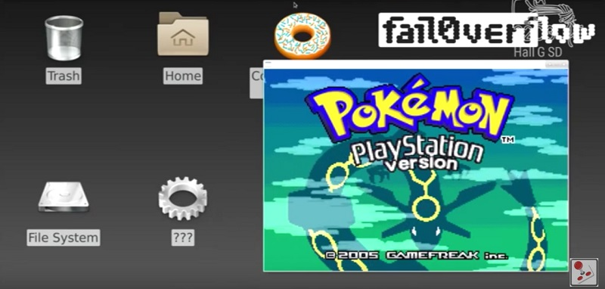
Linux in gaming
https://github.com/fail0verflow/ps4-linux

Slide 63
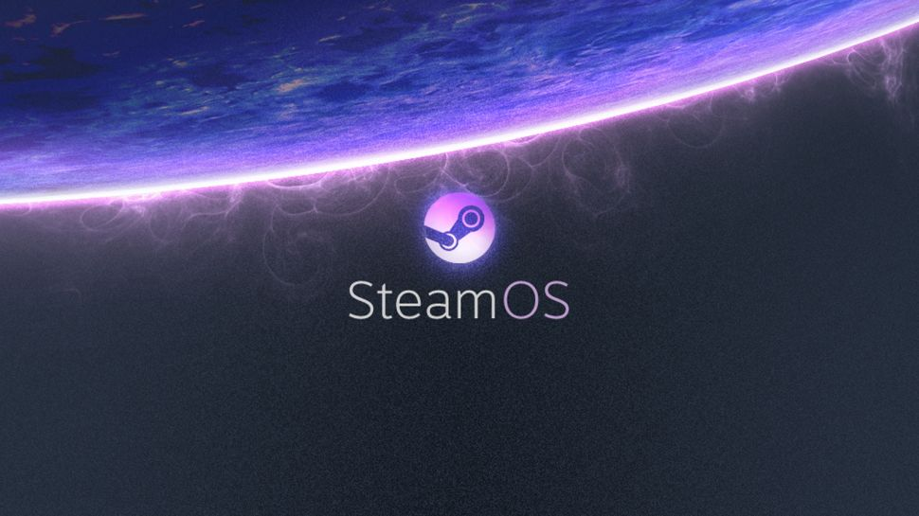

Slide 64
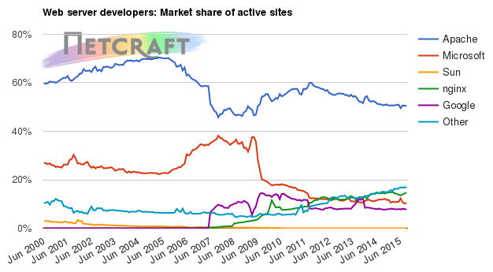

Slide 65
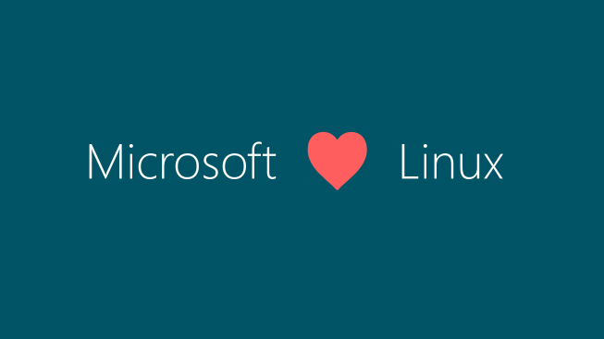

Slide 66
Further reading/watching
https://lwn.net/
https://www.linuxvoice.com/
http://www.omgubuntu.co.uk/
https://fedoramagazine.org/
https://distrowatch.com/
https://www.reddit.com/r/linux
https://phoronix.com
Revolution OS ← Movie
https://www.google.com

Slide 67

Questions?

