Slide 1

How to break the internet
… with source code!

Slide 2



But first what is the internet?
? ? ?

Slide 3
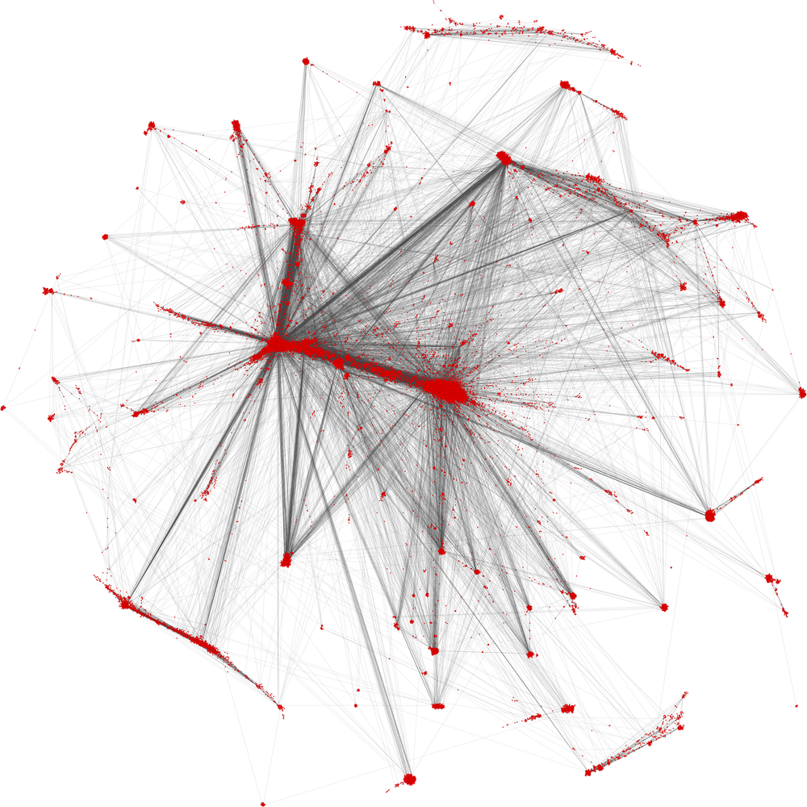

Slide 4
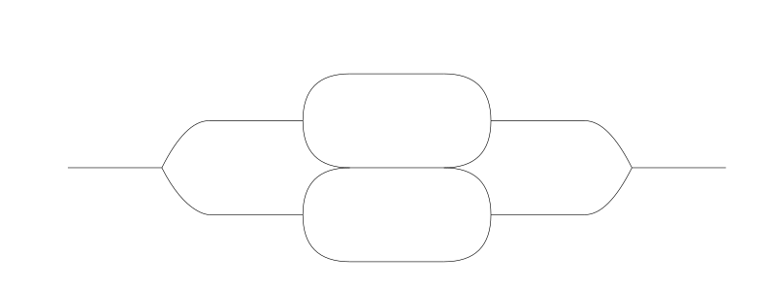


But this will do

Slide 5


DNS – Domain Name System
google.com
72.234.39.23

Slide 6
DNS Records
A – IPv4 address (generally for http)
AAAA – IPv6 address (generally for http)
CNAME – Canonical name
MX – Mail record
LOC – Location record
CERT – Key storage
There are 41 of these
More if you count obsolete records
Some are larger than others

Slide 7
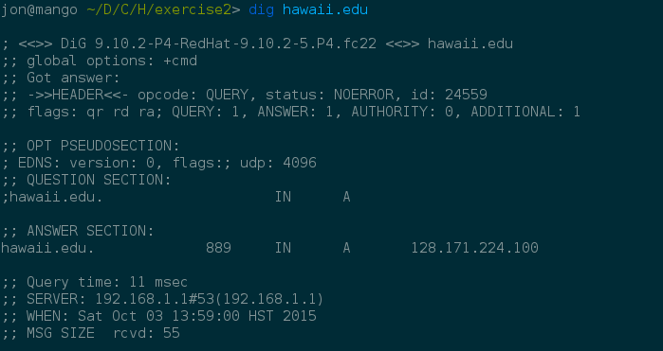
Meet dig

Slide 8
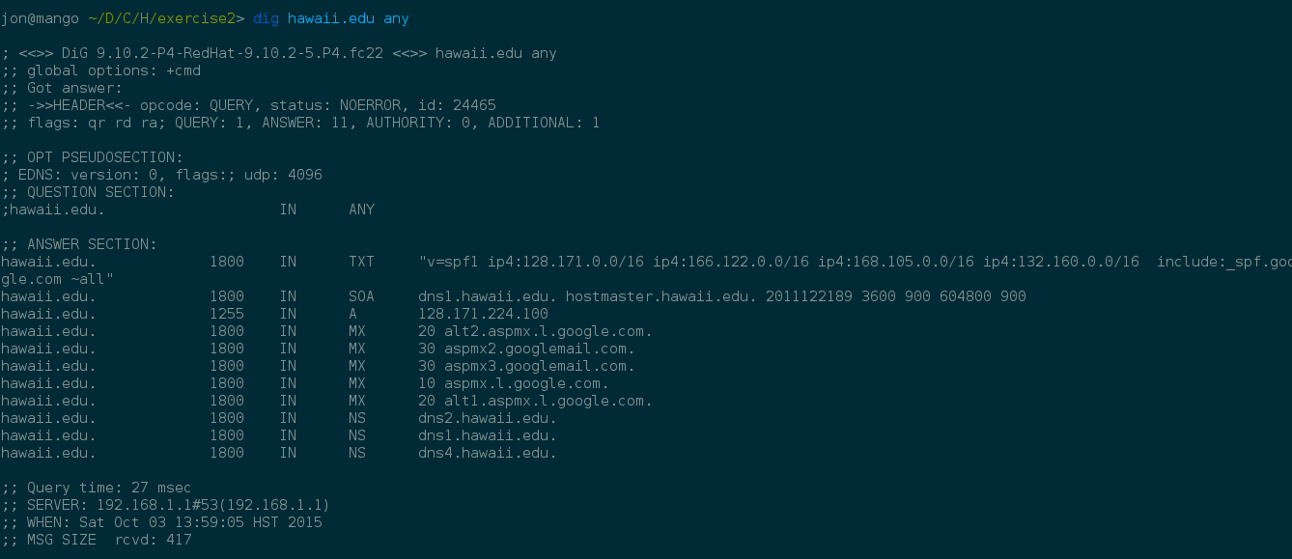
Meet dig

Slide 9
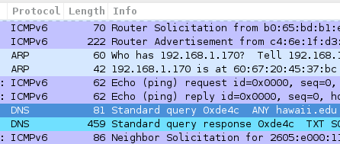
Meet dig

Slide 10
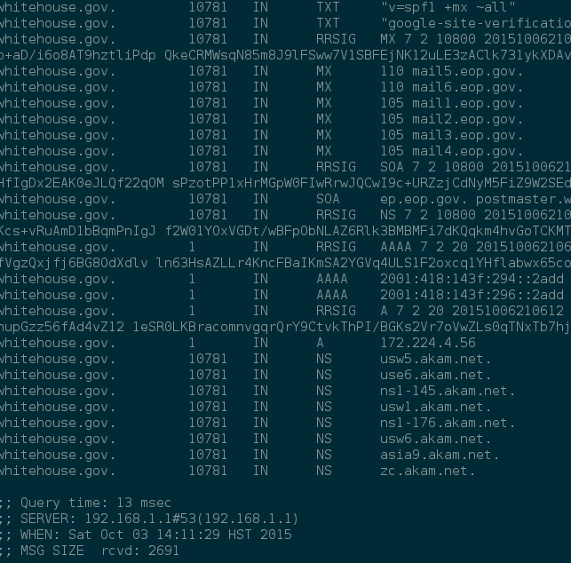
dig meet whitehouse.gov

Slide 11
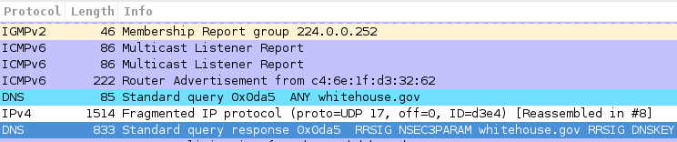
dig meet whitehouse.gov
1514 + 833 = 2279

Slide 12

Traffic implications
Bytes sent | DNS Records | Bytes Received | Traffic Growth
81 | 11 | 459 | x5.6
85 | 27 | 2279 | x26.8

Slide 13

But wait… there's more!
That's 3991 bytes from 79
That's ~x50 growth

Slide 14

And it's all coming back at us

Slide 15

IP spoofing and advanced dig-ing
Spoofed Address: 128.4.79.10
dig ietf.org@some_dns_resolver any +notcp
Responses are then sent to 128.4.79.10

Slide 16
Two things
> I'm not on 128.4.79.10's network
> My network might not like that I'm lying
> I'm going to take down my DNS server

Slide 17
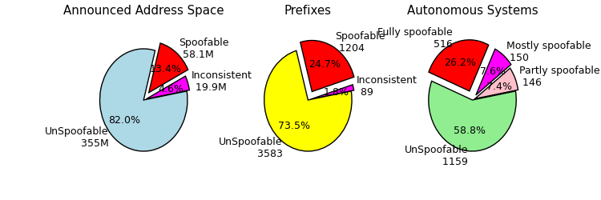
Spoofer Project http://spoofer.cmand.org/

Slide 18
Open Resolver Project http://openresolverproject.org/
Maintains a database of open DNS resolvers
~20 Million open resolvers available
~5 Million are out of date
~600Tb/s estimated aggregate bandwidth

Slide 19
An actual attack
1 Laptop controlling
> 10-12 servers
> Used 3 networks
> Used ~0.1% of the open resolvers
> Resulted in 10-12 * 1Gb/s * 50 = 0.5 – 0.6Tb/s

Slide 20
An actual attack
1 Laptop controlling
> 50-70servers on different networks
> Used 20 networks
> Used ~1% of the open resolvers
> Resulted in ~3Tb/s

Slide 21
An actual attack
1 Laptop controlling
> 200-400 servers on different networks
> Used 100 networks
> Used ~8% of the open resolvers
> Resulted in ~12Tb/s

Slide 22
24 Tb/s
Total US Internet Backbone capacity in 2012

Slide 23
I promised source code
#!/bin/bash
open_resolvers=IP1 IP2 IP3 IP4 ...
while (1)
do
for $resolver_ip in $open_resolvers
do
dig ietf.org@$resolver_ip any +notcp
done
done

Slide 24


