Slide 1
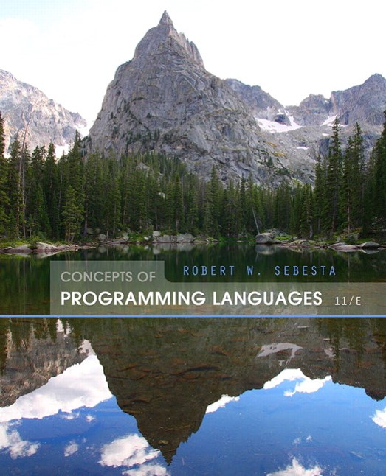
Concepts of Programming Languages
Eleventh Edition
Chapter 10
Implementing Subprograms
Copyright © 2016, 2013, 2010 Pearson Education, Inc. All Rights Reserved
Notes:
If this PowerPoint presentation contains mathematical equations, you may need to check that your computer has the following installed:
1) Math Type Plugin
2) Math Player (free versions available)
3) NVDA Reader (free versions available)

Slide 2
Objectives
10.1 The General Semantics of Calls and Returns
10.2 Implementing “Simple” Subprograms
10.3 Implementing Subprograms with Stack-Dynamic Local Variables
10.4 Nested Subprograms
10.5 Blocks
10.6 Implementing Dynamic Scoping

Slide 3
The General Semantics of Calls and Returns (1 of 2)
The subprogram call and return operations of a language are together called its subprogram linkage
General semantics of calls to a subprogram
Parameter passing methods
Stack-dynamic allocation of local variables
Save the execution status of calling program
Transfer of control and arrange for the return
If subprogram nesting is supported, access to nonlocal variables must be arranged

Slide 4
The General Semantics of Calls and Returns (2 of 2)
General semantics of subprogram returns:
In mode and inout mode parameters must have their values returned
Deallocation of stack-dynamic locals
Restore the execution status
Return control to the caller

Slide 5
Implementing “Simple” Subprograms (1 of 3)
Call Semantics:
Save the execution status of the caller
Pass the parameters
Pass the return address to the called
Transfer control to the called

Slide 6
Implementing “Simple” Subprograms (2 of 3)
Return Semantics:
If pass-by-value-result or out mode parameters are used, move the current values of those parameters to their corresponding actual parameters
If it is a function, move the functional value to a place the caller can get it
Restore the execution status of the caller
Transfer control back to the caller
Required storage:
Status information, parameters, return address, return value for functions, temporaries

Slide 7
Implementing “Simple” Subprograms (3 of 3)
Two separate parts: the actual code and the non-code part (local variables and data that can change)
The format, or layout, of the non-code part of an executing subprogram is called an activation record
An activation record instance is a concrete example of an activation record (the collection of data for a particular subprogram activation)

Slide 8
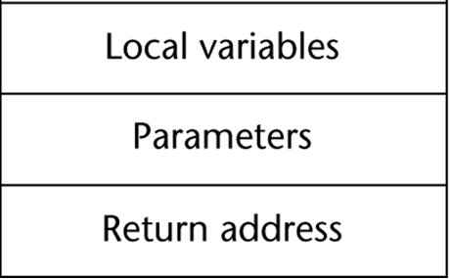
An Activation Record for “Simple” Subprograms

Slide 9
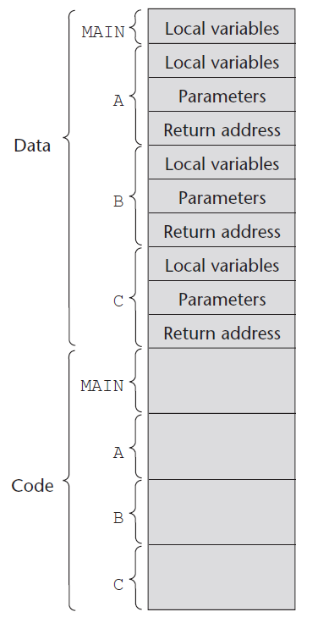
Code and Activation Records of a Program with “Simple” Subprograms

Slide 10
Implementing Subprograms with Stack-Dynamic Local Variables
More complex activation record
The compiler must generate code to cause implicit allocation and deallocation of local variables
Recursion must be supported (adds the possibility of multiple simultaneous activations of a subprogram)

Slide 11
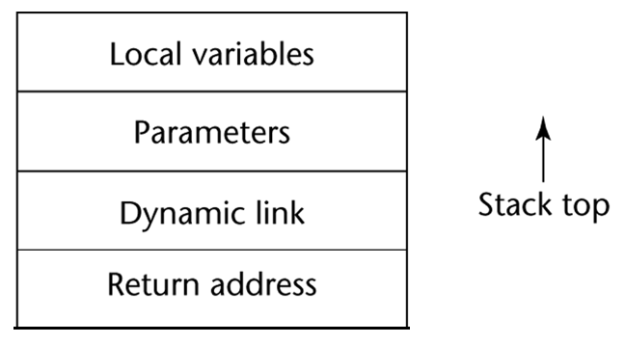
Typical Activation Record for a Language with Stack-Dynamic Local Variables

Slide 12
Implementing Subprograms with Stack-Dynamic Local Variables: Activation Record
The activation record format is static, but its size may be dynamic
The dynamic link points to the top of an instance of the activation record of the caller
An activation record instance is dynamically created when a subprogram is called
Activation record instances reside on the run-time stack
The Environment Pointer (E P) must be maintained by the run-time system. It always points at the base of the activation record instance of the currently executing program unit

Slide 13
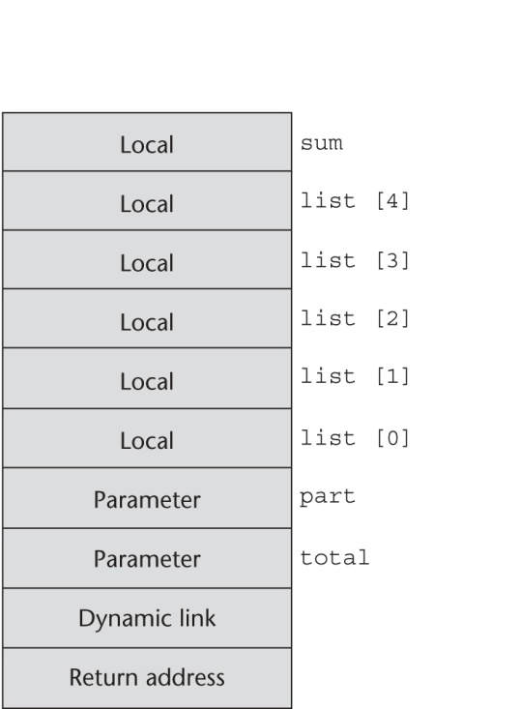
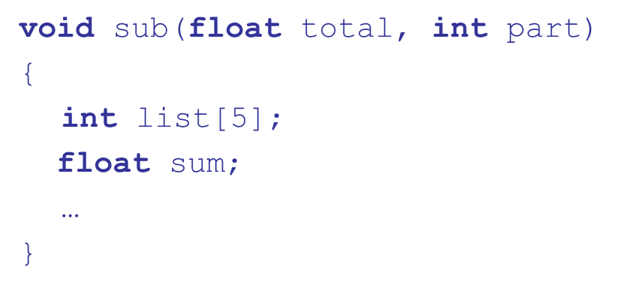
An Example: C Function

Slide 14
Revised Semantic Call/Return Actions (1 of 2)
Caller Actions:
Create an activation record instance
Save the execution status of the current program unit
Compute and pass the parameters
Pass the return address to the called
Transfer control to the called
Prologue actions of the called:
Save the old E P in the stack as the dynamic link and create the new value
Allocate local variables

Slide 15
Revised Semantic Call/Return Actions (2 of 2)
Epilogue actions of the called:
If there are pass-by-value-result or out-mode parameters, the current values of those parameters are moved to the corresponding actual parameters
If the subprogram is a function, its value is moved to a place accessible to the caller
Restore the stack pointer by setting it to the value of the current E P-1 and set the E P to the old dynamic link
Restore the execution status of the caller
Transfer control back to the caller

Slide 16
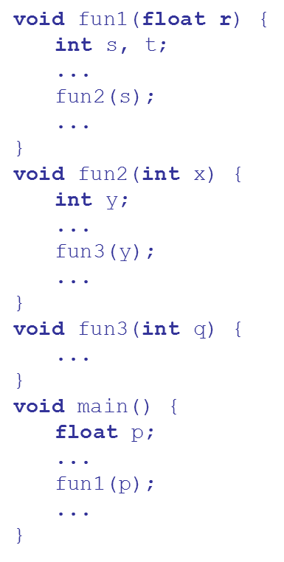
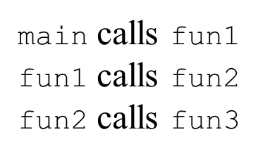
An Example Without Recursion (1 of 2)

Slide 17
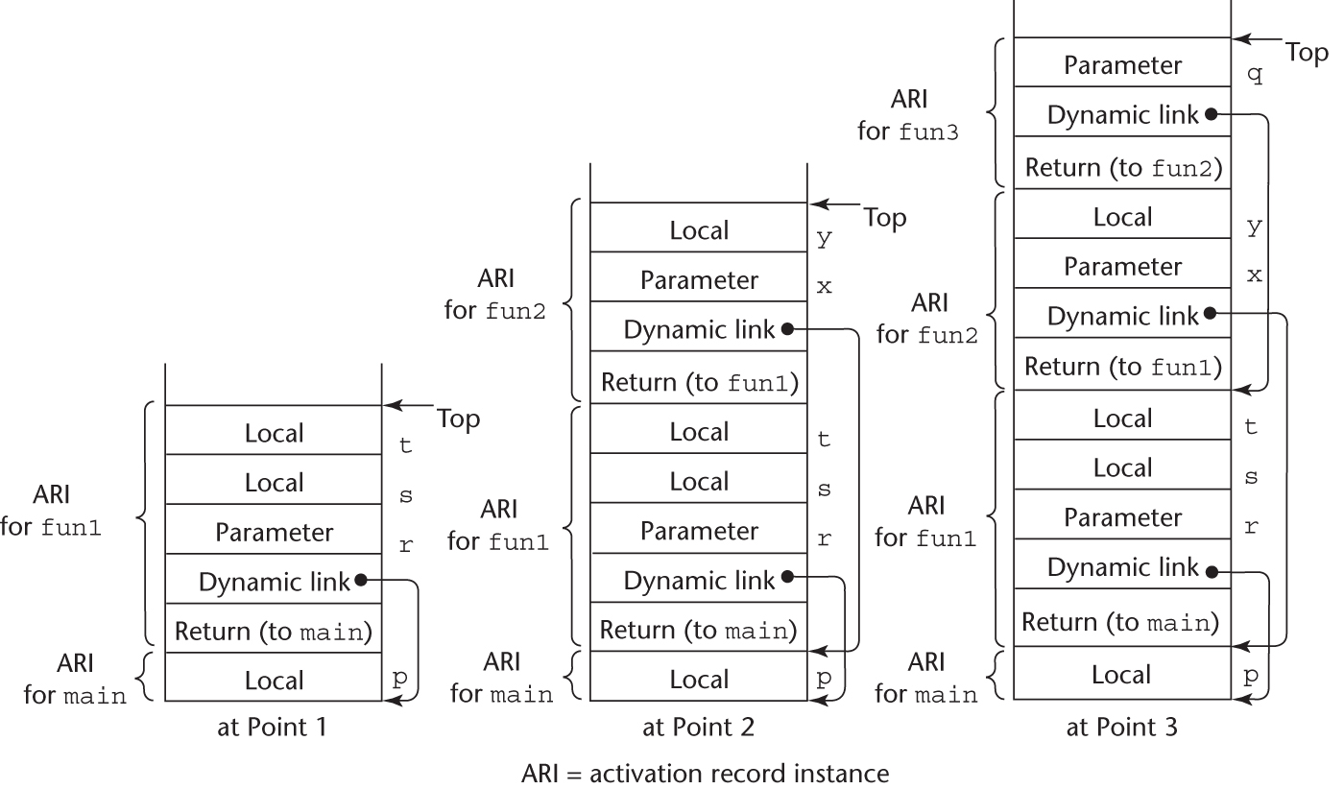
An Example Without Recursion (2 of 2)

Slide 18
Dynamic Chain and Local Offset
The collection of dynamic links in the stack at a given time is called the dynamic chain, or call chain
Local variables can be accessed by their offset from the beginning of the activation record, whose address is in the E P. This offset is called the local_offset
The local_offset of a local variable can be determined by the compiler at compile time

Slide 19
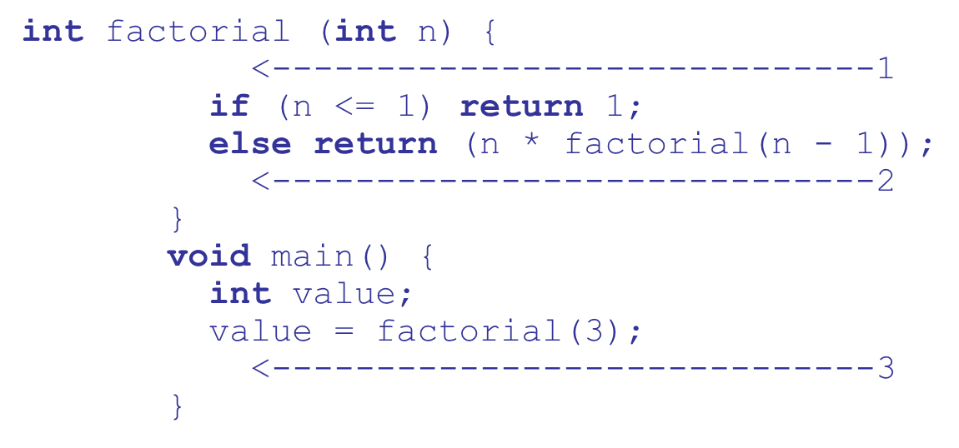
An Example With Recursion
The activation record used in the previous example supports recursion

Slide 20
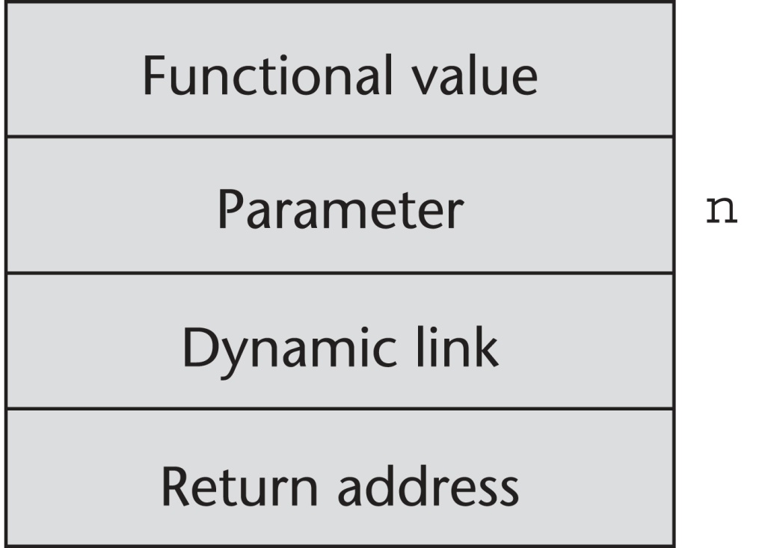
Activation Record for factorial

Slide 21
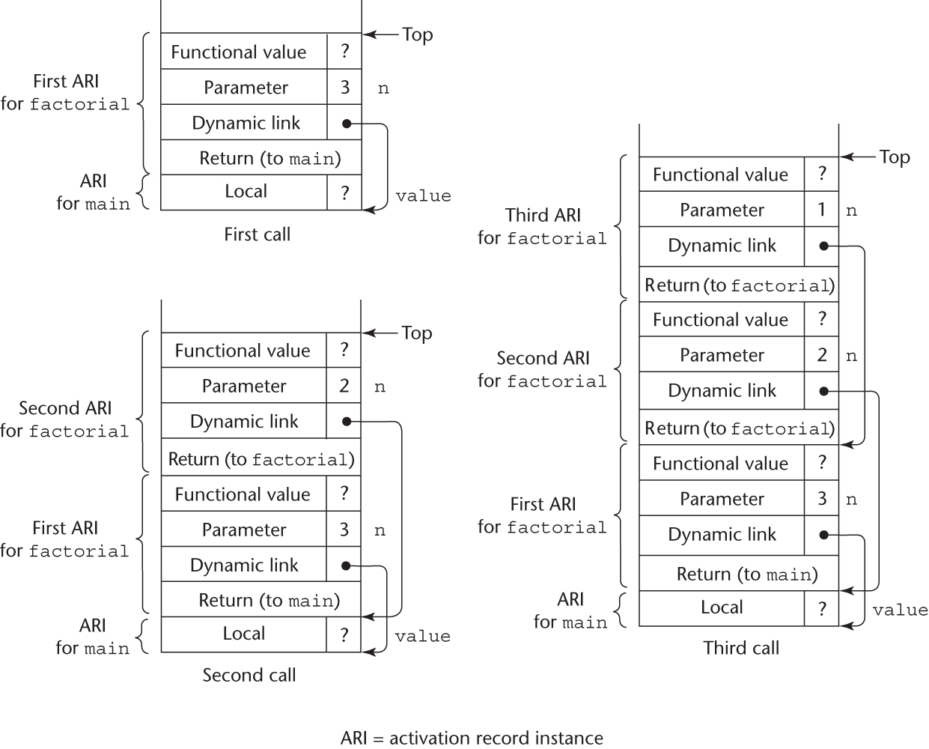
Stacks for calls to factorial (1 of 2)

Slide 22
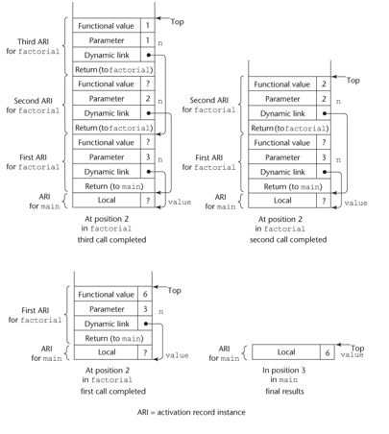
Stacks for calls to factorial (2 of 2)

Slide 23
Nested Subprograms
Some non-C-based static-scoped languages (e.g., Fortran 95+, Ada, Python, JavaScript, Ruby, and Lua) use stack-dynamic local variables and allow subprograms to be nested
All variables that can be non-locally accessed reside in some activation record instance in the stack
The process of locating a non-local reference:
Find the correct activation record instance
Determine the correct offset within that activation record instance

Slide 24
Locating a Non-local Reference
Finding the offset is easy
Finding the correct activation record instance
Static semantic rules guarantee that all non-local variables that can be referenced have been allocated in some activation record instance that is on the stack when the reference is made

Slide 25
Static Scoping (1 of 2)
A static chain is a chain of static links that connects certain activation record instances
The static link in an activation record instance for subprogram A points to one of the activation record instances of A's static parent
The static chain from an activation record instance connects it to all of its static ancestors
Static_depth is an integer associated with a static scope whose value is the depth of nesting of that scope

Slide 26
Static Scoping (2 of 2)
The chain_offset or nesting_depth of a nonlocal reference is the difference between the static_depth of the reference and that of the scope when it is declared
A reference to a variable can be represented by the pair:
(chain_offset, local_offset),
where local_offset is the offset in the activation
record of the variable being referenced

Slide 27
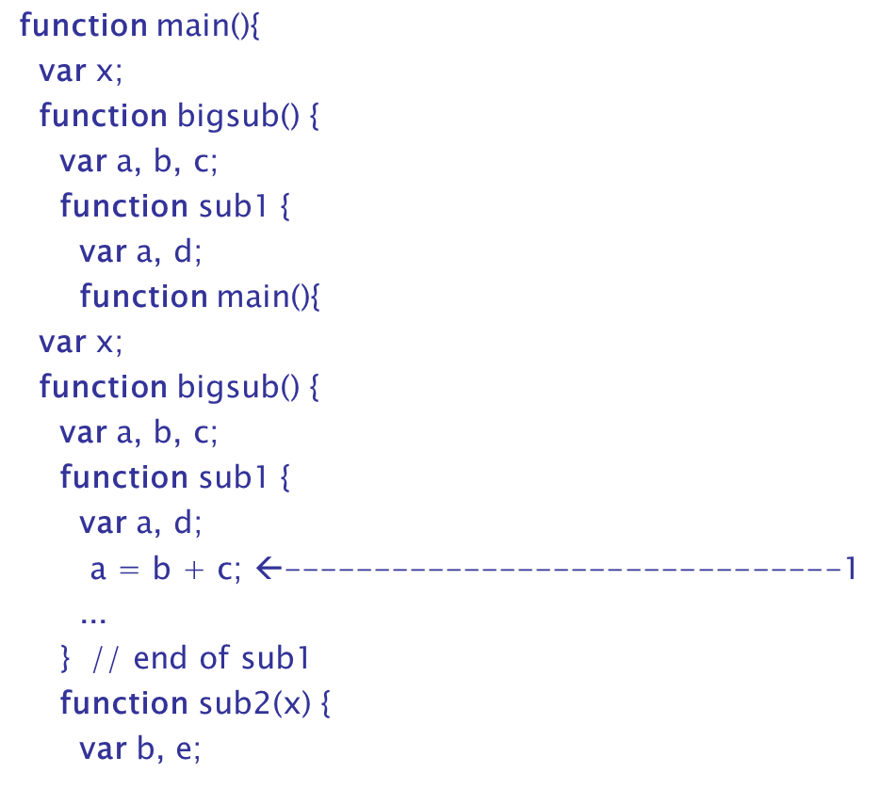
Example JavaScript Program (1 of 3)

Slide 28
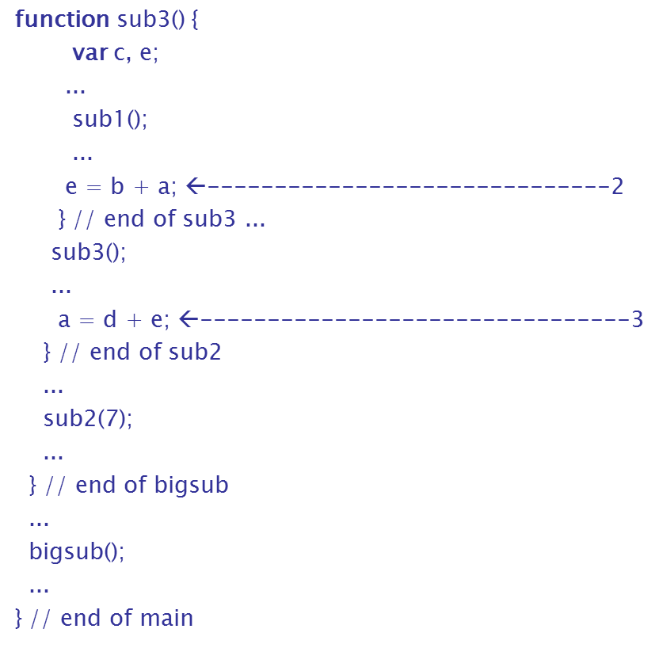
Example JavaScript Program (2 of 3)

Slide 29
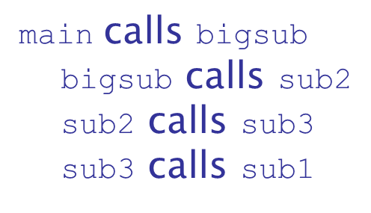
Example JavaScript Program (3 of 3)
Call sequence for main

Slide 30
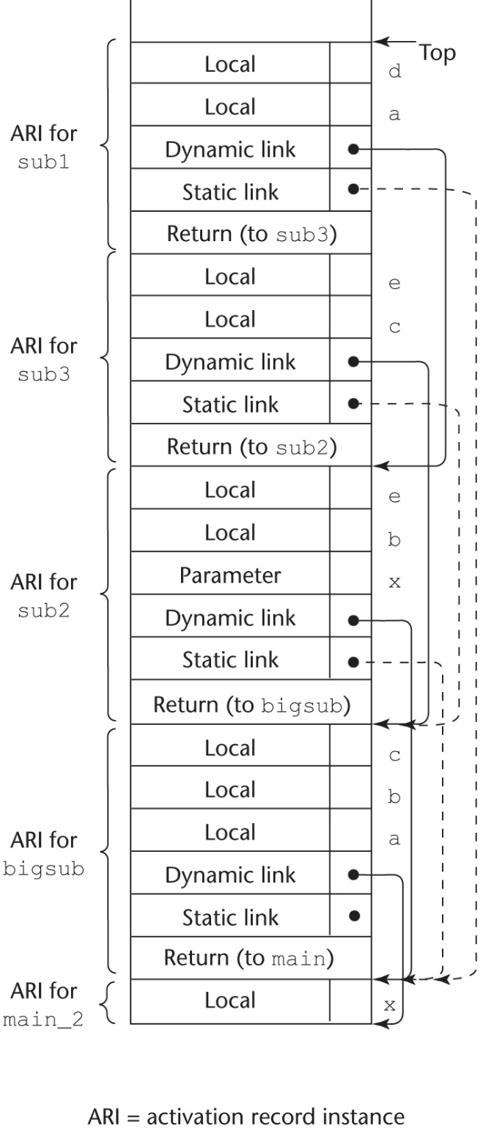
Stack Contents at Position 1

Slide 31
Static Chain Maintenance
At the call,
The activation record instance must be built
The dynamic link is just the old stack top pointer
The static link must point to the most recent ari of the static parent
Two methods:
Search the dynamic chain
Treat subprogram calls and definitions like variable references and definitions

Slide 32
Evaluation of Static Chains
Problems:
A nonlocal reference is slow if the nesting depth is large
Time-critical code is difficult:
Costs of nonlocal references are difficult to determine
Code changes can change the nesting depth, and therefore the cost

Slide 33
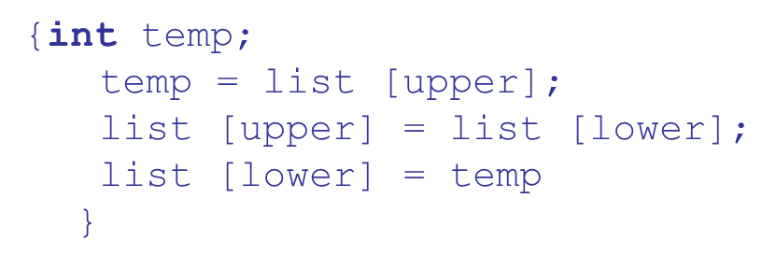
Blocks
Blocks are user-specified local scopes for variables
An example in C
The lifetime of temp in the above example begins when control enters the block
An advantage of using a local variable like temp is that it cannot interfere with any other variable with the same name

Slide 34
Implementing Blocks
Two Methods:
Treat blocks as parameter-less subprograms that are always called from the same location
Every block has an activation record; an instance is created every time the block is executed
Since the maximum storage required for a block can be statically determined, this amount of space can be allocated after the local variables in the activation record

Slide 35
Implementing Dynamic Scoping
Deep Access: non-local references are found by searching the activation record instances on the dynamic chain
Length of the chain cannot be statically determined
Every activation record instance must have variable names
Shallow Access: put locals in a central place
One stack for each variable name
Central table with an entry for each variable name

Slide 36
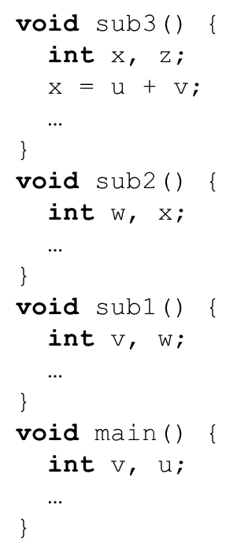
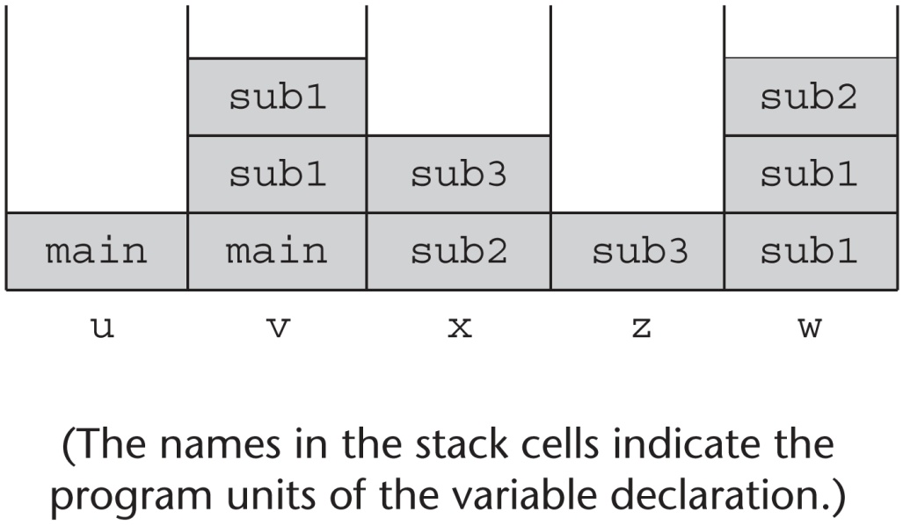
Using Shallow Access to Implement Dynamic Scoping

Slide 37
Summary (1 of 2)
Subprogram linkage semantics requires many action by the implementation
Simple subprograms have relatively basic actions
Stack-dynamic languages are more complex
Subprograms with stack-dynamic local variables and nested subprograms have two components
actual code
activation record

Slide 38
Summary (2 of 2)
Activation record instances contain formal parameters and local variables among other things
Static chains are the primary method of implementing accesses to non-local variables in static-scoped languages with nested subprograms
Access to non-local variables in dynamic-scoped languages can be implemented by use of the dynamic chain or thru some central variable table method

Slide 39
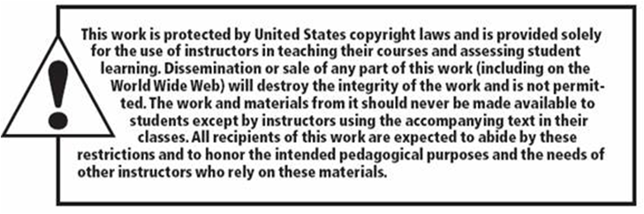
Copyright

