Slide 1
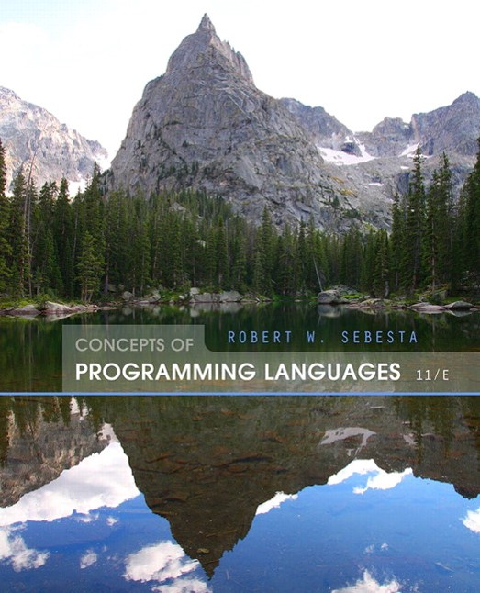
Concepts of Programming Languages
Eleventh Edition
Chapter 12
Support for
Object-Oriented Programming
Copyright © 2016, 2013, 2010 Pearson Education, Inc. All Rights Reserved
Notes:
If this PowerPoint presentation contains mathematical equations, you may need to check that your computer has the following installed:
1) Math Type Plugin
2) Math Player (free versions available)
3) NVDA Reader (free versions available)

Slide 2
Objectives (1 of 2)
12.1 Introduction
12.2 Object-Oriented Programming
12.3 Design Issues for Object-Oriented Languages
12.4 Support for Object-Oriented Programming in Smalltalk
12.5 Support for Object-Oriented Programming in C++
12.6 Support for Object-Oriented Programming in Objective-C
12.7 Support for Object-Oriented Programming in Java
12.8 Support for Object-Oriented Programming in

Slide 3
Objectives (2 of 2)
12.9 Support for Object-Oriented Programming in Ruby
12.10 Implementation of Object-Oriented Constructs
12.11 Reflection

Slide 4
Introduction
Many object-oriented programming (O O P) languages
Some support procedural and data-oriented programming (e.g., C++)
Some support functional program (e.g., C L O S)
Newer languages do not support other paradigms but
use their imperative structures (e.g., Java and
Some are pure O O P language (e.g., Smalltalk & Ruby)
Some functional languages support O O P, but they are not discussed in this chapter

Slide 5
Object-Oriented Programming
Three major language features:
Abstract data types (Chapter 11)
Inheritance
Inheritance is the central theme in O O P and languages that support it
Polymorphism

Slide 6
Inheritance
Productivity increases can come from reuse
A D Ts are difficult to reuse-always need changes
All A D Ts are independent and at the same level
Inheritance allows new classes defined in terms of existing ones, i.e., by allowing them to inherit common parts
Inheritance addresses both of the above concerns--reuse A D Ts after minor changes and define classes in a hierarchy

Slide 7
Object-Oriented Concepts (1 of 5)
A D Ts are usually called classes
Class instances are called objects
A class that inherits is a derived class or a subclass
The class from which another class inherits is a parent class or superclass
Subprograms that define operations on objects are called methods

Slide 8
Object-Oriented Concepts (2 of 5)
Calls to methods are called messages
The entire collection of methods of an object is called its message protocol or message interface
Messages have two parts--a method name and the destination object
In the simplest case, a class inherits all of the entities of its parent

Slide 9
Object-Oriented Concepts (3 of 5)
Inheritance can be complicated by access controls to encapsulated entities
A class can hide entities from its subclasses
A class can hide entities from its clients
A class can also hide entities for its clients while allowing its subclasses to see them
Besides inheriting methods as is, a class can modify an inherited method
The new one overrides the inherited one
The method in the parent is overriden

Slide 10
Object-Oriented Concepts (4 of 5)
Three ways a class can differ from its parent:
The subclass can add variables and/or methods to those inherited from the parent
The subclass can modify the behavior of one or more of its inherited methods.
The parent class can define some of its variables or methods to have private access, which means they will not be visible in the subclass

Slide 11
Object-Oriented Concepts (5 of 5)
There are two kinds of variables in a class:
Class variables - one/class
Instance variables - one/object
There are two kinds of methods in a class:
Class methods - accept messages to the class
Instance methods - accept messages to objects
Single vs. Multiple Inheritance
One disadvantage of inheritance for reuse:
Creates interdependencies among classes that complicate maintenance

Slide 12
Dynamic Binding
A polymorphic variable can be defined in a class that is able to reference (or point to) objects of the class and objects of any of its descendants
When a class hierarchy includes classes that override methods and such methods are called through a polymorphic variable, the binding to the correct method will be dynamic
Allows software systems to be more easily extended during both development and maintenance

Slide 13
Dynamic Binding Concepts
An abstract method is one that does not include a definition (it only defines a protocol)
An abstract class is one that includes at least one virtual method
An abstract class cannot be instantiated

Slide 14
Design Issues for OOP Languages
The Exclusivity of Objects
Are Subclasses Subtypes?
Single and Multiple Inheritance
Object Allocation and Deallocation
Dynamic and Static Binding
Nested Classes
Initialization of Objects

Slide 15
The Exclusivity of Objects (1 of 2)
Everything is an object
Advantage - elegance and purity
Disadvantage - slow operations on simple objects
Add objects to a complete typing system
Advantage - fast operations on simple objects
Disadvantage - results in a confusing type system (two kinds of entities)
Include an imperative-style typing system for primitives but make everything else objects

Slide 16
The Exclusivity of Objects (2 of 2)
Advantage - fast operations on simple objects and a relatively small typing system
Disadvantage - still some confusion because of the two type systems

Slide 17
Are Subclasses Subtypes?
Does an “is-a” relationship hold between a parent class object and an object of the subclass?
If a derived class is-a parent class, then objects of the derived class must behave the same as the parent class object
A derived class is a subtype if it has an is-a relationship with its parent class
Subclass can only add variables and methods and override inherited methods in “compatible” ways
Subclasses inherit implementation; subtypes inherit interface and behavior

Slide 18
Single and Multiple Inheritance
Multiple inheritance allows a new class to inherit from two or more classes
Disadvantages of multiple inheritance:
Language and implementation complexity (in part due to name collisions)
Potential inefficiency - dynamic binding costs more with multiple inheritance (but not much)
Advantage:
Sometimes it is quite convenient and valuable

Slide 19
Allocation and DeAllocation of Objects (1 of 2)
From where are objects allocated?
If they behave line the A D Ts, they can be allocated from anywhere
Allocated from the run-time stack
Explicitly create on the heap (via new)
If they are all heap-dynamic, references can be uniform thru a pointer or reference variable
Simplifies assignment - dereferencing can be implicit

Slide 20
Allocation and DeAllocation of Objects (2 of 2)
If objects are stack dynamic, there is a problem with regard to subtypes - object slicing
Is deallocation explicit or implicit?

Slide 21
Dynamic and Static Binding
Should all binding of messages to methods be dynamic?
If none are, you lose the advantages of dynamic binding
If all are, it is inefficient
Maybe the design should allow the user to specify

Slide 22
Nested Classes
If a new class is needed by only one class, there is no reason to define so it can be seen by other classes
Can the new class be nested inside the class that uses it?
In some cases, the new class is nested inside a subprogram rather than directly in another class
Other issues:
Which facilities of the nesting class should be visible to the nested class and vice versa

Slide 23
Initialization of Objects
Are objects initialized to values when they are created?
Implicit or explicit initialization
How are parent class members initialized when a subclass object is created?

Slide 24
Support for OOP in Smalltalk (1 of 4)
Smalltalk is a pure OOP language
Everything is an object
All objects have local memory
All computation is through objects sending messages to objects
None of the appearances of imperative languages
All objected are allocated from the heap
All deallocation is implicit
Smalltalk classes cannot be nested in other classes

Slide 25
Support for OOP in Smalltalk (2 of 4)
Inheritance
A Smalltalk subclass inherits all of the instance variables, instance methods, and class methods of its superclass
All subclasses are subtypes (nothing can be hidden)
All inheritance is implementation inheritance
No multiple inheritance

Slide 26
Support for OOP in Smalltalk (3 of 4)
Dynamic Binding
All binding of messages to methods is dynamic
The process is to search the object to which the message is sent for the method; if not found, search the superclass, etc. up to the system class which has no superclass
The only type checking in Smalltalk is dynamic and the only type error occurs when a message is sent to an object that has no matching method

Slide 27
Support for OOP in Smalltalk (4 of 4)
Evaluation of Smalltalk
The syntax of the language is simple and regular
Good example of power provided by a small language
Slow compared with conventional compiled imperative languages
Dynamic binding allows type errors to go undetected until run time
Introduced the graphical user interface
Greatest impact: advancement of OOP

Slide 28
Support for OOP in C++ (1 of 3)
General Characteristics:
Evolved from C and SIMULA 67
Among the most widely used OOP languages
Mixed typing system
Constructors and destructors
Elaborate access controls to class entities

Slide 29
Support for OOP in C++ (2 of 3)
Inheritance
A class need not be the subclass of any class
Access controls for members are
Private (visible only in the class and friends) (disallows subclasses from being subtypes)
Public (visible in subclasses and clients)
Protected (visible in the class and in subclasses, but not clients)

Slide 30
Support for OOP in C++ (3 of 3)
In addition, the subclassing process can be declared with access controls (private or public), which define potential changes in access by subclasses
Private derivation - inherited public and protected members are private in the subclasses
Public derivation public and protected members are also public and protected in subclasses

Slide 31
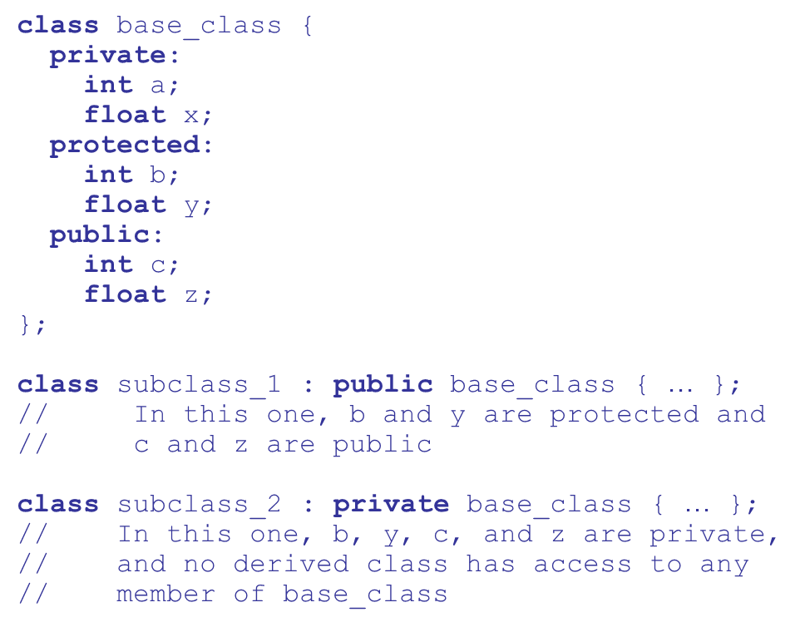
Inheritance Example in C++

Slide 32
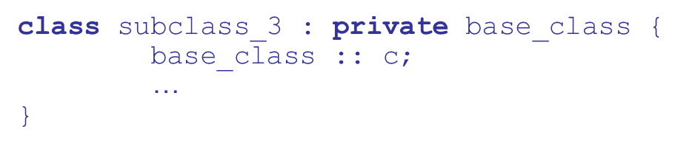
Reexportation in C++
A member that is not accessible in a subclass (because of private derivation) can be declared to be visible there
using the scope resolution operator

Slide 33
Reexportation
One motivation for using private derivation
A class provides members that must be visible, so they are defined to be public members; a derived class adds some new members, but does not want its clients to see the members of the parent class, even though they had to be public in the parent class definition

Slide 34
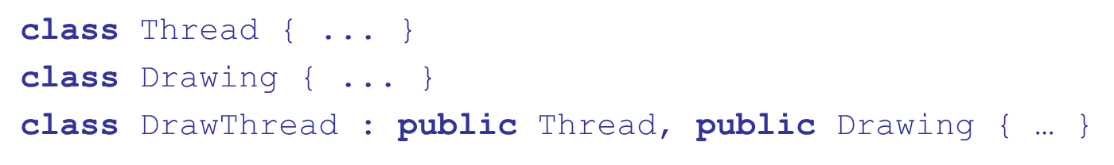
Support for OOP in C++ (1 of 6)
Multiple inheritance is supported
If there are two inherited members with the same name, they can both be referenced using the scope
resolution operator

Slide 35
Support for OOP in C++ (2 of 6)
Dynamic Binding
A method can be defined to be virtual, which means that they can be called through polymorphic variables and dynamically bound to messages
A pure virtual function has no definition at all
A class that has at least one pure virtual function is an abstract class

Slide 36
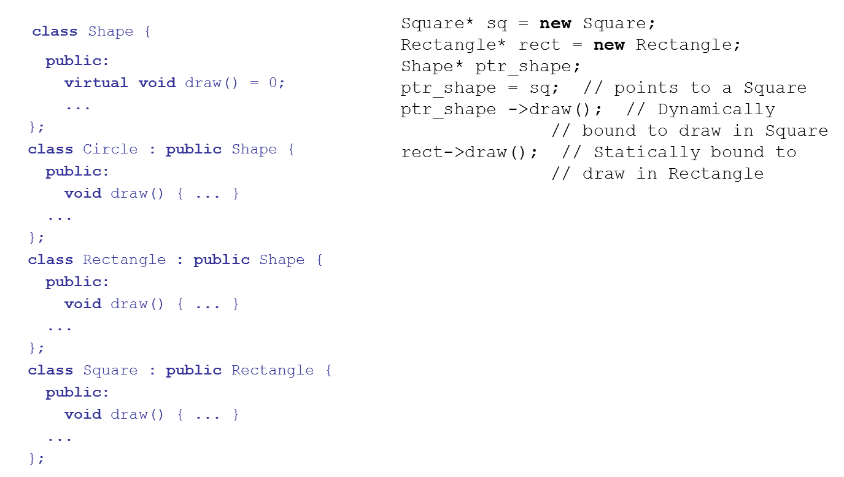
Support for OOP in C++ (3 of 6)

Slide 37
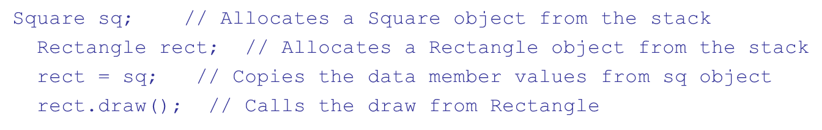
Support for OOP in C++ (4 of 6)
If objects are allocated from the stack, it is quite different

Slide 38
Support for OOP in C++ (5 of 6)
Evaluation
C++ provides extensive access controls (unlike Smalltalk)
C++ provides multiple inheritance
In C++, the programmer must decide at design time which methods will be statically bound and which must be dynamically bound
Static binding is faster!
Smalltalk type checking is dynamic (flexible, but somewhat unsafe)

Slide 39
Support for OOP in C++ (6 of 6)
Because of interpretation and dynamic binding,
Smalltalk is
times slower than C++

Slide 40
Support for OOP in Objective-C (1 of 7)
Like C++, Objective-C adds support for OOP to C
Design was at about the same time as that of C++
Largest syntactic difference: method calls
Interface section of a class declares the instance variables and the methods
Implementation section of a class defines the methods
Classes cannot be nested

Slide 41
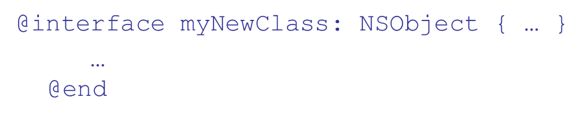
Support for OOP in Objective-C (2 of 7)
Inheritance
Single inheritance only
Every class must have a parent
N SObject is the base class
Because all public members of a base class are also public in the derived class all subclasses are subtypes

Slide 42
Support for OOP in Objective-C (3 of 7)
Any method that has the same name, same return type, and same number and types of parameters as an inherited method overrides the inherited method
An overriden method can be called through super
All inheritance is public (unlike C++)
Objective-C has two approaches besides subclassing to extend a class
A category is a secondary interface of a class that contains declarations of methods (no instance variables

Slide 43
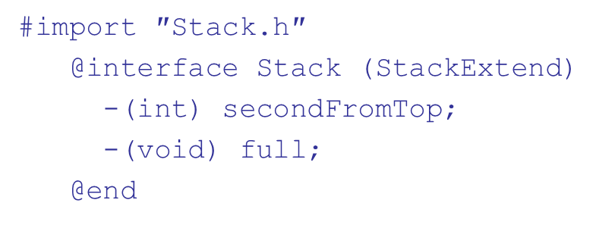
Support for OOP in Objective-C (4 of 7)
A category is a mixin – its methods are added to the parent class
The implementation of a category is in a separate
implementation:
The other way to extend a class: protocols
A protocol is a list of method declarations

Slide 44
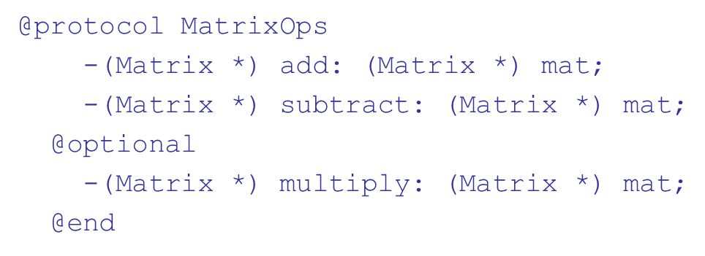
Support for OOP in Objective-C (5 of 7)
MatrixOps is the name of the protocol
The add and subtract methods must be implemented by class that uses the protocol
A class that adopts a protocol must specify it

Slide 45
Support for OOP in Objective-C (6 of 7)
Dynamic Binding
Different from other OOP languages - a polymorphic variable is of type id
An id type variable can reference any object
The run-time system keeps track of the type of the object that an id type variable references
If a call to a method is made through an id type variable, the binding to the method is dynamic

Slide 46
Support for OOP in Objective-C (7 of 7)
Evaluation
Support is adequate, with the following deficiencies:
There is no way to prevent overriding an inherited method
The use of id type variables for dynamic binding is overkill – these variables could be misused
Categories and protocols are useful additions

Slide 47
Support for OOP in Java (1 of 5)
Because of its close relationship to C++, focus is on the differences from that language
General Characteristics
All data are objects except the primitive types
All primitive types have wrapper classes that store one data value
All objects are heap-dynamic, are referenced through reference variables, and most are allocated with new
A finalize method is implicitly called when the garbage collector is about to reclaim the storage occupied by the object

Slide 48
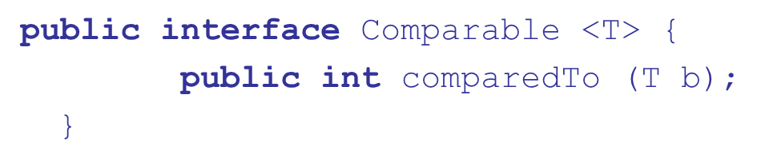
Support for OOP in Java (2 of 5)
Inheritance
Single inheritance supported only, but there is an abstract class category that provides some of the benefits of multiple inheritance (interface)
An interface can include only method declarations and named constants, e.g.,
Methods can be final (cannot be overriden)
All subclasses are subtypes

Slide 49
Support for OOP in Java (3 of 5)
Dynamic Binding
In Java, all messages are dynamically bound to methods, unless the method is final (i.e., it cannot be overriden, therefore dynamic binding serves no purpose)
Static binding is also used if the methods is static or private both of which disallow overriding

Slide 50
Support for OOP in Java (4 of 5)
Nested Classes
All are hidden from all classes in their package, except for the nesting class
Nonstatic classes nested directly are called innerclasses
An innerclass can access members of its nesting class
A static nested class cannot access members of its nesting class
Nested classes can be anonymous

Slide 51
Support for OOP in Java (5 of 5)
A local nested class is defined in a method of its nesting class
No access specifier is used
Evaluation
Design decisions to support OOP are similar to C++
No support for procedural programming
No parentless classes
Dynamic binding is used as “normal” way to bind method calls to method definitions
Uses interfaces to provide a simple form of support for multiple inheritance

Slide 52
Support for OOP in c hash (1 of 5)
General characteristics
Support for OOP similar to Java
Includes both classes and structs
Classes are similar to Java’s classes
structs are less powerful stack-dynamic constructs (e.g., no inheritance)

Slide 53
Support for OOP in c hash (2 of 5)
Inheritance
Uses the syntax of C++ for defining classes
A method inherited from parent class can be replaced in the derived class by marking its definition with new
The parent class version can still be called explicitly with the prefix base:
Subclasses are subtypes if no members of the
parent class is private
Single inheritance only

Slide 54
Support for OOP in c hash (3 of 5)
Dynamic binding
To allow dynamic binding of method calls to methods:
The base class method is marked virtual
The corresponding methods in derived classes are marked override
Abstract methods are marked abstract and must be implemented in all subclasses
All
classes are ultimately derived from a single
root class, Object

Slide 55
Support for OOP in c hash (4 of 5)
Nested Classes
A
class that is directly nested in a nesting class
behaves like a Java static nested class
C
does not support nested classes that behave like
the non-static classes of Java

Slide 56
Support for OOP in c hash (5 of 5)
Evaluation
C
is a relatively recently designed C-based O O
language
The differences between
and Java’s support for
OOP are relatively minor

Slide 57
Support for OOP in Ruby (1 of 4)
General Characteristics
Everything is an object
All computation is through message passing
Class definitions are executable, allowing secondary definitions to add members to existing definitions
Method definitions are also executable
All variables are type-less references to objects

Slide 58
Support for OOP in Ruby (2 of 4)
Access control is different for data and methods
It is private for all data and cannot be changed
Methods can be either public, private, or protected
Method access is checked at runtime
Getters and setters can be defined by shortcuts

Slide 59
Support for OOP in Ruby (3 of 4)
Inheritance
Access control to inherited methods can be different than in the parent class
Subclasses are not necessarily subtypes
Dynamic Binding
All variables are typeless and polymorphic

Slide 60
Support for OOP in Ruby (4 of 4)
Evaluation
Does not support abstract classes
Does not fully support multiple inheritance
Access controls are weaker than those of other languages that support OOP

Slide 61
Implementing O O Constructs
Two interesting and challenging parts
Storage structures for instance variables
Dynamic binding of messages to methods

Slide 62
Instance Data Storage
Class instance records (C I Rs) store the state of an object
Static (built at compile time)
If a class has a parent, the subclass instance variables are added to the parent C I R
Because C I R is static, access to all instance variables is done as it is in records
Efficient

Slide 63
Dynamic Binding of Methods Calls
Methods in a class that are statically bound need not be involved in the C I R; methods that will be dynamically bound must have entries in the C I R
Calls to dynamically bound methods can be connected to the corresponding code thru a pointer in the C I R
The storage structure is sometimes called virtual method tables (vtable)
Method calls can be represented as offsets from the beginning of the vtable

Slide 64
Reflection (1 of 2)
A programming language that supports reflection allows its programs to have runtime access to their types and structure and to be able to dynamically modify their behavior
The types and structure of a program are called metadata
The process of a program examining its metadata is called introspection
Interceding in the execution of a program is called intercession

Slide 65
Reflection (2 of 2)
Uses of reflection for software tools:
Class browsers need to enumerate the classes of a program
Visual I D Es use type information to assist the developer in building type correct code
Debuggers need to examine private fields and methods of classes
Test systems need to know all of the methods of a class

Slide 66
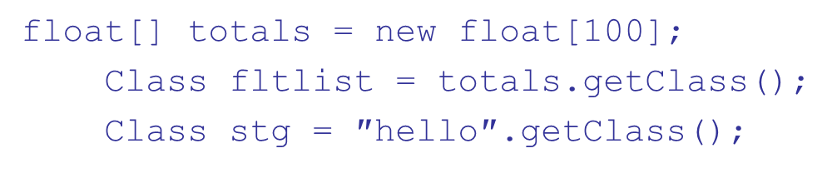

Reflection in Java (1 of 3)
Limited support from
Java runtime instantiates an instance of Class for each object in the program
The getClass method of Class returns the Class object of an object
If there is no object, use class field

Slide 67
Reflection in Java (2 of 3)
Class has four useful methods:
getMethod searches for a specific public method of a class
getMethods returns an array of all public methods of a class
getDeclaredMethod searches for a specific
method of a class
getDeclaredMethods returns an array of all
methods of a class

Slide 68
Reflection in Java (3 of 3)
The Method class defines the invoke method, which is used to execute the method found by getMethod

Slide 69
Reflection in C#
In the .NET languages the compiler places the intermediate code in an assembly, along with metadata about the program
System.Type is the namespace for reflection
getType is used instead of getClass
typeof operator is used instead of .class field
System.Reflection.Emit namespace provides the ability to create intermediate code and put it in an assembly (Java does not provide this capability)

Slide 70
Downsides of Reflection
Performance costs
Exposes private fields and methods
Voids the advantages of early type checking
Some reflection code may not run under a security manager, making code nonportable

Slide 71
Summary (1 of 2)
O O programming involves three fundamental concepts: A D Ts, inheritance, dynamic binding
Major design issues: exclusivity of objects, subclasses and subtypes, type checking and polymorphism, single and multiple inheritance, dynamic binding, explicit and implicit de-allocation of objects, and nested classes
Smalltalk is a pure O O L
C++ has two distinct type systems (hybrid)
Java is not a hybrid language like C++; it supports only OOP

Slide 72
Summary (2 of 2)
C
is based on C++ and Java
Implementing OOP involves some Ruby is a relatively recent pure OOP language; provides some new ideas in support for OOP
new data structures
Reflection is part of Java and
as well as most
dynamically types languages

Slide 73
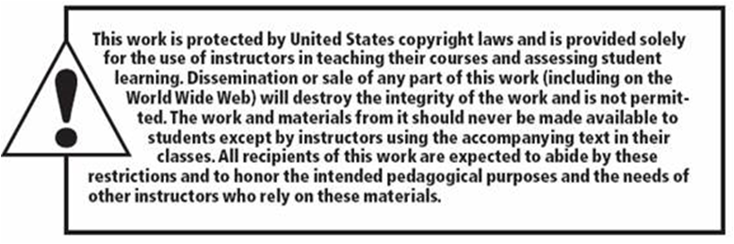
Copyright

