Slide 1
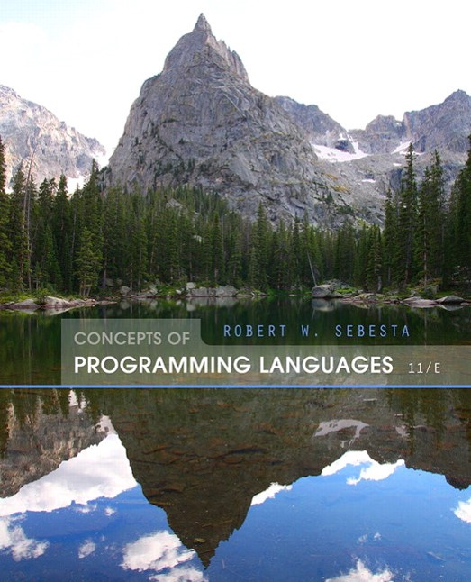
Concepts of Programming Languages
Eleventh Edition
Chapter 13
Concurrency
Copyright © 2016, 2013, 2010 Pearson Education, Inc. All Rights Reserved
Notes:
If this PowerPoint presentation contains mathematical equations, you may need to check that your computer has the following installed:
1) Math Type Plugin
2) Math Player (free versions available)
3) NVDA Reader (free versions available)

Slide 2
Objectives (1 of 2)
13.1 Introduction
13.2 Introduction to Subprogram-Level Concurrency
13.3 Semaphores
13.4 Monitors
13.5 Message Passing
13.6 Ada support for Concurrency
13.7 Java Threads
13.8
Threads

Slide 3
Objectives (2 of 2)
13.9 Concurrency in Functional Languages
13.10 Statement-Level Concurrency

Slide 4
Introduction
Concurrency can occur at four levels:
Machine instruction level
High-level language statement level
Unit level
Program level
Because there are no language issues in instruction- and program-level concurrency, they are not addressed here

Slide 5
Multiprocessor Architectures
Late 1950s - one general-purpose processor and one or more special-purpose processors for input and output operations
Early 1960s - multiple complete processors, used for program-level concurrency
Mid-1960s - multiple partial processors, used for instruction-level concurrency
Single-Instruction Multiple-Data (S I M D) machines
Multiple-Instruction Multiple-Data (M I M D) machines
A primary focus of this chapter is shared memory M I M D machines (multiprocessors)

Slide 6
Categories of Concurrency
Categories of Concurrency:
Physical concurrency - Multiple independent processors ( multiple threads of control)
Logical concurrency - The appearance of physical concurrency is presented by time-sharing one processor (software can be designed as if there were multiple threads of control)
Coroutines (quasi-concurrency) have a single thread of control
A thread of control in a program is the sequence of program points reached as control flows through the program

Slide 7
Motivations for the Use of Concurrency
Multiprocessor computers capable of physical concurrency are now widely used
Even if a machine has just one processor, a program written to use concurrent execution can be faster than the same program written for nonconcurrent execution
Involves a different way of designing software that can be very useful-many real-world situations involve concurrency
Many program applications are now spread over multiple machines, either locally or over a network

Slide 8
Introduction to Subprogram-Level Concurrency
A task or process or thread is a program unit that can be in concurrent execution with other program units
Tasks differ from ordinary subprograms in that:
A task may be implicitly started
When a program unit starts the execution of a task, it is not necessarily suspended
When a task’s execution is completed, control may not return to the caller
Tasks usually work together

Slide 9
Two General Categories of Tasks
Heavyweight tasks execute in their own address space
Lightweight tasks all run in the same address space – more efficient
A task is disjoint if it does not communicate with or affect the execution of any other task in the program in any way

Slide 10
Task Synchronization
A mechanism that controls the order in which tasks execute
Two kinds of synchronization
Cooperation synchronization
Competition synchronization
Task communication is necessary for synchronization, provided by:
Shared nonlocal variables
Parameters
Message passing

Slide 11
Kinds of synchronization
Cooperation: Task A must wait for task B to complete some specific activity before task A can continue its execution, e.g., the producer-consumer problem
Competition: Two or more tasks must use some resource that cannot be simultaneously used, e.g., a shared counter
Competition is usually provided by mutually exclusive access (approaches are discussed later)

Slide 12
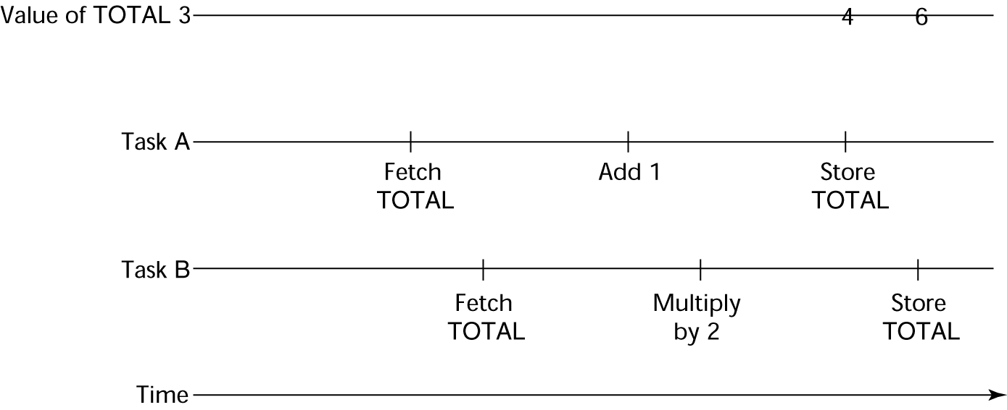
Need for Competition Synchronization
Depending on order, there could be four different results

Slide 13
Scheduler
Providing synchronization requires a mechanism for delaying task execution
Task execution control is maintained by a program called the scheduler, which maps task execution onto available processors

Slide 14
Task Execution States
New - created but not yet started
Ready - ready to run but not currently running (no available processor)
Running
Blocked - has been running, but cannot now continue (usually waiting for some event to occur)
Dead - no longer active in any sense

Slide 15
Liveness and Deadlock
Liveness is a characteristic that a program unit may or may not have
In sequential code, it means the unit will eventually complete its execution
In a concurrent environment, a task can easily lose its liveness
If all tasks in a concurrent environment lose their liveness, it is called deadlock

Slide 16
Design Issues for Concurrency
Competition and cooperation synchronization*
Controlling task scheduling
How can an application influence task scheduling
How and when tasks start and end execution
How and when are tasks created
* The most important issue

Slide 17
Methods of Providing Synchronization
Semaphores
Monitors
Message Passing

Slide 18
Semaphores (1 of 2)
Dijkstra - 1965
A semaphore is a data structure consisting of a counter and a queue for storing task descriptors
A task descriptor is a data structure that stores all of the relevant information about the execution state of the task
Semaphores can be used to implement guards on the code that accesses shared data structures

Slide 19
Semaphores (2 of 2)
Semaphores have only two operations, wait and release (originally called P and V by Dijkstra)
Semaphores can be used to provide both competition and cooperation synchronization

Slide 20
Cooperation Synchronization with Semaphores (1 of 3)
Example: A shared buffer
The buffer is implemented as an A D T with the operations DEPOSIT and FETCH as the only ways to access the buffer
Use two semaphores for cooperation: emptyspots and fullspots
The semaphore counters are used to store the numbers of empty spots and full spots in the buffer

Slide 21
Cooperation Synchronization with Semaphores (2 of 3)
DEPOSIT must first check emptyspots to see if there is room in the buffer
If there is room, the counter of emptyspots is decremented and the value is inserted
If there is no room, the caller is stored in the queue of emptyspots
When DEPOSIT is finished, it must increment the counter of fullspots

Slide 22
Cooperation Synchronization with Semaphores (3 of 3)
FETCH must first check fullspots to see if there is a value
If there is a full spot, the counter of fullspots is decremented and the value is removed
If there are no values in the buffer, the caller must be placed in the queue of fullspots
When FETCH is finished, it increments the counter of emptyspots
The operations of FETCH and DEPOSIT on the semaphores are accomplished through two semaphore operations named wait and release

Slide 23
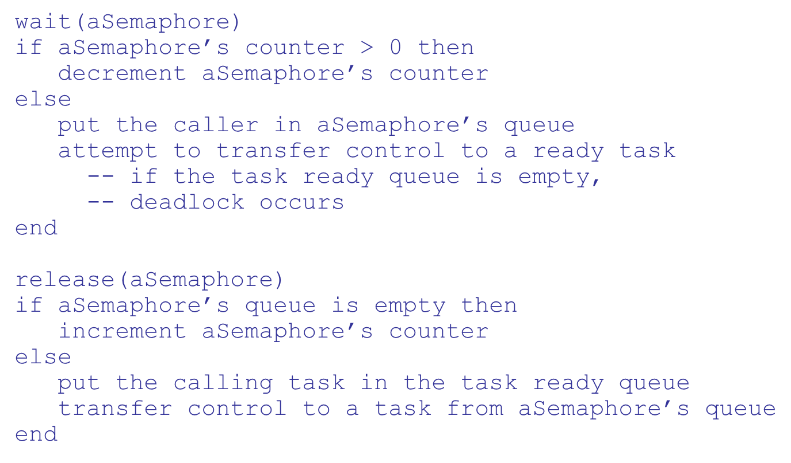
Semaphores: Wait and Release Operations

Slide 24
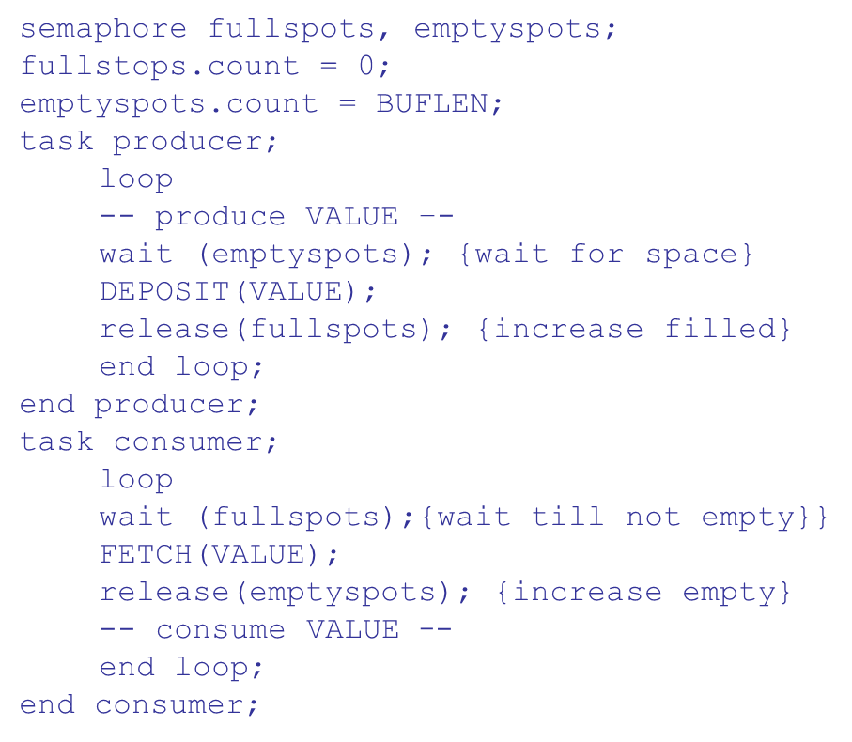
Producer and Consumer Tasks

Slide 25
Competition Synchronization with Semaphores
A third semaphore, named access, is used to control access (competition synchronization)
The counter of access will only have the values 0 and 1
Such a semaphore is called a binary semaphore
Note that wait and release must be atomic!

Slide 26
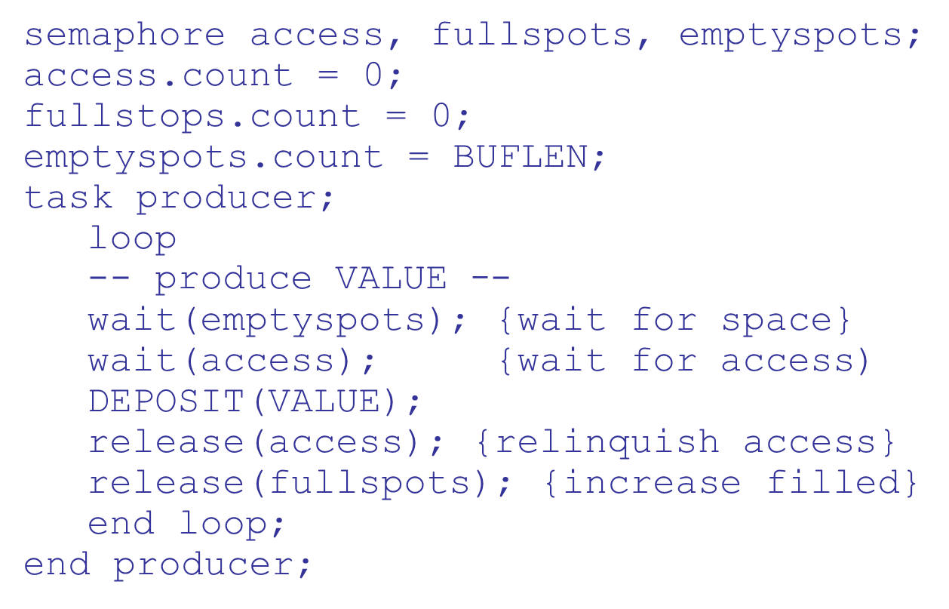
Producer Code for Semaphores

Slide 27
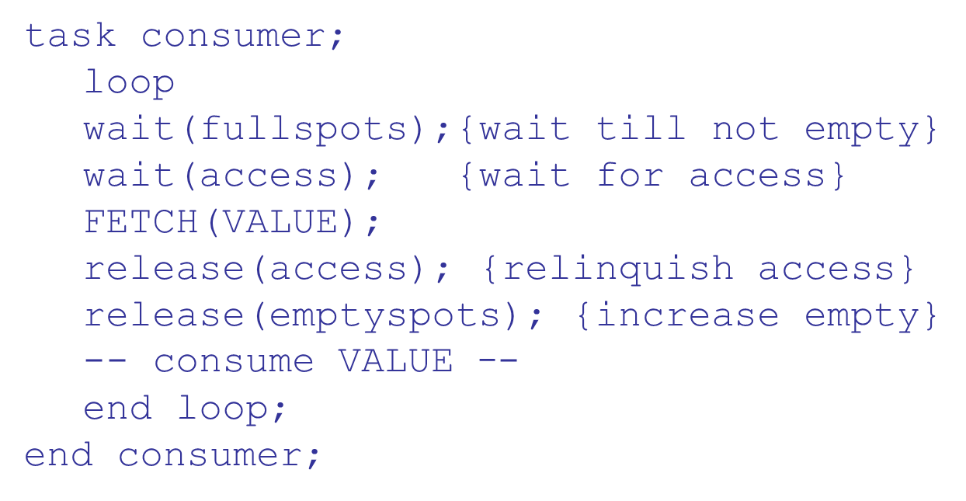
Consumer Code for Semaphores

Slide 28
Evaluation of Semaphores
Misuse of semaphores can cause failures in cooperation synchronization, e.g., the buffer will overflow if the wait of fullspots is left out
Misuse of semaphores can cause failures in competition synchronization, e.g., the program will deadlock if the release of access is left out

Slide 29
Monitors
Ada, Java,
The idea: encapsulate the shared data and its operations to restrict access
A monitor is an abstract data type for shared data

Slide 30
Competition Synchronization
Shared data is resident in the monitor (rather than in the client units)
All access resident in the monitor
Monitor implementation guarantee synchronized access by allowing only one access at a time
Calls to monitor procedures are implicitly queued if the monitor is busy at the time of the call

Slide 31
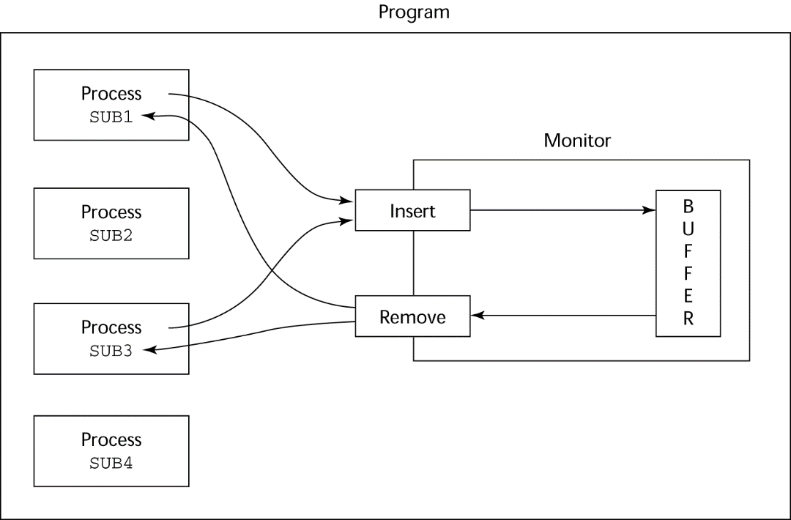
Cooperation Synchronization
Cooperation between processes is still a programming task
Programmer must guarantee that a shared buffer does not experience underflow or overflow

Slide 32
Evaluation of Monitors
A better way to provide competition synchronization than are semaphores
Semaphores can be used to implement monitors
Monitors can be used to implement semaphores
Support for cooperation synchronization is very similar as with semaphores, so it has the same problems

Slide 33
Message Passing
Message passing is a general model for concurrency
It can model both semaphores and monitors
It is not just for competition synchronization
Central idea: task communication is like seeing a doctor--most of the time she waits for you or you wait for her, but when you are both ready, you get together, or rendezvous

Slide 34
Message Passing Rendezvous
To support concurrent tasks with message passing, a language needs:
A mechanism to allow a task to indicate when it is willing to accept messages
A way to remember who is waiting to have its message accepted and some “fair” way of choosing the next message
When a sender task’s message is accepted by a receiver task, the actual message transmission is called a rendezvous

Slide 35
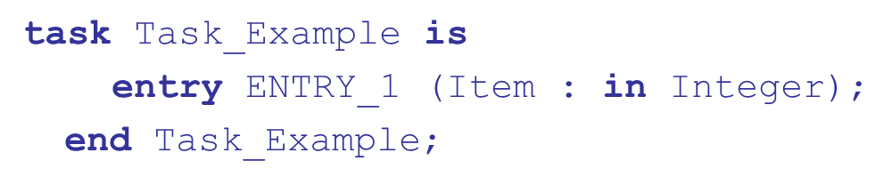
Ada Support for Concurrency
The Ada 83 Message-Passing Model
Ada tasks have specification and body parts, like packages; the spec has the interface, which is the collection of entry points:

Slide 36
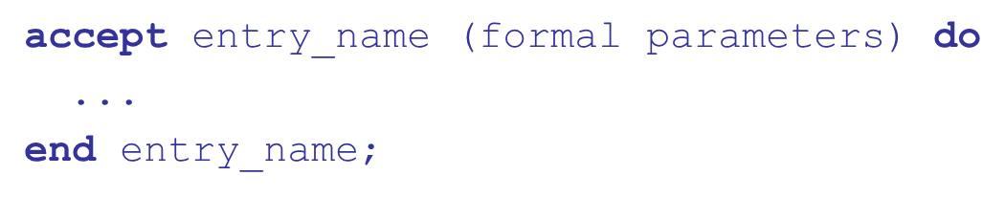
Task Body
The body task describes the action that takes place when a rendezvous occurs
A task that sends a message is suspended while waiting for the message to be accepted and during the rendezvous
Entry points in the spec are described with accept clauses in the body

Slide 37
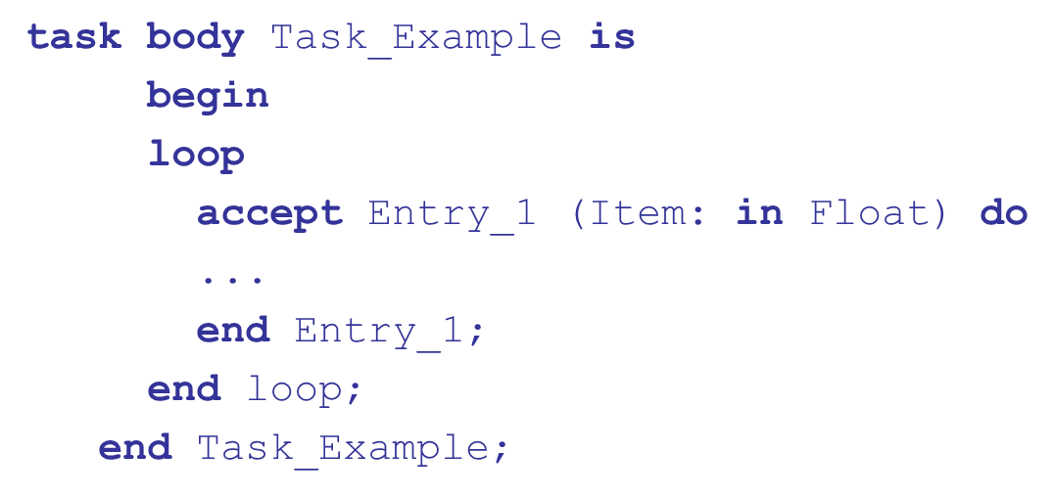
Example of a Task Body

Slide 38
Ada Message Passing Semantics
The task executes to the top of the accept clause and waits for a message
During execution of the accept clause, the sender is suspended
accept parameters can transmit information in either or both directions
Every accept clause has an associated queue to store waiting messages

Slide 39
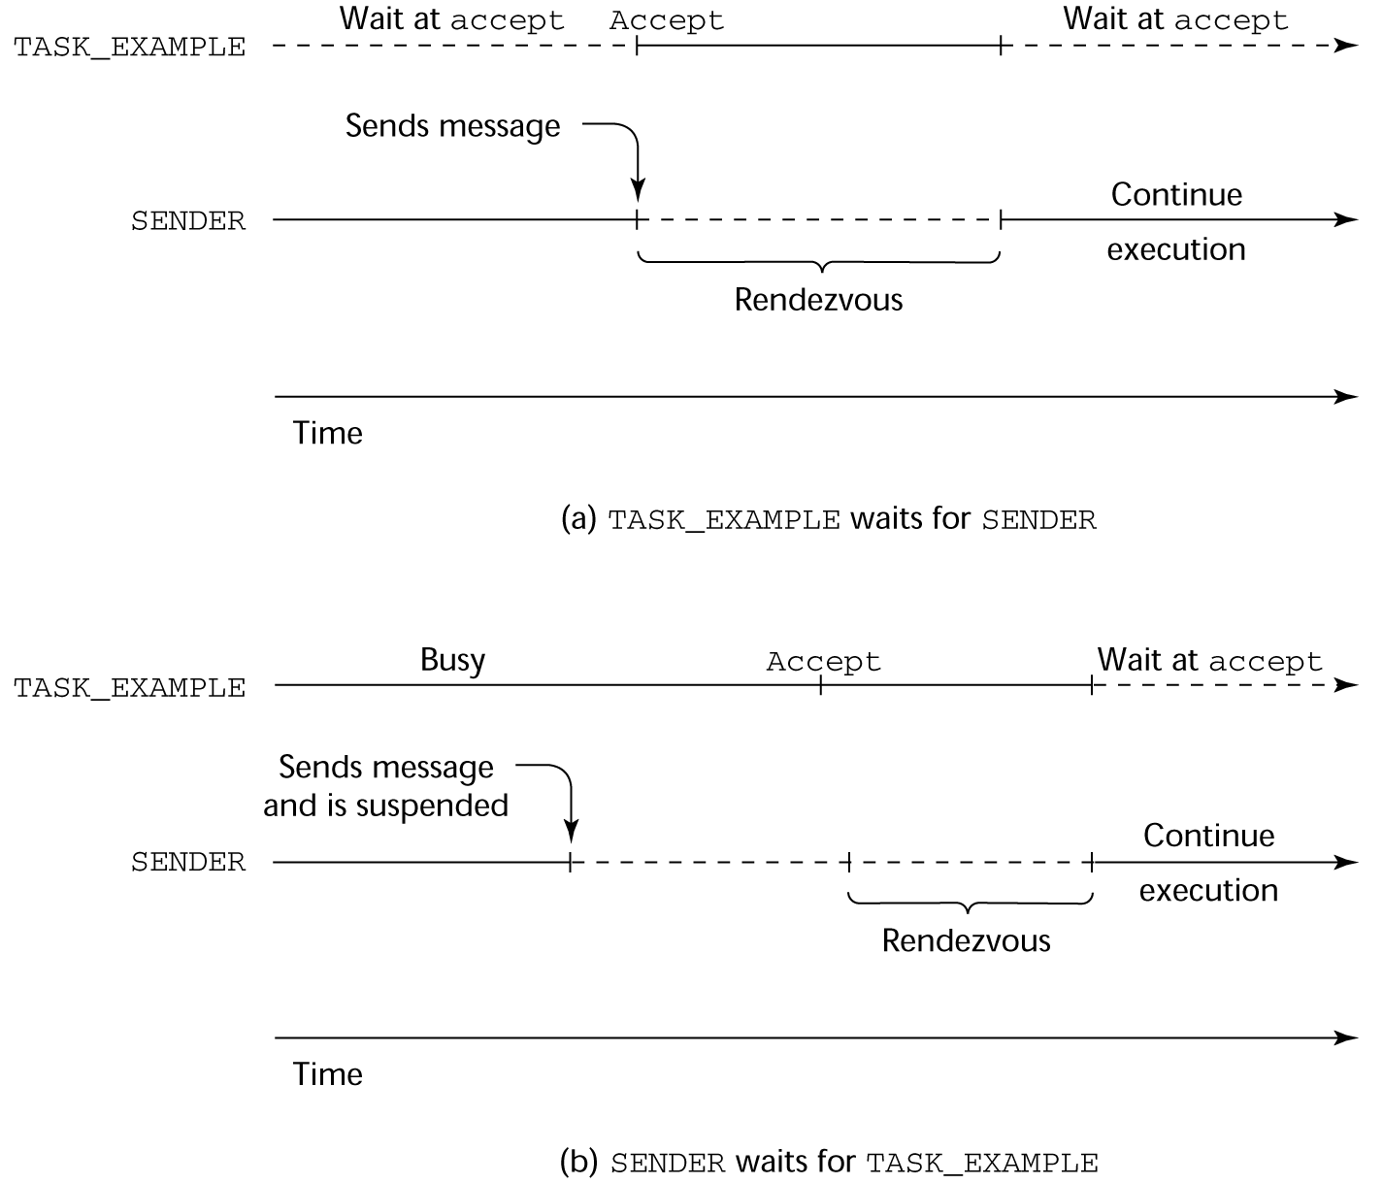
Rendezvous Time Lines

Slide 40
Message Passing: Server/Actor Tasks
A task that has accept clauses, but no other code is called a server task (the example above is a server task)
A task without accept clauses is called an actor task
An actor task can send messages to other tasks
Note: A sender must know the entry name of the receiver, but not vice versa (asymmetric)

Slide 41
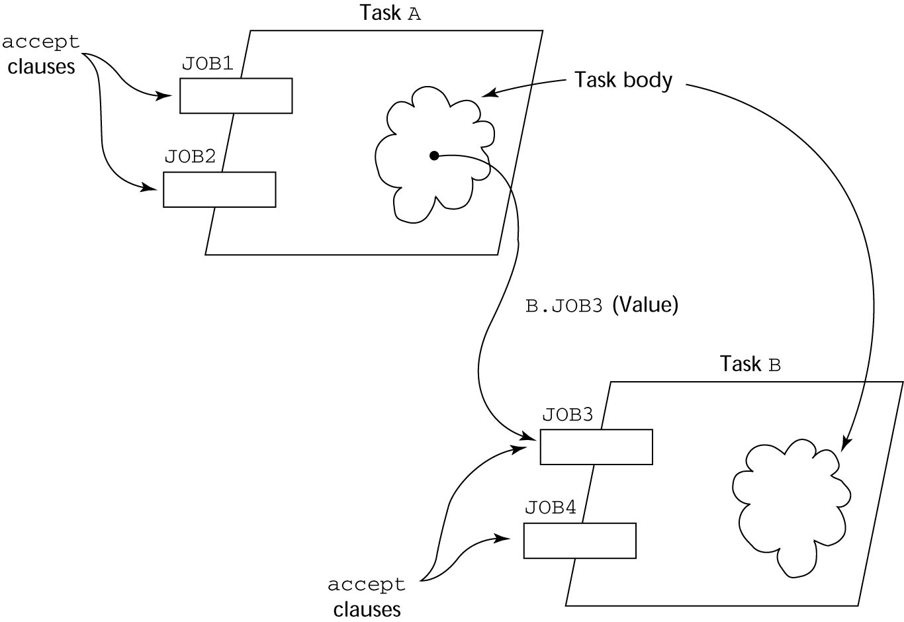
Graphical Representation of a Rendezvous

Slide 42
Multiple Entry Points
Tasks can have more than one entry point
The specification task has an entry clause for each
The task body has an accept clause for each entry clause, placed in a select clause, which is in a loop

Slide 43
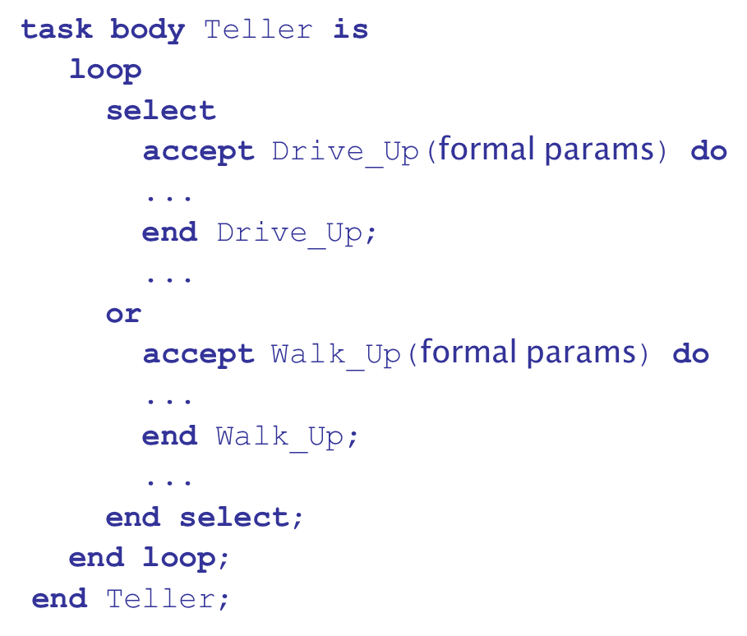
A Task with Multiple Entries

Slide 44
Semantics of Tasks with Multiple accept Clauses
If exactly one entry queue is nonempty, choose a message from it
If more than one entry queue is nonempty, choose one, nondeterministically, from which to accept a message
If all are empty, wait
The construct is often called a selective wait
Extended accept clause - code following the clause, but before the next clause
Executed concurrently with the caller

Slide 45
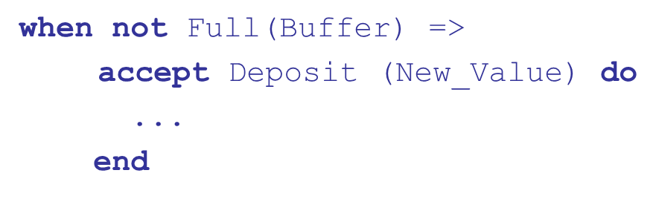
Cooperation Synchronization with Message Passing
Provided by Guarded accept clauses
An accept clause with a with a when clause is either open or closed
A clause whose guard is true is called open
A clause whose guard is false is called closed
A clause without a guard is always open

Slide 46
Semantics of select with Guarded accept Clauses:
select first checks the guards on all clauses
If exactly one is open, its queue is checked for messages
If more than one are open, non-deterministically choose a queue among them to check for messages
If all are closed, it is a runtime error
A select clause can include an else clause to avoid the error
When the else clause completes, the loop repeats

Slide 47
Competition Synchronization with Message Passing
Modeling mutually exclusive access to shared data
Example--a shared buffer
Encapsulate the buffer and its operations in a task
Competition synchronization is implicit in the semantics of accept clauses
Only one accept clause in a task can be active at any given time

Slide 48
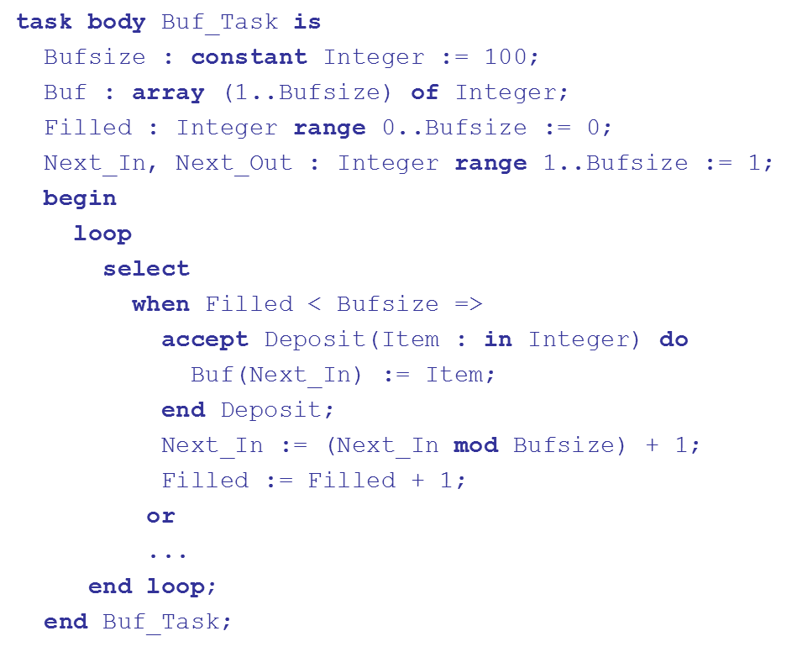
Partial Shared Buffer Code

Slide 49
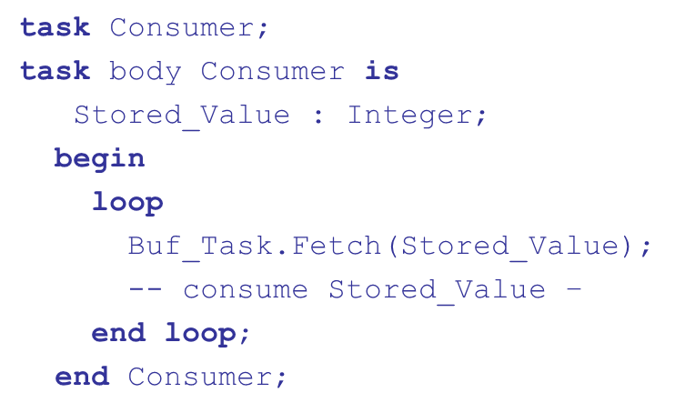
A Consumer Task

Slide 50
Concurrency in Ada 95
Ada 95 includes Ada 83 features for concurrency, plus two new features
Protected objects: A more efficient way of implementing shared data to allow access to a shared data structure to be done without rendezvous
Asynchronous communication

Slide 51
Ada 95: Protected Objects
A protected object is similar to an abstract data type
Access to a protected object is either through messages passed to entries, as with a task, or through protected subprograms
A protected procedure provides mutually exclusive read-write access to protected objects
A protected function provides concurrent read-only access to protected objects

Slide 52
Evaluation of the Ada
Message passing model of concurrency is powerful and general
Protected objects are a better way to provide synchronized shared data
In the absence of distributed processors, the choice between monitors and tasks with message passing is somewhat a matter of taste
For distributed systems, message passing is a better model for concurrency

Slide 53
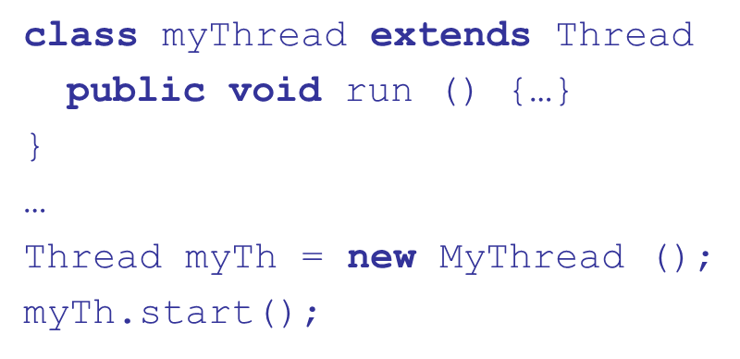
Java Threads
The concurrent units in Java are methods named run
A run method code can be in concurrent execution with other such methods
The process in which the run methods execute is called a thread

Slide 54
Controlling Thread Execution
The Thread class has several methods to control the execution of threads
The yield is a request from the running thread to voluntarily surrender the processor
The sleep method can be used by the caller of the method to block the thread
The join method is used to force a method to delay its execution until the run method of another thread has completed its execution

Slide 55
Thread Priorities
A thread’s default priority is the same as the thread that create it
If main creates a thread, its default priority is NORM_PRIORITY
Threads defined two other priority constants, MAX_PRIORITY and MIN_PRIORITY
The priority of a thread can be changed with the methods setPriority

Slide 56
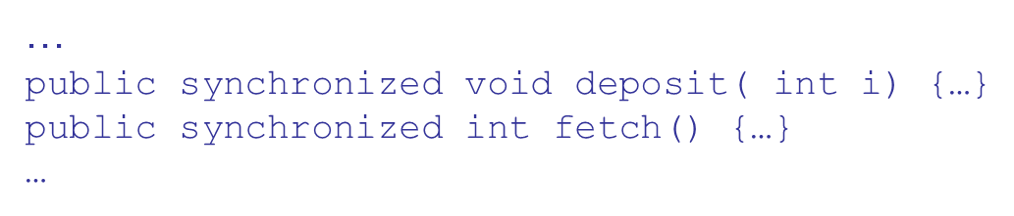
Competition Synchronization with Java Threads (1 of 2)
A method that includes the synchronized modifier disallows any other method from running on the object while it is in execution
The above two methods are synchronized which prevents them from interfering with each other

Slide 57
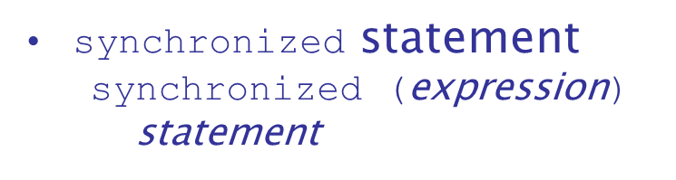
Competition Synchronization with Java Threads (2 of 2)
If only a part of a method must be run without interference, it can be synchronized thru

Slide 58
Cooperation Synchronization with Java Threads
Cooperation synchronization in Java is achieved via wait, notify, and notifyAll methods
All methods are defined in Object, which is the root class in Java, so all objects inherit them
The wait method must be called in a loop
The notify method is called to tell one waiting thread that the event it was waiting has happened
The notifyAll method awakens all of the threads on the object’s wait list

Slide 59
Java’s Thread Evaluation
Java’s support for concurrency is relatively simple but effective
Not as powerful as Ada’s tasks

Slide 60
Threads (1 of 2)
Loosely based on Java but there are significant differences
Basic thread operations
Any method can run in its own thread
A thread is created by creating a Thread object
Creating a thread does not start its concurrent execution; it must be requested through the Start method

Slide 61
Threads (2 of 2)
A thread can be made to wait for another thread to finish with Join
A thread can be suspended with Sleep
A thread can be terminated with Abort

Slide 62
Synchronizing Threads
Three ways to synchronize
threads
The Interlocked class
Used when the only operations that need to be synchronized are incrementing or decrementing of an integer
The lock statement
Used to mark a critical section of code in a thread
The Monitor class
Provides four methods that can be used to provide more sophisticated synchronization

Slide 63
Concurrency Evaluation
An advance over Java threads, e.g., any method can run its own thread
Thread termination is cleaner than in Java
Synchronization is more sophisticated

Slide 64
Statement-Level Concurrency (1 of 2)
Objective: Provide a mechanism that the programmer can use to inform compiler of ways it can map the program onto multiprocessor architecture
Minimize communication among processors and the memories of the other processors

Slide 65
High-Performance Fortran
A collection of extensions that allow the programmer to provide information to the compiler to help it optimize code for multiprocessor computers
Specify the number of processors, the distribution of data over the memories of those processors, and the alignment of data

Slide 66
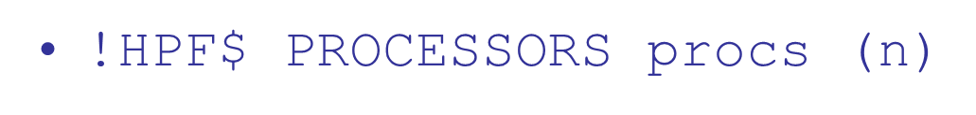


Primary H P F Specifications
Number of processors
Distribution of data
kind can be BLOCK (distribute data to processors in blocks) or CYCLIC (distribute data to processors one element at a time)
Relate the distribution of one array with that of another

Slide 67
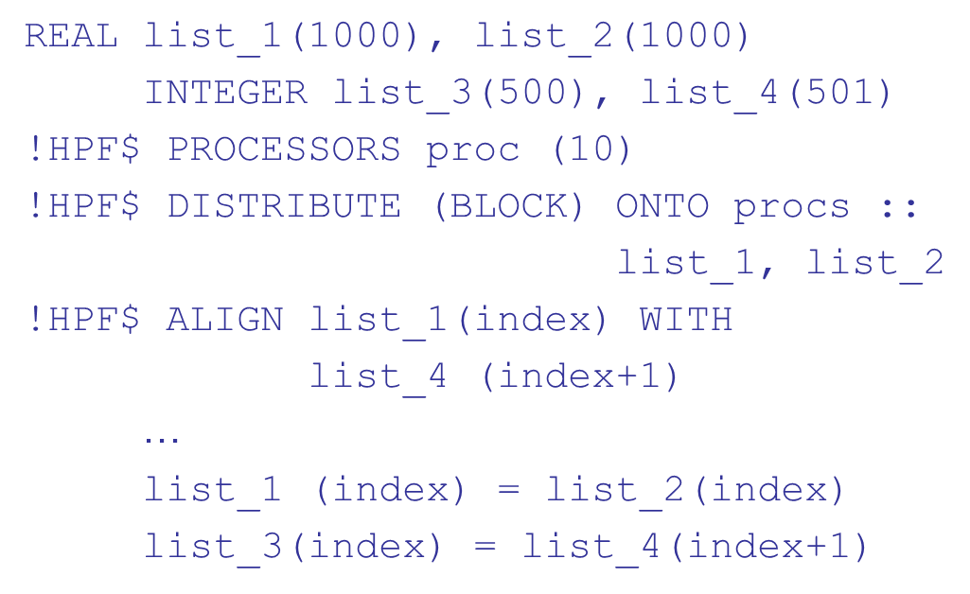
Statement-Level Concurrency Example

Slide 68
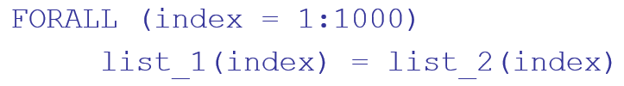
Statement-Level Concurrency (2 of 2)
FORALL statement is used to specify a list of statements that may be executed concurrently
Specifies that all 1,000 R H Ss of the assignments can be evaluated before any assignment takes place

Slide 69
Summary (1 of 2)
Concurrent execution can be at the instruction, statement, or subprogram level
Physical concurrency: when multiple processors are used to execute concurrent units
Logical concurrency: concurrent united are executed on a single processor
Two primary facilities to support subprogram concurrency: competition synchronization and cooperation synchronization

Slide 70
Summary (2 of 2)
Mechanisms: semaphores, monitors, rendezvous, threads
High-Performance Fortran provides statements for specifying how data is to be distributed over the memory units connected to multiple processors

Slide 71

Copyright

