Slide 1
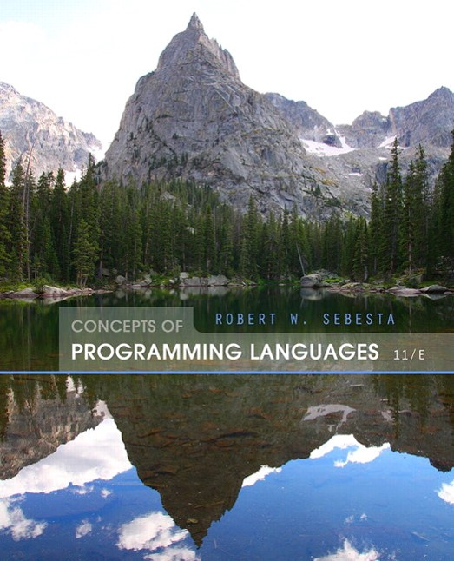
Concepts of Programming Languages
Eleventh Edition
Chapter 15
Functional Programming Languages
Copyright © 2016, 2013, 2010 Pearson Education, Inc. All Rights Reserved
Notes:
If this PowerPoint presentation contains mathematical equations, you may need to check that your computer has the following installed:
1) Math Type Plugin
2) Math Player (free versions available)
3) NVDA Reader (free versions available)

Slide 2
Objectives (1 of 2)
15.1 Introduction
15.2 Mathematical Functions
15.3 Fundamentals of Functional Programming Languages
15.4 The First Functional Programming Language: Lisp
15.5 Introduction to Scheme
15.6 Common Lisp
15.7 M L
15.8 Haskell

Slide 3
Objectives (2 of 2)
15.9
15.10 Support for Functional Programming in Primarily Imperative Languages
15.11 Comparison of Functional and Imperative Languages

Slide 4
Introduction
The design of the imperative languages is based directly on the von Neumann architecture
Efficiency is the primary concern, rather than the suitability of the language for software development
The design of the functional languages is based on mathematical functions
A solid theoretical basis that is also closer to the user, but relatively unconcerned with the architecture of the machines on which programs will run

Slide 5
Mathematical Functions
A mathematical function is a mapping of members of one set, called the domain set, to another set, called the range set
A lambda expression specifies the parameter(s) and the mapping of a function in the following form

Slide 6
Lambda Expressions
Lambda expressions describe nameless functions
Lambda expressions are applied to parameter(s) by placing the parameter(s) after the expression
which evaluates to 8

Slide 7
Functional Forms
A higher-order function, or functional form, is one that either takes functions as parameters or yields a function as its result, or both

Slide 8
Function Composition
A functional form that takes two functions as parameters and yields a function whose value is the first actual parameter function applied to the application of the second

Slide 9
Apply-to-all
A functional form that takes a single function as a parameter and yields a list of values obtained by applying the given function to each element of a list of parameters

Slide 10
Fundamentals of Functional Programming Languages (1 of 2)
The objective of the design of a F P L is to mimic mathematical functions to the greatest extent possible
The basic process of computation is fundamentally different in a F P L than in an imperative language
In an imperative language, operations are done and the results are stored in variables for later use
Management of variables is a constant concern and source of complexity for imperative programming
In an F P L, variables are not necessary, as is the case in mathematics

Slide 11
Fundamentals of Functional Programming Languages (2 of 2)
Referential Transparency - In an F P L , the evaluation of a function always produces the same result given the same parameters

Slide 12
Lisp Data Types and Structures
Data object types: originally only atoms and lists
List form: parenthesized collections of sublists and/or atoms
Originally, Lisp was a typeless language
Lisp lists are stored internally as single-linked lists

Slide 13
Lisp Interpretation (1 of 2)
Lambda notation is used to specify functions and function definitions. Function applications and data have the same form.
e.g., If the list (A B C) is interpreted as data it is
a simple list of three atoms, A, B, and C
If it is interpreted as a function application,
it means that the function named A is
applied to the two parameters, B and C

Slide 14
Lisp Interpretation (2 of 2)
The first Lisp interpreter appeared only as a demonstration of the universality of the computational capabilities of the notation

Slide 15
Origins of Scheme
A mid-1970s dialect of Lisp, designed to be a cleaner, more modern, and simpler version than the contemporary dialects of Lisp
Uses only static scoping
Functions are first-class entities
They can be the values of expressions and elements of lists
They can be assigned to variables, passed as parameters, and returned from functions

Slide 16
The Scheme Interpreter
In interactive mode, the Scheme interpreter is an infinite read-evaluate-print loop (R E P L)
This form of interpreter is also used by Python and Ruby
Expressions are interpreted by the function EVAL
Literals evaluate to themselves

Slide 17
Primitive Function Evaluation
Parameters are evaluated, in no particular order
The values of the parameters are substituted into the function body
The function body is evaluated
The value of the last expression in the body is the value of the function

Slide 18
Primitive Functions & LAMBDA Expressions
Primitive Arithmetic Functions:
Lambda Expressions
Form is based on
notation
x is called a bound variable
Lambda expressions can be applied to parameters

Slide 19
Special Form Function: DEFINE
DEFINE - Two forms:
To bind a symbol to an expression
e.g., (DEFINE pi 3.141593)
These symbols are not variables - they are like the names bound by Java’s final declarations
To bind names to lambda expressions (LAMBDA is implicit)
The evaluation process for DEFINE is different! The first parameter is never evaluated. The second parameter is evaluated and bound to the first parameter.

Slide 20
Output Functions
Usually not needed, because the interpreter always displays the result of a function evaluated at the top level (not nested)
Scheme has PRINTF, which is similar to the printf function of C
Note: explicit input and output are not part of the pure functional programming model, because input operations change the state of the program and output operations are side effects

Slide 21
Numeric Predicate Functions
is true and
is false (sometimes
is used for false)
EVEN?, ODD?, ZERO?, NEGATIVE?
The NOT function inverts the logic of a Boolean expression

Slide 22
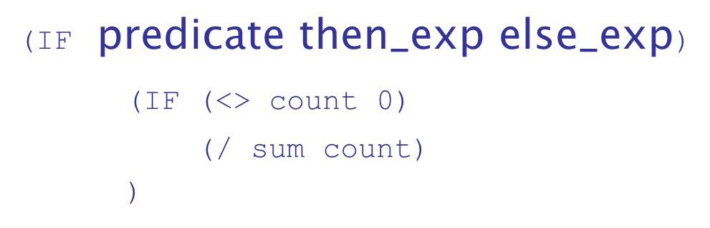
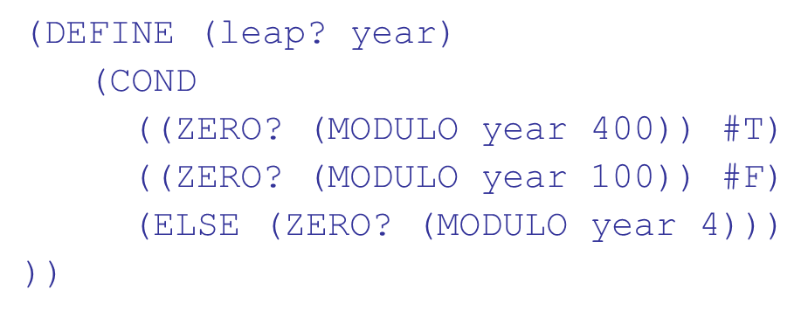
Control Flow
Selection- the special form, IF
Recall from Chapter 8 the COND function:

Slide 23
List Functions (1 of 3)
QUOTE - takes one parameter; returns the parameter without evaluation
QUOTE is required because the Scheme interpreter, named EVAL, always evaluates parameters to function applications before applying the function. QUOTE is used to avoid parameter evaluation when it is not appropriate
QUOTE can be abbreviated with the apostrophe prefix operator
Recall that CAR, CDR, and CONS were covered in Chapter 6

Slide 24
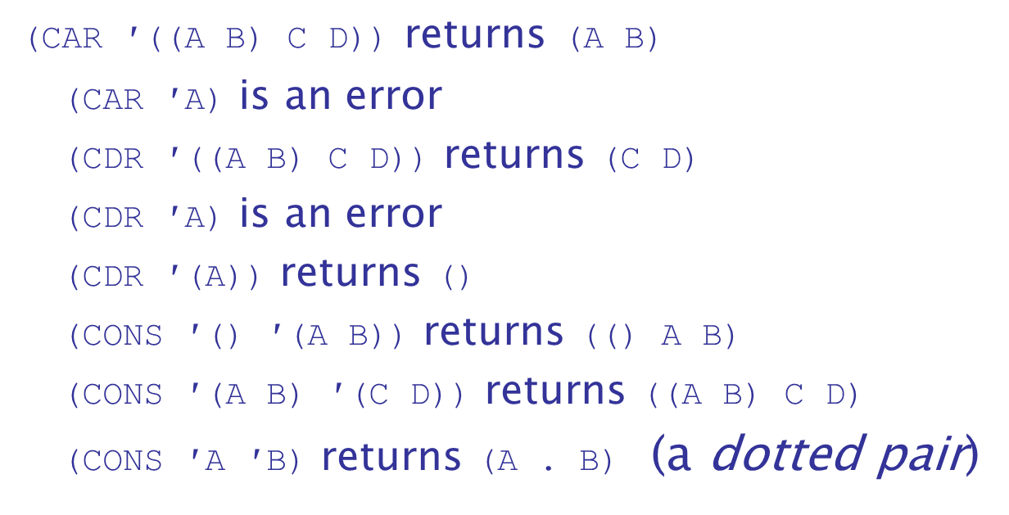
List Functions (2 of 3)
Examples:

Slide 25
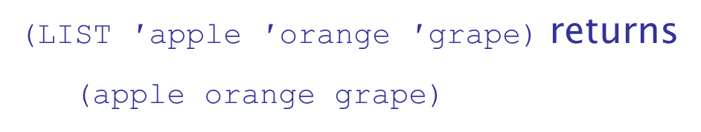
List Functions (3 of 3)
LIST is a function for building a list from any number of parameters

Slide 26
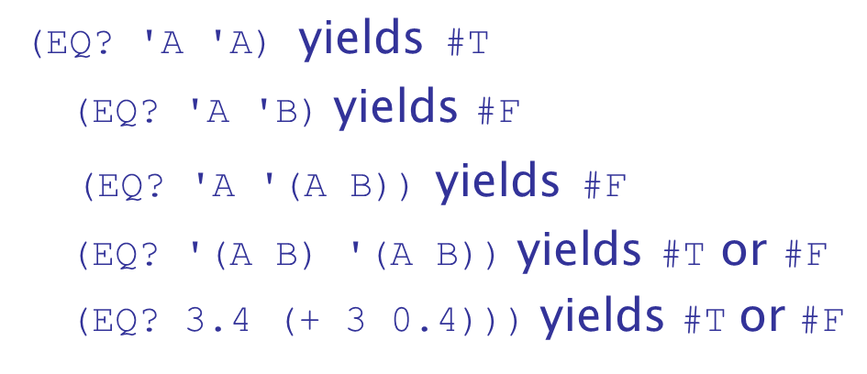
Predicate Function:
takes two expressions as parameters (usually two
atoms); it returns
if both parameters have the same
pointer value; otherwise

Slide 27
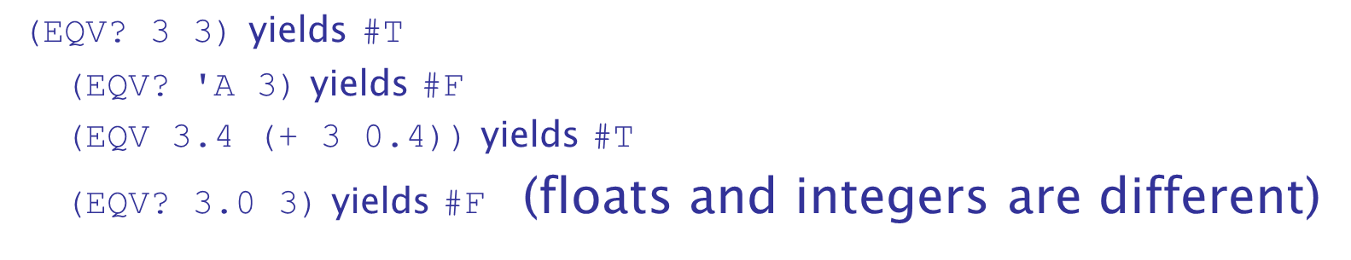
Predicate Function:
is like
, except that it works for both symbolic
and numeric atoms; it is a value comparison, not a pointer
comparison

Slide 28
Predicate Functions:
takes one parameter; it returns
if the parameter
is a list; otherwise
takes one parameter; it returns
if the parameter
is the empty list; otherwise

Slide 29
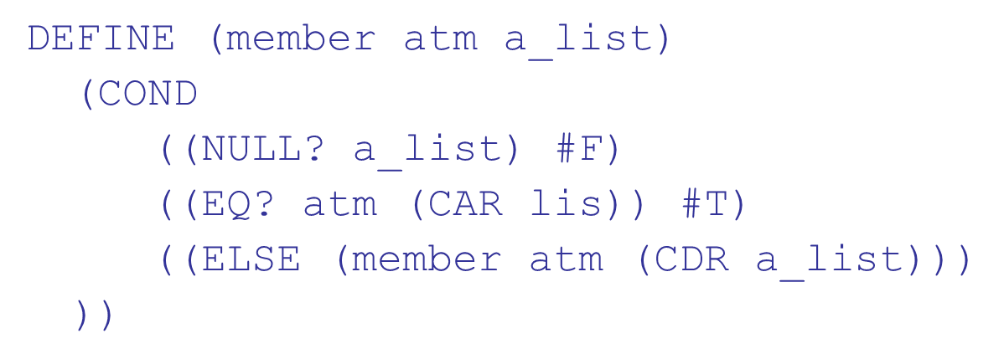
Example Scheme Function: member
member takes an atom and a simple list; returns
if the
atom is in the list;
otherwise

Slide 30
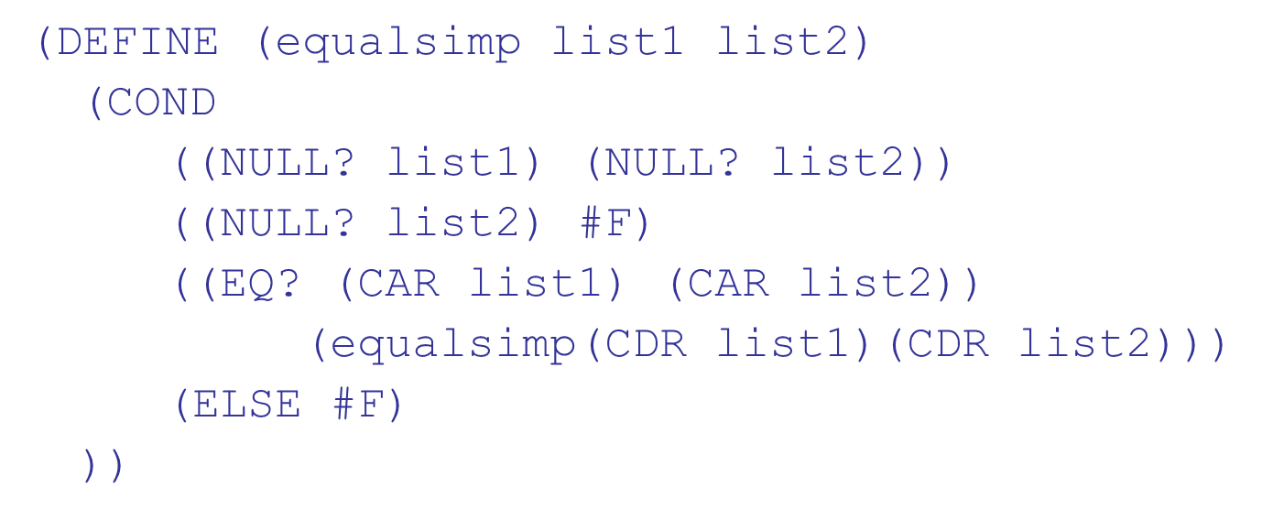
Example Scheme Function:
equalsimp takes two simple lists as parameters; returns
if the two simple lists are equal;
otherwise

Slide 31
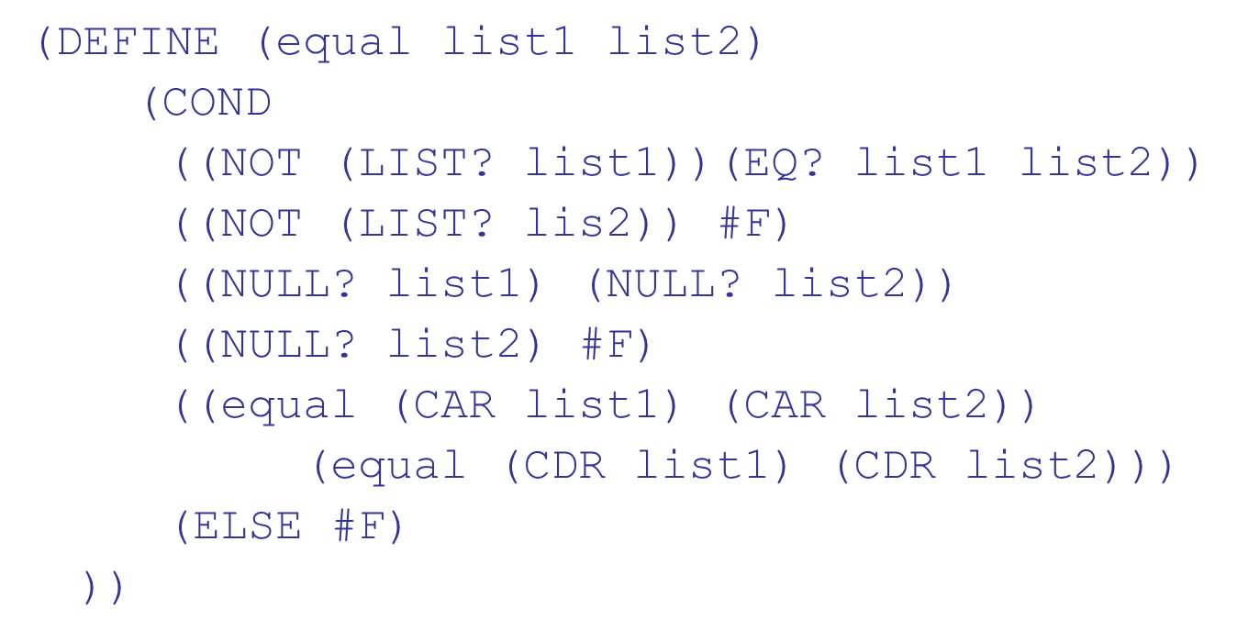
Example Scheme Function: equal
equal takes two general lists as parameters; returns
if the two lists are equal;
otherwise

Slide 32
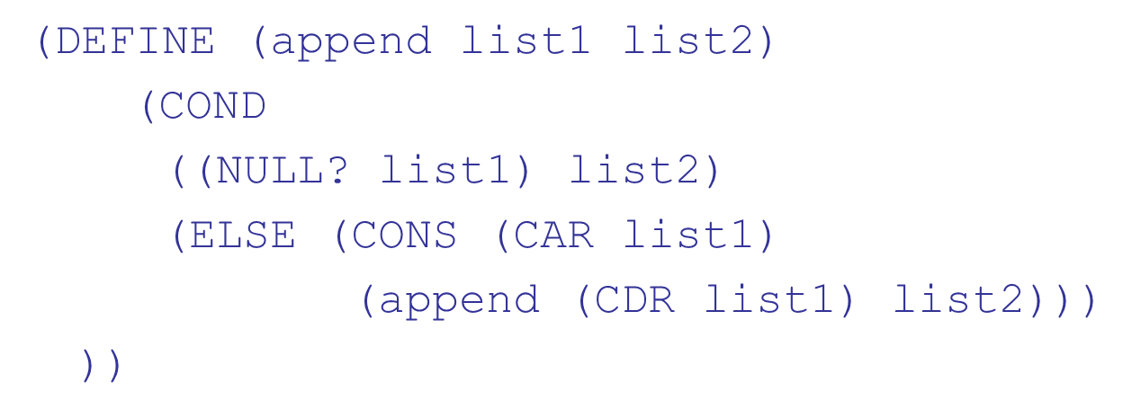
Example Scheme Function: append
append takes two lists as parameters; returns the first parameter list with the elements of the second parameter list appended at the end

Slide 33
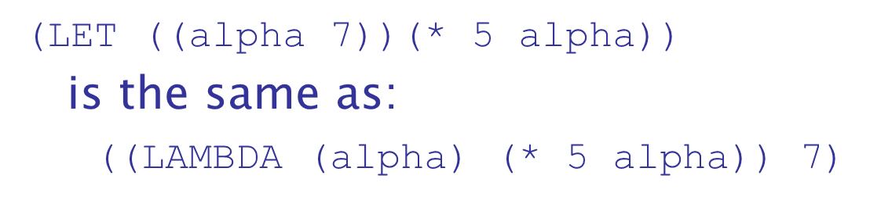
Example Scheme Function: LET
Recall that LET was discussed in Chapter 5
LET is actually shorthand for a LAMBDA expression applied to a parameter

Slide 34
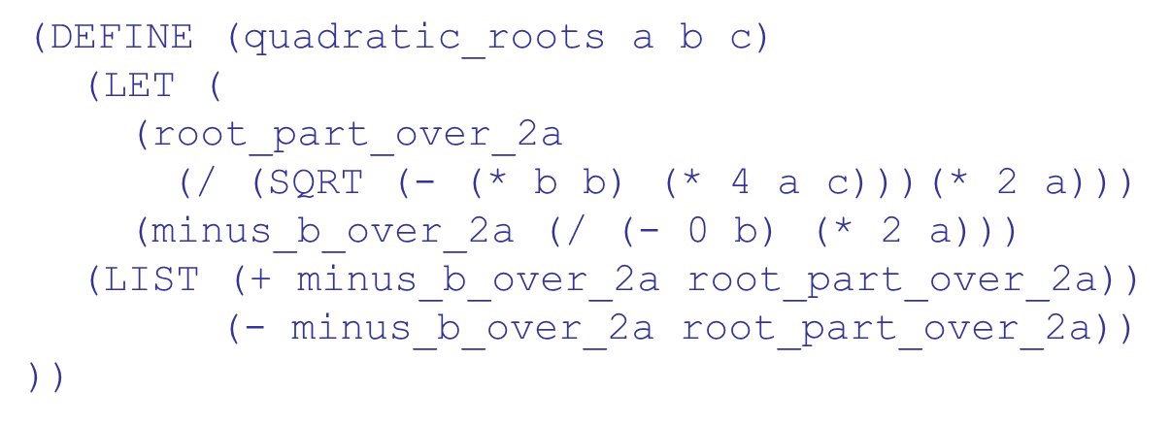
LET Example

Slide 35
Tail Recursion in Scheme (1 of 2)
Definition: A function is tail recursive if its recursive call is the last operation in the function
A tail recursive function can be automatically converted by a compiler to use iteration, making it faster
Scheme language definition requires that Scheme language systems convert all tail recursive functions to use iteration

Slide 36
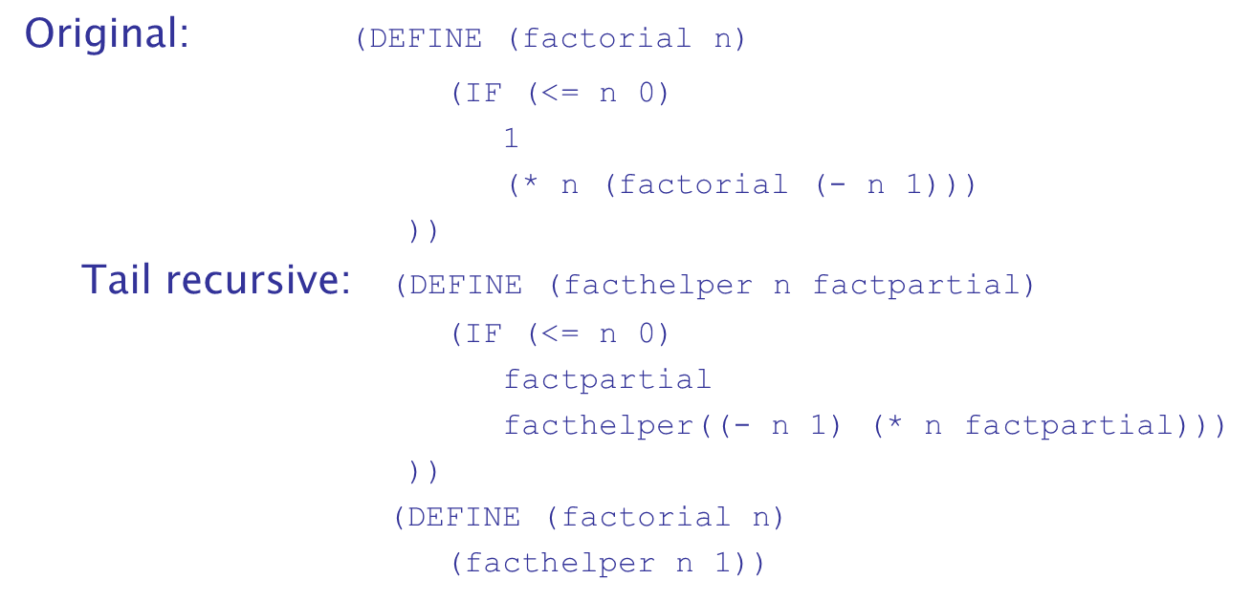
Tail Recursion in Scheme (2 of 2)
Example of rewriting a function to make it tail recursive, using helper a function

Slide 37
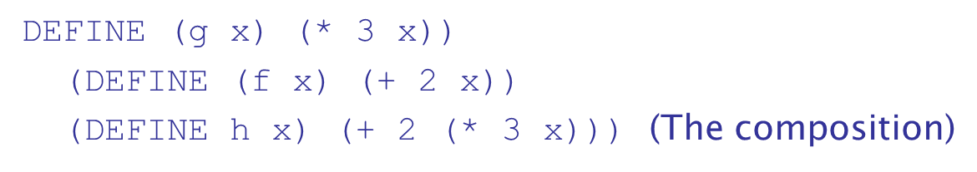
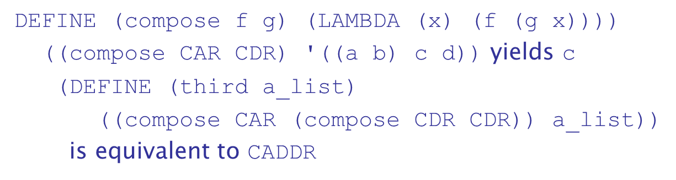
Functional Form - Composition
Composition
If h is the composition of f and g,
In Scheme, the functional composition function compose can be written:

Slide 38
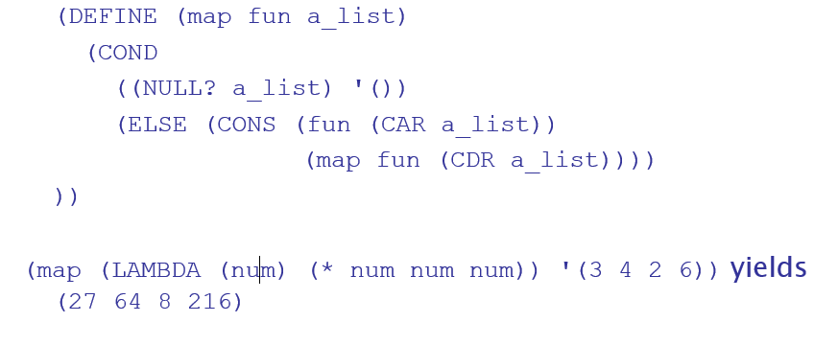
Functional Form - Apply-to-All
Apply to All - one form in Scheme is map
Applies the given function to all elements of the given list;

Slide 39
Functions That Build Code
It is possible in Scheme to define a function that builds Scheme code and requests its interpretation
This is possible because the interpreter is a user-available function, EVAL

Slide 40
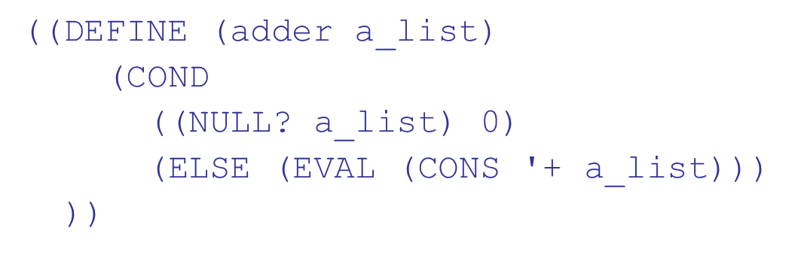
Adding a List of Numbers
The parameter is a list of numbers to be added; adder inserts a + operator and evaluates the resulting list
Use CONS to insert the atom + into the list of numbers.
Be sure that + is quoted to prevent evaluation
Submit the new list to EVAL for evaluation

Slide 41
Common Lisp (1 of 6)
A combination of many of the features of the popular dialects of Lisp around in the early 1980s
A large and complex language--the opposite of Scheme
Features include:
records
arrays
complex numbers
character strings
powerful I/O capabilities
packages with access control
iterative control statements

Slide 42
Common Lisp (2 of 6)
Macros
Create their effect in two steps:
Expand the macro
Evaluate the expanded macro
Some of the predefined functions of Common Lisp are actually macros
Users can define their own macros with DEFMACRO

Slide 43
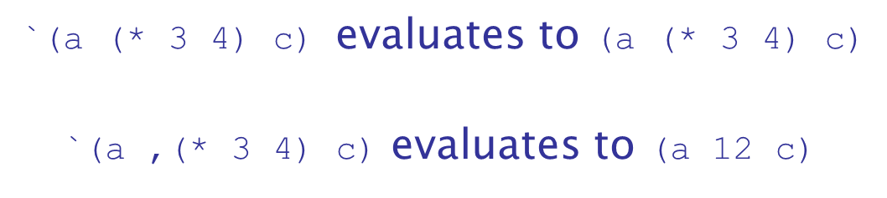
Common Lisp (3 of 6)
Backquote operator
Similar to the Scheme’s QUOTE, except that some parts of the parameter can be unquoted by preceding them with commas

Slide 44
Common Lisp (4 of 6)
Reader Macros
Lisp implementations have a front end called the reader that transforms Lisp into a code representation. Then macro calls are expanded into the code representation.
A reader macro is a special kind of macro that is expanded during the reader phase
A reader macro is a definition of a single character, which is expanded into its Lisp definition
An example of a reader macro is an apostrophe character, which is expanded into a call to QUOTE

Slide 45
Common Lisp (5 of 6)
Users can define their own reader macros as a kind of shorthand
Common Lisp has a symbol data type (similar to that of Ruby)
The reserved words are symbols that evaluate to themselves
Symbols are either bound or unbound
Parameter symbols are bound while the function is being evaluated

Slide 46
Common Lisp (6 of 6)
Symbols that are the names of imperative style variables that have been assigned values are bound
All other symbols are unbound

Slide 47
M L (1 of 2)
A static-scoped functional language with syntax that is closer to Pascal than to Lisp
Uses type declarations, but also does type inferencing to determine the types of undeclared variables
It is strongly typed (whereas Scheme is essentially typeless) and has no type coercions
Does not have imperative-style variables
Its identifiers are untyped names for values

Slide 48
M L (2 of 2)
Includes exception handling and a module facility for implementing abstract data types
Includes lists and list operations

Slide 49
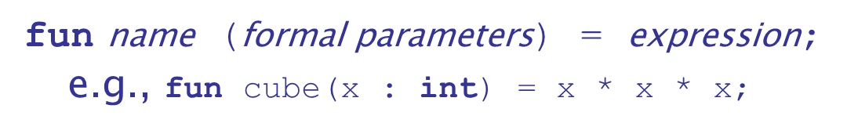
M L Specifics (1 of 9)
A table called the evaluation environment stores the names of all identifiers in a program, along with their types (like a run-time symbol table)
Function declaration form:
The type could be attached to return value, as in
With no type specified, it would default to
int (the default for numeric values)
User-defined overloaded functions are not allowed, so if we wanted a cube function for real parameters, it would need to have a different name

Slide 50

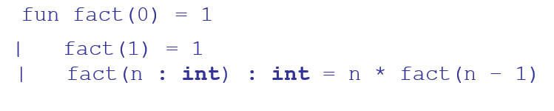
M L Specifics (2 of 9)
M L selection
where the first expression must evaluate to a Boolean value
Pattern matching is used to allow a function to operate on different parameter forms

Slide 51
M L Specifics (3 of 9)
Lists
Literal lists are specified in brackets
is the empty list
CONS is the binary infix operator,
CAR is the unary operator h d CDR is the unary operator t l

Slide 52
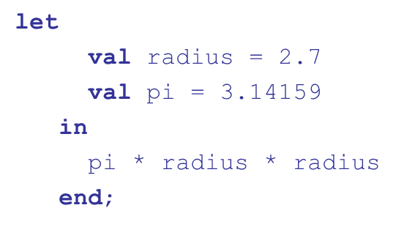
M L Specifics (4 of 9)
The val statement binds a name to a value (similar to DEFINE in Scheme)
As is the case with DEFINE, val is nothing like an assignment statement in an imperative language
If there are two val statements for the same identifier, the first is hidden by the second
val statements are often used in let constructs

Slide 53
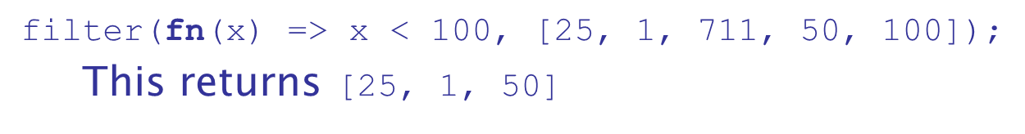
M L Specifics (5 of 9)
filter
A higher-order filtering function for lists
Takes a predicate function as its parameter, often in the form of a lambda expression
Lambda expressions are defined like functions, except with the reserved word f n

Slide 54
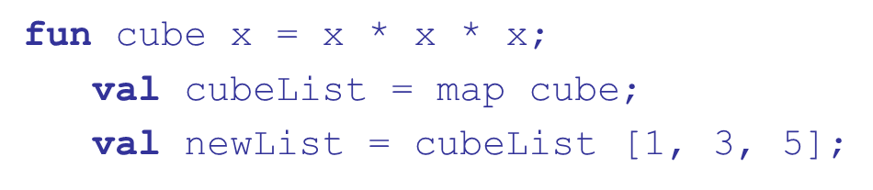
M L Specifics (6 of 9)
map
A higher-order function that takes a single parameter, a function
Applies the parameter function to each element of a list and returns a list of results
This sets
Alternative: use a lambda expression

Slide 55
M L Specifics (7 of 9)
Function Composition
Use the unary operator,

Slide 56
M L Specifics (8 of 9)
Currying
M L functions actually take just one parameter-if more are given, it considers the parameters a tuple (commas required)
Process of currying replaces a function with more than one parameter with a function with one parameter that returns a function that takes the other parameters of the original function
An M L function that takes more than one parameter can be defined in curried form by leaving out the commas in the parameters
A function with one parameter, a. Returns a function that takes b as a parameter.

Slide 57
M L Specifics (9 of 9)
Partial Evaluation
Curried functions can be used to create new functions by partial evaluation
Partial evaluation means that the function is evaluated with actual parameters for one or more of the leftmost actual parameters
Takes the actual parameter 5 and evaluates the add function with 5 as the value of its first formal parameter. Returns a function that adds 5 to its single parameter

Slide 58
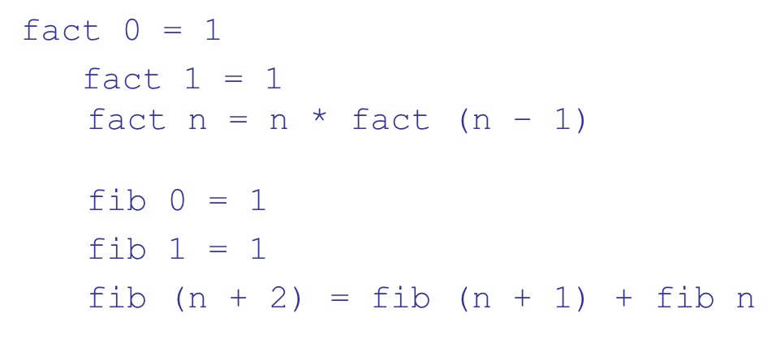
Haskell
Similar to M L (syntax, static scoped, strongly typed, type inferencing, pattern matching)
Different from M L (and most other functional languages) in that it is purely functional (e.g., no variables, no assignment statements, and no side effects of any kind)
Syntax differences from M L

Slide 59
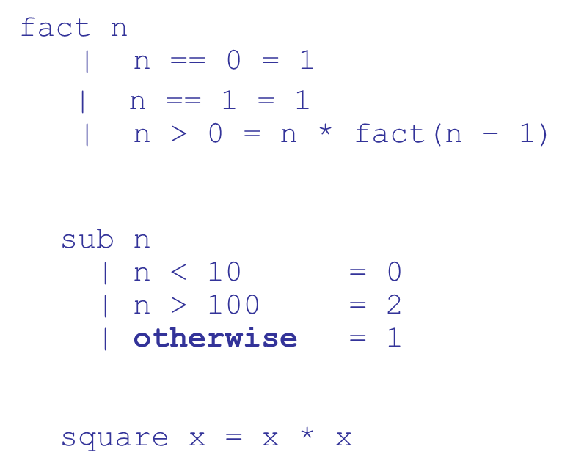
Function Definitions with Different Parameter Ranges
Because Haskell support polymorphism, this works for any numeric type of x

Slide 60
Haskell Lists (1 of 2)
List notation: Put elements in brackets
Length:
Arithmetic series with the . . operator
Catenation is with ++
via the colon operator

Slide 61
Haskell Lists (2 of 2)
Pattern Parameters
Factorial:
List Comprehensions (Chapter 6)
The qualifier in this example has the form of a generator. It could be in the form of a test
The backticks specify the function is used as a binary operator

Slide 62
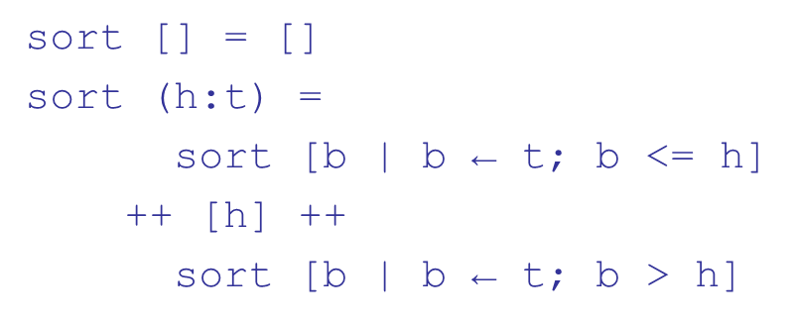
Quicksort
Illustrates the concision of Haskell

Slide 63
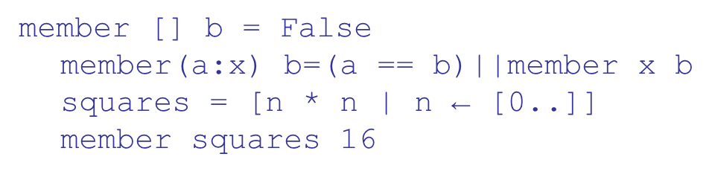
Lazy Evaluation
A language is strict if it requires all actual parameters to be fully evaluated
A language is nonstrict if it does not have the strict requirement
Nonstrict languages are more efficient and allow some interesting capabilities – infinite lists
Lazy evaluation - Only compute those values that are necessary
Positive numbers
Determining if 16 is a square number

Slide 64
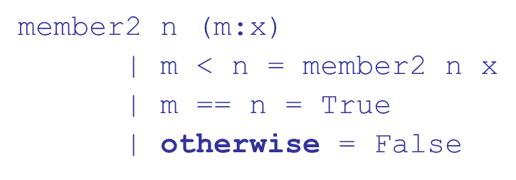
Member Revisited
The member function could be written as:
However, this would only work if the parameter to squares was a perfect square; if not, it will keep generating them forever. The following version will always work:

Slide 65
F (1 of 7)
Based on Ocaml, which is a descendant of M L and Haskell
Fundamentally a functional language, but with imperative features and supports OOP
Has a full-featured I D E, an extensive library of utilities, and interoperates with other .NET languages
Includes tuples, lists, discriminated unions, records, and both mutable and immutable arrays
Supports generic sequences, whose values can be created with generators and through iteration

Slide 66
F (2 of 7)
Sequences
Generation of sequence values is lazy
Default stepsize is 1, but it can be any number
Iterators – not lazy for lists and arrays

Slide 67
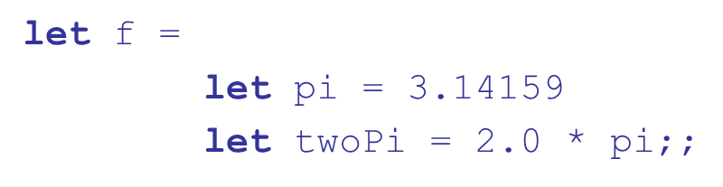
F (3 of 7)
Functions
If named, defined with let; if lambda expressions, defined with fun
No difference between a name defined with let and a function without parameters
The extent of a function is defined by indentation

Slide 68
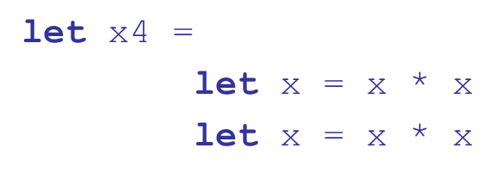
F (4 of 7)
If a function is recursive, its definition must include the rec reserved word
Names in functions can be outscoped, which ends their scope
The first let in the body of the function creates a new version of x; this terminates the scope of the parameter; The second let in the body creates another x, terminating the scope of the second x

Slide 69
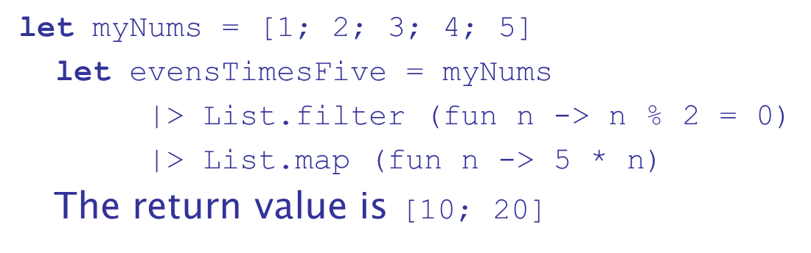
F (5 of 7)
Functional Operators
Pipeline
A binary operator that sends the value of its left operand to the last parameter of the call (the right operand)

Slide 70
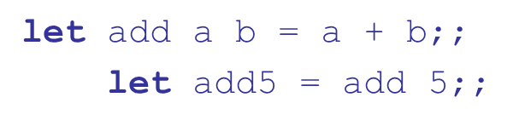
F (6 of 7)
Composition
Builds a function that applies its left operand to a given parameter (a function) and then passes the result returned from the function to its right operand (another function)
The
expression
is equivalent to the
mathematical expression
Curried Functions

Slide 71
F (7 of 7)
Why
is Interesting:
It builds on previous functional languages
It supports virtually all programming methodologies in widespread use today
It is the first functional language that is designed for interoperability with other widely used languages
At its release, it had an elaborate and well-developed I D E and library of utility software

Slide 72
Support for Functional Programming in Primarily Imperative Languages (1 of 3)
Support for functional programming is increasingly creeping into imperative languages
Anonymous functions (lambda expressions)
JavaScript: leave the name out of a function definition
C
(returns true or false
depending on whether the parameter is even or odd)
Python:

Slide 73
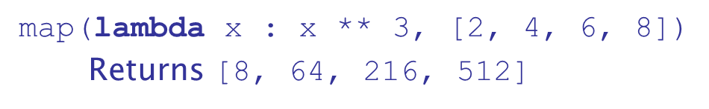
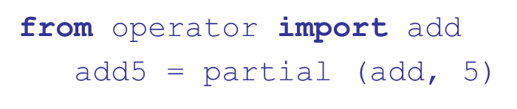
Support for Functional Programming in Primarily Imperative Languages (2 of 3)
Python supports the higher-order functions filter and map (often use lambda expressions as their first parameters)
Python supports partial function applications
(the first line imports add as a function)

Slide 74
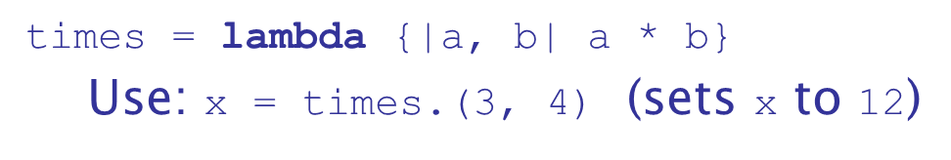
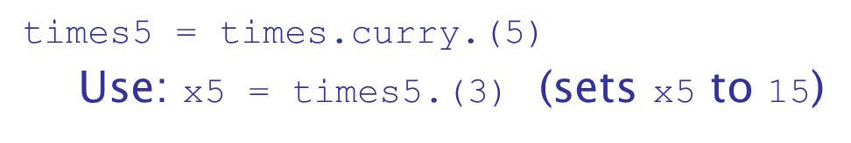
Support for Functional Programming in Primarily Imperative Languages (3 of 3)
Ruby Blocks
Are effectively subprograms that are sent to methods, which makes the method a higher-order subprogram
A block can be converted to a subprogram object with lambda
Times can be curried with

Slide 75
Comparing Functional and Imperative Languages
Imperative Languages:
Efficient execution
Complex semantics
Complex syntax
Concurrency is programmer designed
Functional Languages:
Simple semantics
Simple syntax
Less efficient execution
Programs can automatically be made concurrent

Slide 76
Summary (1 of 2)
Functional programming languages use function application, conditional expressions, recursion, and functional forms to control program execution
Lisp began as a purely functional language and later included imperative features
Scheme is a relatively simple dialect of Lisp that uses static scoping exclusively
Common Lisp is a large Lisp-based language
M L is a static-scoped and strongly typed functional language that uses type inference

Slide 77
Summary (2 of 2)
Haskell is a lazy functional language supporting infinite lists and set comprehension.
F
is a .NET functional language that also supports
imperative and object-oriented programming
Some primarily imperative languages now incorporate some support for functional programming
Purely functional languages have advantages over imperative alternatives, but still are not very widely used

Slide 78

Copyright

