Slide 1
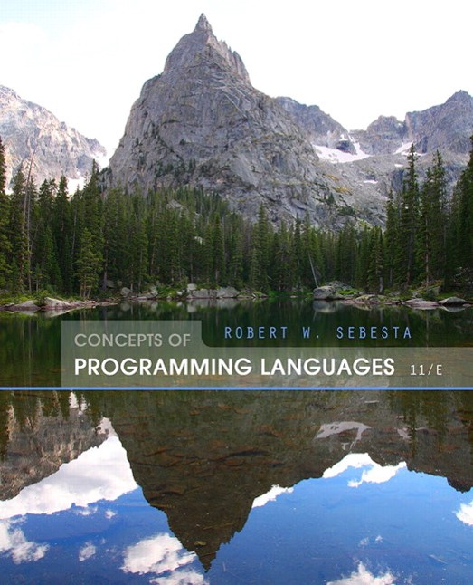
Concepts of Programming Languages
Eleventh Edition
Chapter 16
Logic Programming Languages
Copyright © 2016, 2013, 2010 Pearson Education, Inc. All Rights Reserved
Notes:
If this PowerPoint presentation contains mathematical equations, you may need to check that your computer has the following installed:
1) Math Type Plugin
2) Math Player (free versions available)
3) NVDA Reader (free versions available)

Slide 2
Objectives
16.1 Introduction
16.2 A Brief Introduction to Predicate Calculus
16.3 Predicate Calculus and Proving Theorems
16.4 An Overview of Logic Programming
16.5 The Origins of Prolog
16.6 The Basic Elements of Prolog
16.7 Deficiencies of Prolog
16.8 Applications of Logic Programming

Slide 3
Introduction
Programs in logic languages are expressed in a form of symbolic logic
Use a logical inferencing process to produce results
Declarative rather that procedural:
Only specification of results are stated (not detailed procedures for producing them)

Slide 4
Proposition
A logical statement that may or may not be true
Consists of objects and relationships of objects to each other

Slide 5
Symbolic Logic
Logic which can be used for the basic needs of formal logic:
Express propositions
Express relationships between propositions
Describe how new propositions can be inferred from other propositions
Particular form of symbolic logic used for logic programming called predicate calculus

Slide 6
Object Representation
Objects in propositions are represented by simple terms: either constants or variables
Constant: a symbol that represents an object
Variable: a symbol that can represent different objects at different times
Different from variables in imperative languages

Slide 7
Compound Terms
Atomic propositions consist of compound terms
Compound term: one element of a mathematical relation, written like a mathematical function
Mathematical function is a mapping
Can be written as a table

Slide 8
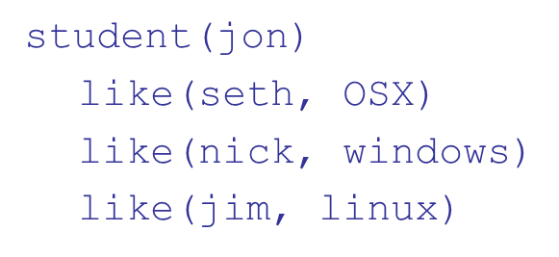
Parts of a Compound Term
Compound term composed of two parts
Functor: function symbol that names the relationship
Ordered list of parameters (tuple)
Examples:

Slide 9
Forms of a Proposition
Propositions can be stated in two forms:
Fact: proposition is assumed to be true
Query: truth of proposition is to be determined
Compound proposition:
Have two or more atomic propositions
Propositions are connected by operators

Slide 10
Logical Operators
Name | Symbol | Example | Meaning
negation | negation | Negation a | not a
conjunction | conjunction | A conjunction b | a and b
disjunction | disjunction | A disjunction b | a or b
equivalence | equivalence | A equivalence b | a is equivalent to b
implication | implication | A implies b B implies a | a implies b b implies a

Slide 11
Quantifiers
Name | Example | Meaning
universal | For all x . p | For all X, P is true
existential | There exists x . p | There exists a value of X such that P is true

Slide 12
Clausal Form
Too many ways to state the same thing
Use a standard form for propositions
Clausal form:
means if all the As are true, then at least one B is true
Antecedent: right side
Consequent: left side

Slide 13
Predicate Calculus and Proving Theorems
A use of propositions is to discover new theorems that can be inferred from known axioms and theorems
Resolution: an inference principle that allows inferred propositions to be computed from given propositions

Slide 14
Resolution
Unification: finding values for variables in propositions that allows matching process to succeed
Instantiation: assigning temporary values to variables to allow unification to succeed
After instantiating a variable with a value, if matching fails, may need to backtrack and instantiate with a different value

Slide 15
Proof by Contradiction
Hypotheses: a set of pertinent propositions
Goal: negation of theorem stated as a proposition
Theorem is proved by finding an inconsistency

Slide 16
Theorem Proving
Basis for logic programming
When propositions used for resolution, only restricted form can be used
Horn clause - can have only two forms
Headed: single atomic proposition on left side
Headless: empty left side (used to state facts)
Most propositions can be stated as Horn clauses

Slide 17
Overview of Logic Programming
Declarative semantics
There is a simple way to determine the meaning of each statement
Simpler than the semantics of imperative languages
Programming is nonprocedural
Programs do not state now a result is to be computed, but rather the form of the result

Slide 18
Example: Sorting a List
Describe the characteristics of a sorted list, not the process of rearranging a list

Slide 19
The Origins of Prolog
University of Aix-Marseille (Calmerauer & Roussel)
Natural language processing
University of Edinburgh (Kowalski)
Automated theorem proving

Slide 20
Terms
This book uses the Edinburgh syntax of Prolog
Term: a constant, variable, or structure
Constant: an atom or an integer
Atom: symbolic value of Prolog
Atom consists of either:
a string of letters, digits, and underscores beginning with a lowercase letter
a string of printable ASCII characters delimited by apostrophes

Slide 21
Terms: Variables and Structures
Variable: any string of letters, digits, and underscores beginning with an uppercase letter
Instantiation: binding of a variable to a value
Lasts only as long as it takes to satisfy one complete goal
Structure: represents atomic proposition
functor(parameter list)

Slide 22
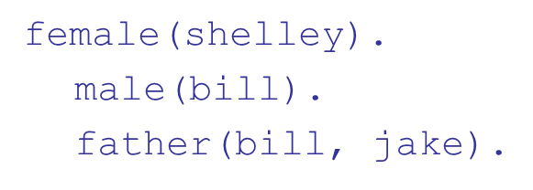
Fact Statements
Used for the hypotheses
Headless Horn clauses

Slide 23
Rule Statements
Used for the hypotheses
Headed Horn clause
Right side: antecedent (if part)
May be single term or conjunction
Left side: consequent (then part)
Must be single term
Conjunction: multiple terms separated by logical AND operations (implied)

Slide 24
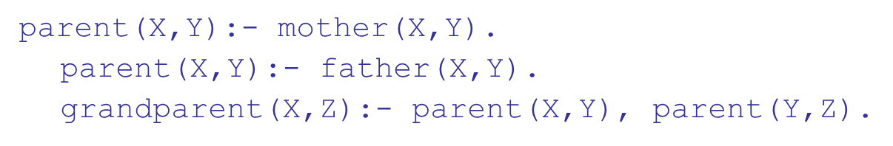
Example Rules
Can use variables (universal objects) to generalize meaning:

Slide 25
Goal Statements
For theorem proving, theorem is in form of proposition that we want system to prove or disprove – goal statement
Same format as headless Horn
Conjunctive propositions and propositions with variables also legal goals

Slide 26
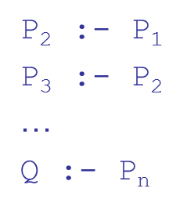
Inferencing Process of Prolog
Queries are called goals
If a goal is a compound proposition, each of the facts is a subgoal
To prove a goal is true, must find a chain of inference rules and/or facts. For goal Q:
Process of proving a subgoal called matching, satisfying, or resolution

Slide 27
Approaches
Matching is the process of proving a proposition
Proving a subgoal is called satisfying the subgoal
Bottom-up resolution, forward chaining
Begin with facts and rules of database and attempt to find sequence that leads to goal
Works well with a large set of possibly correct answers
Top-down resolution, backward chaining
Begin with goal and attempt to find sequence that leads to set of facts in database
Works well with a small set of possibly correct answers
Prolog implementations use backward chaining

Slide 28
Subgoal Strategies
When goal has more than one subgoal, can use either
Depth-first search: find a complete proof for the first subgoal before working on others
Breadth-first search: work on all subgoals in parallel
Prolog uses depth-first search
Can be done with fewer computer resources

Slide 29
Backtracking
With a goal with multiple subgoals, if fail to show truth of one of subgoals, reconsider previous subgoal to find an alternative solution: backtracking
Begin search where previous search left off
Can take lots of time and space because may find all possible proofs to every subgoal

Slide 30
Simple Arithmetic
Prolog supports integer variables and integer arithmetic
is operator: takes an arithmetic expression as right operand and variable as left operand
Not the same as an assignment statement!
The following is illegal:
Sum is Sum + Number.

Slide 31
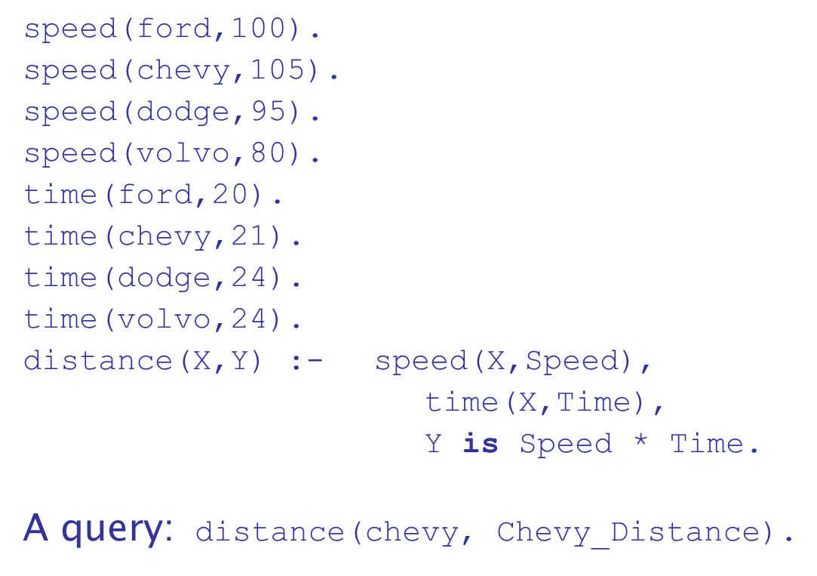
Example: Simple Arithmetic

Slide 32
Trace
Built-in structure that displays instantiations at each step
Tracing model of execution - four events:
Call (beginning of attempt to satisfy goal)
Exit (when a goal has been satisfied)
Redo (when backtrack occurs)
Fail (when goal fails)

Slide 33
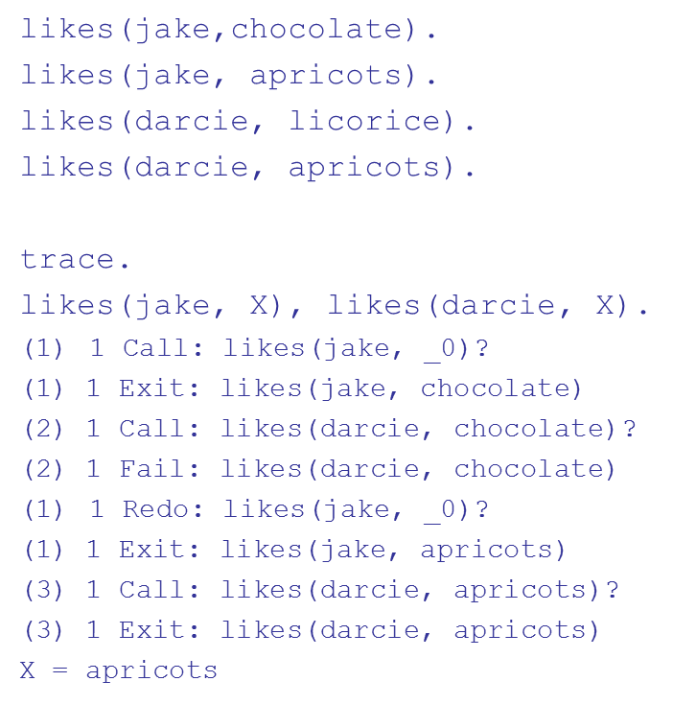
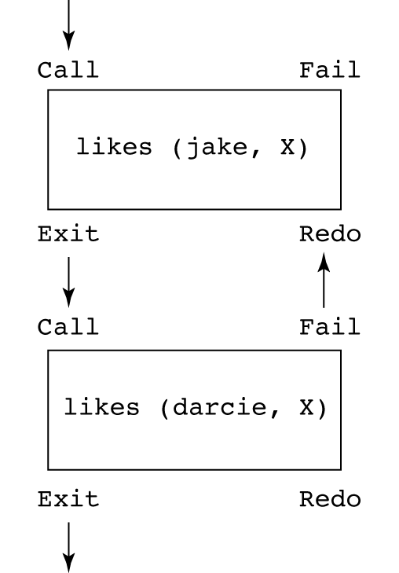
Example: Trace

Slide 34
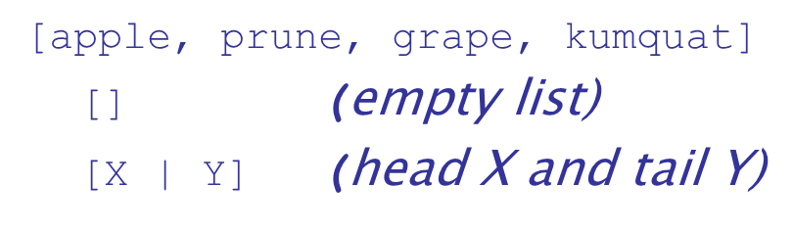
List Structures
Other basic data structure (besides atomic propositions we have already seen): list
List is a sequence of any number of elements
Elements can be atoms, atomic propositions, or other terms (including other lists)

Slide 35
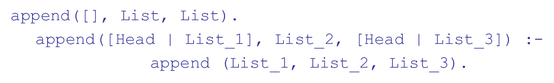
Append Example (1 of 2)

Slide 36
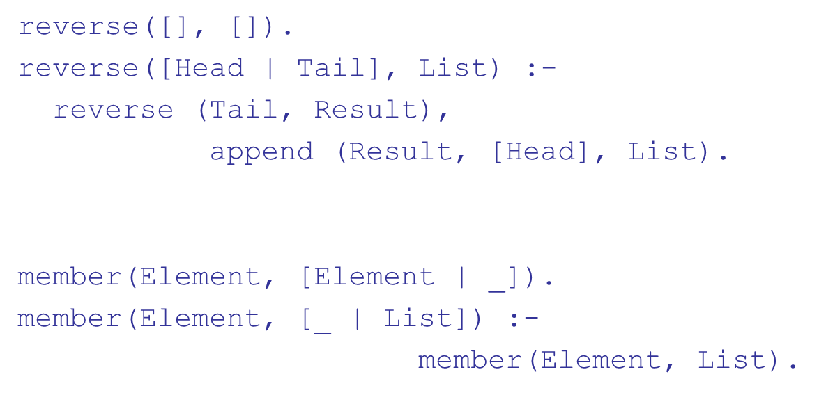
Append Example (2 of 2)
The underscore character means an anonymous variable—it means we do not care what instantiation it might get from unification

Slide 37
Deficiencies of Prolog
Resolution order control
In a pure logic programming environment, the order of attempted matches is nondeterministic and all matches would be attempted concurrently
The closed-world assumption
The only knowledge is what is in the database
The negation problem
Anything not stated in the database is assumed to be false
Intrinsic limitations
It is easy to state a sort process in logic, but difficult to actually do—it doesn’t know how to sort

Slide 38
Applications of Logic Programming
Relational database management systems
Expert systems
Natural language processing

Slide 39
Summary
Symbolic logic provides basis for logic programming
Logic programs should be nonprocedural
Prolog statements are facts, rules, or goals
Resolution is the primary activity of a Prolog interpreter
Although there are a number of drawbacks with the current state of logic programming it has been used in a number of areas

Slide 40

Copyright

