Slide 1
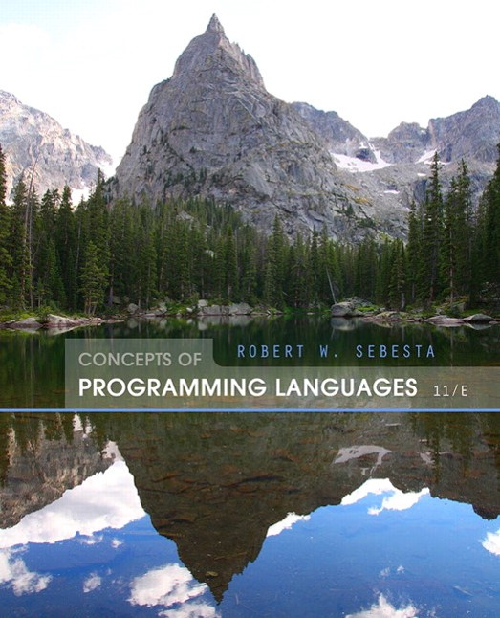
Concepts of Programming Languages
Eleventh Edition
Chapter 1
Preliminaries
Copyright © 2016, 2013, 2010 Pearson Education, Inc. All Rights Reserved
Notes:
If this PowerPoint presentation contains mathematical equations, you may need to check that your computer has the following installed:
1) Math Type Plugin
2) Math Player (free versions available)
3) NVDA Reader (free versions available)

Slide 2
Objectives
1.1 Reasons for Studying Concepts of Programming Languages
1.2 Programming Domains
1.3 Language Evaluation Criteria
1.4 Influences on Language Design
1.5 Language Categories
1.6 Language Design Trade-Offs
1.7 Implementation Methods
1.8 Programming Environments

Slide 3
Reasons for Studying Concepts of Programming Languages
Increased ability to express ideas
Improved background for choosing appropriate languages
Increased ability to learn new languages
Better understanding of significance of implementation
Better use of languages that are already known
Overall advancement of computing

Slide 4
Programming Domains (1 of 2)
Scientific applications
Large numbers of floating point computations; use of arrays
Fortran
Business applications
Produce reports, use decimal numbers and characters
COBOL

Slide 5
Programming Domains (2 of 2)
Artificial intelligence
Symbols rather than numbers manipulated; use of linked lists
L I S P
Systems programming
Need efficiency because of continuous use
C
Web Software
Eclectic collection of languages: markup (e.g., H T M L), scripting (e.g., P H P), general-purpose (e.g., Java)

Slide 6
Language Evaluation Criteria
Readability: the ease with which programs can be read and understood
Writability: the ease with which a language can be used to create programs
Reliability: conformance to specifications (i.e., performs to its specifications)
Cost: the ultimate total cost

Slide 7
Evaluation Criteria: Readability (1 of 2)
Overall simplicity
A manageable set of features and constructs
Minimal feature multiplicity
Minimal operator overloading
Orthogonality
A relatively small set of primitive constructs can be combined in a relatively small number of ways
Every possible combination is legal

Slide 8
Evaluation Criteria: Readability (2 of 2)
Data types
Adequate predefined data types
Syntax considerations
Identifier forms: flexible composition
Special words and methods of forming compound statements
Form and meaning: self-descriptive constructs, meaningful keywords

Slide 9
Evaluation Criteria: Writability
Simplicity and orthogonality
Few constructs, a small number of primitives, a small set of rules for combining them
Support for abstraction
The ability to define and use complex structures or operations in ways that allow details to be ignored
Expressivity
A set of relatively convenient ways of specifying operations
Strength and number of operators and predefined functions

Slide 10
Evaluation Criteria: Reliability
Type checking
Testing for type errors
Exception handling
Intercept run-time errors and take corrective measures
Aliasing
Presence of two or more distinct referencing methods for the same memory location
Readability and writability
A language that does not support “natural” ways of expressing an algorithm will require the use of “unnatural” approaches, and hence reduced reliability

Slide 11
Evaluation Criteria: Cost
Training programmers to use the language
Writing programs (closeness to particular applications)
Compiling programs
Executing programs
Language implementation system: availability of free compilers
Reliability: poor reliability leads to high costs
Maintaining programs

Slide 12
Evaluation Criteria: Others
Portability
The ease with which programs can be moved from one implementation to another
Generality
The applicability to a wide range of applications
Well-definedness
The completeness and precision of the language’s official definition

Slide 13
Influences on Language Design
Computer Architecture
Languages are developed around the prevalent computer architecture, known as the von Neumann architecture
Program Design Methodologies
New software development methodologies (e.g., object-oriented software development) led to new programming paradigms and by extension, new programming languages

Slide 14
Computer Architecture Influence
Well-known computer architecture: Von Neumann
Imperative languages, most dominant, because of von Neumann computers
Data and programs stored in memory
Memory is separate from C P U
Instructions and data are piped from memory to C P U
Basis for imperative languages
Variables model memory cells
Assignment statements model piping
Iteration is efficient

Slide 15
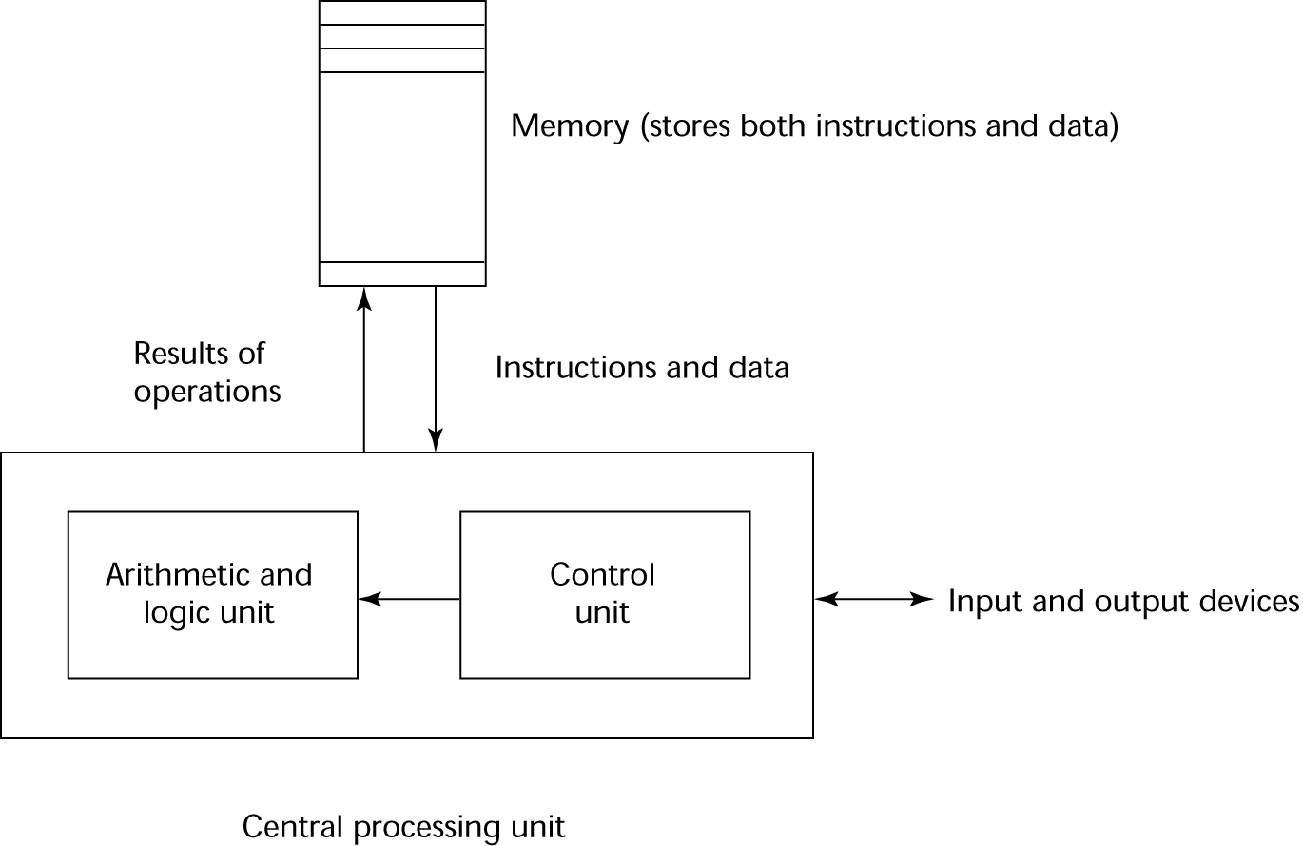
The von Neumann Architecture (1 of 2)

Slide 16
The von Neumann Architecture (2 of 2)
Fetch-execute-cycle (on a von Neumann architecture computer)
initialize the program counter
repeat forever
fetch the instruction pointed by the counter
increment the counter
decode the instruction
execute the instruction
end repeat

Slide 17
Programming Methodologies Influences
1950s and early 1960s: Simple applications; worry about machine efficiency
Late 1960s: People efficiency became important; readability, better control structures
structured programming
top-down design and step-wise refinement
Late 1970s: Process-oriented to data-oriented
data abstraction
Middle 1980s: Object-oriented programming
Data abstraction + inheritance + polymorphism

Slide 18
Language Categories (1 of 2)
Imperative
Central features are variables, assignment statements, and iteration
Include languages that support object-oriented programming
Include scripting languages
Include the visual languages
Examples: C, Java, Perl, JavaScript, Visual BASIC .NET, C++
Functional
Main means of making computations is by applying functions to given parameters
Examples: L I S P, Scheme, M L, F#

Slide 19
Language Categories (2 of 2)
Logic
Rule-based (rules are specified in no particular order)
Example: Prolog
Markup/programming hybrid
Markup languages extended to support some programming
Examples: J S T L, X S L T

Slide 20
Language Design Trade-Offs
Reliability vs. cost of execution
Example: Java demands all references to array elements be checked for proper indexing, which leads to increased execution costs
Readability vs. writability
Example: A P L provides many powerful operators (and a large number of new symbols), allowing complex computations to be written in a compact program but at the cost of poor readability
Writability (flexibility) vs. reliability
Example: C++ pointers are powerful and very flexible but are unreliable

Slide 21
Implementation Methods (1 of 2)
Compilation
Programs are translated into machine language; includes J I T systems
Use: Large commercial applications
Pure Interpretation
Programs are interpreted by another program known as an interpreter
Use: Small programs or when efficiency is not an issue

Slide 22
Implementation Methods (2 of 2)
Hybrid Implementation Systems
A compromise between compilers and pure interpreters
Use: Small and medium systems when efficiency is not the first concern

Slide 23
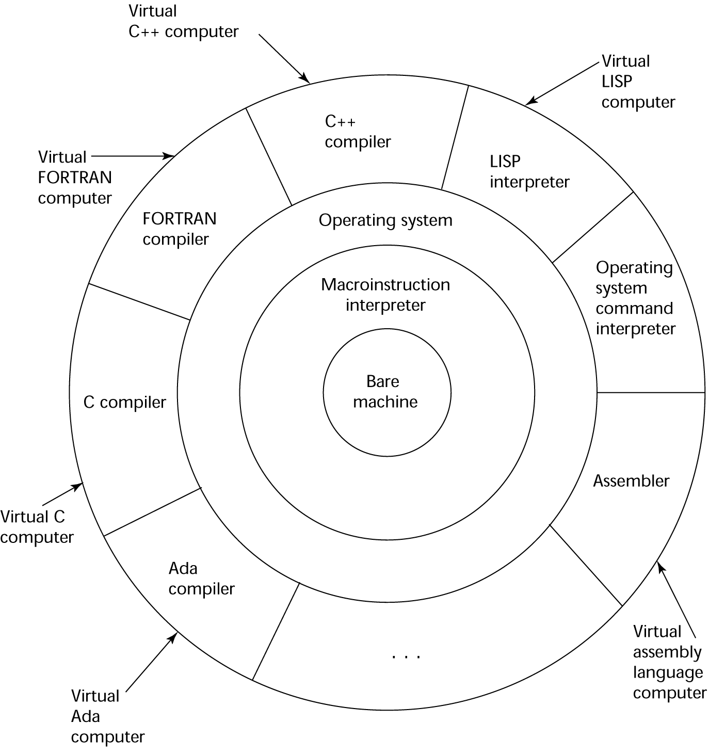
Layered View of Computer
The operating system and language implementation are layered over machine interface of a computer

Slide 24
Compilation
Translate high-level program (source language) into machine code (machine language)
Slow translation, fast execution
Compilation process has several phases:
lexical analysis: converts characters in the source program into lexical units
syntax analysis: transforms lexical units into parse trees which represent the syntactic structure of program
Semantics analysis: generate intermediate code
code generation: machine code is generated

Slide 25
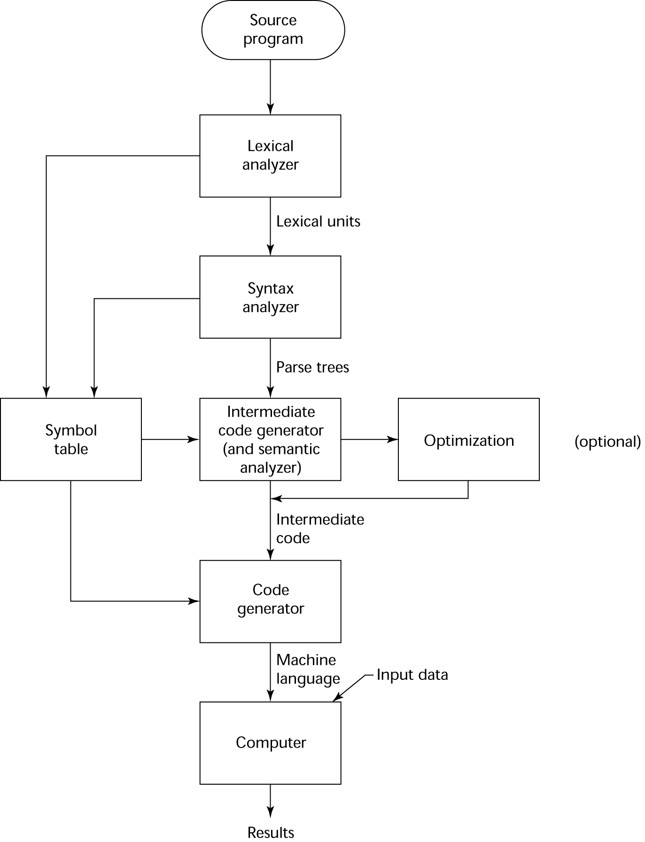
The Compilation Process

Slide 26
Additional Compilation Terminologies
Load module (executable image): the user and system code together
Linking and loading: the process of collecting system program units and linking them to a user program

Slide 27
Von Neumann Bottleneck
Connection speed between a computer’s memory and its processor determines the speed of a computer
Program instructions often can be executed much faster than the speed of the connection; the connection speed thus results in a bottleneck
Known as the von Neumann bottleneck; it is the primary limiting factor in the speed of computers

Slide 28
Pure Interpretation Process (1 of 2)
No translation
Easier implementation of programs (run-time errors can easily and immediately be displayed)
Slower execution (10 to 100 times slower than compiled programs)
Often requires more space
Now rare for traditional high-level languages
Significant comeback with some Web scripting languages (e.g., JavaScript, P H P)

Slide 29
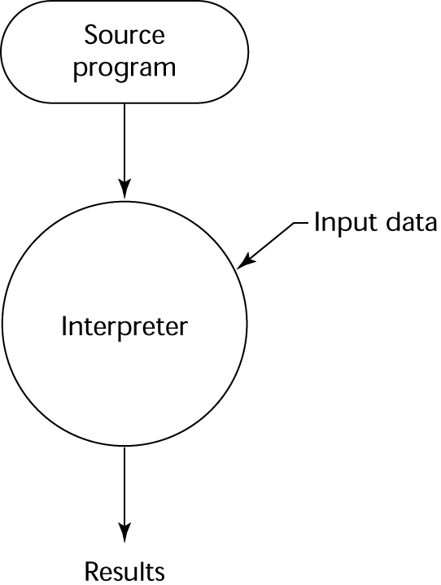
Pure Interpretation Process (2 of 2)

Slide 30
Hybrid Implementation Systems (1 of 2)
A compromise between compilers and pure interpreters
A high-level language program is translated to an intermediate language that allows easy interpretation
Faster than pure interpretation
Examples
Perl programs are partially compiled to detect errors before interpretation
Initial implementations of Java were hybrid; the intermediate form, byte code, provides portability to any machine that has a byte code interpreter and a run-time system (together, these are called Java Virtual Machine)

Slide 31
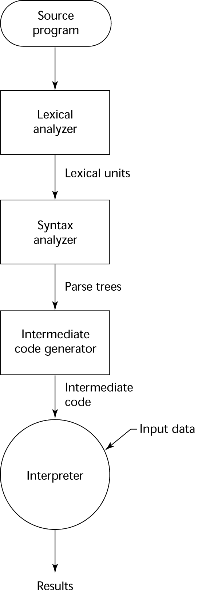
Hybrid Implementation Systems (2 of 2)

Slide 32
Just-in-Time Implementation Systems
Initially translate programs to an intermediate language
Then compile the intermediate language of the subprograms into machine code when they are called
Machine code version is kept for subsequent calls
J I T systems are widely used for Java programs
.NET languages are implemented with a J I T system
In essence, J I T systems are delayed compilers

Slide 33
Preprocessors
Preprocessor macros (instructions) are commonly used to specify that code from another file is to be included
A preprocessor processes a program immediately before the program is compiled to expand embedded preprocessor macros
A well-known example: C preprocesor
expands,

Slide 34
Programming Environments
A collection of tools used in software development
UNIX
An older operating system and tool collection
Nowadays often used through a G U I (e.g., C D E, K D E, or G N O M E) that runs on top of UNIX
Microsoft Visual Studio.NET
A large, complex visual environment
Used to build Web applications and non-Web applications in any .NET language
NetBeans
Related to Visual Studio .NET, except for applications in Java

Slide 35
Summary (1 of 2)
The study of programming languages is valuable for a number of reasons:
Increase our capacity to use different constructs
Enable us to choose languages more intelligently
Makes learning new languages easier
Most important criteria for evaluating programming languages include:
Readability, writability, reliability, cost

Slide 36
Summary (2 of 2)
Major influences on language design have been machine architecture and software development methodologies
The major methods of implementing programming languages are: compilation, pure interpretation, and hybrid implementation

Slide 37
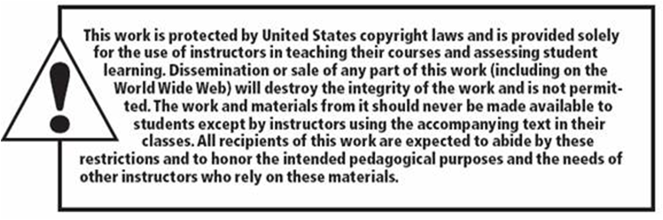
Copyright

